Slide 1
Mining Complex Types of Data
Mining time-series and sequence data
Mining the World-Wide Web
Mining spatial databases
Mining multimedia databases
Summary

Slide 2
Mining Time-Series and Sequence Data
Time-series database
  Consists of sequences of values or events changing with time
  Data is recorded at regular intervals
  Characteristic time-series components
    Trend, cycle, seasonal, irregular
Applications
  Financial: stock price, inflation
  Biomedical: blood pressure
  Meteorological: precipitation

Slide 3
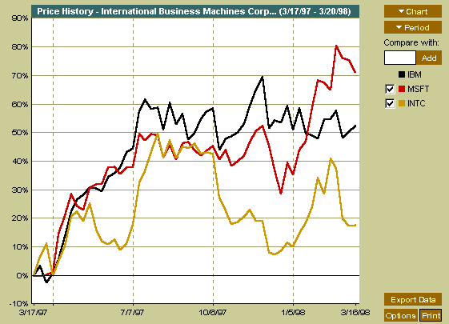
Mining Time-Series and Sequence Data
Time-series plot

Slide 4
Mining Time-Series and Sequence Data: Trend analysis
A time series can be illustrated as a time-series graph which describes a point moving with the passage of time
Categories of Time-Series Movements
  Long-term or trend movements (trend curve)
  Cyclic movements or cycle variations, e.g., business cycles
  Seasonal movements or seasonal variations
    i.e, almost identical patterns that a time series appears to follow during corresponding months of successive years.
  Irregular or random movements

Slide 5
Estimation of Trend Curve
The freehand method
  Fit the curve by looking at the graph
  Costly and barely reliable for large-scaled data mining
The least-square method
  Find the curve minimizing the sum of the squares of the deviation of points on the curve from the corresponding data points
The moving-average method
  Eliminate cyclic, seasonal and irregular patterns
  Sensitive to outliers

Slide 6
Discovery of Trend in Time-Series
Estimation of irregular variations
  By adjusting the data for trend, seasonal and cyclic variations
With the systematic analysis of the trend, cyclic, seasonal, and irregular components, it is possible to make long- or short-term predictions with reasonable quality

Slide 7
Similarity Search in Time-Series Analysis
Normal database query finds exact match
Similarity search finds data sequences that differ only slightly from the given query sequence
Two categories of similarity queries
  Whole matching: find a sequence that is similar to the query sequence
  Subsequence matching: find all pairs of similar sequences
Typical Applications
  Financial market
  Market basket data analysis
  Scientific databases
  Medical diagnosis

Slide 8
Data transformation
Many techniques for signal analysis require the data to be in the frequency domain
Usually data-independent transformations are used
  The transformation matrix is determined a priori
    E.g., discrete Fourier transform (DFT), discrete wavelet transform (DWT)
  The distance between two signals in the time domain is the same as their Euclidean distance in the frequency domain
  DFT does a good job of concentrating energy in the first few coefficients
  If we keep only first a few coefficients in DFT, we can compute the lower bounds of the actual distance

Slide 9
Multidimensional Indexing
Multidimensional index
  Constructed for efficient accessing using the first few Fourier coefficients
Use the index to retrieve the sequences that are at most a certain small distance away from the query sequence
Perform post-processing by computing the actual distance between sequences in the time domain and discard any false matches

Slide 10
Subsequence Matching
Break each sequence into a set of pieces of window with length w
Extract the features of the subsequence inside the window
Map each sequence to a “trail” in the feature space
Divide the trail of each sequence into “subtrails” and represent each of them with minimum bounding rectangle
Use a multipiece assembly algorithm to search for longer sequence matches

Slide 11
Enhanced similarity search methods
Allow for gaps within a sequence or differences in offsets or amplitudes
Normalize sequences with amplitude scaling and offset translation
Two subsequences are considered similar if one lies within an envelope of ε width around the other, ignoring outliers
Two sequences are said to be similar if they have enough non-overlapping time-ordered pairs of similar subsequences
Parameters specified by a user or expert: sliding window size, width of an envelope for similarity, maximum gap, and matching fraction

Slide 12
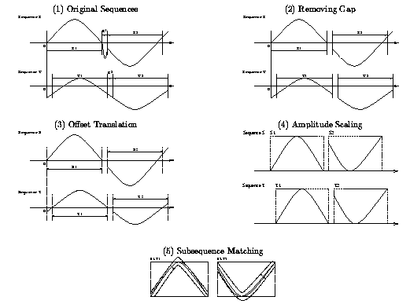
Similar time series analysis

Slide 13
Steps for Performing a Similarity Search
Atomic matching
  Find all pairs of gap-free windows of a small length that are similar
Window stitching
  Stitch similar windows to form pairs of large similar subsequences allowing gaps between atomic matches
Subsequence Ordering
  Linearly order the subsequence matches to determine whether enough similar pieces exist

Slide 14
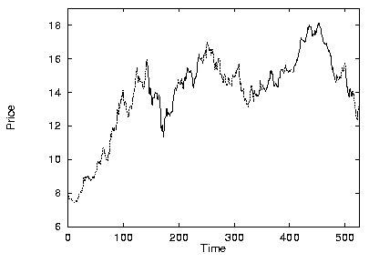
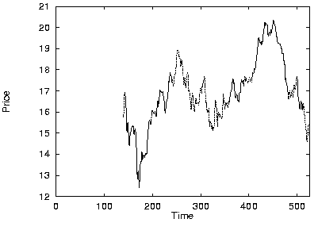
Similar time series analysis
VanEck International Fund
Fidelity Selective Precious Metal and Mineral Fund
Two similar mutual funds in the different fund group

Slide 15
Query Languages for Time Sequences
Time-sequence query language
  Should be able to specify sophisticated queries like
Find all of the sequences that are similar to some sequence in class A, but not similar to any sequence in class B
  Should be able to support various kinds of queries: range queries, all-pair queries, and nearest neighbor queries
Shape definition language
  Allows users to define and query the overall shape of time sequences
  Uses human readable series of sequence transitions or macros
  Ignores the specific details
    E.g., the pattern up, Up, UP can be used to describe increasing degrees of rising slopes
    Macros: spike, valley, etc.

Slide 16
Sequential Pattern Mining
Mining of frequently occurring patterns related to time or other sequences
Sequential pattern mining usually concentrate on symbolic patterns
Examples
  Renting “Terminator I”, then “Terminator II”, then “Terminator III” in that order
  Collection of ordered events within an interval
Applications
  Targeted marketing
  Customer retention
  Weather prediction

Slide 17
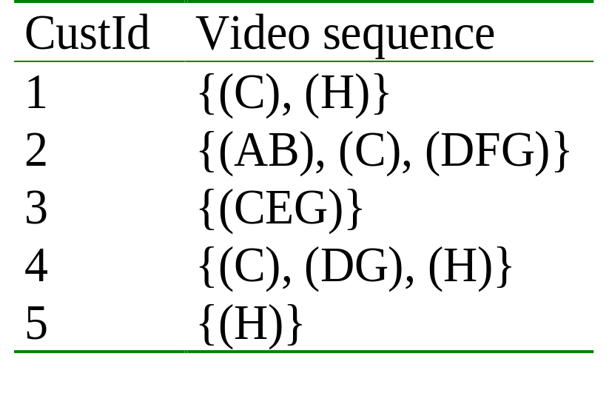
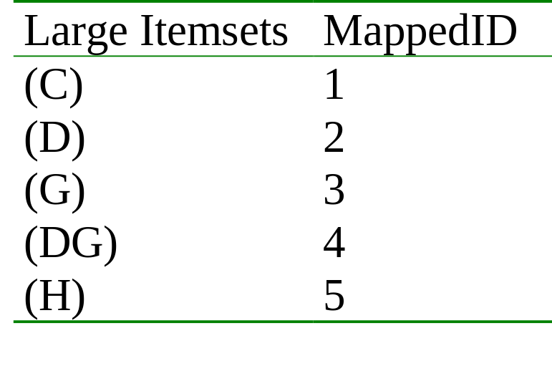
Mining Sequences (cont.)
Customer-sequence
Map Large Itemsets
Sequential patterns with support > 0.25
{(C), (H)}
{(C), (DG)}

Slide 18
Sequential pattern mining: Cases and Parameters
Duration of a time sequence T
  Sequential pattern mining can then be confined to the data within a specified duration
  Ex. Subsequence corresponding to the year of 1999
  Ex. Partitioned sequences, such as every year, or every week after stock crashes, or every two weeks before and after a volcano eruption
Event folding window w
  If w = T, time-insensitive frequent patterns are found
  If w = 0 (no event sequence folding), sequential patterns are found where each event occurs at a distinct time instant
  If 0 < w < T, sequences occurring within the same period w are folded in the analysis

Slide 19
Sequential pattern mining: Cases and Parameters
Time interval, int, between events in the discovered pattern
  int = 0: no interval gap is allowed, i.e., only strictly consecutive sequences are found
    Ex. “Find frequent patterns occurring in consecutive weeks”
  min_int ≤ int ≤ max_int: find patterns that are separated by at least min_int but at most max_int
    Ex. “If a person rents movie A, it is likely she will rent movie B within 30 days” (int ≤ 30)
  int = c ≠ 0: find patterns carrying an exact interval
    Ex. “Every time when Dow Jones drops more than 5%, what will happen exactly two days later?” (int = 2)

Slide 20
Episodes and Sequential Pattern Mining Methods
Other methods for specifying the kinds of patterns
  Serial episodes: A → B
  Parallel episodes: A & B
  Regular expressions: (A | B)C*(D → E)
Methods for sequential pattern mining
  Variations of Apriori-like algorithms, e.g., GSP
  Database projection-based pattern growth
    Similar to the frequent pattern growth without candidate generation

Slide 21
Periodicity Analysis
Periodicity is everywhere: tides, seasons, daily power consumption, etc.
Full periodicity
  Every point in time contributes (precisely or approximately) to the periodicity
Partial periodicity: A more general notion
  Only some segments contribute to the periodicity
    Jim reads NY Times 7:00-7:30 am every week day
Cyclic association rules
  Associations which form cycles
Methods
  Full periodicity: FFT, other statistical analysis methods
  Partial and cyclic periodicity: Variations of Apriori-like mining methods

Slide 22
Mining Complex Types of Data
Mining time-series and sequence data
Mining the World-Wide Web
Mining spatial databases
Mining multimedia databases
Summary

Slide 23
Mining the World-Wide Web
The WWW is huge, widely distributed, global information service center for
  Information services: news, advertisements, consumer information, financial management, education, government, e-commerce, etc.
  Hyper-link information
  Access and usage information
WWW provides rich sources for data mining
Challenges
  Too huge for effective data warehousing and data mining
  Too complex and heterogeneous: no standards and structure

Slide 24
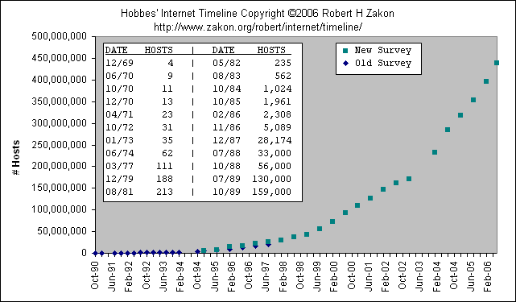
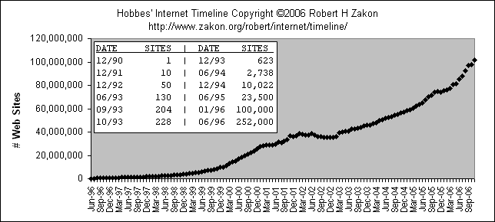
Mining the World-Wide Web
Growing and changing very rapidly
Broad diversity of user communities
Only a small portion of the information on the Web is truly relevant or useful
  99% of the Web information is useless to 99% of Web users
  How can we find high-quality Web pages on a specified topic?

Slide 25
Web search engines
Index-based: search the Web, index Web pages, and build and store huge keyword-based indices
Help locate sets of Web pages containing certain keywords
Deficiencies
  A topic of any breadth may easily contain hundreds of thousands of documents
  Many documents that are highly relevant to a topic may not contain keywords defining them

Slide 26
Web Mining: A more challenging task
Searches for
  Web access patterns
  Web structures
  Regularity and dynamics of Web contents
Problems
  The “abundance” problem
  Limited coverage of the Web: hidden Web sources, majority of data in DBMS
  Limited query interface based on keyword-oriented search
  Limited customization to individual users

Slide 27
Web Mining Taxonomy
Web Mining
Web Content
Mining
Web Structure
Mining
Web Usage
Mining
Web Page
Content Mining
Search Result
Mining
General Access
Pattern Tracking
Customized
Usage Tracking

Slide 28
Mining the World-Wide Web
Web Mining
Web Content
Mining
Web Structure
Mining
Web Usage
Mining
Web Page Content Mining
Web Page Summarization
WebLog (Lakshmanan et.al. 1996), WebOQL(Mendelzon et.al. 1998) …:
Web Structuring query languages;
Can identify information within given web pages
Ahoy! (Etzioni et.al. 1997):Uses heuristics to distinguish personal home pages from other web pages
ShopBot (Etzioni et.al. 1997): Looks for product prices within web pages
Search Result
Mining
General Access
Pattern Tracking
Customized
Usage Tracking

Slide 29
Mining the World-Wide Web
Web Mining
Web Content
Mining
Web Structure
Mining
Web Usage
Mining
Web Page
Content Mining
Search Result Mining
Search Engine Result Summarization
Clustering Search Result (Leouski and Croft, 1996, Zamir and Etzioni, 1997):
Categorizes documents using phrases in titles and snippets
General Access
Pattern Tracking
Customized
Usage Tracking

Slide 30
Mining the World-Wide Web
Web Mining
Web Content
Mining
Web Usage
Mining
Web Structure Mining
Using Links
PageRank (Brin et al., 1998)
CLEVER (Chakrabarti et al., 1998)
Use interconnections between web pages to give weight to pages.
Using Generalization
MLDB (1994), VWV (1998)
Uses a multi-level database representation of the Web. Counters (popularity) and link lists are used for capturing structure.
Search Result
Mining
General Access
Pattern Tracking
Web Page
Content Mining
Customized
Usage Tracking

Slide 31
Mining the World-Wide Web
Web Mining
Web Content
Mining
Web Structure
Mining
Web Usage
Mining
Web Page
Content Mining
General Access Pattern Tracking
Web Log Mining (Zaïane, Xin and Han, 1998)
Uses KDD techniques to understand general access patterns and trends.
Can shed light on better structure and grouping of resource providers.
Customized
Usage Tracking
Search Result
Mining

Slide 32
Mining the World-Wide Web
Web Mining
Web Content
Mining
Web Structure
Mining
Web Usage
Mining
Web Page
Content Mining
General Access
Pattern Tracking
Customized Usage Tracking
Adaptive Sites (Perkowitz and Etzioni, 1997)
Analyzes access patterns of each user at a time.
Web site restructures itself automatically by learning from user access patterns.
Search Result
Mining

Slide 33
Mining the Web's Link Structures
Finding authoritative Web pages
  Retrieving pages that are not only relevant, but also of high quality, or authoritative on the topic
Hyperlinks can infer the notion of authority
  The Web consists not only of pages, but also of hyperlinks pointing from one page to another
  These hyperlinks contain an enormous amount of latent human annotation
  A hyperlink pointing to another Web page, this can be considered as the author's endorsement of the other page

Slide 34
Mining the Web's Link Structures
Problems with the Web linkage structure
  Not every hyperlink represents an endorsement
    Other purposes are for navigation or for paid advertisements
    If the majority of hyperlinks are for endorsement, the collective opinion will still dominate
  One authority will seldom have its Web page point to its rival authorities in the same field
Hub
  Set of Web pages that provides collections of links to authorities

Slide 35
Automatic Classification of Web Documents
Assign a class label to each document from a set of predefined topic categories
Based on a set of examples of preclassified documents
Example
  Use Yahoo!'s taxonomy and its associated documents as training and test sets
  Derive a Web document classification scheme
  Use the scheme classify new Web documents by assigning categories from the same taxonomy
Keyword-based document classification methods
Statistical models

Slide 36
Multilayered Web Information Base
Layer₀: the Web itself
Layer₁: the Web page descriptor layer
  Contains descriptive information for pages on the Web
  An abstraction of Layer₀: substantially smaller but still rich enough to preserve most of the interesting, general information
  Organized into dozens of semistructured classes
    document, person, organization, ads, directory, sales, software, game, stocks, library_catalog, geographic_data, scientific_data, etc.
Layer₂ and up: various Web directory services constructed on top of Layer₁
  provide multidimensional, application-specific services

Slide 37







Multiple Layered Web Architecture
More Generalized Descriptions
Layer_{n}
...
Generalized Descriptions
Layer₁
Layer₀

Slide 38
Mining the World-Wide Web
Layer-0: Primitive data
Layer-1: dozen database relations representing types of objects (metadata)
document, organization, person, software, game, map, image,…
document(file_addr, authors, title, publication, publication_date, abstract, language, table_of_contents, category_description, keywords, index, multimedia_attached, num_pages, format, first_paragraphs, size_doc, timestamp, access_frequency, links_out,...)
person(last_name, first_name, home_page_addr, position, picture_attached, phone, e-mail, office_address, education, research_interests, publications, size_of_home_page, timestamp, access_frequency, ...)
image(image_addr, author, title, publication_date, category_description, keywords, size, width, height, duration, format, parent_pages, colour_histogram, Colour_layout, Texture_layout, Movement_vector, localisation_vector, timestamp, access_frequency, ...)

Slide 39
Mining the World-Wide Web
Layer-2: simplification of layer-1
doc_brief(file_addr, authors, title, publication, publication_date, abstract, language, category_description, key_words, major_index, num_pages, format, size_doc, access_frequency, links_out)
person_brief (last_name, first_name, publications,affiliation, e-mail, research_interests, size_home_page, access_frequency)
Layer-3: generalization of layer-2
cs_doc(file_addr, authors, title, publication, publication_date, abstract, language, category_description, keywords, num_pages, form, size_doc, links_out)
doc_summary(affiliation, field, publication_year, count, first_author_list, file_addr_list)
doc_author_brief(file_addr, authors, affiliation, title, publication, pub_date, category_description, keywords, num_pages, format, size_doc, links_out)
person_summary(affiliation, research_interest, year, num_publications, count)

Slide 40
XML and Web Mining
XML can help to extract the correct descriptors
  Standardization would greatly facilitate information extraction
  Potential problem
    XML can help solve heterogeneity for vertical applications, but the freedom to define tags can make horizontal applications on the Web more heterogeneous
<NAME> eXtensible Markup Language</NAME>
<RECOM>World-Wide Web Consortium</RECOM>
<SINCE>1998</SINCE>
<VERSION>1.0</VERSION>
<DESC>Meta language that facilitates more meaningful and precise declarations of document content</DESC>
<HOW>Definition of new tags and DTDs</HOW>

Slide 41
Benefits of Multi-Layer Meta-Web
Benefits:
  Multi-dimensional Web info summary analysis
  Approximate and intelligent query answering
  Web high-level query answering (WebSQL, WebML)
  Web content and structure mining
  Observing the dynamics/evolution of the Web
Is it realistic to construct such a meta-Web?
  Benefits even if it is partially constructed
  Benefits may justify the cost of tool development, standardization and partial restructuring

Slide 42
Web Usage Mining
Mining Web log records to discover user access patterns of Web pages
Applications
  Target potential customers for electronic commerce
  Enhance the quality and delivery of Internet information services to the end user
  Improve Web server system performance
  Identify potential prime advertisement locations
Web logs provide rich information about Web dynamics
  Typical Web log entry includes the URL requested, the IP address from which the request originated, and a timestamp

Slide 43
Techniques for Web usage mining
Construct multidimensional view on the Weblog database
  Perform multidimensional OLAP analysis to find the top N users, top N accessed Web pages, most frequently accessed time periods, etc.
Perform data mining on Weblog records
  Find association patterns, sequential patterns, and trends of Web accessing
  May need additional information,e.g., user browsing sequences of the Web pages in the Web server buffer
Conduct studies to
  Analyze system performance, improve system design by Web caching, Web page prefetching, and Web page swapping

Slide 44




Mining the World-Wide Web
Design of a Web Log Miner
  Web log is filtered to generate a relational database
  A data cube is generated form database
  OLAP is used to drill-down and roll-up in the cube
  OLAM is used for mining interesting knowledge
Knowledge
Web log
Database
Data Cube
Sliced and diced
cube
1
Data Cleaning
2
Data Cube
Creation
3
OLAP
4
Data Mining

Slide 45
Mining Complex Types of Data
Mining time-series and sequence data
Mining the World-Wide Web
Mining spatial databases
Mining multimedia databases
Summary

Slide 46
Spatial Association Analysis
Spatial association rule: A ⇒ B [s%, c%]
  A and B are sets of spatial or non-spatial predicates
    Topological relations: intersects, overlaps, disjoint, etc.
    Spatial orientations: left_of, west_of, under, etc.
    Distance information: close_to, within_distance, etc.
  s% is the support and c% is the confidence of the rule
Examples
1) is_a(x, large_town) ^ intersect(x, highway) → adjacent_to(x, water)
[7%, 85%]
2) What kinds of objects are typically located close to golf courses?

Slide 47
Progressive Refinement Mining of Spatial Association Rules
Hierarchy of spatial relationship:
  g_close_to: near_by, touch, intersect, contain, etc.
  First search for rough relationship and then refine it
Two-step mining of spatial association:
  Step 1: Rough spatial computation (as a filter)
    Using MBR or R-tree for rough estimation
  Step2: Detailed spatial algorithm (as refinement)
    Apply only to those objects which have passed the rough spatial association test (no less than min_support)

Slide 48
Spatial Classification
Analyze spatial objects to derive classification schemes, such as decision trees, in relevance to certain spatial properties (district, highway, river, etc.)
  Classifying medium-size families according to income, region, and infant mortality rates
  Mining for volcanoes on Venus
Employ most of the methods in classification
  Decision-tree classification, Naïve-Bayesian classifier + boosting, neural network, genetic programming, etc.
  Association-based multi-dimensional classification - Example: classifying house value based on proximity to lakes, highways, mountains, etc.

Slide 49
Spatial Trend Analysis
Function
  Detect changes and trends along a spatial dimension
  Study the trend of non-spatial or spatial data changing with space
Application examples
  Observe the trend of changes of the climate or vegetation with increasing distance from an ocean
  Crime rate or unemployment rate change with regard to city geo-distribution

Slide 50
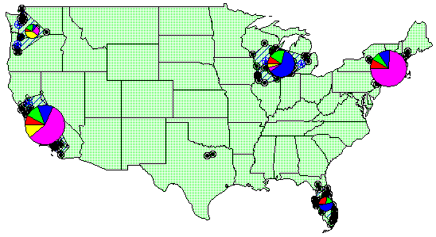
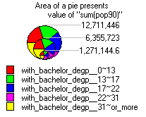
Spatial Cluster Analysis
Mining clusters—k-means, k-medoids, hierarchical, density-based, etc.
Analysis of distinct features of the clusters

Slide 51
Constraint-Based Clustering: Planning ATM Locations
C3
C2
Bridge
C1
River
Mountain
C4
Spatial data with obstacles
Clustering without taking
obstacles into consideration

Slide 52
Mining Complex Types of Data
Mining time-series and sequence data
Mining the World-Wide Web
Mining spatial databases
Mining multimedia databases
Summary

Slide 53
Similarity Search in Multimedia Data
Description-based retrieval systems
  Build indices and perform object retrieval based on image descriptions, such as keywords, captions, size, and time of creation
  Labor-intensive if performed manually
  Results are typically of poor quality if automated
Content-based retrieval systems
  Support retrieval based on the image content, such as color histogram, texture, shape, objects, and wavelet transforms

Slide 54
Queries in Content-Based Retrieval Systems
Image sample-based queries
  Find all of the images that are similar to the given image sample
  Compare the feature vector (signature) extracted from the sample with the feature vectors of images that have already been extracted and indexed in the image database
Image feature specification queries
  Specify or sketch image features like color, texture, or shape, which are translated into a feature vector
  Match the feature vector with the feature vectors of the images in the database

Slide 55



Mining Multimedia Databases
Refining or combining searches
Search for “airplane in blue sky”
(top layout grid is blue and
keyword = “airplane”)
Search for “blue sky and
green meadows”
(top layout grid is blue
and bottom is green)
Search for “blue sky”
(top layout grid is blue)

Slide 56

Mining Multimedia Databases
Three Dimensions
The Data Cube and
the Sub-Space Measurements
JPEG
GIF
Small
Medium
Large
Very Large
Two Dimensions
By Size
By Format
By Format & Size
RED
WHITE
Cross Tab
BLUE
By Colour
By Colour & Size
By Format & Colour
JPEG
GIF
RED
Sum
By Colour
WHITE
BLUE
Format of image
Duration
Colors
Textures
Keywords
Size
Width
Height
Internet domain of image
Internet domain of parent pages
Image popularity
Group By
By Format
Colour
Sum
RED
WHITE
BLUE
Dimensions
Measurement
Sum

Slide 57
Mining Complex Types of Data
Mining time-series and sequence data
Mining the World-Wide Web
Mining spatial databases
Mining multimedia databases
Summary

Slide 58
Summary
Mining complex types of data include object data, spatial data, multimedia data, time-series data, text data, and Web data
Object data can be mined by multi-dimensional generalization of complex structured data, such as plan mining for flight sequences
Spatial data warehousing, OLAP and mining facilitates multidimensional spatial analysis and finding spatial associations, classifications and trends
Multimedia data mining needs content-based retrieval and similarity search integrated with mining methods

Slide 59
Summary
Time-series/sequential data mining includes trend analysis, similarity search in time series, mining sequential patterns and periodicity in time sequence
Text mining goes beyond keyword-based and similarity-based information retrieval and discovers knowledge from semi-structured data using methods like keyword-based association and document classification
Web mining includes mining Web link structures to identify authoritative Web pages, the automatic classification of Web documents, building a multilayered Web information base, and Weblog mining

