Slide 1
Important
Slide 12
Slide 15 tiếng Việt
1

Slide 2
Mining Association Rules in Large Databases
Association rule mining
Algorithms for scalable mining of (single-dimensional Boolean) association rules in transactional databases
Mining various kinds of association/correlation rules
Constraint-based association mining
Sequential pattern mining
Applications/extensions of frequent pattern mining
Summary

Slide 3
What Is Association Mining?
Association rule mining:
  A transaction T in a database supports an itemset S if S is contained in T
  An itemset that has support above a certain threshold, called minimum support, is termed large (frequent) itemset
  Frequent pattern: pattern (set of items, sequence, etc.) that occurs frequently in a database
  Finding frequent patterns, associations, correlations, or causal structures among sets of items or objects in transaction databases, relational databases, and other information repositories.

Slide 4
What Is Association Mining?
Motivation: finding regularities in data
  What products were often purchased together? — Beer and diapers
  What are the subsequent purchases after buying a PC?
  What kinds of DNA are sensitive to this new drug?
  Can we automatically classify web documents?

Slide 5
Basic Concept: Association Rules
Let I={i₁, i₂, . . ., i_{n}} be the set of all distinct items
The association rules can be represented as “A⇒B” where A and B are subsets, namely itemsets, of I
  If A appears in one transaction, it is most likely that B also occurs in the same transaction

Slide 6
Basic Concept: Association Rules
For example
  “Bread ⇒ Milk”
  “Beer ⇒ Diaper”
The measurement of interestingness for association rules
  support, s, probability that a transaction contains A∪B
    s = support(“A⇒B”) = P(A∪B)
  confidence, c, conditional probability that a transaction having A also contains B.
    c = confidence(“A⇒B”) = P(B|A)

Slide 7
Basic Concept: Association Rules
Let min_support = 50%, min_conf = 50%:
  A → C (50%, 66.7%)
  C → A (50%, 100%)
Transaction-id | Items bought
10 | A, B, C
20 | A, C
30 | A, D
40 | B, E, F
Customer
buys both
Customer
buys diaper
Customer
buys beer

Slide 8
Basic Concepts: Frequent Patterns and Association Rules
Association rule mining is a two-step process:
  Find all frequent itemsets
  Generate strong association rules from the frequent itemsets
    For every frequent itemset L, find all non-empty subsets of L. For every such subset A, output a rule of the form “A ⇒ (L-A)” if the ratio of support(L) to support(A) is at least minimum confidence
The overall performance of mining association rules is determined by the first step

Slide 9
Mining Association Rules—an Example
Min. support 50%
Min. confidence 50%
Transaction-id | Items bought
10 | A, B, C
20 | A, C
30 | A, D
40 | B, E, F
Frequent pattern | Support
{A} | 75%
{B} | 50%
{C} | 50%
{A, C} | 50%
For rule A ⇒ C:
  support = support({A}∪{C}) = 50%
  confidence = support({A}∪{C})/support({A}) = 66.6%

Slide 10
Mining Association Rules in Large Databases
Association rule mining
Algorithms for scalable mining of (single-dimensional Boolean) association rules in transactional databases
Mining various kinds of association/correlation rules
Constraint-based association mining
Sequential pattern mining
Applications/extensions of frequent pattern mining
Summary

Slide 11
The Apriori Algorithm
The name, Apriori, is based on the fact that the algorithm uses prior knowledge of frequent itemset properties
Apriori employs an iterative approach known as a level-wise search, where k-itemsets are used to explore (k+1)-itemsets
  The first pass determines the frequent 1-itemsets denoted L₁
  A subsequence pass k consists of two phases
    First, the frequent itemsets L_{k-1} are used to generate the candidate itemsets C_{k}
    Next, the database is scanned and the support of candidates in C_{k} is counted
    The frequent itemsets L_{k} are determined

Slide 12
Apriori Property
Apriori property: any subset of a large itemset must be large
  If {beer, diaper, nuts} is frequent, so is {beer, diaper}
  Every transaction having {beer, diaper, nuts} also contains {beer, diaper}
Anti-monotone: if a set cannot pass a test, all of its supersets will fail the same test as well

Slide 13
Apriori: A Candidate Generation-and-test Approach
Apriori pruning principle: If there is any itemset which is infrequent, its superset should not be generated/tested!
Method: join and prune steps
  Generate candidate (k+1)-itemsets C_{k+1} from frequent k-itemsets L_{k}
  If any k-subset of a candidate (k+1)-itemset is not in L_{k}, then the candidate cannot be frequent either and so can be removed from C_{k}
  Test the candidates against DB to obtain L_{k+1}

Slide 14
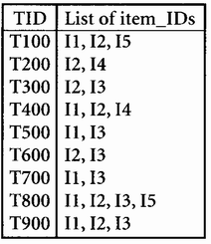
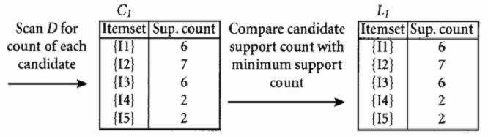
The Apriori Algorithm—Example
Let the minimum support be 20%

Slide 15
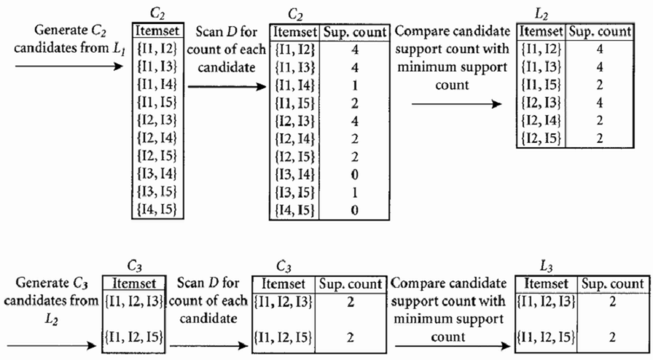
The Apriori Algorithm—Example

Slide 16
The Apriori Algorithm
Pseudo-code:
    C_{k}: Candidate itemset of size k
    L_{k} : frequent itemset of size k
    L₁ = {frequent items};
    for (k = 1; L_{k} !=∅; k++)
    C_{k+1} = candidates generated from L_{k};
    for each transaction t in database
    increment the count of all candidates in C_{k+1} that are contained in t
    end
    L_{k+1} = candidates in C_{k+1} with min_support
    end
    return ∪_{k} L_{k};

Slide 17
Important Details of Apriori
How to generate candidates?
  Step 1: self-joining L_{k}
  Step 2: pruning
How to count supports of candidates?
Example of candidate-generation
  L₃={abc, abd, acd, ace, bcd}
  Self-joining: L₃*L₃
    abcd from abc and abd
    acde from acd and ace
  Pruning:
    acde is removed because ade is not in L₃
  C₄={abcd}

Slide 18
How to Generate Candidates?
Suppose the items in L_{k-1} are listed in an order
Step 1: self-joining L_{k-1}
  insert into C_{k}
  select p.item₁, p.item₂, …, p.item_{k-1}, q.item_{k-1}
  from L_{k-1} p, L_{k-1} q
  where p.item₁=q.item₁, …, p.item_{k-2}=q.item_{k-2}, p.item_{k-1} < q.item_{k-1}
Step 2: pruning
  forall itemsets c in C_{k} do
    forall (k-1)-subsets s of c do
      if (s is not in L_{k-1}) then delete c from C_{k}

Slide 19
Challenges of Frequent Pattern Mining
Challenges
  Multiple scans of transaction database
  Huge number of candidates
  Tedious workload of support counting for candidates
Improving Apriori: general ideas
  Reduce passes of transaction database scans
  Shrink number of candidates
  Facilitate support counting of candidates

Slide 20
DIC — Reduce Number of Scans
The intuition behind DIC is that it works like a train running over the data with stops at intervals M transactions apart.
If we consider Apriori in this metaphor, all itemsets must get on at the start of a pass and get off at the end. The 1-itemsets take the fist pass, the 2-itemsets take the second pass, and so on.
In DIC, we have the added flexibility of allowing itemsets to get on at any stop as long as they get off at the same stop the next time the train goes around.
We can start counting an itemset as soon as we suspect it may be necessary to count it instead of waiting until the end of the previous pass.

Slide 21
DIC — Reduce Number of Scans
For example, if we are mining 40,000 transactions and M = 10,000, we will count all the l-itemsets in the first 40,000 transactions we will read. However, we will begin counting 2-itemsets after the first 10,000 transactions have been read. We will begin counting 3-itemsets after 20,000 transactions.
We assume there are no 4-itemsets we need to count. Once we get to the end of the file, we will stop counting the l-itemsets and go back to the start of the file to count the 2 and 3-itemsets. After the first 10,000 transactions, we will finish counting the 2-itemsets and after 20,000 transactions, we will finish counting the 3-itemsets. In total, we have made 1.5 passes over the data instead of the 3 passes a level-wise algorithm would make.

Slide 22
DIC — Reduce Number of Scans
DIC addresses the high-level issues of when to count which itemsets and is a substantial speedup over Apriori, particularly when Apriori requires many passes.

Slide 23
DIC — Reduce Number of Scans
ABCD
Once both A and D are determined frequent, the counting of AD begins
Once all length-2 subsets of BCD are determined frequent, the counting of BCD begins
ABC
ABD
ACD
BCD
AB
AC
BC
AD
BD
CD
Transactions
1-itemsets
A
B
C
D
Apriori
2-itemsets
…
{}
Itemset lattice
1-itemsets
2-items
DIC
3-items

Slide 24
DIC — Reduce Number of Scans
Solid box - confirmed large itemset - an itemset we have finished counting that exceeds the support threshold.
Solid circle - confirmed small itemset - an itemset we have finished counting that is below the support threshold.
Dashed box - suspected large itemset - an itemset we are still counting that exceeds the support threshold.
Dashed circle - suspected small itemset - an itemset we are still counting that is below the support threshold.

Slide 25
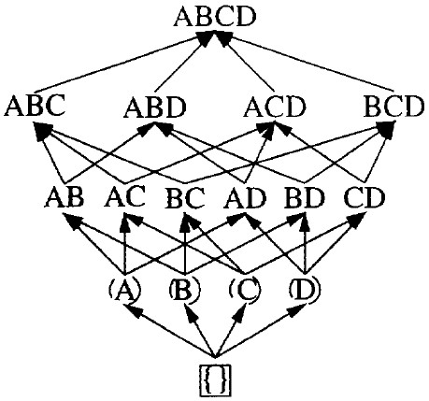
DIC Algorithm
The DIC algorithm works as follows:
  The empty itemset is marked with a solid box. All the l-itemsets are marked with dashed circles. All other itemsets are unmarked.

Slide 26
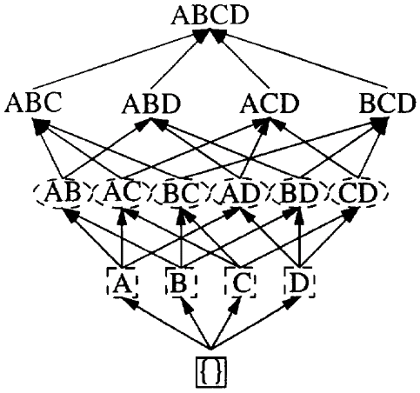
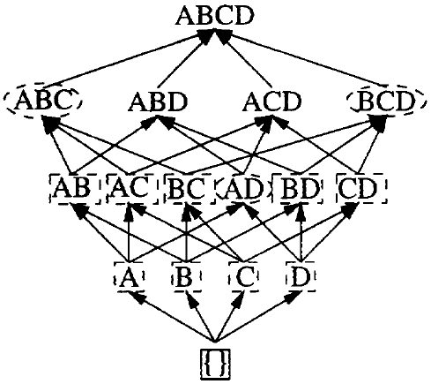
DIC Algorithm
The DIC algorithm works as follows:
  Read M transactions. We experimented with values of M ranging from 100 to 10,000. For each transaction, increment the respective counters for the itemsets marked with dashes.
  If a dashed circle has a count that exceeds the support threshold, turn it into a dashed square. If any immediate superset of it has all of its subsets as solid or dashed squares, add a new counter for it and make it a dashed circle.

Slide 27
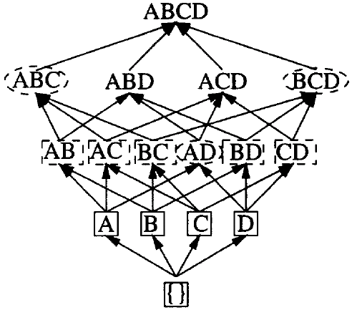
DIC Algorithm
The DIC algorithm works as follows:
  If a dashed itemset has been counted through all the transactions, make it solid and stop counting it.
  If we are at the end of the transaction file, rewind to the beginning.
  If any dashed itemsets remain, go to step 2.

Slide 28
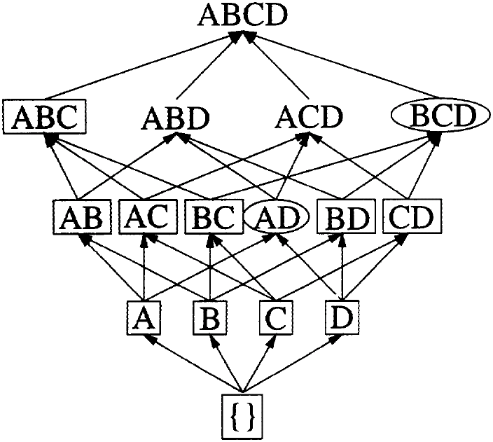
DIC Algorithm — Example

Slide 29
DIC Summary
There are a number of benefits to DIC. The main one is performance. If the data is fairly homogeneous throughout the file and the interval M is reasonably small, this algorithm generally makes on the order of two passes. This makes the algorithm considerably faster than Apriori which must make as many passes as the maximum size of a candidate itemset.
Besides performance, DIC provides considerable flexibility by having the ability to add and delete counted itemsets on the fly. As a result, DIC can be extended to incremental update version.

Slide 30
Partition: Scan Database Only Twice
Any itemset that is potentially frequent in DB must be frequent in at least one of the partitions of DB
  Scan 1: partition database and find local frequent patterns
  Scan 2: consolidate global frequent patterns

Slide 31


Partition Algorithm
Algorithm Partition:
1) P = partition_database(D)
2) n = Number of partitions
3) for i=1 to n begin // Phase I
4) read_in_partition(p_{i}∈P)
5) L^{i} = gen_large_itemsets(p_{i})
6) end
7) for (i=2; ≠∅, j=1, 2, …, n; i++) do
8) = ∪_{j=1,2,…,n} // Merge Phase
9) for i=1 to n begin // Phase II
10) read_in_partition(p_{i}∈P)
11) for all candidates c∈C^{G} gen_count(c, p_{i})
12) end
13) L^{G} = {c∈C^{G} | c.count ≥ min_sup}

Slide 32



Partition Algorithm
Procedure gen_large_itemsets()
1) = {large 1-itemsets along with their tidlists}
2) for (k=2; ≠∅; k++) do begin
3) forall itemsets l₁∈ do begin
4) forall itemsets l₂∈ do begin
5) if l₁[1]=l₂[1] ^ l₁[2]=l₂[2] ^ … ^ l₁[k-2]=l₂[k-2] ^ l₁[k-1]<l₂[k-1] then
6) c = l₁[1]．l₁[2]．．．l₁[k-1]．l₂[k-1]
7) if c cannot be pruned then
8) c.tidlist = l₁.tidlist∩l₂.tidlist
9) if (|c.tidlist| / |p|) ≥ min_sup then
10) = ∪{c}
11) end
12) end
13) end
14) return ∪_{k}

Slide 33
Sampling for Frequent Patterns
Select a sample of original database, mine frequent patterns within sample using Apriori
Scan database once to verify frequent itemsets found in sample, only borders of closure of frequent patterns are checked
  Example: check abcd instead of ab, ac, …, etc.
Scan database again to find missed frequent patterns

Slide 34
Sampling Algorithm
Algorithm Sampling (Phase I):
1) draw a random sample s from D;
2) compute S with lowered minimum support threshold;
3) compute F = {X|X∈S∪Bd⁻(S), ∀x∈X, x.count ≥ min_sup};
4) output all X;
5) report if there possibly was a failure;

Slide 35
Sampling Algorithm
Algorithm Sampling (Phase II):
1) repeat
2) compute S = S∪Bd⁻(S);
3) until S does not grow;
4) compute F = {X|X∈S, ∀x∈X, x.count ≥ min_sup};
5) output all X;

Slide 36
DHP (Direct Hashing and Pruning): Reduce the Number of Candidates
A k-itemset whose corresponding hashing bucket count is below the threshold cannot be frequent

Slide 37
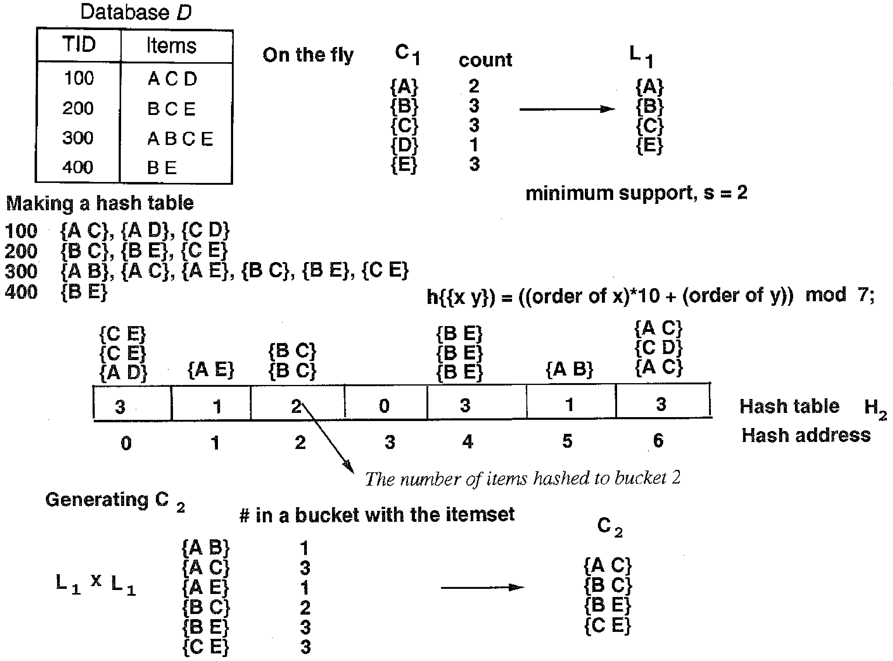
DHP — Example

Slide 38
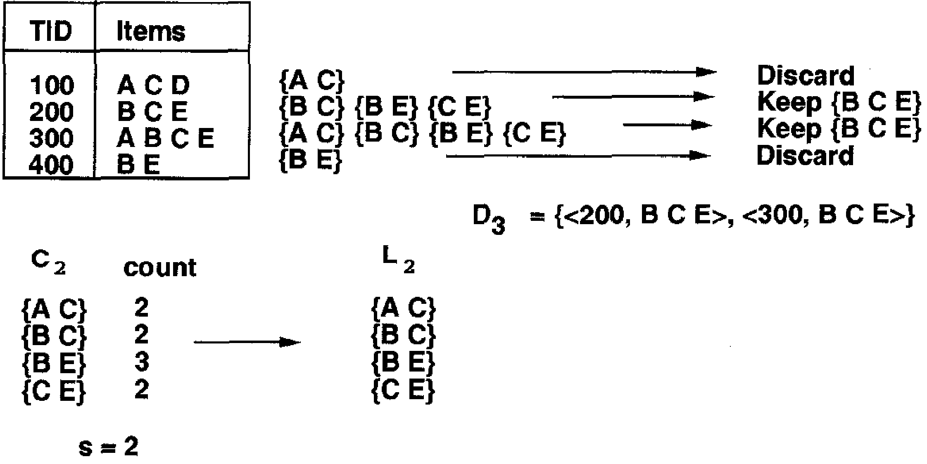
DHP — Example

Slide 39
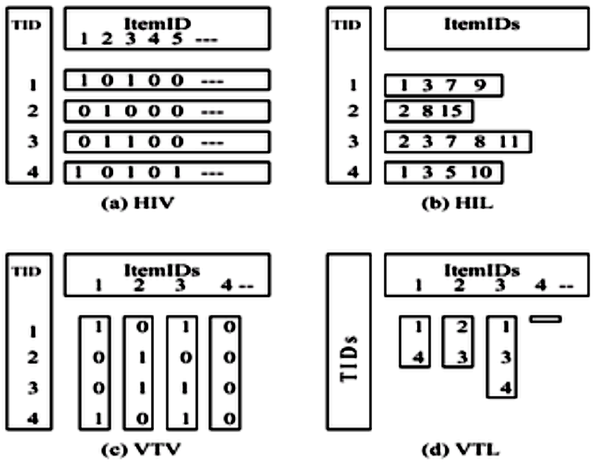
VIPER: Exploring Vertical Data Format

Slide 40
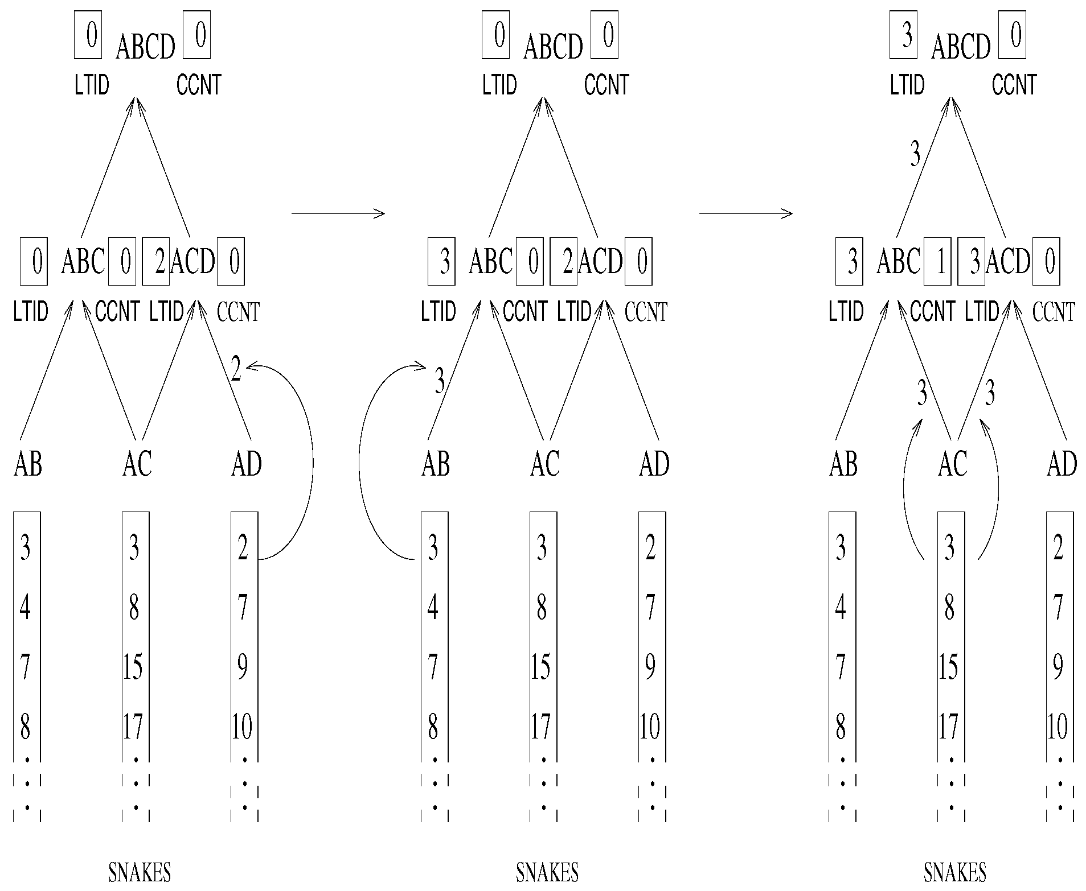
VIPER: Exploring Vertical Data Format

Slide 41
Bottleneck of Frequent-pattern Mining
Multiple database scans are costly
Mining long patterns needs many passes of scanning and generates lots of candidates
  To find frequent itemset i₁i₂…i₁₀₀
    # of scans: 100
    # of Candidates: (₁₀₀¹) + (₁₀₀²) + … + (₁₀₀¹⁰⁰) = 2¹⁰⁰-1 = 1.27*10³⁰ !
Bottleneck: candidate-generation-and-test
Can we avoid candidate generation?

