Slide 1
Mining Association Rules in Large Databases
Association rule mining
Algorithms for scalable mining of (single-dimensional Boolean) association rules in transactional databases
Mining various kinds of association/correlation rules
Constraint-based association mining
Sequential pattern mining
Applications/extensions of frequent pattern mining
Summary

Slide 2
Multi-dimensional Association
Single-dimensional (or intradimension) association rules: single distinct predicate (buys)
    buys(X, “milk”) ⇒ buys(X, “bread”)
Multi-dimensional rules: multiple predicates
  interdimension association rules (no repeated predicates)
    age(X,”20-29”) ∧ occupation(X,“student”) ⇒ buys(X,“laptop”)
  hybrid-dimension association rules (repeated predicates)
    age(X,”20-29”) ∧ buys(X, “laptop”) ⇒ buys(X, “printer”)

Slide 3
Multi-dimensional Association
Database attributes can be categorical or quantitative
Categorical (nominal) Attributes
  finite number of possible values, no ordering among the values
  e.g., occupation, brand, color
Quantitative Attributes
  numeric, implicit ordering among values
  e.g., age, income, price
Techniques for mining multidimensional association rules can be categorized according to three basic approaches regarding the treatment of quantitative attributes.

Slide 4
Techniques for Mining MD Associations
Quantitative attributes are statically discretized using predefined concept hierarchies
  treat the numeric attributes as categorical attributes
  a concept hierarchy for income: “0…20K”, “21K…30K”,…
Quantitative attributes are dynamically discretized into “bins” based on the distribution of the data
  treat the numeric attribute values as quantities
  quantitative association rules
Quantitative attributes are dynamically discretized so as to capture the semantic meaning of such interval data
  consider the distance between data points
  distance-based association rules

Slide 5
Techniques for Mining MD Associations
Search for frequent k-predicate set:
  Example: {age, occupation, buys} is a 3-predicate set
  Techniques can be categorized by how age are treated
age
…
0…20
21…30
31…40
…

Slide 6
Static Discretization of Quantitative Attributes
Discretized prior to mining using concept hierarchy.
Numeric values are replaced by ranges (categories).
In relational database, finding all frequent k-predicate sets will require k or k+1 table scans.
Data cube is well suited for mining.
The cells of an n-dimensional
  cuboid correspond to the
  predicate sets.
Mining from data cubes
can be much faster.
()
(age)
(income)
(buys)
(age, income)
(age,buys)
(income,buys)
(age,income,buys)

Slide 7
Quantitative Association Rules
Numeric attributes are dynamically discretized and may later be further combined during the mining process
2-D quantitative association rules: A_{quan1} ∧ A_{quan2} ⇒ A_{cat}
Example
  age(X,”30-39”) ∧ income(X,”42K - 48K”) ⇒ buys(X,”high resolution TV”)

Slide 8
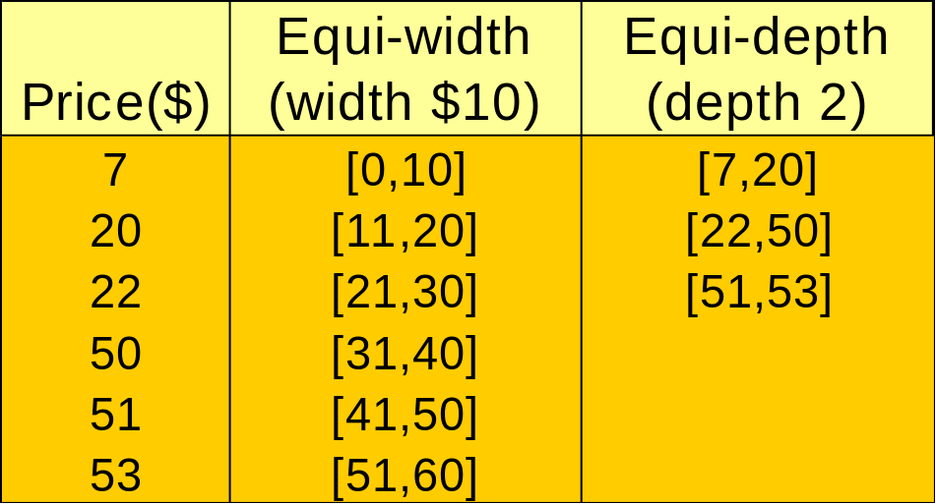
Quantitative Association Rules
The ranges of quantitative attributes are partitioned into intervals
The partition process is referred to as binning
Binning strategies
  Equiwidth binning, the interval size of each bin is the same
  Equidepth binning, each bin has approximately the same number of tuples assigned to it
  Homogeneity-based binning, bin size is determined so that the tuples in each bin are uniformly distributed

Slide 9
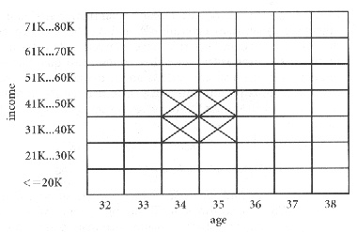
Quantitative Association Rules
Cluster “adjacent” association rules to form general rules using a 2-D grid
  age(X,34) ∧ income(X,”31K - 40K”) ⇒ buys(X,”high resolution TV”)
  age(X,35) ∧ income(X,”31K - 40K”) ⇒ buys(X,”high resolution TV”)
  age(X,34) ∧ income(X,”41K - 50K”) ⇒ buys(X,”high resolution TV”)
  age(X,35) ∧ income(X,”41K - 50K”) ⇒ buys(X,”high resolution TV”)
Clustered to form
  age(X,”34…35”) ∧ income(X,”31K - 50K”) ⇒ buys(X,”high resolution TV”)

Slide 10
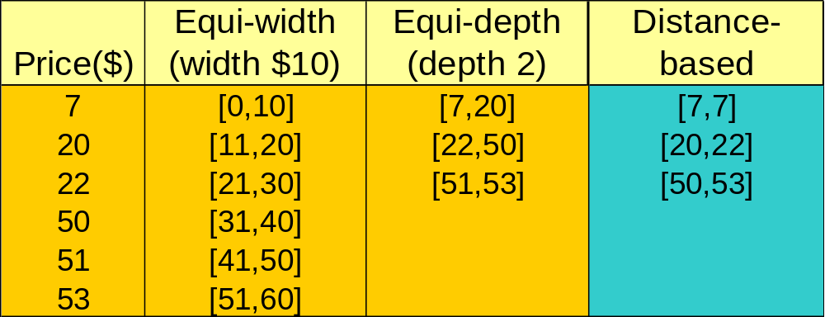
Mining Distance-based Association Rules
Binning methods do not capture the semantics of interval data
Distance-based partitioning, more meaningful discretization considering:
  density/number of points in an interval
  “closeness” of points in an interval

Slide 11
Mining Distance-based Association Rules
Intervals for each quantitative attribute can be established by clustering the values for the attribute
The support and confidence measures do not consider the closeness of values for a given attribute
  Item_type(X,”electronic”) ∧ manufacturer(X,”foreign”) ⇒ price(X,$200)
Distance-based association rules capture the semantics of interval data while allowing for approximation in data values
  The prices of foreign electronic items are close to or approximately $200 rather than exactly $200

Slide 12
Mining Distance-based Association Rules
Two phase algorithm
  employ clustering to find the intervals or clusters
  obtains distance-based association rules by searching for groups of clusters that occur frequently together
To ensure the distance-based association rule C_{{age}} ⇒ C_{{income}} is strong
  When the age-clustered tuples C_{{age}} are projected onto the attribute income, their corresponding income values lie within the income-cluster C_{{income}}, or close to it

Slide 13
Interestingness Measure: Correlations
Strong rules satisfy the minimum support and minimum confidence thresholds
Strong rules are not necessarily interesting
For example,
  Of the 10,000 transactions, 6,000 of which include computer games, while 7,500 include videos, and 4,000 include both computer games and videos
  Let the minimum support be 30% and the minimum confidence be 60%

Slide 14
Interestingness Measure: Correlations
The strong rule buy(X,” computer games”) ⇒ buy(X,”videos”) is discovered with support=40% and confidence=66%
However the rule is misleading since the probability of purchasing videos is 75%
  computer games and videos are negatively associated because the purchase of one of these items actually decreases the likelihood of purchasing the other

Slide 15
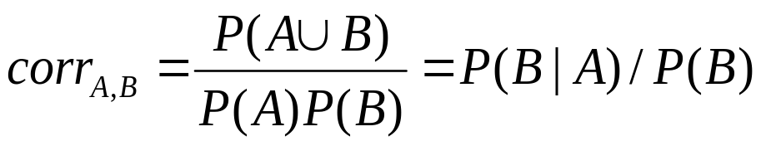
Interestingness Measure: Correlations
The rule “A ⇒ B”
  support = P(A∪B)
  confidence = P(B|A)
Measure of dependent/correlated events:

Slide 16
Interestingness Measure: Correlations
P({game}) = 0.60, P({video}) = 0.75, P({game, video}) = 0.40
P({game, video})/(P({game})*P({video}) ) = 0.40/(0.60*0.75) = 0.89
Since the correlation value is less than 1, there is a negative correlation between the occurrence of {game} and {video}
 | game | game’ | ∑
video | 4,000 | 3,500 | 7,500
video’ | 2,000 | 500 | 2,500
∑ | 6,000 | 4,000 | 10,000

Slide 17
Mining Association Rules in Large Databases
Association rule mining
Algorithms for scalable mining of (single-dimensional Boolean) association rules in transactional databases
Mining various kinds of association/correlation rules
Constraint-based association mining
Sequential pattern mining
Applications/extensions of frequent pattern mining
Summary

Slide 18
Constraint-based Data Mining
Finding all the patterns in a database autonomously? — unrealistic!
  The patterns could be too many but not focused!
Data mining should be an interactive process
  User directs what to be mined using a data mining query language or a graphical user interface
Constraint-based mining
  User flexibility: provides constraints on what to be mined
  System optimization: explores such constraints for efficient mining—constraint-based mining

Slide 19
Constraints in Data Mining
Knowledge type constraint:
  classification, association, etc.
Data constraint — using SQL-like queries
  find product pairs sold together in stores in Vancouver in Dec.’00
Dimension/level constraint
  in relevance to region, price, brand, customer category
Rule (or pattern) constraint
  small sales (price < $10) triggers big sales (sum > $200)
Interestingness constraint
  strong rules: min_support ≥ 3%, min_confidence ≥ 60%

Slide 20
Constrained Frequent Pattern Mining
Given a frequent pattern mining query with a set of constraints C, the algorithm should be
  sound: it only finds frequent sets that satisfy the given constraints C
  complete: all frequent sets satisfying the given constraints C are found
A naïve solution
  First find all frequent sets, and then test them for constraint satisfaction
More efficient approaches:
  Analyze the properties of constraints comprehensively
  Push them as deeply as possible inside the frequent pattern computation.

Slide 21
Anti-Monotonicity in Constraint-Based Mining
Anti-monotonicity
  When an intemset S violates the constraint, so does any of its superset
  sum(S.Price) ≤ v is anti-monotone
  sum(S.Price) ≥ v is not anti-monotone

Slide 22
Convertible Constraints
Let R be an order of items
Convertible anti-monotone
  If an itemset S violates a constraint C, so does every itemset having S as a prefix w.r.t. R
  Ex. avg(S) ≥ v w.r.t. item value descending order
Convertible monotone
  If an itemset S satisfies constraint C, so does every itemset having S as a prefix w.r.t. R
  Ex. avg(S) ≤ v w.r.t. item value descending order

Slide 23
Strongly Convertible Constraints
avg(X) ≥ 25 is convertible anti-monotone w.r.t. item value descending order R: <a, f, g, d, b, h, c, e>
  If an itemset af violates a constraint C, so does every itemset with af as prefix, such as afd
avg(X) ≥ 25 is convertible monotone w.r.t. item value ascending order R⁻¹: <e, c, h, b, d, g, f, a>
  If an itemset d satisfies a constraint C, so does itemsets df and dfa, which having d as a prefix
Thus, avg(X) ≥ 25 is strongly convertible
Item | Profit
a | 40
b | 0
c | -20
d | 10
e | -30
f | 30
g | 20
h | -10

Slide 24
Mining With Convertible Constraints
TDB (min_sup=2)
TID
Transaction
C: avg(S.profit) ≥ 25
List of items in every transaction in value descending order R:
  <a, f, g, d, b, h, c, e>
  C is convertible anti-monotone w.r.t. R
Scan transaction DB once
  remove infrequent items
    Item h in transaction 40 is dropped
  Itemsets a and f are good
10
a, f, d, b, c
20
f, g, d, b, c
30
a, f, d, c, e
40
f, g, h, c, e
Item | Profit
a | 40
f | 30
g | 20
d | 10
b | 0
h | -10
c | -20
e | -30

Slide 25
Mining Association Rules in Large Databases
Association rule mining
Algorithms for scalable mining of (single-dimensional Boolean) association rules in transactional databases
Mining various kinds of association/correlation rules
Constraint-based association mining
Sequential pattern mining
Applications/extensions of frequent pattern mining
Summary

Slide 26
Sequence Databases and Sequential Pattern
Transaction databases, time-series databases vs. sequence databases
Frequent patterns vs. frequent sequential patterns
Applications of sequential pattern mining
  Customer shopping sequences:
    First buy computer, then CD-ROM, and then digital camera, within 3 months.
    First buy “Introduction to Windows 2000”, then “Introduction to Microsoft Visual C++ 6.0” , and then “Windows 2000 Programmer’s Guide”

Slide 27
Sequence Databases and Sequential Pattern
  Medical treatment, natural disasters (e.g., earthquakes), science & engineering processes, stocks and markets, etc.
  DNA sequences and gene structures
  Telephone calling patterns, Weblog click streams

Slide 28
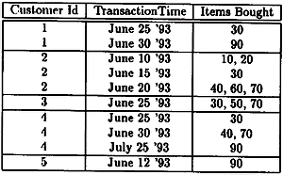
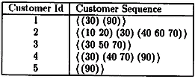
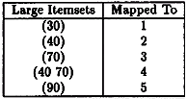
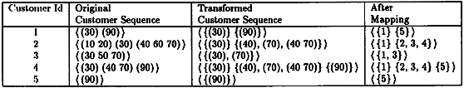
Sequential Pattern Mining — an Example
Database Transformation

Slide 29

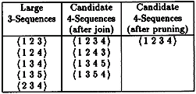
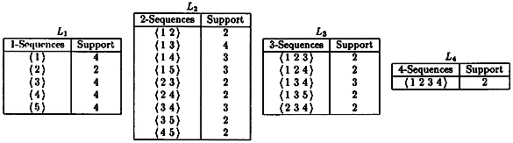
Sequential Pattern Mining — an Example
Let min_sup = 40%

Slide 30
What Is Sequential Pattern Mining?
Given a set of sequences, find the complete set of frequent subsequences
A sequence : < (ef) (ab) (df) c b >
A sequence database
SID | sequence
10 | <a(abc)(ac)d(cf)>
20 | <(ad)c(bc)(ae)>
30 | <(ef)(ab)(df)cb>
40 | <eg(af)cbc>
An element may contain a set of items.
Items within an element are unordered
and we list them alphabetically.
<a(bc)dc> is a subsequence of <a(abc)(ac)d(cf)>
Given support threshold min_sup =2, <(ab)c> is a sequential pattern

Slide 31
Challenges on Sequential Pattern Mining
A huge number of possible sequential patterns are hidden in databases
A mining algorithm should
  find the complete set of patterns, when possible, satisfying the minimum support threshold
  be highly efficient, scalable, involving only a small number of database scans
  be able to incorporate various kinds of user-specific constraints

Slide 32
A Basic Property of Sequential Patterns: Apriori
A basic property: Apriori (Agrawal & Sirkant’94)
  If a sequence S is not frequent, then none of the super-sequences of S is frequent
  E.g, <hb> is infrequent → so do <hab> and <(ah)b>
Seq. ID
Sequence
Let min_sup =2
10
<(bd)cb(ac)>
20
<(bf)(ce)b(fg)>
30
<(ah)(bf)abf>
40
<(be)(ce)d>
50
<a(bd)bcb(ade)>

Slide 33
GSP—A Generalized Sequential Pattern Mining Algorithm
Outline of the method
  Initially, every item in DB is a candidate of length-1
  for each level (i.e., sequences of length-k) do
    scan database to collect support count for each candidate sequence
    generate candidate length-(k+1) sequences from length-k frequent sequences using Apriori
  repeat until no frequent sequence or no candidate can be found
Major strength: Candidate pruning by Apriori

Slide 34
Finding Length-1 Sequential Patterns
Examine GSP using an example
Initial candidates: all singleton sequences
  <a>, <b>, <c>, <d>, <e>, <f>, <g>, <h>
Scan database once, count support for candidates
Let min_sup =2
Cand | Sup
<a> | 3
<b> | 5
<c> | 4
<d> | 3
<e> | 3
<f> | 2
<g> | 1
<h> | 1
Seq. ID
Sequence
10
<(bd)cb(ac)>
20
<(bf)(ce)b(fg)>
30
<(ah)(bf)abf>
40
<(be)(ce)d>
50
<a(bd)bcb(ade)>

Slide 35
Generating Length-2 Candidates
51 length-2 candidates, without Apriori property, 8*8+8*7/2=92 candidates
Apriori prunes 44.57% candidates
 | <a> | <b> | <c> | <d> | <e> | <f>
<a> | <aa> | <ab> | <ac> | <ad> | <ae> | <af>
<b> | <ba> | <bb> | <bc> | <bd> | <be> | <bf>
<c> | <ca> | <cb> | <cc> | <cd> | <ce> | <cf>
<d> | <da> | <db> | <dc> | <dd> | <de> | <df>
<e> | <ea> | <eb> | <ec> | <ed> | <ee> | <ef>
<f> | <fa> | <fb> | <fc> | <fd> | <fe> | <ff>
 | <a> | <b> | <c> | <d> | <e> | <f>
<a> |  | <(ab)> | <(ac)> | <(ad)> | <(ae)> | <(af)>
<b> |  |  | <(bc)> | <(bd)> | <(be)> | <(bf)>
<c> |  |  |  | <(cd)> | <(ce)> | <(cf)>
<d> |  |  |  |  | <(de)> | <(df)>
<e> |  |  |  |  |  | <(ef)>
<f>

Slide 36
Finding Length-2 Sequential Patterns
Scan database one more time, collect support count for each length-2 candidate
There are 19 length-2 candidates which pass the minimum support threshold
  They are length-2 sequential patterns

Slide 37
Generating Length-3 Candidates and Finding Length-3 Patterns
Generate Length-3 Candidates
  Self-join length-2 sequential patterns
    Based on the Apriori property
    <ab>, <aa> and <ba> are all length-2 sequential patterns → <aba> is a length-3 candidate
    <(bd)>, <bb> and <db> are all length-2 sequential patterns → <(bd)b> is a length-3 candidate
  46 candidates are generated
Find Length-3 Sequential Patterns
  Scan database once more, collect support counts for candidates
  19 out of 46 candidates pass support threshold

Slide 38
The GSP Mining Process
5th scan: 1 cand. 1 length-5 seq. pat.
<(bd)cba>
Cand. cannot pass sup. threshold
4th scan: 8 cand. 6 length-4 seq. pat.
<abba> <(bd)bc> …
Cand. not in DB at all
3rd scan: 46 cand. 19 length-3 seq. pat. 20 cand. not in DB at all
<abb> <aab> <aba> <baa> <bab> …
2nd scan: 51 cand. 19 length-2 seq. pat. 10 cand. not in DB at all
<aa> <ab> … <af> <ba> <bb> … <ff> <(ab)> … <(ef)>
1st scan: 8 cand. 6 length-1 seq. pat.
<a> <b> <c> <d> <e> <f> <g> <h>
Seq. ID
Sequence
min_sup =2
10
<(bd)cb(ac)>
20
<(bf)(ce)b(fg)>
30
<(ah)(bf)abf>
40
<(be)(ce)d>
50
<a(bd)bcb(ade)>

Slide 39
The GSP Algorithm
Take sequences in form of <x> as length-1 candidates
Scan database once, find F₁, the set of length-1 sequential patterns
Let k=1; while F_{k} is not empty do
  Form C_{k+1}, the set of length-(k+1) candidates from F_{k};
  If C_{k+1} is not empty, scan database once, find F_{k+1}, the set of length-(k+1) sequential patterns
  Let k=k+1;

Slide 40
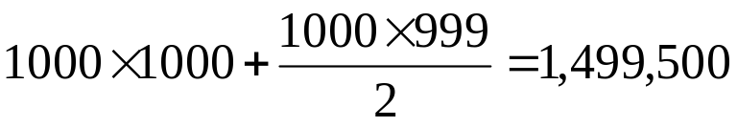
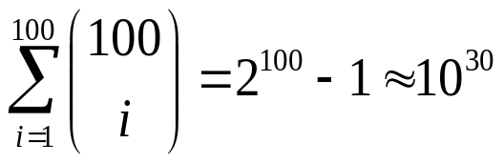
Bottlenecks of GSP
A huge set of candidates could be generated
  1,000 frequent length-1 sequences generate length-2 candidates!
Multiple scans of database in mining
Real challenge: mining long sequential patterns
  An exponential number of short candidates
  A length-100 sequential pattern needs 10³⁰ candidate sequences!

Slide 41
FreeSpan: Frequent Pattern-Projected Sequential Pattern Mining
A divide-and-conquer approach
  Recursively project a sequence database into a set of smaller databases based on the current set of frequent patterns
  Mine each projected database to find its patterns
f_list: b:5, c:4, a:3, d:3, e:3, f:2
Sequence Database
< (bd) c b (ac) >
< (bf) (ce) b (fg) >
< (ah) (bf) a b f >
< (be) (ce) d >
< a (bd) b c b (ade) >
All seq. pat. can be divided into 6 subsets:
Seq. pat. containing item f
Those containing e but no f
Those containing d but no e nor f
Those containing a but no d, e or f
Those containing c but no a, d, e or f
Those containing only item b

Slide 42
From FreeSpan to PrefixSpan: Why?
FreeSpan:
  Projection-based: No candidate sequence needs to be generated
  But, projection can be performed at any point in the sequence, and the projected sequences do will not shrink much
PrefixSpan
  Projection-based
  But only prefix-based projection: less projections and quickly shrinking sequences

Slide 43
Prefix and Suffix (Projection)
<a>, <aa>, <a(ab)> and <a(abc)> are prefixes of sequence <a(abc)(ac)d(cf)>
Given sequence <a(abc)(ac)d(cf)>
Prefix | Suffix (Prefix-Based Projection)
<a> | <(abc)(ac)d(cf)>
<aa> | <(_bc)(ac)d(cf)>
<ab> | <(_c)(ac)d(cf)>

Slide 44
Mining Sequential Patterns by Prefix Projections
Step 1: find length-1 sequential patterns
  <a>, <b>, <c>, <d>, <e>, <f>
Step 2: divide search space. The complete set of seq. pat. can be partitioned into 6 subsets:
  The ones having prefix <a>;
  The ones having prefix <b>;
  …
  The ones having prefix <f>
SID | sequence
10 | <a(abc)(ac)d(cf)>
20 | <(ad)c(bc)(ae)>
30 | <(ef)(ab)(df)cb>
40 | <eg(af)cbc>

Slide 45
Finding Seq. Patterns with Prefix <a>
Only need to consider projections w.r.t. <a>
  <a>-projected database: <(abc)(ac)d(cf)>, <(_d)c(bc)(ae)>, <(_b)(df)cb>, <(_f)cbc>
Find all the length-2 sequential patterns having prefix <a>: <aa>, <ab>, <(ab)>, <ac>, <ad>, <af>
  Further partition into 6 subsets
    Having prefix <aa>;
    …
    Having prefix <af>
SID | sequence
10 | <a(abc)(ac)d(cf)>
20 | <(ad)c(bc)(ae)>
30 | <(ef)(ab)(df)cb>
40 | <eg(af)cbc>

Slide 46
Completeness of PrefixSpan
SDB
SID | sequence
10 | <a(abc)(ac)d(cf)>
20 | <(ad)c(bc)(ae)>
30 | <(ef)(ab)(df)cb>
40 | <eg(af)cbc>
Length-1 sequential patterns
<a>, <b>, <c>, <d>, <e>, <f>
Having prefix <a>
Having prefix <c>, …, <f>
Having prefix <b>
<a>-projected database
<(abc)(ac)d(cf)>
<(_d)c(bc)(ae)>
<(_b)(df)cb>
<(_f)cbc>
<b>-projected database
…
Length-2 sequential
patterns
<aa>, <ab>, <(ab)>,
<ac>, <ad>, <af>
… …
Having prefix <aa>
Having prefix <af>
<aa>-proj. db
…
<af>-proj. db

Slide 47
Efficiency of PrefixSpan
No candidate sequences needs to be generated
Projected databases keep shrinking
Major cost of PrefixSpan: constructing projected databases

Slide 48
Optimization Techniques in PrefixSpan
Physical projection vs. pseudo-projection
  Pseudo-projection may reduce the effort of projection when the projected database fits in main memory

Slide 49
Speed-up by Pseudo-projection
Major cost of PrefixSpan: projection
  Postfixes of sequences often appear repeatedly in recursive projected databases
When (projected) database can be held in main memory, use pointers to form projections
  Pointer to the sequence
  Offset of the postfix
s=<a(abc)(ac)d(cf)>
<a>
s|<a>: ( , 2)
<(abc)(ac)d(cf)>
<ab>
s|<ab>: ( , 4)
<(_c)(ac)d(cf)>

Slide 50
Pseudo-Projection vs. Physical Projection
Pseudo-projection avoids physically copying postfixes
  Efficient in running time and space when database can be held in main memory
However, it is not efficient when database cannot fit in main memory
  Disk-based random accessing is very costly
Suggested Approach:
  Integration of physical and pseudo-projection
  Swapping to pseudo-projection when the data set fits in memory

Slide 51
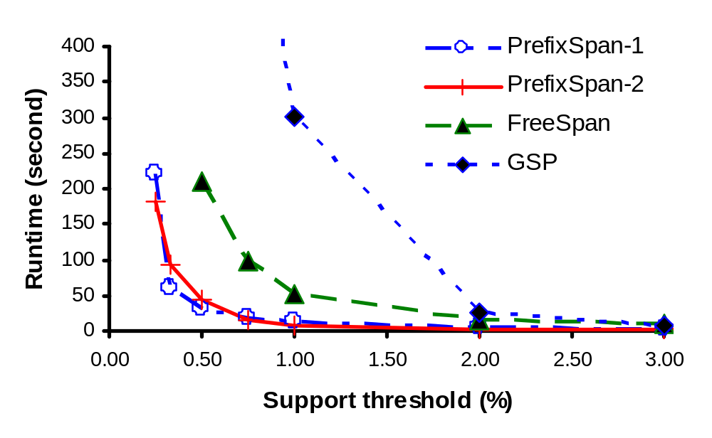
PrefixSpan Is Faster than GSP and FreeSpan

Slide 52
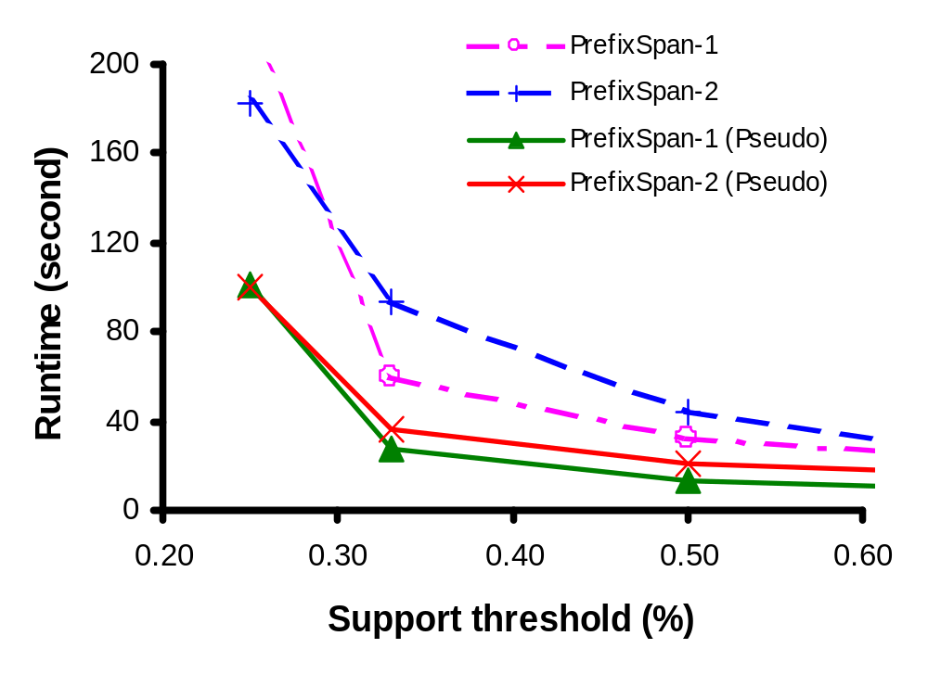
Effect of Pseudo-Projection

Slide 53
Mining Association Rules in Large Databases
Association rule mining
Algorithms for scalable mining of (single-dimensional Boolean) association rules in transactional databases
Mining various kinds of association/correlation rules
Constraint-based association mining
Sequential pattern mining
Applications/extensions of frequent pattern mining
Summary

Slide 54
Applications/extensions of frequent pattern mining
Parallel mining is another technique used to improve the classic algorithm of mining association rules on the premise that there exist multiple processors in the computing environment.

Slide 55
Applications/extensions of frequent pattern mining
The core idea of parallel mining is to separate the mining tasks into several sub-tasks so that the sub-tasks can be performed simultaneously on various processors, which are embedded in the same computer system or even spread over the distributed systems, and thus improve the efficiency of the overall algorithm for mining association rules.

Slide 56
Applications/extensions of frequent pattern mining
Parallel mining algorithms employed either the Apriori algorithm or the method of FP-growth.

Slide 57
Applications/extensions of frequent pattern mining
Dynamic mining algorithm allows users adjusting the minimum support threshold dynamically to obtain the interesting association rules before all the mining tasks are done.

Slide 58
Applications/extensions of frequent pattern mining
Incremental mining algorithms deal with the problem of updating of association rules for the databases that are changed quite rapidly (when new data are inserted into the databases).

Slide 59
Mining Association Rules in Large Databases
Association rule mining
Algorithms for scalable mining of (single-dimensional Boolean) association rules in transactional databases
Mining various kinds of association/correlation rules
Constraint-based association mining
Sequential pattern mining
Applications/extensions of frequent pattern mining
Summary

Slide 60
Frequent-Pattern Mining: Achievements
Frequent pattern mining—an important task in data mining
Frequent pattern mining methodology
  Candidate generation & test vs. projection-based (frequent-pattern growth)
  Vertical vs. horizontal format
  Various optimization methods: database partition, scan reduction, hash tree, sampling, etc.

Slide 61
Frequent-Pattern Mining: Achievements
Related frequent-pattern mining algorithm: scope extension
  Mining closed frequent itemsets and max-patterns (e.g., MaxMiner, CLOSET, CHARM, etc.)
  Mining multi-level, multi-dimensional frequent patterns with flexible support constraints
  Constraint pushing for mining optimization
  From frequent patterns to correlation and causality
Typical application examples
  Market-basket analysis, Weblog analysis, DNA mining, etc.

