Slide 1
Review Concepts & Process
Instructor: ThS. Vũ Đình Hồng

Slide 2
Objectives
After this course, students can:
Understand and apply Verification vs Validation activities in testing
Understand and apply Review activities in testing

Slide 3
Agenda
Overview
Verification vs. Validation
Review Concepts
Review Process
Types of Review
Course Duration: 2h

Slide 4
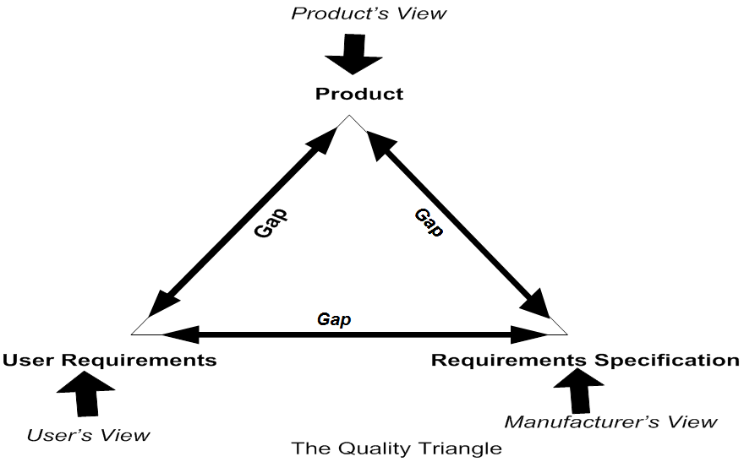
1. Overview
The Quality Triangle
Notes:
If the three views of quality are not well aligned, the sides of the triangle representing gaps between the views, will be long and the triangle will be large.
If the view of quality become better aligned, the sides of triangle will become shorter and the triangle will become smaller. If more better then views of quality be represented by a single dot

Slide 5
1. Overview The UR-RS gaps
The gaps between User Requirement (UR) and Requirement Specification (RS) is likely to include:
Misunderstood requirements
Ignored requirement
Missing requirements
Outdated requirements
Unneeded requirements

Slide 6
1. Overview The RS-Software Gap
The gap is likely to include:
Wrong interpretation of requirement due to vagueness and ambiguity in the specification
Requirements identified after development commenced and included in the software but not described in the specification
Changes to specified requirements identified after development commenced
Features added by the developers to exploit technical opportunities
Requirement ignored by the developers because they were too difficult to implement

Slide 7
1. Overview The Software-UR Gap
The gap occurs because the software doesn’t satisfy the user requirements
The size of the gap is directly dependent on the side of other 2 sides of triangle
The gap is most expensive to close since extensive rework will be necessary to modify the software

Slide 8
1. Overview Closing gaps between 3 views
Spend more money on quality by V&V activities:
Static test: verify products without execution
Review
Dynamic test: verify products with execution
Unit Test
Integration Test
System Test
Acceptance Test
Improve the processes that create the product
Notes:
V&V:Verification & Validation

Slide 9
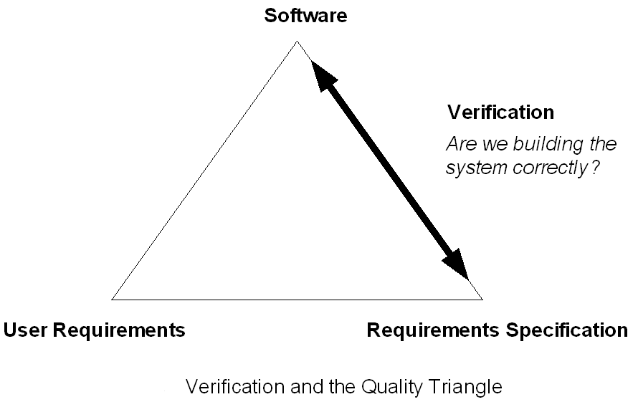
2. Verification
Verification confirms that work products properly reflect the requirements specified for them.
Did we build the system right?
Example: SRS, design and code review, unit test by development team. Integration and system test by test team.

Slide 10
2. Verification (cont)
Step 1 - Prepare for Verification
Select Work Products for Verification
Establish the Verification Environment
Establish Verification Procedures and Criteria
Step 2 – Perform Verification on selected Work Products
Perform Verification
Step 3 - Analyze Verification Results
Analyze Verification Results
Follow up

Slide 11
2. Verification (cont) Verification Products
Typical Work Product: Verification methods Verification environment, procedures, criteria Peer review schedule and checklist Entry and exit criteria for work products Criteria for requiring another peer review Peer review training material Selected work products to be reviewed

Slide 12
2. Verification (cont) Verification Products
Typical Work Product (cont): Peer review results, issues, data, action items Verification results, reports Demonstrations As- run procedure log Analysis reports Trouble reports Change requests for the verification method, criteria and environment Corrective actions to verification methods, criteria and environment

Slide 13
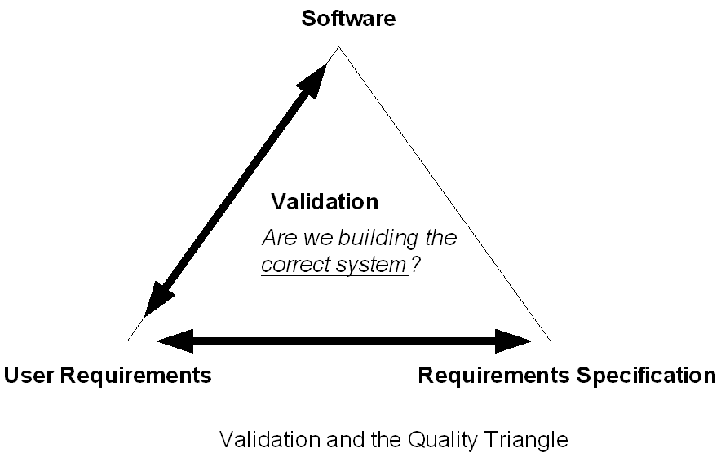
2. Validation
Validation check whether a function needed and expected by customers is present in a software product
Did we build the right system,appropriate, fit-for-use?
Example: SRS, Requirement prototype review by customer, acceptance test, beta test, operational support

Slide 14
2. Validation (cont)
Step 1 - Prepare for Validation
Select Product for Validation
Establish the Validation Environment
Define Validation Procedures and Criteria
Step 2 - Validate Product/Product Component
Perform Validation
Step 3 - Analyze Validation Results
Analyze Validation Results
Follow up

Slide 15
2. Validation Validation Products
Typical Work Product: Verification methods To-be validated requirements Validation constraints Validation environment Validation procedures, criteria Test and evaluation procedures for maintenance, training & support.

Slide 16
2. Validation Validation Products (cont)
Typical Work Product: Validation results, reports, cross-reference matrix Validation deficiency reports Validation issues Procedure change request

Slide 17

3. Review Concepts Static Testing - Review
Static testing (Review):
Testing of a component or system at specification or implementation level without execution of that software, e.g. reviews or static code analysis.
Purpose: identifying defects
Static techniques find causes of failures (defects) rather than the failures themselves
Review should be done from early of life cycle.
Notes:
Dynamic testing: Testing that involves the execution of the software of a component or system.

Slide 18
3. Review Concepts Why is Review necessary ?
Benefits of reviews:
Early defect detection and correction,
development productivity
Improvements, reduced development
timescales, reduced testing cost and time, lifetime cost
Reductions, fewer defects and improved communication. Reviews can find omissions.
Example, in requirements, which are unlikely to be found in dynamic testing.
Through reviews, team members can develop their skills and senior people can mentor less-experienced colleagues.
Notes:
Defects detected during reviews early in the life cycle are often much cheaper to remove than those detected while running tests (e.g. defects found in requirements).
To summarize and evaluate progress of a stage in project’s life cycle, as well as assess the status of the project in order to make decision of whether to let project go into the next stage or not.

Slide 19
3. Review Concepts What can be reviewed ?
Any software work product can be reviewed, including:
Requirements specifications
Design specifications
Code
Test plans
Test specifications
Test cases
Test scripts
User guides or web pages.

Slide 20

3. Review Concepts Defect Types found by Review
Some types of defect can be detects by review easier than dynamic testing (and vice versa).
Typical defects that are easier to find in reviews than in dynamic testing are:
Deviations from standards
Requirement defects
Design defects
Insufficient maintainability
Incorrect interface specifications
Notes:
Dynamic testing: Testing that involves the execution of the software of a component or system.

Slide 21
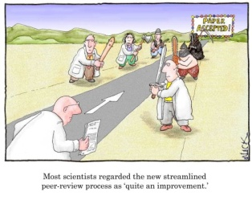
4. Review Process
Phases of a formal review:
Planning
Kick-off
Preparation
Review meeting
Rework
Follow-up
Notes:
1. Planning: selecting the personnel, allocating roles; defining the entry and exit criteria for more
formal review types (e.g. inspection); and selecting which parts of documents to look at.
2. Kick-off: distributing documents; explaining the objectives, process and documents to the
participants; and checking entry criteria (for more formal review types).
3. Individual preparation: work done by each of the participants on their own before the review
meeting, noting potential defects, questions and comments.
4. Review meeting: discussion or logging, with documented results or minutes (for more formal
review types). The meeting participants may simply note defects, make recommendations for
handling the defects, or make decisions about the defects.
5. Rework: fixing defects found, typically done by the author.
6. Follow-up: checking that defects have been addressed, gathering metrics and checking on exit
criteria (for more formal review types).

Slide 22
4. Review Process Roles and Responsibilities
Moderator
Also known as review leader
Performs entry check Follow-up on the rework
Schedules the meeting
Coaches other team
Leads the possible discussion and stores the data that is collected
Scribe
(recorder)
Illuminate the unclear areas and understand the defects found
Basic goal should be to learn as much as possible with regard to improving the quality of the document.
Manager decides on the execution of reviews
Allocates time in project schedules and determines whether review process objectives have been met
Also known as checkers or inspectors
Identify and describe findings (e.g. defects) in the product under review
A separate person to do the logging of the defects found during the review.
Author
Manager
Reviewer(s)
Notes:
Manager: decides on the execution of reviews, allocates time in project schedules and determines if the review objectives have been met.
Moderator: the person who leads the review of the document or set of documents, including planning the review, running the meeting, and follow-up after the meeting. If necessary, the moderator may mediate between the various points of view and is often the person upon whom the success of the review rests.
Author: the writer or person with chief responsibility for the document(s) to be reviewed.
Reviewers: individuals with a specific technical or business background (also called checkers or inspectors) who, after the necessary preparation, identify and describe findings (e.g. defects) in the product under review. Reviewers should be chosen to represent different perspectives and roles in the review process, and should take part in any review meetings.
Scribe (or recorder): documents all the issues, problems and open points that were identified during the meeting.

Slide 23

4. Review Process
Types of review:
Informal review
Walkthrough
Technical review
Inspection
Walkthroughs,
technical reviews
and inspections called a “peer review”
Notes:
- Peer review: review can be performed within a peer group – colleagues at the same organizational level

Slide 24

4. Review Process
Success factors for reviews:
Each review has a clear predefined objective.
The right people are involved.
Defects found are welcomed.
People issues and psychological aspects are dealt with.
Review techniques are applied that are suitable to the type and level of software work products and reviewers.
Checklists or roles are used to increase effectiveness.
Training is given in review techniques.
Management supports a good review process.
There is an emphasis on learning and process improvement.
Notes:
Reviews, allocates time in project schedules and each review has a clear predefined objective.
The right people for the review objectives are involved.
Defects found are welcomed, and expressed objectively.
People issues and psychological aspects are dealt with (e.g. making it a positive experience for the author).
Review techniques are applied that are suitable to the type and level of software work products and reviewers.
Checklists or roles are used if appropriate to increase effectiveness of defect identification.
Training is given in review techniques, especially the more formal techniques, such as inspection.
Management supports a good review process (e.g. by incorporating adequate time for review activities in project schedules).
There is an emphasis on learning and process improvement.

Slide 25
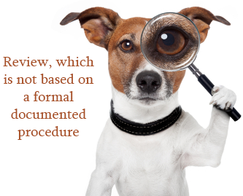
5. Types of Review
Informal review:
No formal process
Optionally may be documented
May vary in usefulness
depending on the reviewer
There may be pair programming
or a technical lead reviewing designs and code
Main purpose: inexpensive way to get some benefit
Notes:
The goal is to help the author and to improve the quality of the
document. Informal reviews come in various shapes and forms, but all have one
characteristic in common - they are not documented.

Slide 26
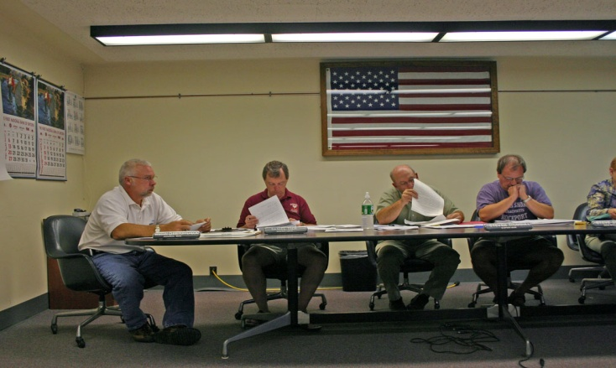
4. Types of Review
Walkthrough:
Meeting led by author
Scenarios, dry runs, peer group
Open-ended sessions
Optionally a pre-meeting preparation of reviewers, review report, list of findings and scribe (who is not the author)
May vary in practice from quite informal to very formal
Main purposes: learning, gaining understanding, defect finding.
Notes:
A walkthrough is especially useful for higher-level documents, such as
requirement specifications and architectural documents.

Slide 27

4. Types of Review
Technical review:
Documented, defined defect-detection process that includes peers and technical experts
May be performed as a peer review without management participation
Ideally led by trained moderator (not the author)
Pre-meeting preparation
Optionally the use of checklists, review report, list of findings and management participation
May vary in practice from quite informal to very formal
Main purposes: discuss, make decisions, evaluate alternatives, find defects, solve technical problems and check conformance to specifications and standards.

Slide 28
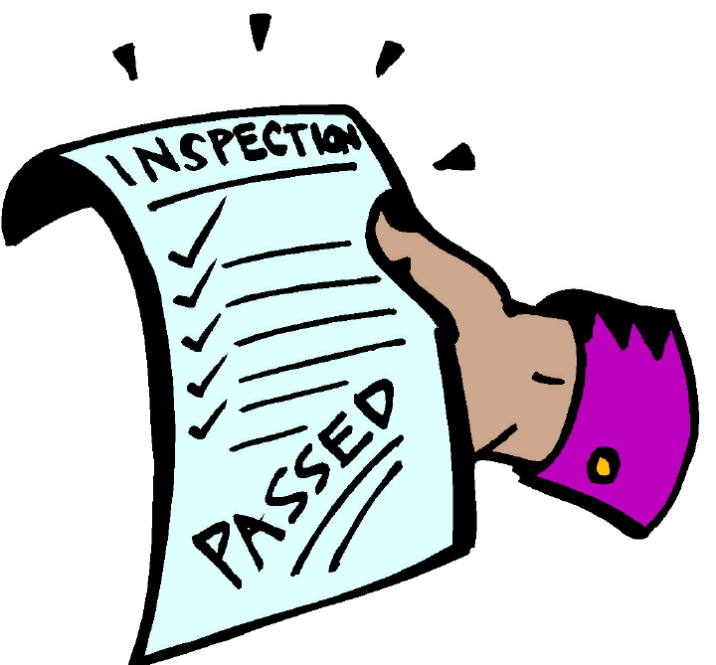
4. Types of Review
Inspection:
Led by trained moderator (not the author)
Usually peer examination
Defined roles
Includes metrics
Formal process based on rules and
checklists with entry and exit criteria
Pre-meeting preparation
Inspection report, list of findings
Formal follow-up process
Optionally, process improvement and reader
Main purpose: find defects
Notes:
The document under inspection is prepared and checked thoroughly by the reviewers before the meeting, using rules and checklists.

Slide 29
Thank you
&
Question - Answer

Slide 30
Reference:
http://istqbexamcertification.com/
http://istqb.org/ (Syllabus Foundation Level)

