Slide 1
Software Testing Basics
Instructor: ThS. Vũ Đình Hồng

Slide 2
Objectives
After this course, students can have:
Basic knowledge about software testing
Basic concepts in software testing
Course Duration: 4h

Slide 3
Agenda
Test Definition
Test Process
Test Levels
Test Types
Test Techniques
Test Documents
Defect Concepts
Test Measurements
Tester Attitudes and Skills

Slide 4
1. Test Definition What is Testing ?
What is Testing ?
The process of exercising or evaluating a system or system component by manual or automated means to verify that it satisfies specified requirements - (IEEE 83a)
Test Objectives:
Primary: Execute a program with the intent of finding defects to:
Determine whether system meets specifications
Determine whether system meets user’s needs
Secondary: gain confidence about the level of quality, providing information, continuous improve test process
4

Slide 5
2. Test Process Testing within a life cycle model
6 phases in every SDLC:
Requirement gathering
and Analysis
Design
Coding
Implementation
Testing
Maintenance
Deployment
5
Notes:
SDLC: Software Development Life Cycle:
There are various Software development models or methodologies. They are as follows:
Waterfall model
V model
Incremental model
RAD model
Agile model
Iterative model
Spiral model

Slide 6
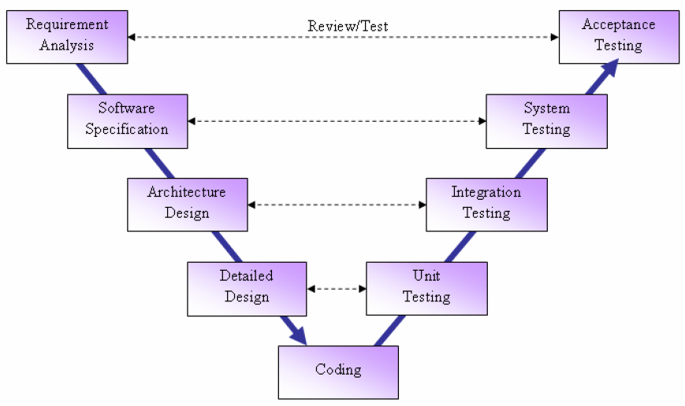
1. Testing Definition Where are testing tasks?
Notes:
For every development activity there is a corresponding testing activity.
Each test level has test objectives specific to that level.
The analysis and design of tests for a given test level should begin during the corresponding development activity.
Testers should be involved in reviewing documents as soon as drafts are available in the development life cycle.

Slide 7
2. Test Process
Business Requirements
Functional Specification
User Stories
Project Plan Document
Solution Document
Test Plan
Business Requirements
Functional Specification
User Stories (Draft)
Project Plan Document
Solution Document
Test Designs
Test Cases
Test Procedures
Test Data
Test Results
Test Scripts
Test Plan
Test Reports
Planning and Control
Analysis and Design
Implementation and Execution
Test Report and Evaluation
Test Closure
Test Plan
Test Designs
Test cases
Test Procedures
Test Data
Test Results
Test Scripts
Defects
Test Reports
Exit Criteria Evaluation
Test Report Summary

Slide 8
2. Test Process
Common Inputs and Outputs
Test Planning:
Input: Project plan, Customer Requirement & Acceptance criteria/SRS
Output: Test Plan document
Test Design:
Input: Test plan, Requirement, detail design
Output: Test cases, test scripts, test data in high level
Test Implementation and Execution:
Input: Test cases, test data, test scripts
Output: Test report, Defect list

Slide 9
2. Test Process Common Test Resources
Guideline: Test process
Templates for test documents:
Test Plan
Test case specification
Test report
Defect analysis report
Test tools:
Defect tracking tool
Test Effort tracking tool
Test schedule
Test automation tools
Rational Robot (Functional & Performance test)
OpenSTA (Open source), Witir (Open source)

Slide 10

3. Test Levels
There are 4 levels of testing:
Unit Test (Component Test)
Integration Test
System Test
Acceptance Test
Notes:
Depend on company/organization, Test Levels and Test Stages can be the same or different.

Slide 11
3. Test Levels Unit Test/Component Test
Component test:
The testing of individual software components (e.g. modules, programs, objects, classes, etc.) that are separately testable.
Test cases are derived from work products:
Specification of the component
Software design
Data model
Doer: Development team

Slide 12
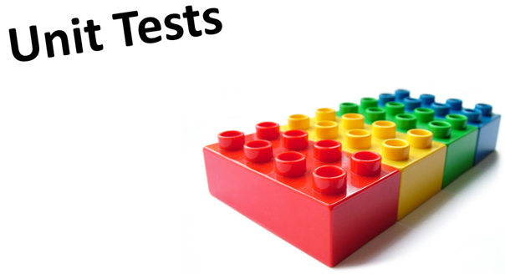
3. Test Levels Unit Test/Component Test
Component test may include:
Testing of functionality
Testing of specific non-functional characteristics, such as resource-behaviour (e.g. memory leaks) or robustness testing
Structural testing (Structure-based techniques)
Notes:
Structure-based techniques = White Box Testing

Slide 13
3. Test Levels Integration Test
Integration test:
Test interfaces between components, interactions to different parts of a system such as an operating system, file system and hardware or interfaces between systems.
Component integration test:
Tests the interactions between software components and is done after component testing.
System integration test:
Tests the interactions between different systems and may be done after system testing.
Doer: independent Test team

Slide 14

3. Test Levels Integration Test
Integration test may include:
Testing of functionality
Testing of specific non-functional characteristics (e.g. performance)
Structural testing (Structure-based techniques)
IT is only after UT/CT
Notes:
IT: Integration test
UT/CT: Unit Test/Component Test

Slide 15
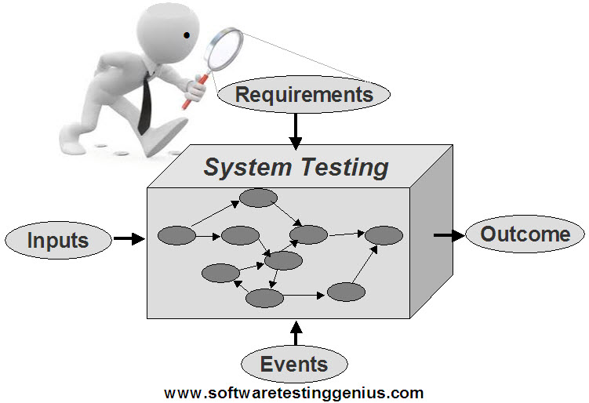
3. Test Levels System Test
System test:
The process of testing an integrated system to verify that it meets specified requirements.
Often using the specification-based (black-box) techniques.

Slide 16
3. Test Levels System Test
System test:
Test environment should correspond to the final target or production environment as much as possible.
Should investigate both functional and non-functional requirements of the system
Independent test team often carries out system testing.
Structure-based techniques (white-box) sometimes may be used
Doer: independent Test team

Slide 17

3. Test Levels Acceptance Test
Acceptance test:
Formal testing with respect to user needs, requirements, and business processes conducted to determine whether or not a system satisfies the acceptance criteria and to enable the user, customers or other authorized entity to determine whether or not to accept the system.
Is often the responsibility of the customers or users of a system.
The goal is to establish confidence.
Finding defects is not the main focus
in acceptance test.
Doer: Customer/independent Test team

Slide 18
4. Test Types
Functional test: testing of “what” the system does
Black-box testing
User Interface testing
Data and database integrity testing
Business cycle testing
Security testing
Interoperability testing
…
Non-Functional test: testing of “how” the system works
Performance testing
Usability testing
Maintainability testing
Notes:
Depend on context of texting, Security can be Functional Testing or Non-Functional Testing

Slide 19
4. Test Types
Non-Functional test: testing of “how” the system works (cont)
Load testing
Stress testing
Reliability testing
Portability testing
Structural testing: white-box testing
What is happening 'inside the box'
Testing relates to changes:
Re-testing: confirmation testing
Regression testing

Slide 20
5. Test Techniques
STATIC
DYNAMIC
Informal Reviews
Static Analysis
Specification-based
Walkthroughs
Data Flow
Experience-based
Equivalence Partitioning
Inspection
Control Flow
Error Guessing
Technical Reviews
Structure-based
Boundary Value Analysis
Exploratory Testing
Statement
Decision Tables
Decision
State Transition
Condition
Use case testing
Multiple Condition
Notes:
Static testing: Testing without execution of the software of a component or system.
Dynamic testing: Testing that involves the execution of the software of a component or system.
Dynamic testing includes:
Structure-based (White Box Testing)
Specification-based (Black Box Testing)
Experience-based (Experience Testing)

Slide 21
5. Test Techniques White Box Testing
White Box Testing:
Structural or structure-based techniques
Base on an analysis of the structure of the component or system.
X
public int (x, y)
int sum = 0;
sum = x + y;
}
return sum;}
Z = X + Y
Y
Notes:
White Box Testing Techniques:
Statement testing and coverage
Decision (branch) testing and coverage
Other structure-based techniques

Slide 22
5. Test Techniques Black Box Testing
Black Box Testing:
Specification-based techniques
Base on an analysis of the test basis documentation without reference to its internal structure.
5
∑
7
2
Notes:
Black Box Testing Techniques:
Boundary value analysis
Decision table testing
Equivalence partitioning
State transition testing
Use case testing

Slide 23

5. Test Techniques Experience Testing
Experience Testing:
Tests are derived from the tester’s skill and intuition and their experience with similar applications and technologies
Effectiveness of this technique depended on the testers’ experience
Notes:
Experience Testing Techniques:
Error Guessing
2. Exploratory testing

Slide 24
6. Test Documents Test Plan
Test Plan to define:
Scope of test: levels and types of test
Risks may affect testing: quantify the loss of the risk
Training needs for testers
Requirements to test: what will be tested
Testing strategy: how will the test be performed
Completion criteria (Pass/Fail)
Tools to be used for testing
Testing environment and testing resource assignment (Responsibilities of testers)
Test Milestone: schedule of testing activities

Slide 25
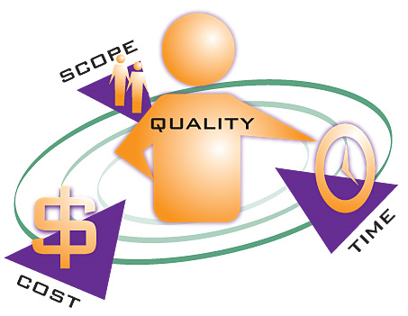
6. Test Documents Test Plan
Test Plan to define:
Test deliverables: outputs of testing
Decide test metrics & manage through metrics
Criteria to stop testing:
Not good Unit Test
Low quality of code,…
Meet requested Test coverage
All Test cases are tested and passed

Slide 26
6. Test Documents Test Design
Specifications:
Basic flow
Alternative flow
Test Design:
All test cases should be traceable to requirements
Design framework and rules for test cases (large/average items)
Plan number of test cases for normal, abnormal & boundary data
Assign testers for module/function/large items

Slide 27
6. Test Documents Test Design
Structure/Framework for Test cases (TC):
Modules or functions
Large items
GUI
Functional cases
Non-functional cases
Number of TC:
Total
For each module
For each type: GUI/Function
For normal/abnormal/boundary cases

Slide 28
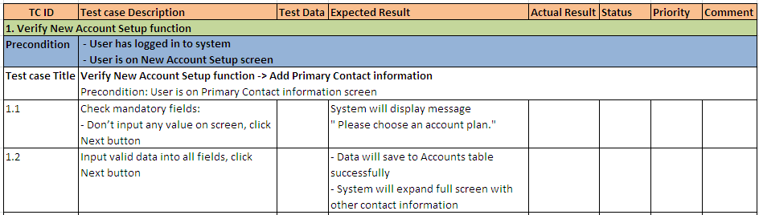
6. Test Documents Test Case
What is a test case?
A test case consists of a set of input values, execution preconditions, expected results and execution post-conditions, developed to cover certain test condition(s).
Test case Sample:
Test case management tools: Test Link, Mercury,…

Slide 29
6. Test Documents Test Case
How is a good test case:
Should be accurate and tests what it is intended to test.
No unnecessary steps should be included in it.
It should be reasonable and reusable.
It should be closed to requirements.
It should be compliant to regulations.
It should be independent i.e. You should be able to execute it in any order without any dependency on other test cases.
It should be simple and clear, any tester should be able to understand it by reading once.
Cover all of cases that can occur

Slide 30
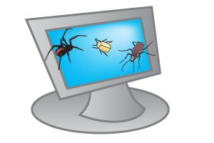
7. Defect Concepts
What is defect?
A defect is any error found by testing and reviewing activities (all errors found by internal reviewer, external reviewer and customer).
Where defects come from?
Products
SRS, DD, Source code, Test cases, etc.
Quality Control
Review, Test, Audit, Inspection
Processes
Requirements, Design, Coding, Test, etc.
Other sources:
Change requests, misunderstanding, carelessness, planning, etc.

Slide 31
7. Defect Concepts Cost of defects

Slide 32
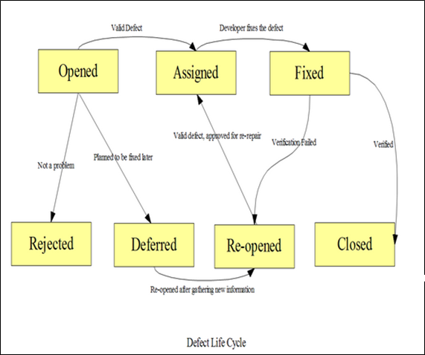
7. Defect Concepts Common Defect Life Cycle

Slide 33
7. Defect Concepts Defect Content
Main items in a defect:
Defect title
Component/Function
Defect description
Step to reproduce
Actual result
Expected result
Screen shot if any
Priority
Severity
Test case ID
Defect type

Slide 34
7. Defect Concepts Defect Content
Defect status:
Opened
Assigned
Fixed
Deferred
Re-opened
Closed
Reject (works as per Requirements, wont fix, works for me)

Slide 35
7. Defect Concepts
How to write a good defect report:
General outline of a bug report:
Summary/Title
Component/Function Name
OS (optional)
Description
Steps to Reproduce
Actual Results
Expected Results
Attachments OS (optional)
Defect summary: Problem + Action + Location
Defect management tools: Bugzilla, Mercury,…

Slide 36
8. Test Measurements Common Test Measurements
Measurements:
Defects: number, severity, type of defects
Test effort: time spend for testing activities
Test coverage: number of executed test cases/ Total number of TCs
Test successful coverage: number of test cases executed pass/total number of test cases

Slide 37

9. Tester Attitudes and Skills
Attitudes:
Careful
Patient
In details
Ethic
Skills:
Communication
Reading Comprehension
Problem Solving
Documentation
Self-organization
Notes:
Attitudes: Mình là người làm chất lượng thì bản thân mình phải là người chất lượng
Skill: item #3: Critical Thinking Skill (Analyzing, Reasoning, Evaluating, Problem Solving, Decision Making)

Slide 38

Recommendation for Testers
Improve your foreign language skills
Self study software testing techniques
Improve the five skills
Attend software testing class
Take testing certificates

Slide 39
Thank you
&
Question - Answer

Slide 40
Reference:
http://istqbexamcertification.com/
http://istqb.org/ (Syllabus Foundation Level)
http://www.qatutorial.com
http://www.softwaretestingmentor.com

