Slide 1
Test Design
Instructor: <Instructor Name>

Slide 2
Objectives
Duration: 1 Hours
Purpose: Introduce how to create test cases with different requirements
Audience: Testers

Slide 3
Training Agenda
1
Test requirements
2
Test case structure
3
Test case design

Slide 4
1. Test Requirements
A system normally includes:
Functional requirement: a number of use cases, functions, present for business of the system.
Workflow: the relationship of use cases
Non functional requirement:
Performance
Usability…
Notes:
Functional requirement: a number of use cases, functions, present for business of the system.
Administration use cases: functions to manage reference/look up data.
Business use cases: individual functions of the system
Reports/Views
Agents/time schedule

Slide 5
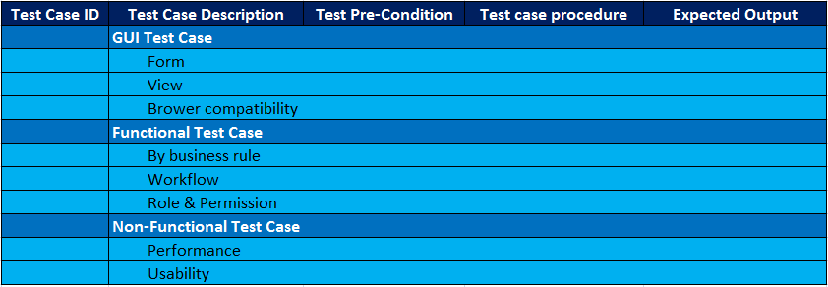
2. System Test Case Structure
GUI test cases
Functional test cases
Non-Functional test cases

Slide 6
3. Test Case Design
1 use case ⬄ 1 function ⬄ 1 screen/window ⬄ 1 group of test cases
Test cases for 1 function include:
User interface test cases
Form, View, Browser compatibility test cases…
Functional test cases
Field validation test cases: validation for difference kind of data
Workflow test cases…
Non-Functional test cases
Performance test cases…
=>Test cases are numbered and managed
Notes:
Test cases for a views/reports
Verify filter condition for a view/report
Verify data in view/report
Verify grouping and verify collapse/expand
Verify sorting
Verify pagination

Slide 7
3. Test Case Design User Interface Test Cases
Based on screen design/ prototype
Test User interface
Interface: size, position, menu, look and feel, field alignment…
Objects: buttons, checkbox, text box, list box, links, combo box…
Object/control type
Editable
Mandatory
Default value
Max length
Enable/disable
Hide/Un-hide…
Access methods: tab keys, mouse movements, accelerator key, tool tip…
Notes:
accelerator key: phim tat

Slide 8
3. Test Case Design Browser compatibility test cases
Define test cases for specific browser, eg: IE6, IE7, etc.
Each test case should present for a screen/window in specific browser.

Slide 9
3. Test Case Design Functional test cases
Test cases with valid/invalid data
Test cases for defined business rules in SRS
Using test techniques to design functional test cases
Test techniques can be:
Equivalent Partition
Boundary Value
Decision Table
State Transition
Use case
Refer to “Test Design Techniques_v1.0.ppt” file

Slide 10
3. Test Case Design: Functional test cases Field validation: Combo box fields
Verify list values of look up field/ combo box field
Verify default value of combo box field
Verify sorting in look up fields (normally order by alphabet)
Verify selecting values in combo box field

Slide 11
3. Test Case Design: Functional test cases Field Validation: Text Fields
Single line of text
Verify mandatory
Verify auto trim
Verify encode (input the text with html tag)
Verify max length
Verify case-sensitive (text field in searching)
Multi line of text / Rich text fields
Verify mandatory
Verify displaying of vertical scroll bar when input multi line of text
Verify inputting multi line of text with format text (bold, italic, colour, link, attachment) to rich text fields
Verify wrap text
Verify table, link, image
Verify links, attachments

Slide 12
3. Test Case Design: Functional test cases Field Validation: Date Fields
Check mandatory fields
Check date picker
Check date format (inputted date, conversion of inputted date)
Compare inputted date to current date (if required)
Compare “From Date” to “To Date” (if required)
Compare dates based on business rules
Display of date field when change Regional setting
Date < min date

Slide 13
3. Test Case Design: Functional test cases Field Validation: Numeric Fields
Check mandatory fields
Check max value/min value
Check integer/decimal number
Check positive/negative number
Check conversion of format (decimal symbol, digit grouping symbol, display leading zero)

Slide 14
3. Test Case Design: Functional test cases Field Validation: Attach Fields
Attachment with various file types (.doc, .xls, .pdf, etc.)
Attachment with file size > 50Mb
Cancel adding attachment (by clicking [Cancel] button on browser page)
Remove the attachment files
Attach many files at the same time
Attach virus file

Slide 15
3. Test Case Design: Functional test cases Workflow test cases
Test workflow
Define pre-condition
Define Action, Role, Status for each step in workflow.
Example

Slide 16
3. Test Case Design Performance test cases
Verify if response time of operations in system meet customer’s expectation or web application standard or not.
Normally measure response time for 1 user using the system (not for concurrent users) but on a specific volume data.
Each test case defined for a specific functions which want to measure the performance
Functions should be measure performance
Core functions/features of system
View/Report which contains many data
Search function
Agent/Time schedule feature

Slide 17
QUESTIONS AND ANSWERS

Slide 18
Thank you!!!

