Slide 1
Test Design Techniques
Instructor: <Instructor Name>

Slide 2
Objective
Duration: 2.5 Hours
Purpose: How to design test cases from given software models using the following test design techniques
Audience: Testers

Slide 3
Training Agenda
1
Equivalent Partitioning
2
Boundary Value Analysis
3
Decision Table
4
State Transition
5
Use case

Slide 4
Black Box Test - Test Techniques
Test techniques for Black Box Test (Specification-Based) can be:
Equivalent Partitioning
Boundary Value
Decision Table
State Transition
Use case

Slide 5
Equivalent Partitioning
The idea behind the technique is to divide (i.e. to partition) a set of test conditions into groups or sets that can be considered the same (i.e. the system should handle them equivalently).
The equivalence-partitioning technique then requires that we need test only one condition from each partition.
Equivalence partitions (or classes) can be found for both valid data and invalid data.
Partitions can also be identified for outputs, internal values, time-related values (e.g. before or after an event) and for interface parameters (e.g. during integration testing), not only for inputs.
Notes:
This method is typically used to reduce the total number of test cases to a finite set of testable test cases, still covering maximum requirements

Slide 6
Equivalent Partitioning
Identify Equivalent Classes
Take each input condition described in the specification and derive at least two equivalence classes for it.
One class that satisfies the condition – the valid class.
Second class that doesn't satisfy the condition – the invalid class

Slide 7
Equivalent Partitioning Identify Equivalent Classes
Equivalent Classes

Slide 8

Equivalent Partitioning
Example
A candidate is given an exam of 40 questions, should get 26 marks to pass (65%), and get more than 80% for get reward.
>> At least, how many test cases to cover all valid and invalid cases?
42 cases (-1, 0, 1, … 40, 41)
5 cases (-1, 11, 21, 31, 41)
I think it’s easy… but I don’t know!
5 cases (-5, 15, 30, 35, 45)

Slide 9

Equivalent Partitioning
Example (cont.)
Answer: 5 cases
invalid
fail
pass
reward
invalid
0
26
32
40
SHE’S RIGHT
5 cases (-5, 15, 30, 35, 45)

Slide 10
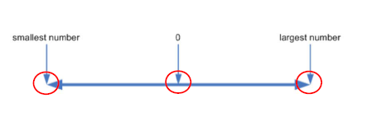
Boundary Value Analysis

Slide 11
Boundary Value Analysis
Boundary Value Analysis (BVA) is based on testing at the boundaries between partitions (the maximum and minimum values of partitions).
This technique is often considered as an extension of equivalence partitioning.
The maximum and minimum values of a partition are its boundary values
Have both valid boundaries (in the valid partitions) and invalid boundaries (in the invalid partitions).
Notes:
Behavior at the edge of each equivalence partition is more likely to be incorrect, so boundaries are an area where testing is likely to yield defects
Tests can be designed to cover both valid and invalid boundary values. When designing test cases, a test for each boundary value is chosen

Slide 12
Boundary Value Analysis
Boundary value analysis can be applied at all test levels. It is relatively easy to apply and its defect finding capability is high; detailed specifications are helpful
Boundary values may also be used for test data selection.
Notes:
This technique is often considered as an extension of equivalence partitioning. It can be used on equivalence classes for user input on screen as well as, for example, on time ranges (e.g. time out, transactional speed requirements) or table ranges (e.g. table size is 256*256).

Slide 13
Boundary Value Analysis
Example
A candidate is given an exam of 40 questions, should get 26 marks to pass (65%), and get more than 80% for get reward.
>> What are boundary values?
I understand. How about you?
Notes:
Open boundaries are more difficult to test, but there are ways to approach them. Actually the best solution to the problem is to find out what the boundary should be specified as! One approach is to go back to the specification to see if a maximum has been stated somewhere else for a balance amount. If so, then we know what our boundary value is. Another approach might be to investigate other related areas of the system. For example, the field that holds the account balance figure may be only six figures plus two decimal figures. This would give a maximum account balance of $999 999.99 so we could use that as our maximum boundary value. If we really cannot find any-thing about what this boundary should be, then we probably need to use an intuitive or experience-based approach to probe various large values trying to make it fail.

Slide 14
Boundary Value Analysis
Example
Boundary Value – 1; Boundary Value; Boundary Value + 1
-1
1
25
27
31
33
39
41
0
26
32
40
-1
1
fail
25
27
31
33
39
41
0
26
pass
32
reward
40
-1
fail
26
31
reward
41
invalid
0
25
pass
32
40
invalid
Boundary Value: -1, 0, 25, 26, 31, 32, 40, 41
Notes:
Open boundaries are more difficult to test, but there are ways to approach them. Actually the best solution to the problem is to find out what the boundary should be specified as! One approach is to go back to the specification to see if a maximum has been stated somewhere else for a balance amount. If so, then we know what our boundary value is. Another approach might be to investigate other related areas of the system. For example, the field that holds the account balance figure may be only six figures plus two decimal figures. This would give a maximum account balance of $999 999.99 so we could use that as our maximum boundary value. If we really cannot find any-thing about what this boundary should be, then we probably need to use an intuitive or experience-based approach to probe various large values trying to make it fail.

Slide 15
Why Both EP and BVA?
Reasons:
Every boundary is in some partition, if you did only boundary value analysis you would also have tested every equivalence partition.
If only testing boundaries we would probably not give the users much confidence as we are using extreme values rather than normal values
Notes:
For example, in the printer copies example described earlier we identified the following boundary values:
Suppose we test only the valid boundary values 1 and 99 and nothing in between. If both tests pass, this seems to indicate that all the values in between should also work. However, suppose that one page prints correctly, but 99 pages do not. Now we don't know whether any set of more than one page works, so the first thing we would do would be to test for say 10 pages, i.e. a value from the equivalence partition.

Slide 16
Decision Table
A good way to deal with combinations of things (e.g. inputs).
This technique is sometimes also referred to as a 'cause-effect' table.
Notes:
It is a technique that works well in conjunction with equivalence partitioning. The combination of conditions explored may be combinations of equivalence partitions

Slide 17
Decision Table Components of Decision Table
Rules
R1 R2 R3 R4 R5 R6 R7 R8
C1
T T T T F F F F
Conditions
/Causes
C2
T T F F T T F F
Values of Conditions
C3
T F T F T F T F
a1
x x x x
a2
x x
Actions
/Outputs
Actions taken
a3
x x
a4
x x x x
a5
x x

Slide 18
Decision Table Example
Example:
You want to open a credit card account, there are three conditions. First, if you are a new customer then you will get a 15% discount on all your purchases today, second if you are an existing customer and you hold a loyalty card, you get a 10% discount and third if you have a coupon, you can get 20% off today (but it can’t be used with the ‘new customer’ discount). Discount amounts are added, if applicable. Note: New customer can’t hold loyalty card.
=> Decision table:
Conditions | Rule 1 | Rule 2 | Rule 3 | Rule 4 | Rule 5 | Rule 6 | Rule 7 | Rule 8
New customer (15%) | T | T | T | T | F | F | F | F
Loyalty card (10%) | T | T | F | F | T | T | F | F
Coupon (20%) | T | F | T | F | T | F | T | F
Actions
Discount 15% |  |  | x | x
Discount 10% |  |  |  |  | x | x
Discount 20% |  |  | x |  | x |  | x
Total Discount (%) | - | - | 20 | 15 | 30 | 10 | 20 | 0
Notes:
It is a technique that works well in conjunction with equivalence partitioning. The combination of conditions explored may be combinations of equivalence partitions

Slide 19
State Transition
Allows the tester to view the software in terms of its states, transitions between states, the inputs or events that trigger state changes (transitions) and the actions which may result from those transitions.
A state table shows the relationship between the states and inputs, and can highlight possible transitions that are valid.
A state diagram also can be used to show a finite state system.

Slide 20
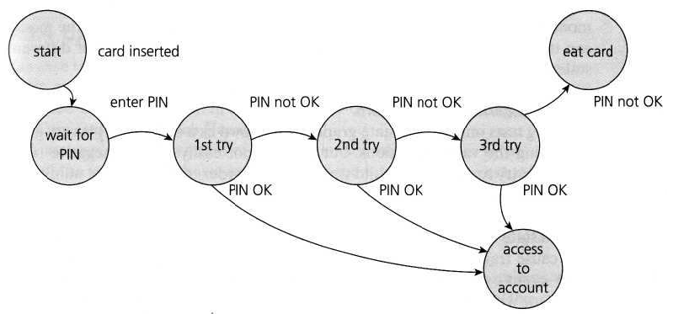
State Transition Example
Example 1: bank ATM
State diagram:
Notes:
Note that a transition does not need to change to a different state; it could stay in the same state. In fact, trying to input an invalid input would be likely to produce an error message as the action, but the transition would be back to the same state the system was in before.

Slide 21
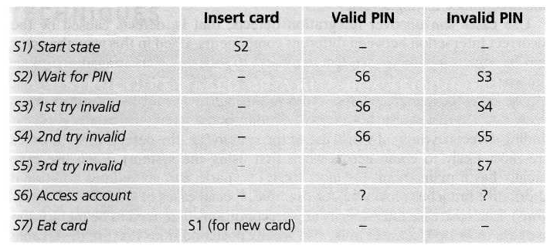
State Transition Example
Example 1: bank ATM
State table:

Slide 22
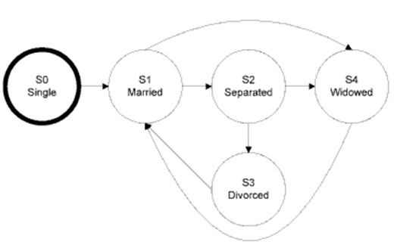
State Transition Example
Example 2: Which test suite will check for an invalid transition using the diagram below?
A. S0-S1-S2-S3-S1-S4
B. S0-S1-S4-S1-S2-S3
C. S0-S1-S3-S1-S2-S1
D. S0-S1-S2-S3-S1-S2

Slide 23
Use case
A use case describes interactions between actors, including users and the system, which produce a result of value to a system user.
Each use case has preconditions, terminates with post-conditions
A use case usually has a mainstream (i.e. most likely) scenario, and sometimes alternative branches.
Use cases, often referred to as scenarios, are very useful for designing acceptance tests with customer/user participation.
They also help uncover integration defects caused by the interaction and interference of different components, which individual component testing would not see.

Slide 24
Use case - Example
Example: ATM system include functions:
Login
Insert card – input password -> go to Main screen
User can input wrong password maximum 2 times
Withdraw money
Main screen – select Withdraw - input money – receive money
User can decide print receipt or not
Check Balance
Main screen – Check Balance
User can decide print receipt or not
Logout
Any screen - press Exit – cancel process - eject card

Slide 25
Use case - Example
Example: Use case which Tester can consider to write Test case:
Use case | Test case | Pre-condition | User | System | Note
Withdraw money | 1 | Right card | Insert card | Go to Login | mainstream scenario
 |  |  | Input right password | Go to Main screen
 |  |  | Select Withdraw | Go to Input Money screen
 |  |  | Enter amount money (< balance) | Process to dispense money
 |  |  |  | Ask user print receipt or not?
 |  |  | Confirm Yes | Eject card
 |  |  | User get card | Eject money
 |  |  | Get money | Print receipt
 |  |  | Get receipt | Go to home page
 | 2 | Right card | Insert card | Go to Login | alternative branches
 |  |  | Input right password | Go to Main screen
 |  |  | Select Withdraw | Go to Input Money screen
 |  |  | Enter amount money (> balance) | Request user re-enter money
 |  |  | Enter amount money again (< balance) | Ask user print receipt or not?
 |  |  | Confirm No | Eject card
 |  |  | User get card | Eject money
 |  |  | Get money | Go to home page
 | … |  | …
Check balance | 1 | Right card | Insert card | Go to Login | mainstream scenario
 |  |  | Input right password | Go to Main screen
 |  |  | Select Check Balance | Check & show balance
 |  |  |  | Ask user print receipt or not?
 |  |  | Confirm Yes | Print receipt
 |  |  |  | Ask user continue or not?
 |  |  | Confirm No | Eject card
 |  |  | Get receipt | Go to home page
 | 2 | Right card | Insert card | Go to Login | alternative branches
 |  |  | Input wrong password | Request user re-enter password 1st
 |  |  | Press exit | Eject card
 |  |  | Get card | Go to home page
 | … |  | …

Slide 26
QUESTIONS AND ANSWERS

Slide 27
Thank you!!!

