Slide 1
Test Case Concepts & Template
Author: ThS. Vũ Đình Hồng
Last updated: Mar-2014

Slide 2
Agenda
Duration: 2 Hours
Audience: Testers
Content:
Test case concepts
Test case guideline
Test case review checklist
Test case management

Slide 3
Objectives
After the course, student will:
Understanding what is Test Case
Aware about Test case template
Able to understand how to read & create test case
Using checklist to review Test Case

Slide 4
What is Test Case?
A set of pre-requisites/pre-conditions, input value, execution steps, expected results
Developed for a particular objective or test condition
For example:
Exercise a particular program path or to verify compliance with a specific requirement
This template is used for writing TCs of Integration test, System Test, User Acceptance Test.

Slide 5
Inputs for creating Test case
Test plan
Test design
Requirement (User requirement, SRS - Software Requirement Specification, User stories,…)
GUI design
Database design
Prototype
User manual, technical manual
Domain knowledge, business experience
…
Notes:
Maintenance project: User manual, technical manual.

Slide 6
Test Case ID
Unique number to identify test case. It should be ID to:
Easy to say it belong to which module
Easy to add new one into a module and don’t change ID of other
Should not replaced by deleted one
For example:
USER_MGT_Create_01
USER_MGT_Create_02
…
USER_MGT_Delete_01
USER_MGT_Delete_02
USER_MGT_Delete_03
…
USER_MGT_Login_01

Slide 7
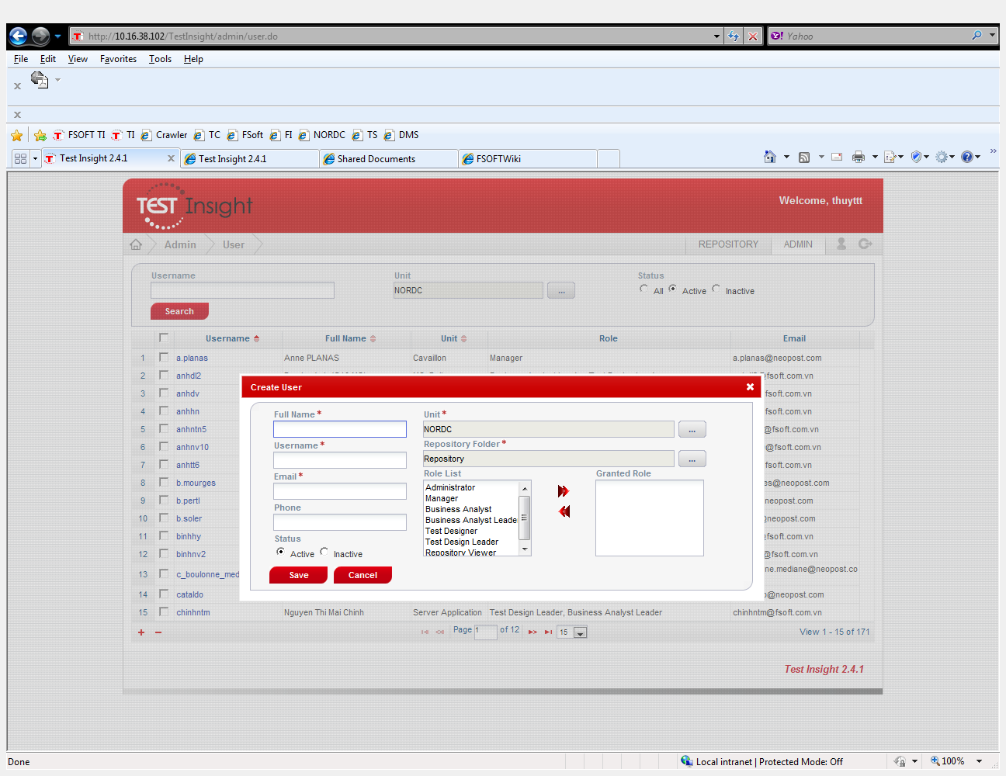
Test case description
The description of objective or condition
Should be clear, brief
Describe generally about test case as same as a title of test case
For example:
Add user successfully
Or
Can not add user with special characters
Or
Can not add duplicated user name
Or
Can not add user without email

Slide 8
Test Pre-Condition
A set of actions need to be done before run a case.
It maybe set for one or a set of test cases
For example:
Open IE
Access to http://10.16.51.8/Test
Login with Admin role (admin/admin)
Select Admin menu and then User menu item
Search to ensure that user test not existed (E.g. “test”)

Slide 9
Test case procedure
A set of steps/actions need to be run to complete a particular objective or condition
Must be detailed, specific
Should be shortly, single step
Should be ordered by number for more clear
For example:
On User list screen, click on [+] button
Input username that not existed (E.g. “test”)
Input Full name, email (E.g. “test”, test@abc.com.vn)
Use other values by default and click on [Save] button

Slide 10
Expected Output
A set of output/result after run test case procedure
For example:
1. Create User screen is displayed
4. “test” is displayed in User list with order of username, number of list increase one
Notes:
+ What is expected of the software, system,…
+ It’s defined base on SRS, Specification, Requirement,… (Never base on Source that is coding by Developer team)

Slide 11
More few common Elements
Test Data
Test Result (Pass / Fail)
Test Date
Executer
Priority of Test case
Traceability
Author
Remark / Note
Inter-test case Dependence
Notes:
+ Test Data: Data that exists (for example, in a database) before a test is executed, and that affects or is affected by the component or system under test.
+ Test Result: The consequence/outcome of the execution of a test. (Pass/Fail/OK/NG/Pending/…)
+ Test Date: the day when execute Test case
+ Executer: person who execute Test case
+ Priority of Test case: The level of (business) importance assigned to Test case. In some case, the executing all Test cases is impossible (because of time, effort,…), so Test case with higher than priority is selected to execute before.
+ Traceability: The ability to identify related items in documentation and software, such as requirements with associated Test cases.
+ Author: person who create Test case
+ Remark / Note: some note or remark of Test case for more clearly.
+ Inter-test case Dependence: One or more Test cases what is input for others. Example: Test suite (A set of several test cases for a component or system under test, where the post-condition of one test is often used as the precondition for the next one.)

Slide 12
Example - Test case which have Test data
Test data is the data that is used in tests of a software system. Test data can be:
In excel sheet which can be entered manually
Or read automatically from files (XML, Flat Files, Database,…) by automation tools.
Test data may be prepared during or after creating Test case, but make sure that it’s prepared before executing Test case.

Slide 13
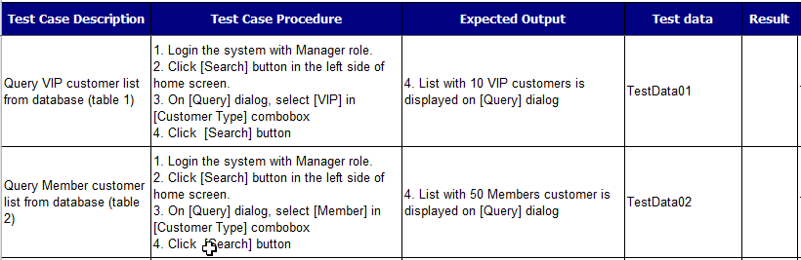
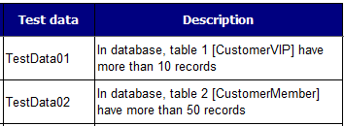
Example - Test case which have Test data
Test case sheet
Test data sheet

Slide 14
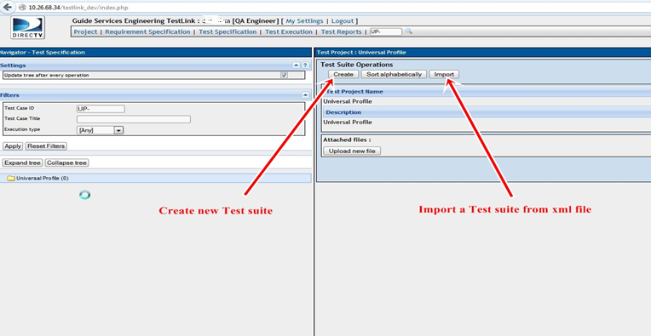
Example - Create Test case on TestLink tool
Create a Test suite
Access [Test Specification] -> select [Universal Profile] project:
-> a screen creating a new Test suite is displayed
Notes:
Test suite: A set of several test cases
[Universal Profile] is project name of this example

Slide 15
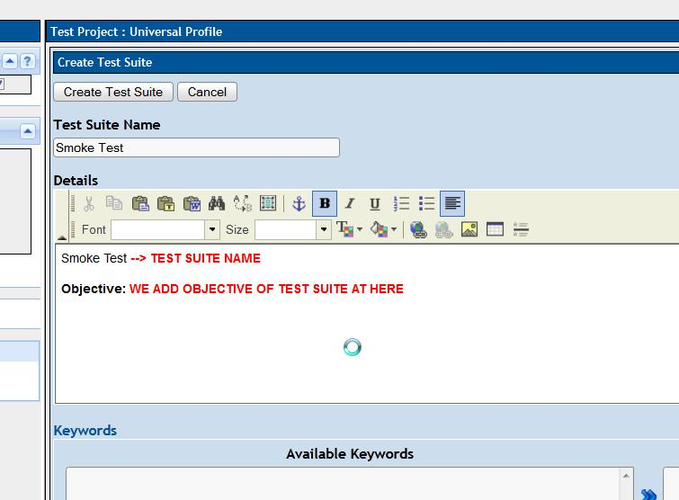
Example - Create Test case on TestLink tool
Create a Test suite
Click [Create] button -> input detail information for Test suite, example as below
Notes:
smoke test: A subset of all defined/planned test cases that cover the main functionality of a component or system
In this example, it’s just a sample name for a Test suite

Slide 16
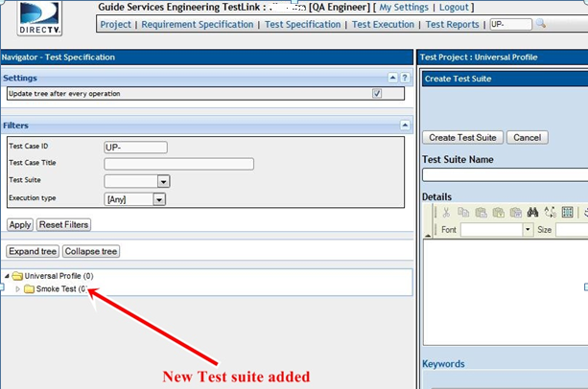
Example - Create Test case on TestLink tool
Create a Test suite
Click [Create Test Suite] button to finish work
-> A new Test suite is created

Slide 17
Example - Create Test case on TestLink tool
Create a Test case
Access [Test Specification] -> select Test suite in the left menu, example [Smoke Test] test suite
Click [Create] button in the right menu
-> a screen for adding test case is displayed as below
Input detail information for Test case, example as below
Notes:
[Smoke Test] test suite is created in the previous slide

Slide 18
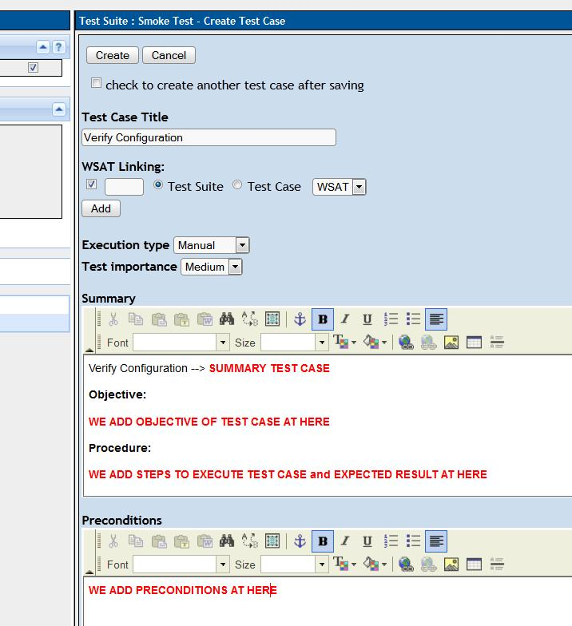
Example - Create Test case on TestLink tool

Slide 19
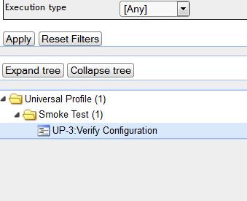
Example - Create Test case on TestLink tool
Create a Test case
Click [Create] button again to finish work
-> A new Test case is created

Slide 20
Manage Test case
Some information about Test case need to be managed:
Result after executing Test case
Number of Test case for a component or system
Status of Test case (how many Test case is passed, how many Test case is fail,…)
….
∗ Test case can be managed manually (example use an excel file) or a tool to support management (example TestLink tool).

Slide 21

Tips for good Test case
Structure of TC is clear and reasonable.
Follow requirement closely.
Cover all of cases that can occur.
Title easy to understand and cover requirement (as user, I can do or can’t do…)
Test step and expected result is a step by step process
* 4 C principal
Correctness: A good test case should be correct
Clear: The test cases should be simple and easy to understand
Completeness: 100% coverage of the requirements
Consistency: consistency in writing the test cases
Notes:
+ TC = Test Case

Slide 22

Test Case Review Checklist
TC checklist? Common questions to ensure that TC created enough and right format
Who do? Reviewer (Test leader, PM, Developers, QA, customer)

Slide 23
QUIZ

