Slide 1
Test Report
Author: <Author Name>
Last updated: Mar-2014

Slide 2
Agenda
Duration: 2 Hours
Audience: Testers
Content:
Test Report concepts
Test Report process
Test Report template

Slide 3
Objectives
After the course, student will:
Understanding what is Test Report, Defect Report
Understanding the way to create test report
Able to analysis about quality & progress based on data collection

Slide 4
Concepts

Slide 5
Test Report Concepts
Test Case Execution Status
Passed
Actual result is meet requirement (expected result)
Failed
Actual result isn’t meet requirement (expected result)
Blocked
Can not executed because pre-condition was failed
Skipped
Not applicable, Not Available, out of scope testing
Not Yet Tested
Has not executed yet

Slide 6
Test Metrics
Test Coverage: The degree, expressed as a percentage, to which a specified coverage item has been exercised
Test Success Coverage: The degree, expressed as a percentage of success, to which a specified coverage item has been exercised

Slide 7
Defect Report Concepts
Defect Type | Description
Business logic
Security – Access control
Feature missing
Functionality (Other)
Performance | Slowly, not response as expected time.
Requirement misunderstand | Team misunderstand requirement from customer specs
Data – Database integrity
User interface | Layout of application different with screen design like image, color
Coding logic
Document

Slide 8
Defect Report Concepts
Defect Severity | Weight | Description
Fatal | 10 | Critical defect making the system crash, cannot recover data
Serious | 5 | Defect making the major function cannot work or work incorrectly. E.g. User can see/do the activity without his permission.
Medium | 3 | Defect making the minor function cannot work or work incorrectly. E.g. System returns incorrectly with invalid data, boundary value, performance slowly.
Cosmetic | 1 | Defect of interface, no impact to functionality. E.g. Layout of form not good, wrong with Tab order, default focus, short key…

Slide 9
Defect Report Concepts
Defect Priority | Description
Immediately | Defect should be fixed right away or within 01 day after logging
High | Defect should be considered fixing within 02 - 04 days after logging
Normal | Defect should be considered fixing within 05 - 08 days after logging
Low | Defect can be delayed (to be fixed later when appropriate)

Slide 10
Defect Metrics
Leakage: measure quality of the product and service after delivery for acceptance test (QC Activity = Acceptance test)
Defect Leakage = #Defects found during next phase / (#Defects found during testing + #Defects found during next phase) * 100
Defect Rate: metric to measures quality of overall project's products.

Slide 11
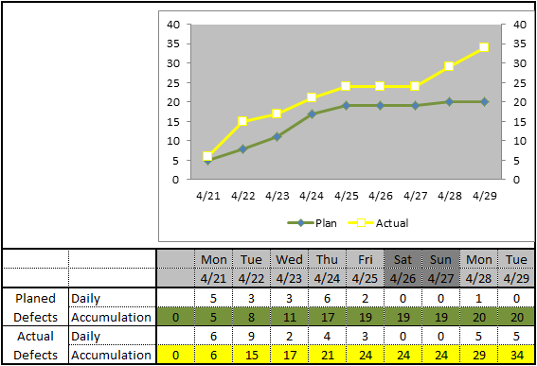
Defect Trend
Defect Trend:
Give an overall picture of product quality
Predict defects in the near future (next days)
Identify high-risk areas to focus for quality improvement
Notes:
Base on the sample chart, project planed that Testing can find out 20 defects. But the chart show that Testing detected 34 defects and one more important problem that the actual defect line is still in increasing trend, that mean Testers should consider that we should continue testing to detect more defect in package
Vice versa, if Tester detected less than the planed number, Testers can also consider about the extending Testing to find out more defect.
Base on Defect Trend – Testers can consider for the next activities
Example: the actual number defect is lower than plan -> Should consider to add more effort for executing
If detect is detected more -> Need add more Test case to detect more defect
If no defect is found -> The quality of package maybe OK -> can consider for next phase or activities
* Of course, the extending Testing can affect to the Cost and Time of project, but in a project, we must consider Cost, Time and Quality.

Slide 12
Process

Slide 13
Test Report Process
Define Objectives for
Test level
Collect
Test results
Analyze Test results
Create Summary report
Test Coverage
Test Success Coverage
Defect Rate
Leakage
Test status
Execute Date
Build Version
Defect Data
Test Log
Compare results against objectives
Point out important issue
Exit criteria

Slide 14
When to create the report?
End of testing level: UT, IT, ST, UAT
Daily, Weekly, or Milestones
Critical bug was found

Slide 15
Questions for creating report
How can testers present that information in an easy-to-understand format?
How can I present the information so that it is believable?
What is important point need to take action?

Slide 16

Tips
Send report to review before baseline a report for team.
No focus to personality
As a service you provide

Slide 17
Templates

Slide 18
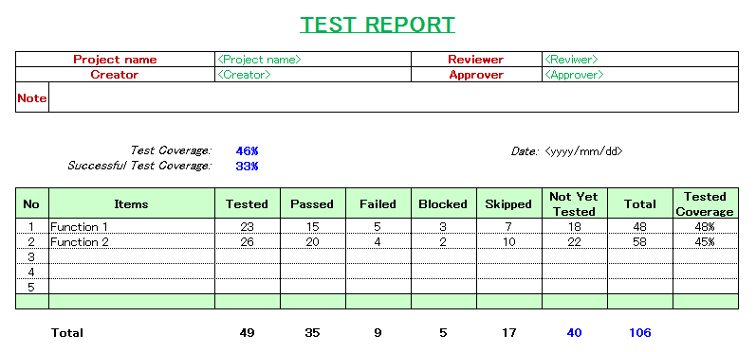
Test Result Report Template
Notes:
Tested = Passed + Failed + Blocked

Slide 19
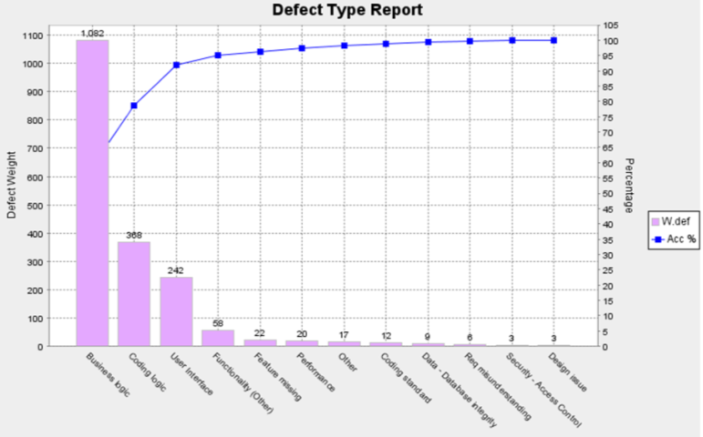
Defect Type Report
Purpose: defect high-defect types
Defect Type | Fatal | Serious | Medium | Cosmetic | Total (W.def) | %
Business logic | 1 | 9 | 332 | 31 | 1082 | 58.7
Coding logic | 1 | 2 | 112 | 12 | 368 | 20
Coding standard |  |  | 4 |  | 12 | 0.7
Data - Database integrity |  |  | 3 |  | 9 | 0.5
Design issue |  |  | 1 |  | 3 | 0.2
Feature missing |  |  | 6 | 4 | 22 | 1.2
Functionality (Other) |  |  | 18 | 4 | 58 | 3.1
Other |  |  | 5 | 2 | 17 | 0.9
Performance |  | 2 | 3 | 1 | 20 | 1.1
Req misunderstanding |  |  | 2 |  | 6 | 0.3
Security - Access Control |  |  | 1 |  | 3 | 0.2
User Interface |  |  | 30 | 152 | 242 | 13.1
Total | 2 | 13 | 517 | 206 | 1842 | 100
Requirement workshop
Review code
Prototype designer
Coding convention

Slide 20
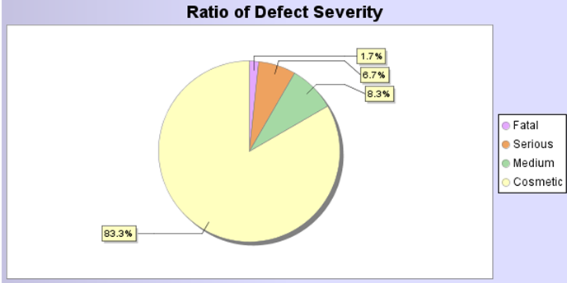
Defect General/Severity Report
Purpose: detect defects relating to severity cause to system hangs or functions work incorrectly
Unit Test before integration
Common defects relating interface

Slide 21
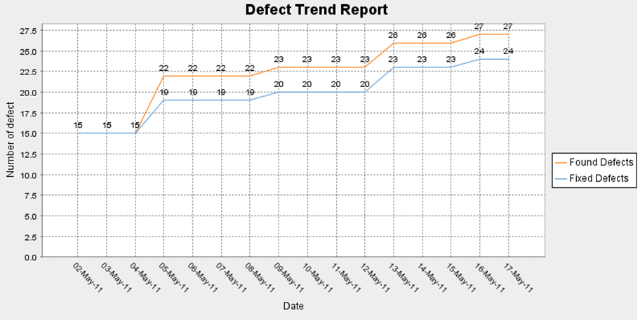
Defect Trend Report
Purpose: give general picture of the defect trend, predict defects in the near future
Package seem that stable in the end of phase.

Slide 22
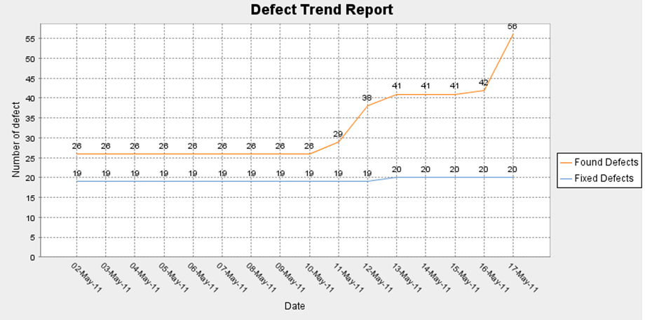
Defect Trend Report
There are many defect found in the end of testing phase

Slide 23
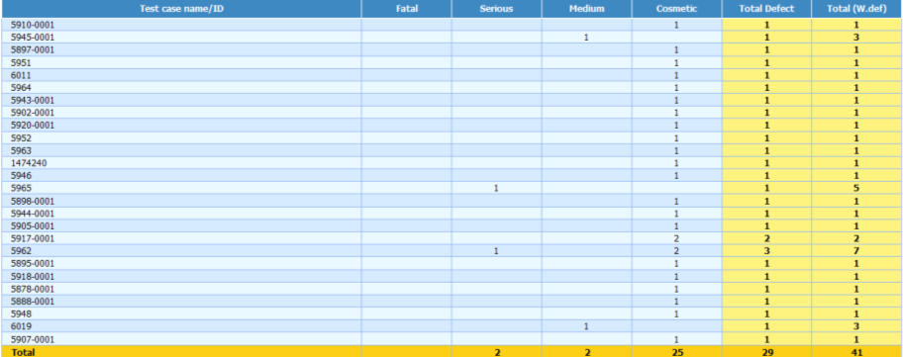
Defect by Test Case
Purpose: List defect found by Test Case

Slide 24
Test Summary Report
Test Summary Report: a document summarizing testing activities and results. It also contains an evaluation of the corresponding test items against exit criteria (E.g. final metrics, status of passed or failed, resource use, efficiency…)
Test Summary Structure:
Summary
Test Case result report
Defect Report
Open point

Slide 25
QUIZ

