Slide 1
Introduction to Functional Automation Testing
Instructor: <instructor name>

Slide 2
Contents
Automation Test Consideration
Classic Reasons for Failure
Scripting Techniques
Tool Selection Process
Test Life Cycle
Generic Automation Test Routine
Platform Under Test

Slide 3
Test Life Cycle
Architect
Create
Execute
Quality Plan
Test Plan
Test Cases
Automation Testing
Results
Reports
Manual Testing
Execute
New Test Cases

Slide 4
Automation Test Consideration
 | Pros | Cons
Manual Testing | Test case creation is quick and inexpensive. | Might not be consistent in rerunning test cases.
 | Better at simulating real world use. | Rerunning large volumes of test cases is expensive.
 | Better at analyzing test results and exploring new test cases.
 | Best when test steps and results are not well-defined.
 | Best when extensive analysis is required.
 | Does not require technically trained staff.
Automation Testing | Execute test cases unattended. | Creating test case is expensive.
 | Cost-effectively rerun large volumes of test cases repetitively. | Maintaining test case is time consuming.
 |  | Require highly technical staff.
 |  | Rerunning old tests is not likely to find new bugs.

Slide 5
Automation Test Consideration
Goals
Ensure consistency
Improve the reliability of testing
Should set clear goals to work and prevent false expectations
Should have some agreements, in advance, on what people will count as success
Notes:
Consistency:nhất quán
Expectations: mong đợi, kỳ vọng

Slide 6
Automation Test Consideration
What to be automated
What is being tested
What can be automated
Selecting tests to be automated
Smoke tests
Configuration tests
Regression, functional tests
Tests with multiple sets of data
Stress, volume, load, performance tests

Slide 7
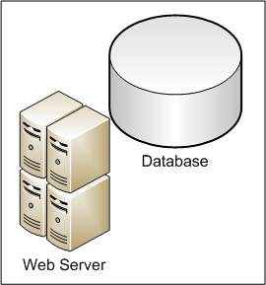


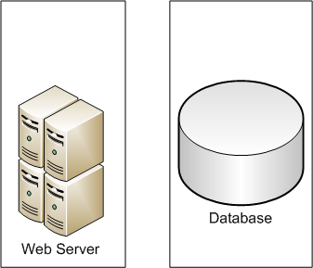
Automation Test Consideration
Configuration 1
Configuration 2
The same client based test suites

Slide 8
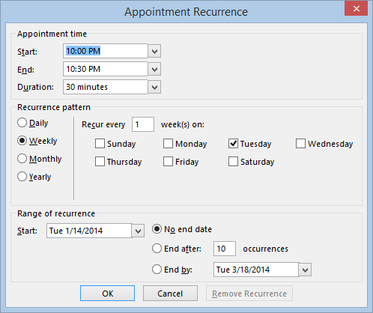
Automation Test Consideration (Cont)
Combination testing challenges

Slide 9
Classic Reasons for Failure
No clear objectives for automation
Lack of methodology to success of the project.
Automation is easy, just record and playback.
Aim for 100% automation.
No clarity of real cost and ROI involved in automation
Wrong selection of Test cases
Not treating automation as software development.
Select wrong automation tool
Automation will replace manual testing
Notes:
Aim: mục tiêu

Slide 10
Generic Automation Test Routine
Repeat for each test case
Screen Navigation
Environment Setup
Execute Test Cases
Validate/ Report
Environment Recovery
Test Data
Main Routine
Main routine: organize steps of test case execution

Slide 11
Generic Automation Test Routine (Cont)
Environment Setup
Screens Navigation
Occur before test execution.
Environment Recovery
User-defined functions to navigate through a screen.
Test Data
Setup necessary system variables (speed, fonts, location etc.).
Declare global variables
Include common libraries of reusable of functions
Write simple functions for each field on the screen instead of writing one big function per screen.
Data access layer.
It SHOULD have the large number of test data than then number of test scripts.
Revert file system
Clean up after a test is executed

Slide 12
Scripting Techniques
Introduction
Like programming
Scripting is very flexible. There are many ways of scripting to perform a given task.
Attributes of good script
Number of script: Less than one script for each test case.
Size of script: Small with annotation, no more than two pages.
Function Oriented: Each script has a clear and single purpose.
Documentation is place at the header of the script.
Reuse: Many scripts are reuse by different test cases.
Structured: Easy to see and understand the structure.
Maintenance: Easy to change according to software.

Slide 13
Scripting Techniques (Cont)
Linear scripting
Structured scripting
Data-driven scripting
Keyword-driven scripting

Slide 14
Scripting Techniques – Linear scripting
Definition
A linear script is what a test is performed manually.
It contains all keystrokes, function keys, arrow keys and input data.
Advantages
No upfront work or planning is required
Good for demonstrations and training.
Disadvantages
Hard-coded for the test input and comparison.
No sharing or reuse of scripts.
Vulnerable to software changes
When to apply
A test case is only used once to investigate test tool.
The software under test is un-changed from user’s perspective.
Notes:
Upfront: báo trước
Vulnerable: dễ bị tổn thương
Investigate: Tìm hiểu
Perspective: Quan điểm

Slide 15
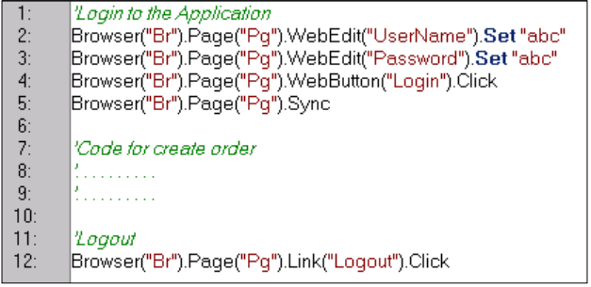
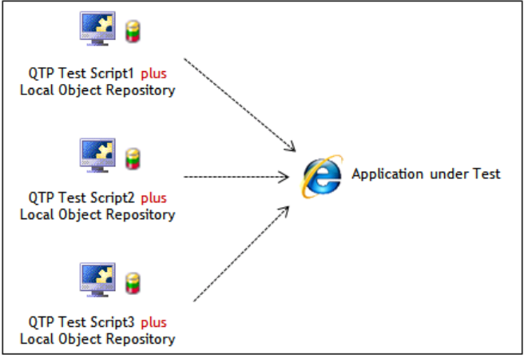
Linear Framework
Notes:
Offers a more flexible, more powerful => use dll, Ranorex plug in

Slide 16
Scripting Techniques – Structured scripting
Definition
Large scripts divide into smaller script
Three basic control structures: Sequence, Selection, Iteration.
Advantages
Robust and flexible.
Easily maintainable.
Disadvantages
Script becomes a complex program.
Data is still hard-coded.
When to apply
The software under test is changed regularly
Special instructions control the execution (main routine) of the script.
Notes:
Robust: Mạnh mẽ

Slide 17
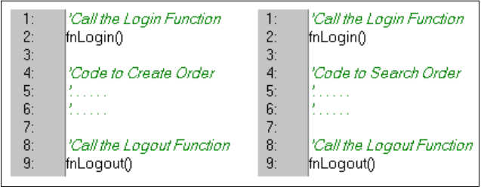
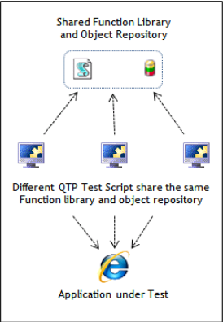
Structured Framework
Notes:
Offers a more flexible, more powerful => use dll, Ranorex plug in

Slide 18
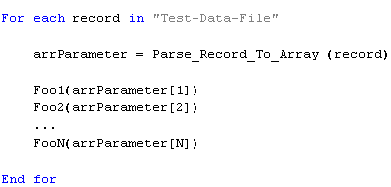
Scripting Techniques – Data-driven scripting
Definition
Test data is stored in a separate file and the control information is in the script.
Advantages
Possible to implement more test cases with very little extra effort.
At data-driven level we can archive benefit from test automation.
Tester have ability to choose format and layout of test data.
Adding new tests can be done by tester without technical knowledge.
Disadvantages
Initial set-up spends lot of effort.
It must be well managed.
When to apply
A test do the same thing but it uses different input and expected outcomes.
Control Script
Test-Data-File
Record 1
Record 2
…
Record N

Slide 19
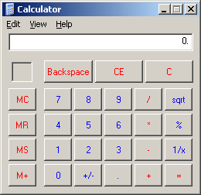
Scripting Techniques – Data-driven scripting
Example
Data file
Data pattern:
Control Script runs the same scenario
Number1, Action, Number2, Expected Result
Data for four test cases:
4, -, 1, 3
2, *, 5, 10
10, /, 0, Cannot divide by zero
Click button named “Number1”.
Click button named “Action”.
Click button named “Number2”.
Click button named “=“.
Compare actual result with “Expected Result”.
Report result according to the above comparison.
Verify functionalities of the Calculator
1, +, 2, 3

Slide 20
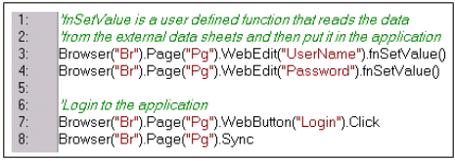
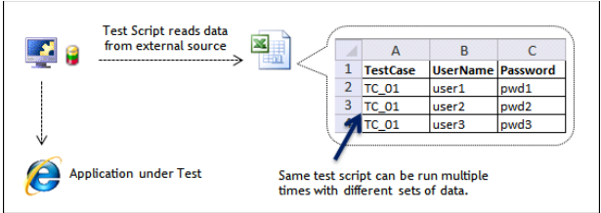
Data-driven Framework
Notes:
Offers a more flexible, more powerful => use dll, Ranorex plug in

Slide 21
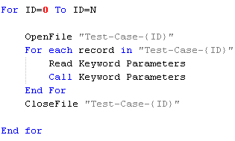
Scripting Techniques – Keyword-driven scripting
Definition
It builds data-driven and logical knowledge into both data and control script.
Advantages
The number of scripts is number of functions of software under test.
Non-programming testers is able to implement test cases
Control Script
Test case files
Read
Test-Case-1
Keyword_1 Parameters_1
Keyword_2 Parameters_2
…
Keyword_N Parameters_N
Test-Case -2
Keyword_1 Parameters_1
Keyword_2 Parameters_2
…
Keyword_N Parameters_N
Supporting Scripts
Test-Case -N
Keyword_1
……………
……………
Keyword_2
……………
……………
Keyword_N
……………
……………
Keyword_1 Parameters_1
Keyword_2 Parameters_2
…
Keyword_N Parameters_N

Slide 22

Scripting Techniques – Keyword-driven scripting
Example
Verify functionalities of the Calculator
Control Script runs different scenarios indicated in test case
Control Script
Test case files with diff scenario
Test-Case-1
Read
Description “Add two positive numbers”
ClickButton “1”
ClickButton “+”
ClickButton “2”
ClickButton “=”
Compare 3
Test-Case-2
Description “Subtract 3 numbers”
ClickButton “4”
ClickButton “-”
ClickButton “2”
ClickButton “-”
ClickButton “1”
ClickButton “=”
Compare 1
Supporting Scripts
Description
……………
……………
ClickButton
……………
……………
Compare
……………
……………

Slide 23
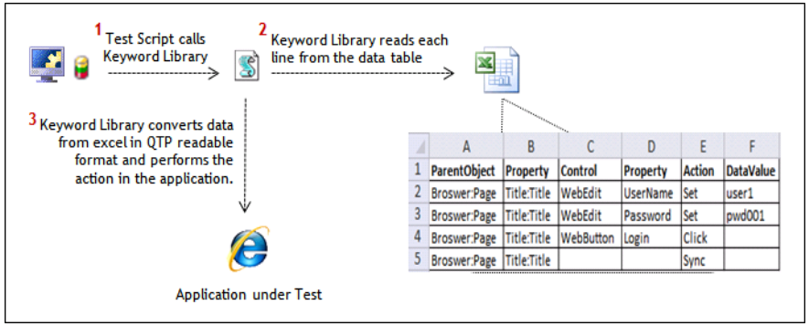
Keyword-driven Framework
Notes:
Offers a more flexible, more powerful => use dll, Ranorex plug in

Slide 24
Tool Selection Process
Define Problem
Define Required Features
Shortlist
Consider automation as a solution
Make business case
Manual testing problem
Evaluate
Demo
Trial
Decide
Build or Buy
Gather problem
Assess Test Tool Features

Slide 25
Platform Under Test and Technology Stack
 | Windows GUI | .NET GUI | Java GUI | Web | iOS | Android | Windows Phone | CLI
QTP
TestComplete
Ranorex
Coded UI
SeeTestAutomation Plug-Ins
Selenium
AutoIt
Win32:GuiTest
Expect
Fully support
Partial support
Web support only

Slide 26
More Reading
http://blog.bughuntress.com/automated-testing
http://www.automationframework.info/
http://www.thoughtworks.com/insights/articles/guide-test-automation

Slide 27


