Slide 1
Principles, Guidelines and Theories in Interactive Systems
Shneiderman and Plaisant, 2
Nielsen, www.useit.com

Slide 2
Overview
Principles and guidelines
  Useful in a practical sense, e.g., Web Style Guide
  Definition and examples
  Relationship to theory

Slide 3

Design for Interfaces, WWW, etc.
Design entails the interaction among theories, principles, guidelines
Will come back in more detail to this, but sets stage to understand context of Yale Style Guide, which is a, well, style guide
  And provides “suggestions”
  (or prescriptions or principles or
  heuristics or rules of thumb or …)
  for how to do things
  This approach is not uncommon
  Following discussion provides background
  for where in the context of “Theories, Principles,
  and Guidelines” the “Style Guide” falls

Slide 4
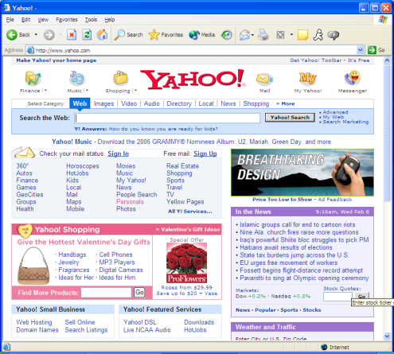
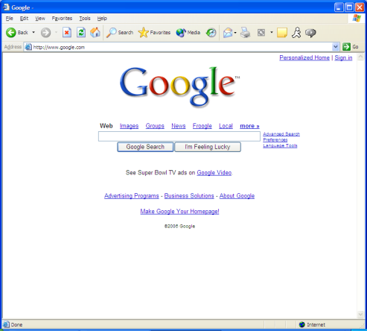
Theories, Principles, Guidelines
Theories
Guidelines (most specific), e.g.:
  Navigating interface, organizing display
  Getting user’s attention, data entry
Principles (less specific “rules of thumb”):
  “Rules that distill out the principles of effective user interfaces”
  Determine users’ skill level
  Identify tasks
  Choose an interaction style
  “Golden rules of interface design”
  Integrating automation and human control
Theories and models (explanation):
  Levels of analysis theories
  Stages-of-action models
  GOMS and keystroke-level model
  Consistency through grammars
  Widget level
  Context of use
Principles
Guidelines

Slide 5
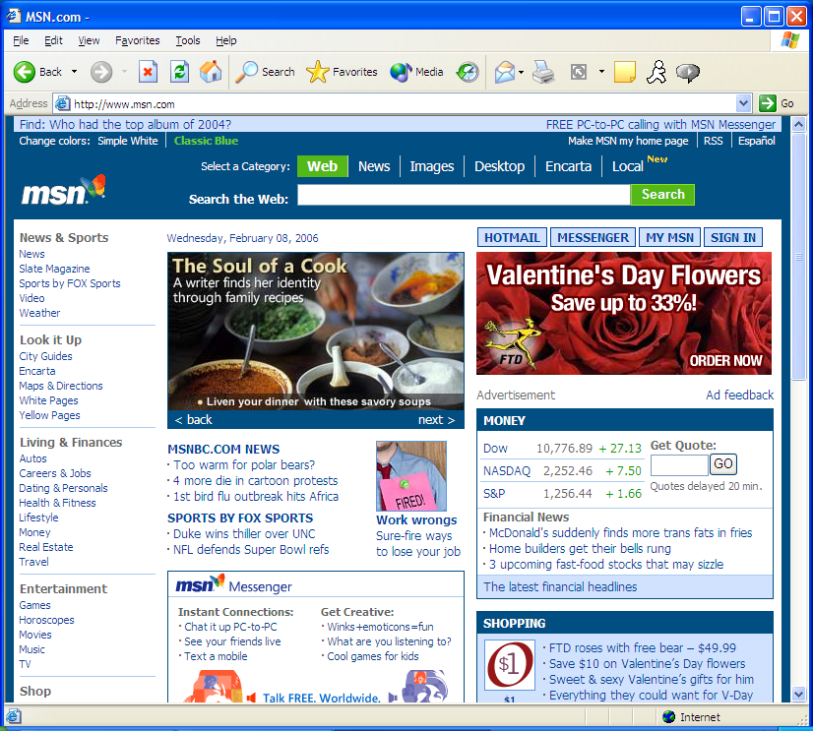

What Guidelines, Principles, Theories?

Slide 6

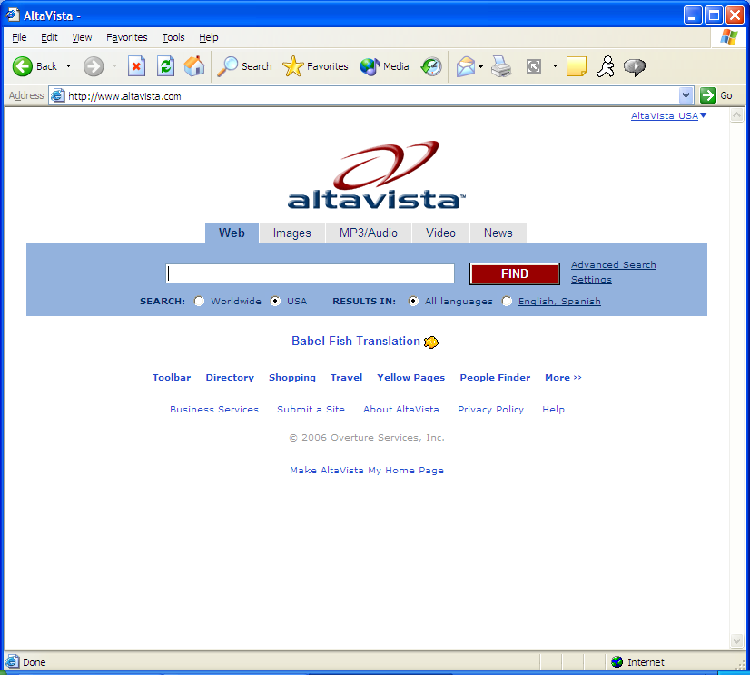
What Guidelines, Principles, Theories?

Slide 7


Guidelines, Principles, and Theories
Intuition is not bad, it’s just not all there is…
  Intuition, after all, comes from (successful, hopefully) experience
But, there are a wealth of bad interfaces
  Ease of system design with web has made ui design accessible to a wide, and untrained (and without intuition) set of designers
Guidance for designers and developers
  from guidelines, principles, and theories
Theories
Principles
Guidelines

Slide 8
Guidelines, Principles, and Theories
Guidelines
  Specific and practical
    Cure for design problems, caution dangers, shared language and terminology
  Accumulates (and encapsulates) past experience and best practices
    “blinking is bad, never use it”
  Often enforces common procedures
  May be: too specific, incomplete, hard to apply, and sometimes wrong
  Lowest level
Principles
  Mid-level
  Help analyze and compare design alternatives
High level theories and models
  Goal is to describe objects and actions with consistent terminology
    Allowing comprehensible explanations to support communication and teaching
  Other theories are predictive
    E.g., reading, pointing, and typing times
Theories
Principles
Guidelines

Slide 9
Guidelines - Overview
Guidelines: Specific and Practical
  Lowest level design tool
Apple, Microsoft early examples
  Most organizations have their own
Often enforces common procedures, shared language consistency
  Interaction style and look generally – “look and feel”
May argue “too specific”, restrictive, incomplete, wrong, etc.!
  At best, are static
But, best provide guidance and codification for efficiency of (low level) design and implementation
Note that much of interface style and interaction are in practice included in windowing system

Slide 10
Guidelines - Examples
Apple Human Interface Guidelines
GNOME 2.0 Human Interface Guidelines
Guidelines for User Interface Developers and Designers
Guidelines on HCI

Slide 11
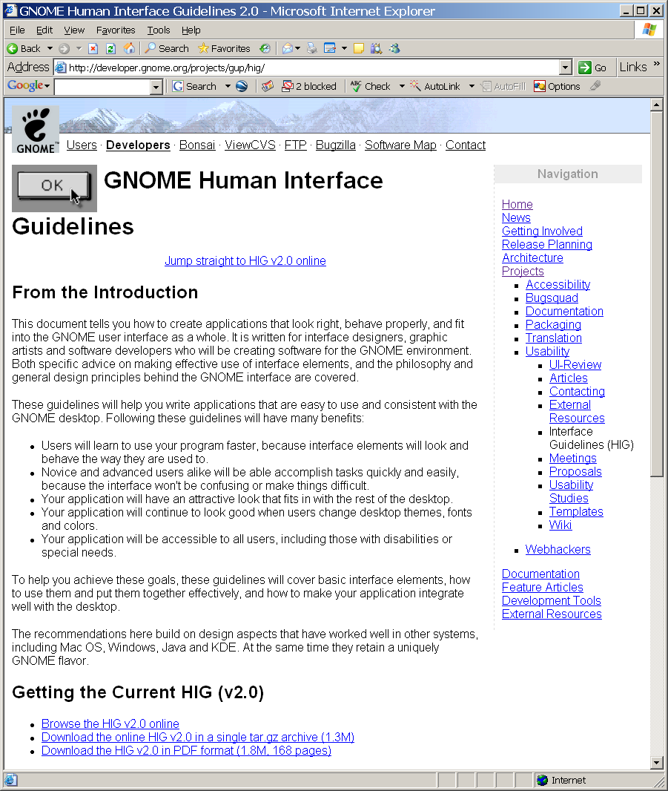
Guidelines – Examples, Gnome
Gnome
  http://developer.gnome.org/projects/gup/hig/
  Unix and Linux desktop suite and development platform
  “Standards”

Slide 12
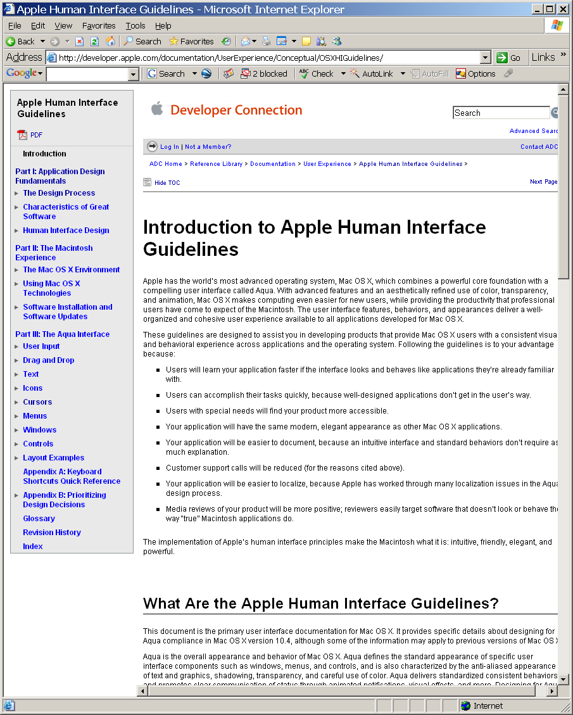
Guidelines – Examples, Apple
Apple
  http://developer.apple.com/documentation/UserExperience/Conceptual/OSXHIGuidelines/
  Aqua

Slide 13
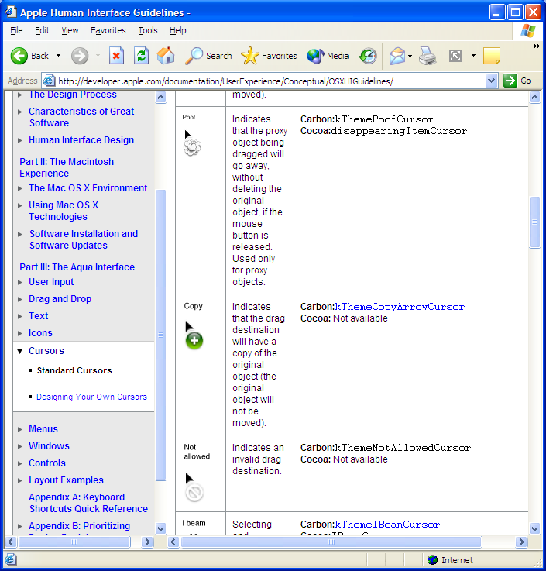
Guidelines – Examples, Apple
Cursor appearance

Slide 14
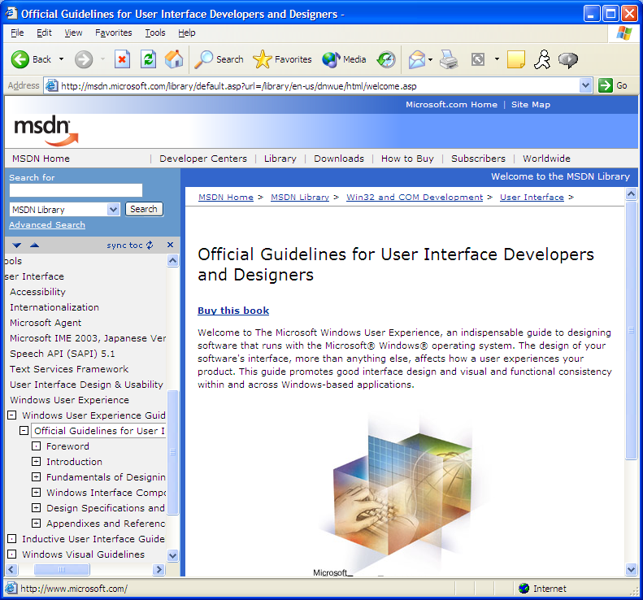
Guidelines – Examples, Microsoft
Microsoft
  http://msdn.microsoft.com/library/en-us/dnwue/html/welcome.asp/
  “… good … functionality across Windows-based applications”

Slide 15
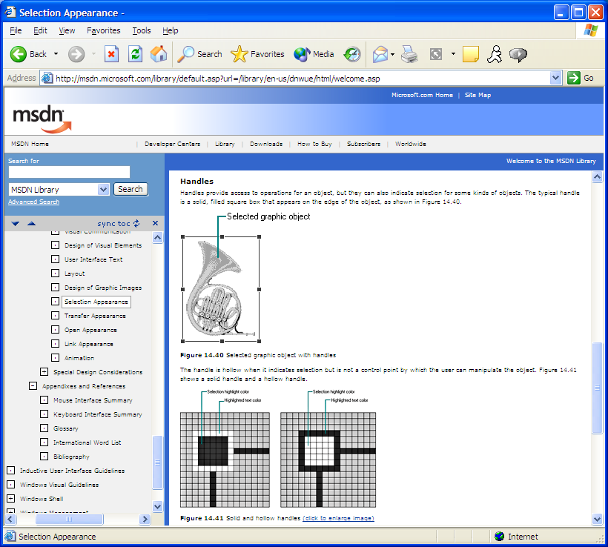
Guidelines – Examples, Microsoft
Selection

Slide 16
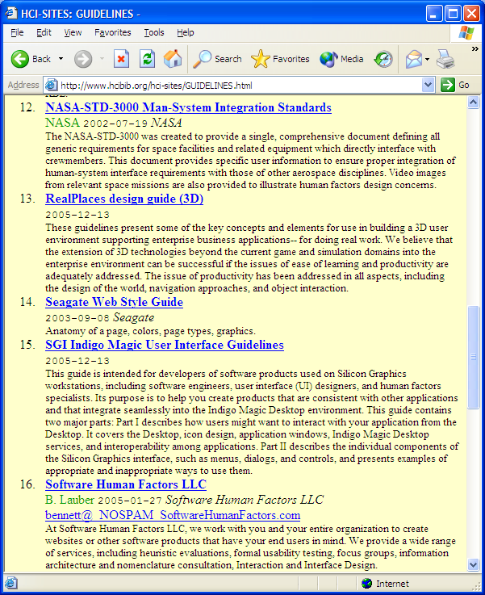
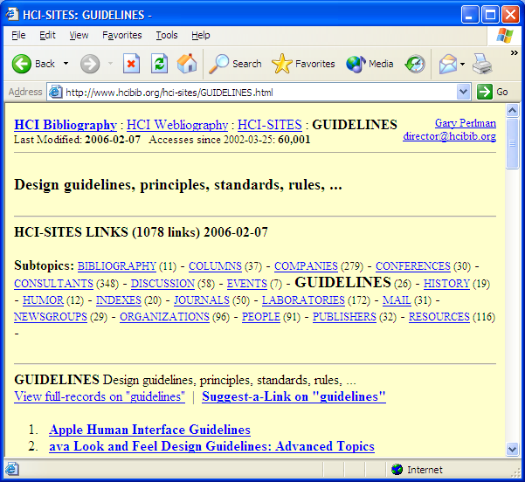
Guidelines – HCI Bibliography
HCI Bibliography
  http://www.hcibib.org/hci-sites/GUIDELINES.html
  Lots available online

Slide 17
Guidelines: Navigating the Interface
(supplementary)
Navigation in an information system is a challenge
  Form varies
    e.g., “reduce user’s workload”, “do not display unsolicited windows or graphics”
Guideline for National Cancer Institutes interface, such as:
  (From Shneiderman)
  Standardize task sequences
  Ensure that embedded links are descriptive
  Use unique and descriptive headings
  Use check boxes for binary choices
  Develop pages that will print properly
  Use thumbnail images to preview larger images

Slide 18
Guidelines: Navigating the Interface
(supplementary)
W3 (www.w3.org) accessibility guidelines:
  Allows users with disabilities to employ screen readers and other technologies
  Provide a text equivalent for every nontext element
  For any time-based multimedia presentation synchronize equivalent alternatives
  Information conveyed with color should also be conveyed without it
  Title each frame to facilitate from identification and navigation

Slide 19
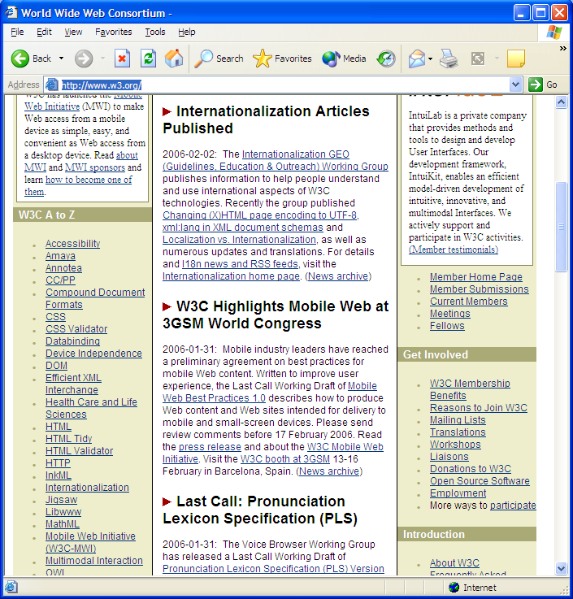
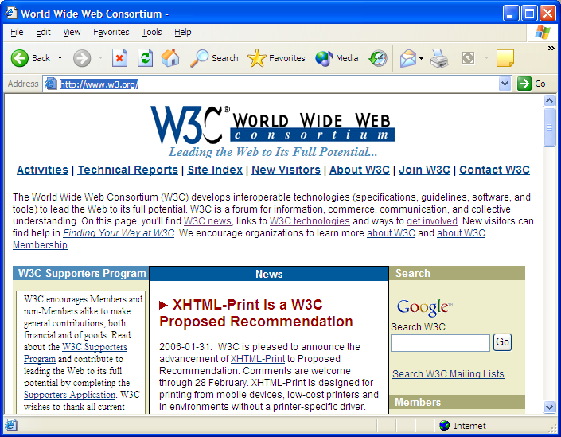
World Wide Web Consortium, W3C
Primary www organization
http://www.w3.org/

Slide 20
Guidelines: Organizing the Display
Display design has many special cases
Smith and Mosier (1986) offer five high level goals
  Consistency of data display
    E.g., standardized terminology, colors
  Efficient information assimilation by the user
    E.g., familiar format, applied consistently
  Minimal memory load on the user
    A common requirement
    E.g., menus vs. command language, help, etc.
  Compatibility of data display with data entry
    E.g., consistency of format
  Flexibility for user control of data display
    Customizable
From these, individual project expands

Slide 21
More Guidelines: Getting User’s Attention
Getting the user’s attention, e.g., Wickens and Hollands, 2000
  Intensity
  Marking
  Size
  Choice of fonts
  Inverse video
  Blinking
  Color
  Audio

Slide 22
Principles – Overview, 1
Term “Principles” somewhat arbitrarily chosen …
  Use “guidelines”, as in “platform specific guidelines”
  Use “principles”, as in “ higher-level usability principles”
    Or, “usability guidelines or heuristics”
    More fundamental, widely applicable, and enduring than guidelines
  Help designers choose design alternatives
  Help evaluators find problems in interfaces
    “heuristic evaluation”

Slide 23
Principles – Overview, 2
Plenty to choose from:
  Shneiderman’s Eight Golden Rules of Interface Design
  Nielsen’s 10 principles
    One version in his book
    A more recent version on his website
  Tognazzini’s 16 principles
  Norman’s rules from Design of Everyday Things
  Mac, Windows, Gnome, KDE guidelines
First, will look at Shneiderman’s overarching design issues:
  Fundamental principles:
    Determine user’s skill levels
    Identify the tasks
  Five primary interaction styles
  Prevent errors

Slide 24
Principle: Determine user’s skill levels
Or “Know thy user”, Hansen (1971)
  Design begins with understanding of user
  Age, gender, physical and cognitive abilities, education, cultural or ethnic background, training, motivation, goals and personality
Design goals based on skill level
  Novice or first-time users
  Knowledgeable intermittent users
  Expert frequent users
“Multi-layer” designs
  Designs that allow users to “know what they need to know”
  Old saying:
    Things that are simple, should be simple; things that are complex should be possible
  Shneiderman’s cell phone example:
    With increasing experience …
      Make call, use list, …, use menus, … configure

Slide 25
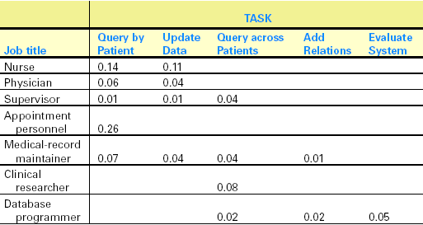
Principle: Identify the Tasks
Seems obvious to begin (and complete) task identification before begin design
  But, in fact design often begins and task analysis continues concurrently!
Large, complex, sometimes cluttered interfaces vs. simple, clean, limited
  E.g., Google vs. Yahoo, Palm Pilot vs. Outlook
Identifying tasks and subtasks entails knowledge of task domain
  E.g., banking, medicine
“Task Analysis” usually involves long hours observing and interviewing users
Decomposition of high level tasks
  Task sequences
    (e.g., for menu trees),
    atomic (1 action) elements
Relative task frequencies

Slide 26
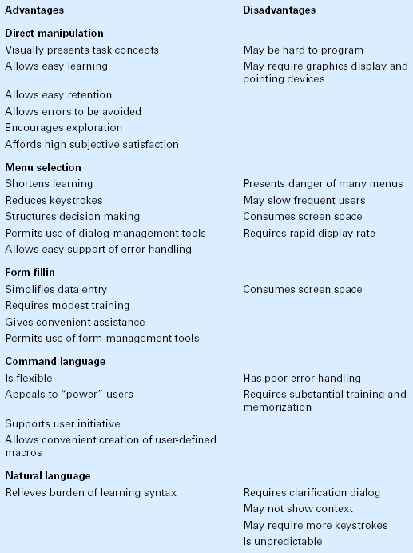
Principle: Choose an Interaction Style
5 main types:
  Direct Manipulation
    More later
  Menu selection
  Form fillin
  Command language
  Natural language
May blend, especially when users are diverse

Slide 27
Principle: Prevent Errors
Make error messages specific, positive in tone, and constructive
Mistakes and slips (Norman, 1983)
Correct actions
  Gray out inappropriate actions
  Selection rather than freestyle typing
  Automatic completion
Complete sequences
  Single abstract commands
  Macros and subroutines

Slide 28
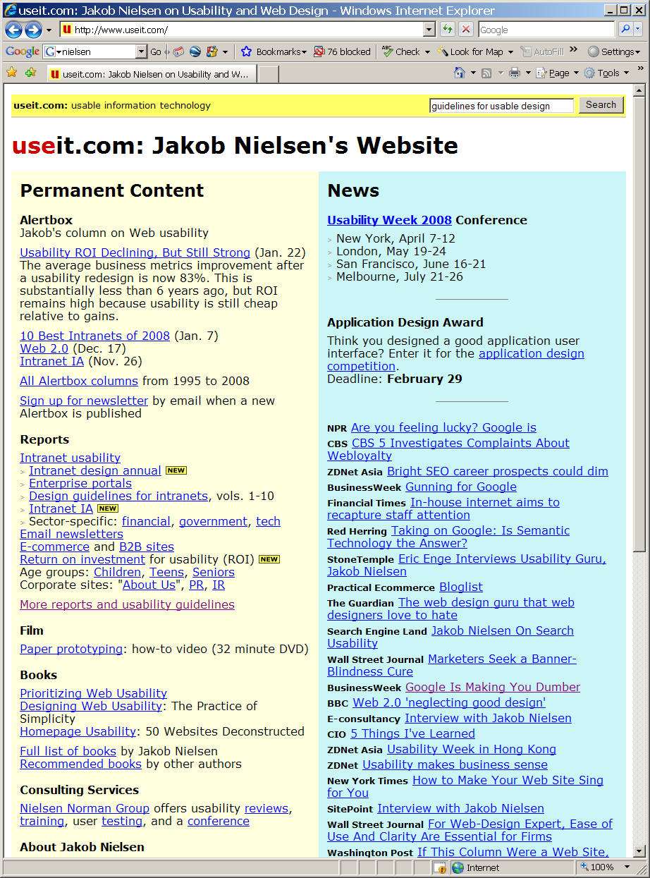

Jakob Nielsen
Jakob Nielsen
  www.useit.com
  Nielsen-Norman Group
    Consulting, etc
  Usability Engineering,
    among best known books
  Recommended:
    Usability 101: Introduction to Usability
      http://www.useit.com/alertbox/20030825.html
    Top Ten Mistakes in Web Design
      http://www.useit.com/alertbox/9605.html

Slide 29
Nielsen’s Guidelines for Usable Design
(plenty of guidelines, we’ll look at Nielsen’s)
Meet expectations
  1. Match the real world
  2. Consistency & standards
  3. Help & documentation
User is the boss
  4. User control & freedom
  5. Visibility of system status
  6. Flexibility & efficiency
Handle errors
  7. Error prevention
  8. Recognition, not recall
  9. Error reporting, diagnosis, and recovery
Keep it simple
  10. Aesthetic & minimalist design

Slide 30
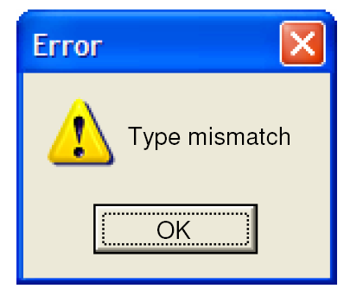
1. Match the Real World
Use common words, not techie jargon
  But use domain-specific terms where appropriate
Don’t put limits on user-defined names
Allow aliases/synonyms in command languages
Metaphors are useful but may mislead

Slide 31
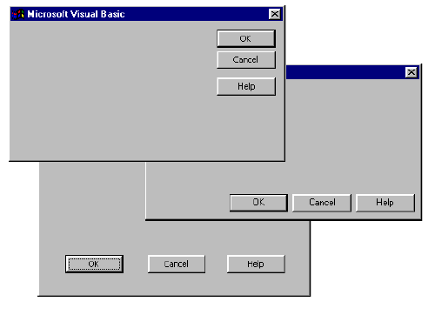
2. Consistency and Standards
“Principle of Least Surprise”
  Similar things should look and act similar
  Different things should look different
Other properties
  Size, location, color, wording, ordering, …
Command/argument order
  Prefix vs. postfix
Follow platform standards
Consistency
  Internal
  External
  Metaphorical
  (or not)

Slide 32
3. Help and Documentation
Users don’t read manuals
  Prefer to spend time working toward their task goals, not learning about your system
But manuals and online help are vital
  Usually when user is frustrated or in crisis
Help should be:
  Searchable
  Context-sensitive
  Task-oriented
  Concrete
  Short

Slide 33
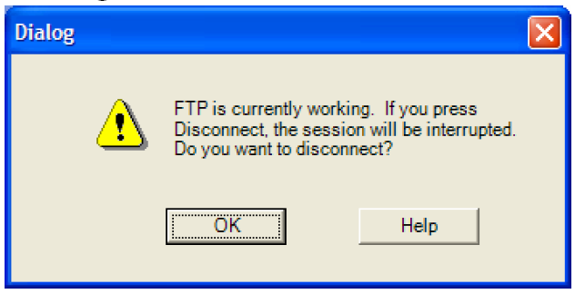
4. User Control and Freedom
Provide undo
Long operations should be cancelable
All dialogs should have a cancel button
  Users should be able to explore interface without fear of being trapped in a corner
  Undo supports exploration

Slide 34
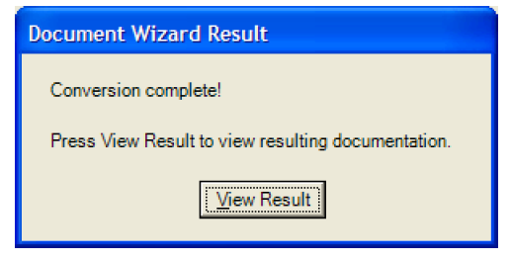
5. Visibility of System Status
Keep user informed of system state - Feedback
  Cursor change
  Selection highlight
  Status bar
  Don’t overdo it…
Response time
  < 0.1 s: seems instantaneous
  0.1-1 s: user notices, but no feedback needed
  1-5 s: display busy cursor
  > 1-5 s: display progress bar

Slide 35
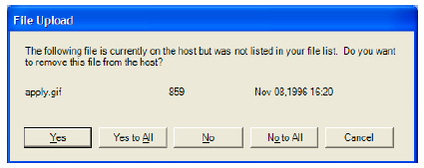
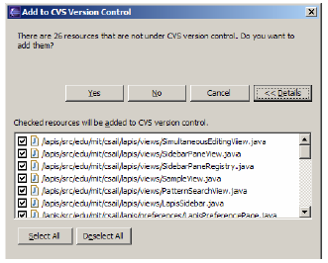
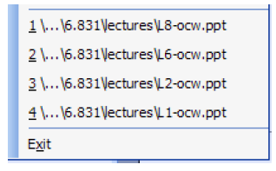
6. Flexibility and Efficiency - Shortcuts
Provide easily-learned shortcuts for frequent operations
  Keyboard accelerators
  Command abbreviations
  Styles
  Bookmarks
  History

Slide 36
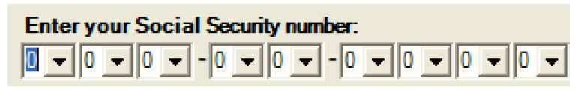
7. Error Prevention
Selection is less error-prone than typing
  But don’t go overboard…
  Disable illegal commands
Error Types (3) follow (supplementary):
1. “Description Error”
  Intended action is replaced by another action with many features in common
    Pouring orange juice into your cereal
    Putting the wrong lid on a bowl
    Throwing shirt into toilet instead of hamper
  Avoid actions with very similar descriptions
    Long rows of identical switches
    Adjacent menu items that look similar

Slide 37
Error Types
(supplementary)
2. Capture Error
  A sequence of actions is replaced by another sequence that starts the same way
    Leave your house and find yourself walking to school instead of where you meant to go
  Avoid habitual action sequences with common prefixes
3. Mode Error
  Modes: states in which actions have different meanings
    Vi’s insert mode vs. command mode
    Caps Lock
    Drawing palette
  Avoiding mode errors
    Eliminate modes
    Visibility of mode
    Spring-loaded or temporary modes
    Disjoint action sets in different modes

Slide 38
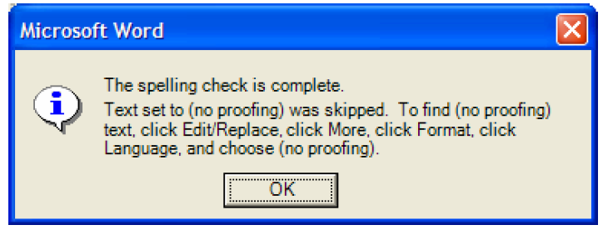
8. Recognition, Not Recall
– Minimize Memory Load
Use menus, not command languages
Use combo boxes, not textboxes
Use generic commands where possible
  E.g., Open, Save, Copy Paste
All needed information should be visible

Slide 39
9. Error Reporting, Diagnosis, Recovery
Be precise; restate user’s input
  Not “Cannot open file”, but “Cannot open file named paper.doc”
Give constructive help
  why error occurred and how to fix it
Message should be polite and nonblaming
  Not “fatal error”, not “illegal”
Hide technical details until requested
  E.g., “address referenced …”

Slide 40

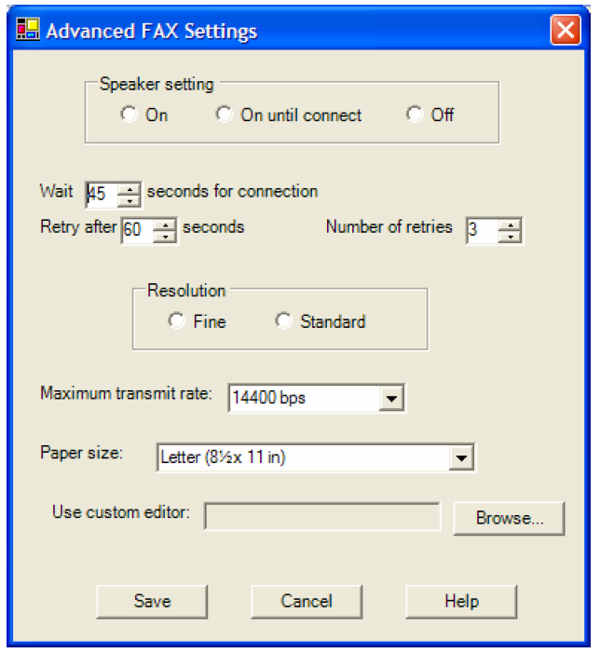
10. Aesthetic and Minimalist Design
“Simplicity”
  More later
“Less is More”
  Omit extraneous info, graphics, features
Good graphic design
  Few, well-chosen colors and fonts
  Group with whitespace
  Align controls sensibly
Use concise language
  Choose labels carefully

Slide 41
Principles: Shneiderman’s
“8 Golden Rules of Interface Design” - quickly
As noted, there are many sets of principles – note similarities
Schneiderman’s 8 rules (principles):
  Strive for consistency
  Cater to universal usability
  Offer informative feedback
  Design dialogs to yield closure
  Prevent errors
  Permit easy reversal of actions
  Support internal locus of control
  Reduce short term memory

Slide 42
Toggazinni’s 16 Principles - quickly
Anticipation
Autonomy
Color blindness
Consistency
Defaults
Efficiency
Explorable interfaces
Fitts’s Law
Human interface objects
Latency reduction
Learnability
Metaphors
Protect users’ work
Readability
Track state
Visible navigation

Slide 43
Theories in HCI (or Interactive Systems)

Slide 44
Theories in HCI (or Interactive Systems)
Human Computer Interaction should have “theories”
  i.e., explanatory (and predictive) accounts, beyond the specifics of guidelines
  Certainly, principles might used to develop theories
Or not, …
  In fact HCI may well not be a discipline as we think of a science
    May more pragmatically be viewed as “engineering” or “design”, and of “interactive systems”, at that,
      which more clearly draws upon more overarching theories
  Still, at very least, HCI will rely heavily upon theories from psychology, etc.
Different types of theories:
  1. Descriptive and explanatory
  2. Predictive
  3. Motor task, perceptual, or cognitive
  4. Taxonomy (explanatory theory)

Slide 45
Types of Theories in HCI
  1. Descriptive and explanatory
    Aid in developing consistent terminology for observation, and even describing events
  2. Predictive
    Aid in comparing high-level concepts of two designs
      Enable designers to compare proposed designs for execution time or error rates
  3. Motor task, perceptual, or cognitive
    Perceptual or Cognitive subtasks theories
    Predicting reading times for free text, lists, or formatted displays
    Motor-task performance times theories:
      Predicting keystroking or pointing times
  4. Taxonomy (explanatory theory)
    Order on a complex set of phenomena
    Facilitate useful comparisons
    Organize a topic for newcomers
    Guide designers
    Indicate opportunities for novel products.

Slide 46
About Theories in HCI
Is early in development of “theories” for HCI and interactive systems
  Still, any theory that can help in design makes a contribution
For HCI,
  Theories should be more central to research and practice
    Should guide researchers in understanding relationships between concepts and generalizing results
    Should guide practitioners in design tradeoffs
  Theories should lead rather than lag behind practice
    Explaining by a “theory” what produced by a commercial product is not exactly science
    Theory should predict, and at least guide, practitioners
    Effective theories should suggest novel products and refine existing
By definition, theory, taxonomy, or model is an abstraction of reality and therefore must be incomplete
  However, a good theory should be at least understandable, produce similar conclusions for all who use it, and help solve specific practical problems
Following descriptive and explanatory theories provide a sampling:
  Levels of analysis theories
  Stages-of-action models
  GOMS and the keystroke-level model
  Consistency through grammars
  Widget level theories
  Context of use theories

Slide 47


Levels of Analysis Theories
(supplementary)
Separate concepts into different “levels”
    1970’s, Foley and van Dam
      “graphics” pioneers, because it’s all interactive systems,
      e.g., “interactive computer graphics”
  Conceptual level:
    User's “mental model” of the interactive system
    How user (vs. designer) views system and task
    E.g., paint (pixels) vs. draw (objects), delete a file vs. loose the address
    Nature of mental model affects lower levels
  Semantic level:
    Describes the meanings conveyed by the user's command input and by the computer's output display
    E.g., deleting an object by a command or an undo, display is the same
  Syntactic level:
    Defines how the user’s actions (units, words) that convey semantics are assembled into a complete sentence that instructs the computer to perform a certain task
    E.g., deleting by selecting, moving, and confirming, or commands rm fname
  Lexical level:
    Deals with device dependencies and with the precise mechanisms by which a user specifies the syntax
    E.g., case sensitivity, double click interval
Approach is convenient for designers
  Top-down nature is easy to explain and captures natural design flow
  Matches the software architecture
  Allows for useful modularity during design
  Was more appropriate for command line than graphical interfaces

Slide 48

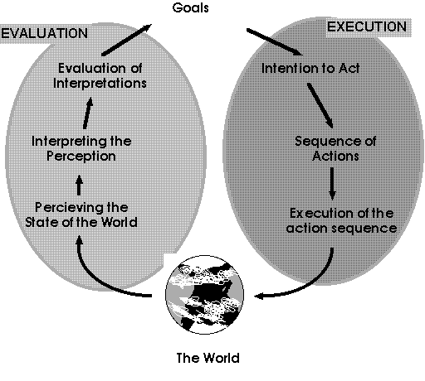
Stages of Action Models, 1
(supplementary)
More cognitively and task oriented description
Norman's seven stages of action:
  Forming the goal
  Forming the intention
  Specifying the action
  Executing the action
  Perceiving the system state
  Interpreting the system state
  Evaluating the outcome
Some correspondences to Foley and van Dam levels of analysis
  User forms a conceptual intention, reformulates it into the semantics of several commands, and eventually produces the lexical tokes
Norman's contributions
  Context of cycles of action and evaluation.
  Gulf of execution: Mismatch between user's intentions and the allowable actions
  Gulf of evaluation: Mismatch between system's representation and the users' expectations
Following from this, Norman suggests four principles of good design:
  …

Slide 49
Stages of Action Models, 2
(supplementary)
Norman four principles of good design
  The state and the action alternatives should be visible
  Should be a good conceptual model with a consistent system image
  Interface should include good mappings the reveal the relationships between stages
  Users should receive continuous feedback
Following from this type of account, can suggest four points at which user failures might occur
  Users can form an inadequate goal
  Users might not find the correct interface object because of an incomprehensible label or icon
  Users may not know how to specify or execute a desire action
  Users may receive inappropriate or misleading feedback
Uses
  Order on a complex set of phenomena
  Facilitate useful comparisons
  Organize a topic for newcomers
  Guide designers
  Indicate opportunities for novel products.

Slide 50

GOMS and the Keystroke-level Model, 1
(supplementary)
Goals, operators, methods, and selection rules (GOMS) model
  David Kieras and Peter Polson
  Levels of analysis approach
  Decomposes user actions into small, measurable steps
  In fact predicts well (which is good) for experts in practiced tasks
Structure:
  User formulates goals, e.g., edit document and subgoals, e.g., insert word
  Then thinks in terms of operators
    “elementary perceptual or motor or cognitive tasks, whose execution is necessary to change any aspect of the user’s mental state or to affect the task environment, e.g., press up arrow key, move hand, verify change made
  Achieves goals by using a method, e.g., move cursor to desired location by following a sequence of arrow keys
  Selection rules are the control structures for choosing between the several methods available for accomplishing a do, e.g., delete by repeated backspace vs. deleted by selecting a region and pushing delete button
Keystroke-level model, simplified version of GOMS
  Predict performance times for error-free expert performance of tasks
    Sums times for keystrokes, pointing, homing, drawing, thinking, and wait for system response
  Transition diagrams
  Natural GOMS Language (NGOMSL)

Slide 51
GOMS and the Keystroke-level Model, 2
(supplementary)
Keystroke-level model, simplified version of GOMS
  Predict performance times for error-free expert performance of tasks
    Sums times for keystrokes, pointing, homing, drawing, thinking, and wait for system response
  Transition diagrams
Several alternative methods to delete fields, e.g.
  Method 1 to accomplish the goal of deleting the field:
      Decide: If necessary, then accomplish the goal of selecting the field
      Accomplish the goal of using a specific field delete method
      Report goal accomplished
  Method 2 to accomplish the goal of deleting the field:
      Decide: If necessary, then use the Browse tool to go to the card with the field
      Choose the field tool in the Tools menu
      Note that the fields on the card background are displayed
      Click on the field to be selected
      Report goal accomplished
  Selection rule set for goal of using a specific field-delete method:
      If you want to past the field somewhere else, then choose "Cut Field" from the Edit menu.
      If you want to delete the field permanently, then choose "Clear Field" from the Edit menu.
      Report goal accomplished.

Slide 52
Consistency through Grammars, 1
(supplementary)
Consistent user is important interface goal
  Definition is elusive - multiple levels sometimes in conflict
  Sometimes advantageous to be inconsistent.
Inconsistent action verbs
  Take longer to learn
  Cause more errors
  Slow down users
  Harder for users to remember
Consistent Inconsistent A Inconsistent B
delete/insert character delete/insert character delete/insert character
delete/insert word remove/bring word remove/insert word
delete/insert line destroy/create line delete/insert line
delete/insert paragraph kill/birth paragraph delete/insert paragraph

Slide 53
Consistency through Grammars, 2
(supplementary)
Task-action grammars (TAGs) try to characterize a complete set of tasks.
Example: TAG definition of cursor control
Dictionary of tasks:
move-cursor-one-character-forward [Direction=forward,Unit=char]
move-cursor-one-character-backward [Direction=backward,Unit=char]
move-cursor-one-word-forward [Direction=forward,Unit=word]
move-cursor-one-word-backward [Direction=backward,Unit=word]
High-level rule schemas describing command syntax:
  task [Direction, Unit] -> symbol [Direction] + letter [Unit]
  symbol [Direction=forward] -> "CTRL"
  symbol [Direction=backward] -> "ESC"
  letter [Unit=word] -> "W"
  letter [Unit=char] -> "C"
Generates a consistent grammar:
move cursor one character forward CTRL-C
move cursor one character backward ESC-C
move cursor one word forward CTRL-W
move cursor one word backward ESC-W

Slide 54
Widget-level Theories
(supplementary)
In fact, significant difficulties in reducing interface interaction tasks to primitive
Alternatively, might follow simplifications made in higher-level, user-interface building tools (widgets)
Potential benefits:
  Possible automatic generation of performance prediction
  A measure of layout appropriateness available as development guide
  Estimates generated automatically and amortized over many designers and projects
      perceptual complexity
      cognitive complexity
      motor load
  Higher-level patterns of usage appear

Slide 55
Object/Action Interface model
(supplementary)
Syntactic-semantic model of human behavior
used to describe
  programming
  database-manipulation facilities
  direct manipulation
Distinction made between meaningfully-acquired semantic concepts and rote-memorized syntactic details
Semantic concepts of user's tasks well-organized and stable in memory
Syntactic details of command languages arbitrary and required frequent rehearsal
With introduction of GUIs, emphasis shifted to simple direct manipulations applied to visual representations of objects and actions
Syntactic aspects not eliminated, but minimized
Object-action design:
Understand the task.
  real-world objects
  actions applied to those object
Create metaphoric representations of interface objects and actions – an art
Designer makes interface actions visible to users

Slide 56
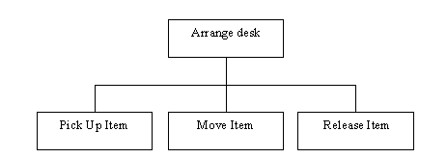
Task Hierarchies of Objects and Actions
(supplementary)
Decomposition of real-world complex systems natural
    human body
    buildings
    cities
    symphonies
    baseball game
Computer system designers must generate a hierarchy of objects and actions to model users' tasks:
    Representations in pixels on a screen
    Representations in physical devices
    Representations in voice or other audio cue
Interface objects and actions based on familiar examples.
Users learn interface objects and actions by:
    seeing a demonstration
    hearing an explanation of features
    conducting trial-and-error sessions
Interface includes hierarchies of objects and actions at high and low levels.
E.g. A computer system:
Interface Objects
  directory
    name
    length
    date of creation
    owner
    access control
  files of information
    lines
    difields
    characters
    fonts
    pointers
    binary numbers
Interface Actions
  load a text data file
  insert into the data file
  save the data file
    save the file
    save a backup of the file
    apply access-control rights
    overwrite previous version
    assign a name

Slide 57
The “Disappearance of Syntax”
(supplementary)
Users used to have to must maintain a profusion of device-dependent details in their human memory.
  Which action erases a character
  Which action inserts a new line after the third line of a text file
  Which abbreviations are permissible
  Which of the numbered function keys produces the previous screen
Learning, use, and retention of this knowledge hampered by two problems:
  Details vary across systems in an unpredictable manner
  Greatly reduces the effectiveness of paired-associate learning
Syntactic knowledge conveyed by example and repeated usage
Syntactic knowledge is system dependent
Minimizing these burdens is the goal of most interface designers
  Modern direct-manipulation systems
  Familiar objects and actions representing their task objects and actions.
  Modern user interface building tools
  Standard widgets

Slide 58

Contextual Theories
Big idea – “Controlled experiments” and such methodologies just not right for understanding human computer interaction
  Rather, users have rich interactions with other people, electronic and paper resources, etc.
  Design can not be separated from patterns of use
Users’ actions are situated in time and place
  User behavior highly responsive to other people and environmental contingencies
  Plans constantly changing
Also, physical space of interaction important
  Consider ubiquitous, pervasive, and embedded devices
Lucy Suchman
Lifetime Research Award,
ACM SIGCHI, 2010

Slide 59
Contextual Theories
Designers can apply contextual theories by observing users in their environments as carry out work, play, engage socially, …
  Data gathering techniques
    Ethnographic observation, focus groups, case studies, surveys, interview data
  (Except things fundamentally change with electronic interaction … cf Facebook, … or do they)
Contextual theories about forming intentions, goal attainment, interaction across environment, emotional states, …
Elements hard to capture by other classes of theories, e.g., predictive mathematical accounts

Slide 60
A Taxonomy of
Mobile Device Applications
Shneiderman, p. 87-8
  Actions tied to objects – suggests both new applications and a way to think about interfaces as objects user encounter and actions the user takes on it
Monitor x and give alerts when y
  Blood pressure, stock prices normal ranges exceeded, criterion
Gather information from x and spread to y
  Meeting attendees, protestors group, individuals, authorities
Participate in group activity by x and relate to specific individuals by y
  Voting sending private messages
Locate x and identify y
  Nearest restaurant, landmark, site rating, cuisine, accessiblity
Capture x and share y
  Information, image … (and from archive) same and more

Slide 61
End
.

