Slide 1
More Practice 3NF and BCNF
CS 4710
Database Systems

Slide 2
Practice 1: 3NF and BCNF
Consider a relation Stocks(B, O, I, S, Q, D), whose attributes may be thought of informally as broker, office (of the broker), investor, stock, quantity (of the stock owned by the investor), and dividend (of the stock). Let the set of FDs for Stocks be
FDs = { S → D, I → B, IS → Q, B → O }
1. Verify that the given set of FDs is a minimal basis
Minimal basis
~ Fc
To verify that the given FDs are their own minimal basis, we need to check:
Can any of the FDs be removed without losing the dependencies?
No. If we remove any one of the four FDs, the remaining FDs do not imply the removed FD.
Can any attributes be removed from LHS and/or RHS without losing the dependencies?
No. If we remove any attribute, we lose the dependency
We can conclude that the given set of FDs is the minimal basis.

Slide 3
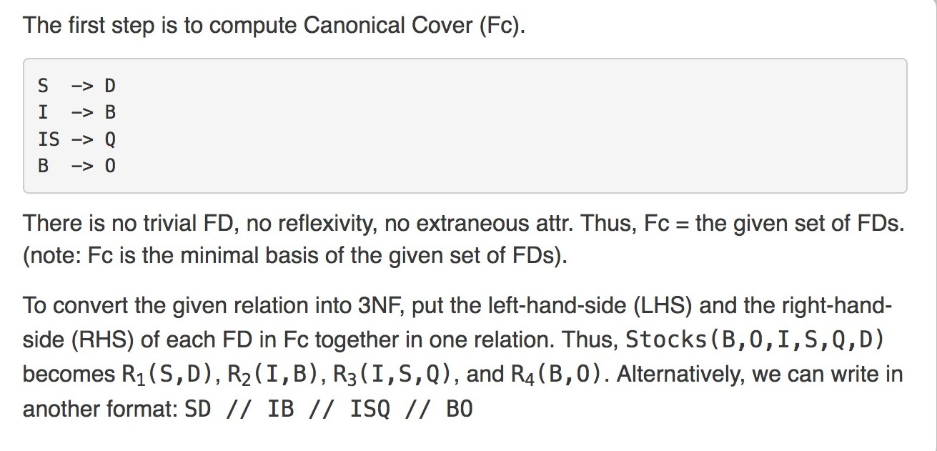
Practice 1: 3NF and BCNF (2)
Stocks(B, O, I, S, Q, D)
FDs = { S → D, I → B, IS → Q, B → O }
2. Use 3NF, decompose the given Stocks relation into proper relations
What is a minimal super key?

Slide 4
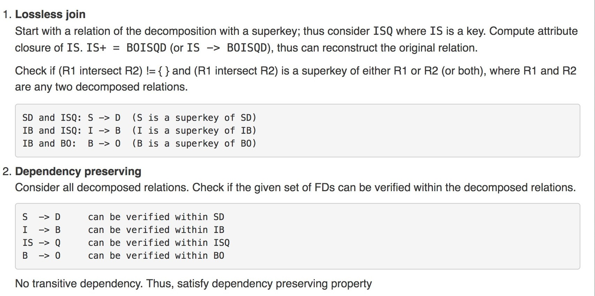
Practice 1: 3NF and BCNF (3)
Stocks(B, O, I, S, Q, D)
FDs = { S → D, I → B, IS → Q, B → O }
Decomposed relations: SD // IB // ISQ // BO
3. Show that the decomposed relations are in 3NF

Slide 5
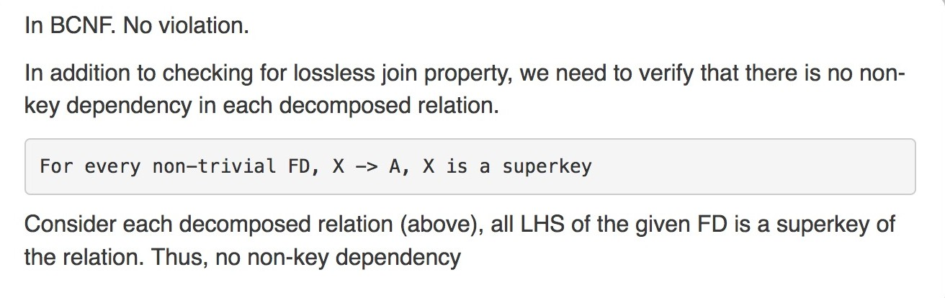
Practice 1: 3NF and BCNF (4)
Stocks(B, O, I, S, Q, D)
FDs = { S → D, I → B, IS → Q, B → O }
Decomposed relations: SD // IB // ISQ // BO
4. Are the decomposed relations in BCNF?

Slide 6
Ready for the next one ??
3
2
1
5
4
Go!!

Slide 7
Practice 2: 3NF
Consider the following relation and functional dependencies R(A, B, C, D)
FDs = { C → A, C → D, C → C, AB → C }
Decompose the given relation R(A, B, C, D) using 3NF
Discuss to show that the decomposed relations are in 3NF
Fc:
What is a minimal super key?
C → AD AB → C
Decomposed relations: ACD // ABC
or written as R1(ACD) and R2(ABC)

Slide 8
Practice 2: 3NF (2)
Discuss to show that the decomposed relations are in 3NF
We need to show that the decomposed relations ACD // ABC satisfy lossless join and dependency preserving. Fc = { C → AD, AB → C }
Lossless join -- check if (R1 intersect R2) != { } and (R1 intersect R2) is a superkey of either R1 or R2 (or both)
Let R1 = ACD and R2 = ABC, (R1 intersect R2) = AC
Consider ACD and check if (R1 intersect R2) is a superkey of ACD.
Since we know that C → AD
C → C, thus C → ACD (reflexive)
A → A, we can augment the above FD by adding attribute A to the left hand side, thus AC → ACD
Therefore, we can conclude that AC (which is R1 intersect R2) is a superkey of ACD (R1)

Slide 9
Practice 2: 3NF (3)
Discuss to show that the decomposed relations are in 3NF
Decomposed relations ACD // ABC, Fc = { C → AD, AB → C }
Lossless join -- check no loose, no gain
First, identify the superkey of the given relation R(ABCD).
Based on the given FDs, compute attribute closure.
Any combination of attributes that contains AB is a superkey. Thus, the only minimal superkey of R(ABCD) is AB.
Then, start with a relation of the decomposition with a superkey AB, which is ABC (refer to Fc: AB → C).
Compute attribute closure of AB.
To help us envision, from the decomposed relation ABC,
Apply AB → C (Fc), AB → AB (reflexive), and C → AD (transitive), thus AB → ABCD. That is, ABC will be expanded to ABCD (~ reconstruct the original relation from this decomposition).
Since AB+ = ABCD (i.e., AB → ABCD), the decomposition satisfies lossless join property (no loose, no gain).

Slide 10
Practice 2: 3NF (4)
Discuss to show that the decomposed relations are in 3NF
Decomposed relations ACD // ABC, Fc = { C → AD, AB → C }
Dependency preserving
Check if the given FDs = { C → A, C → D, C → C, AB → C } can be verified within a single decomposed relation.
Given FDs:
C → A can be verified within ACD
C → D can be verified within ACD
C → C can be verified within ACD
Always true in any relation that contains C
Given FD: AB → C, we can verify it within ABC
No transitive dependency.
Thus, the decomposition satisfies dependency preserving property.
No 3NF violation

Slide 11
Ready for the next one ??
3
2
1
5
4
Go!!

Slide 12
Practice 3: BCNF
Consider the following relation and functional dependencies R(A, B, C, D)
FDs = { C → A, C → D, C → C, AB → C }
Decompose the given relation R(A, B, C, D) using BCNF
Discuss to show that the decomposed relations are in BCNF
Break on c
F+
ABCD
A → A
B → B
tr tr
tr tr ! tr
C → A CD
Verify table ACD if there is any violation.
Just broke on C, cannot break on C twice in a row.
D → D tr
AB → ABCD sk
ACD ^{ok}
ok
BC
tr x tr
Alternatively, we can verify through "for all non-trivial FDs, X→A, X must be a superkey"
For ACD, we know that only C has a non-trivial FD and we know that C → AD (given FD), we can conclude that C is a superkey of ACD, cannot break using the superkey (i.e., no violation).
Decomposed relations: ACD // BC

Slide 13
Practice 3: BCNF (2)
2. Discuss to show that the decomposed relations are in BCNF
We need to show that the decomposed relations ACD // BC satisfy lossless join and For every non-trivial FD, X → Attribute(s), X is a superkey.
F+
A → A
B → B
tr tr
C → A CD
D → D
tr sk
AB → ABCD
Lossless join -- check if (R1 intersect R2) != { } and (R1 intersect R2) is a superkey of either R1 or R2 (or both)
Let R1 = ACD and R2 = BC, (R1 intersect R2) = C
Consider ACD and check if (R1 intersect R2) is a superkey of ACD.
From F+, we can conclude that (R1 intersect R2) is a superkey for ACD (R1)
Thus, the decomposition satisfies lossless join property.

Slide 14
Practice 3: BCNF (3)
2. Discuss to show that the decomposed relations are in BCNF
Decomposed relations ACD // BC, FDs = { C → A, C → D, C → C, AB → C }
F+
Lossless join -- check no loose, no gain
First, identify the superkey of the given relation R(ABCD).
Based on the given FDs, compute attribute closure.
A → A
B → B
tr tr
C → A CD
D → D
tr sk
AB → ABCD
Any combination of attributes that contains AB is a superkey. Thus, the only minimal superkey of R(ABCD) is AB.
Then, start with a relation of the decomposition with a superkey AB, which is ABC (AB → C).
Compute attribute closure of AB.
To help us envision, from the decomposed relation ABC,
Apply AB → C, AB → AB (reflexive), and C → AD (transitive), thus AB → ABCD. That is, ABC will be expanded to ABCD (~ reconstruct the original relation from this decomposition).
Since AB+ = ABCD (i.e., AB → ABCD), the decomposition satisfies lossless join property (no loose, no gain).

Slide 15
Practice 3: BCNF (4)
2. Discuss to show that the decomposed relations are in BCNF
To verify, we need to show that the decomposed relations ACD // BC satisfy lossless join and For every non-trivial FD, X → Attribute(s), X is a superkey.
F+
Given FDs = { C → A, C → D, C → C, AB → C }
A → A
B → B
tr tr
C → A CD
D → D
tr sk
AB → ABCD
For every non-trivial FD, X → Attribute(s), X is a superkey
Consider ACD, we know that C → ACD (A and D have trivial FDs, so ignore)
C is the only non-trivial FD and C is a superkey of ACD.
No non-key dependency in this decomposed relation.
Consider BC, no non-key dependency.
By default, a relation with 2 attributes is always in BCNF (even if there is no dependency at all).
No BCNF violation

Slide 16
Ready for the next one ??
3
2
1
5
4
Go!!

Slide 17
Practice 4: 3NF
Consider the following relation and functional dependencies R(A, B, C, D)
FDs = { A → ABC, C → D, A → C, D → D }
Decompose the given relation R(A, B, C, D) using 3NF
Discuss to show that the decomposed relations are in 3NF
What is a minimal super key?
Fc:
A → BC
C → D
Decomposed relations:
ABC // CD or written as R1(ABC) and R2(CD)

Slide 18
Practice 4: 3NF (2)
Discuss to show that the decomposed relations are in 3NF
We need to show that the decomposed relations ABC // CD satisfy lossless join and dependency preserving. Fc = { A → BC, C → D }
Lossless join -- check if (R1 intersect R2) != { } and (R1 intersect R2) is a superkey of either R1 or R2 (or both)
Let R1 = ABC and R2 = CD, (R1 intersect R2) = C
From Fc, we can conclude that (R1 intersect R2) is a superkey of CD (R2)

Slide 19
Practice 4: 3NF (3)
Discuss to show that the decomposed relations are in 3NF
Decomposed relations ABC // CD, Fc = { A → BC, C → D }
Lossless join -- check no loose, no gain
First, identify the superkey of the given relation R(ABCD).
Based on the given FDs, compute attribute closure.
Any combination of attributes that contains A is a superkey. Thus, the only minimal superkey of R(ABCD) is A.
Then, start with a relation of the decomposition with a superkey A, which is ABC (refer to Fc: A → BC).
Compute attribute closure of A.
To help us envision, from the decomposed relation ABC,
Apply A → BC (Fc), A → A (reflexive), and C → D (transitive), thus A → ABCD. That is, ABC will be expanded to ABCD (~ reconstruct the original relation from this decomposition).
Since A+ = ABCD (i.e., A → ABCD), the decomposition satisfies lossless join property (no loose, no gain).

Slide 20
Practice 4: 3NF (4)
Discuss to show that the decomposed relations are in 3NF
Decomposed relations ABC // CD, Fc = { A → BC, C → D }
Dependency preserving
Check if the given FDs = { A → ABC, C → D, A → C, D → D } can be verified within a single decomposed relation.
Given FDs:
A → ABC can be verified within ABC
C → D can be verified within CD
A → C can be verified within ABC
D → D can be verified within CD
Always true in any relation that contains D
No transitive dependency.
Thus, the decomposition satisfies dependency preserving property.
No 3NF violation

Slide 21
Ready for the next one ??
3
2
1
5
4
Go!!

Slide 22
Practice 5: BCNF
Consider the following relation and functional dependencies R(A, B, C, D)
FDs = { A → ABC, C → D, A → C, D → D }
Decompose the given relation R(A, B, C, D) using BCNF
Discuss to show that the decomposed relations are in BCNF
Break on c
F+
ABCD
A → ABCD sk
B → B tr
C → C
sk tr ! tr
C → CD
D → D tr
Verify table ABC if there is any violation.
Just broke on C, cannot break on C twice in a row.
ok
ok
CD
ABC
sk tr x
Alternatively, we can verify through "for all non-trivial FDs, X→A, X must be a superkey"
For ABC, we know that only A has a non-trivial FD and we know that A → BC (given FD), we can conclude that A is a superkey of ABC, cannot break using the superkey (i.e., no violation).
Decomposed relations: ABC // CD

Slide 23
Practice 5: BCNF (2)
2. Discuss to show that the decomposed relations are in BCNF
To verify, we need to show that the decomposed relations ABC // CD satisfy lossless join and For every non-trivial FD, X → Attribute(s), X is a superkey.
F+
A → ABCD
B → B
sk tr
C → CD
D → D
tr
Lossless join -- check if (R1 intersect R2) != { } and (R1 intersect R2) is a superkey of either R1 or R2 (or both)
Let R1 = ABC and R2 = CD, (R1 intersect R2) = C
From F+, we can conclude that (R1 intersect R2) is a superkey for CD (R2)
Thus, no violation

Slide 24
Practice 5: BCNF (3)
2. Discuss to show that the decomposed relations are in BCNF
Decomposed relations ABC // CD, FDs = { A → ABC, C → D, A → C, D → D }
Lossless join -- check no loose, no gain
First, identify the superkey of the given relation R(ABCD).
Based on the given FDs, compute attribute closure.
F+
A → ABCD
B → B
sk tr
C → CD
D → D
tr
Any combination of attributes that contains A is a superkey. Thus, the only minimal superkey of R(ABCD) is A.
Then, start with a relation of the decomposition with a superkey A (ABC).
Compute attribute closure of A.
To help us envision, from the decomposed relation ABC,
Apply A → ABC (given FD) and C → D (transitive), thus A → ABCD. That is, ABC will be expanded to ABCD (~ reconstruct the original relation from this decomposition).
Since A+ = ABCD (i.e., A → ABCD), the decomposition satisfies lossless join property (no loose, no gain).

Slide 25
Practice 5: BCNF (4)
2. Discuss to show that the decomposed relations are in BCNF
To verify, we need to show that the decomposed relations ABC // CD satisfy lossless join and For every non-trivial FD, X → Attribute(s), X is a superkey.
Given FDs = { A → ABC, C → D, A → C, D → D }
F+
A → ABCD
B → B
sk tr
C → CD
D → D
tr
For every non-trivial FD, X → Attribute(s), X is a superkey
Consider ABC, we know that A → ABC. (B and C have trivial FDs here, ignore)
No non-key dependency in this decomposed relation.
Consider CD, no non-key dependency.
By default, a relation with 2 attributes is always in BCNF (even if there is no dependency at all).
No BCNF violation

Slide 26
Ready for the next one ??
3
2
1
5
4
Go!!

Slide 27
Practice 6: BCNF
Given
R(A,B,C,D,E)
FDs = { B → DE, C → A, A → BC, D → E }
Convert the relation into BCNF
Compute F+
(1) write all LHS & remaining
(2) copy FDs as is
(3) apply reflexivity
(4) apply transitivity
A | → | A | → |  | BC |  | A | → | ABC | A | → | ABCDE
B | → | B | → |  |  | DE | B | → | B DE | B | → | B DE
C | → | C | → | A |  |  | C | → | A C | C | → | ABCDE
D | → | D | → |  |  | E | D | → | DE | D | → | DE
E | → | E | → |  |  |  | E | → | E | E | → | E
F+ = { A → ABCDE, B → BDE, C → ABCDE, D → DE, E → E }

Slide 28
Practice 6: BCNF (2)
(from previous page)
(4) apply transitivity
→ ABCDE
→ B DE
→ ABCDE
→ DE
→ E
F+
Non-trivial FDs. B, D are not super key
Trivial FDs (let’s abbreviate to TR)
Based on F+, let’s rewrite using the following format to help us calculate
R ( A B C D E )
SK ! SK ! TR
TR – trivial
SK – super key
X – neither trivial nor super key
! – (possibly) need to work on

Slide 29
Practice 6: BCNF (3)
F+
→ ABCDE
→ B DE
→ ABCDE
→ DE
→ E
R ( A B C D E )
SK ! SK ! TR
Consider non-trivial FDs and attributes that are not SK
Let’s consider B:
B is not a super key, not trivial, thus B → BDE violates BCNF, thus we can break a relation on B
Let’s consider D:
D is not a super key, not trivial, thus D → DE violates BCNF, thus we can break a relation on D
To choose which FD to work on, two ways:
Choose the first FD, or
Choose the longest FD (yield better solution)
Break on B

Slide 30
Practice 6: BCNF (4)
F+
→ ABCDE
→ B DE
→ ABCDE
→ DE
→ E
R ( A B C D E )
SK ! SK ! TR
B → BDE
RHS, make a table: BDE
LHS, make a table with B plus (original – (RHS)) – thus, ABC
Break on B
ABCDE
Verify table ABC if there is any violation or if we can break any further.
A and C are super keys. – already satisfy, don’t break on them.
Can’t break on B twice.
Verify table BDE if there is any violation.
B is a super key. Also, can’t break on B twice.
E is trivial, can’t break.
ABC ^{ok}
BDE
SK x SK
x ! TR
Break on D

Slide 31
Practice 6: BCNF (5)
F+ A | → | ABCDE
B | → | B DE
C | → | ABCDE
D | → | DE
E | → | E
R ( B D E )
x ! TR
D → DE
RHS, make a table: DE
LHS, make a table with D plus (original – (RHS)) – thus, BD
Break on B
ABCDE
ABC^{ok}
BDE
Break on D
There are only 2 attrs, this relation is ok.
_{BD} ok
_{DE} ok
There are only 2 attrs, this relation is ok.
Decomposed tables: R1(ABC), R2(BD), R3(DE)

Slide 32
Ready for the next one ??
3
2
1
5
4
Go!!

Slide 33
Practice 7: BCNF
Given
R(A,B,C,D,E)
FDs = { A → CE, A → B, B → D, D → CD, C → E }
Convert the relation into BCNF
Compute F+
(1) write all LHS & remaining
(2) copy FDs as is
(3) apply reflexivity
(4) apply transitivity
A | → | A | → | BC E | A | → | ABC E | A | → | ABCDE
B | → | B | → | D | B | → | B D | B | → | BCDE
C | → | C | → | E | C | → | C E | C | → | C E
D | → | D | → | CD | D | → | CD | D | → | CDE
E | → | E | → |  | E | → | E | E | → | E
F+ = { A → ABCDE, B → BCDE, C → CE, D → CDE, E → E }

Slide 34
Practice 7: BCNF (2)
(from previous page)
(4) apply transitivity
→ ABCDE
→ BCDE
→ C E
→ CDE
→ E
F+
Non-trivial FDs. B, C, D are not super key
Trivial FDs (let’s abbreviate to TR)
Based on F+, let’s rewrite using the following format to help us calculate
R ( A B C D E )
SK ! ! ! TR
TR – trivial
SK – super key
X – neither trivial nor super key
! – (possibly) need to work on

Slide 35
Practice 7: BCNF (3)
F+ A | → | ABCDE
B | → | BCDE
C | → | C E
D | → | CDE
E | → | E
R ( A B C D E )
SK ! ! ! TR
Consider non-trivial FDs and attributes that are not SK
B is not a super key, not trivial, thus B → BCDE violates BCNF, thus we can break a relation on B
B is not a super key, not trivial, thus C → CE violates BCNF, thus we can break a relation on C
D is not a super key, not trivial, thus D → CDE violates BCNF, thus we can break a relation on D
To choose which FD to work on, two ways:
Choose the first FD, or
Choose the longest FD (yield better solution)
Break on B

Slide 36
Practice 7: BCNF (4)
Break on B
B → BCDE
F+
→ ABCDE
→ BCDE
→ C E
→ CDE
→ E
R ( A B C D E )
SK ! ! ! TR
RHS, make a table: BCDE
There are only
2 attrs, this relation is ok.
LHS, make a table with B plus (original – (RHS)) – thus, AB
R ( B C D E )
x ! ! TR
Break on D
D → CDE
RHS, make a table: CDE
LHS, make a table with D plus (original – (RHS)) – thus, BD
There are only 2 attrs, this relation is ok.
R ( C D E )
! x TR
Break on C
C → CE
RHS, make a table: CE
LHS, make a table with C plus (original – (RHS)) – thus, CD
There are only
2 attrs, this relation is ok.
Decomposed tables: R1(AB), R2(BD), R3(CE), R4(CD)

Slide 37
Ready for the next one ??
3
2
1
5
4
Go!!

Slide 38
Practice 8: 3NF
Given
R(A,B,C,D,E)
FDs = { A → CE, A → B, B → D, D → CD, C → E }
Convert the relation into BCNF
What is a minimal super key?
Compute Fc
(1) write all LHS & remaining
(2) copy FDs as is
(3) remove
reflexivity
(4) remove
extraneous attr
A →
B →
C →
D →
→ BC E
→ D
→ E
→ CD
→ BC E
→ D
→ E
→ CD
→ BC E
→ D
→ E
→ C
A → B, B → D, D → C, C → E, thus A does not have to directly imply E.
A → B, B → D, D → C, thus A does not have to directly imply C.
Alternatively, if we apply A → C, C → E, thus A does not need to directly imply E. If this was done, C would be kept (i.e., A → BC); then, A → B, B → D, D → C, remove C
Fc = { A → B, B → D, C → E, D → C }
Decomposed tables: R1(AB), R2(BD), R3(CE), R4(CD)

