Slide 1
Study Guide for CSc 4710
Farhan Tanvir

Slide 2
Exam details
Midterm 1 on 02/16
No class on 02/18
No cheat sheet is allowed
5 questions; 75 marks
ER diagram – 30
Relational model -20
SQL – 25

Slide 3
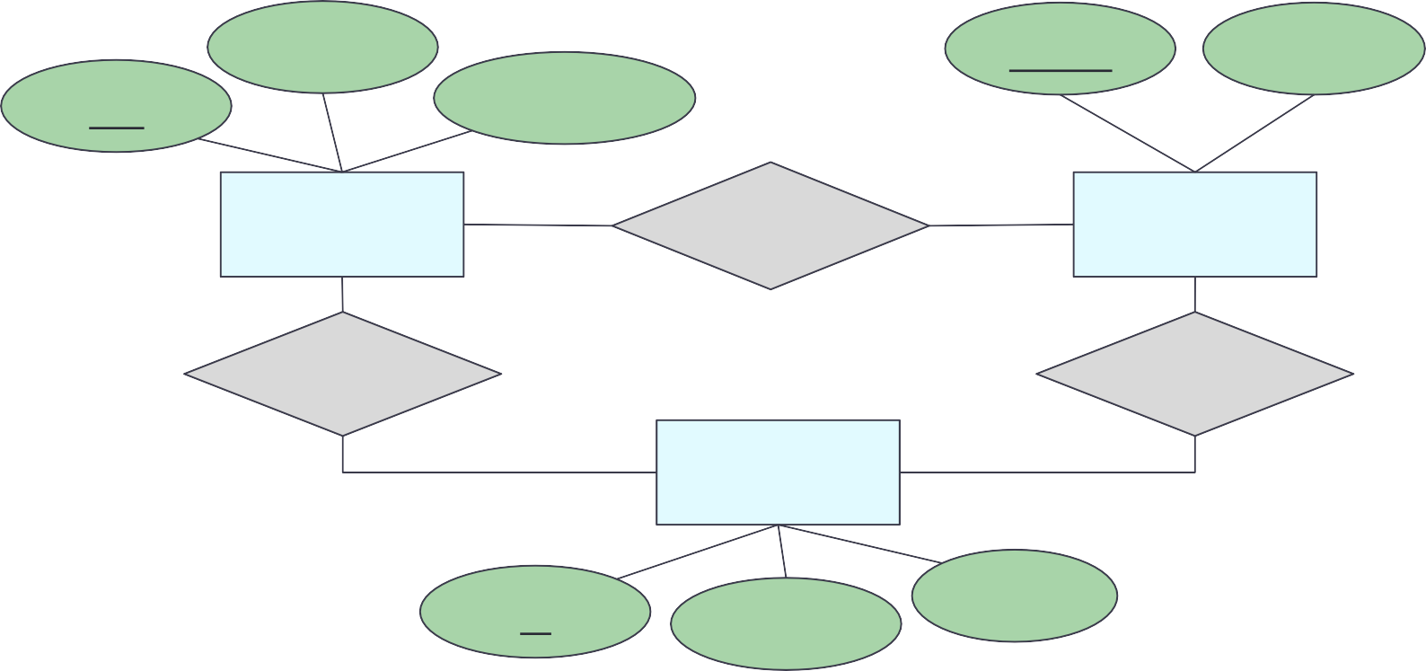
Entity-Relationship Model
E-R diagram – high-level design model representing a database as a collection of entities and relationships among entities
name
name
address
pid
description
product
makes
company
buys
works-for
person
id
address
name

Slide 4
E-R Diagram: Building Blocks
(strong) Entity set
Attribute Relationship
Weak entity
Subclass
is a
Note: colors are not part of E-R Diagram. They simply are used to increase readability.

Slide 5


Entity and Entity Sets
Entity ~an object (thing to keep track to run the business)
Entity set ~a class (~table, a collection of things of the same kind)
Some entity set
examples
Student
Building
Doctor
Treatment
Course
Faculty
Patient
Nurse

Slide 6
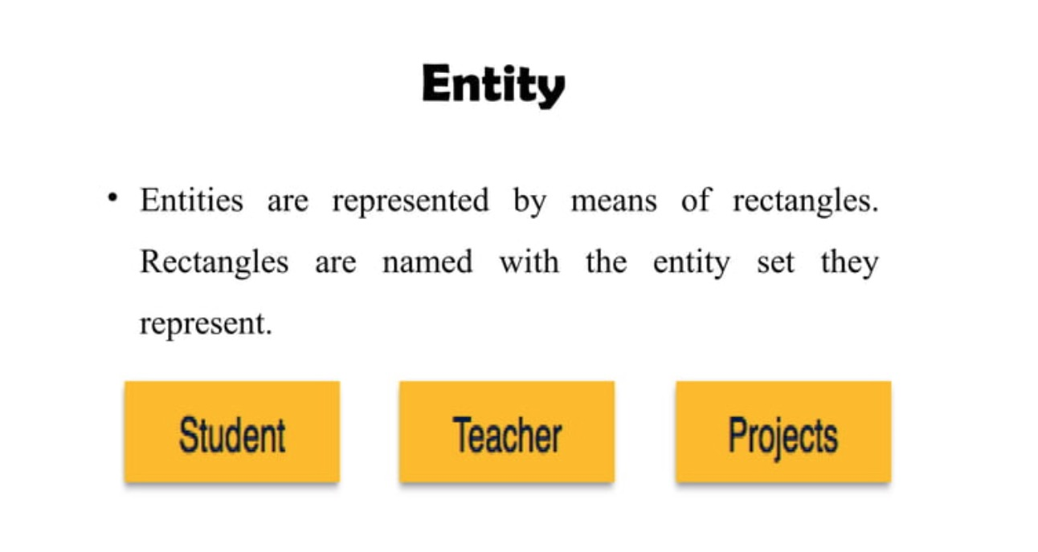

Slide 7
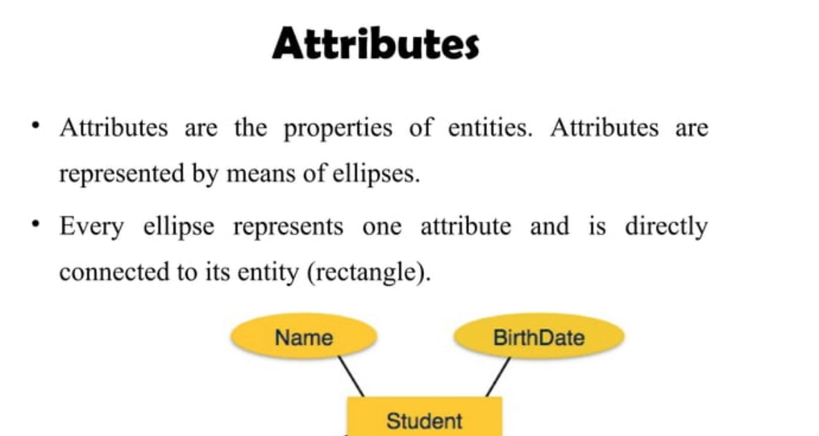

Slide 8
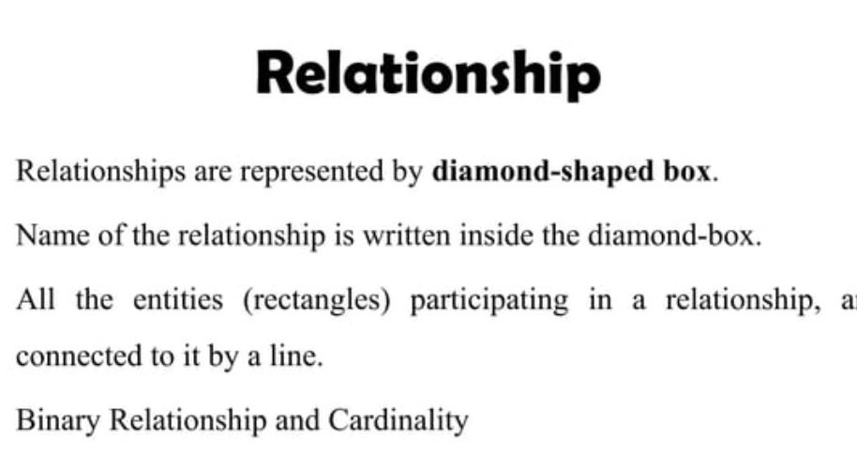

Slide 9
Super Key – Candidate Key - Primary Key
Super key – any attribute(s) that can uniquely identify a tuple
Candidate key – minimal super key
Primary key – a candidate key that is the most important key
Students_info
Identify primary key
computingID | SSN | name
mi1y | 111-11-1111 | Mickey
mi2e | 222-22-2222 | Minnie
do3d | 333-33-3333 | Donald
da4y | 444-44-4444 | Daisy
do5d | 555-55-5555 | Donald
computingID
Primary key

Slide 10
Primary Keys
A relation’s primary key uniquely identifies a single tuple
movies
title | year | length | genre
Gone with the wind | 1939 | 231 | drama
Star wars | 1977 | 124 | sciFi
Wayne’s world | 1992 | 95 | comedy
Unique
Every tuple has
The characteristics of primary keys
Not empty, not NULL
Most important candidate key
No change
Meaningful

Slide 11
Primary Keys
Some DBMSs automatically create an internal primary key if none is defined for the relation
Auto-generation of unique integer primary keys:
SEQUENCE (SQL: 2003)
movies
id | title | year | length | genre
123 | Gone with the wind | 1939 | 231 | drama
456 | Star wars | 1977 | 124 | sciFi
789 | Wayne’s world | 1992 | 95 | comedy
AUTO_INCREMENT (MySQL)

Slide 12

Foreign Keys
A foreign key specifies that an attribute from one relation has to map to a tuple in another relation
Artist(id, name, year, country)
Attribute(s) that uniquely identify a row in another table
id | name | year | country
123 | Mickey | 1992 | USA
456 | Minnie | 1992 | USA
789 | Donald | 1994 | USA
Primary key
Album(id, name, artists, year)
id | name | artists | year
11 | Mickey’s Club House | 123 | 1993
22 | Awesome Minnie | 456 | 1994
33 | Most wanted | 789 | 1995
How about 2 artists (123 and 789)?
33 | Most wanted | 123 | 1995
33 | Most wanted | 789 | 1995
Foreign key

Slide 13
Foreign Keys
ArtistAlbum(artist_id, album_id)
Artist(id, name, year, country)
artist_id | album_id
123 | 11
123 | 33
789 | 33
456 | 22
id | name | year | country
123 | Mickey | 1992 | USA
456 | Minnie | 1992 | USA
789 | Donald | 1994 | USA
PK
PK
Album(id, name, year)
id | name | year
11 | Mickey’s Club House | 1993
22 | Awesome Minnie | 1994
33 | Most wanted | 1995
How about a primary key?
PK

Slide 14


Entity Sets and Attributes
Every entity set should have a primary key
An entity is an object that is distinguishable from other types of objects
person
id
address
name
An attribute has domain specifying acceptable values
Underline indicates that the attribute is part of the primary key
E-R model is a static concept, involving the structure of data and not the operations on data.
Thus, no methods associated with an entity set

Slide 15
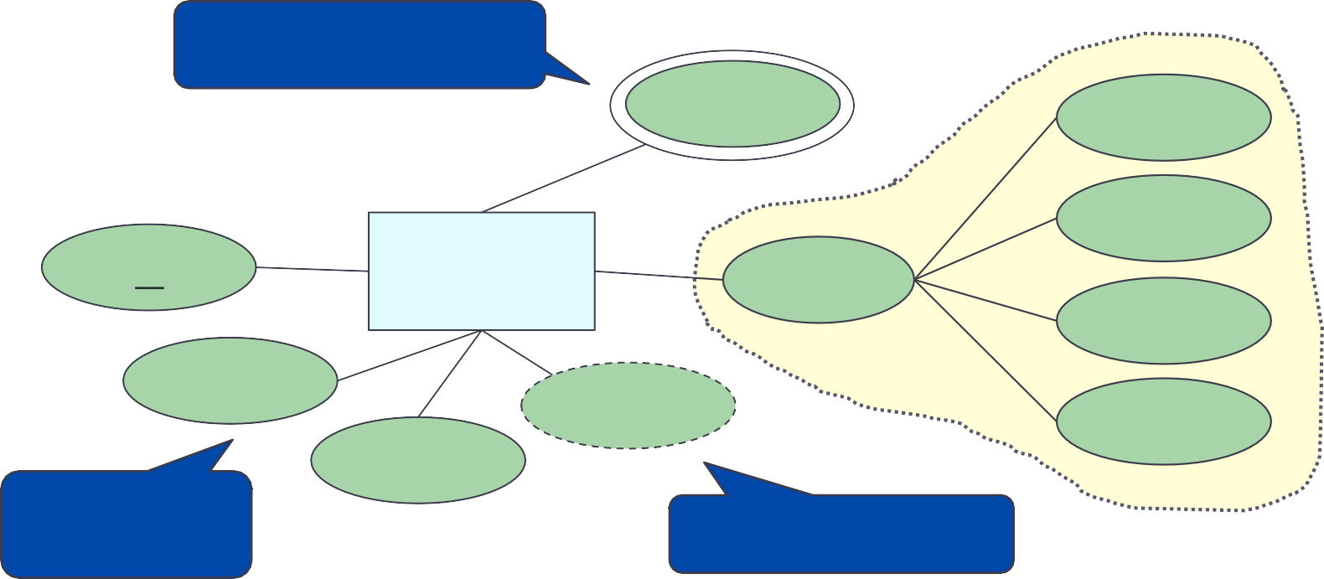
Attributes
Single-valued attribute – allows a single value
Multi-valued attribute – allows multiple values at the same time
Derived attribute –can be calculated from one or more attributes
Composite attribute – consists of multiple values
Multi-valued attribute
phone
street
Composite attribute
city
id
person
address
Ensure atomic
state
name
age
zipcode
DOB
Single-valued attribute
Derived attribute

Slide 16
Relationships
Connections among two or more entity sets
Binary relationships – connections between two entity sets
Multi-way relationships (u-ary) – connections involving more than two entity sets

Slide 17
Binary Relationships
If A and B are sets, a relationship R is a subset of A X B
product
company
pid | name | description |  | name | address
11 | Beyblade | … |  | Dreamwork | …
22 | Trolls | … |  | Hashbro | …
… | … | … |  | Nyform | …
name
name
address
pid
description
product
makes
company
Note: instances do not exist in E-R. These tables are only to help visualize the database being designed.

Slide 18
Cardinality (or Multiplicity)
A binary relationship can connect any member of one of its entity sets to any number of members of the other entity set
One-to-one
One-to-many
Many-to-one
Many-to-many

Slide 19
Cardinality: One-to-One
product company
pid | name | description |  | name | address
11 | Beyblade | … |  | Dreamwork | …
22 | Trolls | … |  | Hashbro | …
… | … | … |  | Nyform | …
person
owns
passport
Arrow pointing to the entity that is constrained to one
Arrow pointing to the entity that is constrained to one
Each passport can be owned by at most one person. Each person can own at most one passport.
“at most one” – Guarantee existence?
Note: instances do not exist in E-R. These tables are only to help visualize the database being designed.

Slide 20
Example
each student has one backpack, and that each backpack belongs to one student.
One person has one passport, and the passport can only be used by one person.
One family lives in one house, and the house contains one family.
One person owns one car, and the car is owned by one person.

Slide 21
Cardinality: One-to-Many
product company
pid | name | description |  | name | address
11 | Beyblade | … |  | Dreamwork | …
22 | Trolls | … |  | Hashbro | …
… | … | … |  | Nyform | …
mother
child
mother of
Arrow pointing to the entity that is constrained to one
Each mother can have many children. Each child has one mother.
“at most one” and “many” – Guarantee existence?
Note: instances do not exist in E-R. These tables are only to help visualize the database being designed.

Slide 22
Example
parent-child relationship
book authors and their books
websites with multiple web pages

Slide 23
Cardinality: Many-to-Many
product company
pid | name | description |  | name | address
11 | Beyblade | … |  | Dreamwork | …
22 | Trolls | … |  | Hashbro | …
… | … | … |  | Nyform | …
product
makes
company
Each product can be made by many companies. Each company can make many products.
“many” – Guarantee existence?
Note: instances do not exist in E-R. These tables are only to help visualize the database being designed.

Slide 24
Example
Students and Courses
Teacher and students
Library books and borrowers

Slide 25
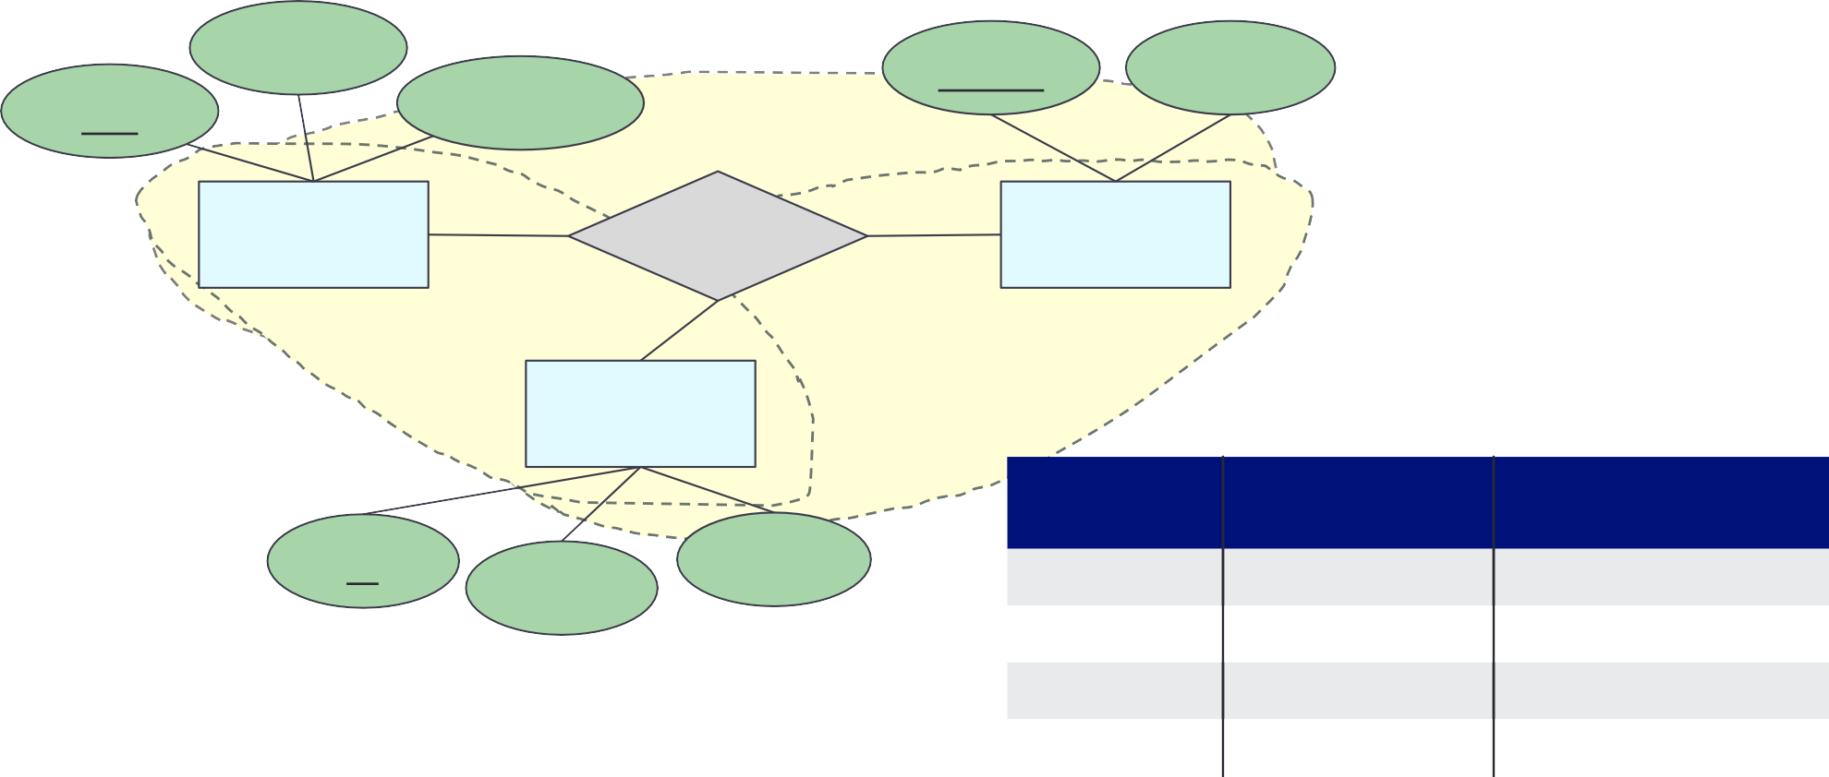
Multi-Way Relationships
name
name
address
pid
description
product
buys
company
person
buys
person.id | product.pid | company.name
11 | p111 | Humpty Inc.
11 | p222 | Humpty Inc.
22 | p111 | Humpty Inc.
22 | p111 | Dumpty Shop
id
name
address
Each (person, product) pair can connect to many companies. Each (person, company) pair can connect to many products. Each (company, product) pair can connect to many persons.
Note: instances do not exist in E-R. These tables are only to help visualize the database being designed.

Slide 26
Multiway Relationships
How do we model a purchase relationship between buyers,
products and stores?
Product
Purchase
Store
Person

Slide 27
Roles in Relationships
What if we need an entity set twice in one relationship?
Product
Purchase
Store
Person
Person
?
Salesperson
Buyer

Slide 28
Roles in Relationships
Label the edges to indicate the roles
Collapse the two entity sets into one
Product
Purchase
Store
Salesperson
Buyer
Person

Slide 29


Strong and Weak Entity Sets
Strong entity set
What we have been discussing so far
Entities can be identified by the values of their attributes (a primary key)
A weak entity’s existence depends on its strong entity
Weak entity set
No primary key → cannot be identified by their attributes
To identify, need a combination of their attributes (“discriminator”) and the relationship they have with another entity set (“identifying relationship”)
If X and Y are entities and each instance of Y must have a corresponding instance of X, Y is “existence dependent” on X
→ Y is a weak entity, and X is its strong entity
→ Y must have total participation in its relationship set with X

Slide 30

Weak Entity Set
By definition, there must be total participation between the weak entity set and its identifying relationship “existence dependency”
Discriminator
Total participation
PantherID
payment_number
Name
date
Payment
Tuition Fee Payment
Student
Strong entity set
payment_amount
Weak entity set
Identifying relationship
Does not have sufficient attributes to form a primary key.
Depends on the strong entity set it is associated with.
Needs a discriminator and a primary key of the strong entity set.

Slide 31
Weak Entity Set
Entity sets are weak when their key attributes come from other classes to which they are related
This happens if:
part-of hierarchies
Diamond with double border
If an attribute of it is a part of the key, underline it
Loan Number
ssn
Amount
Payment Number
Date
)
Loan Payment
Payment
Officer

Slide 32
Weak Entity Set
The entity set E is said to be weak if
in order to identify entities of E uniquely, we need to follow one or more many-one relationships from E and include the key of the related entities from the owner entity sets: one owner, many weak entities
name
ssn
lot
cost
pname
age
Employees
)
Policy
Dependents

Slide 33
Let’s try: Weak Entity Set
What can be concluded from the following E-R diagram?
hw_number
c_number
course
title
due_date
homework
have
total_scores
Homework cannot exist without a course. Every homework must belong to a single class. A course can have many homework.
Different courses may have the same homework number.
To identify a homework, we need c_number and hw_number.

Slide 34
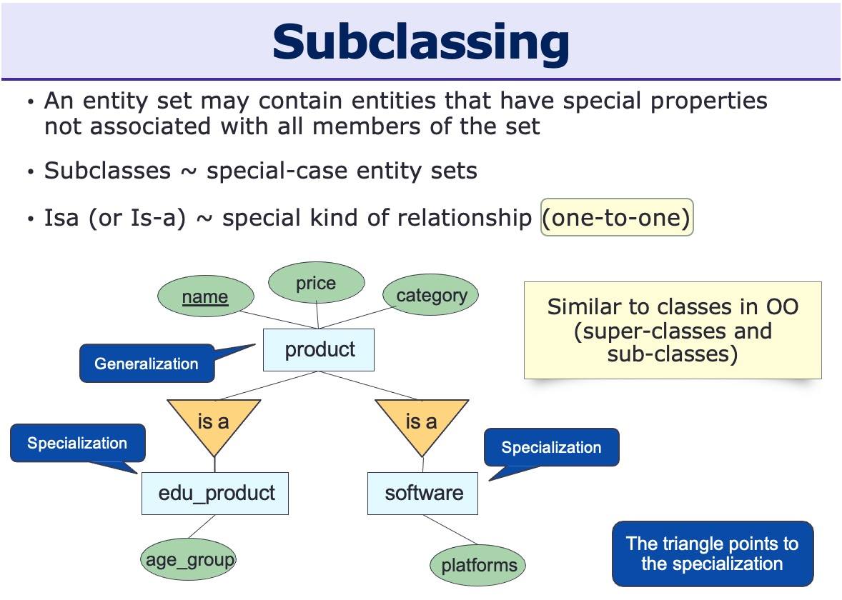

Slide 35
Inheritance in the E/R Model Subclasses(subentities)
Entity set containing special properties not associated with all members of the set
Subclass = special case
= with its own special properties and/or relationships
Example: Products
Software products
Educational products
Let us suppose that in addition to all the properties (attributes and relationships) of products, Software products also have the other attributes, e.g. platform

Slide 36
Inheritance in the E/R Model Subclasses(subentities)
Assume subclasses form a tree
No multiple inheritance
Isa triangles indicate the subclass relationship
Point to the superclass
Superclass contains all common attributes
Subclasses contain specific attributes.

Slide 37
E-R Diagrams to Relations
There is a unique table which is assigned the name of the corresponding entity set or relationship set
name
cname
address
pid
description
product
makes
company
product(pid, name, description) company(cname, address) makes(cname, pid)
“Schema statement”
[ER to schema worksheet]

Slide 38
Strong Entity Set
Direct map:
Entity name → relation name Attributes → columns Primary key: same as entity
name
cname
address
pid
description
product
makes
company
product(pid, name, description) company(cname, address) makes(cname, pid)

Slide 39
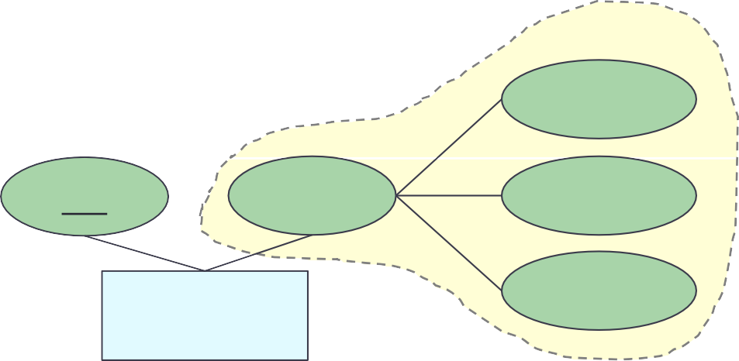
Strong Entity Set with Composite Attribute
Create separate attributes for each component Don’t include the higher level attribute
first
pid
name
middle
person
last
person(pid, first_name, middle_name, last_name)

Slide 40
Strong Entity Set with Multivalued Attribute
Create a separate table for the multivalued attribute
Name the table with the concatenation, separated by “_”
entityname_attributename
Primary key: all attributes
pid
name
phone
person
person(pid, name) person_phone(pid, phone_number)

Slide 41
Weak Entity Set
Let A be a weak entity set and B be the identifying strong entity set on which A depends
Create a table with primary key of B and all A’s attributes Primary key: primary key of B (strong entity) and
discriminator of A
hw_number
c_number
title
due_date
homework
have
course
total_scores
course(c_number, title)
homework(c_number, hw_number, due_date, total_scores)

Slide 42
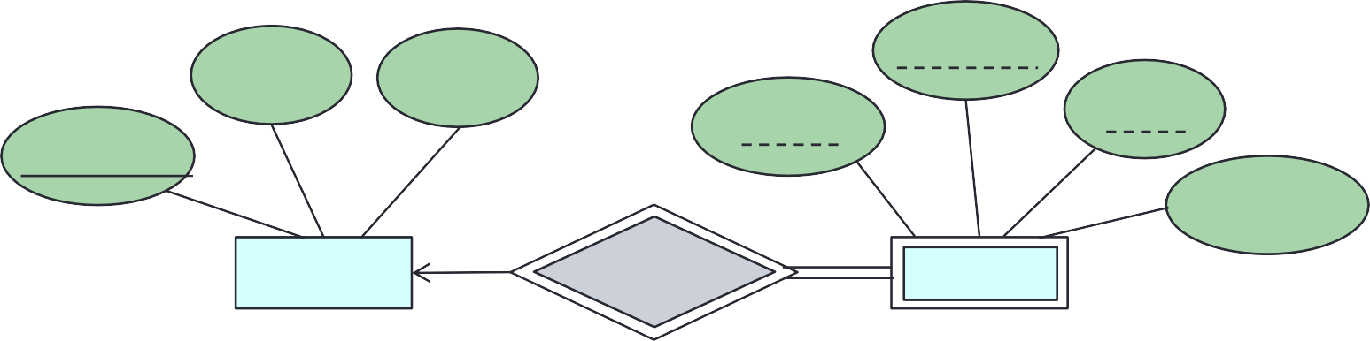
Let’s try: E-R to Relations (2)
Convert the following E-R diagram into relations
title
semester
credits
sec_id
year
course_id
enroll_limit
course
sec_course
section
course (course_id, title, credits)
section (course_id, sec_id, semester, year, enroll_limit)

Slide 43
Relationship Set: Many-to-One / One-to-Many
Table: primary keys of both participating entity sets and any attributes on the relationship itself
Primary key: primary keys of the entity set on the “many” side
mother
child
mother of
Arrow pointing to the entity that is constrained to one
mother(SSN, name)
child(SSN, name)
motherOf(ChildSSN, motherSSN)
Each mother can have many children. Each child has one mother.
“at most one” and “many” – Guarantee existence?
Note: instances do not exist in E-R. These tables are only to help visualize the database being designed.

Slide 44
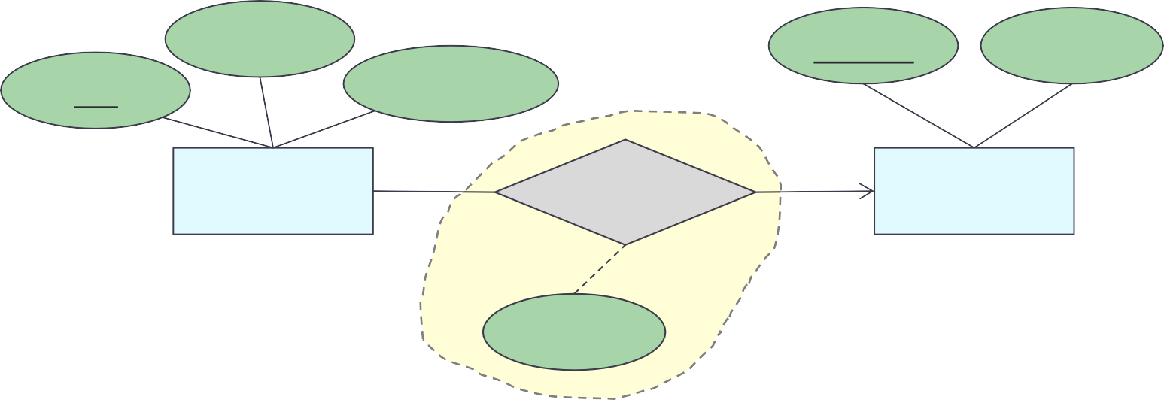
Relationship Set: Many-to-One / One-to-Many
Table: primary keys of both participating entity sets and any attributes on the relationship itself
Primary key: primary keys of the entity set on the “many” side
name
cname
address
pid
description
product
makes
company
quantity
product(pid, name, description) company(cname, address) makes(pid, cname, quantity)
Primary key of the “many” side

Slide 45
Relationship Set: One-to-One
Table: Either side can be used as the main table
(Which side? doesn’t matter. Pick the one that makes the most sense)
Add the other side’s primary key to it
Primary key: primary keys of the entity set you pick
person
owns
passport
Arrow pointing to the entity that is constrained to one
Arrow pointing to the entity that is constrained to one
Each passport can be owned by at most one person. Each person can own at most one passport.
person(SSN, name)
passport(passportNo, SSN)
Note: instances do not exist in E-R. These tables are only to help visualize the database being designed.

Slide 46
CREATE TABLE (Entity Set)
person
first
id
name
middle
id
address
name
person
last
person(id,
name,
address)
person(id, first_name, middle_name, last_name)
CREATE
TABLE person (
CREATE
TABLE person (
id INT,
id INT,
name VARCHAR(40),
first_name VARCHAR(20),
address VARCHAR(255), PRIMARY KEY (id) );
middle_name VARCHAR(3),
last_name VARCHAR(20),
PRIMARY KEY (id) );

Slide 47
CREATE TABLE (Entity Set)
id
name
person
address
phone
person(id, name, address) person_phone(id, phone)
CREATE TABLE person ( id INT,
name VARCHAR(40),
address VARCHAR(255), PRIMARY KEY (id) );
CREATE TABLE person_phone ( id
INT REFERENCES person(id),
phone VARCHAR(10),
PRIMARY KEY (id, phone) );

Slide 48
CREATE TABLE (One-to-One)
Option 1: create tables for entity sets and a relationship set
product
makes
company
CREATE
TABLE product(pid VARCHAR(10), ...,
PRIMARY KEY (pid) );
CREATE
TABLE company(cname PRIMARY KEY (cname)
VARCHAR(100), ...,
);
CREATE | TABLE | makes(
 | cname | VARCHAR(100) | UNIQUE | REFERENCES | company(cname),
pid | VARCHAR(100) | UNIQUE | REFERENCES | product(pid),
... | );
PRIMARY KEY (cname, pid)
Do we need all these tables?

Slide 49
CREATE TABLE (One-to-One)
Option 2: create tables for entity sets, store a primary key of one entity in another entity, no table for relationship set
product
makes
company
CREATE
TABLE product(pid PRIMARY KEY (pid)
VARCHAR(10),
);
...,
CREATE TABLE company(cname VARCHAR(100), ..., pid VARCHAR(10),
PRIMARY KEY (cname),
FOREIGN KEY (pid) REFERENCES product(pid) );
Make use of the one-to-one fact. Better design – fewer tables

Slide 50
CREATE TABLE (Many-to-Many)
product
makes
company
CREATE
TABLE product(pid PRIMARY KEY (pid)
VARCHAR(10),
);
...,
CREATE
TABLE company(cname PRIMARY KEY (cname)
VARCHAR(100), ...,
);
CREATE TABLE makes(
cname VARCHAR(100) REFERENCES company(cname), pid VARCHAR(100) REFERENCES product(pid), ..., PRIMARY KEY (cname, pid) );

Slide 51

CREATE TABLE
(One-to-Many / Many-to-One)
Option 1: create tables for entity sets and a relationship set
product
makes
company
CREATE
TABLE product(pid PRIMARY KEY (pid)
VARCHAR(10),
);
...,
CREATE
TABLE company(cname PRIMARY KEY (cname)
VARCHAR(100), ...,
);
CREATE
TABLE
cname
makes(
VARCHAR(100) REFERENCES company(cname),
pid VARCHAR(100)
REFERENCES product(pid), ...,
);
PRIMARY KEY (pid)
FOREIGN KEY (cname) REFERENCES company(cname)
Do we need all these tables?

Slide 52
CREATE TABLE
(One-to-Many / Many-to-One)
Option 2: create tables for entity sets, store a primary key of the “one” side in the “many” side, no table for relationship set
product
makes
company
CREATE
TABLE
cname
product(pid
VARCHAR(10),
...,
VARCHAR(100),
PRIMARY KEY (pid),
FOREIGN KEY (cname) REFERENCES company(cname) );
CREATE
VARCHAR(100), ..., PRIMARY KEY (cname) );
TABLE
company(cname

Slide 53
CREATE TABLE
(Multi-Way Relations)
price
personID
person
buys
product
pid
company
cname
CREATE
TABLE product(pid VARCHAR(10), ..., PRIMARY KEY (pid) );
TABLE company(cname VARCHAR(100), ..., PRIMARY KEY (cname) );
TABLE person VARCHAR(10), ...,
PRIMARY KEY (personid) );
TABLE buys(
cname VARCHAR(100) REFERENCES company(cname), pid VARCHAR(100) REFERENCES product(pid), personID VARCHAR(10) REFERENCE person(personID), price FLOAT,
PRIMARY KEY (cname, pid, personID,) );
CREATE
CREATE
CREATE
...,

Slide 54
CREATE TABLE (Weak Entity Set)
hw_number
c_number
course
title
due_date
homework
have
total_scores
CREATE
TABLE course(c_number VARCHAR(10), ..., PRIMARY KEY (c_number) );
CREATE TABLE homework(hw_number VARCHAR(10), ..., c_number VARCHAR(10) REFERENCES course(c_number), PRIMARY KEY (c_number, hw_number) );

Slide 55
ALTER TABLE … ADD/DROP
cname
address
CREATE
TABLE company ( cname VARCHAR(40),
address VARCHAR(255), PRIMARY KEY (cname));
company
cname
address
ALTER TABLE company
ADD ceo VARCHAR(40);
ceo
company
cname
address
ALTER
DROP ceo;
TABLE
company
company

Slide 56
INSERT INTO … VALUE
Student_lecture
S_id | Address | Course | Teaching_assistant
1234 | 57 Hockanum Blvd | Database Systems | Minnie
2345 | 1400 E. Bellows | Database Systems | Humpty
3456 | 900 S. Detroit | Cloud Computing | Dumpty
1234 | 57 Hockanum Blvd | Web Programming Lang. | Mickey
5678 | 2131 Forest Lake Ln. | Software Analysis | Minnie
INSERT VALUES
INTO
Student_lecture
(“9999”, “85 Engineer’s Way”,
“Database Systems”, “Humpty”);
Student_lecture

Slide 57
INSERT INTO … VALUE
Student_lecture
S_id | Address | Course | Teaching_assistant
1234 | 57 Hockanum Blvd | Database Systems | Minnie
2345 | 1400 E. Bellows | Database Systems | Humpty
3456 | 900 S. Detroit | Cloud Computing | Dumpty
1234 | 57 Hockanum Blvd | Web Programming Lang. | Mickey
5678 | 2131 Forest Lake Ln. | Software Analysis | Minnie
INSERT VALUES
INTO
Student_lecture
(“9999”, “85 Engineer’s Way”,
“Database Systems”, “Humpty”);
Student_lecture
S_id | Address | Course | Teaching_assistant
1234 | 57 Hockanum Blvd | Database Systems | Minnie
2345 | 1400 E. Bellows | Database Systems | Humpty
3456 | 900 S. Detroit | Cloud Computing | Dumpty
1234 | 57 Hockanum Blvd | Web Programming Lang. | Mickey
5678 | 2131 Forest Lake Ln. | Software Analysis | Humpty
9999 | 85 Engineer’s Way | Database Systems | Humpty

Slide 58
UPDATE … SET ... WHERE
Student_lecture
S_id | Address | Course | Teaching_assistant
1234 | 57 Hockanum Blvd | Database Systems | Minnie
2345 | 1400 E. Bellows | Database Systems | Humpty
3456 | 900 S. Detroit | Cloud Computing | Dumpty
1234 | 57 Hockanum Blvd | Web Programming Lang. | Mickey
5678 | 2131 Forest Lake Ln. | Software Analysis | Minnie
UPDATE Student_lecture
SET Teaching_assistant = “Humpty” WHERE S_id = “5678”;
Student_lecture
S_id | Address | Course | Teaching_assistant
1234 | 57 Hockanum Blvd | Database Systems | Minnie
2345 | 1400 E. Bellows | Database Systems | Humpty
3456 | 900 S. Detroit | Cloud Computing | Dumpty
1234 | 57 Hockanum Blvd | Web Programming Lang. | Mickey
5678 | 2131 Forest Lake Ln. | Software Analysis | Humpty
9999 | 85 Engineer’s Way | Database Systems | Humpty

Slide 59
DELETE FROM … WHERE
Student_lecture
S_id | Address | Course | Teaching_assistant
1234 | 57 Hockanum Blvd | Database Systems | Minnie
2345 | 1400 E. Bellows | Database Systems | Humpty
3456 | 900 S. Detroit | Cloud Computing | Dumpty
1234 | 57 Hockanum Blvd | Web Programming Lang. | Mickey
5678 | 2131 Forest Lake Ln. | Software Analysis | Minnie
9999 | 85 Engineer’s Way | Database Systems | Humpty
DELETE FROM Student_lecture WHERE
Teaching_assistant = ”Humpty”;
Student_lecture
S_id | Address | Course | Teaching_assistant
1234 | 57 Hockanum Blvd | Database Systems | Minnie
3456 | 900 S. Detroit | Cloud Computing | Dumpty
1234 | 57 Hockanum Blvd | Web Programming Lang. | Mickey
5678 | 2131 Forest Lake Ln. | Software Analysis | Minnie

Slide 60

Aggregation: Order of Actions
SELECT select_list
FROM table_source
[WHERE search_condition] [GROUP BY group_by_expression] [HAVING search_condition]
[ORDER BY order_expression [ASC | DESC] ]
Order matter
The FROM clause generates the data set
The WHERE clause filters the data set generated by the FROM clause
The GROUP BY clause aggregates the data set that was filtered by the WHERE clause (note: GROUP BY does not sort the result set)
The HAVING clause filters the data set that was aggregated by the GROUP BY clause
The SELECT clause transforms the filtered aggregated data set
The ORDER BY clause sorts the transformed data set

Slide 61
SELECT * FROM ...
Student_lecture
S_id | Address | Course | Teaching_assistant
1234 | 57 Hockanum Blvd | Database Systems | Minnie
2345 | 1400 E. Bellows | Database Systems | Humpty
3456 | 900 S. Detroit | Cloud Computing | Dumpty
1234 | 57 Hockanum Blvd | Web Programming Lang. | Mickey
5678 | 2131 Forest Lake Ln. | Software Analysis | Minnie
SELECT * FROM Student_lecture;
S_id | Address | Course | Teaching_assistant
1234 | 57 Hockanum Blvd | Database Systems | Minnie
2345 | 1400 E. Bellows | Database Systems | Humpty
3456 | 900 S. Detroit | Cloud Computing | Dumpty
1234 | 57 Hockanum Blvd | Web Programming Lang. | Mickey
5678 | 2131 Forest Lake Ln. | Software Analysis | Minnie

Slide 62

SELECT Specific Attribute
Student_lecture
S_id | Address | Course | Teaching_assistant
1234 | 57 Hockanum Blvd | Database Systems | Minnie
2345 | 1400 E. Bellows | Database Systems | Humpty
3456 | 900 S. Detroit | Cloud Computing | Dumpty
1234 | 57 Hockanum Blvd | Web Programming Lang. | Mickey
5678 | 2131 Forest Lake Ln. | Software Analysis | Minnie
SELECT
S_id,
Course
FROM
Student_lecture;
S_id | Course
1234 | Database Systems
2345 | Database Systems
3456 | Cloud Computing
1234 | Web Programming Lang.
5678 | Software Analysis
“Projection”

Slide 63
SELECT with WHERE Clause (1)
Student_lecture
S_id | Address | Course | Teaching_assistant
1234 | 57 Hockanum Blvd | Database Systems | Minnie
2345 | 1400 E. Bellows | Database Systems | Humpty
3456 | 900 S. Detroit | Cloud Computing | Dumpty
1234 | 57 Hockanum Blvd | Web Programming Lang. | Mickey
5678 | 2131 Forest Lake Ln. | Software Analysis | Minnie
SELECT * FROM Student_lecture WHERE
Teaching_assistant = “Minnie” ;
S_id | Address | Course | Teaching_assistant
1234 | 57 Hockanum Blvd | Database Systems | Minnie
5678 | 2131 Forest Lake Ln. | Software Analysis | Minnie

Slide 64
Recap 1: SELECT .. FROM .. WHERE
Student_lecture
S_id | Address | Course | Teaching_assistant
1234 | 57 Hockanum Blvd | Database Systems | Minnie
2345 | 1400 E. Bellows | Database Systems | Humpty
3456 | 900 S. Detroit | Cloud Computing | Dumpty
1234 | 57 Hockanum Blvd | Web Programming Lang. | Mickey
5678 | 2131 Forest Lake Ln. | Software Analysis | Minnie
Find Courses that Minnie is a TA. Also, list all S_id who takes those courses
SELECT distinct Course
FROM Student_lecture
WHERE Teaching_assistant= “Minnie”
SELECT S_id, Course
FROM Student_lecture
WHERE Teaching_assistant= “Minnie”

Slide 65
ORDER BY (Ascending)
Student_lecture
S_id | Address | Course | Teaching_assistant
1234 | 57 Hockanum Blvd | Database Systems | Minnie
2345 | 1400 E. Bellows | Database Systems | Humpty
3456 | 900 S. Detroit | Cloud Computing | Dumpty
1234 | 57 Hockanum Blvd | Web Programming Lang. | Mickey
5678 | 2131 Forest Lake Ln. | Software Analysis | Minnie
SELECT WHERE ORDER
S_id, Course FROM Student_lecture
<> “Dumpty”
Teaching_assistant
BY S_id;
S_id | Course
1234 | Database Systems
1234 | Web Programming Lang.
2345 | Database Systems
5678 | Software Analysis
Ascending, by default Or include ASC

Slide 66
ORDER BY (Descending)
Student_lecture
S_id | Address | Course | Teaching_assistant
1234 | 57 Hockanum Blvd | Database Systems | Minnie
2345 | 1400 E. Bellows | Database Systems | Humpty
3456 | 900 S. Detroit | Cloud Computing | Dumpty
1234 | 57 Hockanum Blvd | Web Programming Lang. | Mickey
5678 | 2131 Forest Lake Ln. | Software Analysis | Minnie
SELECT WHERE ORDER
S_id, Course FROM Student_lecture
<> “Dumpty”
Teaching_assistant
BY S_id DESC;
S_id | Course
5678 | Software Analysis
2345 | Database Systems
1234 | Web Programming Lang.
1234 | Database Systems

Slide 67
Aggregation: Order of Actions
SELECT select_list
FROM table_source
[WHERE search_condition] [GROUP BY group_by_expression] [HAVING search_condition]
[ORDER BY order_expression [ASC | DESC] ]
Order matter
The FROM clause generates the data set
The WHERE clause filters the data set generated by the FROM clause
The GROUP BY clause aggregates the data set that was filtered by the WHERE clause (note: GROUP BY does not sort the result set)
The HAVING clause filters the data set that was aggregated by the GROUP BY clause
The SELECT clause transforms the filtered aggregated data set
The ORDER BY clause sorts the transformed data set

Slide 68
Recap 2: SELECT .. FROM .. WHERE
Student_lecture
S_id | Address | Course | Teaching_assistant
1234 | 57 Hockanum Blvd | Database Systems | Minnie
2345 | 1400 E. Bellows | Database Systems | Humpty
3456 | 900 S. Detroit | Cloud Computing | Dumpty
1234 | 57 Hockanum Blvd | Web Programming Lang. | Mickey
5678 | 2131 Forest Lake Ln. | Software Analysis | Minnie
Find all S_id who is taking Database Systems and have Humpty as a TA
SELECT S_id
FROM Student_lecture
WHERE Teaching_assistant= “Minnie” and
Course = “Database Systems”

Slide 69
Recap 3: SELECT .. FROM .. WHERE
hiring
TA_id | Name | Year | Two_week_hours
1234 | Minnie | 4 | 20
2345 | Humpty | 3 | 24
3456 | Dumpty | 4 | 30
3333 | Minnie | 3 | 12
5678 | Mickey | 2 | 16
List all names of TAs and the number of hours the TAs work per week, rename the hours as “Hours_per_week”
SELECT TA_id, Two_week_hours as “Hours_per_week”
FROM hiring

Slide 70
Recap 4: SELECT .. FROM .. WHERE
hiring
TA_id | Name | Year | Two_week_hours
1234 | Minnie | 4 | 20
2345 | Humpty | 3 | 24
3456 | Dumpty | 4 | 30
3333 | Minnie | 3 | 12
5678 | Mickey | 2 | 16
List all years
SELECT Year
FROM hiring

Slide 71
Recap 5: SELECT .. FROM .. WHERE
hiring
TA_id | Name | Year | Two_week_hours
1234 | Minnie | 4 | 20
2345 | Humpty | 3 | 24
3456 | Dumpty | 4 | 30
3333 | Minnie | 3 | 12
5678 | Mickey | 2 | 16
List all years the TAs are in. If multiple TAs are in the same year, list the year only once
SELECT distinct Year
FROM hiring

Slide 72
Recap 6: SELECT .. FROM .. WHERE
hiring
TA_id | Name | Year | Two_week_hours
1234 | Minnie | 4 | 20
2345 | Humpty | 3 | 24
3456 | Dumpty | 4 | 30
3333 | Minnie | 3 | 12
5678 | Mickey | 2 | 16
List all names of TAs and the number of hours the TAs work per week, rename the hours as “Hours_per_week”, then order the result set by names and then Hours_per_week
SELECT TA_id, Two_week_hours as Hours_per_week
FROM hiring
ORDER BY Name, Hours_per_week

Slide 73
Aggregation Functions
Calculate a value across an entire set or across groups of rows within the set
SQL uses five aggregation operators:
SUM – produces the sum of a column with numerical values
AVG – produces the average of a column with numerical values
MIN – applied to a column with numerical values, produces the smallest value
MAX – applied to a column with numerical values, produces the largest value
COUNT – produces the number of (not necessarily distinct) values in a column

Slide 74
Example: SUM
Given the loan schema
loan(loan_number,
branch_name,
amount)
loan_number | branch_name | amount
L-11 | Round Hill | 900
L-14 | Downtown | 1500
L-15 | Perryridge | 1500
L-16 | Perryridge | 1300
L-17 | Downtown | 1000
L-23 | Redwood | 2000
L-93 | Mianus | 500
The sum of the amounts of all loans is expressed by
SELECT SUM(amount) FROM loan
SELECT SUM(amount) AS Total FROM loan
SUM(amount)
Total
8700
8700

Slide 75
Example: AVG
Given the loan schema
loan(loan_number,
branch_name,
amount)
loan_number | branch_name | amount
L-11 | Round Hill | 900
L-14 | Downtown | 1500
L-15 | Perryridge | 1500
L-16 | Perryridge | 1300
L-17 | Downtown | 1000
L-23 | Redwood | 2000
L-93 | Mianus | 500
The average of the amounts of all loans is expressed by
SELECT AVG(amount) FROM loan
AVG(amount)
1242.857142857143

Slide 76
Example: MIN
Given the loan schema
loan(loan_number,
branch_name,
amount)
loan_number | branch_name | amount
L-11 | Round Hill | 900
L-14 | Downtown | 1500
L-15 | Perryridge | 1500
L-16 | Perryridge | 1300
L-17 | Downtown | 1000
L-23 | Redwood | 2000
L-93 | Mianus | 500
The smallest amount of loans is expressed by
SELECT MIN(amount) FROM loan
min(amount)
500

Slide 77
Example: MAX
Given the loan schema
loan(loan_number,
branch_name,
amount)
loan_number | branch_name | amount
L-11 | Round Hill | 900
L-14 | Downtown | 1500
L-15 | Perryridge | 1500
L-16 | Perryridge | 1300
L-17 | Downtown | 1000
L-23 | Redwood | 2000
L-93 | Mianus | 500
The largest amount of loans is expressed by
SELECT MAX(amount) FROM loan
max(amount)
2000

Slide 78
Example: COUNT
Given the loan schema
loan(loan_number, branch_name, amount)
loan_number | branch_name | amount
L-11 | Round Hill | 900
L-14 | Downtown | 1500
L-15 | Perryridge | 1500
L-16 | Perryridge | 1300
L-17 | Downtown | 1000
L-23 | Redwood | 2000
L-93 | Mianus | 500
Count the number of tuples in the loan table
SELECT count(*) SELECT count(loan_number)
FROM loan FROM loan
Count
Count values of a specified column
count(*)
rows
Count(loan_number)
7
7

Slide 79
Example: COUNT .. DISTINCT
Given the loan schema
loan(loan_number, branch_name, amount)
loan_number | branch_name | amount
L-11 | Round Hill | 900
L-14 | Downtown | 1500
L-15 | Perryridge | 1500
L-16 | Perryridge | 1300
L-17 | Downtown | 1000
L-23 | Redwood | 2000
L-93 | Mianus | 500
Count the number of values in the branch_name column
SELECT count(branch_name) FROM loan
SELECT count(DISTINCT branch_name) FROM loan
count(branch_name)
count(distinct branch_name)
7
5

Slide 80
Aggregation: Order of Actions
SELECT select_list
FROM table_source
[WHERE search_condition] [GROUP BY group_by_expression] [HAVING search_condition]
[ORDER BY order_expression [ASC | DESC] ]
Order matter
The FROM clause generates the data set
The WHERE clause filters the data set generated by the FROM clause
The GROUP BY clause aggregates the data set that was filtered by the WHERE clause (note: GROUP BY does not sort the result set)
The HAVING clause filters the data set that was aggregated by the GROUP BY clause
The SELECT clause transforms the filtered aggregated data set
The ORDER BY clause sorts the transformed data set

Slide 81


Grouping Requirement
Several DBMS requires that the columns appear in the GROUP BY clause that are not used in an aggregation function must appear in the SELECT clause
SELECT column_A, column_B, some_aggregation_function
FROM table_source
GROUP BY column_A, column_B
SELECT
column_A, column_B, some_aggregation_function
FROM table_source
GROUP BY column_B

Slide 82
Example: SUM with GROUP BY
Given the loan schema
loan(loan_number, branch_name, amount)
loan_number | branch_name | amount
L-11 | Round Hill | 900
L-14 | Downtown | 1500
L-15 | Perryridge | 1500
L-16 | Perryridge | 1300
L-17 | Downtown | 1000
L-23 | Redwood | 2000
L-93 | Mianus | 500
The sum of the amounts of all loans for each branch is expressed by
branch_name | SUM(amount)
Downtown | 2500
Mianus | 500
Perryridge | 2800
Redwood | 2000
Round Hill | 900
SELECT branch_name, SUM(amount) FROM loan
GROUP BY branch_name;

Slide 83
Grouping, Aggregation, and Null
The value NULL is ignored in any aggregation
Not contribute to a sum, average, or count of an attribute
Cannot be the minimum or maximum in its column
Null is treated as an ordinary value when forming groups
Can have a group with NULL attribute(s)
When performing any aggregation except count over an empty bag of values, the result is NULL
The count of an empty bag is 0

Slide 84
HAVING Clauses
An aggregation in a HAVING clause applies only to the tuples of the group being tested – filter groups
Any attributes of relations in the FROM clause may be aggregated in the HAVING clause
But only those attributes that are in the GROUP BY list may appear unaggregated in the having clause
The sum of the amounts of all loans for each branch that has more than one loan is expressed by
SELECT branch_name, sum(amount) FROM loan
GROUP BY branch_name
HAVING COUNT(branch_name) > 1;
branch_name | SUM(amount)
Downtown | 2500
Perryridge | 2800

