Slide 1

UML Interoduction
Software Development
CSc 3350
Dr. William Greg Johnson
Department of Computer Science
Georgia State University

Slide 2
UML in Software Development
UML = Unified Modeling Language
A standard language for specifying, visualizing, constructing, and documenting a system in which software represents the most significant part
Different from the other common programming languages like Python, C++, Java, SQL
Pictorial language used to make software ‘blueprints’
Can serve as a central notation for software development process
Using UML helps project teams communicate, explore potential designs, and validate the architectural designs of software
Diagrams are made using notation of things and relationships

Slide 3
Today’s UML…
“A good 70% of UML was a useless farce to sell overpriced, clunky tools. Don’t learn UML to go around annoying people with useless class diagrams. Do learn the basics so you can read a sequence diagram and learn to think this way.”
Andrew Oliver
InfoWorld
“7 Books you must read to be a real software developer”
April 19, 2018

Slide 4







UML is Centric to Software Development
Analysis
Design
Documentation
UML
Prototyping
Refactoring
Code Generation
Automated Tests

Slide 5
Conceptual Model
Conceptual model: can be defined as a model which is made of logical relationships between software components, structures, and behaviors.
As UML describes the real time systems it is very important to make a conceptual model and then proceed gradually.
Conceptual models can be better understood by learning the following three major elements :
UML building blocks
Rules to connect the building blocks
Common mechanisms of UML

Slide 6

Building Blocks of UML
The building blocks of UML can be defined as:
Things
Relationships
Diagrams
These building blocks of UML and can be a category:
Structural
Behavioral
Interaction
4

Slide 7
Historical UML Diagram Categories

Slide 8
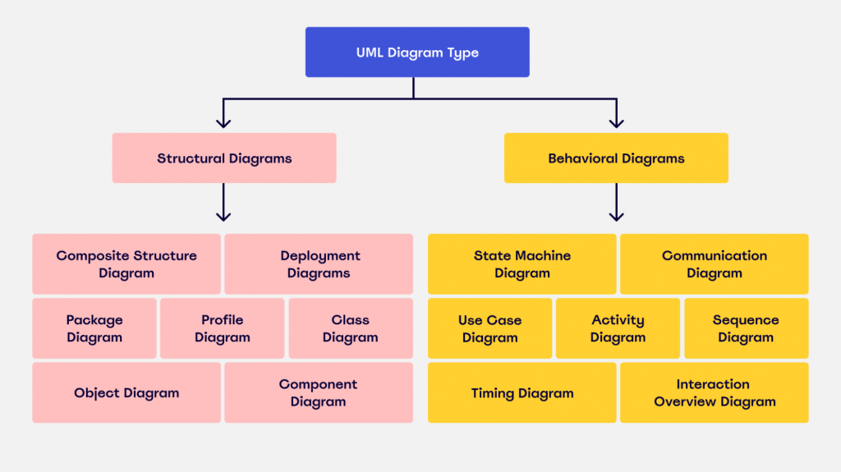
Modern UML Diagram Categories

Slide 9
Structural
These define the static part of the model. They represent physical and conceptual elements.
Descriptions
Class: represents set of objects having similar responsibilities
Interface: defines a set of operations which specify the responsibility of a class.
Collaboration: defines interaction between elements
Use case: represents a set of actions performed by a system for a specific goal
Component: describes physical part of a system
Node: can be defined as a physical element that exists at run time.

Slide 10
Behavioral
These consist of the dynamic parts of UML models.
Examples:
Interaction: is defined as a behavior that consists of a group of messages exchanged among elements to accomplish a specific task
State machine: useful when the state of an object in its life cycle is important. It defines the sequence of changes an object goes through in response to events. Events are external factors responsible for state change

Slide 11
Relationships
These show how elements are associated and describes the functionality of a software system.
There are four types:
Dependency: is a relationship between two things in which change in one element also affects the other one.
Association: is a set of links that connects elements of an UML model. It also describes how many objects are taking part in that relationship.
Generalization: can be defined as a relationship which connects a specialized element with a generalized element. It describes inheritance relationship in the world of objects.
Realization: can be defined as a relationship in which two elements are connected. One element describes some responsibility which is not implemented and the other one implements them. This relationship exists in case of interfaces.

Slide 12
UML Diagrams
These nine diagrams in UML can be used to model a system at different points of time in the SDLC:
Class diagram
Object diagram
Use case diagram
Sequence diagram
Collaboration diagram
Activity diagram
State diagram
Deployment diagram
Component diagram

Slide 13
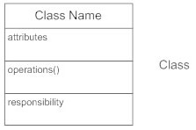
Class Diagrams
Class diagrams model the static structure of a system. They show relationship between classes, objects, attributes, and operations.
They have three parts; name at the top, attributes in the middle and operations/methods at the bottom.
The functionalities provided by the class are termed ‘methods’ of the class.
Attributes uniquely identify the class.
The class diagram is a static view of a part of the application.
Purpose of a class diagram:
Analysis and design
Describe responsibilities
Basis for deployment and component diagrams

Slide 14
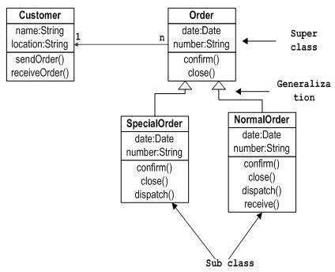
Sample Class Diagram

Slide 15
Drawing a Class Diagram
The following points should be remembered :
The name should be meaningful to describe the aspect of the system.
Each element and their relationships should be identified in advance.
Responsibility (attributes and methods) of each class should be clearly identified.
For each class, a minimum number of properties should be specified because unnecessary properties will make the diagram complicated.
Use notes when ever required to describe some aspect because at the end of the drawing it should be understandable to the developer/coder.
Finally, before making the final version, it should be drawn on plain paper and reworked as many times as possible to make it correct

Slide 16
Object Diagram
Object diagrams describe the static structure of a system at a particular time. They can be used to test class diagrams for accuracy.
It is a special kind of class diagram. Recall, object is an instance of a class.
The object diagram captures the state of different classes in the software system and the associations at a given point of time.
Can be used for:
Making the prototype of a system.
Reverse engineering.
Modelling complex data structures.
Understanding the system from practical perspective.

Slide 17
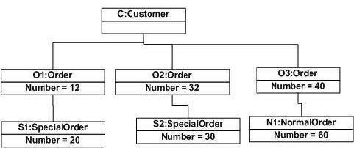
Object Diagram: Order Management System

Slide 18
State Diagram
As the name suggests, it describes different states of a component in a system. The states are specific to a component/object of a system.
Objects in the system change status in response to events. Used to model dynamic nature of a system.
They describe the flow of control from one state to another state. States are defined as a condition in which an object exists and it changes when some event is triggered.
Main purposes:
To model dynamic aspect of a system.
To model lifetime of a reactive system.
To describe different states of an object during its lifetime.
Define a state machine to model states of an object.

Slide 19
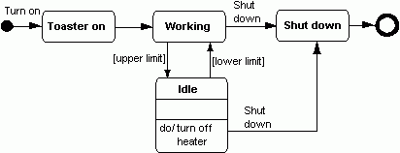
State Diagram for a toaster

Slide 20
Activity Diagram
Activity diagram is a flow chart to represent the flow form one activity to another activity. The activity can be described as an operation of the system.
The control flow is drawn from one operation to another. This flow can be sequential, branched or concurrent. Activity diagrams deal with all types of flow control by using different elements like fork, join etc.
Purposes can be described as:
Draw the activity flow of a system.
Describe the sequence from one activity to another.
Describe the parallel, branched and concurrent flow of the system.
Before drawing an activity diagram, should identify the following elements:
Activities, Conditions, Associations, Constraints

Slide 21
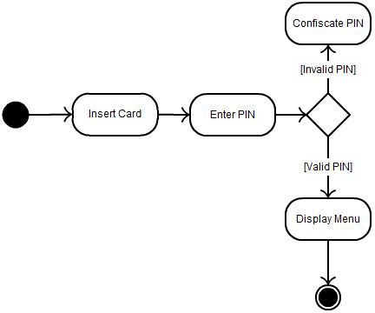
Activity Diagram: ATM

Slide 22
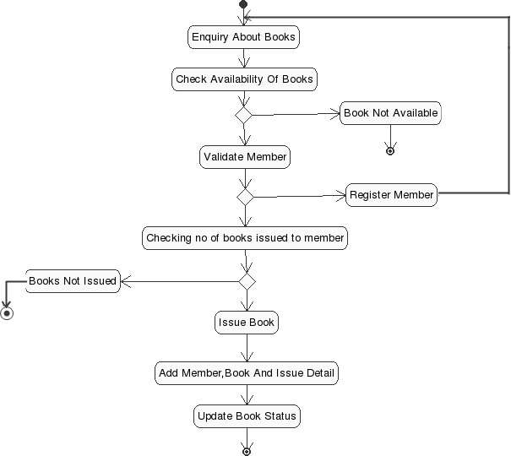
Activity Diagram: Library Checkout

Slide 23
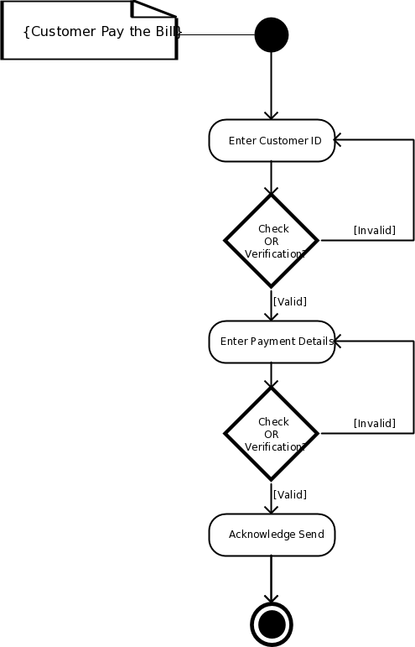
Activity Diagram: Pay Electric Bill

Slide 24
Sequence Diagram
Used to describe some interactions among different objects/actors in the software system.
Interactions are time-ordered.
Purposes can be described as:
Capture dynamic behavior of a system.
Describe the message flow of a system.
Describe structural organization and interactions of objects
Before drawing, identify the following elements:
Objects/actors taking part in the interaction
Message flow among these objects/actors
Sequence of messages flowing between
Object/actor organization

Slide 25
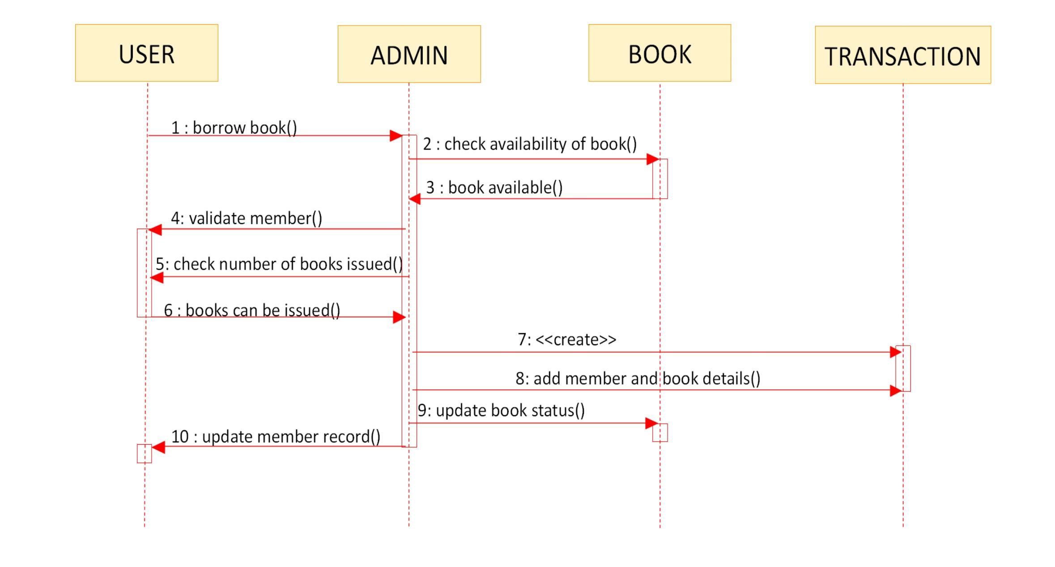
Sequence Diagram: Borrow Library Book

Slide 26
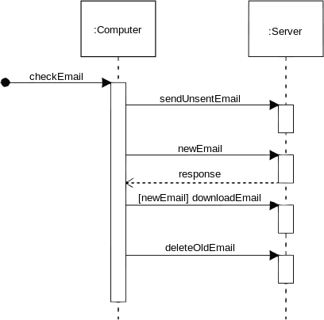
Sequence Diagram: Check Email

Slide 27
Component Diagram
Difficult in terms of nature and behavior because they are used to model physical aspects of a system.
Physical aspects are executables, libraries, configuration files, documents that are held in a node (run-time).
Used to visualize the organization and relationships among components in a software system.
Purposes can be described as:
Visualize components of a system
Construct executables by using forward and reverse engineering
Show the organization and relationship with components
Before drawing, identify the following elements:
Files used by the system
Libraries and other API relevant to the system
Relationships among the APIs and libraries used

Slide 28
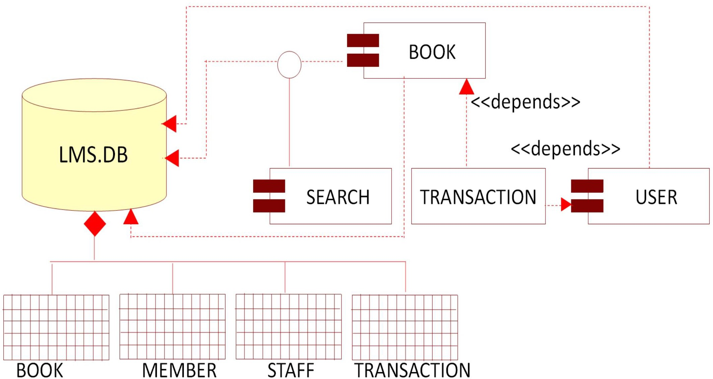
Component Diagram: Library Management System

Slide 29
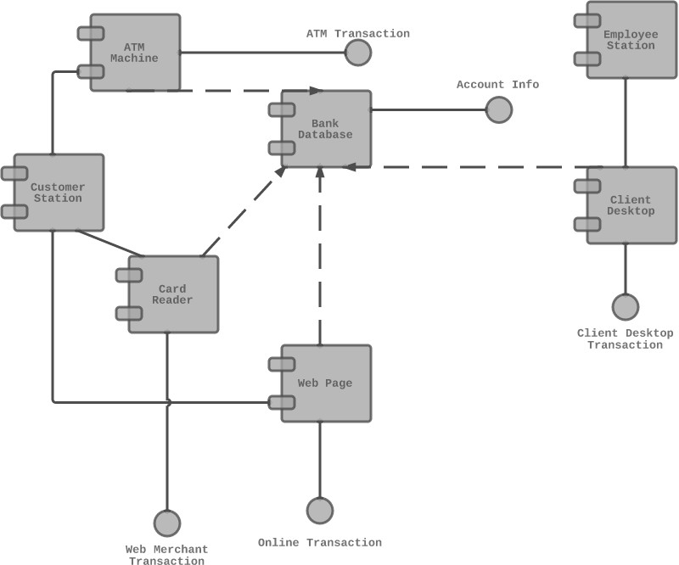
Component Diagram For ATM

Slide 30
Deployment Diagram
Used to visualize the topology of the physical components of a system and where the software components are deployed. Deployment diagrams consist of nodes and their relationships.
Purposes can be described as:
Visualize cloud/hosted topology of a system.
Describe the components used to deploy software components.
Describe runtime processing nodes.
Before drawing, identify the following:
Nodes and relationship among themselves
Useful for system engineers it shows control of these:
Performance
Scalability
Maintainability
Portability

Slide 31
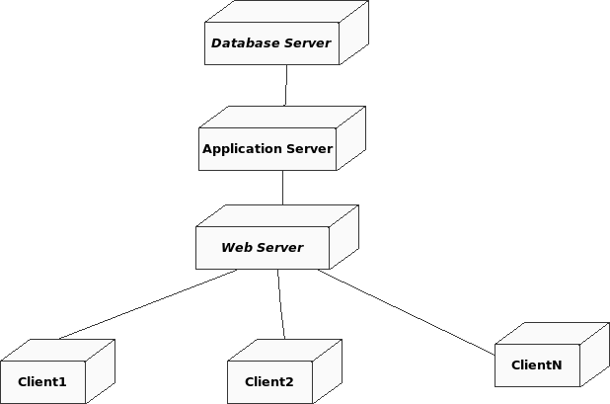
Deployment Diagram: Library Management System

Slide 32
Use Case Diagram
Use case diagrams consists of actors, components, and their relationships. The diagram is used to model a system/subsystem of an application. A single use case diagram captures a particular functionality of a system.
Purposes can be described as:
Gather requirements of a system
Get an outside view of a system.
Identify external and internal factors influencing the system
Show interactions among the requirements of actors.

Slide 33
Use Case Diagram
Guidelines for drawing:
The name of a use case is very important and should be chosen in such a way so that it can identify the functionalities performed
Give a suitable name for actors (Human or component)
Show relationships and dependencies clearly
Do not try to include all types of relationships
The main purpose is to identify requirements and use notations to clarify some important points
Places where use case diagrams are used:
Requirement analysis and high-level design
Model the context of a system
Reverse engineering
Forward engineering

Slide 34
Use Case Diagram: Inventory System

Slide 35
Attributions
Ashita Agrawal, https://www.slideshare.net/ASHadventurelover/introduction-to-uml-diagrams
Nwabueze Obioma, https://www.slideshare.net/Zed4rReal/uml-and-software-modeling-toolspptx
Brad Beiermann, https://www.slideshare.net/BradBeiermann/the-language-of-application-architecture
http://uml.org Maintained by the Object Management Group, Inc.

Slide 36
End.
UML Introduction
Software Development
CSc 3350
Dr. William Greg Johnson
Department of Computer Science
Georgia State University

