Slide 1
CS523 – BDT Project
Prof. mrudula mukadam
Penguin GROUP
HOANG DUY VU - 986170
NGuyEN TRUNG VO - 986241

Slide 2
Project Description JOBs ANALYSIS
Using Spark streaming to stream data
Using hbase/hive to store data
Using spark sql to analyze data
Using tool to visualize data
Simple demo using kafka

Slide 3
PROJECT TIMELINE (03/14 – 03/18)
Day 1 – TOPICs BRAINSTORM, TECHNOLOGIES Will BE USED
DAY 2 – sharpening Knowledge, conducting research
day 3 – preparing environment, creating simple demo
Day 4 – integrating, testing, trouble shooting
day 5 – documentation

Slide 4



Data streaming flow
HappyBase
JOB Description

Slide 5



DATA QUERY & Visualization

Slide 6
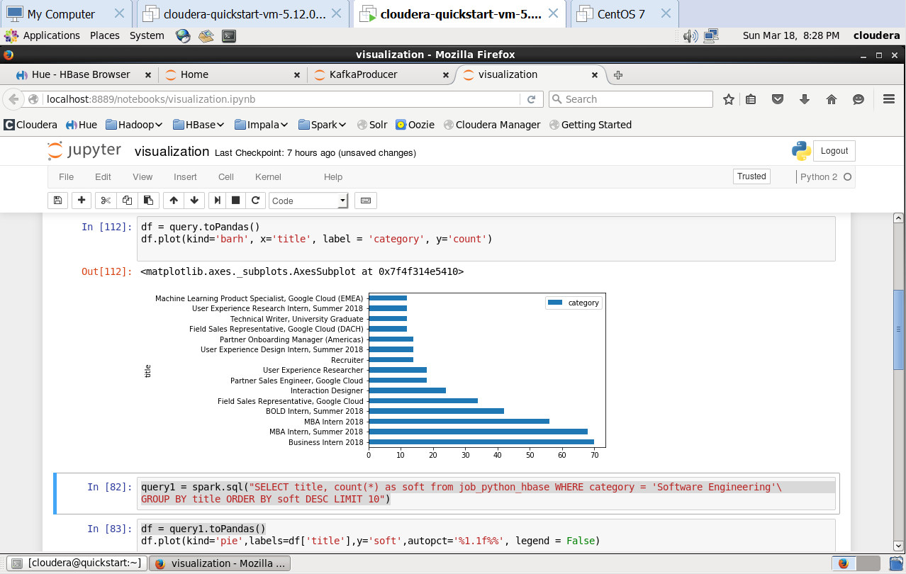
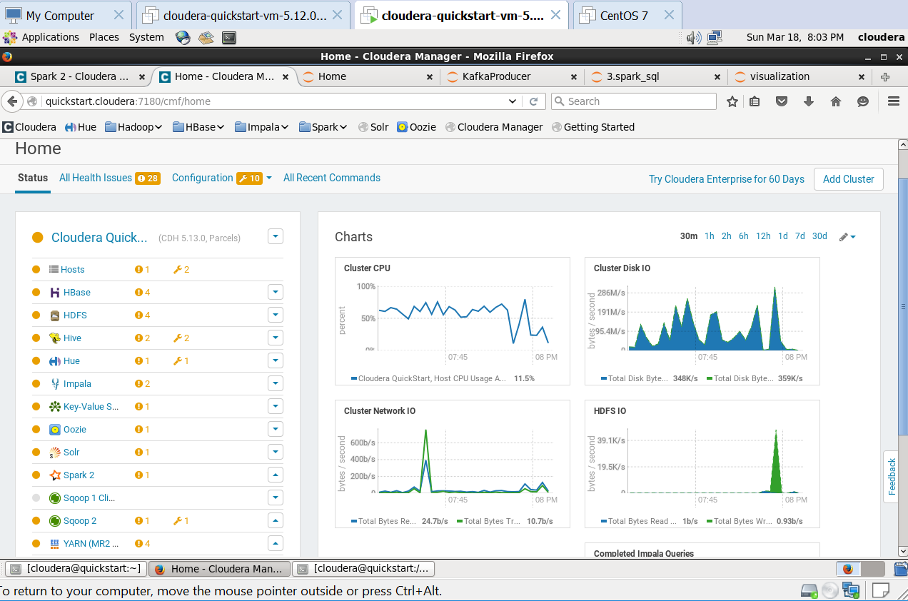
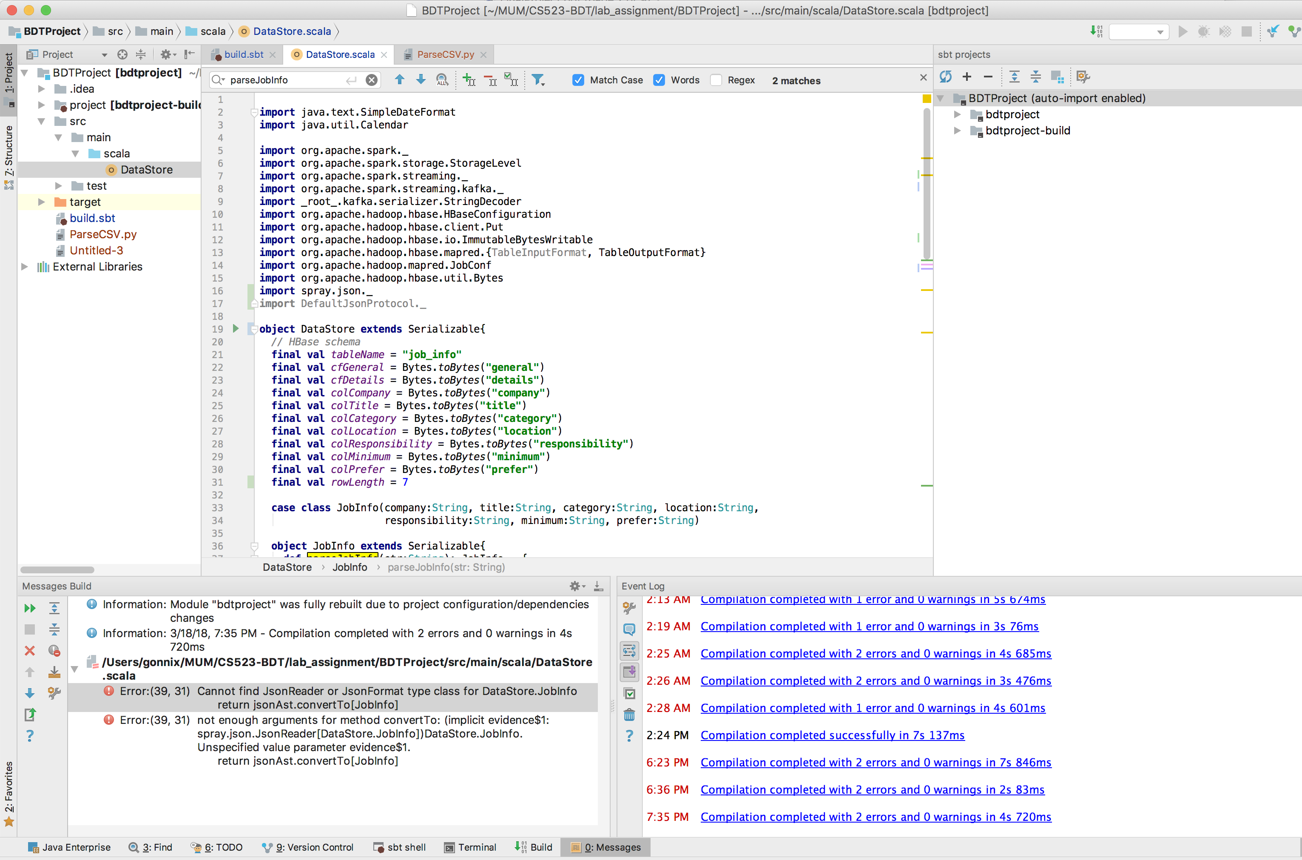
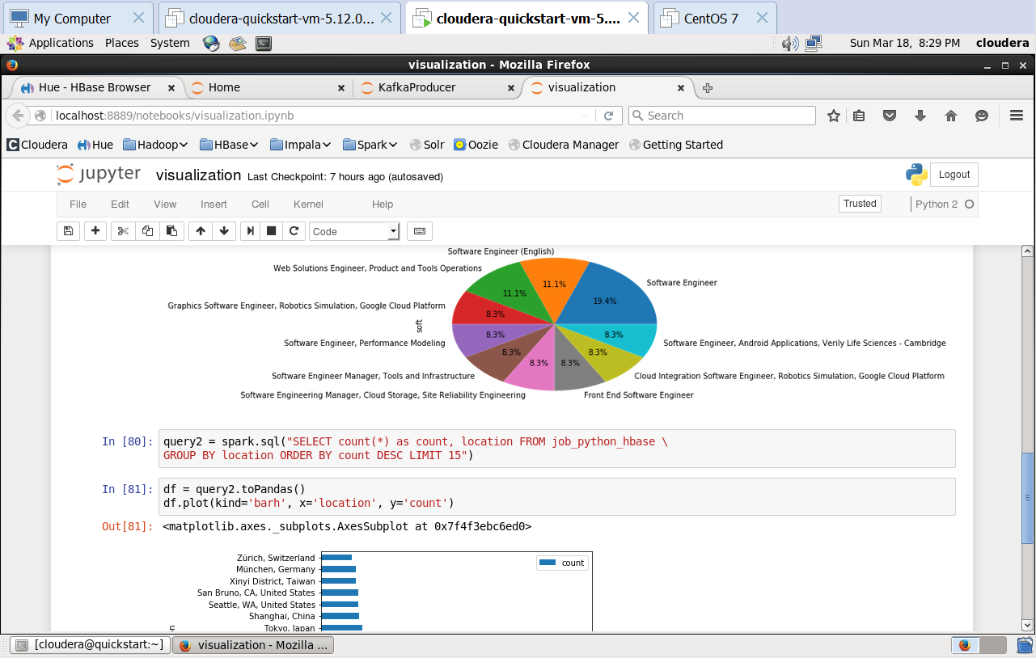
OUR WORKING

Slide 7

DEMO

Slide 8


