Slide 1

Lesson-1 Introduction to Android

Slide 2
Agenda
What is Android?
Android Architecture
Android Features
Android Releases
Android Components

Slide 3
What is Android?
The Android Developer’s Guide formally defines Android as a software stack.
A set of software subsystems needed to deliver a fully functional solution for mobile devices.
This stack includes an operating system (a modified version of the Linux kernel),
middleware (software that connects the low-level operating system to high-level apps) that’s partly based on Java,
and key apps (written in Java) such as a web browser (known as Browser) and a contact manager (known as Contacts).

Slide 4
Android Architecture

Slide 5

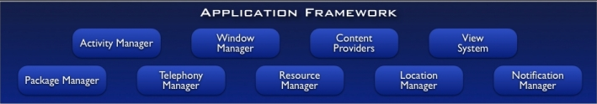
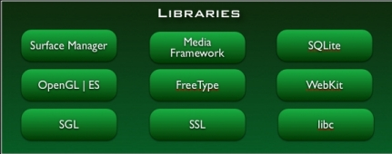
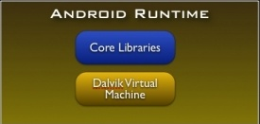
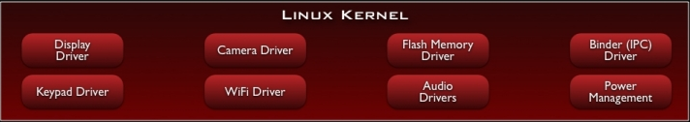
Notes:
Android is a Mobile Platform which consist of OS(Linux), Middleware (Libraries and Application Framework) and Key Applications.
The Android architecture as shown in figure is made up of different layers. Each layer consists of several program components. All the layers are connected to each other.
The Android architecture consists of the following four layers and divided into five sections:
Linux Kernel – Hardware and Software interaction. IPC stands for Inter-Process Communication.
Libraries : Example : (Native language(C/C++) libraries for other support – OpenGL – Graphics Library to display.
SGL stands for "Scalable Graphics Library“
SSL stands for “Secure Socket Layer”
Android Runtime(ART) : meet the needs of running in an embedded environment ,i.e., where is limited battery, limited Memory and limited CPU.
DALVIK VIRTUAL MACHINE:
→ The Dalvik VM executes applications that require minimum processing power and memory.
→ It is similar to the Java Virtual Machine (JVM).
→ The JVM runs .class files whereas the Dalvik VM runs .dex files, which are tailored to provide higher efficiency.
→ The Dalvik VM provides support for security, memory management, isolation, and threading.
→ DVM allows every Android application to run as a separate process, but with its own instance of DVM.
→ DVM is a virtual machine that is created when a process starts and is destroyed when the process exits
Android Libraries:
In addition to a set of standard Java development libraries, the Android development environment also includes the Android Libraries.
Application Framework : Provides a readymade library for doing several task. (Eg : GPS, Wi-Fi)
Applications : At this top layer are the applications that ship with the Android device(such as Phone, Contacts, Browser, and so on), as well as
applications that you download and install from the Android Market. Any applications that you write are located at this layer.

Slide 6
Android Features
Complete, open, and free mobile platform with secure OS and robust framework.
Application framework enabling reuse and replacement of app components
Bluetooth, EDGE, 3G, and WiFi support (hardware dependent)
Camera, GPS, compass, and accelerometer support (hardware dependent)
Dalvik Virtual Machine is optimized for mobile devices.
Telephony support
Integrated browser based on the open source WebKit engine for rendering web pages
Media support for common audio, video, and still-image formats (MPEG-4,  H.264, MP3, AAC, AMR, JPG, PNG, GIF)
Optimized graphics powered by a custom 2D graphics library; 3D graphics based on the OpenGL ES 1.0, 1.1, or 2.0 specification
GPS support
XML support for Designing
SQLite for structured data storage by default.

Slide 7
Android Releases
Android did not originate with Google. Instead, Android was initially developed by Android, Inc., a small Palo Alto, California–based startup company.
Google bought this company in the summer of 2005 and released a beta version of the Android Software Development Kit (SDK) in November 2007.
On September 23, 2008, Google released Android 1.0, whose core features included a web browser, camera support, Google Search, and more.
Table from the next slide outlines subsequent releases. (Starting with version 1.5, each major release comes under a code name that’s based on a dessert item.)
More Info : https://source.android.com/setup/build-numbers

Slide 8
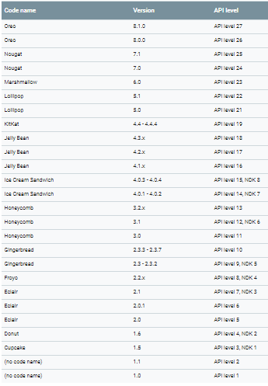
Android Version, Codename, API Level
Notes:
NDK (Native Development Kit)
The Android NDK is a toolset that lets you implement parts of your app in native code, using languages such as C and C++. For certain types of apps, this can help you reuse code libraries written in those languages.

Slide 9
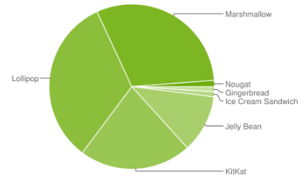
Android Version, Codename, API Level

Slide 10
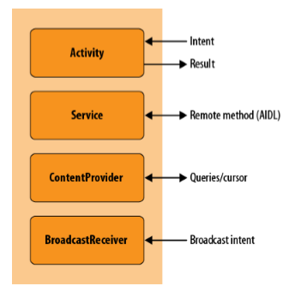
Android Components
Application components are the essential building blocks of an Android application. To make use of any of them, an application must include corresponding declarations in its AndroidManifest.xml file(will discuss in next lesson).
Notes:
AIDL (Android Interface Definition Language) is an IDL language used to generate code that enables two processes on an Android-powered device to talk using inter process communication (IPC).

Slide 11
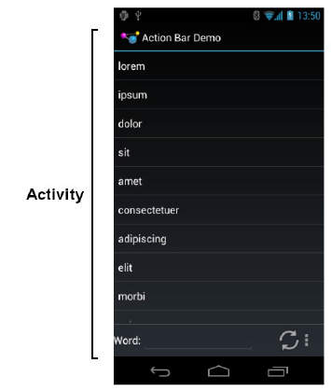
Android Components
Activity :
Every single screen is one activity. It’s a java file.
The building block of the user interface is the activity.
It represents a chunk of your user interface and, in some cases, a discrete entry point into your app (i.e., a way for other apps to link to your app).
When you make an interactive Android program, you start by sub classing the Activity class.
Activities provide the reusable, interchangeable parts of the flow of UI components across Android applications.

Slide 12
2. Service :
The Android Service class is for background tasks that may be active but not visible on the screen. It works without user interaction.
Example : A music-playing application would likely be implemented as a service in order to continue to play music while a user might be viewing web pages.
WiFi availability status

Slide 13
3. Content Providers :
Applications can not directly share data between them in Android. It is one of the important security feature. But Content Providers implement a mechanism for the sharing of data between applications.
A content provider component supplies data from one application to others on request.
Example Whatsapp can read data from Contacts with the help of Content Providers.

Slide 14
4. Broadcast Receiver
The BroadcastReceiver class implements another variant of Android’s high-level inter process communication mechanism using Intent objects.
It is registered for system announcements.
A typical use for a broadcast receiver might be to receive an alarm that causes an app to become active at a particular time.
Broadcast Receivers operate in the background and do not have a user interface.
Example : Once you insert a head phone, automatically your phone recognize that by showing a headphone symbol, device starts charging, data downloaded.

