Slide 1
Lesson – 9 JSON & Gson

Slide 2
Agenda
Today we will discuss three things
How to work with built-in JSON Parsing, also discussing how to create JSONObject and JSONArray to store and retrieve on File.
Third Party Library Googleson(Gson), discussing how to work with Shared Preference to store and retrieve object using Gson.
How to store and retrieve list objects into file using Gson.

Slide 3
JSON
JSON stands for JavaScript Object Notation. It is an independent data exchange format and is the best alternative for XML.
A modifiable set of name/value mappings. Names are unique, non-null strings. Values may be any mix of JSONObjects, JSONArrays, Strings, Booleans, Integers, Longs, Doubles. Values may not be null.
It is easy for machines to parse and generate" (Introducing JSON. Retrieved on Dec 10, 2015 from www.json.org)
JSON object represented using { } braces. JSON arrays represented using [ ] braces.

Slide 4
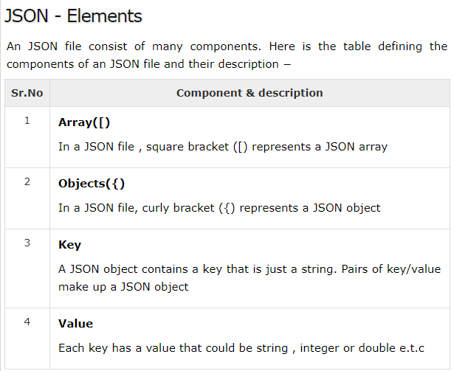

Slide 5
XML & JSON Format of Employee record
XML Format
<employees>
<employee>
<id> 123 </id>
<name> Renuka </name>
<desig> AP </desig>
<dept> CS </dept>
</employee>
<employee>
<id> 125 </id>
<name> Mohanraj </name>
<desig> GD </desig>
<dept> CS </dept>
</employee>
</employees>
JSON Format
{“employees”:[
{
“id” : 123,
“name”: “Renuka”,
“desig” : “AP”
“dept”:”CS”
},
{
“id” : 125,
“name”: “Mohanraj”,
“desig” : “GD”
“dept”:”CS”
}
]}

Slide 6
XML vs JSON
Both are used to transfer data from one technology to another technology.
JSON occupies less space and load faster than XML.
Information is represented as a collection of key/value pairs, and that each key/value pair is grouped into an ordered list of objects. JSON can provide data type like Integer, String.
“id” : 123,
“name”: “Renuka”
JSON parsing is simple. Converting object to JSON and JSON to object.
Android has a build-in support for JSON parsing.
Third party libraries are available in the market for paring such as GSON, Retrofit, Jackson & Jettison etc.
In our course we will discuss, JSON basics and Gson to store the list of objects also to store object on Shared Preferences.

Slide 7
Hands on Example
Here is the example to store an Employee record in your device external storage in a JSON format and also read the stored data from your device and display as a Toast.
Add this line into AndriodManifest.xml
<uses-permission android:name="android.permission.WRITE_EXTERNAL_ STORAGE"/>

Slide 8
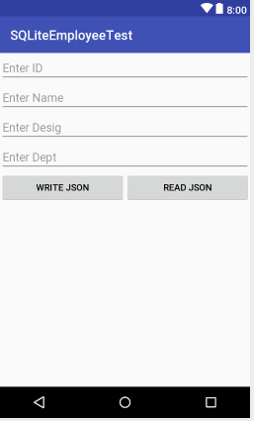
Hands on Example – 1 for built-in JSON
Design your activity_main.xml as per the screen shot.
If the user click the WRITE JSON button, Entered data will be stored in your device external storage.
If the user click the READ JSON button, file data will be displayed on Toast
Ref : Lesson9\JSON Demo

Slide 9
Create JSON object and Store into File
JSON uses JSON Object and JSON Array
Create JSON Object using
JSONObject main = new JSONObject();
JSONObject emp_obj = new JSONObject();
Insert a Key/Value pair
emp_obj.put("id", Integer.parseInt(et1.getText().toString())); emp_obj.put("name", et2.getText().toString()); emp_obj.put("desig", et3.getText().toString()); emp_obj.put("dept", et4.getText().toString());
Create JSON array using
JSONArray array = new JSONArray();
array.put(emp_obj);
Finally add emp_obj and array into main JSON object.
main.put("employees", array);
To Store into a File
String path = Environment.getExternalStorageDirectory() .getAbsolutePath()+"/employe.json"; File f=new File(path);
FileWriter writer=new FileWriter(f);
writer.write(main.toString());

Slide 10
Retrieve from File and Store into JSON
String path = Environment.getExternalStorageDirectory() .getAbsolutePath()+"/employe.json"; File f=new File(path);
FileReader reader = new FileReader(f); String msg = ""; int i = reader.read(); while (i != -1) { // Check the file is empty or not msg = msg + (char) i; i = reader.read(); }

Slide 11
Retrieve from File and Store into JSON
// Pass the String object and retrieve as a JSONObejct
JSONObject object = new JSONObject(msg);
// Pass the Key name which is used on writing into JSON object JSONArray array = object.getJSONArray("employees");
for(int j=0;j<array.length();j++){
// Read the individual object JSONObject emp_obj=array.getJSONObject(j); Toast.makeText(getApplicationContext(), emp_obj.getInt("id")+"\n"+ emp_obj.getString("name")+"\n"+ emp_obj.getString("desig")+"\n"+ emp_obj.getString("dept") ,Toast.LENGTH_LONG).show(); }

Slide 12
Google Gson (Gson)
Gson is a Java library that can be used to convert Java Objects into their JSON representation.
It can also be used to convert a JSON string to an equivalent Java object.
It has extensive support for java generics.
Provide simple toJson() and fromJson() methods to convert Java objects to JSON and vice-versa.
To use Gson in Android add the below dependencies
dependencies { compile 'com.google.code.gson:gson:2.8.2' }
Square’s Retrofit, including its Gson-based converter code, for retrieving JSON data from Web services.

Slide 13
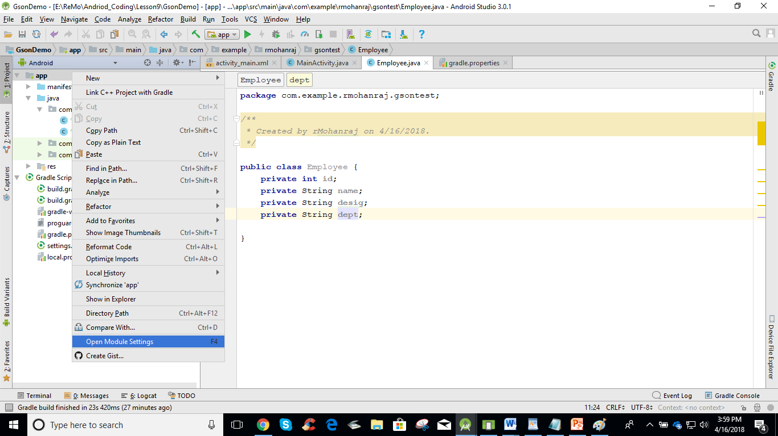
Add Gson dependencies
Step 1 : Right click app-> Open Module Settings

Slide 14
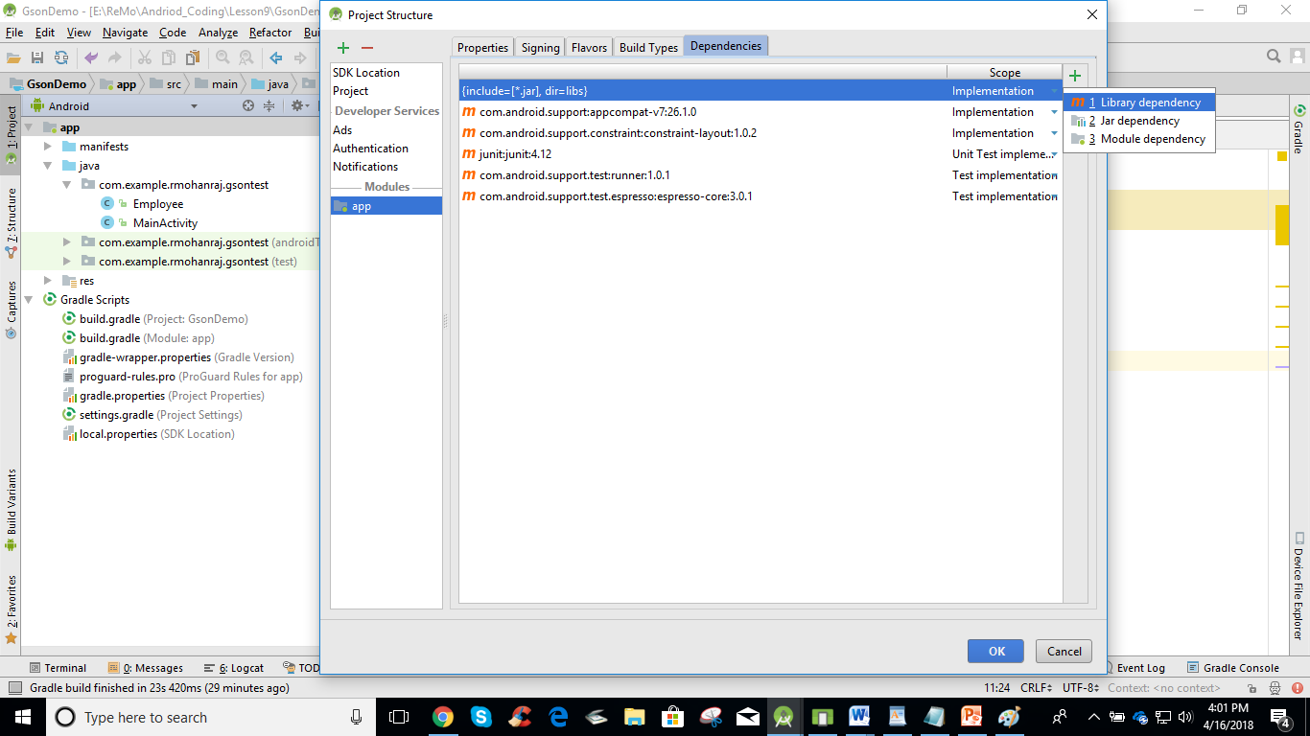
Add Gson dependencies
Step 2 : Choose the Dependencies Tab and click Library Dependency

Slide 15
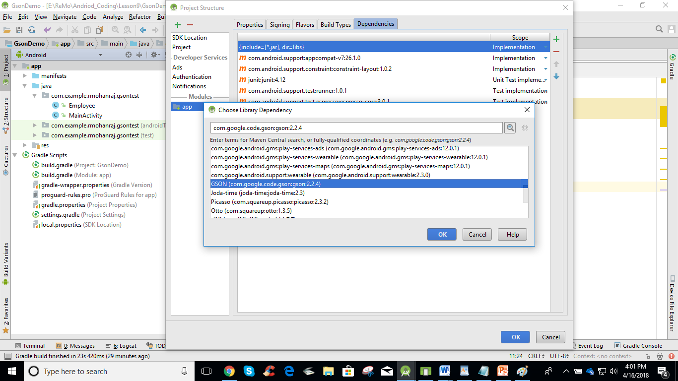
Add Gson dependencies
Step 3 : Choose the Gson Dependencies and Click OK

Slide 16
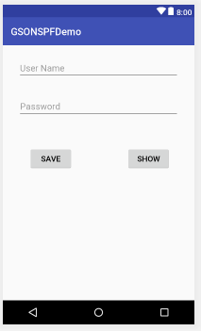
Hands on Example – 2 using Gson
Here User Name and Password stored as a User Object.
Using Gson, object is stored and retrieved on Shared Preferences.
Once the user select the SAVE button, data will be stored into Shared Preference.
Once the user select the SHOW button, data will be retrieved from Shared Preference.
Refer : Lesson9\GSONSPF

Slide 17
User.java
public class User { String uname; String password; public User(String uname, String password) { this.uname = uname; this.password = password; } }
// Need to include Getters and Setters

Slide 18
MainActivity.java
// This demonstrates to insert User object into Shared Preferences using GSON public class MainActivity extends AppCompatActivity { EditText uname,pwd; @Override protected void onCreate(Bundle savedInstanceState) { super.onCreate(savedInstanceState); setContentView(R.layout.activity_main); uname = (EditText) findViewById(R.id.et1); pwd = (EditText) findViewById(R.id.et2); }

Slide 19
public void save(View view) { // Create Gson obeject to store into Shared Preferences Gson gson = new Gson(); String name = uname.getText().toString(); String pass = pwd.getText().toString(); // Get the Input from the Edit text and make an User Object User ob = new User(name,pass); // Convert User object into String object using toJson() method String first = gson.toJson(ob); // Store the retrieved Sting into Shared Preferences SharedPreferences spf = getSharedPreferences("user", 0); SharedPreferences.Editor edit = spf.edit(); edit.putString("data",first); edit.commit(); }

Slide 20
public void show(View view) { // Create Gson object to retrieve data from Shared Preferences Gson gson = new Gson(); SharedPreferences spf = getSharedPreferences("user", 0); String res = spf.getString("data",""); // Convert the String object into User object using fromJson() method, return a type of User User opt = gson.fromJson(res,User.class); uname.setText(opt.getUname()); pwd.setText(opt.getPassword()); }

Slide 21
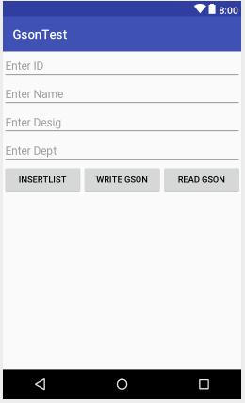
Hands on Example-3 to store Multiple objects using Gson
File Reading and Writing JSON format using Gson
If the user click the INSERT LIST button, Entered employee data will be stored into ArrayList<Employee>.
If the user click the WRITE GSON button, Employee List will be stored on File.
If the user click the READ GSON button, employee data will be read from file and displayed one by one on Toast.
Ref : Lesson9\GSON Demo

Slide 22
POJO Classes
POJO, or Plain Old Java Object, is a normal Java object class (that is, not a JavaBean, Entity Bean etc.)
To work with Example – 3, you have to create two POJO classes.
1.Employee(Structure of Individual Employee)
2. Employees ( Structure to store Multiple Employees)
Data member of these classes annotated with @SerializedName
indicates this member should be serialized to
JSON with the provided name value as its field name.

Slide 23
Employee class
public class Employee { /* @SerializedName annotation indicates this member should be serialized to
JSON with the provided name value as its field name. It will be serialized with that key, if Serialized {"id":10}*/ @SerializedName("id") private int id; @SerializedName("name") private String name; @SerializedName("desig") private String desig; @SerializedName("dept") private String dept;
}
// Need to provide Getters and Setters

Slide 24
Employee s class
// This class helps to hold multiple Employee object public class Employees { @SerializedName("employees") private ArrayList<Employee> employees; public ArrayList<Employee> getEmployees() { return employees; } public void setEmployees(ArrayList<Employee> employees) { this.employees = employees; } }
// Need to provide Getters and Setters

Slide 25
INSERT LIST BUTTON CLICK LOGIC
// This class helps to hold multiple Employee object
ArrayList<Employee> list = new ArrayList<>(); public void add(View v){ // Create an Employee object using the EditText Inputs Employee e = new Employee(); e.setId(Integer.parseInt(et1.getText().toString())); e.setName(et2.getText().toString()); e.setDesig(et3.getText().toString()); e.setDept(et4.getText().toString()); // Add an Employee into the list list.add(e); }

Slide 26
WRITE GSON BUTTON CLICK LOGIC
public void write(View v){ // Set the list of Employees Employees emps = new Employees(); emps.setEmployees(list); // Conversion Employees list object to JSON using Gson Gson gson = new Gson(); String response = gson.toJson(emps); // Writing the converted data into File using FileWriter in Your device external storage String path = Environment.getExternalStorageDirectory() .getAbsolutePath() + "/emps_gson.json"; try { FileWriter writer = new FileWriter(path); writer.write(response); writer.flush(); writer.close(); } catch (IOException e1) { e1.printStackTrace(); } } }

Slide 27
READ GSON BUTTON CLICK LOGIC
public void read(View v){ // Read the File using FileReader String path = Environment.getExternalStorageDirectory() .getAbsolutePath()+"/emps_gson.json"; try { FileReader reader = new FileReader(path); Gson gson = new Gson(); Employees emps = gson.fromJson(reader, Employees.class); ArrayList<Employee> list = emps.getEmployees(); if (list.size() > 0) { for (Employee e : list) { Toast.makeText(getApplicationContext(), e.toString(), Toast.LENGTH_LONG).show(); } } else Toast.makeText(getApplicationContext(), "No data", Toast.LENGTH_LONG).show(); } catch(FileNotFoundException e){ e.printStackTrace(); } }

