Slide 1
Lesson – 9 SQLite Database

Slide 2
Agenda
Introduction to SQLite Database
SQLiteOpenHelper
Content values
Cursor
CRUD Queries
Hands on Example-1
Hands on Example-1
SQLite Browser

Slide 3
INTRODUCTION
SQLite is a lightweight, embedded relational database management system that is included as part of the Android framework and provides a mechanism for implementing organized persistent data storage for Android applications.
In addition to the SQLite database, the Android framework also includes a range of Java classes that may be used to create and manage SQLite based databases and tables.

Slide 4
Introduction
SQLite is an open source storage database that manages all database related queries.
Maintain structures data.
Server less and self contained.
Full documentation is available at http://www.sqlite.org
Android provides its own API to deal with database connectivity. This API is provided in android.database and android.database.sqlite packages.
In apps, we interact with a SQLite database using the SQLiteOpenHelper class and the SQLiteDatabase class.
For the full syntax of all SQLite comments see https://sqlite.org/lang.html
Notes:
SQLiteDatabase has methods to create, delete, execute SQL commands, and perform other common database management tasks. More specifically SQLiteDatabase provides the insert(), update() and delete() methods.
SQLiteOpenHelper provides utilities to simplify the tasks of creating and initializing the database if it's not already created. In simple, it is a helper class to manage database creation and version management. The onUpgrade that comes with SQLiteOpenHelper is really handy when upgrading your application.

Slide 5
SQLiteOpenHelper
Using SQLiteOpenHelper
The main functionality of the class is to open the database if it exists, create if it does not, and upgrade the version as required.
It provides a constructor to construct a helper class by subclassing this class and overriding the methods named onCreate() an onUpgrade().
Syntax:
SQLiteOpenHelper (Context context, String name, SQLiteDatabase.CursorFactory factory, int version)
where,
context – represent the context to create or open the database
name – represents the name of the database
factory – represents the factory class used for creating the cursor object ,its an optional parameter passed as null.
version – represent the number of the database

Slide 6
SQLiteOpenHelper Example
Create your DBHelper class which extends from SQLiteOpenHelper and provide a constructor for this class and call super class constructor by passing 4 parameters.
public class EmployeeDBHelper extends SQLiteOpenHelper {
private static final String DATABASE_NAME = "empdb.db"; private static final int DATABASE_VERSION = 1;
// Constructor
public EmployeeDBHelper(Context context) { super(context, DATABASE_NAME, null, 1); } }

Slide 7
Some of the commonly used methods of this class are as follows:
onCreate (SQLiteDatabase db)
The method is invoked when the database is created for the first time. This is where the table is created and populated. The database name is passed as an argument.
onUpgrade (SQLiteDatabase db, int oldVersion, int newVersion)
The method is invoked when the database needs to be upgraded. The implementation should use this method to drop tables, add tables, or perform any other operations such as the need to upgrade to the new schema version.
Note : Refer SQLite version from
https://developer.android.com/reference/android/database/sqlite/package-summary.html

Slide 8
Employee Table
Column | Data Type
Id | Number
Name | Varchar
Desig | Varchar
Dept | Varchar

Slide 9
Example – Override onCreate() and onUpgrade()
public class EmployeeDBHelper extends SQLiteOpenHelper {
private static final String DATABASE_NAME = "empdb.db"; private static final int DATABASE_VERSION = 1;
// Constructor
public EmployeeDBHelper(Context context) { super(context, DATABASE_NAME, null, 1); } // Create a table @Override
public void onCreate(SQLiteDatabase db) { db.execSQL("create table employee(id number, name varchar(50), desig varchar(50), dept varchar(50))"); } // Upgrade Table @Override public void onUpgrade(SQLiteDatabase db, int i, int i1) { db.execSQL("drop table if exists employee"); onCreate(db); } }

Slide 10
Notable Methods of the SQLiteOpenHelper Class
getWritableDatabase() – Opens or creates a database for reading and writing. Returns a reference to the database in the form of a SQLiteDatabase object.
getReadableDatabase() – Creates or opens a database for reading only. Returns a reference to the database in the form of a SQLiteDatabase object.
close() – Closes the database.

Slide 11
Content values
ContentValues is a convenience class that allows key/value pairs to be declared consisting of table column identifiers and the values to be stored in each column.
This class is of particular use when inserting or updating entries in a database table.
Example
ContentValues values=new ContentValues();
values.put("id",Integer.parseInt(et1.getText().toString())); values.put("name",et2.getText().toString()); values.put("desig",et3.getText().toString()); values.put("dept", et4.getText().toString());

Slide 12
Cursor Class
Cursor : A class provided specifically to provide access to the results of a database query. Key methods of this class are as follows:
close() – Releases all resources used by the cursor and closes it.
getCount() – Returns the number of rows contained within the result set.
moveToFirst() – Moves to the first row within the result set.
moveToLast() – Moves to the last row in the result set. moveToNext() – Moves to the next row in the result set. moveToPosition(int position): Moves the cursor to the specified position
get<type>() – Returns the value of the specified <type> contained at the specified column index of the row at the current cursor position (variations consist of getString(), getInt(), getShort(), getFloat() and getDouble()).

Slide 13
CRUD Queries
SQLiteDatabase : The class has methods to create, delete, execute SQL commands, and perform other common database management tasks. Some of the commonly used methods of this class are as follows:
execSQL (String sql) - perform Create, Insert, Update and Delete
This method is used to execute a single SQL statement that is not a SELECT statement or any other SQL statement that returns data. It is used generally for creating table. The sql statement to be executed is passed as an argument.
long insert (String table, String nullColumnHack, ContentValues values)
It is a convenience method used for inserting a row into the database. The method returns the row ID of the newly inserted row, or -1 if an error takes place. The method accepts the table name and the initial column values for the row.
long count=dBase.insert("employee",null,values);
values argument is the object of ContentValues.

Slide 14
CRUD Queries
int update (String table, ContentValues values, String whereClause, String[] whereArgs)
It is a convenience method used for updating rows in the database. The method returns the number of rows affected. It accepts the table name, new column values, and an optional where clause.
int delete (String table, String whereClause, String[] whereArgs)
It is a convenience method used for deleting rows in the database. The method returns the number of rows affected if a where clause is passed, otherwise it returns 0.
Cursor query (String table, String[] columns, String selection, String[] selectionArgs, String groupBy, String having, String orderBy)
The method queries the given table and returns a Cursor over the result set.
RawQuery methods can only be used for read queries.

Slide 15
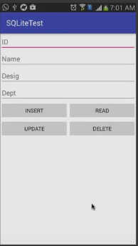
Hands on example - 1
Work with simple Employee database with single table to perform CRUD operation using SQLiteOpenHelper and SQLiteDatabase. Eg : Lesson9\EmployeeDB

Slide 16
activity_main.xml
<?xml version="1.0" encoding="utf-8"?> <LinearLayout xmlns:android="http://schemas.android.com/apk/res/android" android:layout_width="match_parent" android:layout_height="match_parent" android:orientation="vertical"> <EditText android:layout_width="match_parent" android:layout_height="wrap_content" android:id="@+id/et1" android:hint="Enter ID" /> <EditText android:layout_width="match_parent" android:layout_height="wrap_content" android:id="@+id/et2" android:hint="Enter Name" /> <EditText android:layout_width="match_parent" android:layout_height="wrap_content" android:id="@+id/et3" android:hint="Enter Desig" /> <EditText android:layout_width="match_parent" android:layout_height="wrap_content" android:id="@+id/et4" android:hint="Enter Dept" />

Slide 17
activity_main.xml
<LinearLayout android:layout_width="match_parent" android:layout_height="wrap_content" android:orientation="horizontal"> <Button android:layout_width="0dp" android:layout_height="wrap_content" android:layout_weight="0.5" android:text="Insert" android:onClick="insert"/> <Button android:layout_width="0dp" android:layout_height="wrap_content" android:layout_weight="0.5" android:text="Read" android:onClick="read"/> </LinearLayout> <LinearLayout android:layout_width="match_parent" android:layout_height="wrap_content" android:orientation="horizontal"> <Button android:layout_width="0dp" android:layout_height="wrap_content" android:layout_weight="0.5" android:text="Update" android:onClick="update" /> <Button android:layout_width="0dp" android:layout_height="wrap_content" android:layout_weight="0.5" android:text="Delete" android:onClick="delete" /> </LinearLayout> </LinearLayout>

Slide 18
MainActivity.java
public class MainActivity extends AppCompatActivity {
// Declare the objects for EditText control
EditText et1,et2,et3,et4;
// Declare an object for SQLiteDatabase
SQLiteDatabase dBase;
EmployeeDBHelper dbHelper;
@Override
protected void onCreate(Bundle savedInstanceState) {
super.onCreate(savedInstanceState);
setContentView(R.layout.activity_main);
// Initialize database objects
dbHelper = new EmployeeDBHelper(this);
dBase = dbHelper.getWritableDatabase();
// get all the EditText components into your activity class
et1=(EditText)findViewById(R.id.et1);
et2=(EditText)findViewById(R.id.et2);
et3=(EditText)findViewById(R.id.et3);
et4=(EditText)findViewById(R.id.et4);

Slide 19
// Insert Query
public void insert(View v){ ContentValues values=new ContentValues(); // Using put method to add key(Column name) and Value
values.put("id",Integer.parseInt(et1.getText().toString())); values.put("name",et2.getText().toString()); values.put("desig",et3.getText().toString()); values.put("dept", et4.getText().toString()); /* call insert method by passing three parameters which return a long value * 1. Table name, * 2. nullColumnHack is an optional String type - pass null - helps to insert null value in the specified column by using this parameter * 3. Object of ContentValues - It is used to insert or update values into database tables*/
// How many records are affected with these query is a count long count=dBase.insert("employee",null,values); if(count!=-1){ Toast.makeText(MainActivity.this, "Successfully
Inserted",Toast.LENGTH_SHORT).show(); et1.setText(""); et2.setText(""); et3.setText(""); et4.setText(""); }else{ Toast.makeText(MainActivity.this, "Unable to Insert",
Toast.LENGTH_SHORT).show(); }
}

Slide 20
// Read Query
public void read(View v){ // Use query() method by passing seven parameter according to the requirement
// Query returns the type of Cursor // select * from employee where id = et1.getText(); Cursor c=dBase.query("employee",null,"id=?", new String[]{et1.getText().toString()},null,null,null); // This logic retrieve all the records from the employee select * from employee //Cursor c = dBase.query ("employee",null,null,null,null,null,null); // Initially cursor points -1, to set the pointer to 1 using moveToNext c.moveToNext(); if(c.getCount()>0){ //Retrieve name,desig,dept et2.setText(c.getString(1)); et3.setText(c.getString(2)); et4.setText(c.getString(3)); } else{ Toast.makeText(getApplicationContext(), et1.getText().toString() + " Not found",
Toast.LENGTH_LONG).show(); et1.setText(""); et2.setText(""); et3.setText(""); et4.setText(""); }
}

Slide 21
// Update Query
public void update(View v){ ContentValues values=new ContentValues(); values.put("name",et2.getText().toString()); values.put("desig",et3.getText().toString()); values.put("dept",et4.getText().toString()); // update employee columns where id = et1.getText() int count=dBase.update("employee",values,"id=?", new String[]{et1.getText().toString()}); if(count>0){ // Update happen in the table record Toast.makeText(getApplicationContext(),count+ "row Updated...", Toast.LENGTH_LONG).show(); }else{ // No Update Toast.makeText(getApplicationContext(), "Failed to Updated", Toast.LENGTH_LONG).show(); } }

Slide 22
// delete Query
public void delete(View v){ // delete from employee where id = et1.getText(); int count= dBase.delete("employee","id=?",new String[]{et1.getText().toString()}); if(count>0){ Toast.makeText(getApplicationContext(), count+"row deleted...", Toast.LENGTH_LONG).show(); }
else{ Toast.makeText(getApplicationContext(), "Failed to delete", Toast.LENGTH_LONG).show(); } }
}

Slide 23
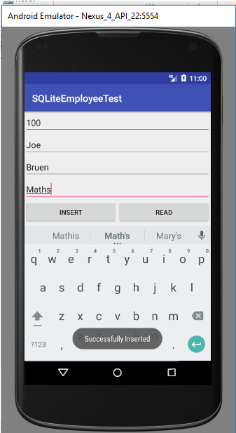
Run the App
Performing Insert Operation

Slide 24
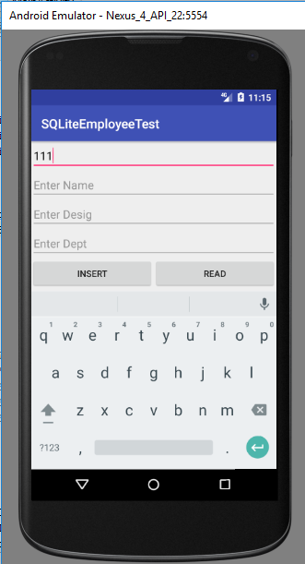
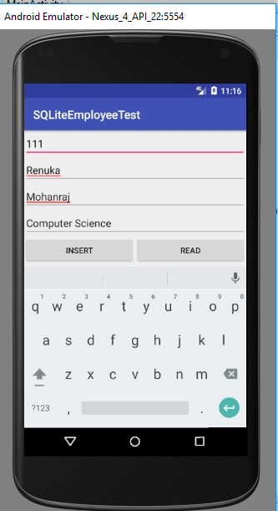
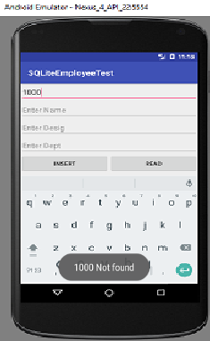
Performing Read Operation
Entering id 111 and click the Read button, you will get the Employee record or else Not Found Toast Message

Slide 25
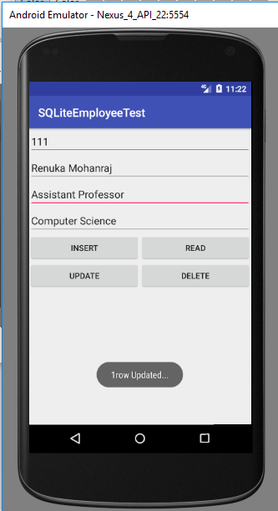
Performing Update Operation

Slide 26
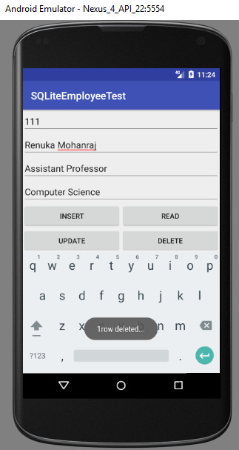
Performing Delete Operation

Slide 27
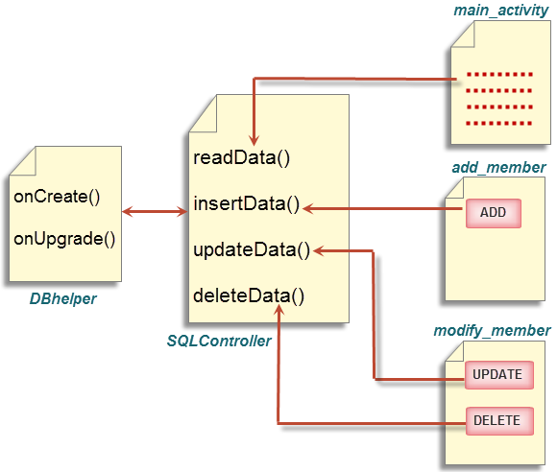
Hands on Example - 2
Here a database called contact with a table test to hold contactid, name, mobile and email and perform the following operation. Refer : Lesson9/CustomerSQLite

Slide 28
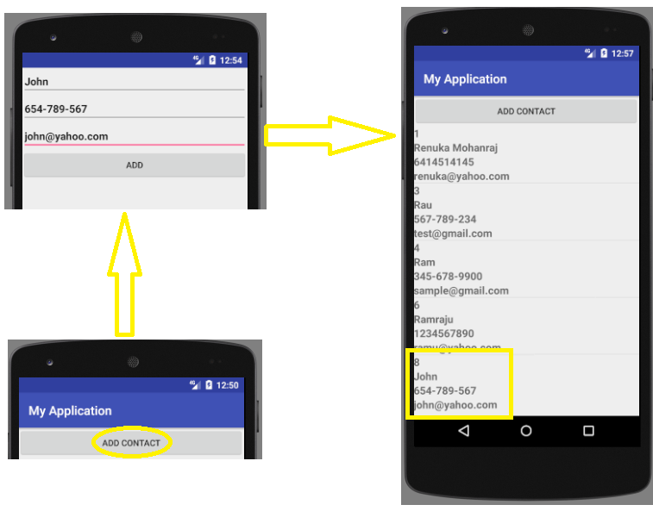
Adding Contacts
Add_member.java
MainActivity.java
MainActivity.java

Slide 29
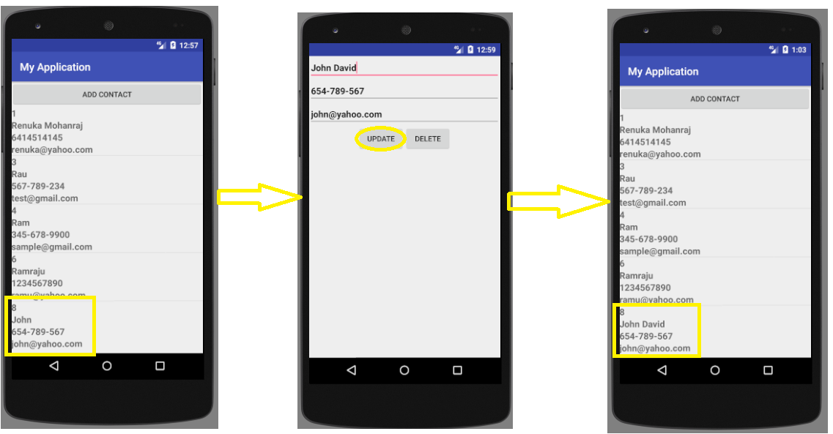
Updating Contacts
Once you click on entry from the Listview, then you will get Modify_member activity. You can go for Update, changes will be reflect in the MainActivity ListView.
MainActivity.java
Modify_member.java
MainActivity.java

Slide 30
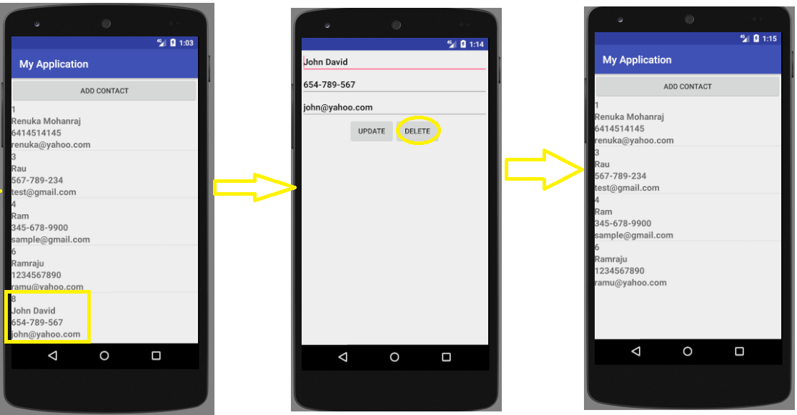
Deleting Contacts
Once you click on entry from the Listview, then you will get Modify_member activity. You can go for Delete, changes will be reflect in the MainActivity ListView.
MainActivity.java
Modify_member.java
MainActivity.java

Slide 31
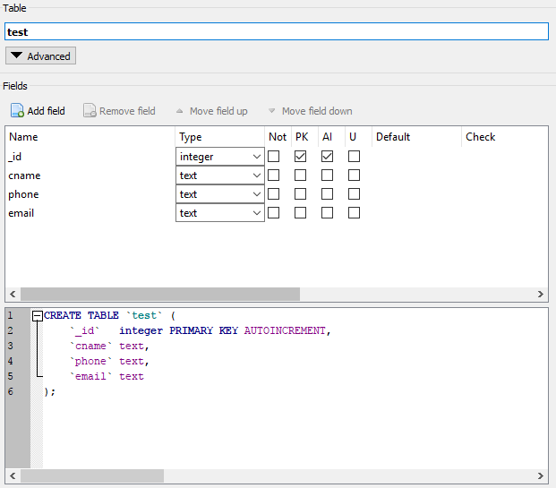
Database and table structure
Database name : Contacts, Table name : test, below is the table structure

Slide 32
SQL Operation | Activity Layout File | Java File
Select | activity_main.xml view_member_entry.xml | MainActivity.java ListView Component Layout
Insert | add_member.xml | Add_member.java
Update and Delete | modify_member.xml | Modify_member.java
Database and Table Creation |  | DBHelper.java
CRUD operations methods |  | SQLController.java

Slide 33
Simple Cursor Adapter
An easy adapter to map columns from a cursor to TextViews or ImageViews defined in an XML file. You can specify which columns you want, which views you want to display the columns, and the XML file that defines the appearance of these views.
Example:
lv = (ListView) findViewById(R.id.lv1); Cursor cursor = dbcon.readData();
// Columns String[] from = new String[]{DBHelper.KEY_ROWID,DBHelper.NAME,DBHelper.PHONE,DBHelper.EMAIL};
// Matching ids from view for the specified columns int[] to = new int[] { R.id.cid,R.id.vname, R.id.vmobile,R.id.vemail };
SimpleCursorAdapter adapter = new SimpleCursorAdapter( MainActivity.this, R.layout.view_member_entry, cursor, from, to); /*Notifies the attached observers that the underlying data has been changed and any View reflecting the data set should refresh itself. */
adapter.notifyDataSetChanged(); lv.setAdapter(adapter);

Slide 34
How to view the table using SQLite browser
Step 1 : Install SQLite browser according to your OS.
Step 2 : Keep the code in Running mode.
Step 3 : Open Android Device Monitor by clicking Tools→Android→Android Device Monitor

Slide 35
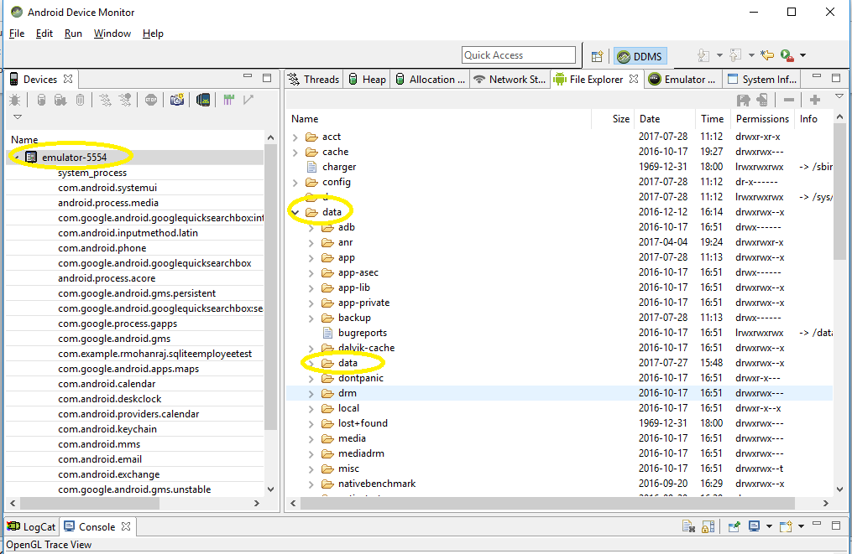
How to view the table using SQLite browser
Step 4 : Choose your device on the left side, then on right side click data→ data and then choose the correct package

Slide 36
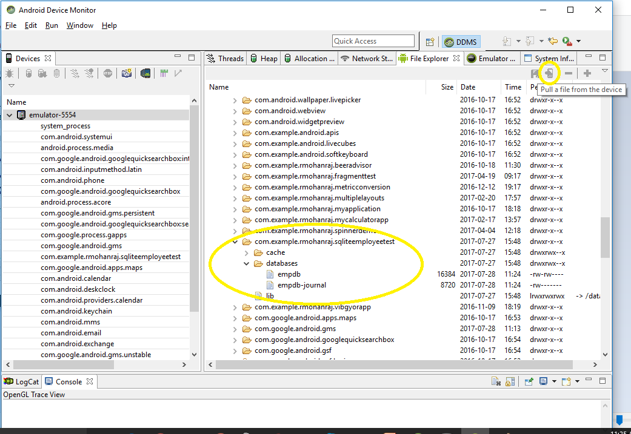
How to view the table using SQLite browser
Step 5 : Click databases from the data in the concerned package to view your database then select the empdb and click pull a file from device icon to store in your local drive.

Slide 37
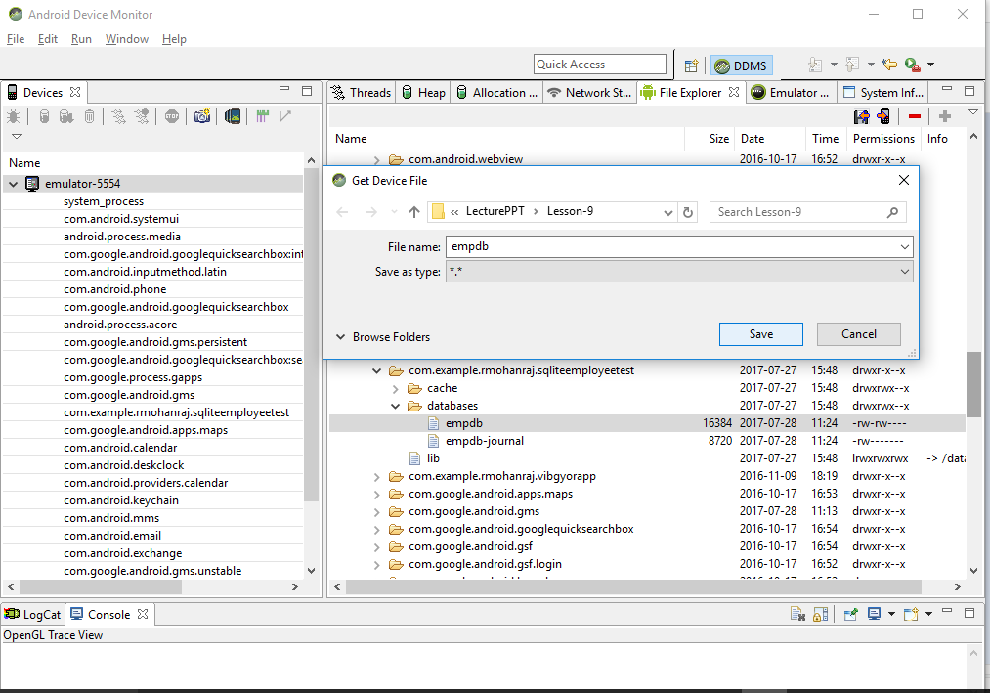
Step 5 : Screen shots to save the database
1 → Click your table ; 2→ Click pull a file from the device ; 3→ Save the File in your drive
2
3
1

Slide 38
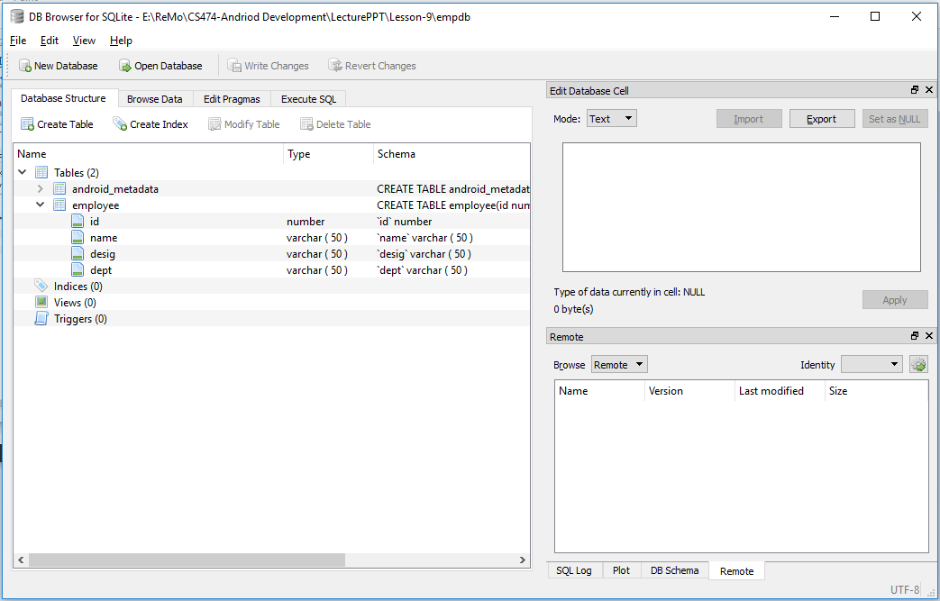
Step 6 : Open your saved database file using SQLite Browser.

Slide 39
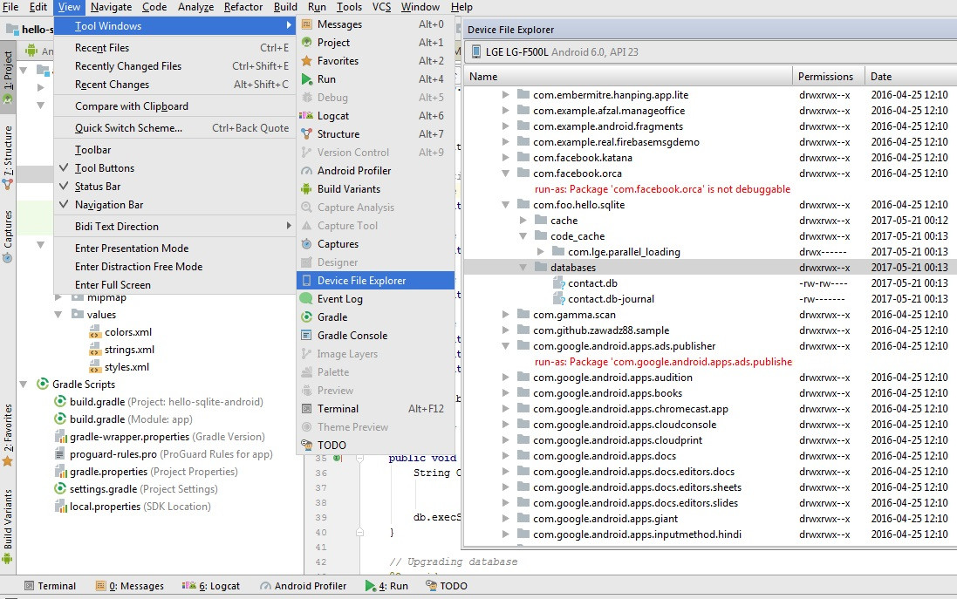
If you are using Android Studio 3.0 or later version then follow these steps.
Click View > Tool Windows > Device File Explorer.
Expand /data/data/[package-name] nodes.
You can only expand packages which runs in debug mode for non rooted device.
Notes:
Rooted Android phones provide a higher level of facility to the user. The user gets to customize and change application and settings of the system as desired. On the other hand, unrooted Android phones are the reverse of rooted android phones. Unrooted android phones do not provide these services of a super user.

