Slide 1
Chapter – 4
Intents

Slide 2
Agenda
Implicit intents
Explicit intents
Hands on example
Explicit event - send a message from one activity to another activity.
Implicit event – sending message through e-mail, dial up screen and WhatsApp
Run apps on real device
Getting result from the activity

Slide 3
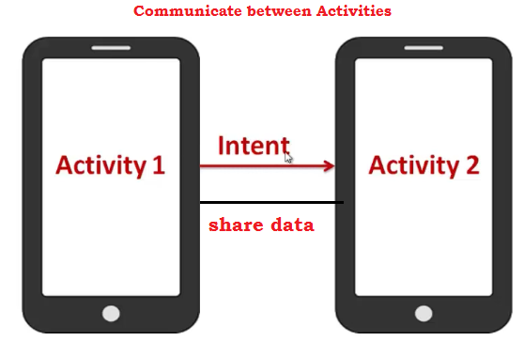
Introduction
We’re going to show you how to build apps with multiple activities, and how you can get your apps talking to each other using intents.
An Intent is a messaging object you can use to request an action from another app component. The only components you have seen so far are Activities, but there are also Services, Broadcast receivers, and Content Providers.
Intents are multi-purpose communication tools, and the Intent class provides different constructors depending on what you are using the intent to do.

Slide 4
Types of intents
Explicit intents specify the component to start by name (the fully-qualified class name). You'll typically use an explicit intent to start a component in your own app, because you know the class name of the activity or service you want to start. For example, you can start a new activity in response to a user action or start a service to download a file in the background.
Implicit intents do not name a specific component, but instead declare a general action to perform, which allows a component from another app to handle it. For example, if you want to show the user a location on a map, you can use an implicit intent to request that another capable app show a specified location on a map.
Intents are created using Intent class. Following are the major method in Intents class.
setAction() setData() putExtra()
setComponent() setType() getExtra()

Slide 5
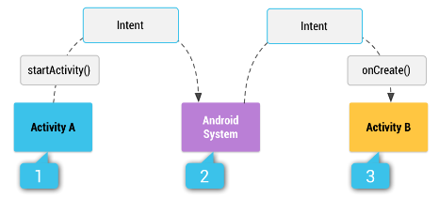
How Intent works
Figure 1. How an implicit intent is delivered through the system to start another activity: [1] activity A creates an intent for Activity B with an action description and passes it to startActivity(). [2] the android system searches all apps for an intent filter that matches the intent. When a match is found, [3]the system starts the matching activity (activity B) by invoking its onCreate() method and passing it the intent.
Notes:
Collection of Intent are called Intent Filters. If you want to perform bulk of actions you have to make use of Intent Filters to specify the activities.
Activities, services, and broadcast receivers use Intent filters to inform the system about the Intents that they can manage.
Every filter provides information on a particular ability of the component, and the Intents that the component can receive.
An explicit Intent does not require a filter as it directly communicates with the component.
An implicit Intent can communicate with a component only if the filters allow it to.
Intent filters are executed as an object of IntentFilter class.
To know more about it in : https://developer.android.com/guide/components/intents-filters.html

Slide 6
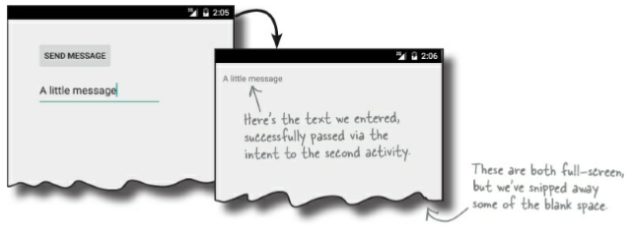
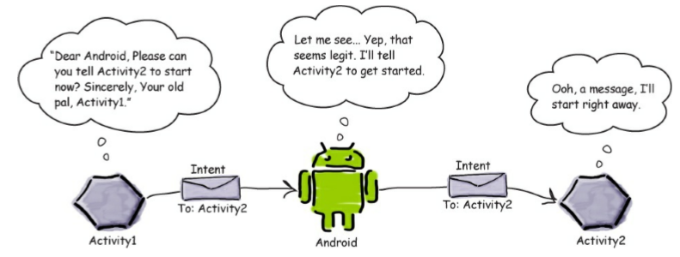
Hands on Example – Explicit Intent
Problem : Send a message from one activity to another activity.

Slide 7
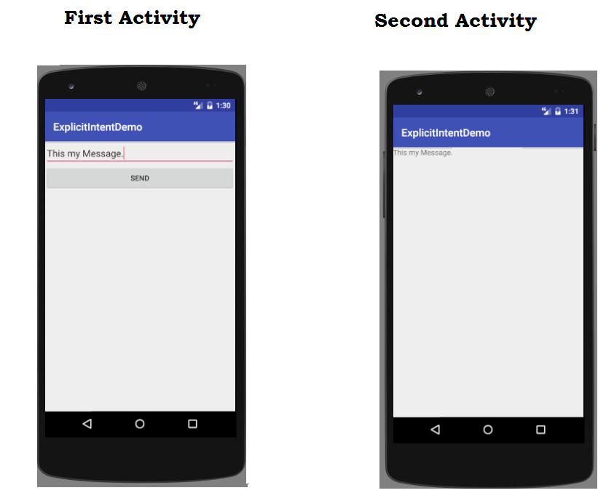
Problem Requirement

Slide 8

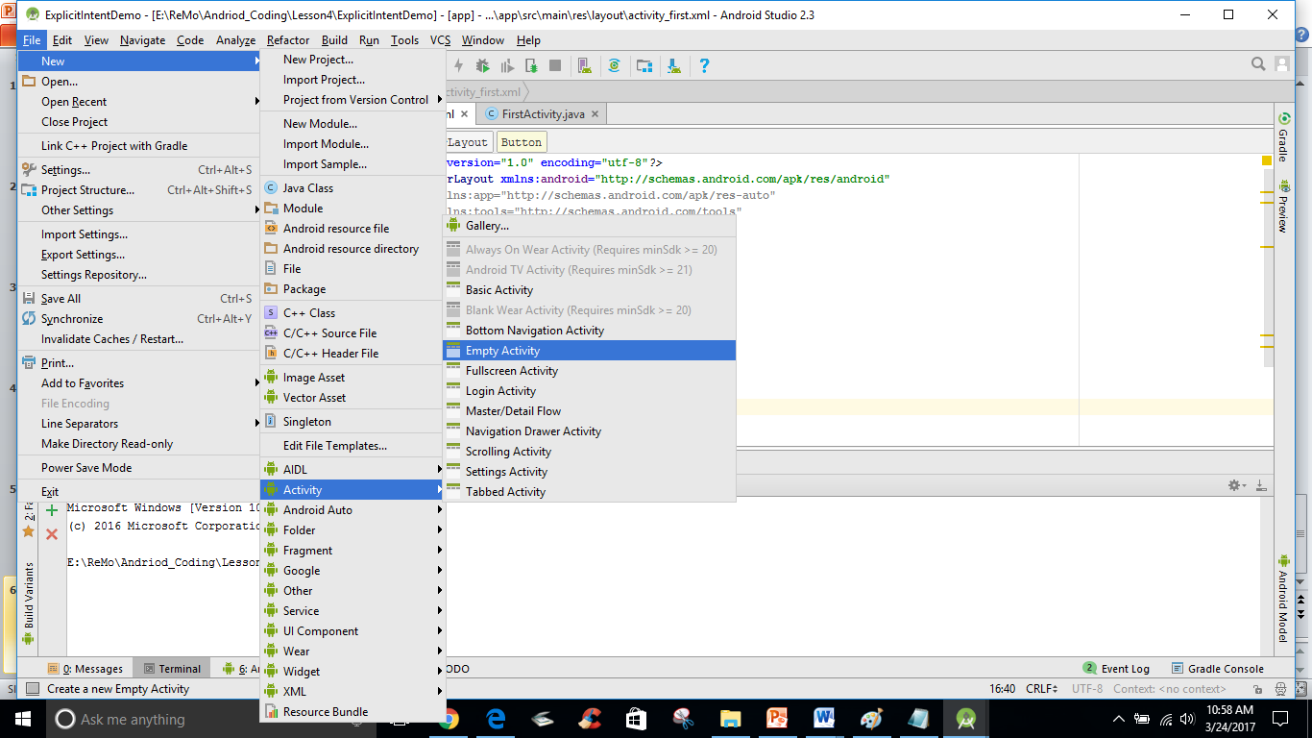
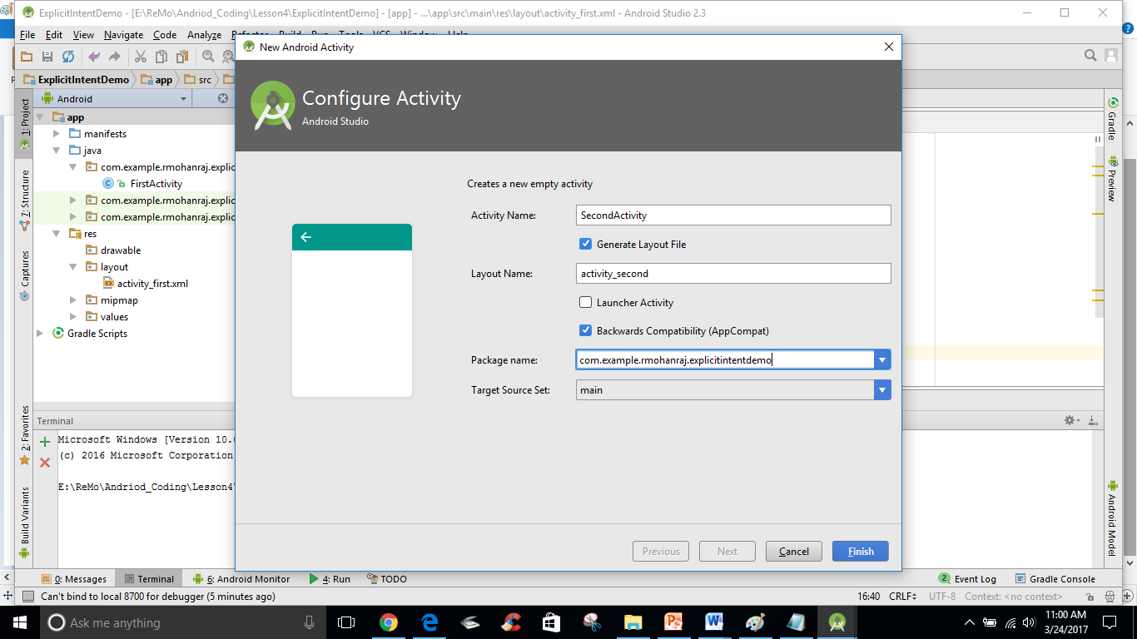
Steps to find the solution
Step 1: Create your first activity with the controls of one text box and one button.
Step 2 : Create a second activity with one Text view to receive message from the first activity in the same project by choosing File→ New → Activity and choose the option for Blank Activity

Slide 9
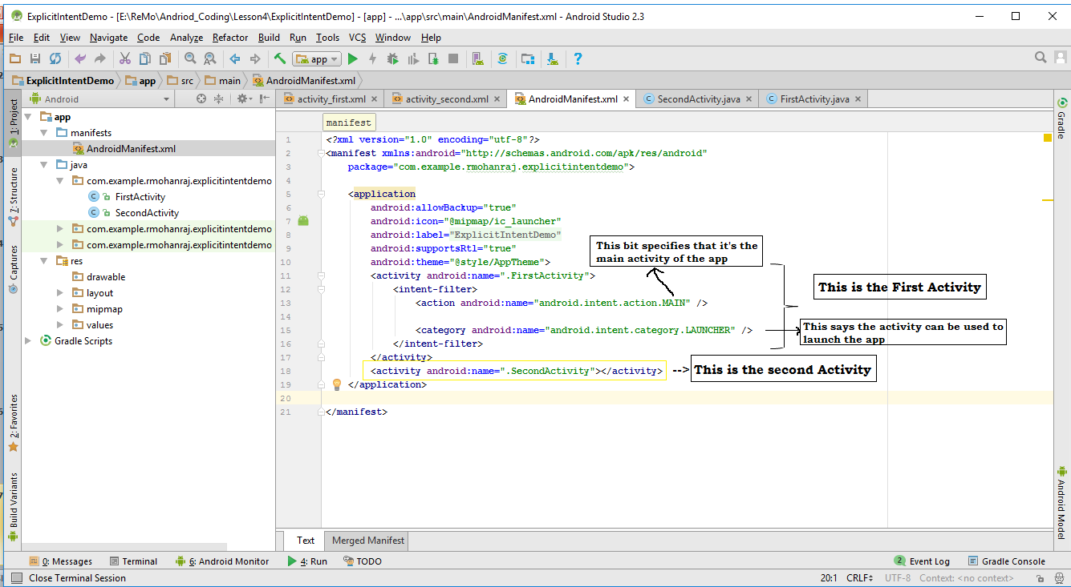
Step : 3 Configure Second Activity in manifest folder → AndriodManifest.xml and include
<activity android:name=".SecondActivity"></activity>

Slide 10
Step : 4 : Create an Intent and StartActivity
You can create and send an intent using just a couple of lines of code. You start by creating the intent like this:
Intent intent = new Intent(this,TargetClassname.class);
The first parameter tells Android which object the intent is from, and you can use the word this to refer to the current activity. The second parameter is the class name of the activity that needs to receive the intent. Once you’ve created the intent object, you pass it to Android like this:
startActivity(intent);
This tells Android to start the activity specified by the intent. Once Android receives the intent, it checks everything’s OK and tells the activity to start. If it can’t find the activity, it throws an ActivityNotFoundException.
public void onSendMessage(View view){
Intent intent = new Intent(this,SecondActivity.class);
startActivity(intent);
}

Slide 11
Step 5:Pass text to the Second Activity from the First Activity.
Put the data into the intent as Key/Value pairs. To do this, you use the putExtra() method
intent.putExtra("message", value);
Change the onSendMessge() with putExtra().
public void onSendMessage(View view){
et1 = (EditText) findViewById(R.id.smsg);
String input = et1.getText().toString();
Intent intent = new Intent(this,SecondActivity.class);
intent.putExtra("message",input); // Here message is a key to retrieve the input text in the second activity
startActivity(intent);
}
The putExtra() method is overloaded so value has many possible types. As an example, it can be a primitive such as a boolean or int, an array of primitives, or a String. You can use putExtra() repeatedly to add numerous extra data to the intent. If you do this, make sure you give each one a unique name.

Slide 12
Step 6 : Retrieve extra information from an intent in the Second Activity
There are a couple of useful methods that can help with this. The first of these is getIntent();
getIntent() returns the intent that started the activity, and you can use this to retrieve any extra information that was sent along with it.
How you do this depends on the type of information that was sent.
As an example, if you know the intent includes a string value with a name of “message”, you would use the following:
Intent intent = getIntent();
String output = intent.getStringExtra(“message”);
You’re not just limited to retrieving String values. As an example, you can use
int intNum = intent.getIntExtra("name", default_value);
to retrieve an int with a name of name. default_value specifies what int value you should use as a default.

Slide 13
Write this code in the second activity class.
public class SecondActivity extends AppCompatActivity {
@Override
protected void onCreate(Bundle savedInstanceState) {
super.onCreate(savedInstanceState);
setContentView(R.layout.activity_second);
Intent intent = getIntent();
String output = intent.getStringExtra("message");
TextView tv = (TextView) findViewById(R.id.rmsg);
tv.setText(output);
}
}

Slide 14
Step 7 : Run your code. After running the app, you will get result as below.

Slide 15
Hands on Example – Implicit Intent
However, you can also start up activities from the operating system or third-party apps. In those cases, though, you will not have a Java Class object representing the other activity in your project, so you cannot use the Intent constructor that takes a Class.
Instead, you will use what are referred as the “Implicit” Intent structure.
Lets enhance the previous example by introducing implicit intents to perform the following.
Sending message to the particular person through Email
Showing a Dial screen App (Intent.ACTION_DIAL)
Showing a WhatsApp App

Slide 16
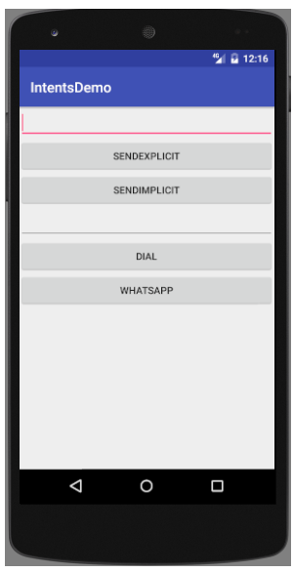
Design Screen

Slide 17
Implicit intent to send message
XML Code for the Button SendImplicit
<Button
android:layout_width="match_parent"
android:layout_height="wrap_content"
android:id="@+id/send2"
android:onClick="onSendMessageImplicit"
android:text="SendImplicit"/>
Java Code for the Button Click Event
public void onSendMessageImplicit(View view){
et1 = (EditText) findViewById(R.id.smsg);
String input = et1.getText().toString();
Intent intent = new Intent();
intent.setAction(Intent.ACTION_SEND);
intent.setType("text/plain");
intent.putExtra(Intent.EXTRA_TEXT,input);
startActivity(intent);
}
The intent specifies an action of ACTION_SEND, and a MIME type of text/plain.
Notes:
Multi-Purpose Internet Mail Extensions is an extension of the original Internet e-mail protocol that lets people use the protocol to exchange different kinds of data files on the Internet.
PLAIN_TEXT_TYPE ("text/plain")
"image/*“ accepts any type of image or with specific type like “image/jpeg”
"video/*“ accepts any type of Video (specific type mp4,wav)

Slide 18
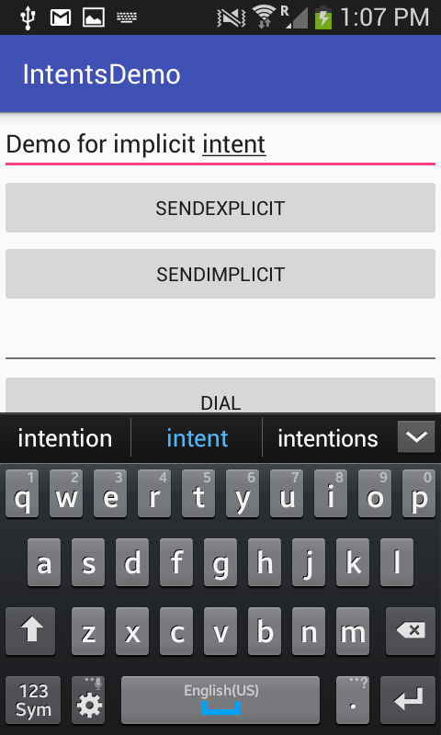
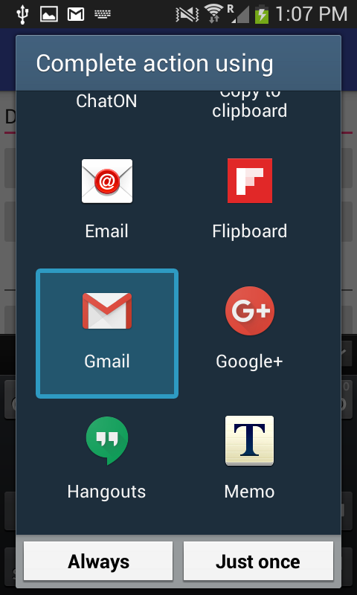
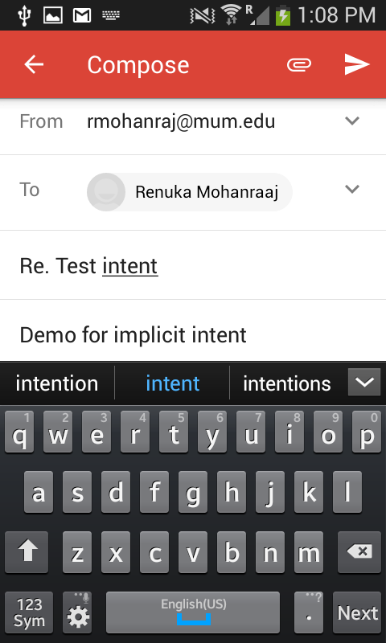
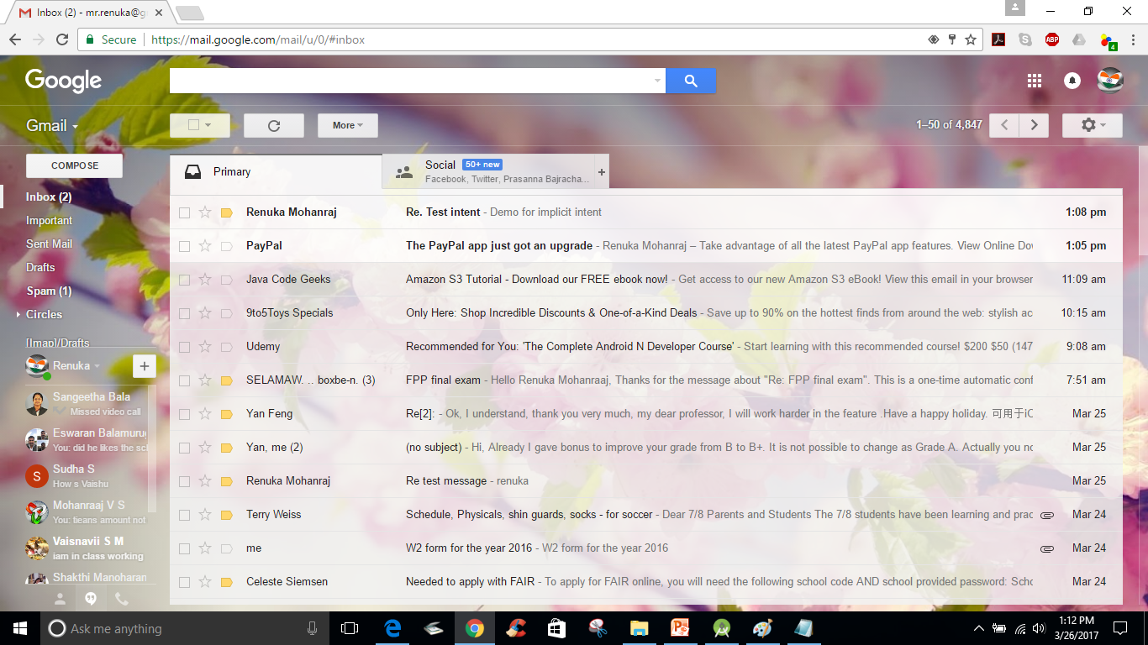
After clicking SENDIMPLICIT button

Slide 19
Implicit intent – dial screen
public void dial(View view){
Intent i = new Intent();
i.setAction(Intent.ACTION_DIAL);
EditText et2 = (EditText) findViewById(R.id.tel);
i.setData(Uri.parse("tel:"+et2.getText().toString()));
startActivity(i);
}
<EditText
android:id="@+id/tel"
android:layout_width="match_parent"
android:layout_height="wrap_content" />
<Button
android:layout_width="match_parent"
android:layout_height="wrap_content"
android:id="@+id/dl"
android:onClick="dial"
android:text="Dial"/>
Whenever the user clicks the DIAL button, calling built-in dial screen by invoking Intent.ACTION_DIAL to call number when the application is launched.
To send any data to the built in activity use setData(), the parameter for this method is Uri component. To get the Uri component use Uri.parse() method which takes the String input along with what type of data we are sending. Here we are sending telephony type of data which accepts number, #, and *. Ordinary number accepts 0-9.
tel : A data representing kind of telephone number.

Slide 20
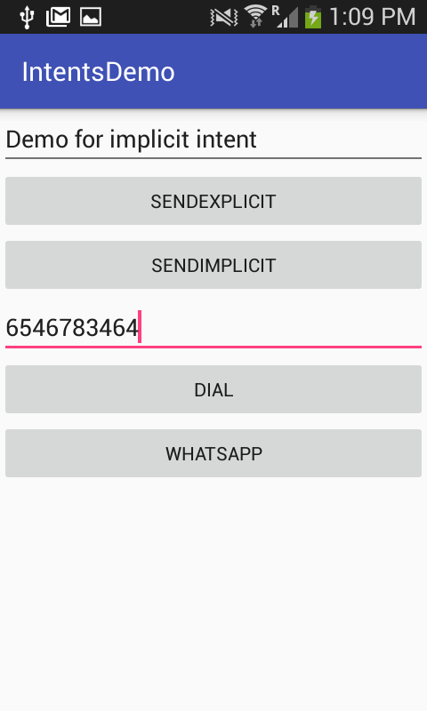
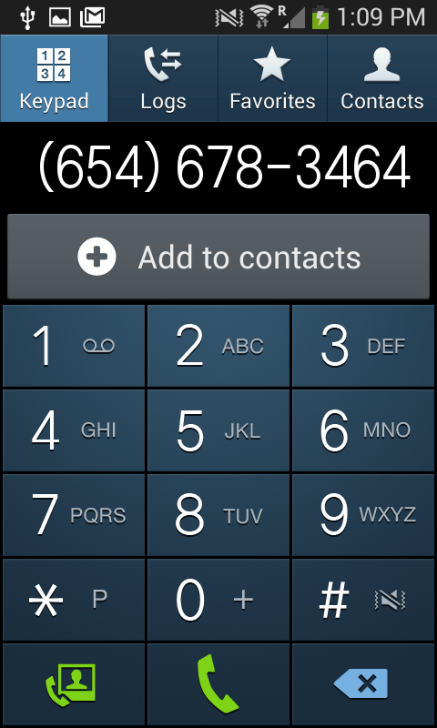
After clicking DIAL button

Slide 21
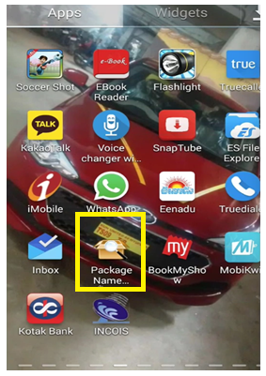
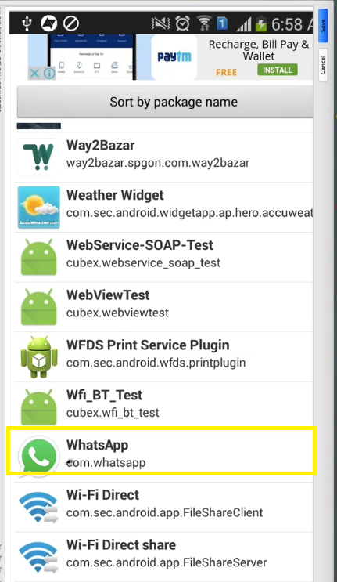
Implicit intent-whatsapp
<Button
android:layout_width="match_parent"
android:layout_height="wrap_content"
android:onClick="whatsapp"
android:text="WhatsApp"/>
public void whatsapp(View view){
Intent i = getPackageManager().getLaunchIntentForPackage("com.whatsapp");
startActivity(i);
}
If you want to call any third party application in your logic, first you should get the package name from your App called as PackageNameViewer. If you don’t have the application install the app from play store. Then see package name and use that in the code.

Slide 22
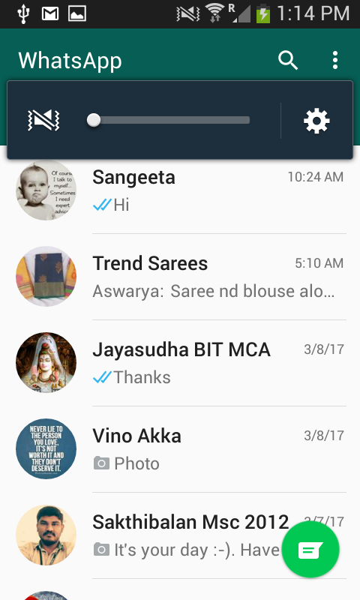
After clicking whatsapp Button

Slide 23
Frequently used Implicit Intents
Web browser
Email
Alarm clock
Calendar
Camera
Contacts/people app
File storage
Maps
Music or video
Phone
Settings
Text messaging
Refer for complete information : https://developer.android.com/guide/components/intents-common.html

Slide 24
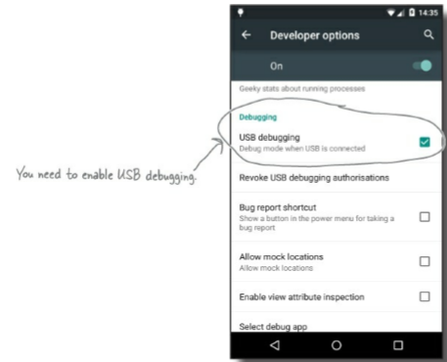
Run on your Android Mobile device
Enable USB debugging on your device
On your device, open “Developer options” (in Android 4.0 onward, this is hidden by default). To enable it, go to Settings → About Phone or About Device and tap the build number seven times. When you return to the previous screen, you should be able to see “Developer options.”
Within “Developer options,” tick the box to enable USB debugging.

Slide 25
2. Set up your system to detect your device
if you’re using a mac, you can skip this step.
If you’re using windows, if need to install a USB driver. You can find the latest instructions here:
http://developer.android.com/tools/extras/oem-usb.html
3. Plug your device into your computer with a USB cable
Your device may ask you if you want to accept an RSA key that allows USB debugging with your computer. If it does, you can tick the “Always allow from this computer” option and choose OK to enable this.
4. Run your app in Android Studio as normal
Android Studio will install the app on your device and launch it. You may be asked to choose which device you want to run your app on. If so, select your device from the list available and click OK.

Slide 26
Getting a result back from a child activity
Starting another activity doesn't have to be one-way. You can also start another activity and receive a result back. To receive a result, call startActivityForResult() (instead of startActivity()).
For example, your app can start a camera app and receive the captured photo as a result. Or, you might start the People app in order for the user to select a contact and you'll receive the contact details as a result.
Of course, the activity that responds must be designed to return a result. When it does, it sends the result as another Intent object. Your activity receives it in the onActivityResult() callback.
When you want to hear back from the child activity, you call the following Activity method:
public void startActivityForResult(Intent intent, int requestCode)
An Intent that carries the result data.
A result code specified by the second activity. This is either RESULT_OK if the operation was successful or RESULT_CANCELED if the user backed out or the operation failed for some reason.

Slide 27
Fetching the result
In the first activity, when the result has been returned, the
onActivityResult(int resultCode, int requestCode, Intent intent) method will be called.
Check resultCode for Andriod.RESULT_OK
Check requestCode to see if it matches the int you passed to startActivityForResult.
Retrieve the data from the intent, and use it.

Slide 28
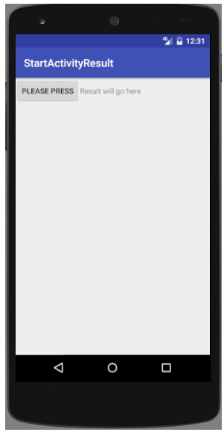
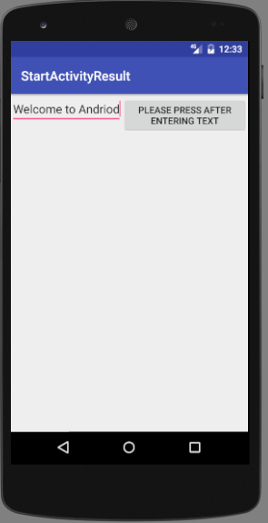
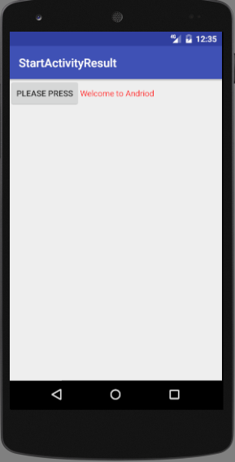
Fetching Result from Activity B to Activity A
Activity A
Activity B
Activity A

Slide 29
Getting a result back from a child activity
// Partial Coding part from the MainActivity.java
View.OnClickListener bListener = new View.OnClickListener(){
@Override
public void onClick(View v)
{
Intent intent=new Intent(MainActivity.this,SecondActivity.class);
startActivityForResult(intent, 1); // Here 1 is the request code
}
};
// You should implement this below method in your MainActivity.java, file to need to retrieve the result
public void onActivityResult(int requestCode, int resultCode, Intent data) {
if (requestCode == 1) {
if (resultCode == RESULT_OK) {
t.setTextColor(Color.RED);
String returnedResult = data.getData().toString();
t.setText(returnedResult);
}
}
}

Slide 30
Getting a result back from a child activity
// Partial Coding part from the SecondActivity.java
View.OnClickListener bListener = new View.OnClickListener(){ @Override public void onClick(View v) { Intent data = new Intent(); String text = input.getText().toString(); // fetch the result to Main Activity data.putExtra("Data",text); // Accept a key Value setResult(RESULT_OK,data); //---close the activity--- finish(); } };
// Find the complete code from demo in Lesson4\StartActivityResult folder

