Slide 1

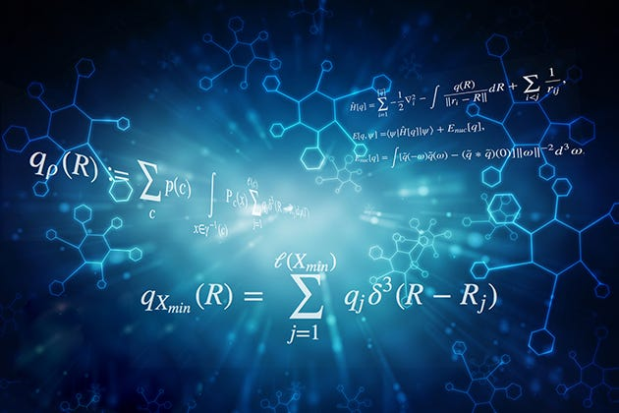
Regression challenge using a Parametric and a NonParametric Approach Linear Regression Vs. KNN
Students: Hsham Ngim

Slide 2
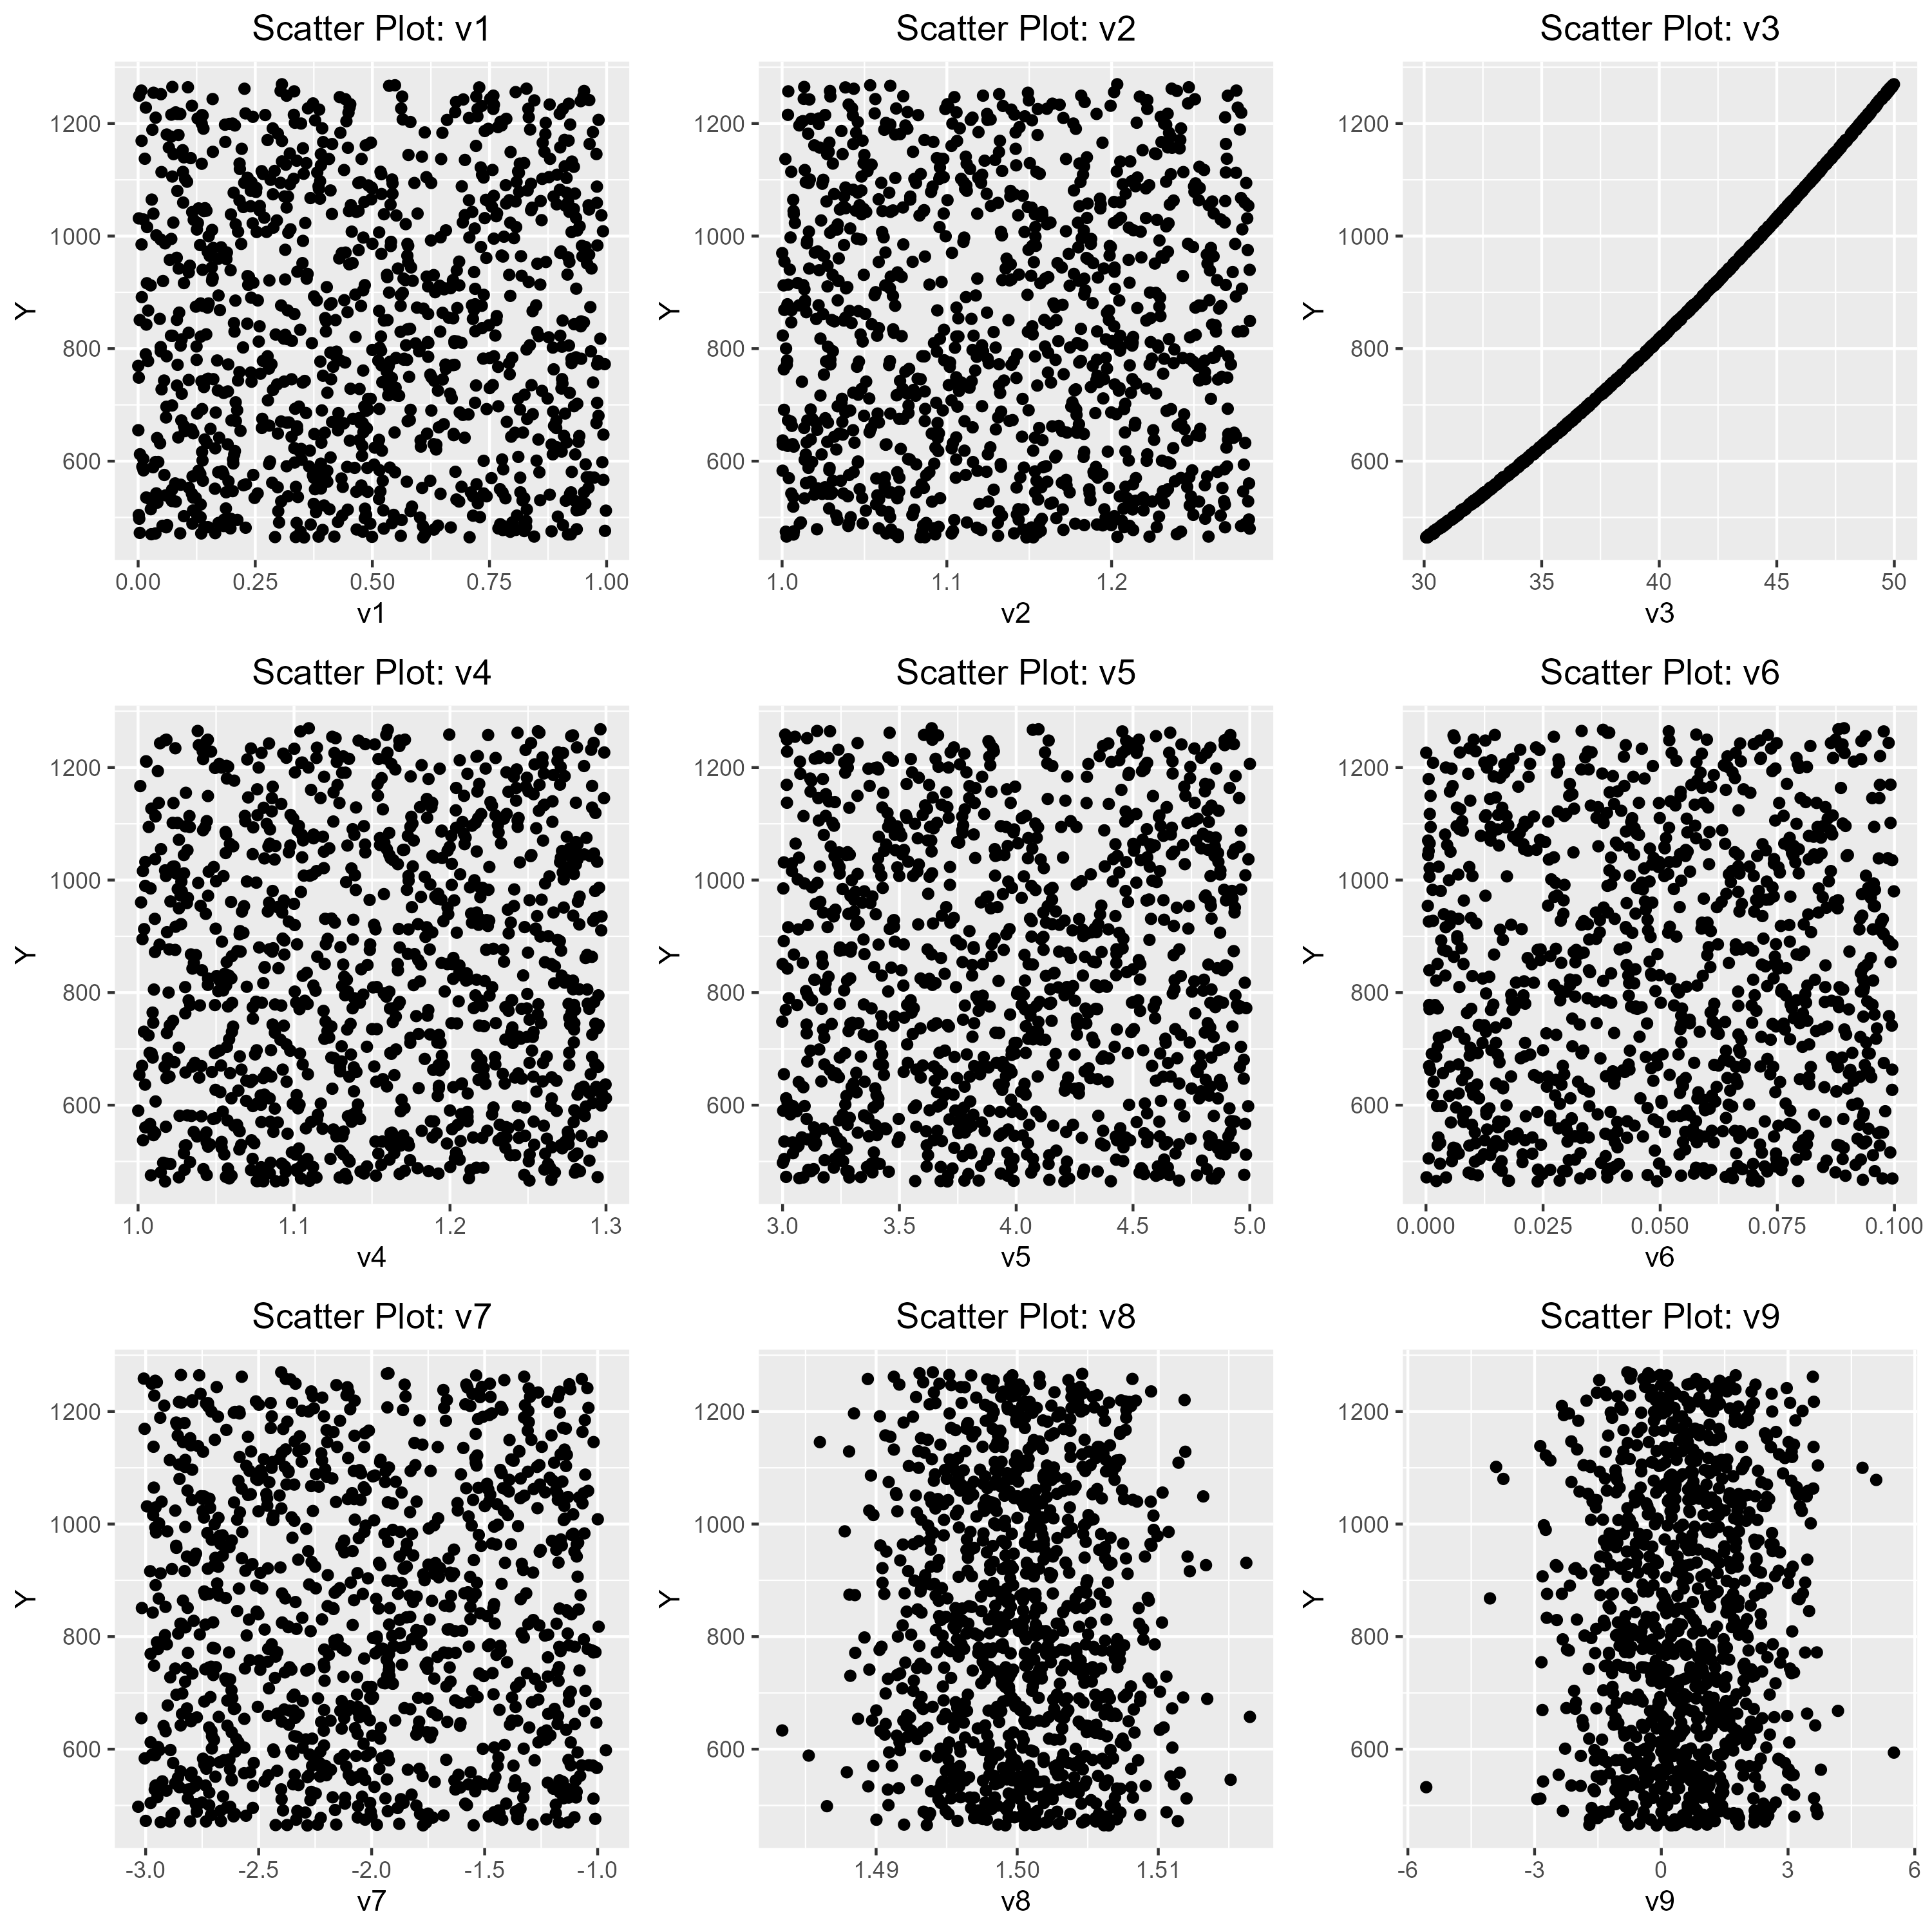
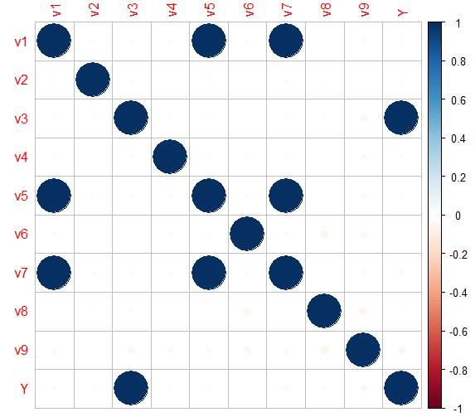
Exploratory Data Analysis
Scatter Plot:
Correlation Matrix :
It can be seen that only V3 has a linear relationship with Y.
V1, V5, and V7 have high correlation.
2

Slide 3
Methodology - Feature Engineering
Interaction Terms:
Created interaction terms (e.g. v1*v2) by combining all 9 predictors (v1, v2, ..., v9) pairwise.
Captured potential combined effects and interactions between predictors.
Non-Linear Transformations:
Applied non/linear transformations to the original 9 features (e.g. pow(v1,2), pow(v6,3), etc.).
Generated new features capturing complex relationships and enhancing model flexibility
2

Slide 4
Methodology - Model Training
Machine Learning Models: The following models were trained using the original and the engineered features:
Linear Regression & KNN.
Pre-processing: Data standardization is applied to have a mean of zero and a standard deviation of one.
Data Split: The training data was split into 60% training, 20% validation, and 20% test sets.
Best Model Selection: The model that performed best on the validation set was selected as the final model for evaluation and testing. For KNN, the best k = 9.
3

Slide 5
RESULTS
Model | RMSE | MAE
Linear Regression with original features | 14.87623 | 12.72461
Linear Regression with only “V3” predictor | 14.87623 | 12.72461
Linear Regression with original and engineered features | 0.00114 | 0.00087
KNN with original features | 8.15605 | 6.24124
KNN with engineered features | 1.78139 | 1.42702
The results of the Linear Regression with original and engineered features model on the 20% test set outperformed all other models of linear regression and KNN.
Nonlinear transformations seem to have a crucial importance in improving the model’s performance as it helps to capture non-linear relationship of the data.
5

Slide 6
THANK YOU

