Slide 1
REPORT OF COFFEE PURCHASES ON AMAZON First published October 2022 Updated November 06, 2022 Group 2

Slide 2
REPORT OF COFFEE PURCHASES ON AMAZON
Report overview
Chapter 1 PROJECT OVERVIEW
Chapter 2 LITERATURE REVIEW
Chapter 3 THEORETICAL BASIS
Chapter 4 TEST METHOD AND RESULTS

Slide 3
PROJECT OVERVIEW
01
04
Reasons for choosing the topic
Research Methods
02
Objectives of the study
05
New contributions
03
06
Object and scope of the study
Project structure

Slide 4
Project overview
Object and scope of the study:
Customer feedback in e-commerce in general and in the field of E-commerce
Extract customer opinions
Customer perspectives and aspects to be found in response to product reviews on AMAZON
Research Scope : Online customer comments in Vietnamese, including usernames, comment content, rating points on a scale of 1-5,...
From the most popular e-commerce AMAZON about Starbucks.
Reasons for choosing the topic:
Customer opinion is extremely important for e-commerce platforms and their commercial success. The goal of e-commerce platforms is to generate sales and increase customer satisfaction
Objectives of the study:
Understanding customers through opinion analysis to increase experience
The model of aspect extraction, opinion mining and experimentation proposed model in Vietnamese is customer feedback in the field of e-commerce
New contributions:
Building a dictionary of opinions (negative or positive)
The proposed research model, methods and experimental results can be applied in practice
The research results can also be applied to building data analysis systems, network listening systems (Social listening)
Research Methods:
Survey and study secondary data from previous studies relevant to the research objective.
Survey customer comments on the Website and find the right data source for research to solve problem posed
Survey the theory of customer experience in e-commerce, survey models and mining methods user opinions, analyze survey results to find gaps from previous studies
* Use descriptive system method to survey and evaluate the collected data.
Project structure:
I.Project overview
II.Review of related studies
III.Theoretical basis
IV.Proposed and experimental research model
V.Evaluation of experimental results and conclusions
Apply method partitioning classes in machine learning such as Logistic Regression, Bayes Naïve, Support Vectors and Decision tree on file architecture client.
Conduct model testing, compare and evaluate the model's results.

Slide 5
LITERATURE REVIEW
According to the report, the crew proposed to pick 2 out of 15 analytical items, the articles are pretty thrilling and associated with this system the organization is researching and we have opinions for 2 reviews
Generally : Currently, along with certain growth steps in both clean and pure coffee products and coffee drinks, the status of dirty, padded, and cheap coffee is becoming more and more popular in the market, causing confusion for consumers. user.

Slide 6
Our Opinion
•The articles 1 :
CONCLUSION about the paper: This study provides a comprehensive and recent analysis of the international coffee market structure and competitiveness, contributing to the analysis of the international market of the product.
The articles 2 :
CONCLUSION about the paper: The present study used online reviews to understand coffee shop costumer experience and satisfaction through a set of analytical methods. The textual reviews and numeric reviews were concerned simultaneously to unearth qualitative perception and quantitative data information for customers of coffee shops.

Slide 7
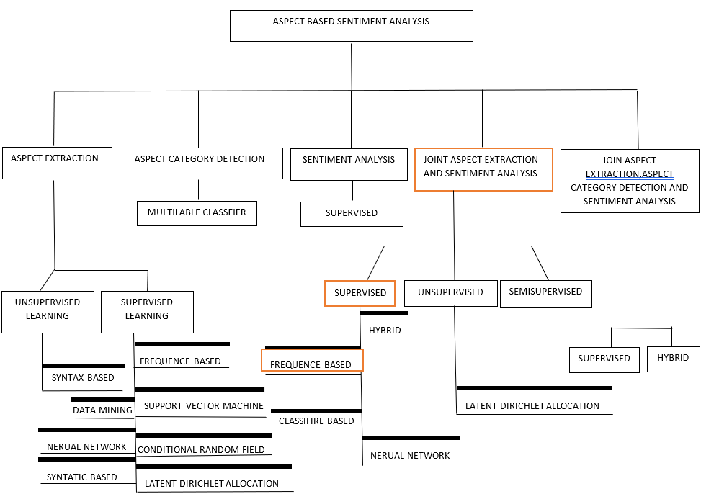

Slide 8
THEORETICAL BASIS
Amazon's Orientation
Overview of supervised machine learning methods
Feature extraction technique.
1.Online grocery
2.Amazon one
3.Amazon advertising
4.Fulfilment by Amazon
5.Gaming
Logistic regression
Bag of words.
TF-IDF (Term Frequency – Inverse Document Frequency).
Part-of-speech tagging ( POS tagging).
Model Evaluation Indicators: The Confusion Matrix. Model evaluation metrics: Confusion Matrix
What is logistic regression?
What is the purpose of logistic regression?
Advantages and disadvantages of logistic regression ?
▪Support Vector Machine- SVM
▪Mathematical formulation.
Effective and the advantages of SVM
The disadvantages of support vector machines
Mathematical formulation.
The Logistic Curve
Loss Function •
Where on Earth Did This Stuff Come From?

Slide 9
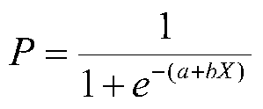
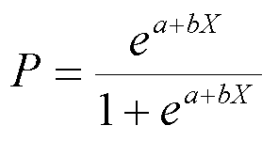

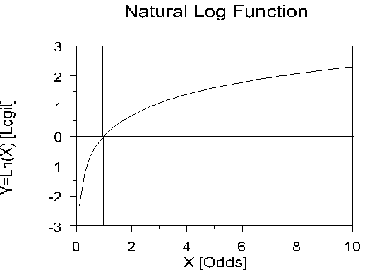

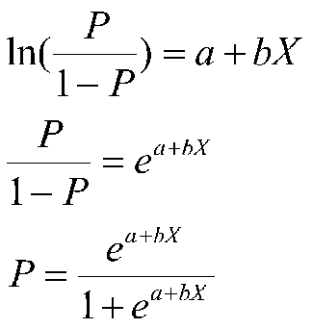


▪Mathematical formulation.
01
•The Logistic Curve
05
LinearSVC
or
02
•Loss Function
b = (X'X)-1X'y
b = R-1r
LinearSVR 06
03
$$odds=\frac{P}{1−P}$$
04
08

Slide 10
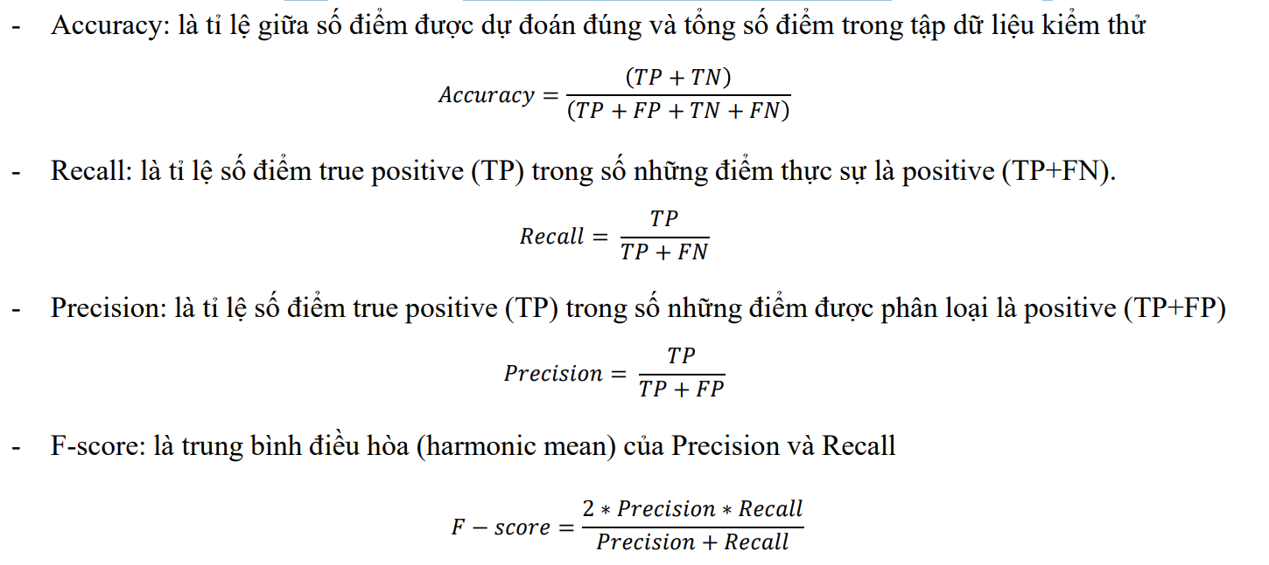
Model evaluation metrics: Confusion Matrix
01

Slide 11
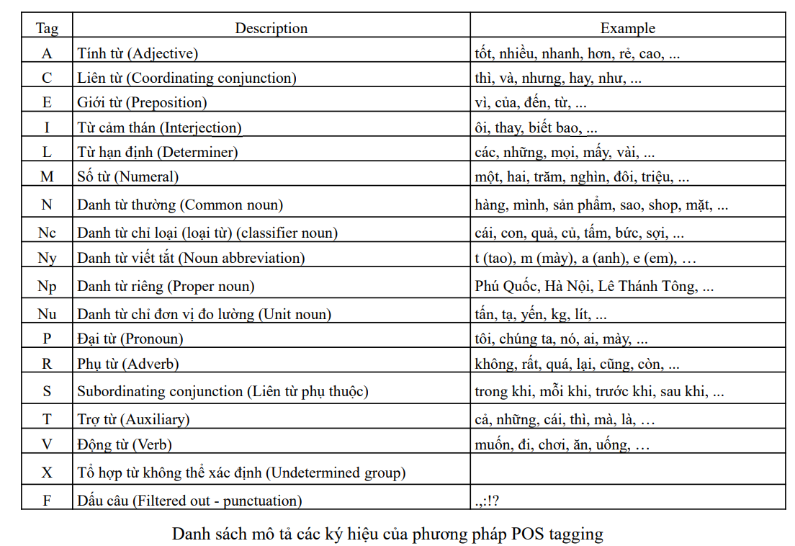
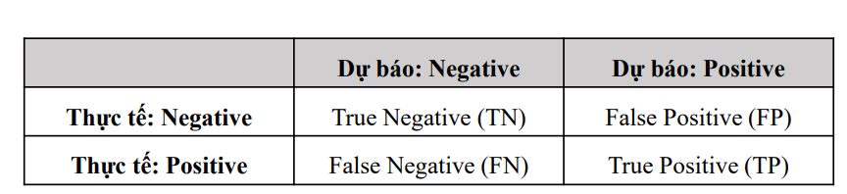
Feature extraction technique.
Bag of words.
TF-IDF (Term Frequency – Inverse Document Frequency).
Part-of-speech tagging ( POS tagging).
Model Evaluation Indicators: The Confusion Matrix.
+ True Negative (TN): the number of points of the negative class that are properly classified as negative. + False Negative (FN): the number of points in the positive class that were mistakenly classified as negative. + True Positive (TP): the number of points of the positive class that are properly classified as positive. + False Positive (FP): the number of points of the negative class that were mistakenly classified as positive.

Slide 12
TEST METHOD AND RESULTS
01
02
03
Behavior of customer on ecommerce app
Data collection
EDA
04
05
Data pre-processing
Machine learning

Slide 13
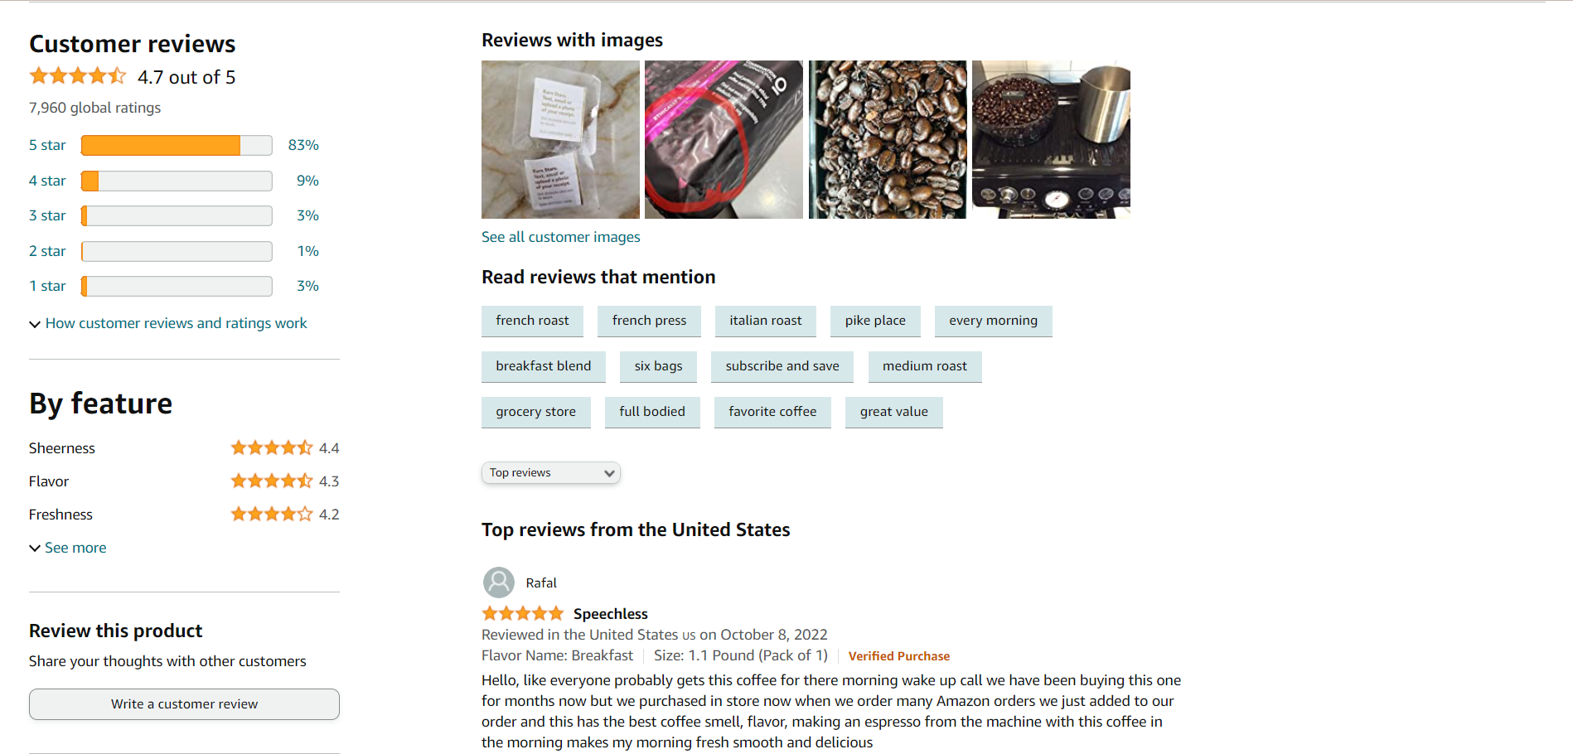
Behavior of customer on ecommerce app :
Collecting data - Data in our research is public in Amazon.com - Data collected include 11.530 comment, feedback of customer from 2019-now.

Slide 14
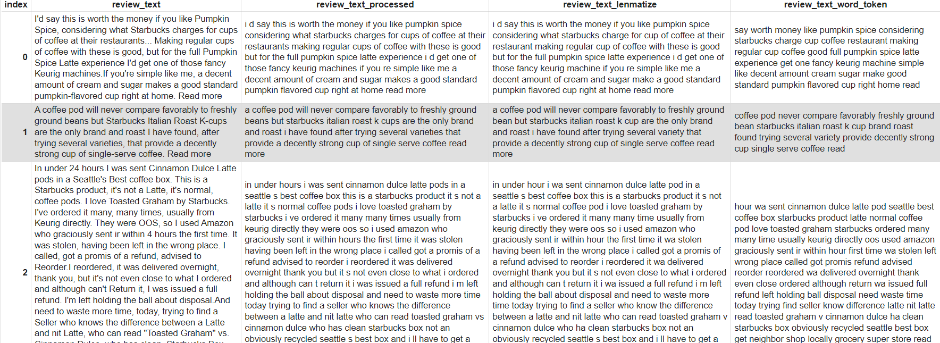

Slide 15
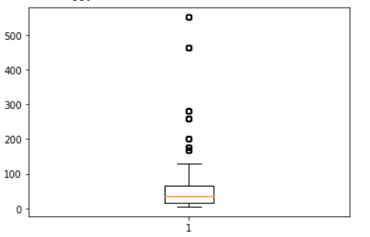
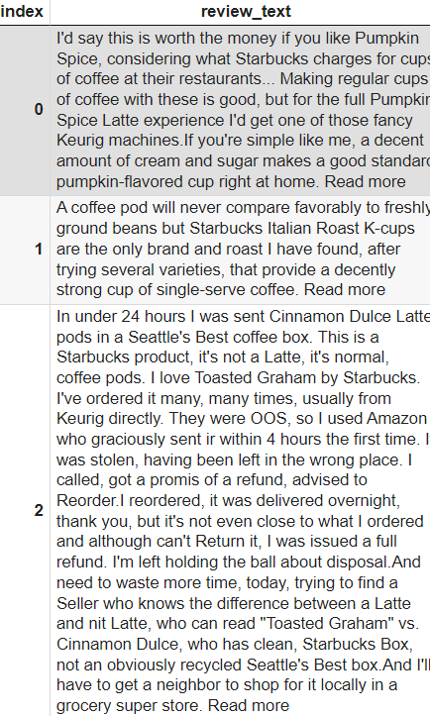
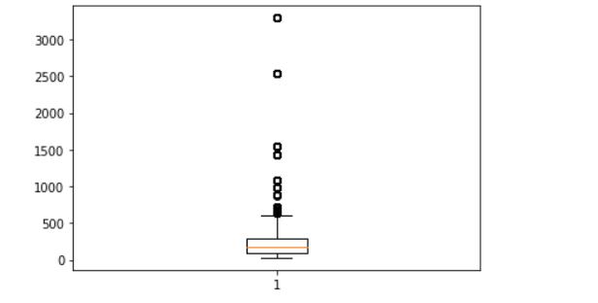
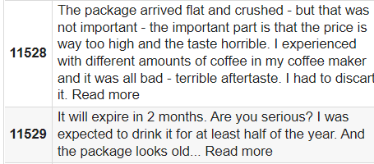
EDA (Exploratory Data Analysis ) - Num_char, num_word, avg_word_lenght - Draw boxplot from data :
num_word
Num_char
Num_count > 21
Num_char > 86

Slide 16
Data Pro-Processing
Yes ?
English
Change emotion to words
No
Translate
Tokenizing
Stop Words

Slide 17
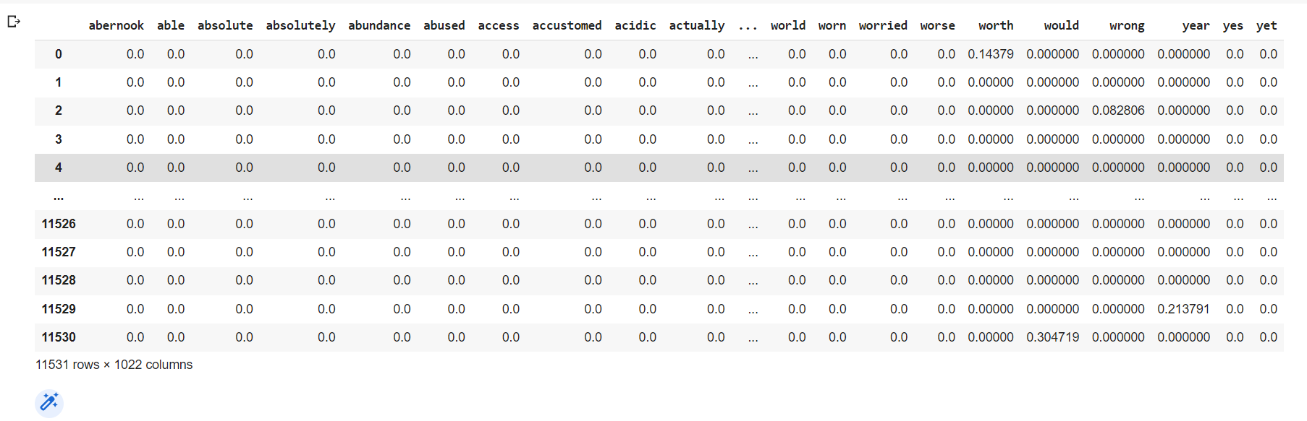
MACHINE LEARING TO ANALYSIS

Slide 18
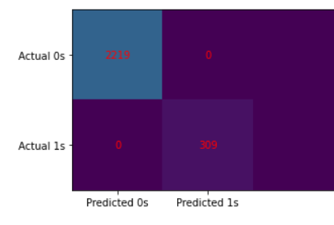
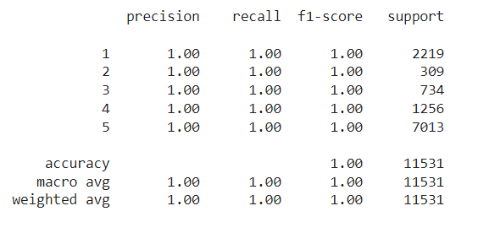
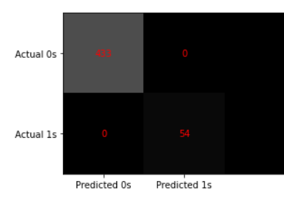
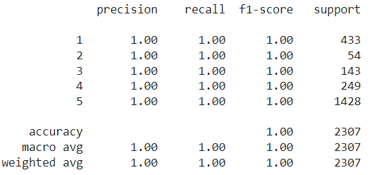
CHAP 5 : EVALUATE RESULTS AND DISCUSSION
Confusion matrix ( LR )
Logistic regression
Confusion matrix ( SVM )
SVM – Support Vector Machine

Slide 19
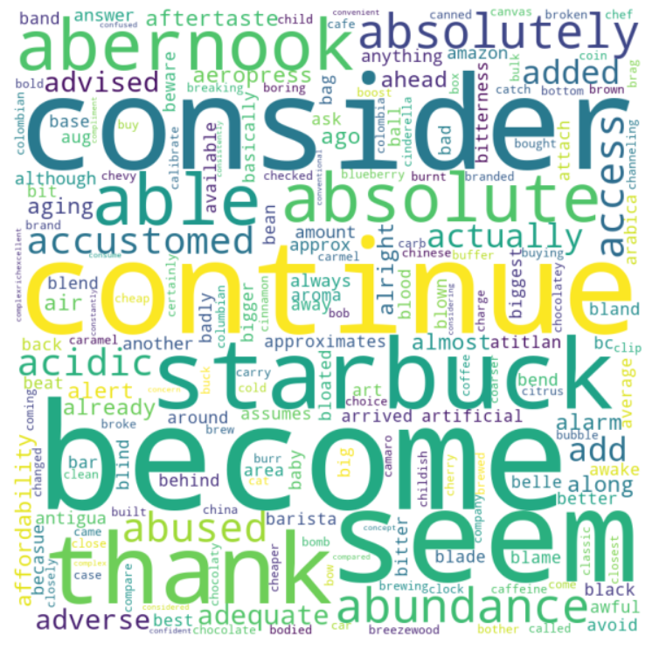
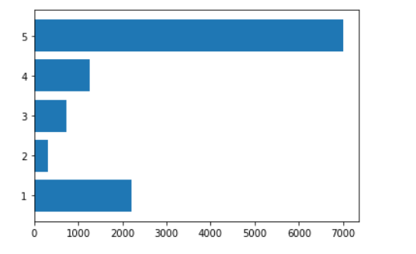
Results :
Line chart about rating of customer in Amazon
Word cloud comment in Amazon

Slide 20
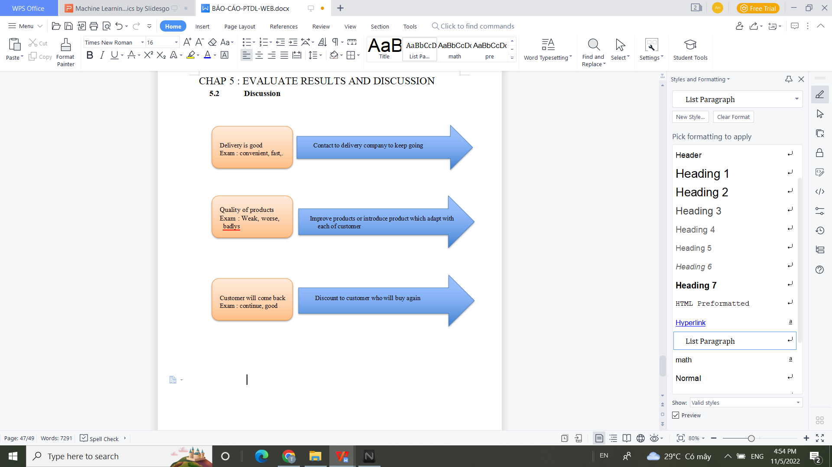

Slide 21
CONCLUSION:
(2) Propose a hybrid model between clearing and classification of opinions;
(1) Building a dictionaries specifically for the field of Ecommerce;
(3) The results of testing the method of learning on the file computer with the accuracy in turn Logistic regression: 100%, SVM: 100%,. In which, logistic regression the highest standard is selected to test for the model proposal on the analysis score of the word and phrase.
With the results achieved, it is possible to apply to the built-in dashboard to track customer experience directly Over time, to assist managers in making time decisions, to improve products and services, enhance customer satisfaction.

Slide 22
RESTRICT :
-Data collection sill small and haven’t collect from another Ecommerce
-Research focus on model with possitive comment and negative comment.
CONCLUSION:
Improve in future:
In the future, research will expand to another Ecommerce, and neutral comment will be collected. And we will improve to collect image, video of customer’s comment.

Slide 23
REFERENCES (1)https://www.analyticsvidhya.com/blog/2015/11/beginners-guide-on-logistic-regression-in-r/ (2) http://faculty.cas.usf.edu/mbrannick/regression/Logistic.html (3) https://viblo.asia/p/gioi-thieu-ve-support-vector-machine-svm-6J3ZgPVElmB (4) https://scikit-learn.org/stable/modules/svm.html LINK SOURCE CODE : https://colab.research.google.com/drive/1yHQX2pTLP5Cp_pKJBOh5UJgFnpKQ6XQ7?usp=sharing

Slide 24
Thanks for watching

