Slide 1
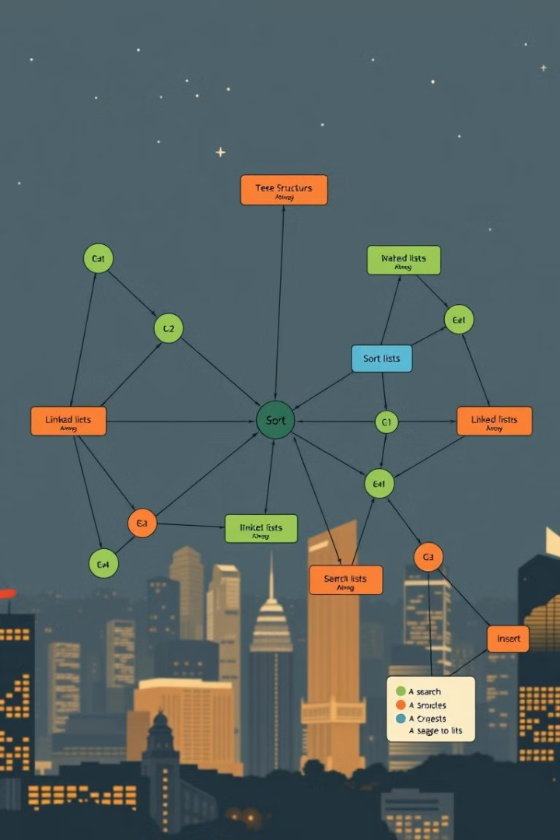

Fundamentals of Data Structures and Algorithms
Welcome to this exploration of essential data structures and algorithms! We'll delve into the concepts of abstract data types (ADTs), specific implementations of queues and stacks, and then explore sorting and pathfinding algorithms.
by Ngo Hoai Nam (BTEC HN)

Slide 2
Understanding Abstract Data Types
ADT: The Blueprint
Stacks: Last In, First Out (LIFO)
An ADT defines operations without specifying how they're implemented. Think of it as a blueprint, outlining what a data structure *does*, not *how* it does it.
Imagine a stack of plates; the last one placed on top is the first one taken off. This is LIFO, a key principle of stack operations.

Slide 3
Queues: First In, First Out (FIFO)
Queues: First In, First Out (FIFO)
Stack vs Queue
Think of a queue at a shop: the first person in line is served first, followed by those who came after. This is FIFO, how queues work.
Stacks use LIFO, while queues use FIFO. Understanding these differences helps us choose the right structure for different tasks.

Slide 4
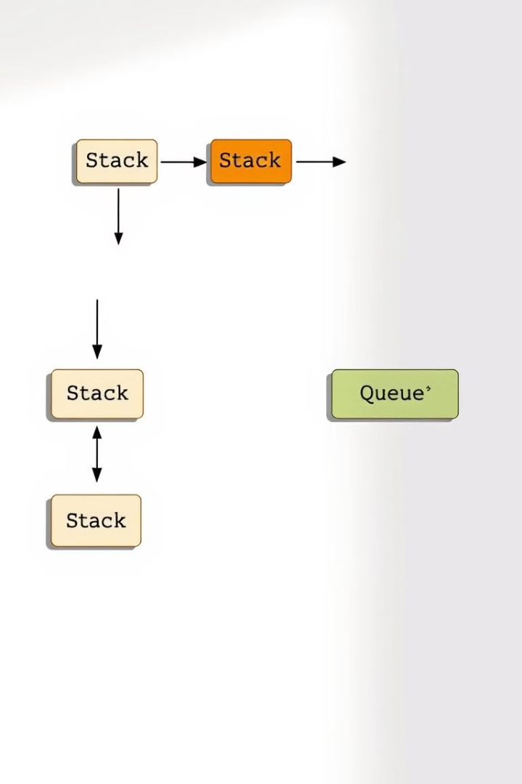
Implementing Stacks and Queues
1
1. Arrays
2
2. Linked Lists
Stacks and queues can be implemented using arrays, allowing efficient access to elements.
Linked lists provide a more flexible way to implement stacks and queues, especially for dynamic resizing.

Slide 5
Exploring Sorting Algorithms
Bubble Sort
Merge Sort
Repeatedly steps through the list, comparing adjacent elements and swapping them if they're in the wrong order. Simple but inefficient for large datasets.
Divides the list into smaller sublists, sorts them, and then merges the sorted sublists. Efficient and widely used for various applications.

Slide 6
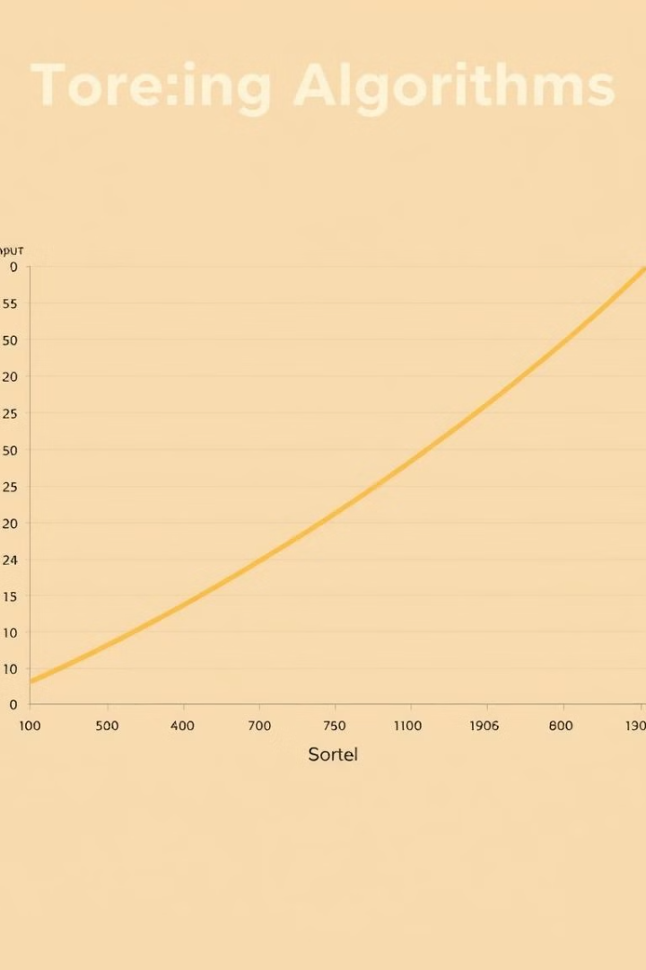
Comparing Algorithm Complexity
1
1. Time Complexity
2
2. Space Complexity
Bubble sort has a time complexity of O(n^2), meaning its execution time grows quadratically with input size.
Merge sort has a space complexity of O(n), meaning its memory usage grows linearly with input size.

Slide 7
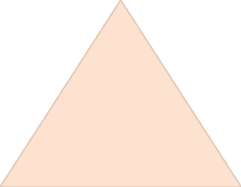
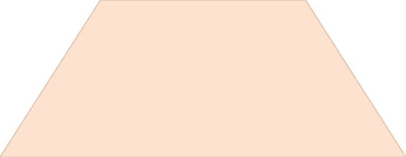
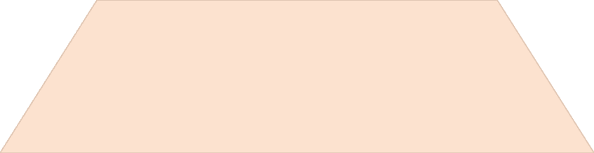
Shortest Path Algorithms
Shortest Path
1
Finding the shortest route between two points, a fundamental problem in computer science and real-world applications.
Dijkstra's Algorithm
2
A greedy algorithm that finds the shortest path from a source node to all other nodes in a weighted graph.
Applications
3
Used in navigation systems, network routing, and resource allocation, among many other areas.

Slide 8
Dijkstra's Algorithm in Action
1. Initialization
1
Set the distance to the source node to 0 and all other nodes to infinity. Mark all nodes as unvisited.
2. Iteration
2
Select the unvisited node with the smallest distance and mark it as visited. Update the distances to its neighbours.
3. Termination
3
Repeat step 2 until the destination node is visited. The shortest path is then reconstructed by tracing back the edges.

Slide 9

Key Takeaways: Data Structures and Algorithms
Abstraction
Efficiency
Applications
ADTs provide a high-level view of data structures, focusing on operations rather than implementation details.
Understanding algorithm complexity is crucial for choosing efficient solutions for different tasks and datasets.
Data structures and algorithms have wide-ranging applications in various fields, from software development to scientific research.

Slide 10



Next Steps: Dive Deeper
Explore
Practice
Read further on advanced data structures, such as trees, graphs, and heaps.
Implement various algorithms to solidify your understanding and build practical skills.

