Slide 1
Example Class 2
Group 2:
Annie
Jason
Lewis
Stephen
Kenrick

Slide 2
Applications and Empirical Analysis of Searching Algorithms
Using closed address hashing, compare between hash tables of prime and non- prime sizes (Group 2).

Slide 3

Problem scenario
Searching products in database in E-commerce

Slide 4

Selected data set:
A collection of 20,000 products listed on Flipkart

Slide 5
Hashing Algorithm
public int computeHash(String data) {
int sum = 0;
int length = data.length();
for (int j = 0; j < length; j++) {
int charVal = Character. getNumericValue(data.charAt(j));
// The ASCII value of character
sum += (int) (charVal * j);
}
return sum % hashSize; //hashSize is the size of hash table
}
Method: Folding Method
Summing the ASCII value of each character multiply by (index number+1)
Then return sum mod hashSize

Slide 6
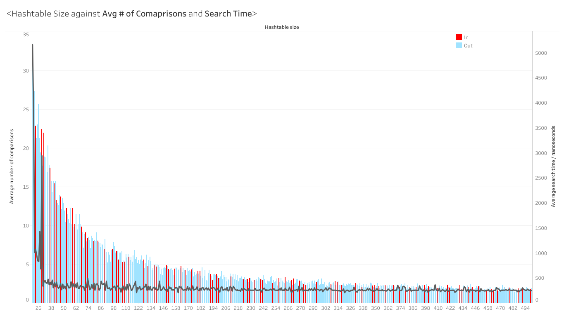
Statistics
Prime
Non-Prime

Slide 7
Statistics
The orange circles marks the prime number sizes of hashtables that takes less comparison to finish a search than similar size non-prime number hashtables

Slide 8

Conclusion
Prime Size Table

