Slide 1
MISRA C -2012
Prepared by –Chiranjit Adhikary
Software Design Engineer

Slide 2
Session 1
Rules( 1-38)

Slide 3
MISRA C -2012
What is MISRA -C
Session 1
MISRA C refers to a set of coding guidelines for the C programming language.
What is MISRA
Motor Industry Software Reliability Association
Why we need to know about MISRA -C
MISRA C provides rules and recommendations for writing C code in a structured, consistent, and reliable manner. These guidelines cover various aspects of C programming, including syntax, semantics, and language features, with the aim of reducing potential errors and vulnerabilities in software.

Slide 4
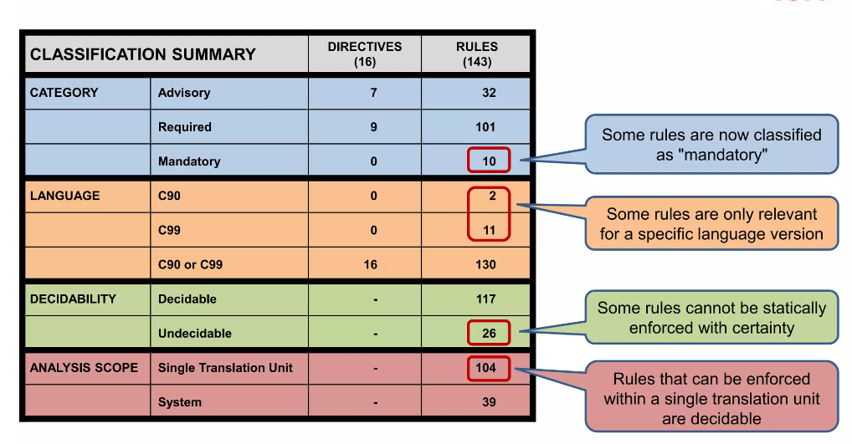
Introduction
MISRA C -2012
Session 1
MISRA- The Motor Industry Software Reliability Association

Slide 5
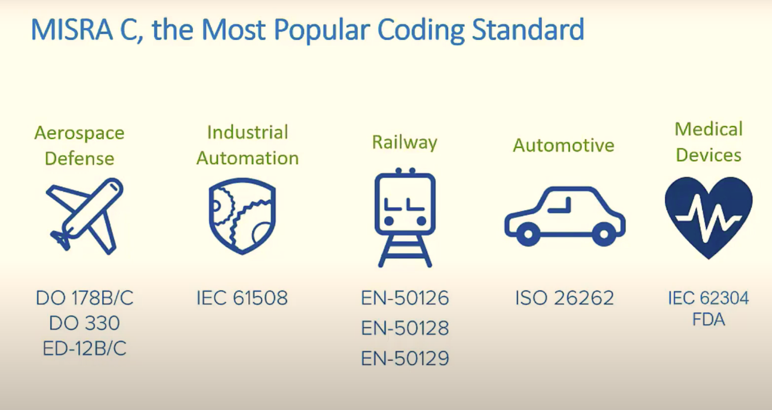
MISRA C -2012
Session 1

Slide 6
MISRA C -2012
Important Terms
Session 1
Mandatory- Mandatory guidelines shall always be complied with
Required - Required guidelines shall be complied with, unless subject to a Deviation
Advisory - Advisory guidelines are considered good practice, but compliance is less formal.
Decidable- If a rule can be conclusively verified using a static code analysis tool such as Polyspace. and so, is totally covered within the capabilities of the tool.
Undecidable- An Undecidable rule in theory cannot be checked by a static analyzer.
Single Translation Unit -A single translation unit roughly consists of a source file after it has been processed by the C preprocessor, meaning that header files listed in #include directives are literally included.
System- A system rule requires the entire program to be analyzed to assess compliance

Slide 7
History of MISRA-C
MISRA C -2012
Session 1
Improvisation
MISRA C:2012
MISRA C:2012 is the third edition of MISRA C, published in 2012. It was written for C99 and C90 to provide better rationales for the guidelines and more precise descriptions. There are 143 rules, 17 directives, including:

Slide 8
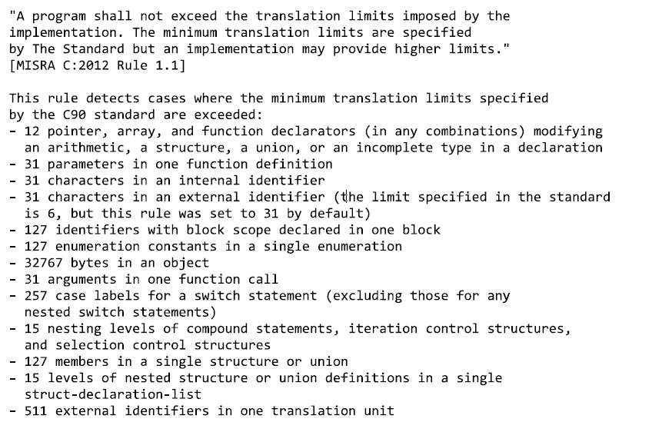
History of MISRA-C
MISRA C -2012
Session 1
Misra2012:Rule-1.1
The program shall contain no violations of the standard C syntax and constraints, and shall not exceed the implementation's translation limits
Category –Required Analysis -Decidable, Single Translation Unit Applies to -C90, C99

Slide 9
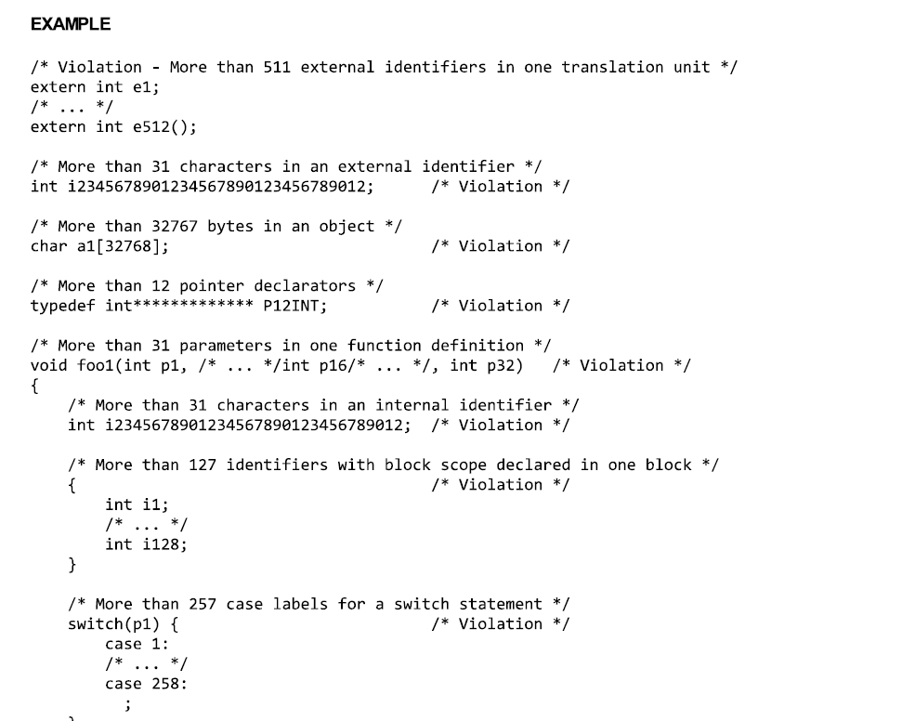
History of MISRA-C
MISRA C -2012
Session 1
Misra2012:Rule-1.1
Example

Slide 10
History of MISRA-C
MISRA C -2012
Session 1
Misra2012:Rule-1.1
BENEFITS
This rule prevents undefined behaviors and improves the readability of code.
REPAIR
Do not exceed the translation limits of an implementation.
REFERENCES
1. MISRA C:2012 Guidelines for the use of the C language in critical systems
Section 8: Rules, Rule 1.1

Slide 11
History of MISRA-C
MISRA C -2012
Session 1
Misra2012:Rule-1.2
Language extensions should not be used
Category - Advisory Analysis -Undecidable, Single Translation Unit Applies to - C90, C99
Many compilers provide extensions, which are additional features not defined in the standard but supported by that specific compiler.
GNU Compiler Collection (GCC), which often provides extensions beyond the C standard
Example
#include <stdio.h> int main()
{ int num1 = 10;
int num2 = 20; // Violation: Using a language extension (C99-style inline declaration)
for (int i = 0; i < 5; i++)
{
printf("Iteration %d: %d\n", i+1, num1 + num2);
}
return 0;
}

Slide 12
History of MISRA-C
MISRA C -2012
Session 1
Misra2012:Rule-1.2
REPAIR
Loop counter declaration moved outside the loop
Example
#include <stdio.h> int main()
{ int num1 = 10;
int num2 = 20; // Violation: Using a language extension (C99-style inline declaration)
int i; // Loop counter declaration moved outside the loop
for (i = 0; i < 5; i++)
{
printf("Iteration %d: %d\n", i+1, num1 + num2); // Loop counter initialization moved outside the loop
}
return 0;
}

Slide 13
History of MISRA-C
MISRA C -2012
Session 1
Misra2012:Rule-1.3
There shall be no occurrence of undefined or critical unspecified behaviour
Category –Required Analysis -Undecidable, System Applies to -C90, C99
It can occur when a program performs operations that are not specified by the standard, such as dividing by zero, accessing uninitialized variables, or overflowing signed integers.
Example
int main()
{
int p = 5;
int q = 0;
int = q x p; Division by zero, leading to undefined behavior /* Non-compliant */
int Division = p / q; // Division by zero, leading to undefined behavior ; /* Non-compliant */
printf("Result: %d\n %d\n", Multiplication, Division);
return 0;
}

Slide 14
History of MISRA-C
MISRA C -2012
Session 1
Misra2012:Rule-2.1
A project shall not contain unreachable code
Category –Required Analysis -Undecidable, System Applies to -C90, C99
This refers to sections of code that can never be executed during the program's execution under any circumstances. Unreachable code often occurs due to logical errors, incorrect control flow, or redundant statements.
Example
int main()
{
int x = 10;
if (x > 100)
{
printf("x is greater than 100\n");
}
else
{
printf("x is less than or equal to 100\n");
}
printf("This line is unreachable\n"); // Unreachable code
return 0;
}

Slide 15
History of MISRA-C
MISRA C -2012
Session 1
Misra2012:Rule-2.2
There shall be no dead code
Category –Required Analysis -Undecidable, System Applies to -C90, C99
Dead code refers to portions of the program that are written but never executed during the program's runtime. This could be due to conditional statements that are never true, unreachable function calls, or variables that are declared but never used..
Example
int main() {
int x = 10;
if (x > 100)
{
printf("x is greater than 100\n");
}
else {
printf("x is less than or equal to 100\n");
}
// Dead code below
int y = 20; // Variable declared but never used
return 0;
}

Slide 16
History of MISRA-C
MISRA C -2012
Session 1
Misra2012:Rule-2.3
A project should not contain unused type declarations
Category –Advisory Analysis - Decidable, System Applies to -C90, C99
This refers to declarations of data types (e.g., structures, enums, typedefs) that are defined but not used anywhere in the project. These declarations may occur due to refactoring, changes in requirements, or oversight during development.
Example
// Unused type declaration
typedef struct {
int x;
int y;
} Point;
int main() {
int a = 10;
int b = 20;
int sum = a + b;
printf("Sum: %d\n", sum);
return 0;
}

Slide 17
History of MISRA-C
MISRA C -2012
Session 1
Misra2012:Rule-2.4
A project should not contain unused tag declarations
Category –Advisory Analysis - Decidable, System Applies to -C90, C99
This refers to declarations of data types (e.g., structures, enums, typedefs) that are defined but not used anywhere in the project. These declarations may occur due to refactoring, changes in requirements, or oversight during development.
Example
/ Unused union tag declaration
union Data {
int i;
float f;
};
int main() {
int a = 10;
int b = 20;
int sum = a + b;
printf("Sum: %d\n", sum);
return 0;
}

Slide 18
History of MISRA-C
MISRA C -2012
Session 1
Misra2012:Rule-2.5
A project should not contain unused macro declarations
Category –Advisory Analysis - Decidable, System Applies to -C90, C99
This refers to the definitions of macros that are declared but not used anywhere in the project.
Example
// Used macro declaration
#define SQUARE(x) ((x) * (x))
// Unused macro declaration
#define UNUSED_MACRO 100
int main() {
int a = 5;
int b = SQUARE(a); // Macro is used
printf("Result: %d\n", b);
return 0;
}

Slide 19
History of MISRA-C
MISRA C -2012
Session 1
Misra2012:Rule-2.6
A function should not contain unused label declarations
Category –Advisory Analysis - Decidable, Single Translation Unit Applies to -C90, C99
To comply with the rule, the unused label declaration should be removed or used as a target for control flow within the function.
Example
#include <stdio.h>
void exampleFunction() {
int x = 10;
// Unused label declaration
unused_label:
printf("Value of x: %d\n", x);
}
int main() {
exampleFunction();
return 0;
}

Slide 20
History of MISRA-C
MISRA C -2012
Session 1
Misra2012:Rule-2.6
REPAIR
In this corrected example, the label used_label is declared within the function exampleFunction and is used as a target for control flow with a goto statement
#include <stdio.h>
void exampleFunction() {
int x = 10;
// Used label declaration
used_label:
printf("Value of x: %d\n", x);
// Usage of the label as a target for control flow
goto used_label;
}
int main() {
exampleFunction();
return 0;
}

Slide 21
History of MISRA-C
MISRA C -2012
Session 1
Misra2012:Rule-2.7
There should be no unused parameters in functions
Category –Advisory Analysis - Decidable, Single Translation Unit Applies to -C90, C99
Unused parameters may indicate potential inefficiencies in the codebase, as unnecessary data may be passed around without any real use.
Example
#include <stdio.h>
// Function with an unused parameter
void exampleFunction(int x, int y) {
printf("Value of x: %d\n", x);
// Parameter y is declared but not used
}
int main() {
exampleFunction(10, 20);
return 0;
}

Slide 22
History of MISRA-C
MISRA C -2012
Session 1
Misra2012:Rule-3.1
The character sequences /* and // shall not be used within a comment
Category –Required Analysis - Decidable, Single Translation Unit Applies to -C90, C99
To prevent potential confusion or errors caused by nested comments or unintended termination of comments.
Example
x = y // /*
+ z
// */
;
This gives x = y + z; but would have been x = y;

Slide 23
History of MISRA-C
MISRA C -2012
Session 1
Misra2012:Rule-3.2
Line-splicing shall not be used in // comment
Category –Required Analysis - Decidable, Single Translation Unit Applies to -C99
line-splicing (\) is used within a // comment, which is not allowed
Example
// This is an invalid comment with line-splicing \
int x = 5 + // Line-splicing used within // comment \
10; // This line continues the comment
// This is a valid comment without line-splicing
int x = 5 + // Line-splicing is not used within // comments
10;

Slide 24
History of MISRA-C
MISRA C -2012
Session 1
Misra2012:Rule-4.1
Octal and hexadecimal escape sequences shall be terminated
Category –Required Analysis - Decidable, Single Translation Unit Applies to - C90, C99
Octal and hexadecimal escape sequences within string literals should be properly terminated
Example
// Non-compliant: Improperly terminated hexadecimal escape sequence
const char *s1 = "\x41g";
// Compliant: Hexadecimal escape sequence terminated by end of literal
const char *s2 = "\x41" "g";
// Compliant: Hexadecimal escape sequences terminated by another escape
const char *s3 = "\x41\x67";
// Non-compliant: Improperly terminated octal escape sequence
int c1 = '\141t';
// Compliant: Octal escape sequence terminated by another escape
int c2 = '\141\t';

Slide 25
History of MISRA-C
MISRA C -2012
Session 1
Misra2012:Rule-4.2
Trigraphs should not be used
Category –Advisory Analysis - Decidable, Single Translation Unit Applies to - C90, C99
Trigraphs are sequences of three characters that represent a single character. They were introduced in C programming to allow input of special characters on keyboards that lacked certain symbols.
Example
int main() {
printf("This is a backslash: ??/"); // Using trigraph instead of backslash
return 0;
}

Slide 26
History of MISRA-C
MISRA C -2012
Session 1
Misra2012:Rule-5.1
External identifiers shall be distinct
Category –Required Analysis - Decidable, System Applies to - C90, C99
Rule 5.1 states that external identifiers, such as variable names, function names, and structure tags, shall be distinct
Example
#include <stdio.h>
// Violation: Non-distinct external identifiers
int variable = 10;
int variable = 20; // Attempting to declare another variable with the same name
void function() {
printf("Hello, world!\n");
}
void function() { // Attempting to declare another function with the same name
printf("Hello again!\n");
}
int main() {
variable = 30; // Using the non-distinct variable identifier
function(); // Calling the non-distinct function identifier
return 0;
}

Slide 27
History of MISRA-C
MISRA C -2012
Session 1
Misra2012:Rule-5.2
Identifiers declared in the same scope and name space shall be distinct
Category –Required Analysis - Decidable, System Applies to - C90, C99
Rule 5.1 states that external identifiers, such as variable names, function names, and structure tags, shall be distinct
Example
void exampleFunction() {
int localVar = 10;
int localVar = 20; // Violation: Attempting to declare another identifier with the same name
printf("Local variable: %d\n", localVar);
}
int main() {
int localVar = 30; // Violation: Identifier already declared in the same namespace
printf("Local variable: %d\n", localVar);
return 0;
}

Slide 28
History of MISRA-C
MISRA C -2012
Session 1
Misra2012:Rule-5.3
An identifier declared in an inner scope shall not hide an identifier declared in an outer scope
Category –Required Analysis - Decidable, System Applies to - C90, C99
Rule 5.3 states that an identifier declared in an inner scope shall not hide an identifier declared in an outer scope
Example
void fn1 ( void )
{
int16_t i; /* Declare an object "i" */
{
int16_t i; /* Non-compliant - hides previous "i " */
i = 3; /* Could be confusing as to which "i" this refers */
}
}

Slide 29
History of MISRA-C
MISRA C -2012
Session 1
Misra2012:Rule-5.4
Macro identifiers shall be distinct
Category –Required Analysis - Decidable, System Applies to - C90, C99
Each macro identifier must be unique and distinct within the same namespace. If necessary, choose different names for macros to prevent naming conflicts and ensure clarity in the code.
Example
#include <stdio.h>
#define MAX_SIZE 100
#define MAX_SIZE 200 // Violation: Attempting to redefine the macro identifier MAX_SIZE
int main() {
int array[MAX_SIZE]; // Using the MAX_SIZE macro
return 0;
}

Slide 30
History of MISRA-C
MISRA C -2012
Session 1
Misra2012:Rule-5.5
Identifiers shall be distinct from macro names
Category –Required Analysis - Decidable, Single Translation Unit Applies to - C90, C99
Rule 5.5 states that identifiers shall be distinct from macro names
Example
#include <stdio.h>
#define MAX_SIZE 100
int main() {
int MAX_SIZE = 200; // Violation: Identifier has the same name as a macro
printf("Array size: %d\n", MAX_SIZE); // Accessing the identifier MAX_SIZE
return 0;
}

Slide 31
History of MISRA-C
MISRA C -2012
Session 1
Misra2012:Rule-5.6
A typedef name shall be a unique identifier
Category –Required Analysis - Decidable, System Applies to - C90, C99
Rule 5.6 states that a typedef name shall be a unique identifier.
Example
#include <stdio.h>
// Define a typedef name for a custom type
typedef struct {
int x;
int y;
} Point;
// Violation: Reusing the same typedef name for a different type
typedef struct {
float x;
float y;
} Point;
int main() {
// Declaration of variables is omitted for brevity
return 0;
}

Slide 32
History of MISRA-C
MISRA C -2012
Session 1
Misra2012:Rule-5.7
A tag name shall be a unique identifier
Category –Required Analysis - Decidable, System Applies to - C90, C99
Rule 5.7 states that a tag name shall be a unique identifier
Example
#include <stdio.h>
// Define a structure type with the tag name 'Point'
struct Point {
int x;
int y;
};
// Violation: Reusing the same tag name 'Point' for a different structure type
struct Point {
float x;
float y;
};
int main() {
// Declaration of variables is omitted for brevity
return 0;
}

Slide 33
History of MISRA-C
MISRA C -2012
Session 1
Misra2012:Rule-5.8
Identifiers that define objects or functions with external linkage shall be unique
Category –Required Analysis - Decidable, System Applies to - C90, C99
Rule 5.8 states that identifiers that define objects or functions with external linkage shall be unique
Example
// File: module1.c
int globalVariable; // Identifier defining an object with external linkage
void function() {} // Identifier defining a function with external linkage
// File: module2.c
int globalVariable; // Violation: Reusing the same identifier for a different object with external linkage
void function() {} // Violation: Reusing the same identifier for a different function with external linkage

Slide 34
History of MISRA-C
MISRA C -2012
Session 1
Misra2012:Rule-5.9
Identifiers that define objects or functions with internal linkage should be unique
Category –Required Analysis - Decidable, System Applies to - C90, C99
Rule 5.9 states that identifiers that define objects or functions with internal linkage should be unique
Example
// File: module.c
static int moduleVariable; // Identifier defining an object with internal linkage
static void moduleFunction() {} // Identifier defining a function with internal linkage
// Violation: Reusing the same identifier for a different object with internal linkage
static int moduleVariable;
// Violation: Reusing the same identifier for a different function with internal linkage
static void moduleFunction() {}

Slide 35
History of MISRA-C
MISRA C -2012
Session 1
Misra2012:Rule-6.1
Bit-fields shall only be declared with an appropriate type
Category –Required Analysis - Decidable, Single Translation Unit Applies to - C90, C99
Bit-fields are members of structures or unions that specify a certain number of bits to be allocated for a particular field
Example
#include <stdio.h>
// Violation: Bit-field declared with an inappropriate type (float)
struct Flags {
float flag : 1;
};
int main() {
// Declaration of variables is omitted for brevity
return 0;
}

Slide 36
History of MISRA-C
MISRA C -2012
Session 1
Misra2012:Rule-6.2
Single-bit named bit fields shall not be of a signed type
Category –Required Analysis - Decidable, Single Translation Unit Applies to - C90, C99
To ensure that single-bit named bit-fields are not declared with signed types
Example
#include <stdio.h>
// Define a structure with single-bit named bit-fields
struct Flags {
unsigned int flag1 : 1; // Single-bit named bit-field of unsigned type
unsigned int flag2 : 1; // Single-bit named bit-field of unsigned type
};
int main() {
// Declaration of variables is omitted for brevity
return 0;
}

Slide 37
History of MISRA-C
MISRA C -2012
Session 1
Misra2012:Rule-7.1
Octal constants shall not be used
Category –Required Analysis - Decidable, Single Translation Unit Applies to - C90, C99
Developers writing constants that have a leading zero might expect them to be interpreted as decimal
constants
Example
#include <stdint.h>
extern uint16_t code[10];
int main() {
code[1] = 109; // Compliant - decimal 109
code[2] = 100; // Compliant - decimal 100
code[3] =052; // Compliant - decimal 42 (instead of octal 052)
code[4] = 071; // Compliant - decimal 57 (instead of octal 071)
return 0;
}

Slide 38
History of MISRA-C
MISRA C -2012
Session 1
Misra2012:Rule-7.2
A "u" or "U" suffix shall be applied to all integer constants that are represented in an unsigned type
Category –Required Analysis - Decidable, Single Translation Unit Applies to - C90, C99
To avoid confusion and to make the code more explicit, especially when dealing with unsigned types, it's recommended to append a 'u' or 'U' suffix to integer constants that are intended to be unsigned.
Example
Constant Type Compliance
32767 signed int Compliant
32768 signed long Compliant
32768u unsigned int Compliant
0x8000U unsigned int Compliant (Added 'U' suffix)
0x8000u unsigned int Compliant

Slide 39
History of MISRA-C
MISRA C -2012
Session 1
Misra2012:Rule-7.3
The lowercase character "l" shall not be used in a literal suffix
Category –Required Analysis - Decidable, Single Translation Unit Applies to - C90, C99
Using the uppercase suffix “L” removes the potential ambiguity between “1” (digit 1) and “l” (letter “el”)
when declaring literals.
Example
const int64_t a = 0L;
const int64_t b = 0l; /* Non-compliant */
const uint64_t c = 0Lu;
const uint64_t d = 0lU; /* Non-compliant */
const uint64_t e = 0ULL;
const uint64_t f = 0Ull; /* Non-compliant */
const int128_t g = 0LL;
const int128_t h = 0ll; /* Non-compliant */
const float128_t m = 1.2L;
const float128_t n = 2.4l; /* Non-compliant

Slide 40
History of MISRA-C
MISRA C -2012
Session 1
Misra2012:Rule-7.4
A string literal shall not be assigned to an object unless the object's type is "pointer to const-qualified char"
Category –Required Analysis - Decidable, Single Translation Unit Applies to - C90, C99
Any attempt to modify a string literal results in undefined behavior
Example
char *name1 ( void )
{
return ( "MISRA" ); /* Non-compliant - return type is not
* const-qualified */
}
const char *name2 ( void )
{
return ( "MISRA" ); /* Compliant

Slide 41
History of MISRA-C
MISRA C -2012
Session 1
Misra2012:Rule-8.1
Types shall be explicitly specified
Category –Required Analysis - Decidable, Single Translation Unit Applies to - C90
The C90 standard permits types to be omitted in some circumstances, in which case the int type is
implicitly specified.
Example
extern x; /* Non-compliant - implicit int type */
extern int16_t x; /* Compliant - explicit type */
const y; /* Non-compliant - implicit int type */
const int16_t y; /* Compliant - explicit type */
The following examples show compliant and non-compliant function-type declarations:
extern f ( void ); /* Non-compliant - implicit
* int return type */
extern int16_t f ( void ); /* Compliant */
extern void g ( char c, const k ); /* Non-compliant - implicit
* int for parameter k */
extern void g ( char c, const int16_t k ); /* Compliant */

Slide 42
History of MISRA-C
MISRA C -2012
Session 1
Misra2012:Rule-8.2
Function types shall be in prototype form with named parameters
Category –Required Analysis - Decidable, Single Translation Unit Applies to - C90,C99
A function prototype provides information about the function's interface, including its return type, name, and parameter types. Prototypes with named parameters specify the parameter types and names, making the function declaration clearer and more self-explanatory.
Example
/* Compliant */
extern int16_t func1 ( int16_t n );
/* Non-compliant - parameter name not specified */
extern void func2 ( int16_t );
/* Non-compliant - not in prototype form */
static int16_t func3 ( );
/* Compliant - prototype specifies 0 parameters */
static int16_t func4 ( void );
/* Compliant */
int16_t func1 ( int16_t n )
{
return n;
}

Slide 43
History of MISRA-C
MISRA C -2012
Session 1
Misra2012:Rule-8.3
All declarations of an object or function shall use the same names and type qualifiers
Category –Required Analysis - Decidable, System Applies to - C90, C99
A violation of Rule 8.3 would occur if there is inconsistency in the names or type qualifiers between different declarations of the same object or function
Example
extern int16_t func ( int16_t num, int16_t den );
/* Non-compliant - parameter names do not match */
int16_t func ( int16_t den, int16_t num )
{
return num / den;
}

Slide 44
History of MISRA-C
MISRA C -2012
Session 1
Misra2012:Rule-8.4
A compatible declaration shall be visible when an object or function with external linkage is defined
Category –Required Analysis - Decidable, Single Translation Unit Applies to - C90, C99
If a declaration for an object or function is visible when that object or function is defined, a compiler
must check that the declaration and definition are compatible.
Example
extern int16_t count;
int16_t count = 0; /* Compliant */
extern uint16_t speed = 6000u; /* Non-compliant - no declaration
* prior to this definition */
uint8_t pressure = 101u; /* Non-compliant - no declaration
prior to this definition */
extern int16_t count;
int16_t count = 0; // Compliant
extern uint16_t speed; // Declaration added
uint16_t speed = 6000u; // Compliant
extern uint8_t pressure; // Declaration added
uint8_t pressure = 101u; // Compliant

Slide 45
History of MISRA-C
MISRA C -2012
Session 1
Misra2012:Rule-8.5
An external object or function shall be declared once in one and only one file
Category –Required Analysis - Decidable, System Applies to - C90, C99
Typically, a single declaration will be made in a header file that will be included in any translation unit in
which the identifier is defined or used
Example
/* featureX.h */
extern int16_t a; /* Declare a */
/* file.c */
#include "featureX.h"
int16_t a = 0; /* Define a */

Slide 46
History of MISRA-C
MISRA C -2012
Session 1
Misra2012:Rule-8.6
An identifier with external linkage shall have exactly one external definition
Category –Required Analysis - Decidable, System Applies to - C90, C99
Multiple definitions in different files are not permitted by this rule even if the definitions are the same.
Example
In this example the object i is defined twice.
/* file1.c */
int16_t i = 10;
/* file2.c */
int16_t i = 20; /* Non-compliant - two definitions of i */
In this example the object j has one tentative definition and one external definition.
/* file3.c */
int16_t j; /* Tentative définition */
int16_t j = 1; /* Compliant - external definition */
The following example is non-compliant because the object k has two external definitions. The
tentative definition in file4.c becomes an external definition at the end of the translation unit.
/* file4.c */
int16_t k; /* Tentative definition – Be comes external */
/* file5.c */
int16_t k = 0; /* External definition */

Slide 47
History of MISRA-C
MISRA C -2012
Session 1
Misra2012:Rule-8.7
Functions and objects should not be defined with external linkage if they are referenced in only one translation unit
Category –Advisory Analysis - Decidable, System Applies to - C90, C99
External linkage means that the function or object can be accessed from other translation units. In contrast, internal linkage means that the function or object is only accessible within the same translation unit.
Example
// File: math_utils.c
#include "math_utils.h"
int add(int a, int b) {
return a + b;
}
// File: math_utils.h
#ifndef MATH_UTILS_H
#define MATH_UTILS_H
int add(int a, int b); // Declaration of the function
#endif // MATH_UTILS_H

Slide 48
History of MISRA-C
MISRA C -2012
Session 1
Misra2012:Rule-8.7
Example
// File: main.c
#include "math_utils.h"
#include <stdio.h>
extern int add(int a, int b); // Declaration with external linkage
int main() {
int result = add(3, 4);
printf("Result: %d\n", result);
return 0;
}

Slide 49
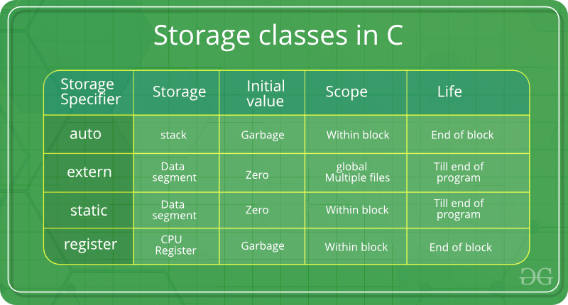
History of MISRA-C
MISRA C -2012
Session 1
Misra2012:Rule-8.8
The static storage class specifier shall be used in all declarations of objects and functions that have internal linkage
Category –Required Analysis - Decidable, Single Translation Unit Applies to - C90, C99
Mandates the use of the static storage class specifier in all declarations of objects and functions that have internal linkage.
Example
static int32_t x = 0; /* definition: internal linkage */
extern int32_t x; /* Non-compliant */
static int32_t f ( void ); /* declaration: internal linkage */
int32_t f ( void ) /* Non-compliant */
{
return 1;
}
static int32_t g ( void ); /* declaration: internal linkage */
extern int32_t g ( void ) /* Non-compliant */
{
return 1;
}

Slide 50
MISRA C -2012
Session 1
Session 1
END

