Slide 1
MISRA C -2012
Prepared by –Chiranjit Adhikary
Software Design Engineer

Slide 2
Session 3
Rules( 54-95)
The essential type model
Pointer type conversions
Operator
Control statement
Control flow
Switch statements

Slide 3
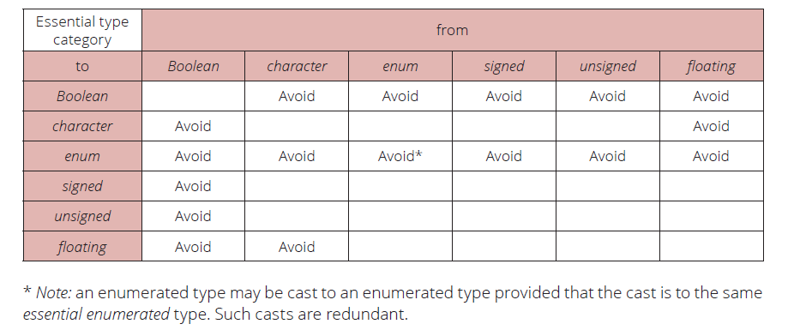
History of MISRA-C
MISRA C -2012
Session 3
Misra2012:Rule-10.5
The value of an expression should not be cast to an inappropriate essential type
Category –Advisory Analysis - Decidable, Single Translation Unit Applies to - C90, C99
The casts that should be avoided are shown in the following table, where values are cast (explicitly
converted) to the essential type category of the first column.
Example
(bool_t ) false /* Compliant - C99 'false' is essentially Boolean */
( int32_t ) 3U /* Compliant */
( bool_t ) 0 /* Compliant - by exception */
( int32_t ) ena /* Compliant */
( char ) enc /* Compliant */
( bool_t ) 3U /* Non-compliant */

Slide 4
History of MISRA-C
MISRA C -2012
Session 3
Misra2012:Rule-10.6
The value of a composite expression shall not be assigned to an object with wider essential type
Category –Required Analysis - Decidable, Single Translation Unit Applies to - C90, C99
The result of an expression to a variable that has a wider type, which can lead to unintended data widening and potential loss of information.
Example
u16c = u16a + u16b; /* Same essential type */
u32a = ( uint32_t ) u16a + u16b; /* Cast causes addiction in uint32_t */
The following are non-compliant:
u32a = u16a + u16b; /* Implicit conversion on assignment */

Slide 5
History of MISRA-C
MISRA C -2012
Session 3
Misra2012:Rule-10.7
If a composite expression is used as one operand of an operator in which the usual arithmetic conversions are performed, then the other operand shall not have wider essential type
Category –Required Analysis - Decidable, Single Translation Unit Applies to - C90, C99
Restricting implicit conversions on composite expressions means that sequences of arithmetic
operations within an expression must be conducted in the same essential type. This reduces
possible developer confusion
Example
The following are compliant:
u32a * u16a + u16b /* No composite conversion */
( u32a * u16a ) + u16b /* No composite conversion */
The following are non-compliant:
u32a * ( u16a + u16b ) /* Implicit conversion of ( u16a + u16b ) */

Slide 6
History of MISRA-C
MISRA C -2012
Session 3
Misra2012:Rule-10.7
u32a * u16a + u16b /* No comp osite conversion */
This is compliant because there is no composite conversion. The multiplication u32a * u16a is evaluated first, then the result is added to u16b. The addition does not involve a wider type than the multiplication result.
u32a * ( u16a + u16b ) /* Implicit conversion of ( u16a + u16b ) */
This is non-compliant because u16a + u16b is evaluated first, resulting in a uint16_t. When this result is multiplied by u32a, an implicit conversion occurs, promoting the uint16_t result to uint32_t.

Slide 7
History of MISRA-C
MISRA C -2012
Session 3
Misra2012:Rule-10.8
The value of a composite expression shall not be cast to a different essential type category or a wider essential type
Category –Required Analysis - Decidable, Single Translation Unit Applies to - C90, C99
Casting to a narrower type with the same essential type category is acceptable as the explicit truncation
of the result always leads to the same loss of information
Example
Compliant:
(uint16_t) (u32a + u32b); //Cast after the operation on compatible types.
(uint16_t) s32a; Simple cast without composite expression.
Non-compliant:
(uint16_t) (s32a + s32b); Different essential type categories.
(uint32_t) (u16a + u16b); Cast to a wider essential type

Slide 8
History of MISRA-C
MISRA C -2012
Session 3
Misra2012:Rule-11.1
Conversions shall not be performed between a pointer to a function and any other type
Category –Required Analysis - Decidable, Single Translation Unit Applies to - C90, C99
The MISRA C rule states that you should not perform type conversions between function pointers and any other type, including:
Converting a function pointer to an integer or vice versa.
Converting a function pointer to a data pointer (e.g., void*) or vice versa.
Converting a function pointer to a pointer of a different function type.
Example
typedef void ( *fp16 ) ( int16_t n );
typedef void ( *fp32 ) ( int32_t n );
#include <stdlib.h> /* To obtain macro-NULL */
fp16 fp1 = NULL; /* Compliant - exception 1 */
fp32 fp2 = ( fp32 ) fp1; /* Non-compliant - function
* pointer into different
* function pointer */
if ( fp2 != NULL ) /* Compliant - exception 1 */
{
}
fp16 fp3 = ( fp16 ) 0x8000; /* Non-compliant - integer into
* function pointer */

Slide 9
History of MISRA-C
MISRA C -2012
Session 3
Misra2012:Rule-11.2
Conversions shall not be performed between a pointer to an incomplete type and any other type
Category –Required Analysis - Decidable, Single Translation Unit Applies to - C90, C99
The conversion of a pointer to a function into or from any of:
• Pointer to object;
• Pointer to incomplete;
• void *
results in undefined behavior.
Example
struct s; /* Incomplete type */
struct t; /* A different incomplete type */
struct s *sp;
struct t *tp;
int16_t *ip;
#include <stdlib.h> /* To obtain macro NULL */
ip = ( int16_t * ) sp; /* Non-compliant */
sp = ( struct s * ) 1234; /* Non-compliant */
tp = ( struct t * ) sp; /* Non-compliant - casting pointer into a
* different incomplete type */
sp = NULL; /* Compliant - exception 1 */

Slide 10
History of MISRA-C
MISRA C -2012
Session 3
Misra2012:Rule-11.3
A cast shall not be performed between a pointer to an object type and a pointer to a different object type
Category –Required Analysis - Decidable, Single Translation Unit Applies to - C90, C99
Casting a pointer to an object into a pointer to a different object may result in a pointer that is not
correctly aligned, resulting in undefine behavior
Example
int32_t a = 10;
int32_t *p1 = &a;
int32_t *p2 = (int32_t *)p1; /* Compliant - casting to the same type */
int32_t a = 10;
int32_t *p1 = &a;
float *p2 = (float *)p1; /* Non-compliant - casting between different types */

Slide 11
History of MISRA-C
MISRA C -2012
Session 3
Misra2012:Rule-11.4
A conversion should not be performed between a pointer to object and an integer type
Category –Required Analysis - Decidable, Single Translation Unit Applies to - C90, C99
A pointer should not be converted into an integer.
An integer should not be converted into a pointer.
Example
uint8_t *PORTA = ( uint8_t * ) 0x0002; /* Non-compliant */
uint16_t *p;
int32_t addr = ( in t32_t ) &p; /* Non-compliant */
uint8_t *q = ( uint8_t * ) addr; /* Non-compliant */
bool_t b = ( bool_t ) p; /* Non-compliant */
enum etag { A, B } e = ( enum etag ) p; /* Non-compliant */

Slide 12
History of MISRA-C
MISRA C -2012
Session 3
Misra2012:Rule-11.5
A conversion should not be performed from pointer to void into pointer to object
Category –Required Analysis - Decidable, Single Translation Unit Applies to - C90, C99
Conversion of a pointer to void into a pointer to an object may result in a pointer that is not correctly
aligned, resulting in undefined behaviour.
Example
uint32_t *p32;
void *p;
uint16_t *p16;
p = p32; /* Compliant - pointer to uint32_t into
* pointer to void */
p16 = p; /* Non-compliant */
p = ( void * ) p16; /* Compliant */
p32 = ( uint32_t * ) p; /* Non-compliant */

Slide 13
History of MISRA-C
MISRA C -2012
Session 3
Misra2012:Rule-11.6
A cast shall not be performed between pointer to void and an arithmetic type
Category –Required Analysis - Decidable, Single Translation Unit Applies to - C90, C99
Conversion of an integer into a pointer to void may result in a pointer that is not correctly aligned,
resulting in undefined behaviour.
Example
void * p;
uint32_t u;
/* Non-compliant - implementation-defined */
p = ( void * ) 0x1234u;
/* Non-compliant - undefined */
p = ( void * ) 1024.0f;
/* Non-compliant - implementation-defined */
u = ( uint32_t ) p;

Slide 14
History of MISRA-C
MISRA C -2012
Session 3
Misra2012:Rule-11.7
A cast shall not be performed between pointer to object and a non-integer arithmetic type
Category –Required Analysis - Decidable, Single Translation Unit Applies to - C90, C99
Conversion of an essentially Boolean, essentially character, or essentially enum type into a pointer to
object may result in a pointer that is not correctly aligned, resulting in undefined behavior.
Example
int16_t * p;
float32_t f;
f = ( float32_t ) p; /* Non-compliant */
p = ( int16_t * ) f; /* Non-compliant */

Slide 15
History of MISRA-C
MISRA C -2012
Session 3
Misra2012:Rule-11.8
A cast shall not remove any const or volatile qualification from the type pointed to by a pointer
Category –Required Analysis - Decidable, Single Translation Unit Applies to - C90, C99
Any attempt to remove the qualification associated with the addressed type by using casting is a
violation of the principle of type qualification.
Example
uint16_t x;
uint16_t * const cpi = &x; // const pointer to uint16_t
uint16_t * const *pcpi; // pointer to const pointer to uint16_t
uint16_t **ppi; // pointer to pointer to uint16_t
const uint16_t *pci; // pointer to const uint16_t
volatile uint16_t *pvi; // pointer to volatile uint16_t
uint16_t *pi; // pointer to uint16_t
pi = cpi; // Compliant - no conversion, no cast required
pi = (uint16_t *)pci; // Non-compliant
pi = (uint16_t *)pvi; // Non-compliant
ppi = (uint16_t * *)pcpi; // Non-compliant

Slide 16
History of MISRA-C
MISRA C -2012
Session 3
Misra2012:Rule-11.9
The macro NULL shall be the only permitted form of integer null pointer constant
Category –Required Analysis - Decidable, Single Translation Unit Applies to - C90, C99
Using NULL rather than 0 makes it clear that a null pointer constant was intended..
Example
int32_t *p1 = 0; /* Non-compliant */
int32_t *p2 = ( void * ) 0; /* Compliant */
And
#define MY_NULL_1 0
#define MY_NULL_2 ( void * ) 0
if ( p1 == MY_NULL_1 ) /* Non-compliant */
{
}
if ( p2 == MY_NULL_2 ) /* Compliant */
{
}
Using 0 directly, as in MY_NULL_1, is non-compliant because it does not explicitly indicate a null pointer constant.
Correct Usage: MY_NULL_2, which expands to (void *)0, is compliant because it explicitly represents a null pointer constant.

Slide 17
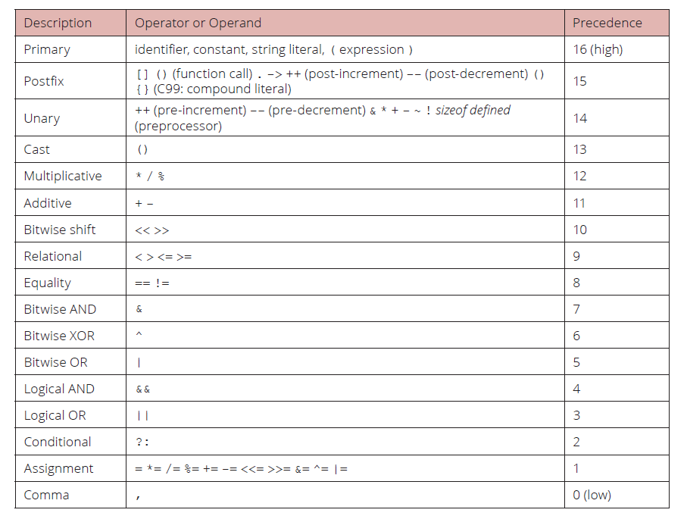
History of MISRA-C
MISRA C -2012
Session 3
Misra2012:Rule-12.1
The precedence of operators within expressions should be made explicit
Category –Advisory Analysis - Decidable, Single Translation Unit Applies to - C90, C99

Slide 18
History of MISRA-C
MISRA C -2012
Session 3
Misra2012:Rule-12.2
The right-hand operand of a shift operator shall lie in the range zero to one less than the width in bits of the essential type of the left-hand operand
Category –Required Analysis - Decidable, Single Translation Unit Applies to - C90, C99
If the right-hand operand is negative, or greater than or equal to the width of the left-hand operand,
then the behavior is undefined.
Example
u8a = u8a << 7; /* Compliant */
u8a = u8a << 8; /* Non-compliant */
u16a = ( uint16_t ) u8a << 9; /* Compliant */
To assist in understanding the following examples, it should be noted that the essential type of 1u is
essentially unsigned char, whereas the essential type of 1UL is essentially unsigned long.
1u << 10u; /* Non-compliant */
( uint16_t ) 1u << 10u; /* Compliant */
1UL << 10u; /* Compliant */

Slide 19
History of MISRA-C
MISRA C -2012
Session 3
Misra2012:Rule-12.3
The comma operator should not be used
Category –Advisory Analysis - Decidable, Single Translation Unit Applies to - C90, C99
Use of the comma operator is generally detrimental to the readability of code, and the same eff ect
can usually be achieved by other means
Example
f ( ( 1, 2 ), 3 ); /* Non-compliant - how many parameters? */

Slide 20
History of MISRA-C
MISRA C -2012
Session 3
Misra2012:Rule-12.4
Evaluation of constant expressions should not lead to unsigned integer wrap-around
Category –Advisory Analysis - Decidable, Single Translation Unit Applies to - C90, C99
Unsigned integer expressions do not strictly overflow, but instead wrap-around. Although there may
be good reasons to use modulo arithmetic at run-time, it is less likely for its use to be intentional at
compile-time
Example
In this example, the expression DELAY + WIDTH has the value 70 000 but this will wrap-around to
4 464 on a machine with a 16-bit int type.
#define DELAY 10000u
#define WIDTH 60000u
void fixed_pulse ( void )
{
uint16_t off_time16 = DELAY + WIDTH; /* Non-compliant */
}
65535 is the maximum value of an unsigned 16-bit integer.

Slide 21
History of MISRA-C
MISRA C -2012
Session 3
Misra2012:Rule-13.1
Initializer lists shall not contain persistent side effects
Category –Required Analysis - Decidable, Single Translation Unit Applies to - C99
C90 constrains the initializers for automatic objects with aggregate types to contain only constant
expressions. However, C99 permits automatic aggregate initializers to contain expressions that are
evaluated at run-time.
Example
volatile u int16_t v1;
void f ( void )
{
/* Non-compliant - volatile access is a persistent side effect */
uint16_t a[ 2 ] = { v1, 0 };
}
void g ( uint16_t x, uint16_t y )
{
/* Compliant - no side effects */
uint16_t a[ 2 ] = { x + y, x - y };
}

Slide 22
History of MISRA-C
MISRA C -2012
Session 3
Misra2012:Rule-13.2
The value of an expression and its persistent side effects shall be the same under all permitted evaluation orders
Category –Required Analysis - Decidable, Single Translation Unit Applies to –C90, C99
1. No object shall be modified more than once;
2. No object shall be both modified and read unless any such read of the object’s value
contributes towards computing the value to be stored in the object;
3. There shall be no more than one modification access with volatile-qualified type;
4. There shall be no more than one read access with volatile-qualified type.
Example
int i = i++ + 1; // i is modified twice within the same expression
i = i + (i = 2); // i is read and modified in an unpredictable manner
volatile int v;
v = v + 1; // This might involve multiple reads and writes, leading to issues
volatile int v;
int a = v + v; // Two read accesses to the volatile variable `v`

Slide 23
History of MISRA-C
MISRA C -2012
Session 3
Misra2012:Rule-13.3
A full expression containing an increment (++) or decrement (--) operator should have no other potential side effects other than that caused by the increment or decrement operator
Category –Advisory Analysis - Decidable, Single Translation Unit Applies to –C90, C99
The use of increment and decrement operators in combination with other operators is not
recommended because:
• It can significantly impair the readability of the code;
• It introduces additional side effects into a statement with the potential for undefined behaviors
(covered by Rule 13.2).
It is clearer to use these operations in isolation from any other operators.
Example
The expression:
u8a = u8b++;
is non-compliant. The non-compliant expression statement:
u8a = ++u8b + u8c--;
is clearer when written as the following sequence:
++u8b;
u8a = u8b + u8c;
u8c--;

Slide 24
History of MISRA-C
MISRA C -2012
Session 3
Misra2012:Rule-13.4
The result of an assignment operator should not be used
Category –Advisory Analysis - Decidable, Single Translation Unit Applies to –C90, C99
The use of assignment operators, simple or compound, in combination with other arithmetic operators
is not recommended because:
• It can significantly impair the readability of the code;
• It introduces additional side effects into a statement-making it more difficult to avoid the
undefined behavior covered by Rule 13.2.
Example
x = y; /* Compliant */
a[ x ] = a[ x = y ]; /* Non-compliant - the value of x = y is used */
if ( bool_var = false )
{
}
* Non-compliant - value of bool_var = false is used but
* bool_var == false was probably intended
*/
Best Practices: To maintain clarity and avoid potential bugs:
Use = for assignments (x = y;).
Use == for comparisons (if (bool_var == false))

Slide 25
History of MISRA-C
MISRA C -2012
Session 3
Misra2012:Rule-13.5
The right hand operand of a logical && or || operator shall not contain persistent side effects
Category –Required Analysis - Undecidable, System Applies to –C90, C99
If the evaluation of the right-hand operand would produce side effects that are not persistent at the point
in the program where the expression occurs then it does not matter whether the right-hand operand
is evaluated or not.
Example
void g ( void )
{
/* Compliant - f ( ) has no persistent side effects */
if ( is high && ( a == f ( x ) ) )
{
}
/* Non-compliant - h ( ) has a persistent side effect */
if ( is high && ( a == h ( x ) ) )
{
}
}
The logical expression is_high && (a == h(x)) is problematic because:
h(x) modifies state during its execution.

Slide 26
History of MISRA-C
MISRA C -2012
Session 3
Misra2012:Rule-13.6
The operand of the size of operator shall not contain any expression which has potential side effects
Category –Mandatory Analysis - Decidable, Single Translation Unit Applies to –C90, C99
The operand of a size of operator may be either an expression or may specify a type. If the operand
contains an expression, a possible programming error is to expect that expression to be evaluated
when it is actually not evaluated in most circumstances
Example
volatile int32_t i;
int32_t j;
size_t s;
s = sizeof ( j ); /* Compliant */
s = sizeof ( j++ ); /* Non-compliant */
s = sizeof ( i ); /* Compliant - exception */
s = sizeof ( int32_t ); /* Compliant */

Slide 27
History of MISRA-C
MISRA C -2012
Session 3
Misra2012:Rule-14.1
A loop counter shall not have essentially floating type
Category –Required Analysis - Undecidable, System Applies to –C90, C99
When using a floating-point loop counter, accumulation of rounding errors may result in a mismatch
between the expected and actual number of iterations. This can happen when a loop step that is not
a power of the floating-point radix is rounded to a value that can be represented.
Example
uint32_t counter = 0u;
for ( float32_t f = 0.0f; f < 1.0f; f += 0.001f )
{
++counter;
}

Slide 28
History of MISRA-C
MISRA C -2012
Session 3
Misra2012:Rule-14.2
A for loop shall be well-formed
Category –Required Analysis - Undecidable, System Applies to –C90, C99
The for-statement provides a general-purpose looping facility. Using a restricted form of loop makes
code easier to review and analyze
Example
#include <stdio.h>
int main() {
// Well-formed for loop
for (int i = 0; i < 10; i++) {
printf("%d\n", i);
}
return 0;
}
In this well-formed loop:
Initialization: The loop control variable i is initialized to 0.
Condition: The loop will continue as long as i is less than 10.
Iteration: The loop control variable i is incremented by 1 after each iteration.

Slide 29
History of MISRA-C
MISRA C -2012
Session 3
Misra2012:Rule-14.3
Controlling expressions shall not be invariant
Category –Required Analysis - Undecidable, System Applies to –C90, C99
If a controlling expression has an invariant value, it is possible that there is a programming error. Any
code that cannot be reached due to the presence of an invariant expression may be removed by the
compiler. This might have the effect of removing defensive code, for instance, from the executable.
Example
if ( 2 > 3 )
{
/* Non-compliant - always false */
}
for ( s8a = 0; s8a < 130; ++s8a )
{
/* Non-compliant - always true */
}
if ( ( s8a < 10 ) && ( s8a > 20 ) )
{
/* Non-compliant - always false */
}

Slide 30
History of MISRA-C
MISRA C -2012
Session 3
Misra2012:Rule-14.4
The controlling expression of an if statement and the controlling expression of an iteration-statement shall have essentially Boolean type
Category –Required Analysis - Decidable, Single Translation Unit Applies to –C90, C99
Strong typing requires the controlling expression of an if statement or iteration-s tatement to have
essentially Boolean type.
Example
int32_t *p, *q;
while ( p ) /* Non-compliant - p is a pointer */
{
}
while ( q != NULL ) /* Compliant */
{
}
while ( true ) /* Compliant */
{
}

Slide 31
History of MISRA-C
MISRA C -2012
Session 3
Misra2012:Rule-15.1
The goto statement should not be used
Category –Advisory Analysis - Decidable, Single Translation Unit Applies to –C90, C99
Unconstrained use of goto can lead to programs that are unstructured and extremely difficult to
understand
guidance in Rule 15.2 and Rule 15.3.

Slide 32
History of MISRA-C
MISRA C -2012
Session 3
Misra2012:Rule-15.2
The goto statement shall jump to a label declared later in the same function
Category –Required Analysis - Decidable, Single Translation Unit Applies to –C90, C99
Unconstrained use of goto can lead to programs that are unstructured and extremely difficult to
understand.
Example
void f ( void )
{
int32_t j = 0;
L1:
++j;
if ( 10 == j )
{
goto L2; /* Compliant */
}
goto L1; /* Non-compliant */
L2 :
++j;
}

Slide 33
History of MISRA-C
MISRA C -2012
Session 3
Misra2012:Rule-15.3
Any label referenced by a goto statement shall be declared in the same block, or in any block enclosing the goto statement
Category –Required Analysis - Decidable, Single Translation Unit Applies to –C90, C99
Unconstrained use of goto can lead to programs that are unstructured and extremely difficult to
understand.
Preventing jumps between blocks, or into nested blocks, helps to minimize visual code complexity.
Example
switch ( x )
{
case 0:
if ( x == y )
{
goto L1;
}
break;
case 1:
y = x;
L1:
++x;
break;
default:
break;
}
In the following example, the label L1 is defined in a block that encloses the block containing the
goto statement. However, the jump crosses from one switch clause to another, and, since switch-clauses
are treated like blocks for the purposes of this rule, the goto statement is non-compliant

Slide 34
History of MISRA-C
MISRA C -2012
Session 3
Misra2012:Rule-15.4
There should be no more than one break or goto statement used to terminate any iteration statement
Category –Advisory Analysis - Decidable, Single Translation Unit Applies to –C90, C99
Restricting the number of exits from a loop helps to minimize visual code complexity. The use of one
break or goto statement allows a single secondary exit path to be created when early loop termination
is required
Example
for ( x = 0; x < LIMIT; ++x )
{
if ( ExitNow ( x ) )
{
break;
}
for ( y = 0; y < x; ++y )
{
if ( Exit Now ( LIMIT - y ) )
{
break;
}
}
}
Both of the following nested loops are compliant as each has a single break used for early loop
termination

Slide 35
History of MISRA-C
MISRA C -2012
Session 3
Misra2012:Rule-15.5
A function should have a single point of exit at the end
Category –Advisory Analysis - Decidable, Single Translation Unit Applies to –C90, C99
If a function has exit points interspersed with statements that produce persistent side effects, it is not
easy to determine which side effects will occur when the function is executed.
Example
bool_t f ( uint16_t n, char *p )
{
if ( n > MAX )
{
return false;
}
if ( p == NULL )
{
return false;
}
return true;
}
In the following non-compliant code example, early returns are used to validate the function
parameters

Slide 36
History of MISRA-C
MISRA C -2012
Session 3
Misra2012:Rule-15.6
The body of an iteration-statement or a selection-statement shall be a compound- statement
Category –Required Analysis - Decidable, Single Translation Unit Applies to –C90, C99
The body of an iteration statement (while, do … while or for) or a selection -statement (if, else, switch) shall
be a compound-statement.
Example
when the actual behavior is
if ( flag_1 )
{
if ( flag_2 )
{
action_1 ( );
}
else
{
action_2 ( );
}
if ( flag_1 )
if ( flag_2 ) /* Non-compliant */
action_1 ( ); /* Non-compliant */
else
action_2 ( ); /* Non-compliant */

Slide 37
History of MISRA-C
MISRA C -2012
Session 3
Misra2012:Rule-15.7
All if ... else if constructs shall be terminated with an else statement
Category –Required Analysis - Decidable, Single Translation Unit Applies to –C90, C99
A final else statement shall always be provided whenever an if statement is followed by a sequence
of one or more else if constructs. The else statement shall contain at least either one side effect or a
comment.
Example
if ( flag_1 )
{
action_1 ( );
}
else if ( flag_2 )
{
action_2 ( );
}
/* Non-compliant */
The following shows a compliant terminating else.
else
{
; /* No action required - ; is optional */
}

Slide 38
History of MISRA-C
MISRA C -2012
Session 3
Misra2012:Rule-16.1
All switch statements shall be well-formed
Category –Required Analysis - Decidable, Single Translation Unit Applies to –C90, C99
The syntax for the switch statement in C is not particularly rigorous and can allow complex, unstructured
behavior. This and other rules impose a simple and consistent structure on the switch statement.
Example
The remaining rules in this section give examples that are also relevant to this rule.

Slide 39
History of MISRA-C
MISRA C -2012
Session 3
Misra2012:Rule-16.2
A switch label shall only be used when the most closely-enclosing compound statement is the body of a switch statement
Category –Required Analysis - Decidable, Single Translation Unit Applies to –C90, C99
The Standard permits a switch label, i.e. a case label or default label, to be placed before any statement
contained in the body of a switch statement, potentially leading to unstructured code. In order to
prevent this, a switch label shall only appear at the outermost level of the compound statement
forming the body of a switch statement.
Example
switch ( x )
{
case 1: /* Compliant */
if ( flag )
{
case 2: /* Non-compliant */
x = 1;
}
break;
default:
break;
}

Slide 40
History of MISRA-C
MISRA C -2012
Session 3
Misra2012:Rule-16.3
An unconditional break statement shall terminate every switch-clause
Category –Required Analysis - Decidable, Single Translation Unit Applies to –C90, C99
if the switch-clause is a compound statement, the last statement in the compound
statement shall be a break statement.
Example
switch ( x )
{
case 0:
break; /* Compliant - unconditional break */
case 1: /* Compliant - empty fall through allows a group */
case 2:
break; /* Compliant */
case 4:
a = b; /* Non-compliant - break omitted */
case 5:
if ( a == b )
{
++a;
break; /* Non-compliant - conditional break */
}
break; /* Compliant - moved unconditional break outside of if */
default:
; /* Non-compliant - default must also have a break */
}

Slide 41
History of MISRA-C
MISRA C -2012
Session 3
Misra2012:Rule-16.4
Every switch statement shall have a default label
Category –Required Analysis - Decidable, Single Translation Unit Applies to –C90, C99
The requirement for a default label is defensive programming. Any statements following the default
label is intended to take some appropriate action.
Example
int16_t x;
switch ( x )
{
case 0:
++x;
break;
case 1:
case 2:
break;
/* Non-compliant - default label is required */
}
default:
break; /* Compliant - added unconditional break */

Slide 42
History of MISRA-C
MISRA C -2012
Session 3
Misra2012:Rule-16.5
A default label shall appear as either the first or the last switch label of a switch statement
Category –Required Analysis - Decidable, Single Translation Unit Applies to –C90, C99
This rule makes it easy to locate the de fault label within a switch statement
Example
switch ( x )
{
default: /* Compliant - default is the first label */
case 0:
++x;
break;
case 1:
case 2:
break;
}

Slide 43
History of MISRA-C
MISRA C -2012
Session 3
Misra2012:Rule-16.5
Every switch statement shall have at least two switch-clauses
Category –Required Analysis - Decidable, Single Translation Unit Applies to –C90, C99
A switch statement with a single path is redundant and may be indicative of a programming error.
Example
switch ( z )
{
case 1:
z = 2;
break;
default: /* Compliant */
z = 0;
break;
}
switch ( x )
{
default: /* Non-compliant - switch is redundant */
x = 0;
break;
}

Slide 44
History of MISRA-C
MISRA C -2012
Session 3
Misra2012:Rule-16.7
A switch-expression shall not have essentially Boolean type
Category –Required Analysis - Decidable, Single Translation Unit Applies to –C90, C99
The Standard requires the controlling expression of a switch statement to have an integer type. Since
the type that is used to implement Boolean values is an integer, it is possible to have a switch statement
controlled by a Boolean expression. In this instance an if-else construct would be more appropriate.
Example
switch ( x == 0 ) /* Non-compliant - essentially Boolean */
{ /* In this case an "if-else" would be more logical */
case false:
y = x;
break;
default:
y = z;
break;
}

Slide 45
History of MISRA-C
MISRA C -2012
Session 3
Session 3
END

