Slide 1
MISRA C -2012
Prepared by –Chiranjit Adhikary
Software Design Engineer

Slide 2
Session 2
Rules( 39-53)

Slide 3
MISRA C -2012
MISRA C -2012
Session 2
Misra2012:Rule-8.9
An object should be defined at block scope if its identifier only appears in a single function
Category –Advisory Analysis - Decidable, System
Defining an object at block scope reduces the possibility that the object might be accessed inadvertently
and makes clear the intention that it should not be accessed elsewhere.
Example
In this compliant example, i is declared at block scope because it is a loop counter. There is no need
for other functions in the same file to use the same object for any other purpose.
void func ( void )
{
int32_t i;
for ( i = 0; i < N; ++i )
{
}
}

Slide 4
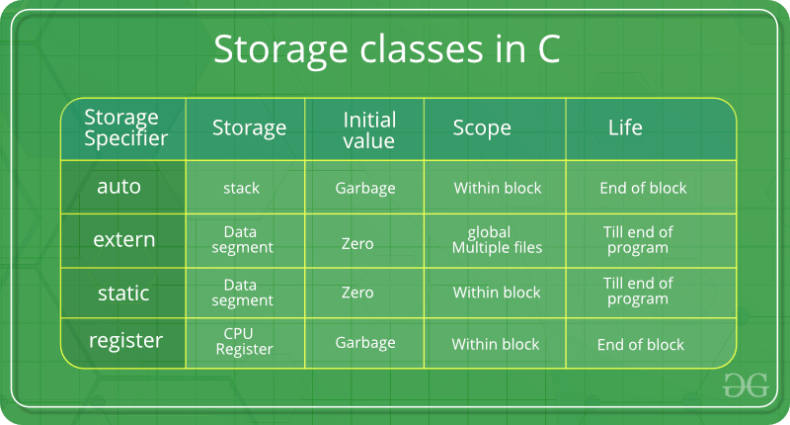
MISRA C -2012
MISRA C -2012
Session 2
Misra2012:Rule-8.10
An inline function shall be declared with the static storage class
Category –Required Analysis - Decidable, Single Translation Unit
Rule 8.10 states that an inline function should be declared with the static storage class.
Example
// File: math_utils.h
#ifndef MATH_UTILS_H
#define MATH_UTILS_H
static inline int add(int a, int b) {
return a + b;
}
#endif // MATH_UTILS_H
Inline Function are those function whose definitions are small and be substituted at the place where its function call is happened
Note: an inline function can be made available to several translation units by placing its definition in a
header file.

Slide 5
MISRA C -2012
MISRA C -2012
Session 2
Misra2012:Rule-8.11
When an array with external linkage is declared, its size should be explicitly specified
Category –Advisory Analysis - Decidable, Single Translation Unit
Although it is possible to declare an array with incomplete type and access its elements, it is safer
to do so when the size of the array may be explicitly determined.
Example
extern int32_t array1[ 10 ]; /* Compliant */
extern int32_t array2[ ]; /* Non-compliant */

Slide 6
MISRA C -2012
MISRA C -2012
Session 2
Misra2012:Rule-8.12
Within an enumerator list, the value of an implicitly-specified enumeration constant shall be unique
Category –Required Analysis - Decidable, Single Translation Unit
An explicitly-specified enumeration constant has the value of the associated constant expression.
Example
/* Non-compliant
enum Color {
RED = 0, // Value: 0
GREEN = 1, // Value: 1
BLUE = 1, // Value: 2(Violation: Not unique)
YELLOW = 3 // Value: 3
};
/* Compliant */
enum Color {
RED = 0, // Value: 0
GREEN = 1, // Value: 1
BLUE = 2, // Value: 2 (Distinct from GREEN)
YELLOW = 3 // Value: 3
};

Slide 7
MISRA C -2012
MISRA C -2012
Session 2
Misra2012:Rule-8.13
A pointer should point to a const-qualified type whenever possible
Category –Advisory Analysis - Decidable, System
This rule encourages best practice by ensuring that pointers are always use const-qualified type
Example
In the following non-compliant example, p is not used to modify an object but the type to which it
points is not const-qualified.
uint16_t f ( uint16_t *p )
{
return *p;
}
The code would be compliant if the function were defined with:
uint16_t f ( const uint16_t *p )
Using const-qualified pointers helps improve code safety, maintainability,
and readability by enforcing intended behavior and preventing accidental modifications of data.

Slide 8
MISRA C -2012
MISRA C -2012
Session 2
Misra2012:Rule-8.13
Example
#include <stdio.h>
int main() {
const int number = 10; // Declare a const-qualified variable
const int *ptr = &number; // Declare a const-qualified pointer
// Attempting to modify the data pointed to by the pointer will result in a compilation error
// *ptr = 20; // This line will result in a compilation error
printf("Value of number: %d\n", *ptr); // Output: Value of number: 10
return 0;
}

Slide 9
MISRA C -2012
MISRA C -2012
Session 2
Misra2012:Rule-8.14
The restrict type qualifier shall not be used
Category –Required Analysis - Decidable, Single Translation Unit
There is a significant risk that a compiler will generate code that does not behave as expected if restrict
is used incorrectly.
Example
The following example is non-compliant because a function has been defined using restrict.
void add_arrays(int n, int *restrict a, int *restrict b, int *restrict result) {
for (int i = 0; i < n; i++) {
result[i] = a[i] + b[i]; Aliasing occurs when two or more pointers refer to the same memory location
a[i] = result[i]; // Potential aliasing issue
}
}
This results in undefined behavior, as modifying ‘a’ would also affect result,
leading to unexpected behavior or crashes.
When you use restrict, you're essentially telling the compiler that the pointer is "restricted"
and that it doesn't alias with any other pointer in the same scope.

Slide 10
MISRA C -2012
MISRA C -2012
Session 2
Misra2012:Rule-9.1
The value of an object with automatic storage duration shall not be read before it has been set
Category –Mandatory Analysis - Undecidable, System
According to The Standard, objects with static storage duration are automatically initialized to zero
unless initialized explicitly. Objects with automatic storage duration are not automatically initialized
and can therefore have indeterminate values..
Example
void f ( bool_t b, uint16_t *p )
{
if ( b )
{
*p = 3U;
}
}
void g ( void )
{
uint16_t u; // uint16_t u = 0U; // Initialize u to a known value
f ( false, &u );
if ( u == 3U )
{
/* Non-compliant - u has not been assigned a value */
}
}

Slide 11
MISRA C -2012
MISRA C -2012
Session 2
Misra2012:Rule-9.2
The initializer for an aggregate or union shall be enclosed in braces
Category –Required Analysis - Decidable, Single Translation Unit
Using braces to indicate initialization of sub objects improves the clarity of code and forces programmers
to consider the initialization of elements in complex data structures such as multi-dimensional arrays
or arrays of structures
Example
int16_t y[ 3 ][ 2 ] = { 1, 2, 0, 0, 5, 6 }; /* Non-compliant */
int16_t y[ 3 ][ 2 ] = { { 1, 2 }, { 0 }, { 5, 6 } }; /* Compliant */
int16_t y[ 3 ][ 2 ] = { { 1, 2 }, { 0, 0 }, { 5, 6 } }; /* Compliant */
struct s1 {
uint16_t len;
char buf[ 8 ]; /* Compliant - buf initialized implicitly */
} s[ 3 ] = {
{ 5u, { 'a', 'b', 'c', 'd', 'e', '\0', '\0', '\0' } },
{ 2u, { 0 } },
{ .len = 0u }
}; /* Compliant - s[ ] fully initialized */

Slide 12
MISRA C -2012
MISRA C -2012
Session 2
Misra2012:Rule-9.3
Arrays shall not be partially initialized
Category –Required Analysis - Decidable, Single Translation Unit
Providing an explicit initialization for each element of an array makes it clear that every element has
been considered
Example
/* Compliant */
int32_t x[ 3 ] = { 0, 1, 2 };
/* Non-compliant - y[ 2 ] is implicitly initialized */
int32_t y[ 3 ] = { 0, 1 };
/* Non-compliant - t[ 0 ] and t[ 3 ] are implicitly initialized */
float32_t t[ 4 ] = { [ 1 ] = 1.0f, 2.0f };
/* Compliant - designated initializers for sparse matrix */
float32_t z[ 50 ] = { [ 1 ] = 1.0f, [ 25 ] = 2.0f };

Slide 13
MISRA C -2012
MISRA C -2012
Session 2
Misra2012:Rule-9.4
An element of an object shall not be initialized more than once
Category –Mandatory Analysis - Decidable, Single Translation Unit
To allow sparse arrays and structures, it is acceptable to only initialize those which are
necessary to the application.
Example
Repeated designated initializer element values overwrite earlier ones
* Non-compliant - a3 is -5, -4, -2, 0, -1
*/
int16_t a3[ 5 ] = { [ 0 ] = -5, [ 1 ] = -4, [ 2 ] = -3,
[ 2 ] = -2, [ 4 ] = -1 };
* Similar behavior using designated initializers
* Compliant - a2 is -5, -4, -3, -2, -1
*/
int16_t a2[ 5 ] = { [ 0 ] = -5, [ 1 ] = -4, [ 2 ] = -3,
[ 3 ] = -2, [ 4 ] = -1 };

Slide 14
MISRA C -2012
MISRA C -2012
Session 2
Misra2012:Rule-9.5
Where designated initializers are used to initialize an array object the size of the array shall be specified explicitly
Category –Mandatory Analysis - Decidable, Single Translation Unit Applies to - C99
To make the intent clear, the array size shall be declared explicitly
Example
/* Non-compliant - probably unintentional to have a single element */
int a1[ ] = { [ 0 ] = 1 };
/* Compliant */
int a2[ 10 ] = { [ 0 ] = 1 };

Slide 15
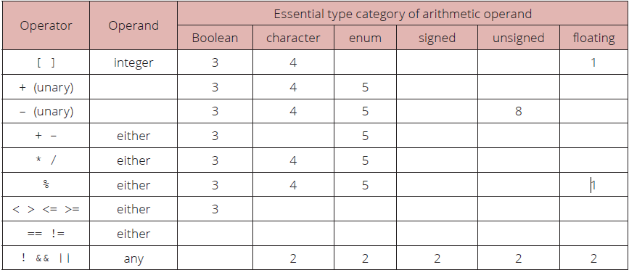
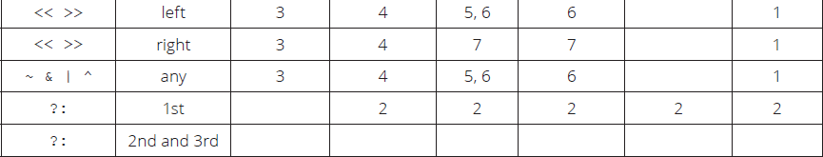
MISRA C -2012
MISRA C -2012
Session 2
Misra2012:Rule-10.1
Operands shall not be of an inappropriate essential type
Category –Mandatory Analysis - Decidable, Single Translation Unit

Slide 16
MISRA C -2012
MISRA C -2012
Session 2
Misra2012:Rule-10.1
Example
1. The use of an expression of essentially floating type for these operands is a constraint violation.
f32a & 2U /* Rationale 1 - constraint violation */
f32a << 2 /* Rationale 1 - constraint violation */
2. An expression of essentially Boolean type should always be used where an operand is
interpreted as a Boolean value.
cha && bla /* Rationale 2 - char type used as a Boolean value */
s8a && bla /* Rationale 2 - signed type used as a Boolean value */
f32a && bla /* Rationale 2 - floating type used as a Boolean value */
3. An operand of essentially Boolean type should not be used where an operand is interpretedas a numeric value.
bla * blb /* Rationale 3 - Boolean used as a numeric value */
bla > blb /* Rationale 3 - Boolean used as a numeric value */

Slide 17
MISRA C -2012
MISRA C -2012
Session 2
Misra2012:Rule-10.1
Example
4. An operand of essentially character type should not be used where an operand is
Interpreted as a numeric value. The numeric values of character data are implementation-defined.
cha & chb /* Rationale 4 - char type used as a numeric value */
cha << 1 /* Rationale 4 - char type used as a numeric value */
5. An operand of essentially enum type should not be used in an arithmetic operation because an enum object uses an implementation-defined integer type. An operation involving an Enum object may therefore yield a result with an unexpected type. Note that an enumeration Constant from an anonymous enum has essentially a signed type.
ena-- /* Rationale 5 - enum type used in arithmetic operation */
ena * a1 /* Rationale 5 - enum type used in arithmetic operation */

Slide 18
MISRA C -2012
MISRA C -2012
Session 2
Misra2012:Rule-10.1
Example
6. Shift and bitwise operations should only be performed on operands of essentially unsigned
type. The numeric value resulting from their use on essentially signed types is implementation defiend.
s8a & 2 /* Rationale 6 - bitwise operation on signed type */
50 << 3U /* Rationale 6 - shift operation on signed type */
7. The right-hand operand of a shift operator should be of essentially unsigned type to ensure that undefined behaviour does not result from a negative shift.
u8a << s8a /* Rationale 7 - shift magnitude uses signed type */
u8a << -1 /* Rationale 7 - shift magnitude uses signed type */
8. An operand of essentially unsigned type should not be used as the operand to the unary minus operator, as the signedness of the result is determined by the implemented size of int.
-u8a /* Rationale 8 - unary minus on unsigned type */

Slide 19
MISRA C -2012
MISRA C -2012
Session 2
Misra2012:Rule-10.2
Expressions of essentially character type shall not be used inappropriately in addition
and subtraction operations
Category –Required Analysis - Decidable, Single Translation Unit
This guideline aims to prevent potential confusion and unintended behavior arising from mixing characters with numeric operations, as the numeric values of character data are implementation-defined.
Example
The following examples are non-compliant:
s16a - 'a'
'0' + f32a
cha + ':'
cha - ena

Slide 20
MISRA C -2012
MISRA C -2012
Session 2
Misra2012:Rule-10.3
The value of an expression shall not be assigned to an object with a narrower essential type or of a different essential type category
Category –Required Analysis - Decidable, Single Translation Unit
We should ensure that assignments are made between compatible types, or if narrowing or different type conversions are necessary, they should be performed explicitly using appropriate type conversion operators or functions.
Example
The following are non-compliant as they have diff erent essential type categories:
uint8_t u8a = 1.0f; /* unsigned and floating */
bool_t bla = 0; /* boolean and signed */
cha = 7; /* character and signed */
u8a = 'a'; /* unsigned and character */
u8b = 1 - 2; /* unsigned and signed */
u8c += 'a'; /* u8c = u8c + 'a' assigns character to unsigned */
use_uint32 ( s32a ); /* signed and unsigned */

Slide 21
MISRA C -2012
MISRA C -2012
Session 2
Misra2012:Rule-10.4
Both operands of an operator in which the usual arithmetic conversions are performed shall have the same essential type category
Category –Required Analysis - Decidable, Single Translation Unit
We should ensure that both operands of an operator in arithmetic expressions have the same essential type category. If necessary, explicitly convert one or both operands to a common type before performing the operation to maintain consistency and predictability in the code.
Example
The following are non-compliant as they have different essential type categories:
The following are non-compliant:
u8b + 2 /* unsigned and signed */
enb > A1 /* enum<enumb> and enum<enuma> */
ena == enb /* enum<enuma> and enum<enumb> */
u8a += cha /* unsigned and char */
The following are compliant a s they have the same essential type category:
enum enuma { A1, A2, A3 } ena;
enum enumb { B1, B2, B3 } enb;
ena > A1
u8a + u16b

Slide 22
MISRA C -2012
Session 2
Session 2
END

