Slide 1
Changelog
Changelog:
V5.1 Date 10.6.26
Added resources and summary page prompts
V5.0 Date 3.27.26
Added “Level Up” Field Maps
Updated Calendar Pages
V4.0 Date 3.27.25
Added “Level Up” Field Maps
Updated Calendar Pages
V3.0 Date 6.10.24
Added “Rapid Relay” Field Map
Updated Calendar pages
V2.1 Date 6.12.23
Added new calendar and planner layouts starting on slide 21. These are not in the “layouts” dropdown, so if you delete one by mistake you will need to copy it from the template again. This keeps the layout options from getting too crowded.
Added more customizable front covers. There is an option with black text for lighter colors and an option with white text for darker colors.
Moved extra controller map and brain map assets to parts library document
Changed the divider page to be customizable.
V2.0 Date 5.16.23
Added second title page template for additional customizability
Added new template pages for controller map & brain map
Added “Full Volume” Field Maps
You can delete this page from your Team’s notebook!
Christine G.
10/06/2026
01

Slide 2
Season Summary Page
New this Season: Summary Pages
When your team is judged at an event, you submit three short summaries alongside your Engineering Notebook: a Season Summary, a Code Summary, and a Credit Summary.
For more information on summary pages, click here

Slide 3
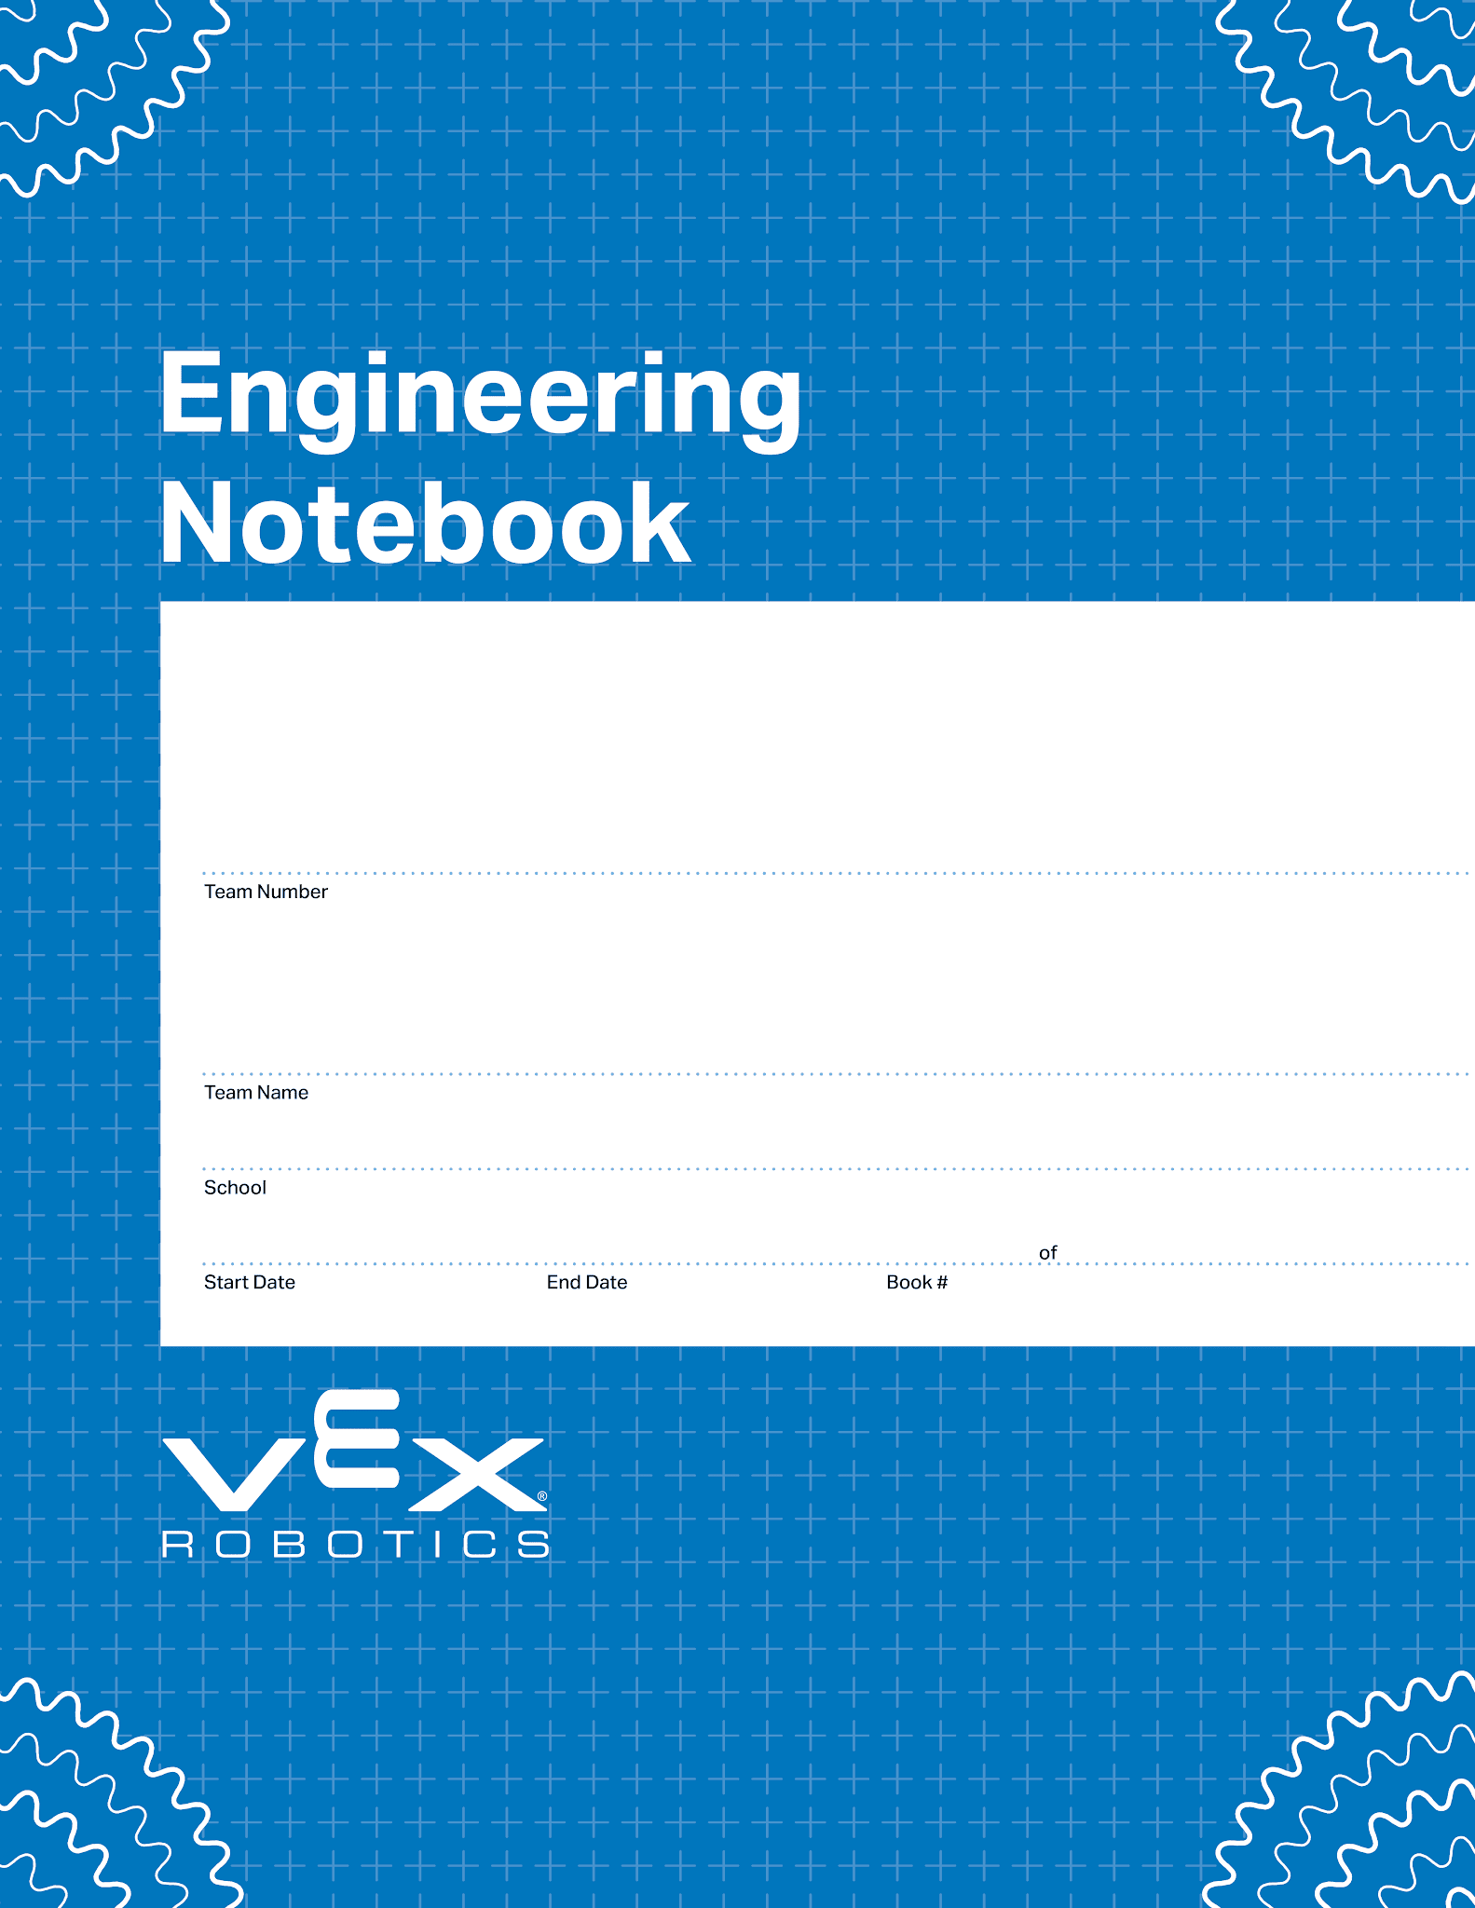
This is the basic notebook cover page.
0000
Your Team Name Here
Your School Name Here
00/00/0000
00/00/0000
1
1
V5.1 Date 10.12.26

Slide 4
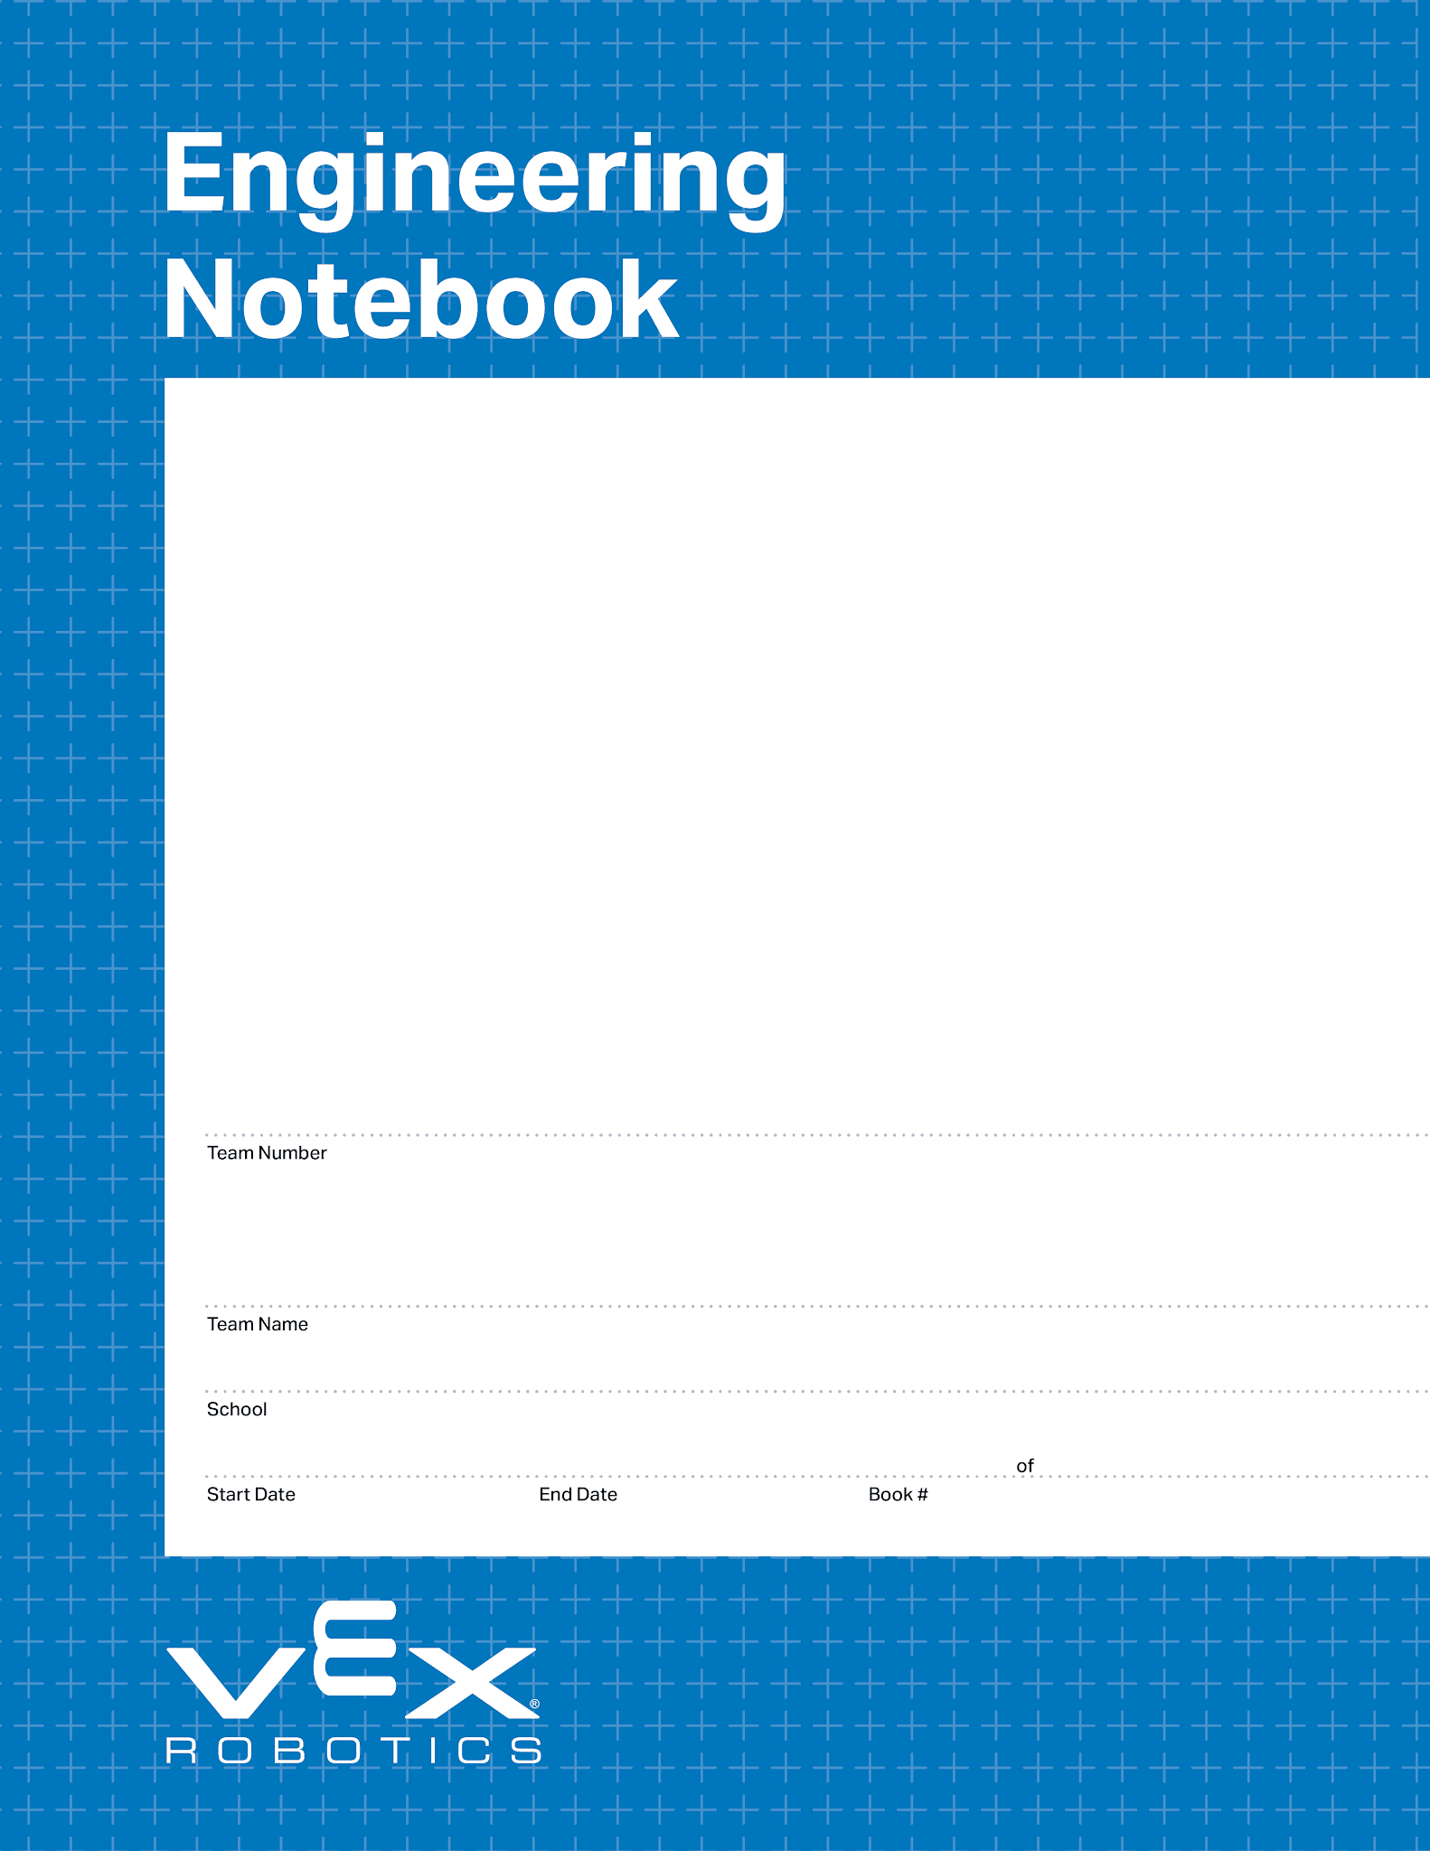
This is an alternate front page.
Place a team photo or other information here.
0000
Your Team Name Here
Your School Name Here
00/00/0000
00/00/0000
1
1
V5.1 Date 10.12.26

Slide 5
This is an alternate front page.
Place a team photo or other information here.
Right click me and select “Format Background” and then choose your team’s favorite color!
0000
Your Team Name Here
Your School Name Here
00/00/0000
00/00/0000
1
1
V5.1 Date 10.12.26

Slide 6
This is an alternate front page.
Place a team photo or other information here.
Right click me and select “Format Background” and then choose your team’s favorite color!
0000
Your Team Name Here
Your School Name Here
00/00/0000
00/00/0000
1
1
V5.1 Date 10.12.26

Slide 7
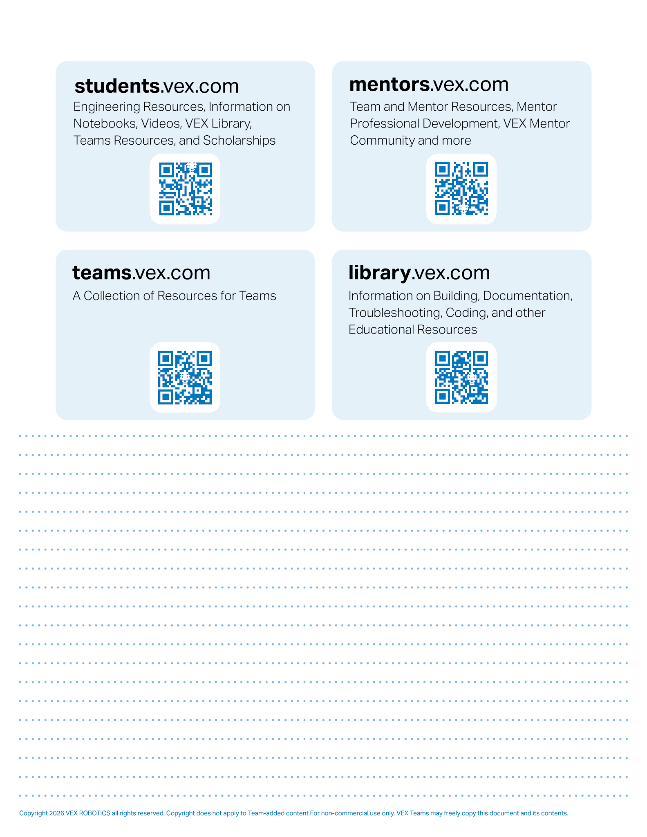
Resources
engineering.vex.com
notebooking.vex.com
coding.vex.com
vex.com
VIQRC 2026-2027 Game - Rules & Game Video
Engineering Notebook Rubric
Student-Friendly Engineering Notebook Rubric
Send suggestions and comments about these Digital Notebooks and Digital Parts
to notebooks@vex.com

Slide 8
12345 Title Title Title Date Date Date

Slide 11
Section A

Slide 16
Port
Port
Port
Port
Port
Port
Port
Port
Port
Port
Port
Port

Slide 17
Bumper
Bumper
Bumper
Bumper
Stick
Stick
Stick
Stick
Stick
Stick
Button
Button
Button
Button

Slide 18
“Level Up” Blank Field

Slide 19



“Level Up” Starting Field with Moveable Game Objects

Slide 20
“Level Up” Starting Field with Static Game Objects

Slide 21
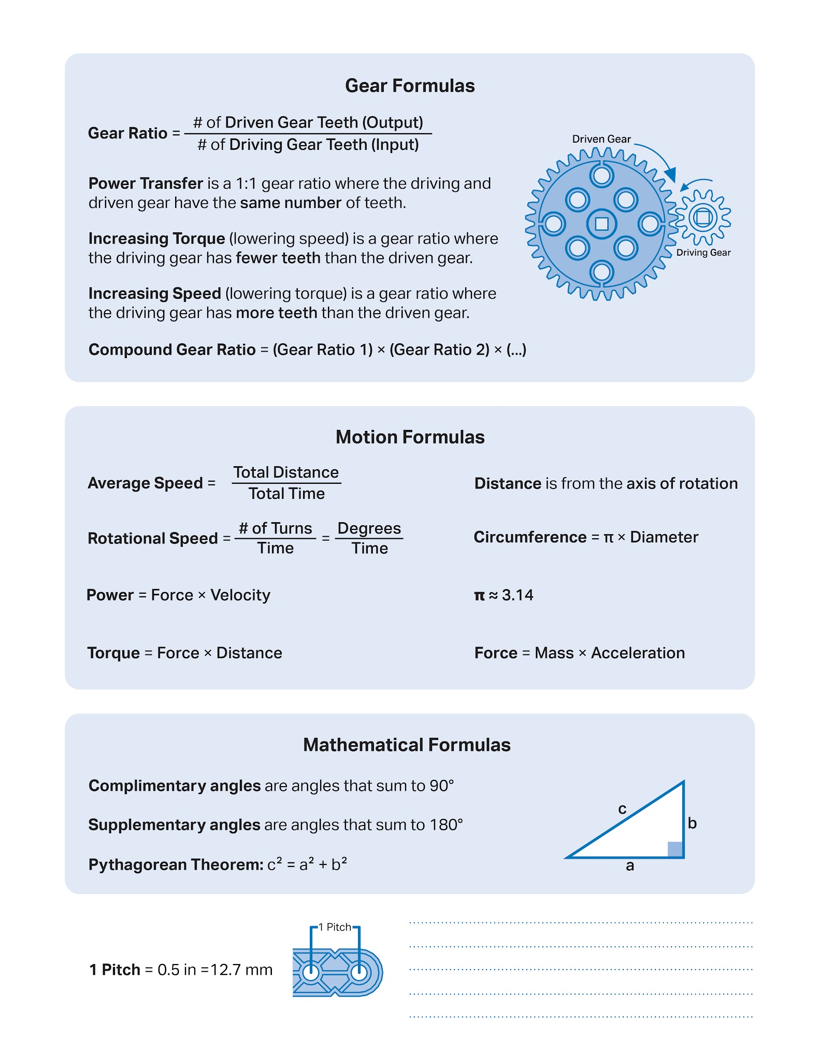

Slide 22
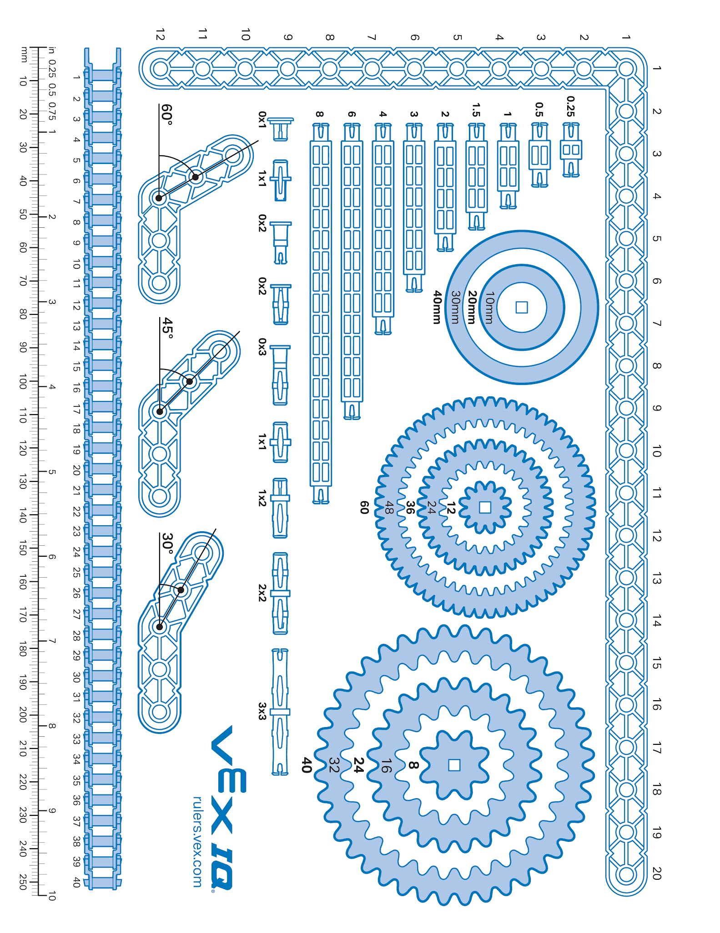

Slide 23
Week of: MM/DD/YYYY

Slide 24
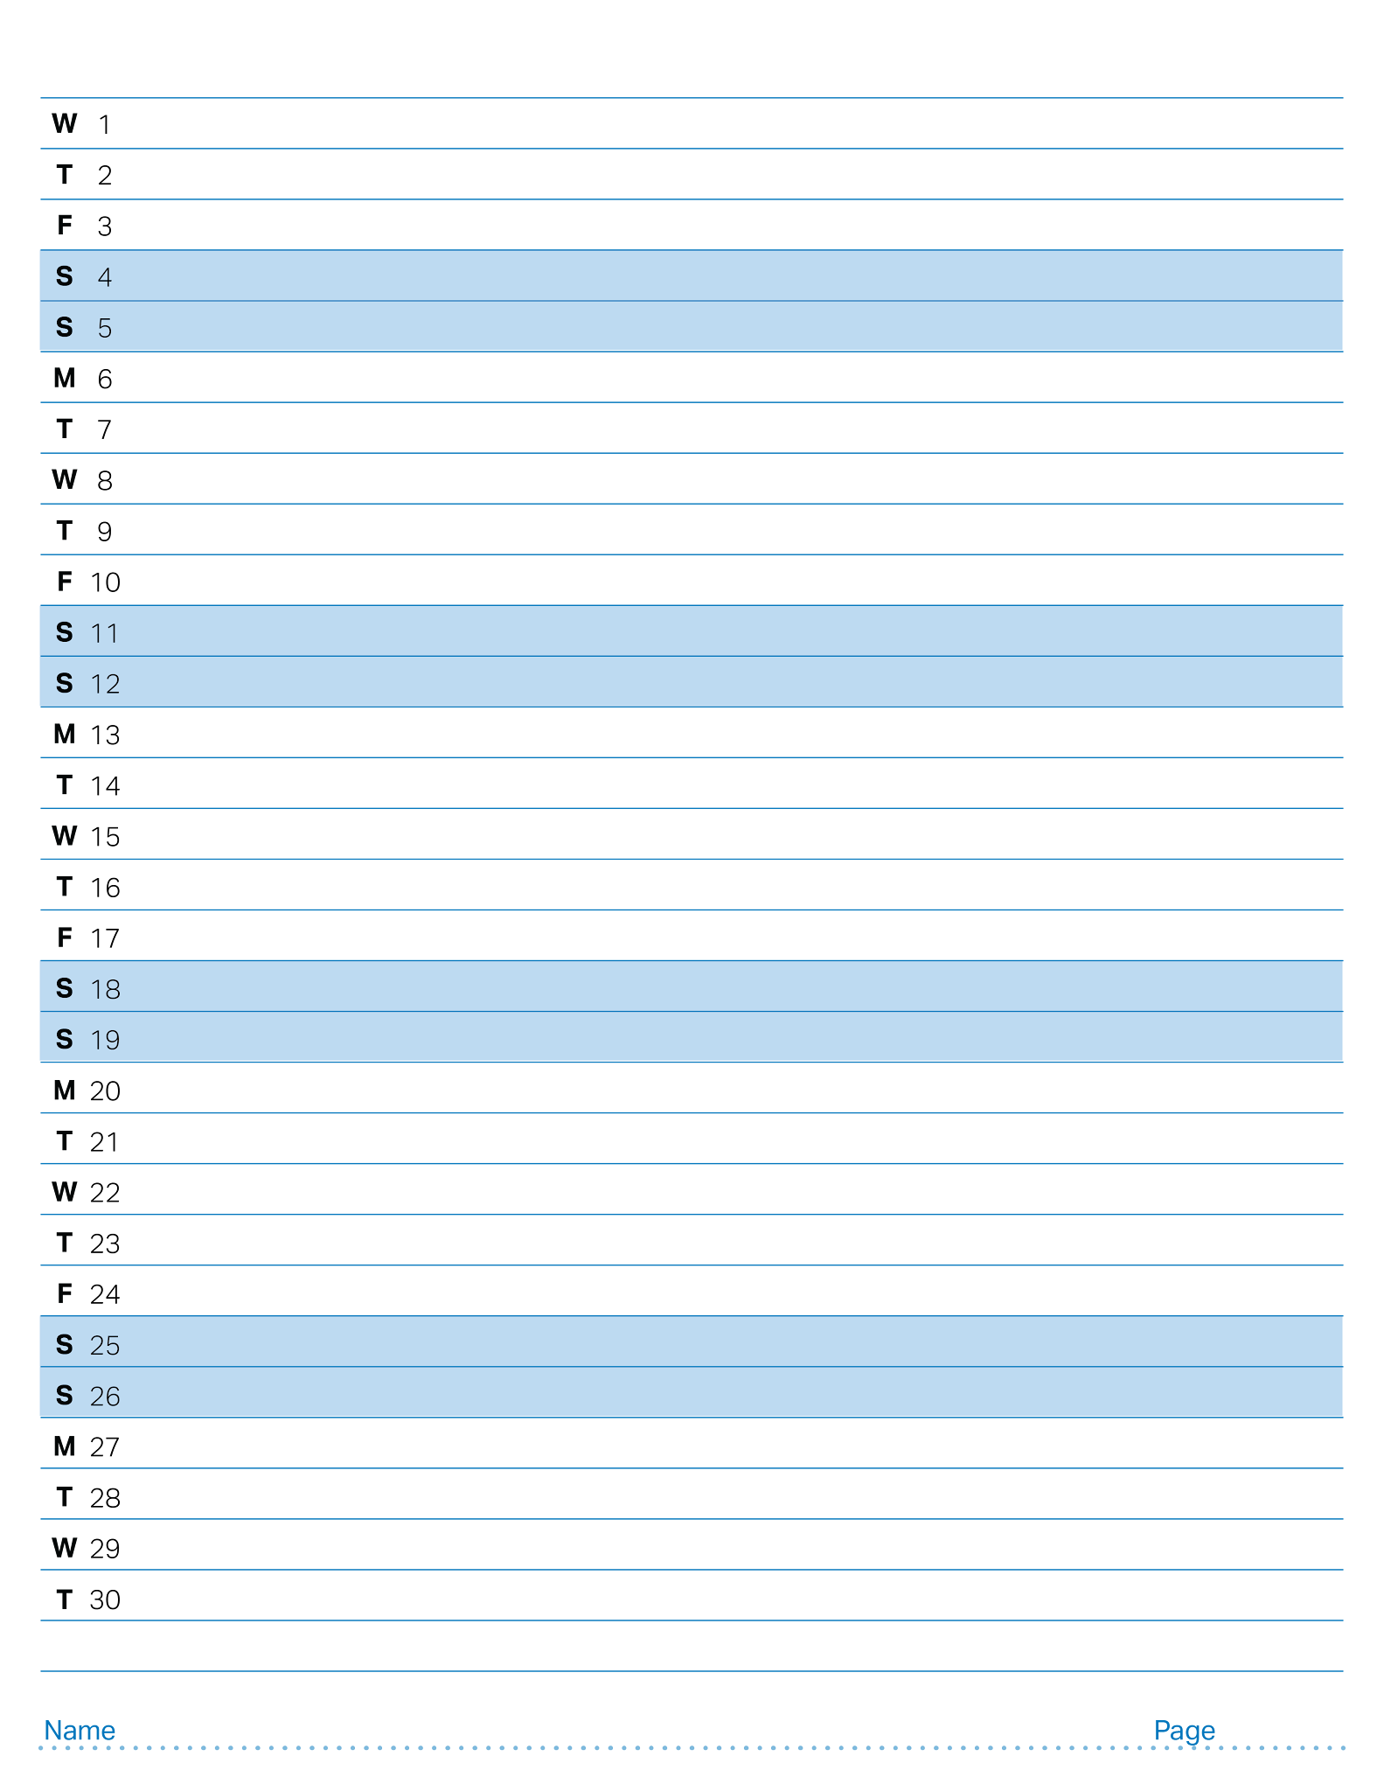
April 2026

Slide 25
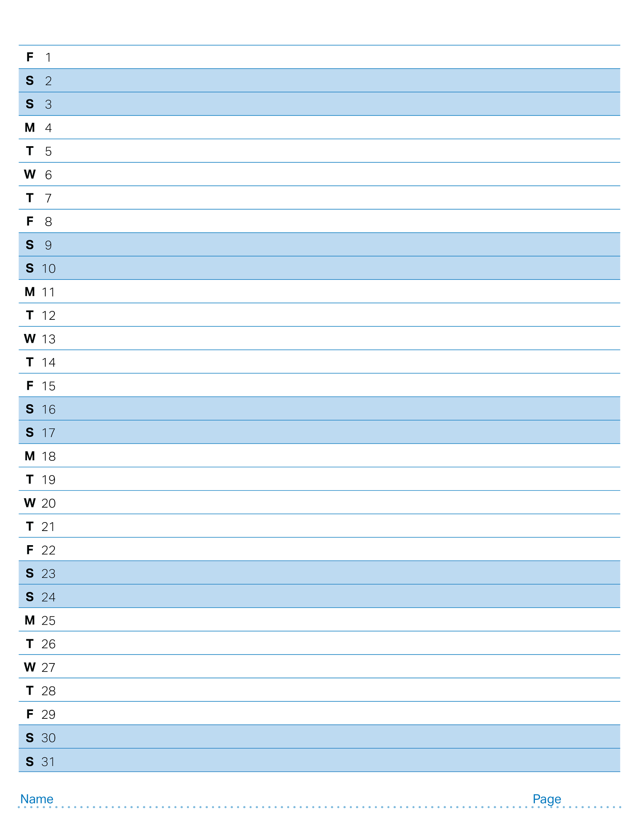
May 2026

Slide 26
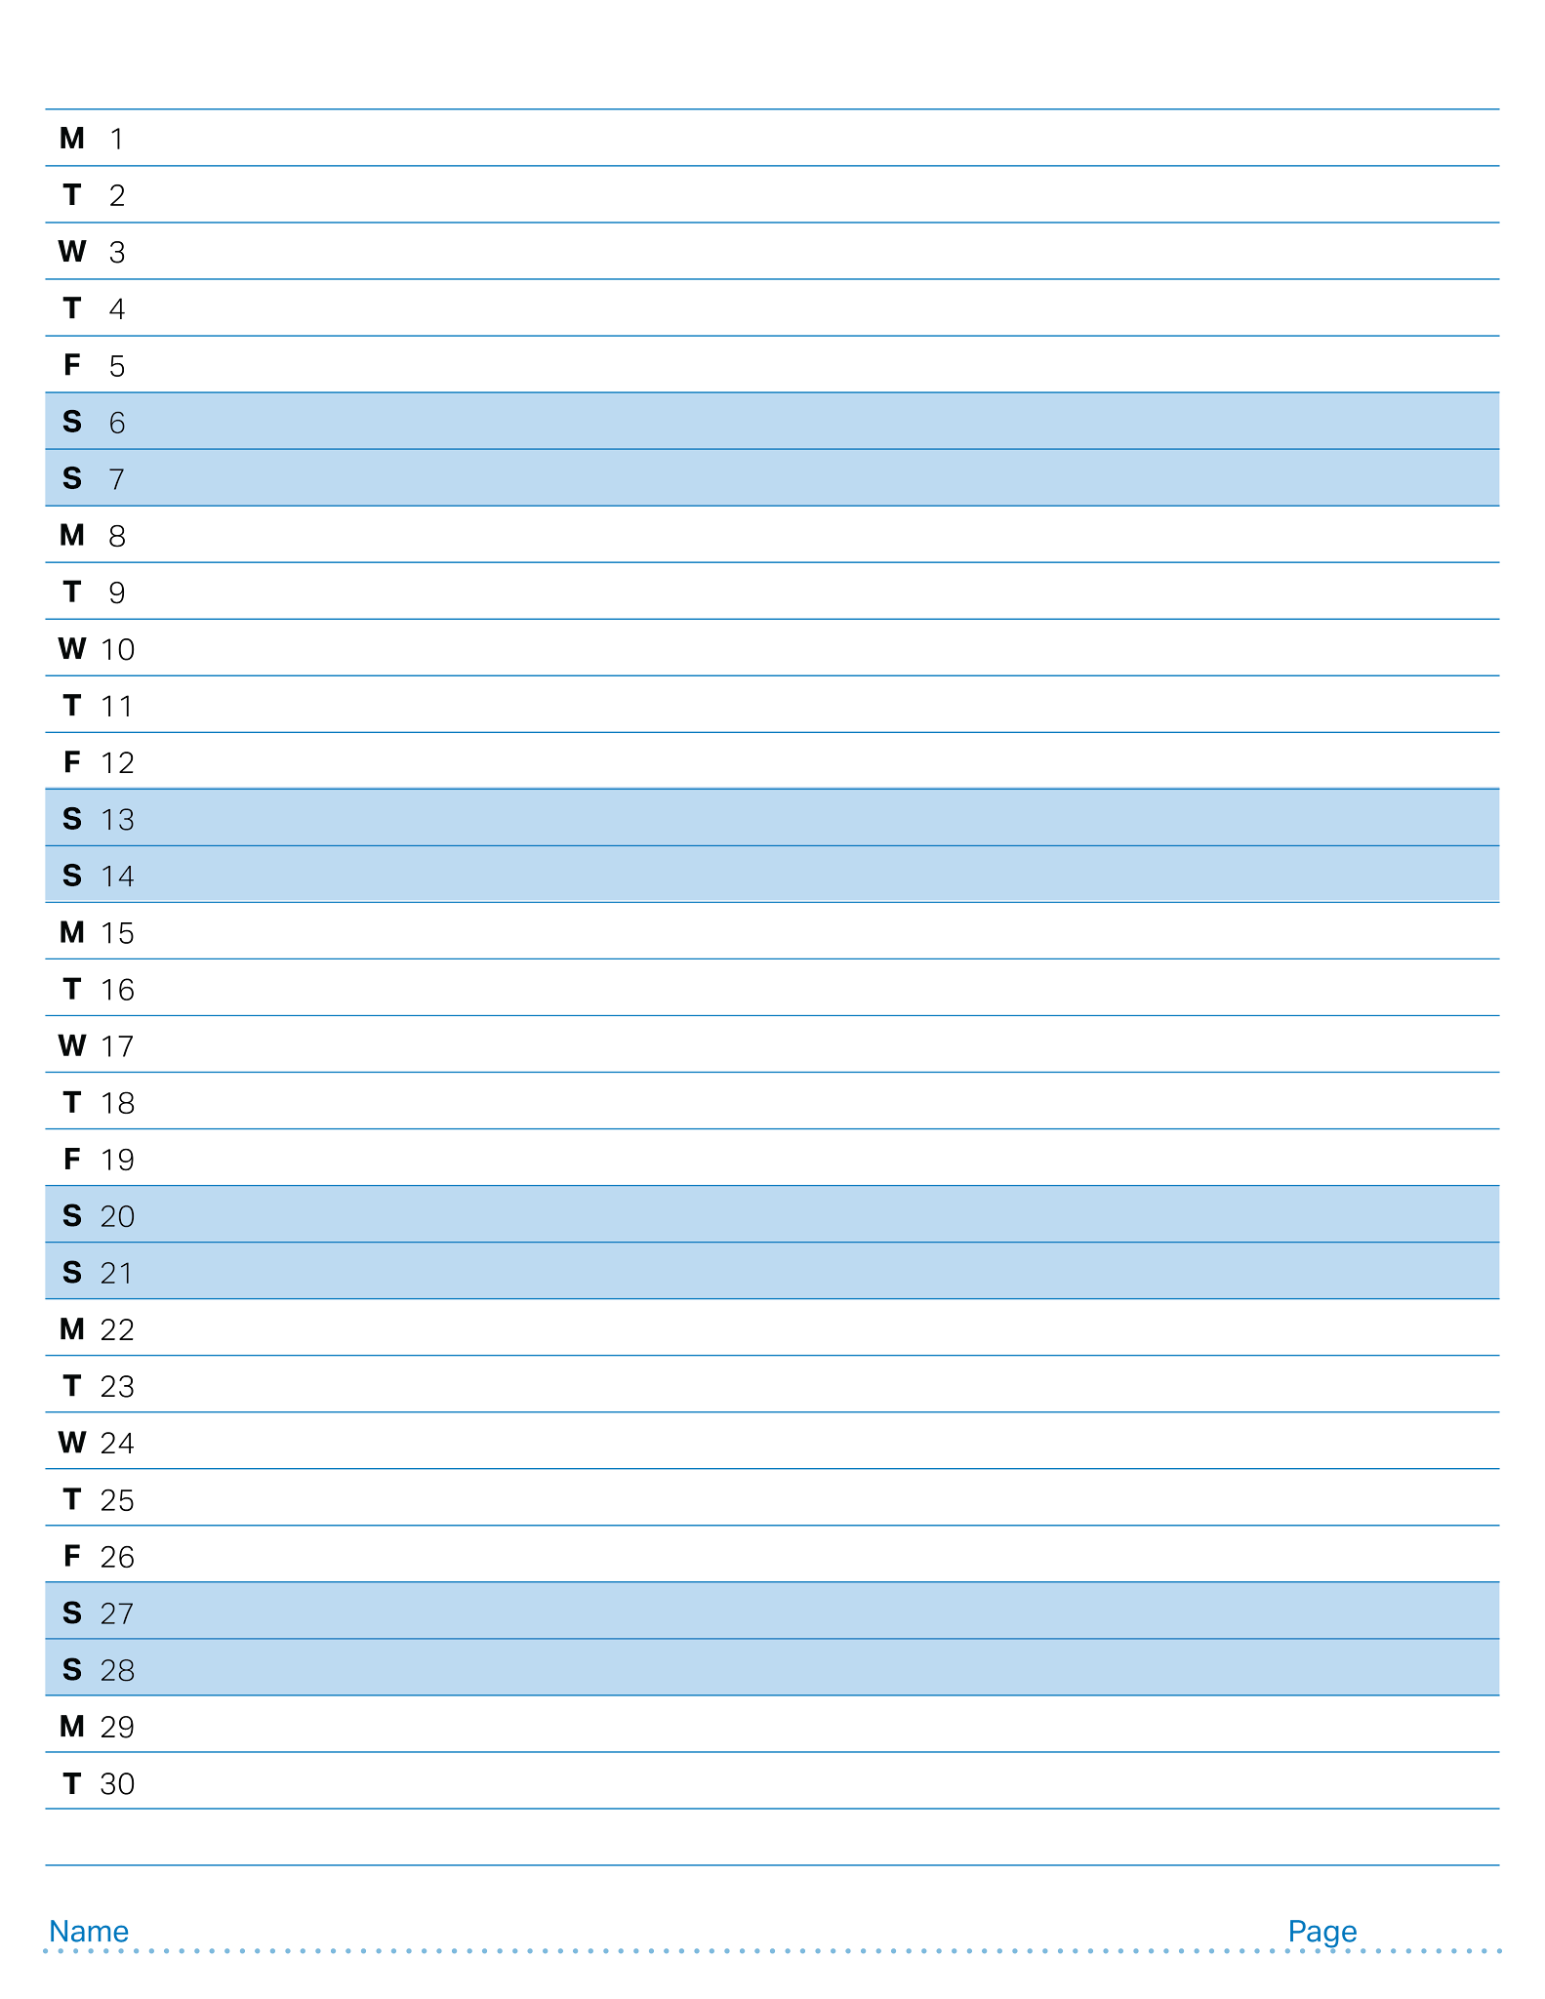
June 2026

Slide 27
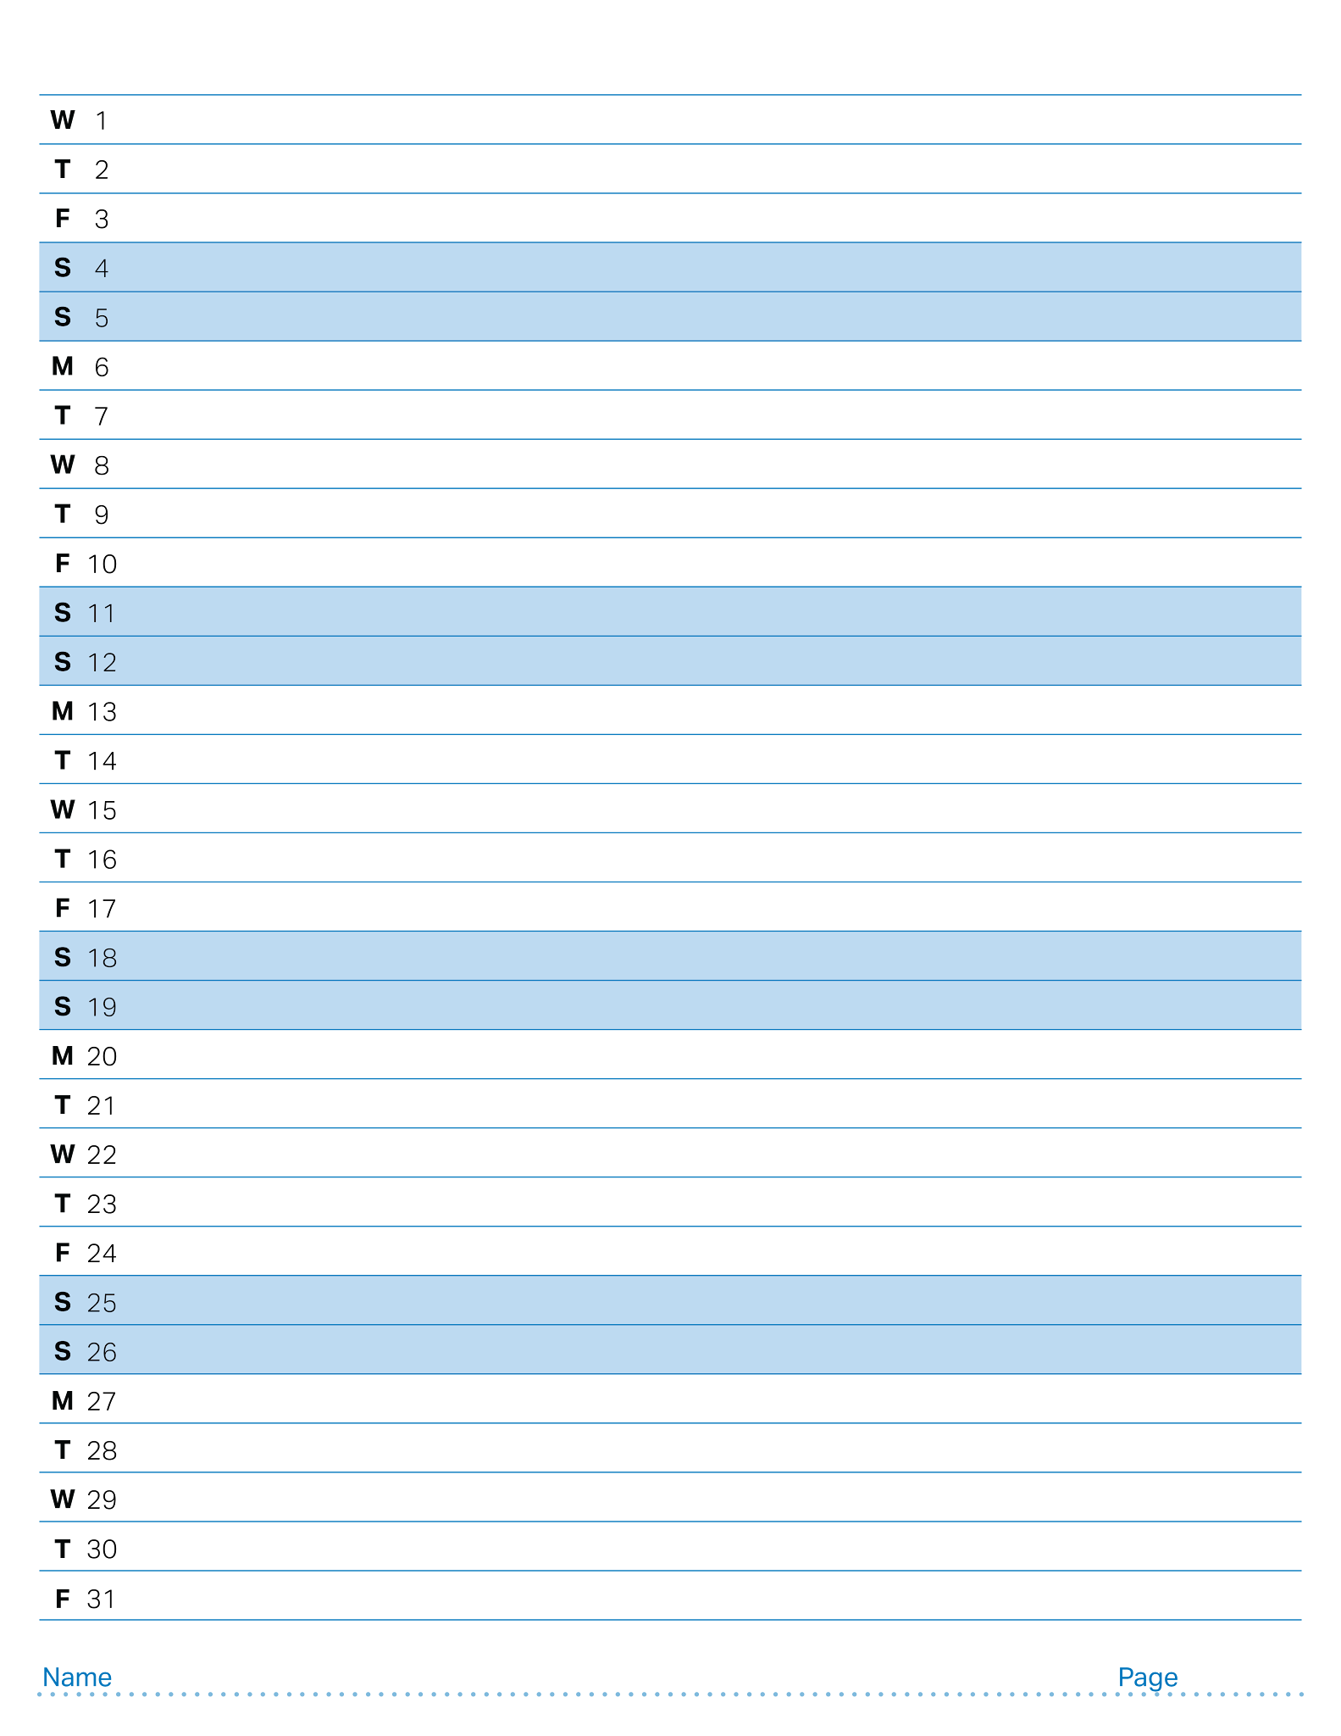
July 2026

Slide 28
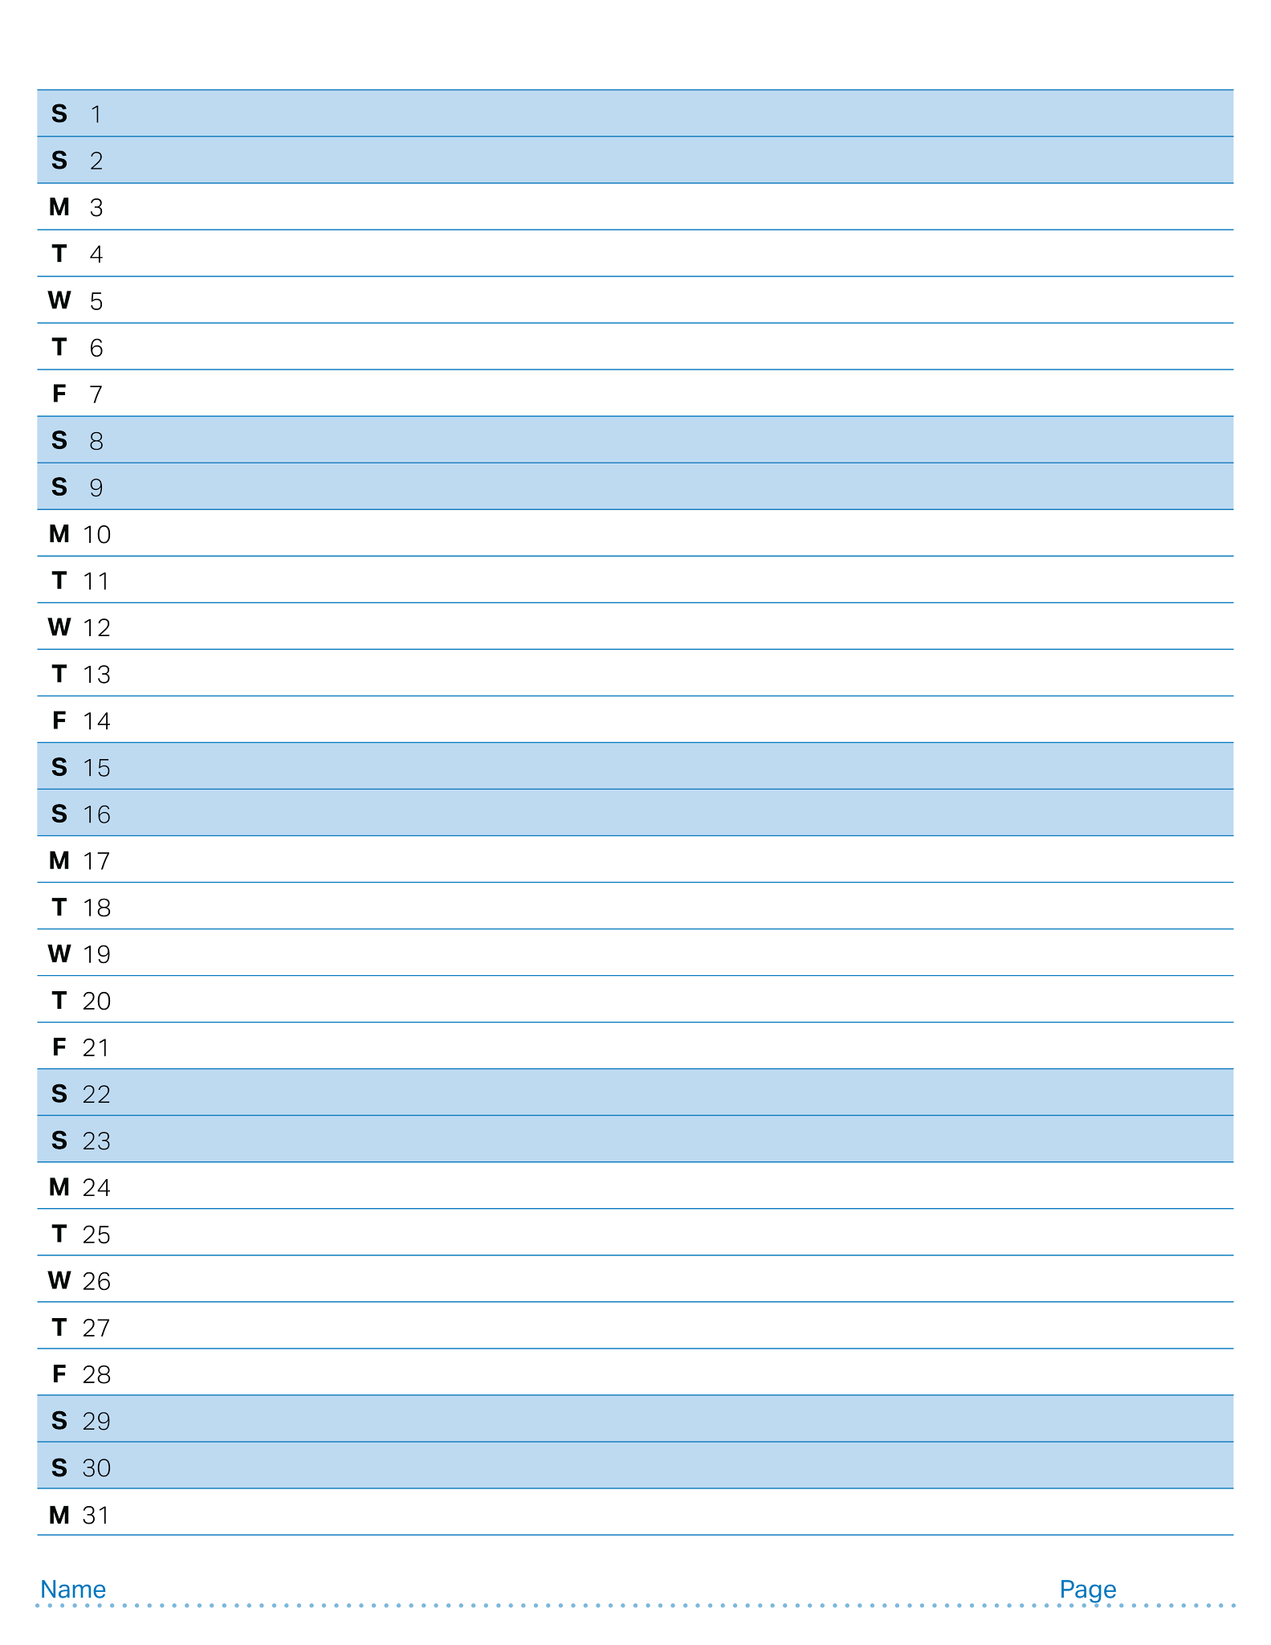
August 2026

Slide 29
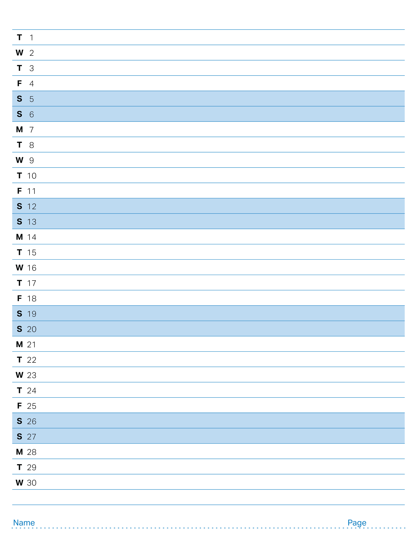
September 2026

Slide 30
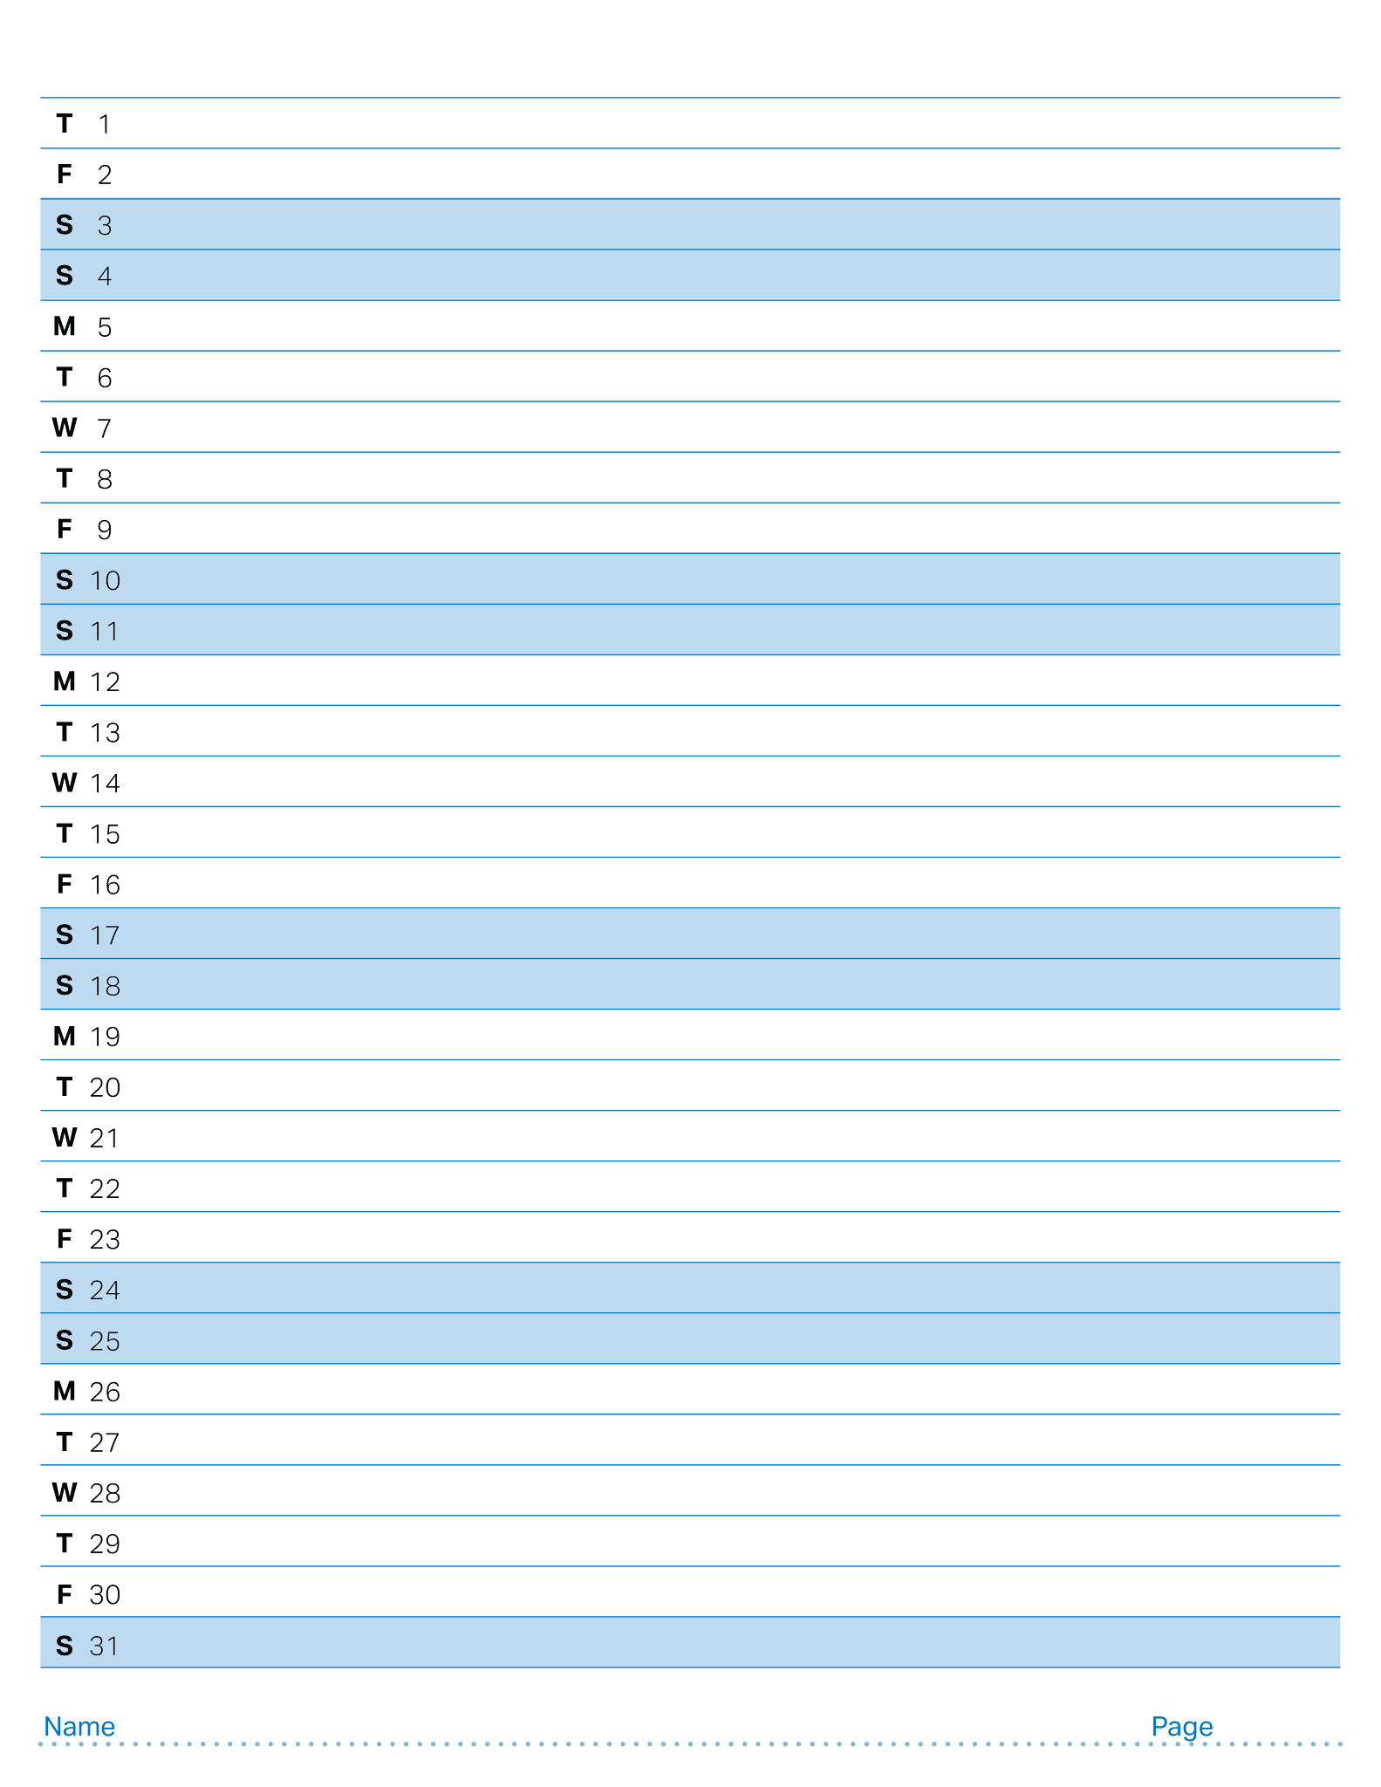
October 2026

Slide 31
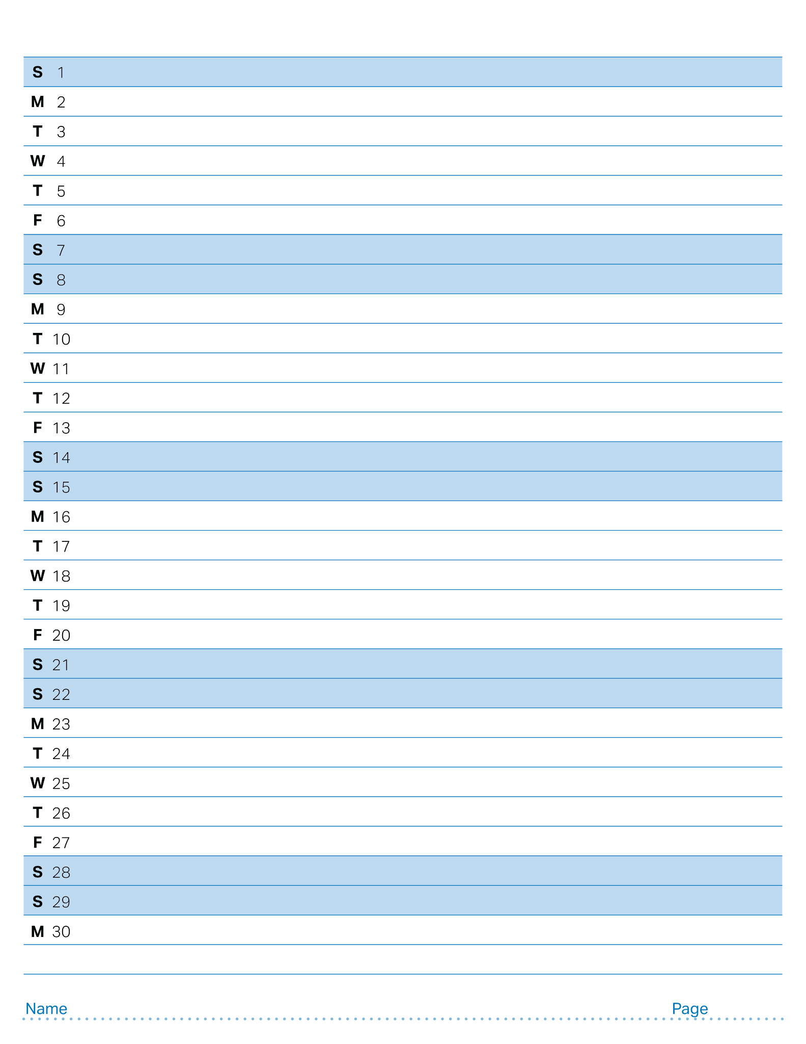
November 2026

Slide 32
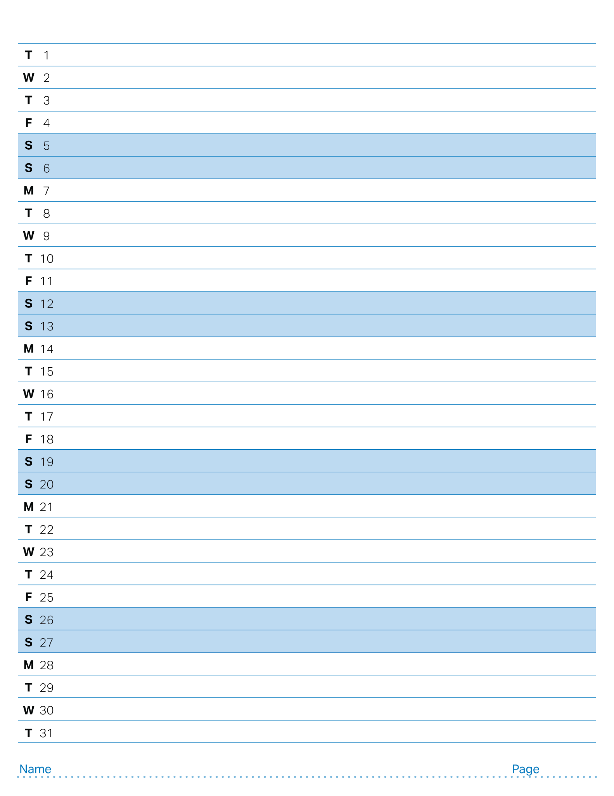
December 2026

Slide 33
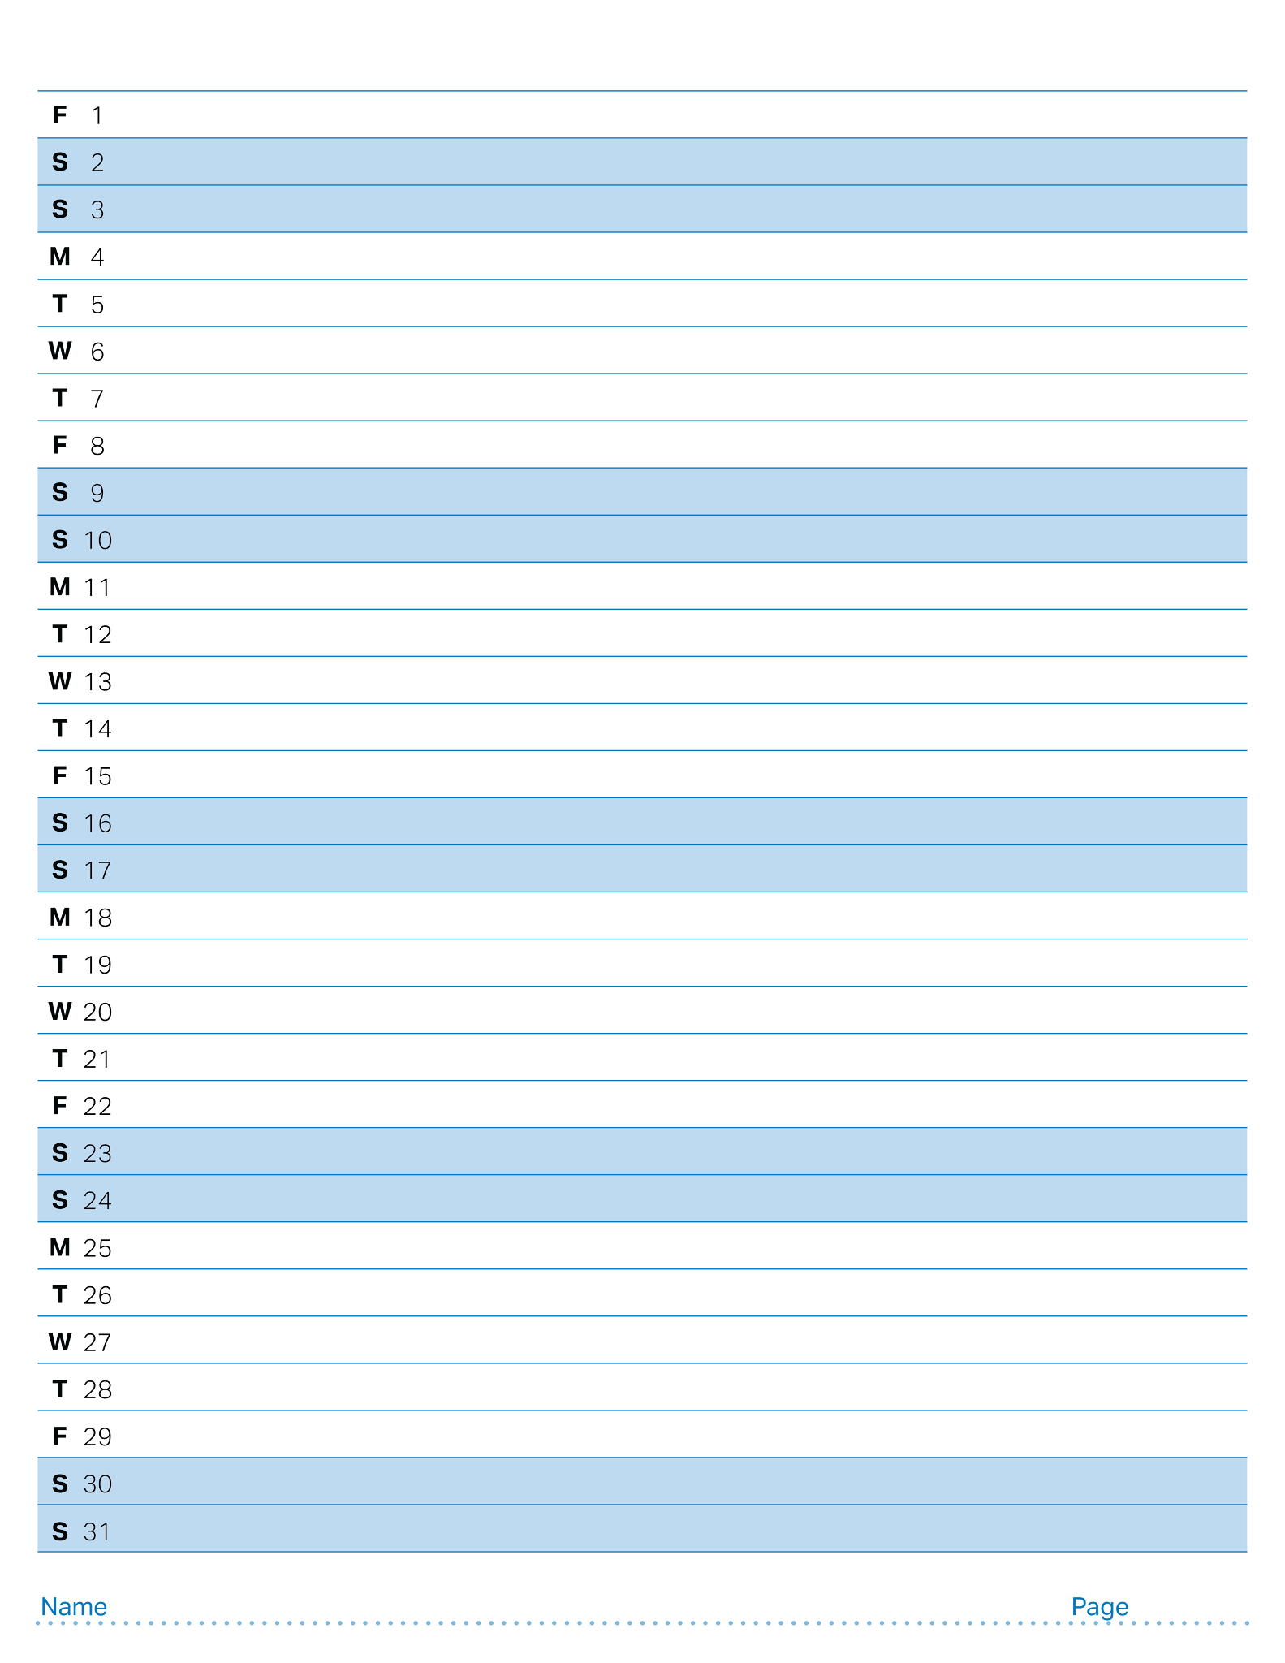
January 2027

Slide 34
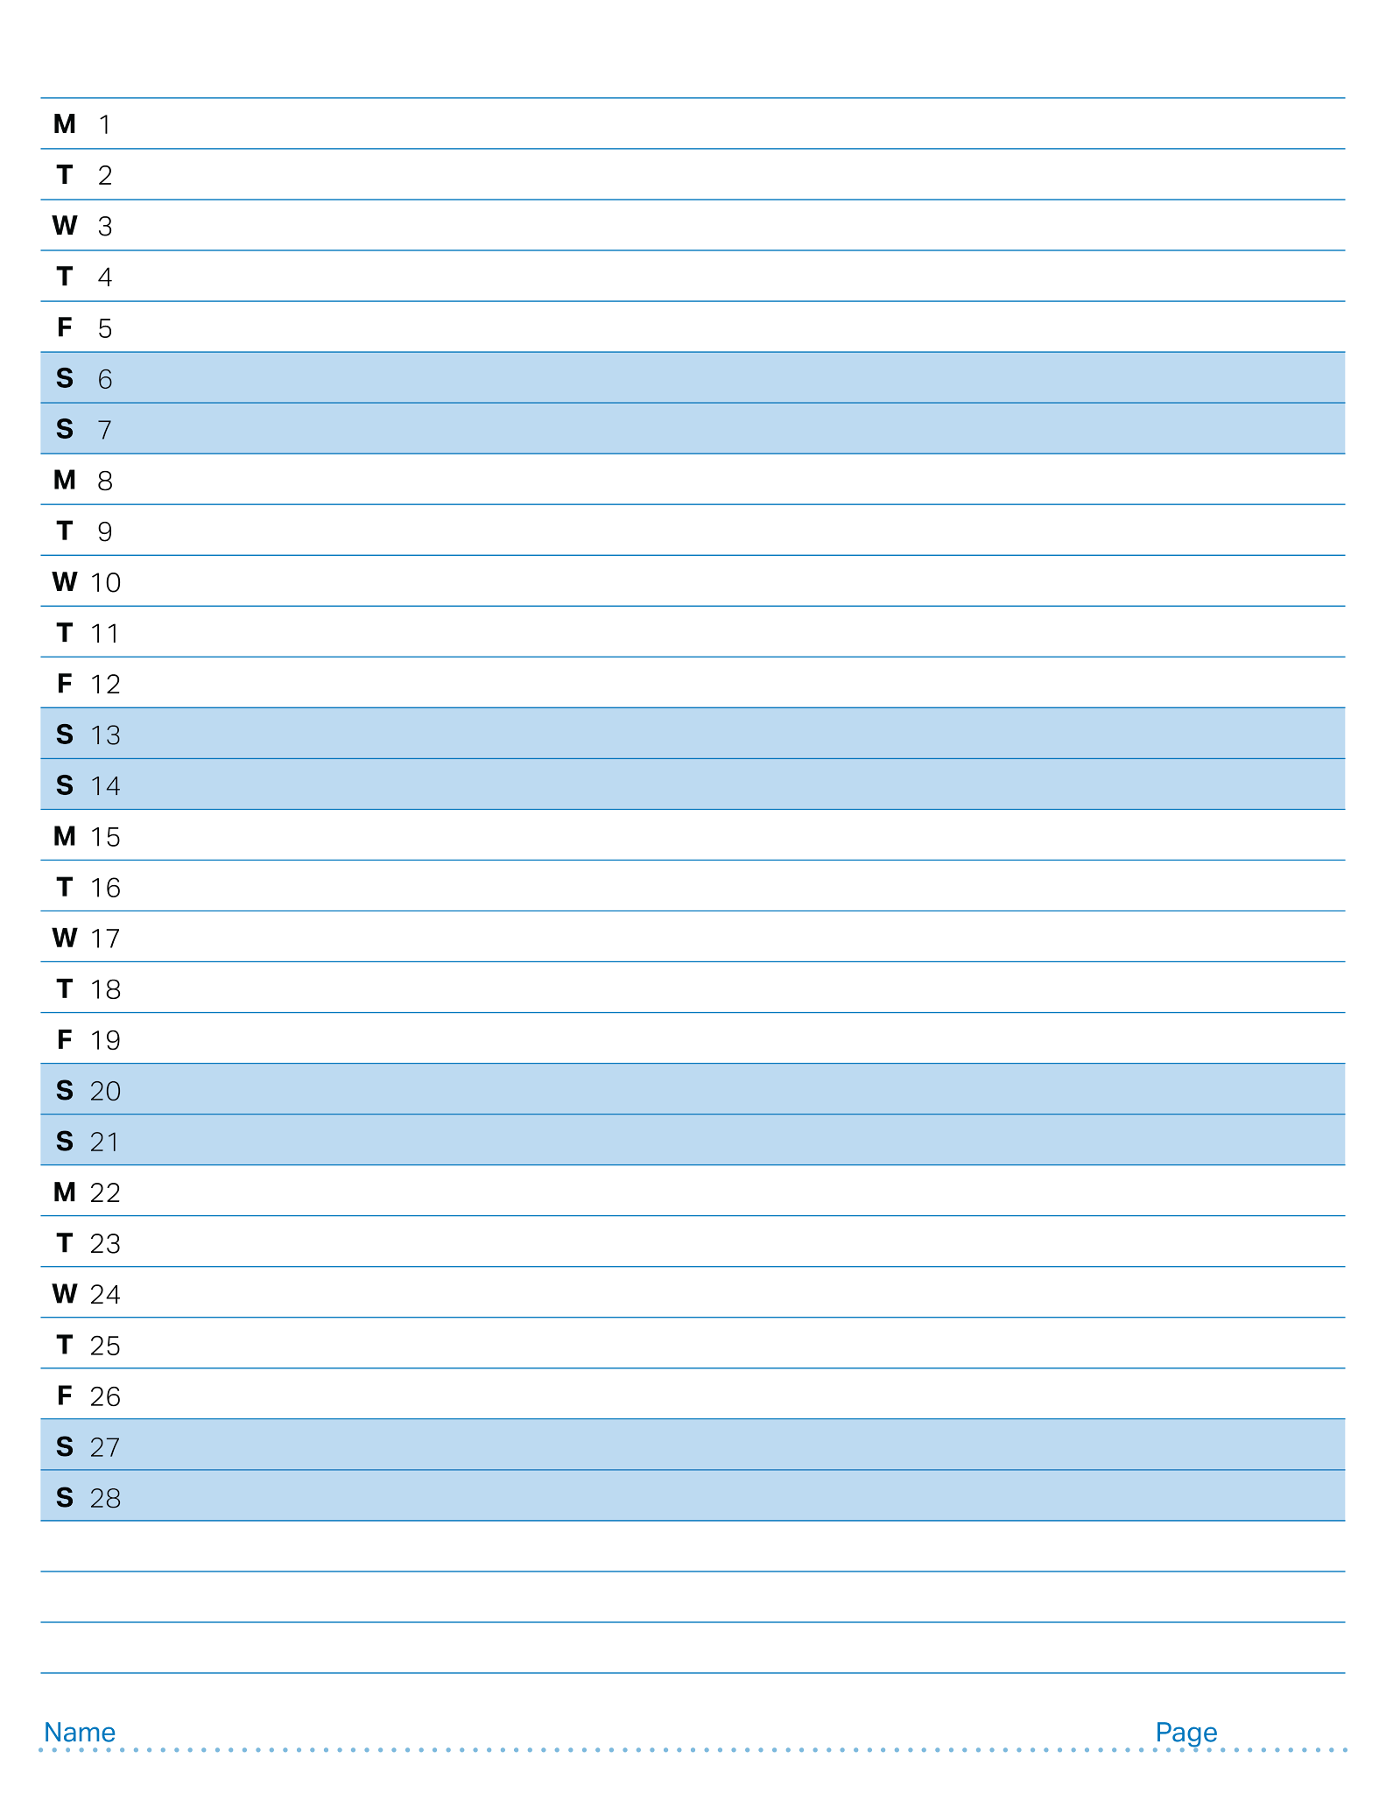
February 2027

Slide 35
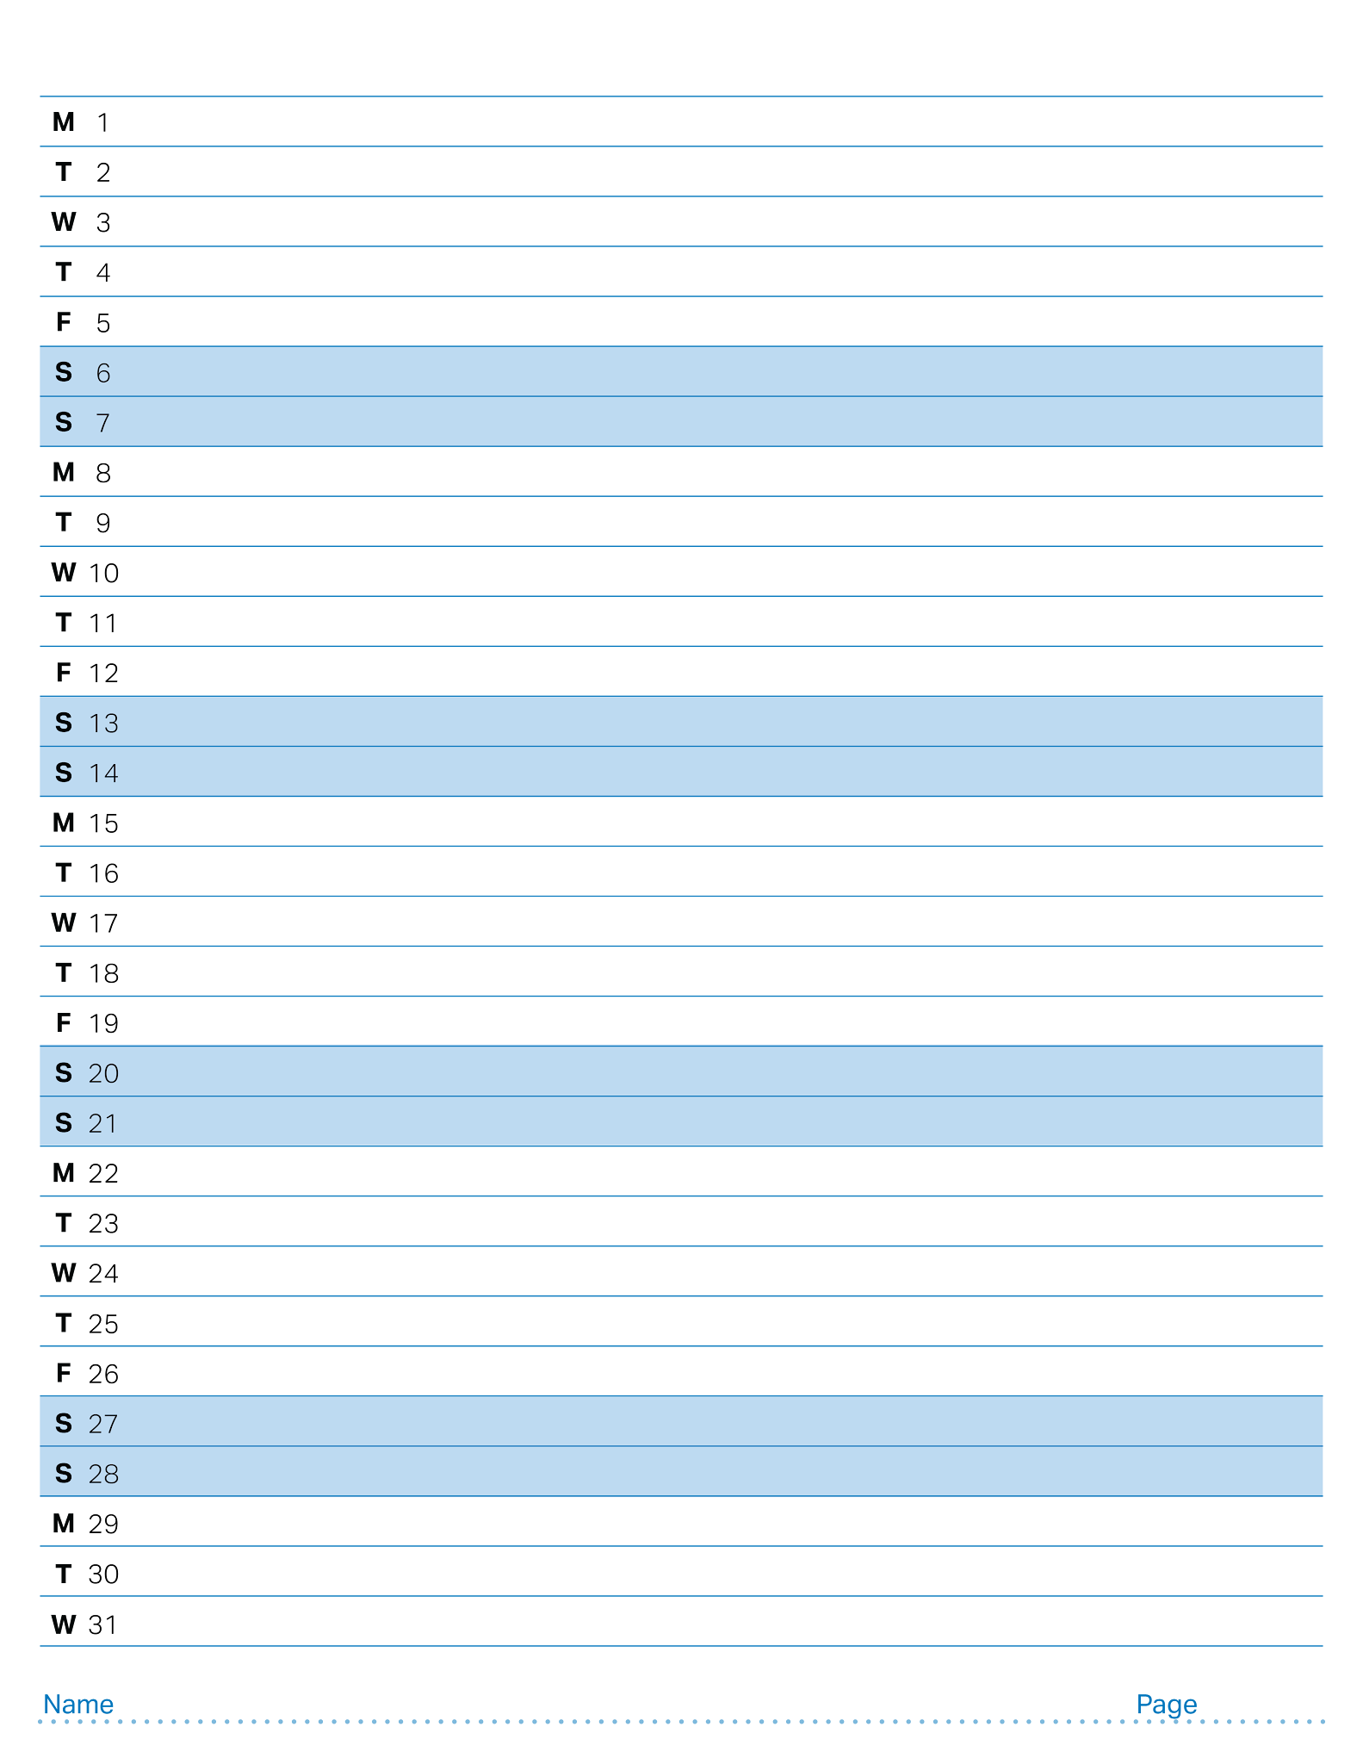
March 2027

Slide 36
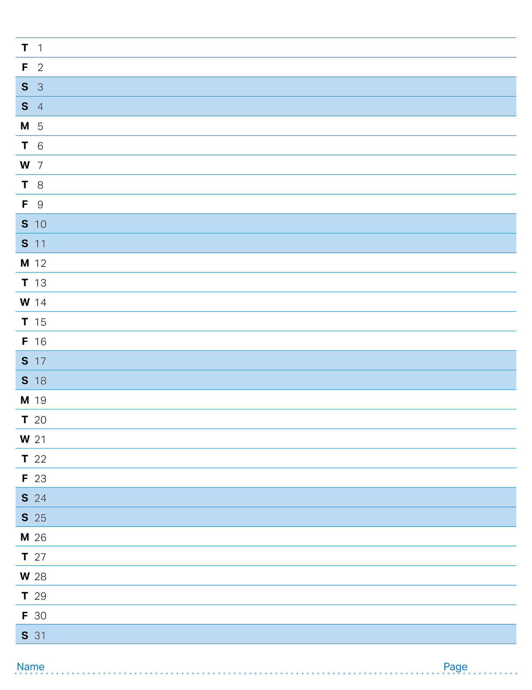
April 2027

Slide 37
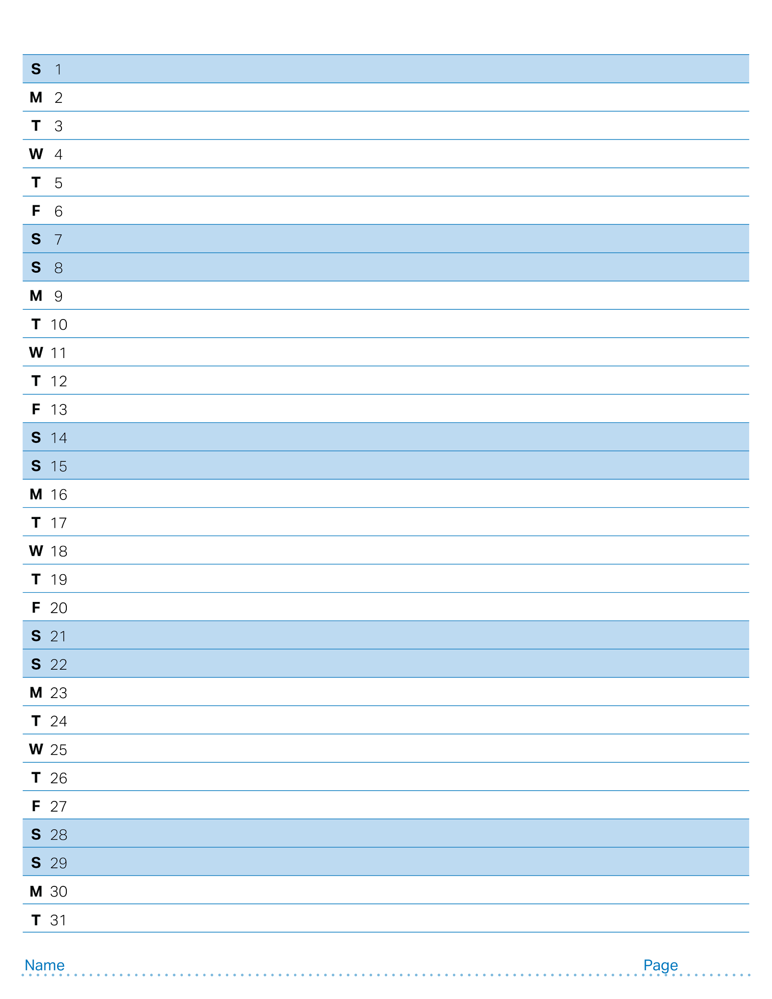
May 2027

Slide 38
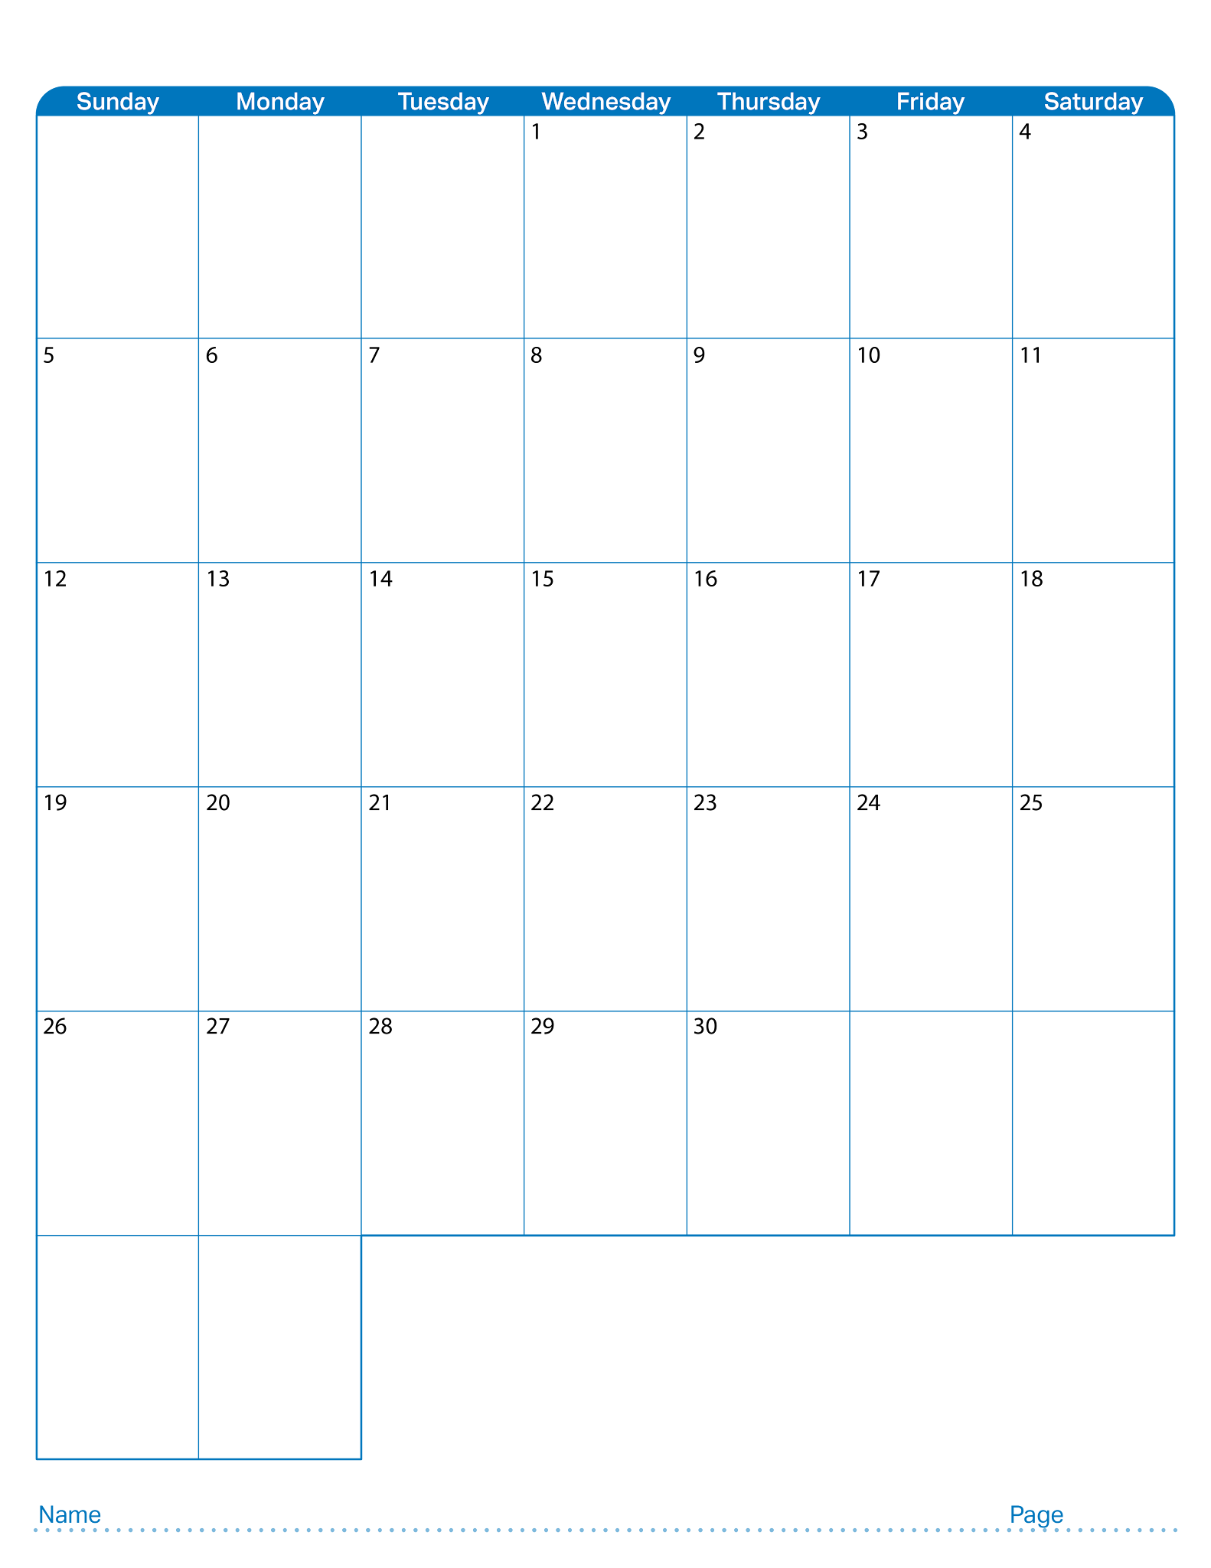
April 2026

Slide 39

May 2026

Slide 40
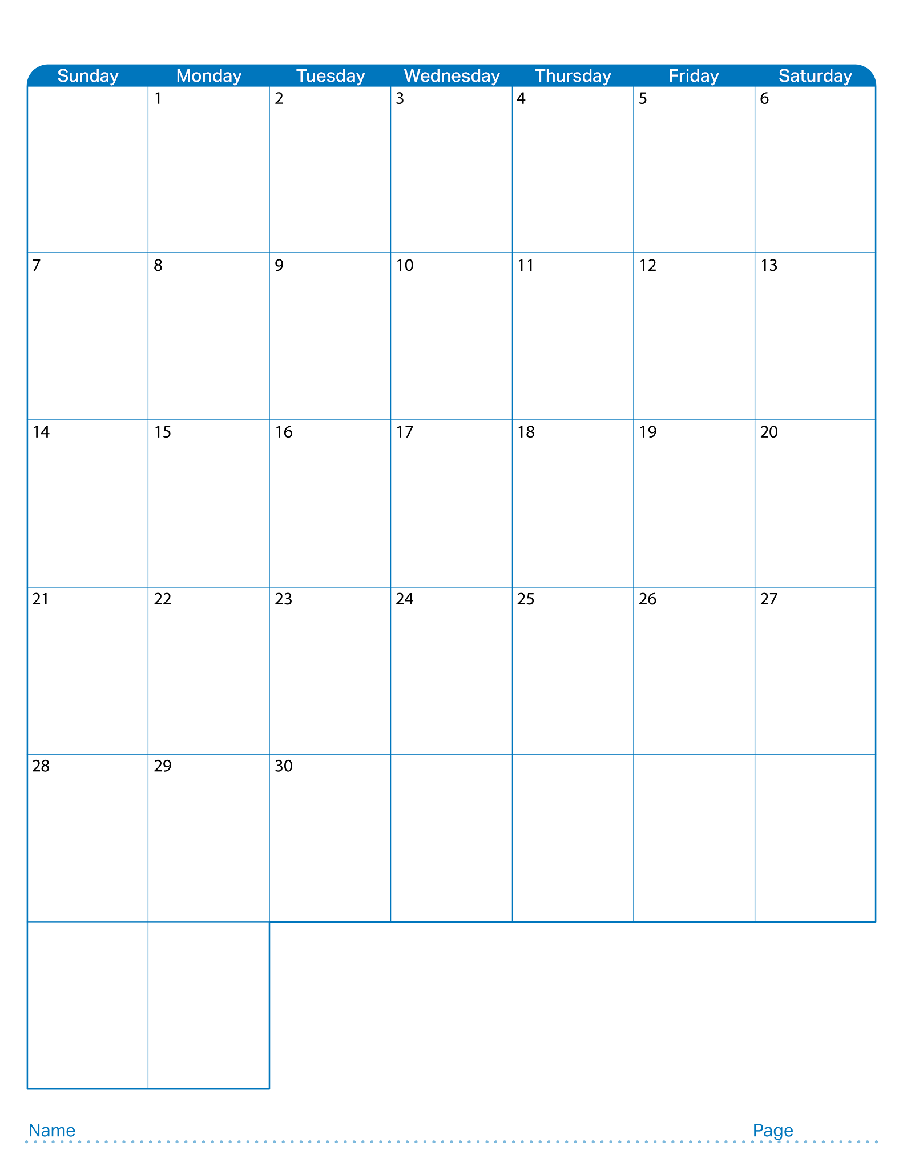
June 2026

Slide 41

July 2026

Slide 42

August 2026

Slide 43

September 2026

Slide 44

October 2026

Slide 45

November 2026

Slide 46

December 2026

Slide 47

January 2027

Slide 48

February 2027

Slide 49

March 2027

Slide 50

April 2027

Slide 51
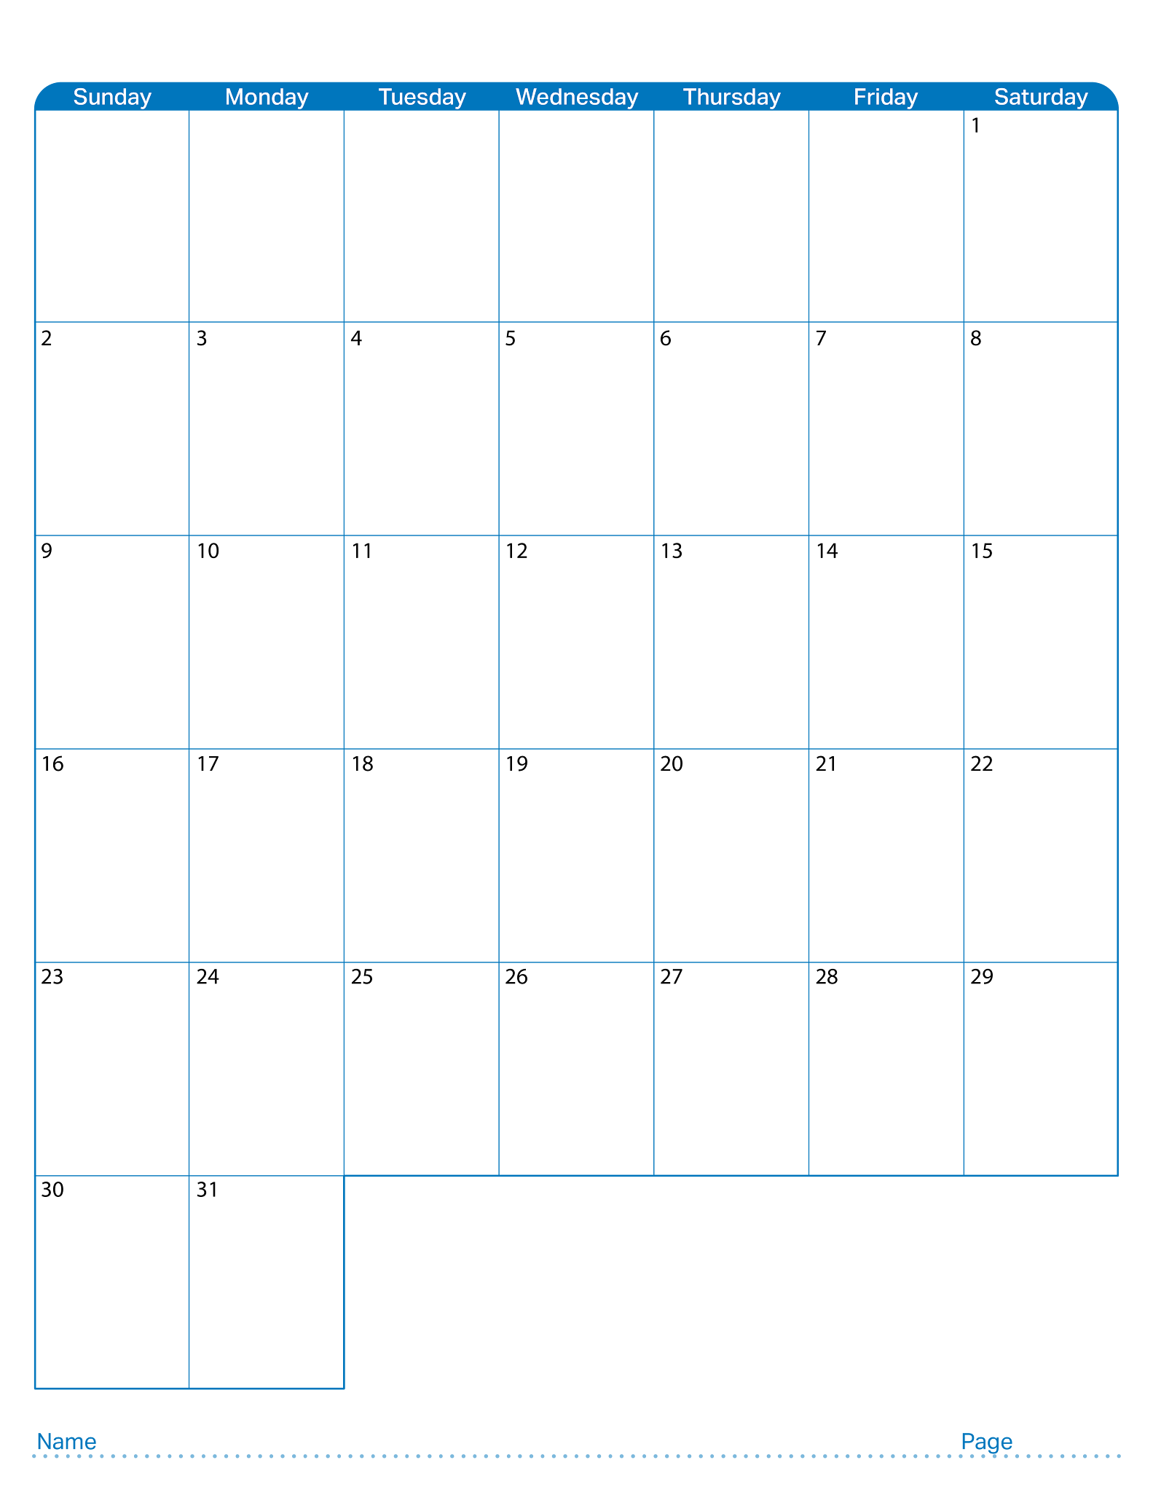
May 2027

