Slide 1
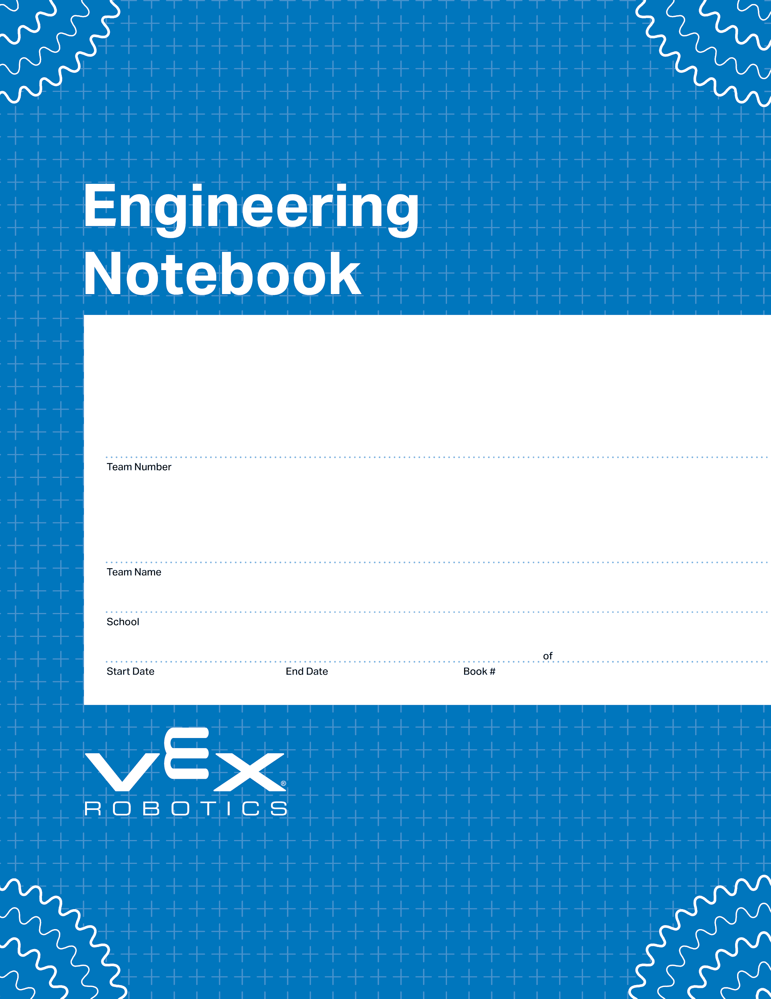
Digital IQ Parts
VEX IQ Parts for Engineering Notebooks
V5.0 Date 3.30.26

Slide 2

Changelog
Changelog:
V5.0 Date 3.30.26
Added game elements for “Level Up”
Added IQ AI Vision Sensor
V4.0 Date 4.02.25
Added game elements for “Mix & Match”
V3.0 Date 6.10.24
Added game elements for “Rapid Relay”
V2.1 Date 7.11.23
Added IQ Pneumatics Kit and Part Outlines
V2.0 Date 5.16.23
Added game objects for “Full Volume” Game
Don’t forget to delete this page!
Christine G.
03/30/2026
01

Slide 3
Full Scale Parts
Electronics
Pneumatics
Structure - Beams
Structure - Connectors & Standoffs
Motion - Gears
Motion - Wheels
Game Elements
Half Scale Parts
Electronics
Pneumatics
Structure - Beams
Structure - Connectors & Standoffs
Motion - Gears
Motion - Wheels
Game Elements
Third Scale Parts
Electronics
Pneumatics
Structure - Beams
Structure - Connectors & Standoffs
Motion - Gears
Motion - Wheels
Game Elements

Slide 4

Identifying Parts
Once you copy a part out of this document and into your notebook, you may forget which part it is. We made it easy to identify parts anytime.
The part below can be identified by
Right clicking on the part
Selecting Alt Text

Slide 5


Changing Part Color
The default color for parts in this document is gray. You can change the color by using Recolor.
Right click on the part
Select Picture Format
Use the drop down menu to select a new color

Slide 6
Rulers - Full Scale, Half Scale, Third Scale
Third Scale
Half Scale
These rulers make measuring parts easy.
There are horizontal and vertical Rulers.
There are rulers for Full Scale, Half Scale and Third Scale
Place the Rulers next to, under, or over your drawings to measure hole counts
Full Scale

Slide 7
Full Scale IQ Parts

Slide 8
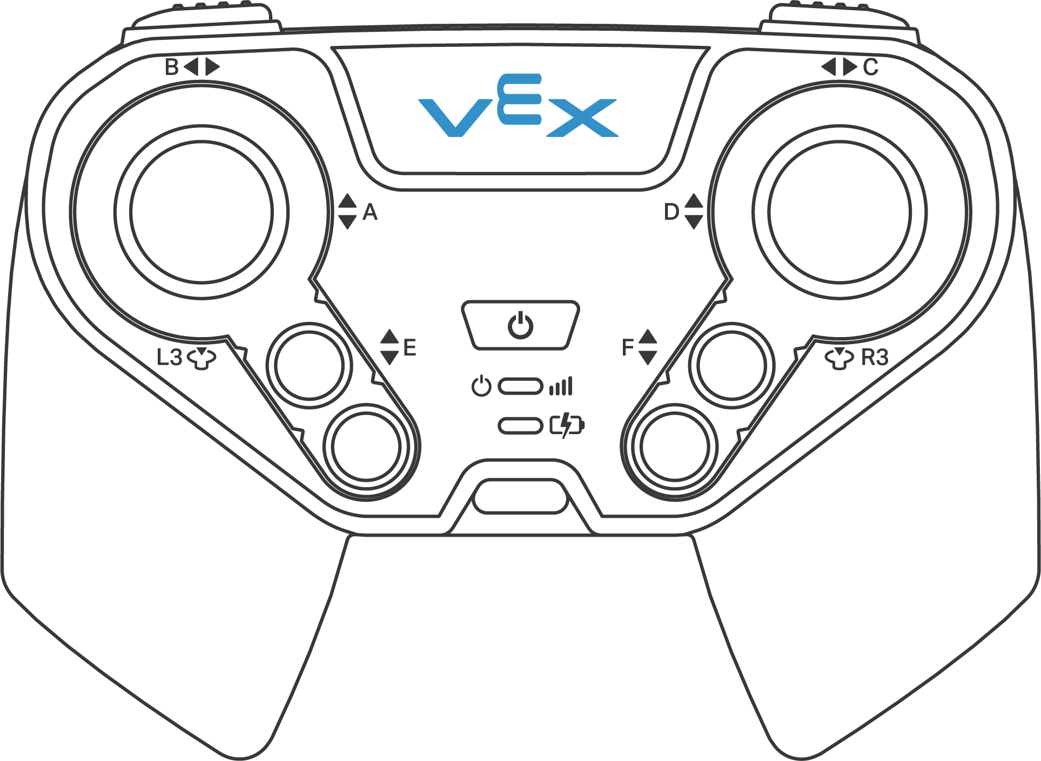
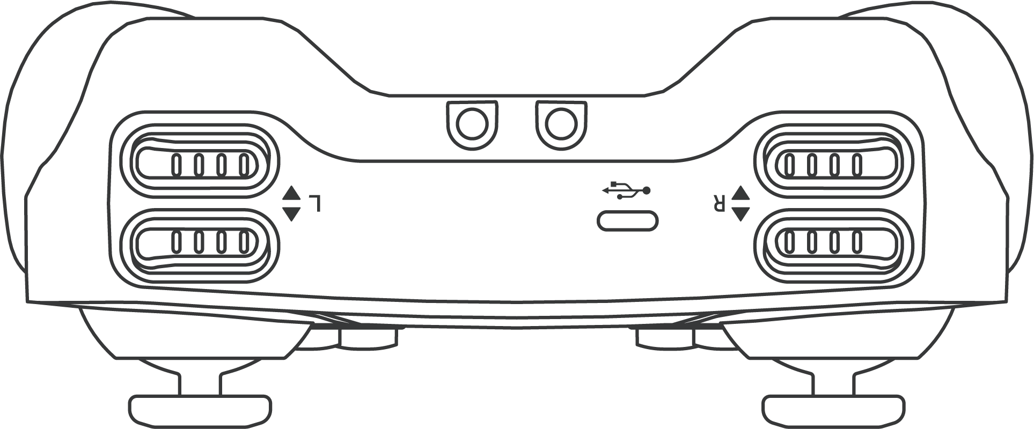
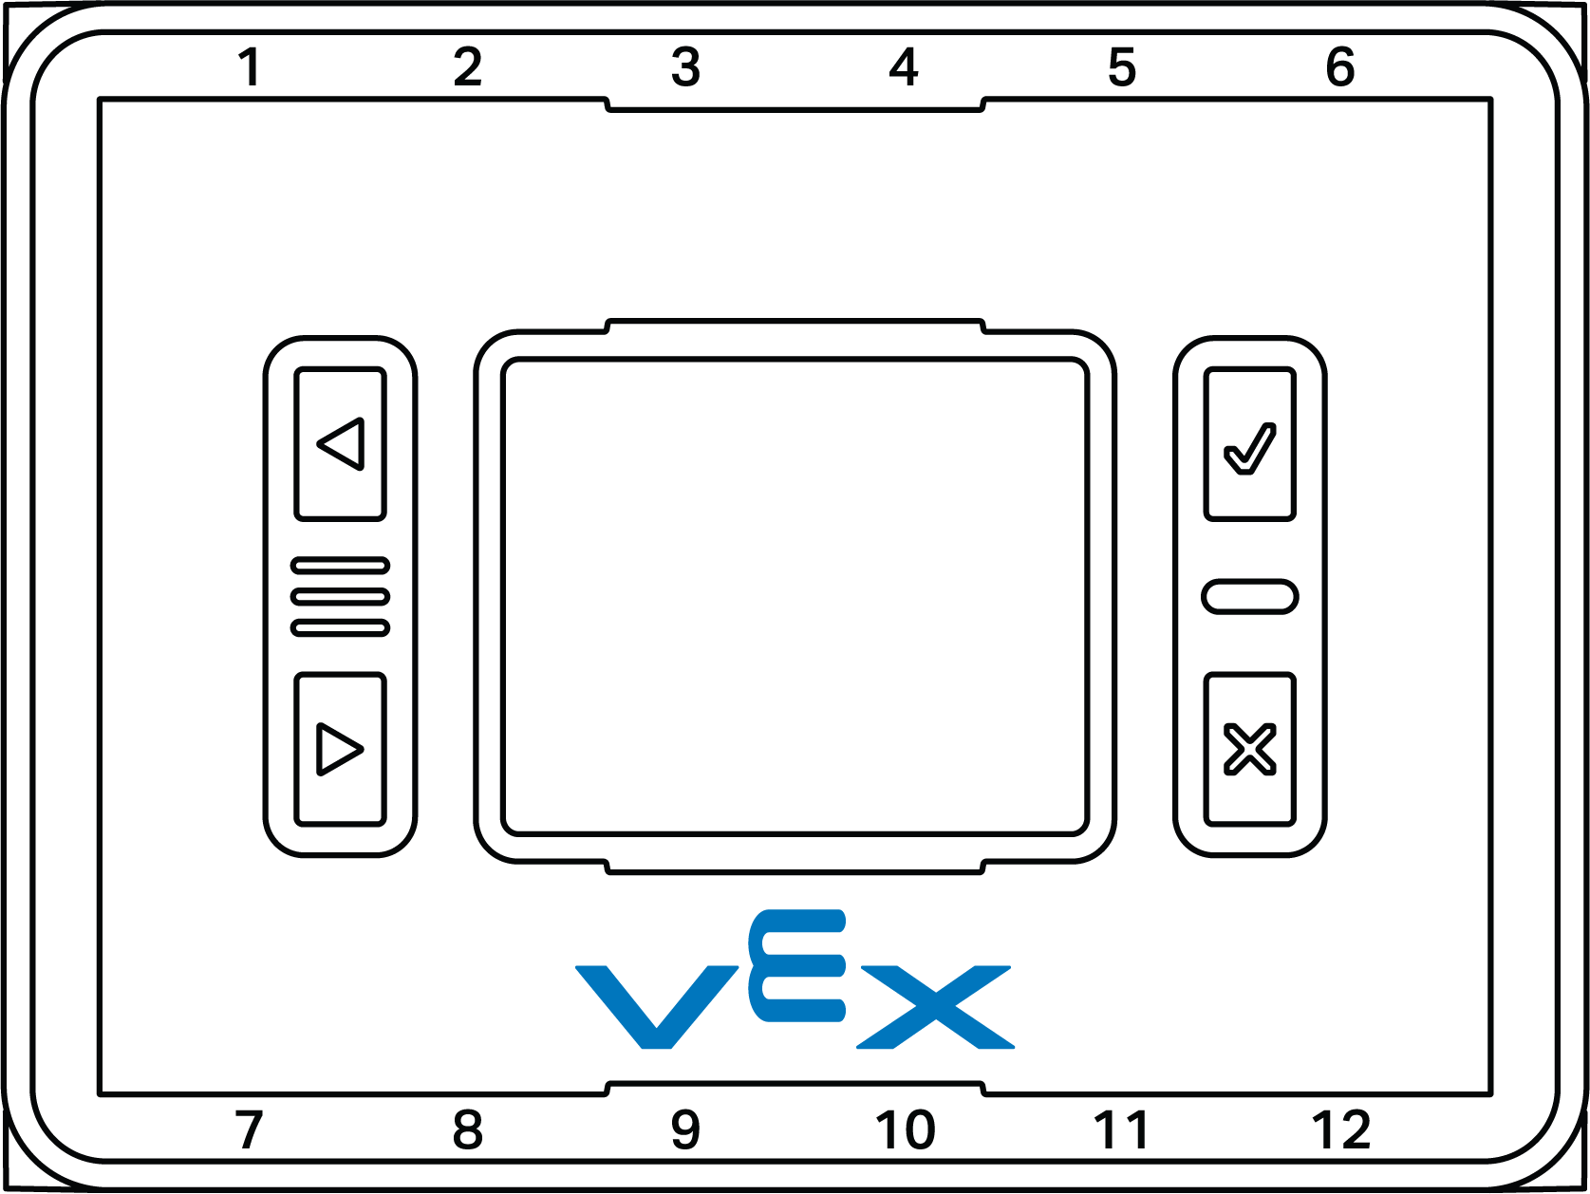
Electronics - Part Outlines

Slide 9
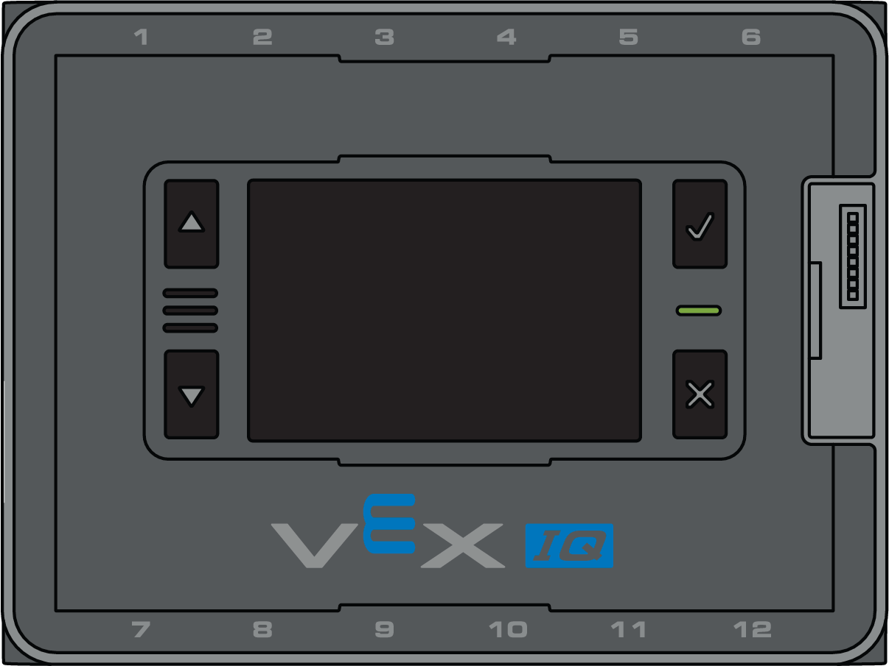
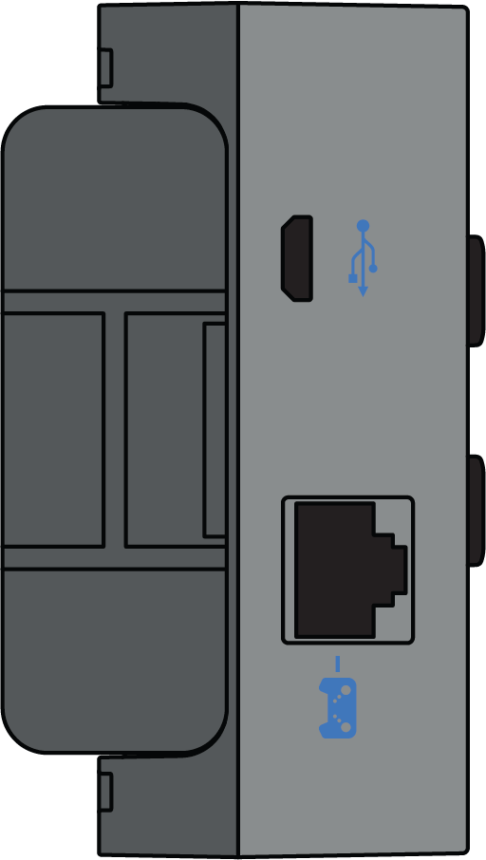
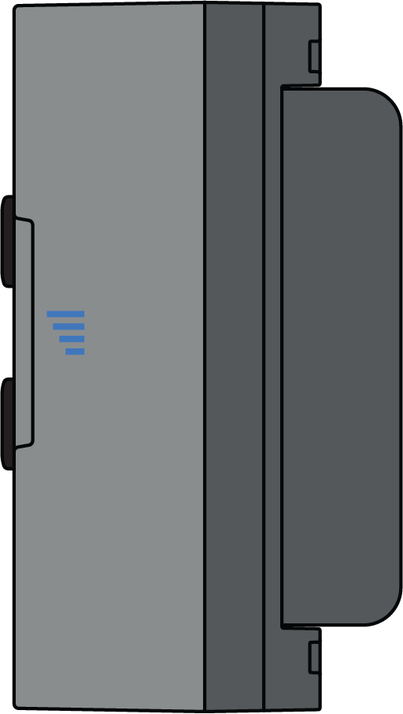
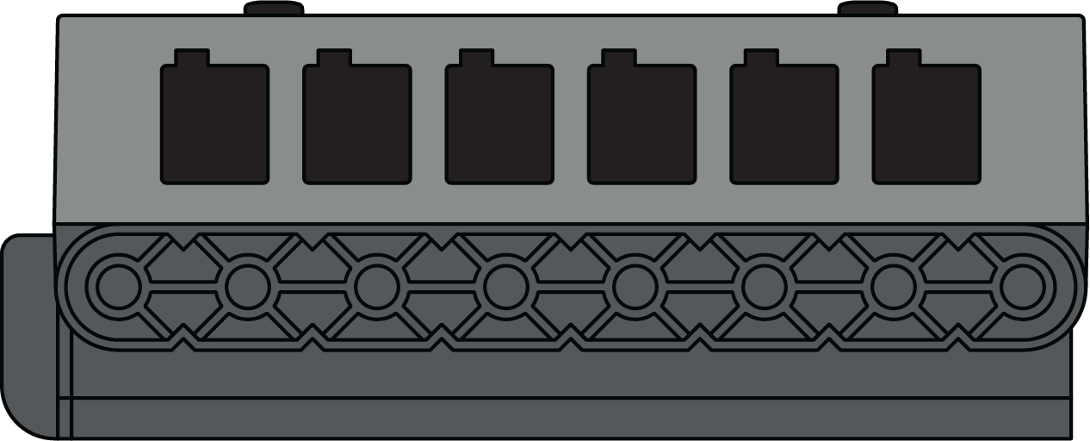
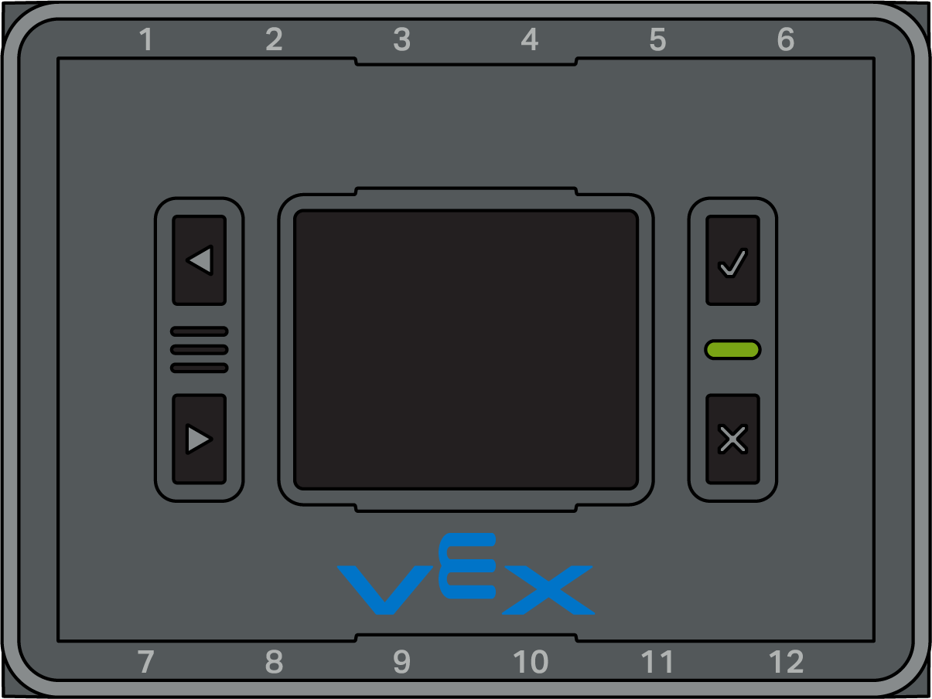
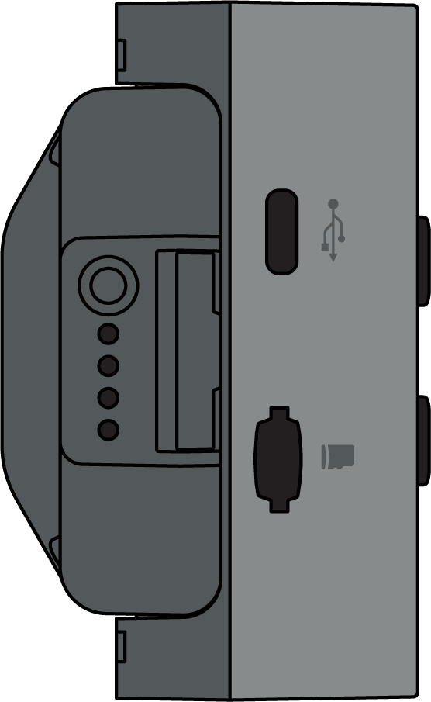
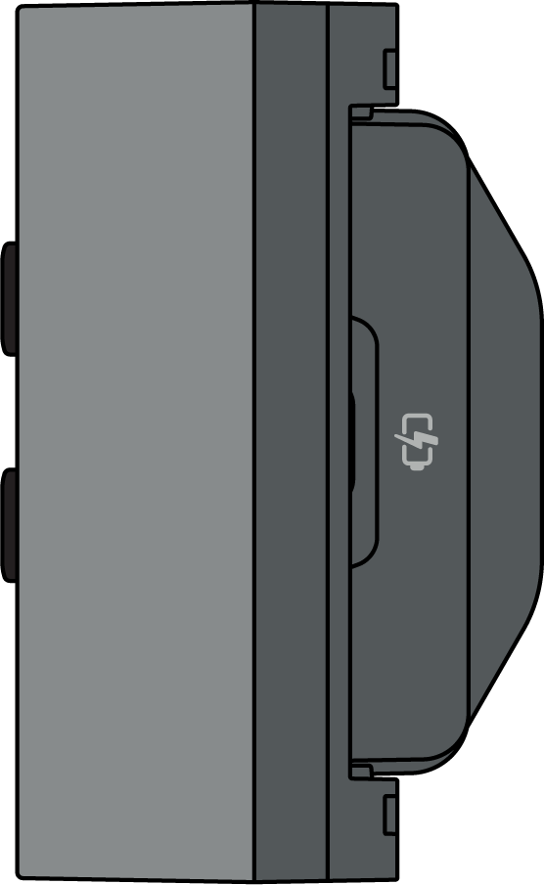
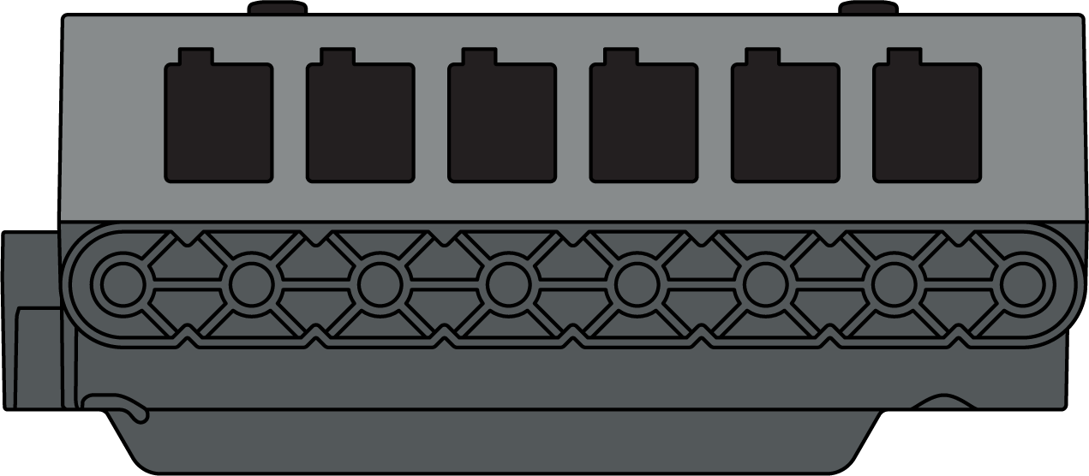
Electronics - Brains (Full Scale)
IQ Robot Brain (1st Gen)
228-2540
IQ Robot Brain (2nd Gen)
228-6480

Slide 10














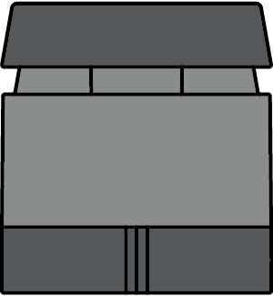
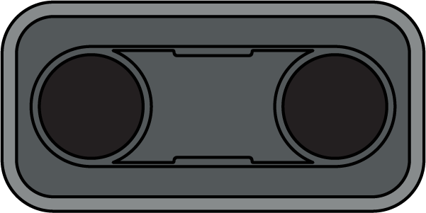


Electronics - Sensors (Full Scale)
IQ Touch LED
228-3010
IQ Color Sensor
228-3012
IQ Optical Sensor
228-7082
IQ Distance Sensor (2nd Gen)
228-7106
IQ Gyro Sensor
228-3014
IQ Bumper Switch
228-2677
IQ Distance Sensor (1st Gen)
228-3011

Slide 11




Electronics - Sensors (Full Scale)
IQ AI Vision Sensor
228-3012

Slide 12
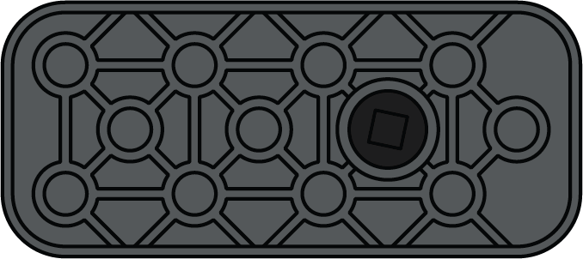
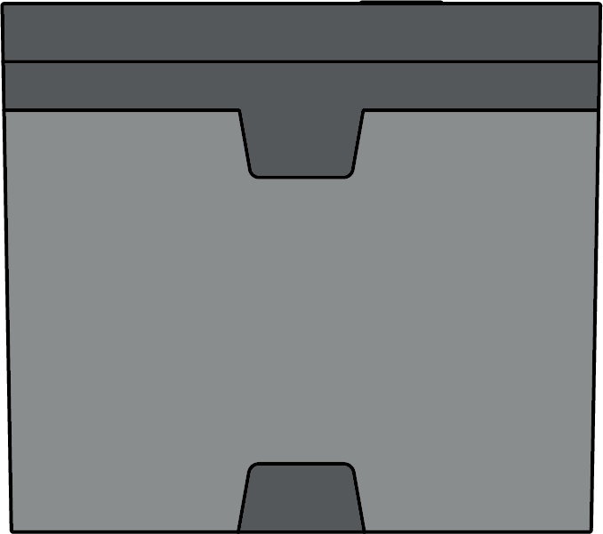



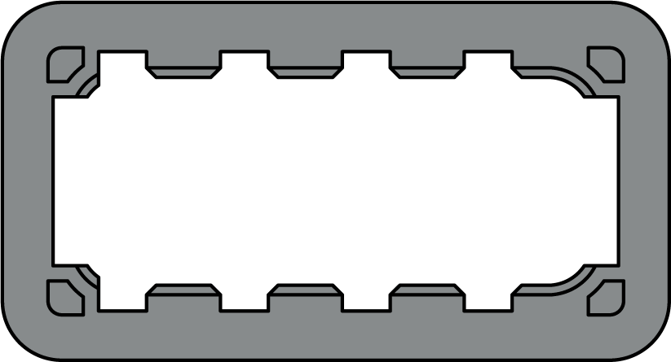



Electronics - Smart Motor & Accessories (Full Scale)
IQ Smart Motor
228-2560
Single Motor Support Cap
228-2500-159
Dual Motor Support Cap
228-2500-160
Cable Anchor
228-2500-158

Slide 13
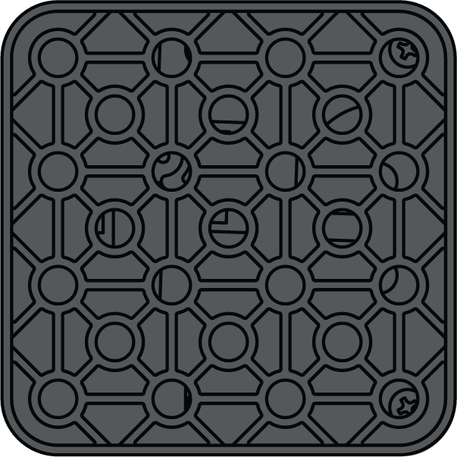

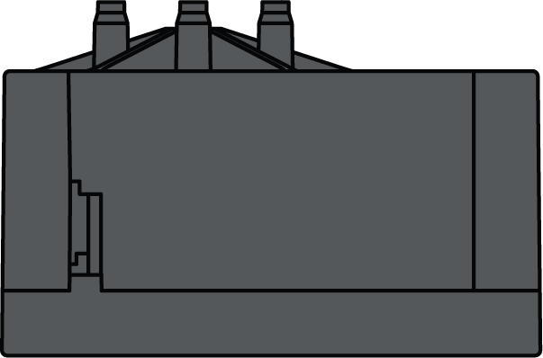
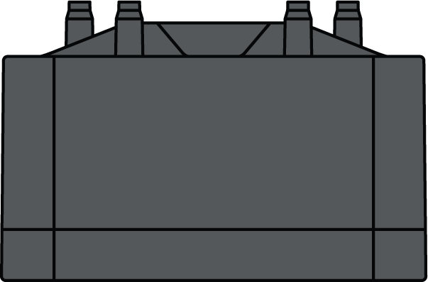
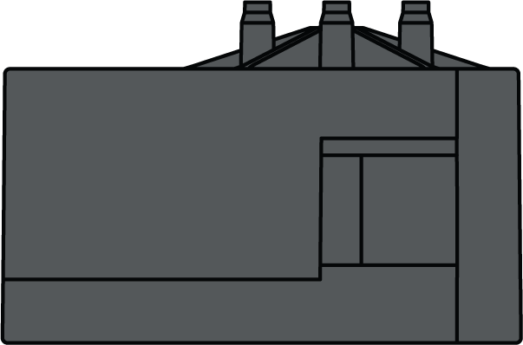


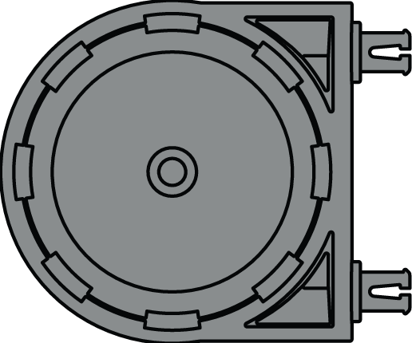
Pneumatics (Full Scale)
Pneumatic Control Unit
228-8795
Air Tank
228-8795

Slide 14



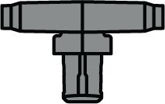

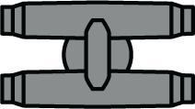





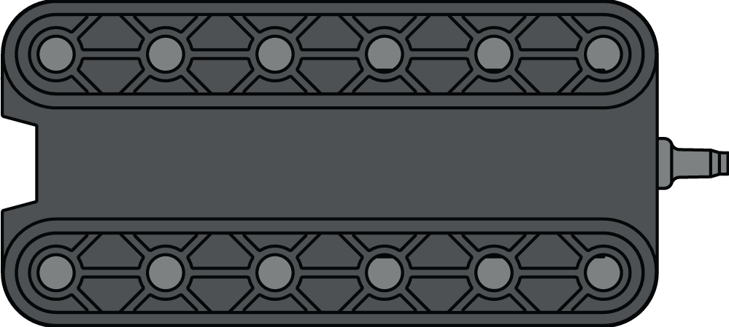
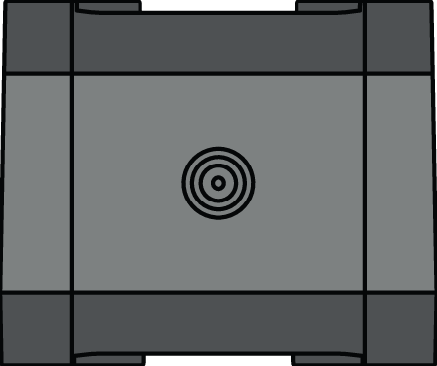
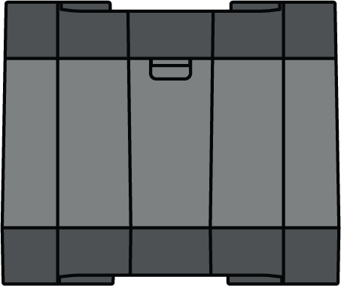
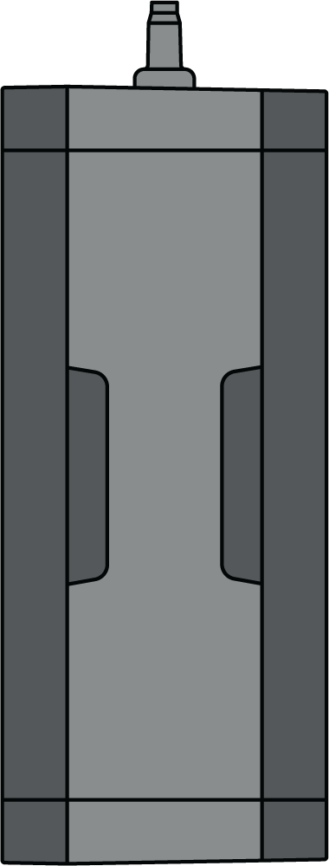
Pneumatics (Full Scale)
2x Pitch Pneumatic Cylinder
228-8795
Pneumatic Fittings
228-8795
4x Pitch Pneumatic Cylinder
228-8795
Pneumatic Pump
228-8795

Slide 15















Structure - 1x Beams (Full Scale)
1x1 Beam
228-2500-154
1x12 Beam
228-2500-011
1x2 Beam
228-2500-001
1x11 Beam
228-2500-010
1x3 Beam
228-2500-002
1x10 Beam
228-2500-009
1x4 Beam
228-2500-003
1x9 Beam
228-2500-008
1x5 Beam
228-2500-004
1x8 Beam
228-2500-007
1x6 Beam
228-2500-005
1x7 Beam
228-2500-006

Slide 16
Structure - 1x Beams (Full Scale)
1x13 Beam
228-2500-012
1x14 Beam
228-2500-013
1x16 Beam
228-2500-014
1x18 Beam
228-2500-015
1x20 Beam
228-2500-016

Slide 17

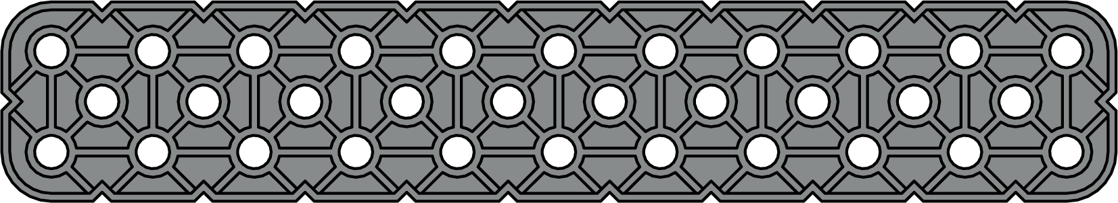

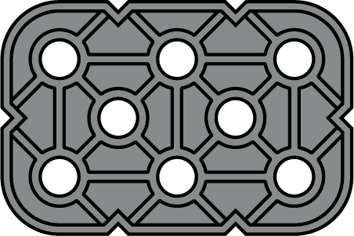
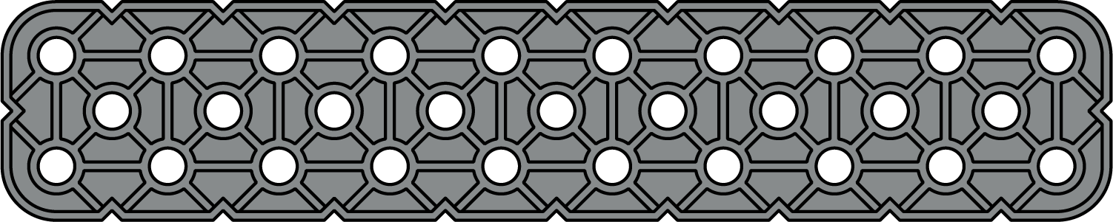

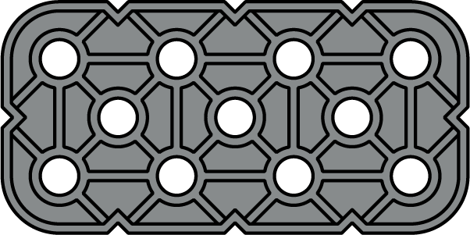
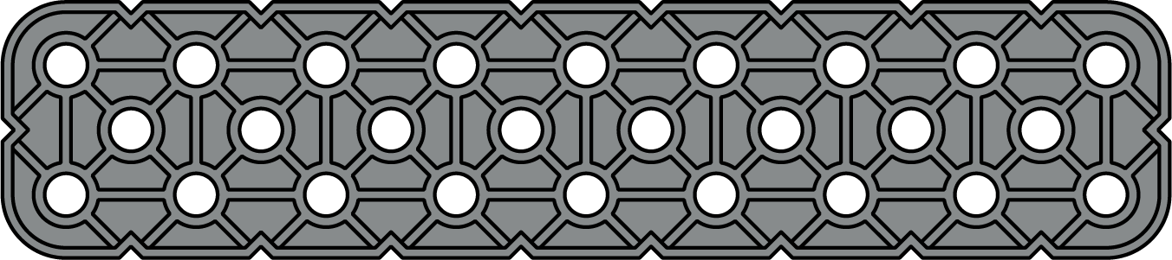

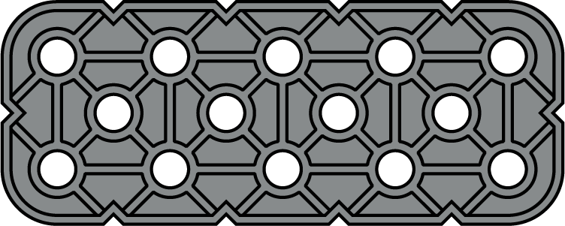
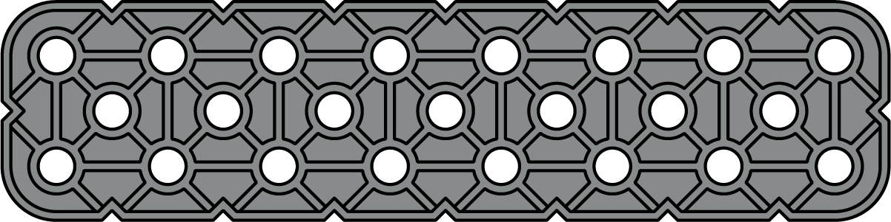

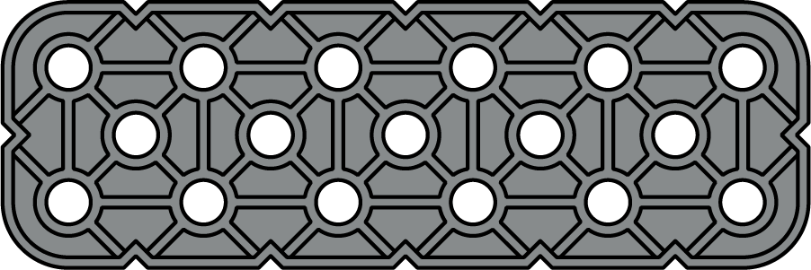
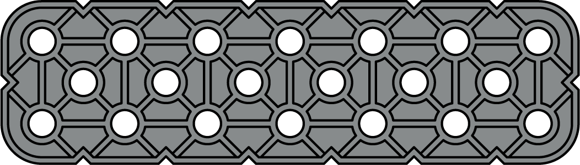
Structure - 2x Beams (Full Scale)
2x2 Beam
228-2500-017
2x11 Beam
228-2500-206
2x3 Beam
228-2500-018
2x10 Beam
228-2500-025
2x4 Beam
228-2500-019
2x9 Beam
228-2500-024
2x5 Beam
228-2500-020
2x8 Beam
228-2500-023
2x6 Beam
228-2500-021
2x7 Beam
228-2500-022

Slide 18
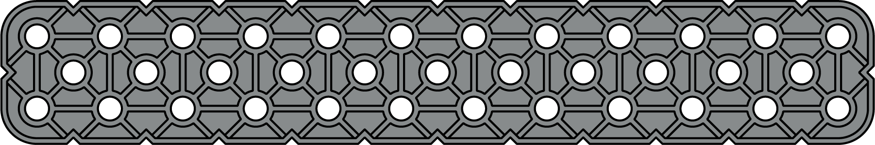
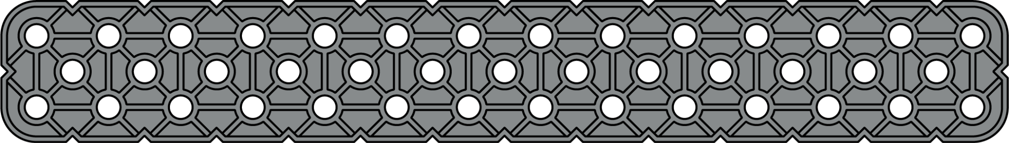
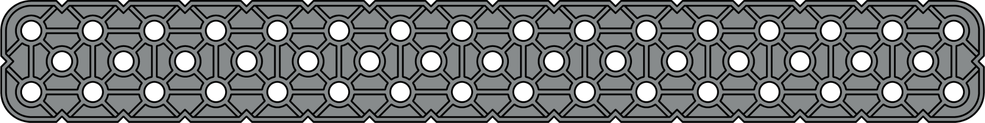
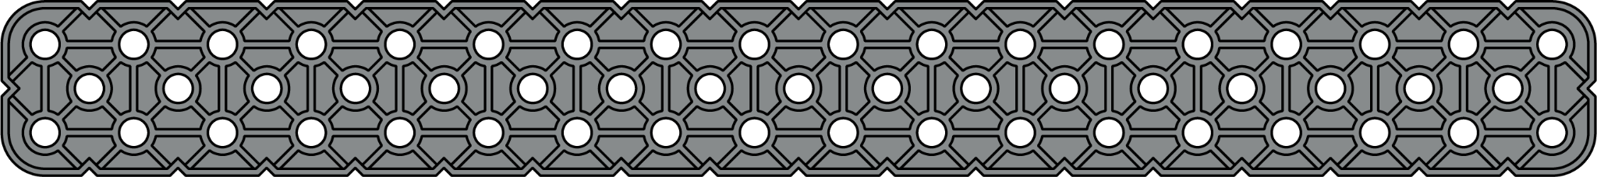
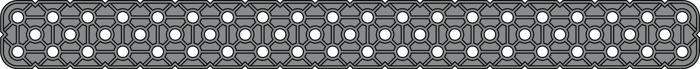
Structure - 2x Beams (Full Scale)
2x12 Beam
228-2500-026
2x14 Beam
228-2500-027
2x16 Beam
228-2500-028
2x18 Beam
228-2500-029
2x20 Beam
228-2500-030

Slide 19
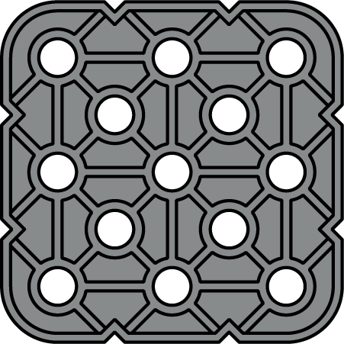
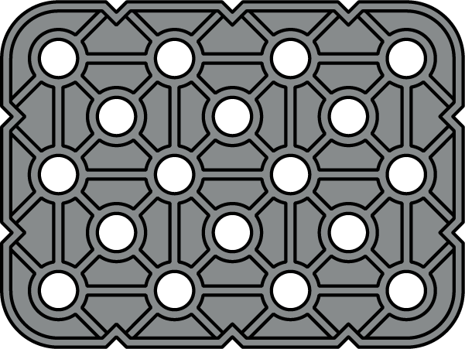
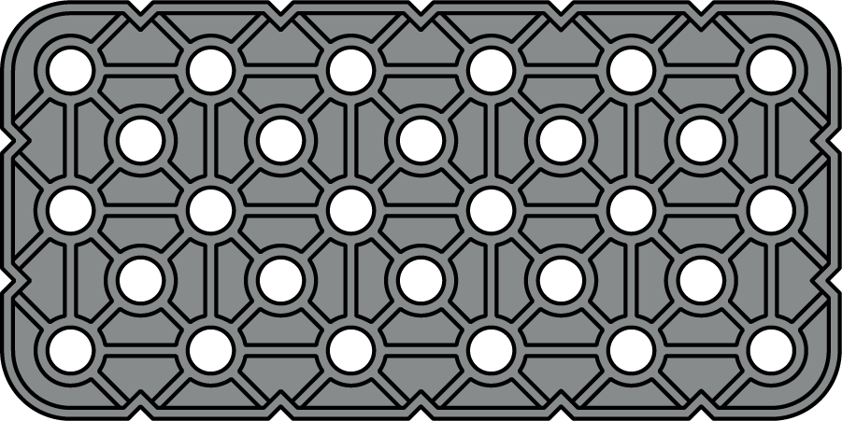


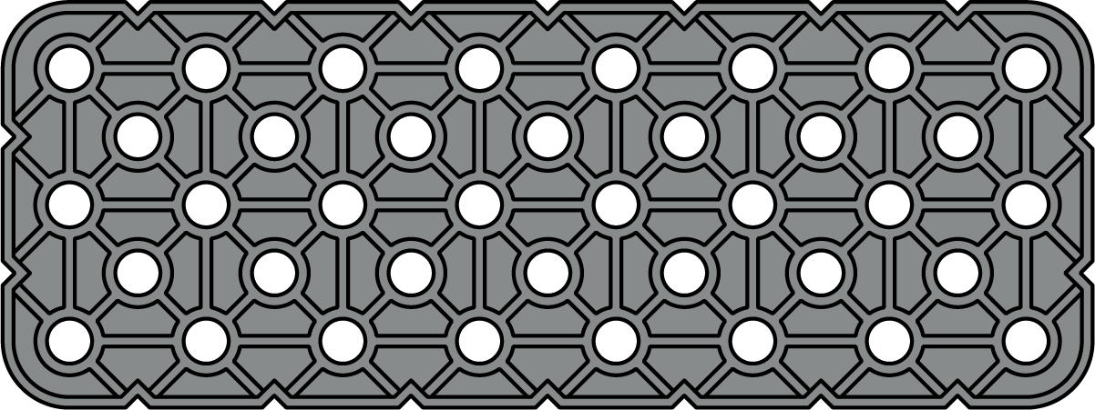
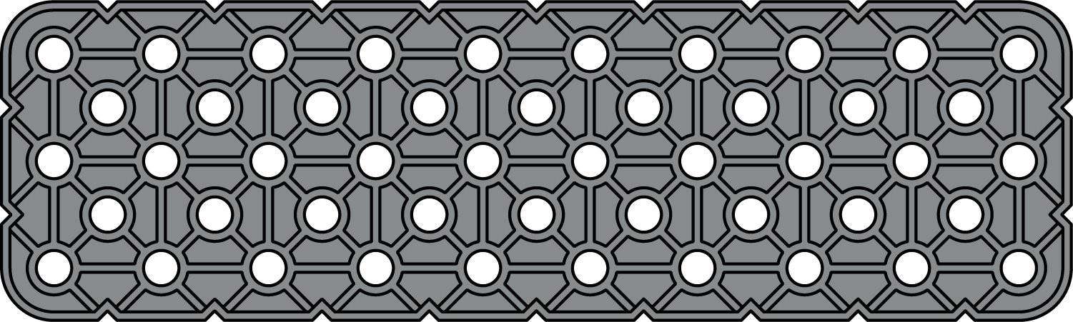
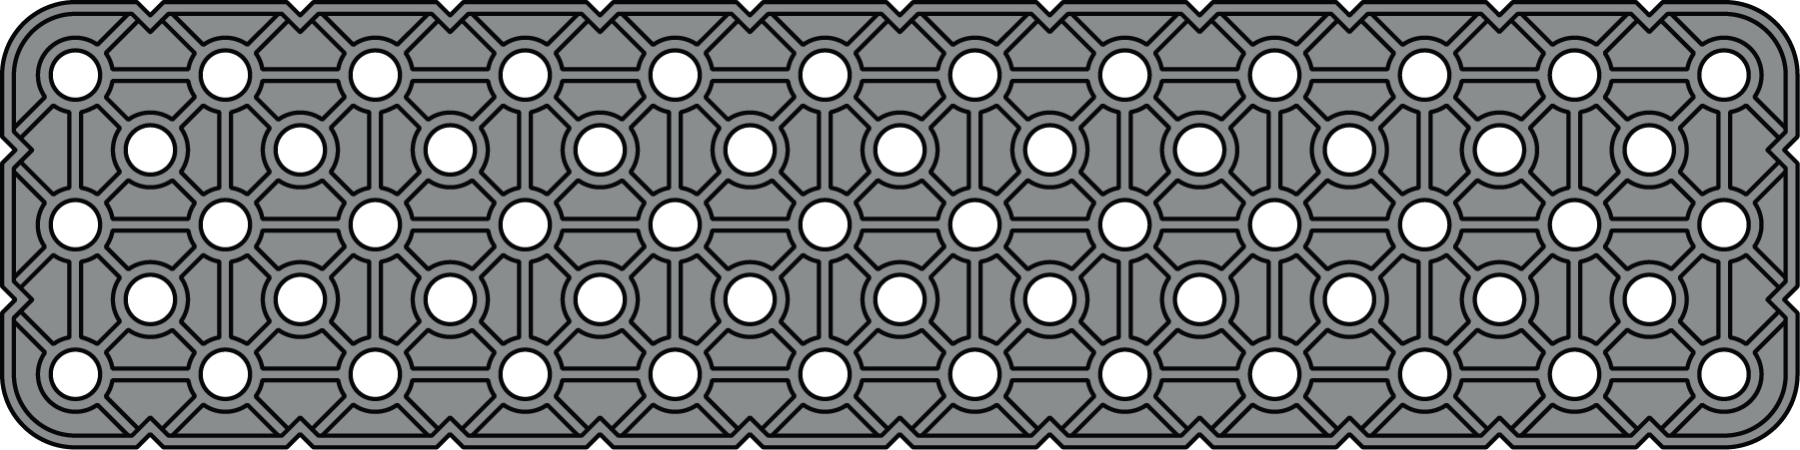
Structure - Plates (Full Scale)
3x3 Plate
228-2500-031
3x4 Plate
228-2500-032
3x6 Plate
228-2500-034
3x8 Plate
228-2500-035
3x10 Plate
228-2500-036
3x12 Plate
228-2500-037

Slide 20
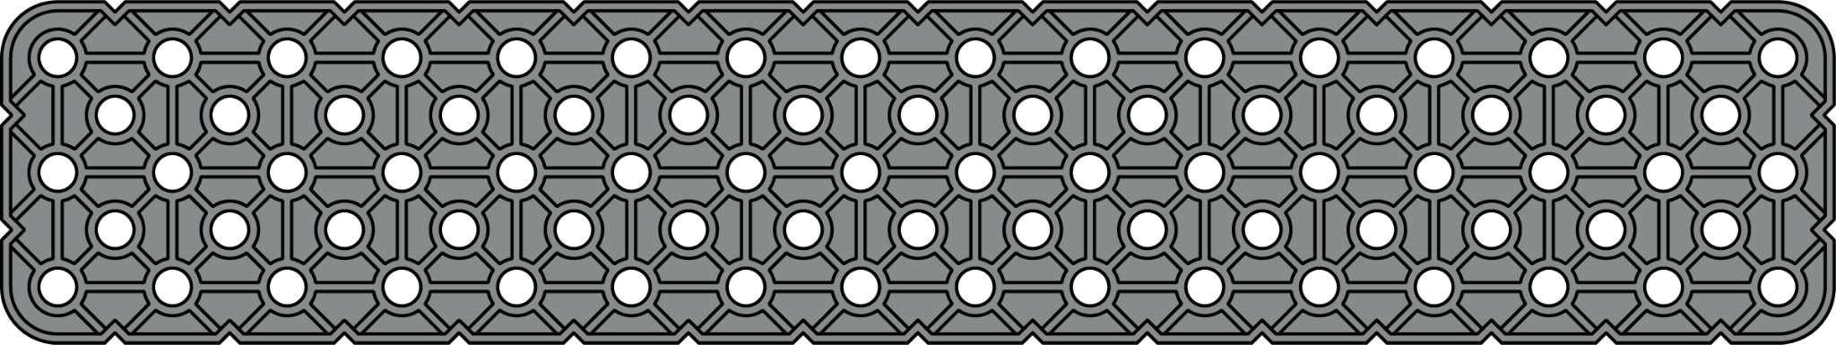
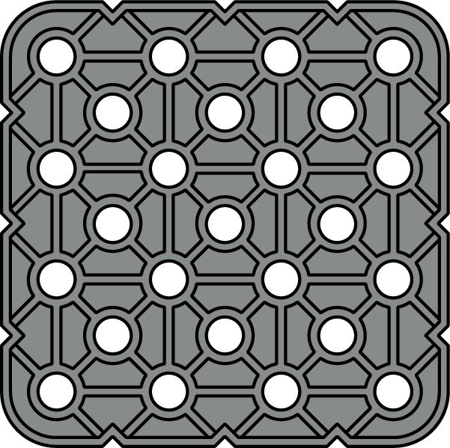



Structure - Plates (Full Scale)
3x16 Plate
228-2500-038
4x4 Plate
228-2500-040
4x6 Plate
228-2500-042
4x8 Plate
228-2500-043

Slide 21



Structure - Plates - Page 3 (Full Scale)
4x10 Plate
228-2500-044
4x12 Plate
228-2500-045
4x16 Plate
228-2500-046

Slide 22


Structure - Plates (Full Scale)
6x12 Plate
228-2500-051
12x12 Plate
228-2500-059

Slide 23















Structure - Specialty Beams (Full Scale)
3x3 30 Degree Angle Beam
228-2500-147
2x6x2 30 Degree Jogged Beam
228-2500-1556
2x2 30 Degree Beam
228-2500-1485
2x2 45 Degree Beam
228-2500-1486
3x3 45 Degree Angle Beam
228-2500-148
3x3 60 Degree Angle Beam
228-2500-149
2x Wide, 3x3 60 Degree Angle Beam
228-2500-1268
2x4x2 Double 60 Degree Beam
228-2500-1199

Slide 24












Structure - Specialty Beams (Full Scale)
2x3 Right Angle Beam
228-2500-145
3x3 Right Angle Beam
228-2500-146
3x5 Right Angle Beam
228-2500-150
5x2x2 Tee Beam
228-2500-1601
6x2x2 Tee Beam
228-2500-478
4x4 Offset Right Angle Beam
228-2500-151
5x6.5 Tee Beam
228-2500-152
3x4 Tee Beam
228-2500-144

Slide 25








Structure - Specialty Beams (Full Scale)
2x4 Wedge Beam
228-2500-1240
2x3 Delta Tee Beam
228-2500-1189
3x5 Wedge Beam
228-2500-1245
4x7x4 Offset Channel Beam
228-2500-2001
7x9x11 (6x8x10 Triangle) Truss Plate
228-2500-1117

Slide 26





Structure - Specialty Beams (Full Scale)
3x3 Plus Gusset Beam
228-2500-156
3x4 1x Offset Trapezoid Plate
228-2500-1357
6x10 Bone Plate
228-2500-203
3x12 Girder Plate; 2x8 2x Offset Trapezoid
228-2500-1600

Slide 27



Structure - Specialty Beams (Full Scale)
12x12 Truss Plate
228-2500-205
1x6 (3-4-5 Triangle) Diagonal Offset Truss Beam
228-2500-1110

Slide 28

Structure - Specialty Beams (Full Scale)
14x14 Octagon Truss Plate
228-2500-1381

Slide 29





Structure - Specialty Beams (Full Scale)
6x6 Hexagon Plate
228-2500-2000
17x Robot Arm Beam
228-2500-471
12x Robot Arm Beam
228-2500-472
Hand Knob
228-2500-473

Slide 30















Structure - Specialty Beams (Full Scale)
2x2 Center Lock Beam
228-2500-1140
1x3 Center Lock Beam
228-2500-1141
1x4 Low Profile End Lock Beam
228-2500-1548
2x2 Center Offset Round Lock Beam
228-2500-1925
3x3 Wye Lock Beam
228-2500-1159
6x Pitch Cube Face
228-2500-204
2x1x1 Landing Gear Beam
228-2500-1924
Rubber Band Anchor
228-2500-157

Slide 31
















Structure - Panels (Full Scale)
2x2, Extended 0.5 x 1x Pitch Sloped Panel
228-2500-1702
2x4, Extended 0.5 x 1x Pitch Sloped Panel
228-2500-1704
2x5, Extended 0.5 x 1x Pitch Sloped Panel
228-2500-1705
1x1 Smooth Panel
228-2500-510
1x2 Smooth Panel
228-2500-511
1x4 Smooth Panel
228-2500-513
2x4 Smooth Panel
228-2500-520
2x8 Smooth Panel
228-2500-524
00000X
Team Number Plate
228-2500-291

Slide 32
























Structure - Corner Beams (Full Scale)
2x2 Left Corner Beam
228-2500-406
1x1 Left Corner Beam
228-2500-391
2x2 Right Corner Beam
228-2500-407
1x1 Right Corner Beam
228-2500-392
2x1 Extended Left Corner Beam
228-2500-408
2x1 Left Corner Beam
228-2500-400
2x1 Extended Right Corner Beam
228-2500-409
2x1 Right Corner Beam
228-2500-401
2x2 Extended Left Corner Beam
228-2500-412
2x2 Extended Right Corner Beam
228-2500-413

Slide 33






















Structure - Connectors (Full Scale)
1x Wide, 1x1 Corner Connector
228-2500-129
2x Wide, 1x2 Corner Connector
228-2500-128
1x Wide, 1x2 Corner Connector
228-2500-279
2x Wide, 1x2 Offset Corner Connector
228-2500-135
1x Wide, 1x1 Offset Corner Connector
228-2500-130
2x Wide, 2x2 Corner Connector
228-2500-134
2x Wide, 1x1 Offset Corner Connector
228-2500-133
2x Wide, 2x2 Offset Corner Connector
228-2500-136
2x Wide, 2x1 Corner Connector
228-2500-132
2x Wide, 2x1 Offset Corner Connector
228-2500-131
2x Wide, 2x3 Corner Connector
228-2500-137

Slide 34


















Structure - Connectors (Full Scale)
Double 1x Wide, 1x1 Corner Connector
228-2500-270
2x Wide, 60 Degree Omni 1x2 Corner Connector
228-2500-368
Triple 1x Wide, 1x1 Corner Connector
228-2500-1250
2x Wide, 30 Degree Left 1x2 Corner Connector
228-2500-372
Small Chassis Corner Connector
228-2500-127
2x Wide, 30 Degree Right 1x2 Corner Connector
228-2500-371
Double 1x Wide, 2x1 Corner Connector
228-2500-272
2x Wide, 1x3 Offset Corner Connector
228-2500-283
Triple 1-2-1x Wide, 1x2 Corner Connector
228-2500-1251

Slide 35




















Structure - Connectors (Full Scale)
Double 2x Wide, 1x2 Corner Connector
228-2500-271
Large Chassis Corner Connector
228-2500-126
Double 2x Wide, 1x2 Offset Corner Connector
228-2500-274
Triple 2x Wide, 2x2 Corner Connector
228-2500-1253
Double 2x Wide, 2x2 Corner Connector
228-2500-220
Quad 2x Wide, 2x2 Corner Connector
228-2500-1258
Double 2x Wide, 2x2 Double Offset Corner Connector
228-2500-277
1x2 Left Chassis Corner Connector
228-2500-1254
Double 2x Wide, ½” Pipe Connector
228-2500-259
1x2 Right Chassis Corner Connector
228-2500-1255

Slide 36




























Structure - Standoffs (Full Scale)
0.25x Pitch Standoff
228-2500-063
Shaft Bushing
228-2500-125
0.5x Pitch Standoff Extender
228-2500-109
0.5x Pitch Standoff
228-2500-064
Straight Standoff Connector
228-2500-171
End Standoff Connector
228-2500-172
1x Pitch Standoff
228-2500-065
1.5x Pitch Standoff
228-2500-066
45 Degree Standoff Connector
228-2500-175
90 Degree Standoff Connector
228-2500-178
2x Pitch Standoff
228-2500-067
15 Degree Offset Locking Angle End Standoff Connector
228-2500-192
Mini Standoff Connector
228-2500-170
3x Pitch Standoff
228-2500-069
4x Pitch Standoff
228-2500-070
Universal Joint
228-2500-350
Truss Standoff Connector
228-2500-1109
6x Pitch Standoff
228-2500-072
1x1 Idler Pin
228-2500-073
0x2 Idler Pin
228-2500-084
8x Pitch Standoff
228-2500-1061
0x2 Connector Pin
228-2500-086
0x3 Connector Pin
228-2500-087
1x1 Connector Pin
228-2500-060
1x2 Connector Pin
228-2500-061
2x2 Connector Pin
228-2500-062

Slide 37
















Motion - Gears (Full Scale)
12 Tooth Gear
228-2500-213
1x4 Crank Gear with 23 Tooth Gear
228-2500-246
24 Tooth Gear
228-2500-227
48 Tooth Gear
228-2500-228
36 Tooth Gear
228-2500-214
60 Tooth Gear
228-2500-215
36 Tooth Crown Gear
228-2500-218
Worm Gear
228-2500-219

Slide 38
















Motion - Gears (Full Scale)
Differential Gear
228-2500-245
High Strength Differential Gear
228-2500-347
15 Tooth Gear (34DP)
228-2500-461
12 Tooth High Strength Bevel Gear
228-2500-463
36 Tooth Gear (34DP)
228-2500-462
18 Tooth Bevel Gear
228-2500-244
36 Tooth Idler Gear
228-2500-451

Slide 39
















Motion - Gears (Full Scale)
12 Tooth Hybrid Gear
228-2500-250
8 Tooth High Strength Hybrid Gear
228-2500-2180
24 Tooth Hybrid Gear
228-2500-251
16 Tooth High Strength Hybrid Gear
228-2500-2181
36 Tooth Hybrid Gear
228-2500-252
24 Tooth High Strength Hybrid Gear
228-2500-2182
48 Tooth Hybrid Gear
228-2500-253
60 Tooth Hybrid Gear
228-2500-254

Slide 40






Motion - Turntables (Full Scale)
Small Turntable Center Bushing
228-2500-191
Small Turntable Outer Housing
228-2500-193
Large Turntable Center Bushing
228-2500-194
Large Turntable Outer Bushing
228-2500-195

Slide 41



Motion - Turntables (Full Scale)
XL Turntable Outer Housing
228-2500-199
XL Turntable Plain Bushing
228-2500-200
XL Turntable 36 Tooth Ring Gear Bushing
228-2500-202

Slide 42


Motion - Ring Gears (Full Scale)
Spider 48 Tooth Ring Gear
228-2500-229
60 Tooth Internal Ring Gear
228-2500-247

Slide 43


















Motion - Linear Motion (Full Scale)
1x20 Linear Motion Rack Gear
228-2500-1454
1x6 Linear Motion Rack Gear
228-2500-1472
2x Pitch Linear Motion Bracket (Side Mount)
228-2500-1469
1x Pitch Linear Motion Bracket (Snap Mount)
228-2500-1470
1x6 Continuous Linear Motion Rack Gear
228-2500-1473
1x5 Linear Motion Beam
228-2500-1456
Rack Gear
228-2500-216
1x6 Linear Motion Beam
228-2500-1457
1x8 Linear Motion Beam
228-2500-1459
Linear Slide
228-2500-217

Slide 44





















Motion - Sprockets & Chain (Full Scale)
8 Tooth Sprocket
228-2500-232
32 Tooth Sprocket
228-2500-236
16 Tooth Sprocket
228-2500-233
24 Tooth Sprocket
228-2500-235
40 Tooth Sprocket
228-2500-237
Tank Tread/Attachment Link
228-2500-231
Chain Link
228-2500-230
Long Intake Flap
228-2500-242
Medium Intake Flap
228-2500-241
Short Intake Flap
228-2500-240
Traction Link
228-2500-239

Slide 45





Motion - Cams (Full Scale)
Cam Follower
228-2500-1303
Small 2x Pitch Drop Cam
228-2500-1305
Large 1x Pitch Drop Cam
228-2500-1306

Slide 46
















Motion - Pulleys (Full Scale)
10mm Pulley
228-2500-163
1x Wide Spool
228-2500-420
20mm Pulley
228-2500-164
2x Wide Spool
228-2500-421
30mm Pulley
228-2500-165
6x Pitch Flywheel
228-2500-1402
40mm Pulley
228-2500-166
1x3 Large Crane Hook
228-2500-1658
0.5x Pitch Idler Pulley
228-2500-1413

Slide 47












Motion - Miscellaneous (Full Scale)
16 Tooth Ratchet
228-2500-1407
1x3 Ball Socket Linkage
228-2500-1664
1x4 Ball Socket Linkage
228-2500-1665
40 Tooth Ratchet
228-2500-1410
1x4 Single-Ended Ball Socket Beam
228-2500-1689
Short Low-Profile Pawl
228-2500-1411
2x Pitch Shock Absorber (Strong)
228-2500-1480
2x Pitch Shock Absorber (Weak)
228-2500-1560

Slide 48









Motion - Shafts (Full Scale)
1.5x Pitch Capped Shaft
228-2500-2218
2x Pitch Shaft
228-2500-074, 117
2x Pitch Motor Shaft
228-2500-078, 2234
2x Pitch Capped Shaft
228-2500-080, 2219
3x Pitch Shaft
228-2500-075, 119
3x Pitch Motor Shaft
228-2500-094, 2236
2.5x Pitch Capped Shaft
228-2500-2220
4x Pitch Shaft
228-2500-076, 120
4x Pitch Motor Shaft
228-2500-079, 2238
3x Pitch Capped Shaft
228-2500-081, 2221
5x Pitch Shaft
228-2500-077, 121
3.5x Pitch Capped Shaft
228-2500-2222
6x Pitch Shaft
228-2500-122
4x Pitch Capped Shaft
228-2500-082, 2223
7x Pitch Shaft
228-2500-123
4.5x Pitch Capped Shaft
228-2500-2224
8x Pitch Shaft
228-2500-124
5x Pitch Capped Shaft
228-2500-083, 2225
9x Pitch Shaft
228-2500-260
10x Pitch Shaft
228-2500-261

Slide 49




Motion - Shafts (Full Scale)
11x Pitch Shaft
228-2500-262
12x Pitch Shaft
228-2500-263
14x Pitch Shaft
228-2500-264
16x Pitch Shaft
228-2500-265
18x Pitch Shaft
228-2500-266
20x Pitch Shaft
228-2500-267
22x Pitch Shaft
228-2500-268
24x Pitch Shaft
228-2500-269
High Strength Shaft Adapter (1/8" Square Bore, 1/2" Long)
228-2500-454
Rubber Shaft Collar
228-2500-143

Slide 50












Motion - Wheels (Full Scale)
2x Wide Hub, 3x Pitch Diameter Tire (Straight Offroad Tread)
228-2500-1950, 1951
200mm Omni-Directional Wheel
228-2536
4x Pitch Diameter (160 mm Travel) Smooth Wheel
228-2500-1383
2x Wide Hub, 3.5x Pitch Diameter Balloon Tire (Chevron Offroad Tread)
228-2500-1950, 1952
2x Wide Hub, 3.5x Pitch Diameter Balloon Tire (Trapezoid Offroad Tread)
228-2500-1950, 1957
Large Wheel Hub, 250 mm Travel Tire
228-2500-211, 212

Slide 51




Motion - Wheels (Full Scale)
2x Wide, 7x Pitch Diameter Balloon Tire (Racing Slick Tread)
228-2500-1953, 1954
2x Wide, 7x Pitch Diameter Balloon Tire (Offroad Hex Tread)
228-2500-1953, 1955

Slide 52








Motion - Wheels (Full Scale)
2x Wide, 5.5x Pitch Diameter Balloon Tire (Trapezoid Offroad Tread)
228-2500-1953, 1956
Small Wheel Hub, 200mm Travel Tire
228-2500-1208, 209
2x Wide, 5x Pitch Diameter Balloon Tire (Racing Slick Tread)
228-2500-1953, 1958
Small Wheel Hub, 160mm Travel Tire
228-2500-1208, 210

Slide 53



Game Elements - Level Up (Full Scale)
Level Up Scoring Object
228-9258-012

Slide 54
Half Scale IQ Parts

Slide 55
Pneumatics (Half Scale)
Pneumatic Control Unit
228-8795
Pneumatic Pump
228-8795
Pneumatic Fittings
228-8795
Air Tank
228-8795
2x Pitch Pneumatic Cylinder
228-8795
4x Pitch Pneumatic Cylinder
228-8795

Slide 56
Electronics & Accessories (Half Scale)
IQ Smart Motor
228-2560
IQ Robot Brain (1st Gen)
228-2540
Single Motor Support Cap
228-2500-159
Dual Motor Support Cap
228-2500-160
IQ Robot Brain (2nd Gen)
228-6480
Cable Anchor
228-2500-158
IQ Touch LED
228-3010
IQ Color Sensor
228-3012
IQ Distance Sensor (2nd Gen)
228-7106
IQ AI Vision Sensor
228-3012
IQ Optical Sensor
228-7082
IQ Gyro Sensor
228-3014
IQ Bumper Switch
228-2677
IQ Distance Sensor (1st Gen)
228-3011

Slide 57
Structure - 1x Beams (Half Scale)
1x1 Beam
228-2500-154
1x2 Beam
228-2500-001
1x3 Beam
228-2500-002
1x4 Beam
228-2500-003
1x5 Beam
228-2500-004
1x6 Beam
228-2500-005
1x7 Beam
228-2500-006
1x8 Beam
228-2500-007
1x9 Beam
228-2500-008
1x10 Beam
228-2500-009
1x11 Beam
228-2500-010
1x12 Beam
228-2500-011
1x13 Beam
228-2500-012
1x14 Beam
228-2500-013
1x16 Beam
228-2500-014
1x18 Beam
228-2500-015
1x20 Beam
228-2500-016

Slide 58
Structure - 2x Beams (Half Scale)
2x2 Beam
228-2500-017
2x20 Beam
228-2500-030
2x3 Beam
228-2500-018
2x18 Beam
228-2500-029
2x4 Beam
228-2500-019
2x16 Beam
228-2500-028
2x5 Beam
228-2500-020
2x14 Beam
228-2500-027
2x6 Beam
228-2500-021
2x12 Beam
228-2500-026
2x7 Beam
228-2500-022
2x11 Beam
228-2500-206
2x8 Beam
228-2500-023
2x10 Beam
228-2500-025
2x9 Beam
228-2500-024

Slide 59
Structure - Plates (Half Scale)
3x3 Plate
228-2500-031
3x4 Plate
228-2500-032
3x6 Plate
228-2500-034
3x8 Plate
228-2500-035
3x10 Plate
228-2500-036
3x12 Plate
228-2500-037
3x16 Plate
228-2500-038
4x4 Plate
228-2500-040
4x6 Plate
228-2500-042
4x8 Plate
228-2500-043
4x10 Plate
228-2500-044
4x12 Plate
228-2500-045
4x16 Plate
228-2500-046

Slide 60
Structure - Plates - (Half Scale)
6x12 Plate
228-2500-051
12x12 Plate
228-2500-059

Slide 61
Structure - Specialty Beams (Half Scale)
3x3 30 Degree Angle Beam
228-2500-147
2x6x2 30 Degree Jogged Beam
228-2500-1556
2x2 30 Degree Beam
228-2500-1485
2x2 45 Degree Beam
228-2500-1486
3x3 45 Degree Angle Beam
228-2500-148
3x3 60 Degree Angle Beam
228-2500-149
2x4x2 Double 60 Degree Beam
228-2500-1199
2x Wide, 3x3 60 Degree Angle Beam
228-2500-1268
2x3 Right Angle Beam
228-2500-145
3x3 Right Angle Beam
228-2500-146
3x5 Right Angle Beam
228-2500-150
4x4 Offset Right Angle Beam
228-2500-151
4x7x4 Offset Channel Beam
228-2500-2001
6x2x2 Tee Beam
228-2500-478
5x2x2 Tee Beam
228-2500-1601
7x9x11 (6x8x10 Triangle) Truss Plate
228-2500-1117
3x5 Wedge Beam
228-2500-1245
2x4 Wedge Beam
228-2500-1240
5x6.5 Tee Beam
228-2500-152
3x4 Tee Beam
228-2500-144
2x3 Delta Tee Beam
228-2500-1189

Slide 62
Structure - Specialty Beams (Half Scale)
6x10 Bone Plate
228-2500-203
1x6 (3-4-5 Triangle) Diagonal Offset Truss Beam
228-2500-1110
12x12 Truss Plate
228-2500-205
14x14 Octagon Truss Plate
228-2500-1381
6x6 Hexagon Plate
228-2500-2000
3x12 Girder Plate; 2x8 2x Offset Trapezoid
228-2500-1600
3x4 1x Offset Trapezoid Plate
228-2500-1357
3x3 Plus Gusset Beam
228-2500-156

Slide 63
Structure - Specialty Beams - (Half Scale)
1x3 Center Lock Beam
228-2500-1141
1x4 Low Profile End Lock Beam
228-2500-1548
2x2 Center Offset Round Lock Beam
228-2500-1925
2x2 Center Lock Beam
228-2500-1140
3x3 Wye Lock Beam
228-2500-1159
2x1x1 Landing Gear Beam
228-2500-1924
Rubber Band Anchor
228-2500-157
Hand Knob
228-2500-473
17x Robot Arm Beam
228-2500-471
00000X
Team Number Plate
228-2500-291
12x Robot Arm Beam
228-2500-472
2x2, Extended 0.5 x 1x Pitch Sloped Panel
228-2500-1702
2x4, Extended 0.5 x 1x Pitch Sloped Panel
228-2500-1704
2x5, Extended 0.5 x 1x Pitch Sloped Panel
228-2500-1705
6x Pitch Cube Face
228-2500-204
1x1 Smooth Panel
228-2500-510
1x2 Smooth Panel
228-2500-511
1x4 Smooth Panel
228-2500-513
2x4 Smooth Panel
228-2500-520
2x8 Smooth Panel
228-2500-524

Slide 64
Structure - Corner Beams (Half Scale)
2x2 Left Corner Beam
228-2500-406
2x2 Right Corner Beam
228-2500-407
2x1 Extended Left Corner Beam
228-2500-408
2x1 Extended Right Corner Beam
228-2500-409
2x2 Extended Left Corner Beam
228-2500-412
2x2 Extended Right Corner Beam
228-2500-413
1x1 Left Corner Beam
228-2500-391
1x1 Right Corner Beam
228-2500-392
2x1 Left Corner Beam
228-2500-400
2x1 Right Corner Beam
228-2500-401

Slide 65
Structure - Connectors (Half Scale)
1x2 Left Chassis Corner Connector
228-2500-1254
1x2 Right Chassis Corner Connector
228-2500-1255
2x Wide, 30 Degree Right 1x2 Corner Connector
228-2500-371
2x Wide, 30 Degree Left 1x2 Corner Connector
228-2500-372
Large Chassis Corner Connector
228-2500-126
1x Wide, 1x2 Corner Connector
228-2500-279
Small Chassis Corner Connector
228-2500-127
2x Wide, 1x3 Offset Corner Connector
228-2500-283
2x Wide, 1x2 Corner Connector
228-2500-128
Double 2x Wide, 2x2 Double Offset Corner Connector
228-2500-277
1x Wide, 1x1 Corner Connector
228-2500-129
1x Wide, 1x1 Offset Corner Connector
228-2500-130
2x Wide, 60 Degree Omni 1x2 Corner Connector
228-2500-368
Triple 1x Wide, 1x1 Corner Connector
228-2500-1250
2x Wide, 2x1 Offset Corner Connector
228-2500-131

Slide 66
Structure - Connectors (Half Scale)
2x Wide, 2x1 Corner Connector
228-2500-132
Quad 2x Wide, 2x2 Corner Connector
228-2500-1258
2x Wide, 1x1 Offset Corner Connector
228-2500-133
Triple 2x Wide, 2x2 Corner Connector
228-2500-1253
2x Wide, 2x2 Corner Connector
228-2500-134
2x Wide, 2x3 Corner Connector
228-2500-137
2x Wide, 1x2 Offset Corner Connector
228-2500-135
Double 2x Wide, 2x2 Corner Connector
228-2500-220
2x Wide, 2x2 Offset Corner Connector
228-2500-136
Double 2x Wide, 1x2 Offset Corner Connector
228-2500-274
Double 1x Wide, 1x1 Corner Connector
228-2500-270
Double 2x Wide, ½” Pipe Connector
228-2500-259
Double 2x Wide, 1x2 Corner Connector
228-2500-271
Triple 1-2-1x Wide, 1x2 Corner Connector
228-2500-1251
Double 1x Wide, 2x1 Corner Connector
228-2500-272

Slide 67
Structure - Standoffs (Half Scale)
0.25x Pitch Standoff
228-2500-063
Mini Standoff Connector
228-2500-170
0.5x Pitch Standoff
228-2500-064
Straight Standoff Connector
228-2500-171
1x Pitch Standoff
228-2500-065
End Standoff Connector
228-2500-172
1.5x Pitch Standoff
228-2500-066
45 Degree Standoff Connector
228-2500-175
2x Pitch Standoff
228-2500-067
90 Degree Standoff Connector
228-2500-178
3x Pitch Standoff
228-2500-069
15 Degree Offset Locking Angle End Standoff Connector
228-2500-192
4x Pitch Standoff
228-2500-070
Truss Standoff Connector
228-2500-1109
6x Pitch Standoff
228-2500-072
8x Pitch Standoff
228-2500-1061
Rubber Shaft Collar
228-2500-143
0.5x Pitch Standoff Extender
228-2500-109
Shaft Bushing
228-2500-125
Universal Joint
228-2500-350

Slide 68
Motion - Gears (Half Scale)
12 Tooth Gear
228-2500-213
12 Tooth Hybrid Gear
228-2500-250
8 Tooth High Strength Hybrid Gear
228-2500-2180
24 Tooth Gear
228-2500-227
24 Tooth Hybrid Gear
228-2500-251
16 Tooth High Strength Hybrid Gear
228-2500-2181
36 Tooth Gear
228-2500-214
36 Tooth Hybrid Gear
228-2500-252
24 Tooth High Strength Hybrid Gear
228-2500-2182
12 Tooth High Strength Bevel Gear
228-2500-463
48 Tooth Gear
228-2500-228
48 Tooth Hybrid Gear
228-2500-253
15 Tooth Gear (34DP)
228-2500-461
36 Tooth Gear (34DP)
228-2500-462
60 Tooth Gear
228-2500-215
60 Tooth Hybrid Gear
228-2500-254
18 Tooth Bevel Gear
228-2500-244
36 Tooth Idler Gear
228-2500-451
1x4 Crank Gear w/ 23T Gear
228-2500-246
Worm Gear
228-2500-219
36 Tooth Crown Gear
228-2500-218
Differential Gear
228-2500-245
High Strength Differential Gear
228-2500-347

Slide 69
Motion - Turntables & Ring Gears (Half Scale)
Small Turntable Center Bushing
228-2500-191
Small Turntable Outer Housing
228-2500-193
Large Turntable Center Bushing
228-2500-194
Large Turntable Outer Bushing
228-2500-195
XL Turntable Outer Housing
228-2500-199
XL Turntable 36T Ring Gear Bushing
228-2500-202
XL Turntable Plain Bushing
228-2500-200
Spider 48 Tooth Ring Gear
228-2500-229
60 Tooth Internal Ring Gear
228-2500-247

Slide 70
Motion - Linear Motion (Half Scale)
1x20 Linear Motion Rack Gear
228-2500-1454
1x6 Linear Motion Rack Gear
228-2500-1472
1x6 Continuous Linear Motion Rack Gear
228-2500-1473
Rack Gear
228-2500-216
1x5 Linear Motion Beam
228-2500-1456
1x6 Linear Motion Beam
228-2500-1457
1x8 Linear Motion Beam
228-2500-1459
2x Pitch Linear Motion Bracket (Side Mount)
228-2500-1469
1x Pitch Linear Motion Bracket (Snap Mount)
228-2500-1470
Linear Slide
228-2500-217

Slide 71
Motion - Sprockets & Chain (Half Scale)
8 Tooth Sprocket
228-2500-232
Traction Link
228-2500-239
Short Intake Flap
228-2500-240
Medium Intake Flap
228-2500-241
Long Intake Flap
228-2500-242
16 Tooth Sprocket
228-2500-233
Tank Tread/ Attachment Link
228-2500-231
Chain Link
228-2500-230
24 Tooth Sprocket
228-2500-235
32 Tooth Sprocket
228-2500-236
40 Tooth Sprocket
228-2500-237

Slide 72
Motion - Pulleys & Misc. (Half Scale)
10mm Pulley
228-2500-163
16 Tooth Ratchet
228-2500-1407
20mm Pulley
228-2500-164
Small 2x Pitch Drop Cam
228-2500-1305
40 Tooth Ratchet
228-2500-1410
30mm Pulley
228-2500-165
1x3 Ball Socket Linkage
228-2500-1664
Large 1x Pitch Drop Cam
228-2500-1306
1x4 Ball Socket Linkage
228-2500-1665
40mm Pulley
228-2500-166
1x4 Single-Ended Ball Socket Beam
228-2500-1689
Cam Follower
228-2500-1303
0.5x Pitch Idler Pulley
228-2500-1413
2x Pitch Shock Absorber (Strong)
228-2500-1480
1x Wide Spool
228-2500-420
2x Pitch Shock Absorber (Weak)
228-2500-1560
2x Wide Spool
228-2500-421
Short Low-Profile Pawl
228-2500-1411
1x3 Large Crane Hook
228-2500-1658
6x Pitch Flywheel
228-2500-1402

Slide 73
Motion - Shafts - (Half Scale)
2x Pitch Shaft
228-2500-074, 117
2x Pitch Motor Shaft
228-2500-078, 2234
1.5x Pitch Capped Shaft
228-2500-2218
3x Pitch Shaft
228-2500-075, 119
3x Pitch Motor Shaft
228-2500-094, 2236
2x Pitch Capped Shaft
228-2500-080, 2219
4x Pitch Shaft
228-2500-076, 120
4x Pitch Motor Shaft
228-2500-079, 2238
2.5x Pitch Capped Shaft
228-2500-2220
5x Pitch Shaft
228-2500-077, 121
3x Pitch Capped Shaft
228-2500-081, 2221
High Strength Shaft Adapter (1/8" Square Bore, 1/2" Long)
228-2500-454
6x Pitch Shaft
228-2500-122
3.5x Pitch Capped Shaft
228-2500-2222
7x Pitch Shaft
228-2500-123
4x Pitch Capped Shaft
228-2500-082, 2224
8x Pitch Shaft
228-2500-124
4.5x Pitch Capped Shaft
228-2500-2224
9x Pitch Shaft
228-2500-260
5x Pitch Capped Shaft
228-2500-083, 2225
10x Pitch Shaft
228-2500-261
11x Pitch Shaft
228-2500-262
18x Pitch Shaft
228-2500-266
12x Pitch Shaft
228-2500-263
20x Pitch Shaft
228-2500-267
14x Pitch Shaft
228-2500-264
22x Pitch Shaft
228-2500-268
16x Pitch Shaft
228-2500-265
24x Pitch Shaft
228-2500-269

Slide 74
Motion - Wheels - (Half Scale)
4x Pitch (160mm Travel) Smooth Wheel
228-2500-1383
2x Wide Hub, 3x Pitch Tire (Straight Offroad Tread)
228-2500-1950,1951
2x Wide, 5.5x Pitch Tire (Trapezoid Offroad Tread)
228-2500-1953,1956
2x Wide Hub, 3.5x Pitch Tire (Chevron Offroad Tread)
228-2500-1950,1952
2x Wide Hub, 3.5x Pitch Tire (Trapezoid Offroad Tread)
228-2500-1950,1957
2x Wide, 5x Pitch Tire (Racing Slick Tread)
228-2500-1953,1958
200mm Omni-Directional Wheel
228-2536
Large Wheel Hub, 250 mm Travel Tire
228-2500-1211,212
2x Wide, 7x Pitch Balloon Tire (Racing Slick Tread)
228-2500-1953,1954
2x Wide, 7x Pitch Balloon Tire (Offroad Hex Tread)
228-2500-1953,1955

Slide 75
Motion - Wheels (Half Scale)
Small Wheel Hub, 200mm Travel Tire
228-2500-1208, 209
Small Wheel Hub, 160mm Travel Tire
228-2500-1208, 210

Slide 76
Game Elements - Level Up (Half Scale)
Level Up Scoring Object
228-9258-012

Slide 77
Third Scale IQ Parts

Slide 78
Electronics & Accessories (Third Scale)
IQ Robot Brain (1st Gen)
228-2540
IQ Robot Brain (2nd Gen)
228-6480
IQ Touch LED
228-3010
IQ Optical Sensor
228-7082
IQ Gyro Sensor
228-3014
IQ Color Sensor
228-3012
IQ AI Vision Sensor
228-3012
IQ Distance Sensor (2nd Gen)
228-7106
IQ Bumper Switch
228-2677
IQ Distance Sensor (1st Gen)
228-3011
Single Motor Support Cap
228-2500-159
Cable Anchor
228-2500-158
IQ Smart Motor
228-2560
Dual Motor Support Cap
228-2500-160

Slide 79
Pneumatics (Third Scale)
Pneumatic Control Unit
228-8795
Air Tank
228-8795
2x Pitch Pneumatic Cylinder
228-8795
4x Pitch Pneumatic Cylinder
228-8795
Pneumatic Pump
228-8795
Pneumatic Fittings
228-8795

Slide 80
Structure - Beams (Third Scale)
1x1 Beam
228-2500-154
1x20 Beam
228-2500-016
2x2 Beam
228-2500-017
2x20 Beam
228-2500-030
1x2 Beam
228-2500-001
1x18 Beam
228-2500-015
2x3 Beam
228-2500-018
2x18 Beam
228-2500-029
1x3 Beam
228-2500-002
1x16 Beam
228-2500-014
2x4 Beam
228-2500-019
2x16 Beam
228-2500-028
1x4 Beam
228-2500-003
1x14 Beam
228-2500-013
1x5 Beam
228-2500-004
1x13 Beam
228-2500-012
2x5 Beam
228-2500-020
2x14 Beam
228-2500-027
1x6 Beam
228-2500-005
1x12 Beam
228-2500-011
2x6 Beam
228-2500-021
2x12 Beam
228-2500-026
1x7 Beam
228-2500-006
1x11 Beam
228-2500-010
2x7 Beam
228-2500-022
2x11 Beam
228-2500-206
1x8 Beam
228-2500-007
1x10 Beam
228-2500-009
2x8 Beam
228-2500-023
2x10 Beam
228-2500-025
1x9 Beam
228-2500-008
2x9 Beam
228-2500-024

Slide 81
Structure - Plates (Third Scale)
3x3 Plate
228-2500-031
4x16 Plate
228-2500-046
6x12 Plate
228-2500-051
3x4 Plate
228-2500-032
4x12 Plate
228-2500-045
3x6 Plate
228-2500-034
4x10 Plate
228-2500-044
12x12 Plate
228-2500-059
3x8 Plate
228-2500-035
4x8 Plate
228-2500-043
3x10 Plate
228-2500-036
4x6 Plate
228-2500-042
3x12 Plate
228-2500-037
3x16 Plate
228-2500-038
4x4 Plate
228-2500-040

Slide 82
Structure - Specialty Beams (Third Scale)
3x3 30 Degree Angle Beam
228-2500-147
2x6x2 30 Degree Jogged Beam
228-2500-1556
2x2 30 Degree Beam
228-2500-1485
2x2 45 Degree Beam
228-2500-1486
3x3 45 Degree Angle Beam
228-2500-148
3x3 60 Degree Angle Beam
228-2500-149
2x Wide, 3x3 60 Degree Angle Beam
228-2500-1268
2x4x2 Double 60 Degree Beam
228-2500-1199
2x3 Right Angle Beam
228-2500-145
3x3 Right Angle Beam
228-2500-146
3x5 Right Angle Beam
228-2500-150
5x2x2 Tee Beam
228-2500-1601
4x4 Offset Right Angle Beam
228-2500-151
5x6.5 Tee Beam
228-2500-152
3x4 Tee Beam
228-2500-144
6x2x2 Tee Beam
228-2500-478
2x4 Wedge Beam
228-2500-1240
2x3 Delta Tee Beam
228-2500-1189
3x5 Wedge Beam
228-2500-1245
4x7x4 Offset Channel Beam
228-2500-2001
7x9x11 (6x8x10 Triangle) Truss Plate
228-2500-1117
3x3 Plus Gusset Beam
228-2500-156
3x4 1x Offset Trapezoid Plate
228-2500-1357

Slide 83
Structure - Specialty Beams (Third Scale)
6x10 Bone Plate
228-2500-203
3x12 Girder Plate; 2x8 2x Offset Trapezoid
228-2500-1600
12x12 Truss Plate
228-2500-205
14x14 Octagon Truss Plate
228-2500-1381
6x6 Hexagon Plate
228-2500-2000
2x2, Extended 0.5 x 1x Pitch Sloped Panel
228-2500-1702
2x4, Extended 0.5 x 1x Pitch Sloped Panel
228-2500-1704
2x5, Extended 0.5 x 1x Pitch Sloped Panel
228-2500-1705
1x1 Smooth Panel
228-2500-510
1x2 Smooth Panel
228-2500-511
1x4 Smooth Panel
228-2500-513
00000X
2x4 Smooth Panel
228-2500-520
2x8 Smooth Panel
228-2500-524
Team Number Plate
228-2500-291
1x6 (3-4-5 Triangle) Diagonal Offset Truss Beam
228-2500-1110

Slide 84
Structure - Specialty Beams (Third Scale)
17x Robot Arm Beam
228-2500-471
12x Robot Arm Beam
228-2500-472
Hand Knob
228-2500-473
2x2 Center Lock Beam
228-2500-1140
1x3 Center Lock Beam
228-2500-1141
1x4 Low Profile End Lock Beam
228-2500-1548
2x2 Center Offset Round Lock Beam
228-2500-1925
3x3 Wye Lock Beam
228-2500-1159
6x Pitch Cube Face
228-2500-204
2x1x1 Landing Gear Beam
228-2500-1924
Rubber Band Anchor
228-2500-157
2x2 Left Corner Beam
228-2500-406
1x1 Left Corner Beam
228-2500-391
2x1 Extended Left Corner Beam
228-2500-408
2x2 Right Corner Beam
228-2500-407
1x1 Right Corner Beam
228-2500-392
2x1 Extended Right Corner Beam
228-2500-409
2x1 Left Corner Beam
228-2500-400
2x2 Extended Left Corner Beam
228-2500-412
2x1 Right Corner Beam
228-2500-401
2x2 Extended Right Corner Beam
228-2500-413

Slide 85
Structure - Connectors (Third Scale)
Large Chassis Corner Connector
228-2500-126
Small Chassis Corner Connector
228-2500-127
2x Wide, 1x2 Corner Connector
228-2500-128
1x Wide, 1x1 Corner Connector
228-2500-129
1x Wide, 1x1 Offset Corner Connector
228-2500-130
2x Wide, 2x1 Offset Corner Connector
228-2500-131
2x Wide, 2x1 Corner Connector
228-2500-132
2x Wide, 1x1 Offset Corner Connector
228-2500-133
1x Wide, 1x2 Corner Connector
228-2500-279
2x Wide, 1x3 Offset Corner Connector
228-2500-283
Double 2x Wide, 2x2 Double Offset Corner Connector
228-2500-277
2x Wide, 60 Degree Omni 1x2 Corner Connector
228-2500-368
1x2 Left Chassis Corner Connector
228-2500-1254
2x Wide, 30 Degree Right 1x2 Corner Connector
228-2500-371
Triple 1x Wide, 1x1 Corner Connector
228-2500-1250
Quad 2x Wide, 2x2 Corner Connector
228-2500-1258
Triple 2x Wide, 2x2 Corner Connector
228-2500-1253
1x2 Right Chassis Corner Connector
228-2500-1255
2x Wide, 30 Degree Left 1x2 Corner Connector
228-2500-372

Slide 86
Structure - Connectors (Third Scale)
2x Wide, 2x2 Corner Connector
228-2500-134
Double 2x Wide, 2x2 Corner Connector
228-2500-220
2x Wide, 1x2 Offset Corner Connector
228-2500-135
Double 1x Wide, 1x1 Corner Connector
228-2500-270
2x Wide, 2x2 Offset Corner Connector
228-2500-136
Double 2x Wide, 1x2 Corner Connector
228-2500-271
2x Wide, 2x3 Corner Connector
228-2500-137
Double 1x Wide, 2x1 Corner Connector
228-2500-272
Double 2x Wide, ½” Pipe Connector
228-2500-259
Double 2x Wide, 1x2 Offset Corner Connector
228-2500-274
Triple 1-2-1x Wide, 1x2 Corner Connector
228-2500-1251

Slide 87
Structure - Standoffs (Third Scale)
0.25x Pitch Standoff
228-2500-063
Mini Standoff Connector
228-2500-170
0.5x Pitch Standoff
228-2500-064
Straight Standoff Connector
228-2500-171
1x Pitch Standoff
228-2500-065
1.5x Pitch Standoff
228-2500-066
End Standoff Connector
228-2500-172
2x Pitch Standoff
228-2500-067
45 Degree Standoff Connector
228-2500-175
3x Pitch Standoff
228-2500-069
90 Degree Standoff Connector
228-2500-178
4x Pitch Standoff
228-2500-070
6x Pitch Standoff
228-2500-072
15 Degree Offset Locking Angle End Standoff Connector
228-2500-192
8x Pitch Standoff
228-2500-1061
Truss Standoff Connector
228-2500-1109
0.5x Pitch Standoff Extender
228-2500-109
Shaft Bushing
228-2500-125
Universal Joint
228-2500-350

Slide 88
Motion - Gears (Third Scale)
12 Tooth Hybrid Gear
228-2500-250
12 Tooth Gear
228-2500-213
8 Tooth High Strength Hybrid Gear
228-2500-2180
15 Tooth Gear (34DP)
228-2500-461
24 Tooth Hybrid Gear
228-2500-251
24 Tooth Gear
228-2500-227
16 Tooth High Strength Hybrid Gear
228-2500-2181
36 Tooth Gear (34DP)
228-2500-462
36 Tooth Hybrid Gear
228-2500-252
36 Tooth Gear
228-2500-214
24 Tooth High Strength Hybrid Gear
228-2500-2182
36 Tooth Idler Gear
228-2500-451
12 Tooth High Strength Bevel Gear
228-2500-463
48 Tooth Hybrid Gear
228-2500-253
48 Tooth Gear
228-2500-228
18 Tooth Bevel Gear
228-2500-244
36 Tooth Crown Gear
228-2500-218
60 Tooth Hybrid Gear
228-2500-254
60 Tooth Gear
228-2500-215
Worm Gear
228-2500-219
1x4 Crank Gear with 23 Tooth Gear
228-2500-246
High Strength Differential Gear
228-2500-347
Differential Gear
228-2500-245

Slide 89
Motion - Turntables & Ring Gears (Third Scale)
Small Turntable Center Bushing
228-2500-191
XL Turntable Plain Bushing
228-2500-200
Large Turntable Center Bushing
228-2500-194
Spider 48 Tooth Ring Gear
228-2500-229
Small Turntable Outer Housing
228-2500-193
Large Turntable Outer Bushing
228-2500-195
60 Tooth Internal Ring Gear
228-2500-247
XL Turntable Outer Housing
228-2500-199
XL Turntable 36 Tooth Ring Gear Bushing
228-2500-202

Slide 90
Motion - Linear Motion & Misc. (Third Scale)
1x20 Linear Motion Rack Gear
228-2500-1454
10mm Pulley
228-2500-163
1x6 Linear Motion Rack Gear
228-2500-1472
20mm Pulley
228-2500-164
1x6 Continuous Linear Motion Rack Gear
228-2500-1473
30mm Pulley
228-2500-165
1x5 Linear Motion Beam
228-2500-1456
1x6 Linear Motion Beam
228-2500-1457
40mm Pulley
228-2500-166
1x8 Linear Motion Beam
228-2500-1459
0.5x Pitch Idler Pulley
228-2500-1413
2x Pitch Linear Motion Bracket (Side Mount)
228-2500-1469
1x Wide Spool
228-2500-420
1x Pitch Linear Motion Bracket (Snap Mount)
228-2500-1470
2x Wide Spool
228-2500-421
Rack Gear
228-2500-216
2x Pitch Shock Absorber (Strong)
228-2500-1480
Linear Slide
228-2500-217
2x Pitch Shock Absorber (Weak)
228-2500-1560
6x Pitch Flywheel
228-2500-1402
1x3 Ball Socket Linkage
228-2500-1664
1x4 Ball Socket Linkage
228-2500-1665
1x4 Single-Ended Ball Socket Beam
228-2500-1689

Slide 91
Motion - Sprocket & Chain Misc. (Third Scale)
8 Tooth Sprocket
228-2500-232
Traction Link
228-2500-239
16 Tooth Ratchet
228-2500-1407
16 Tooth Sprocket
228-2500-233
Short Intake Flap
228-2500-240
40 Tooth Ratchet
228-2500-1410
Medium Intake Flap
228-2500-241
Short Low-Profile Pawl
228-2500-1411
24 Tooth Sprocket
228-2500-235
1x3 Large Crane Hook
228-2500-1658
Long Intake Flap
228-2500-242
32 Tooth Sprocket
228-2500-236
Chain Link
228-2500-230
Tank Tread/Attachment Link
228-2500-231
40 Tooth Sprocket
228-2500-237
Large 1x Pitch Drop Cam
228-2500-1306
Small 2x Pitch Drop Cam
228-2500-1305
Cam Follower
228-2500-1303

Slide 92
Motion - Shafts (Third Scale)
2x Pitch Shaft
228-2500-074, 117
2x Pitch Motor Shaft
228-2500-078, 2234
1.5x Pitch Capped Shaft
228-2500-2218
3x Pitch Shaft
228-2500-075, 119
3x Pitch Motor Shaft
228-2500-094, 2236
2x Pitch Capped Shaft
228-2500-080, 2219
4x Pitch Shaft
228-2500-076, 120
4x Pitch Motor Shaft
228-2500-079, 2238
2.5x Pitch Capped Shaft
228-2500-2220
5x Pitch Shaft
228-2500-077, 121
3x Pitch Capped Shaft
228-2500-081, 2221
6x Pitch Shaft
228-2500-122
3.5x Pitch Capped Shaft
228-2500-2222
7x Pitch Shaft
228-2500-123
4x Pitch Capped Shaft
228-2500-082, 2223
8x Pitch Shaft
228-2500-124
4.5x Pitch Capped Shaft
228-2500-2224
9x Pitch Shaft
228-2500-260
5x Pitch Capped Shaft
228-2500-083, 2225
10x Pitch Shaft
228-2500-261
11x Pitch Shaft
228-2500-262
12x Pitch Shaft
228-2500-263
Rubber Shaft Collar
228-2500-143
14x Pitch Shaft
228-2500-264
16x Pitch Shaft
228-2500-265
High Strength Shaft Adapter (1/8" Square Bore, 1/2" Long)
228-2500-454
18x Pitch Shaft
228-2500-266
22x Pitch Shaft
228-2500-268
20x Pitch Shaft
228-2500-267
24x Pitch Shaft
228-2500-269

Slide 93
Motion - Wheels (Third Scale)
200mm Omni-Directional Wheel
228-2536
2x Wide, 7x Pitch Balloon Tire (Racing Slick Tread)
228-2500-1953, 1954
4x Pitch (160 mm Travel) Smooth Wheel
228-2500-1383
2x Wide, 7x Pitch Balloon Tire (Offroad Hex Tread)
228-2500-1953, 1955
Large Wheel Hub, 250 mm Travel Tire
228-2500-211, 212
Small Wheel Hub, 160mm Travel Tire
228-2500-1208, 210
2x Wide Hub, 3x Pitch Tire (Straight Offroad Tread)
228-2500-1950, 1951
Small Wheel Hub, 200mm Travel Tire
228-2500-1208, 209
2x Wide Hub, 3.5x Pitch Balloon Tire (Chevron Offroad Tread)
228-2500-1950, 1952
2x Wide Hub, 3.5x Pitch Balloon Tire (Trapezoid Offroad Tread)
228-2500-1950, 1957

Slide 94
Game Elements - Mix & Match (Third Scale)
Level Up Scoring Object
228-9258-012

