Slide 1
LEARNING PYTHON RECORD

Slide 2
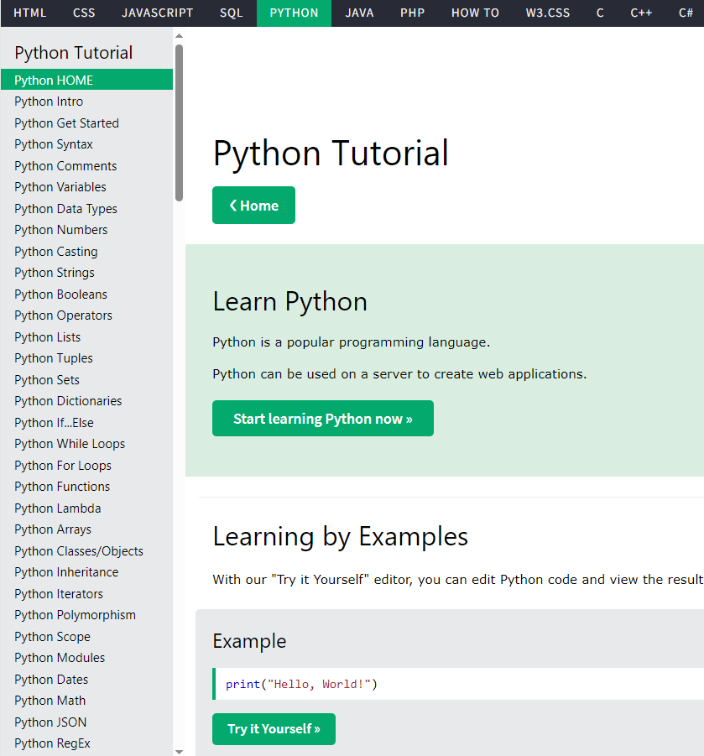
Day 1 2024/02/26
1. Complete basic python lessons for beginner
Python lessons for beginner
BASIC PYTHON LESSON COMPLETED
1. Python Comments
2. Python Variales
3. Python Data types
4. Python Numbers
5. Python Casting
6. Python String
7. Python Booleans
8. Python Operators
9. Python Lists
10. Python Tuptle

Slide 3
Day 1 2024/02/26
2. Learning how to process data CSV files in python
2.1 Lessons about CSV file in python completed
1. Reading CSV File with csv
2. Reading CSV Files into a Dictionary With csv
3. Optional Python CSV reader
4. Writing CSV File From a Dictionary With csv
2.2 Complete Homework
Use Python to organize 50 test data and then create new test reports

Slide 4
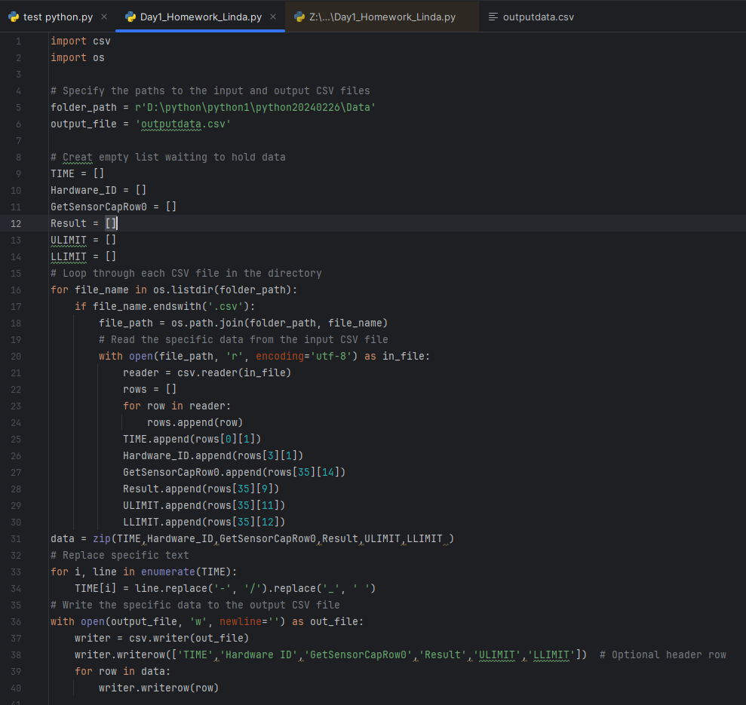
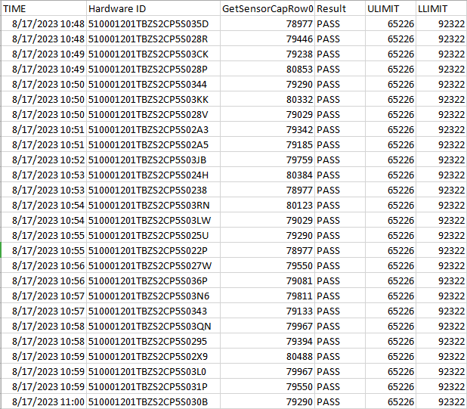

Slide 5
Day 2 2024/02/29
1. Learn Basic USB camera control, basic image recognition processing: RGB calculation, barcode decoding, basic OCR...
LESSONS FOR DAY 2 NEED TO LEARN
1. Basic USB camera control with Python code
2. Basic Image recognition processing with Python code
2. Do homework
1. Take pictures and archive them: file name rules - date and time.
2. Archiving of test results: file name rules-date and time.
Target before 2024/03/04:
1. Complete lessons Basic USB camera control, basic image recognition processing
2. Done homework Day 2

