Slide 1
LEARNING PYTHON RECORD

Slide 2
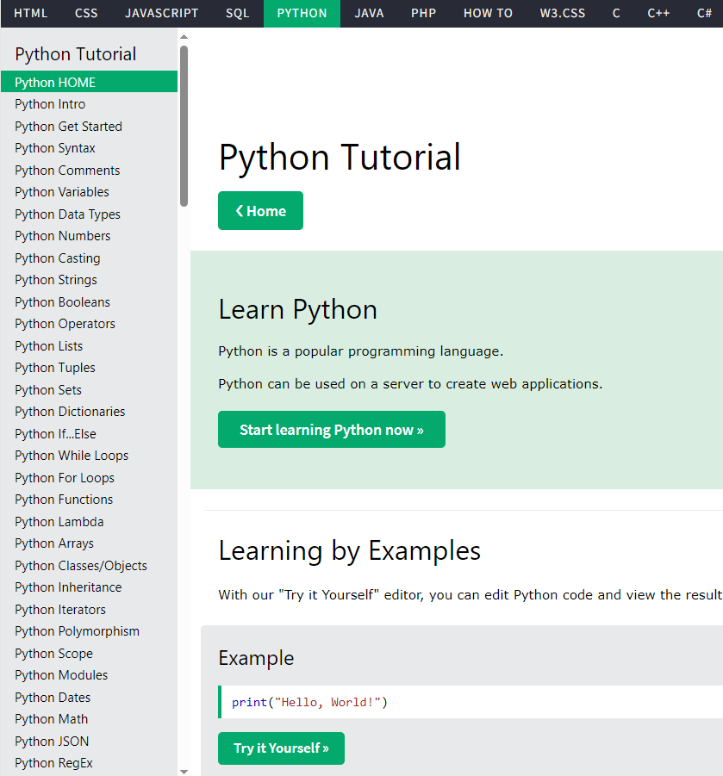
Day 1 2024/02/26
1. Complete basic python lessons for beginner

Slide 3
Day 1 2024/02/26
2. Learning how to process data CSV files in python
2.1 Lessons about CSV file in python completed
1. Reading CSV File with csv
2. Reading CSV Files into a Dictionary With csv
3. Optional Python CSV reader
4. Writing CSV File From a Dictionary With csv
2.2 Complete Homework
Use Python to organize 50 test data and then create new test reports

Slide 4
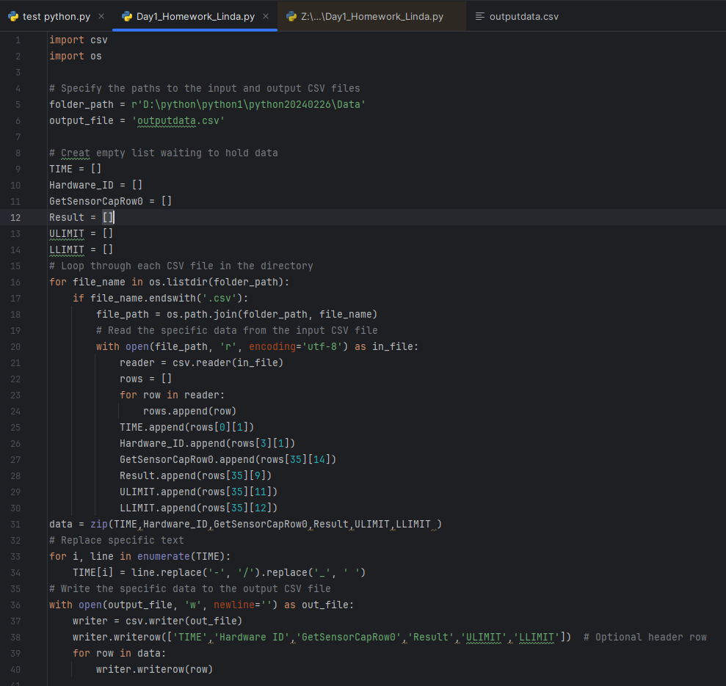
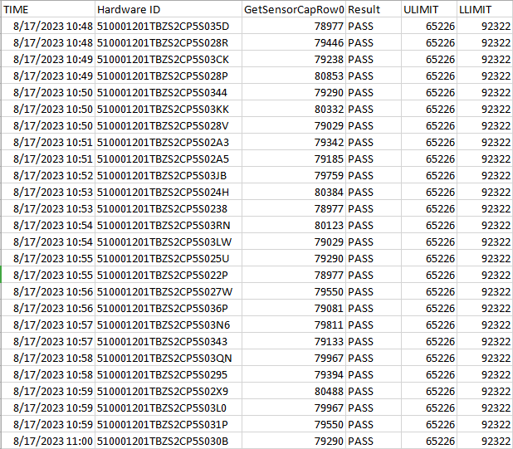

Slide 5
Day 2 2024/02/29
1. Learn Basic USB camera control, basic image recognition processing: RGB calculation, barcode decoding, basic OCR...
LESSONS FOR DAY 2 NEED TO LEARN
1. Basic USB camera control with Python code
2. Basic Image recognition processing with Python code
2. Do homework
1. Take pictures and archive them: file name rules - date and time.
2. Archiving of test results: file name rules-date and time.

Slide 6
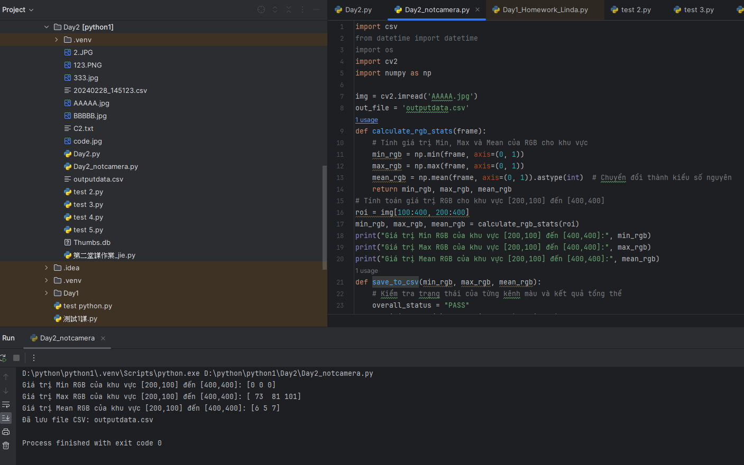
2. Result after learning process images in python (opencv-python)
This code is written based on the existing code
After reading and researching related documents, I can read and understand the image processing code by python. However, I have not yet come up with a solution to write code to handle this problem.

Slide 7
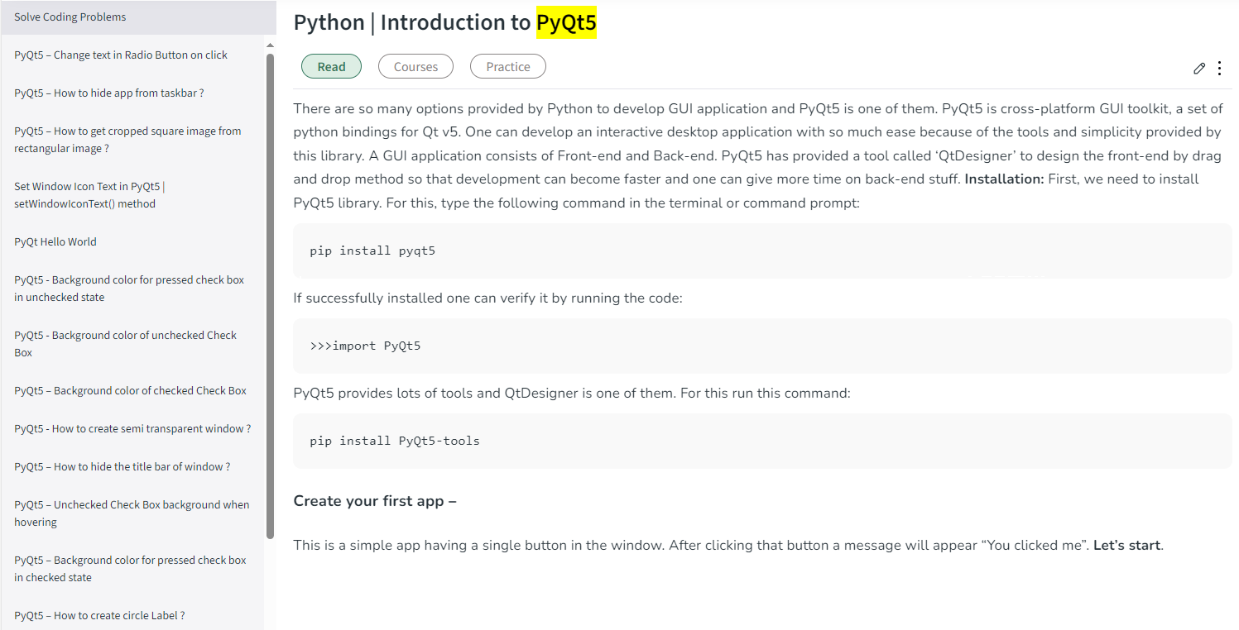
Day 3 2024/03/04
1. Learn design a simple UI
The content below needs to be read and research before practicing designing a simple UI:

