Slide 1

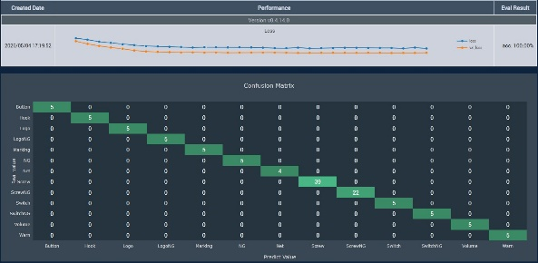
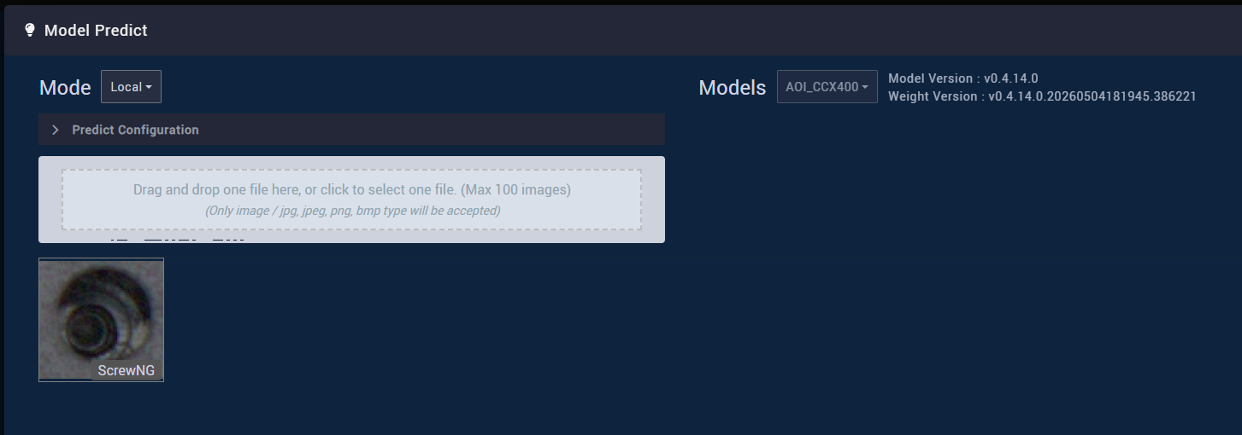
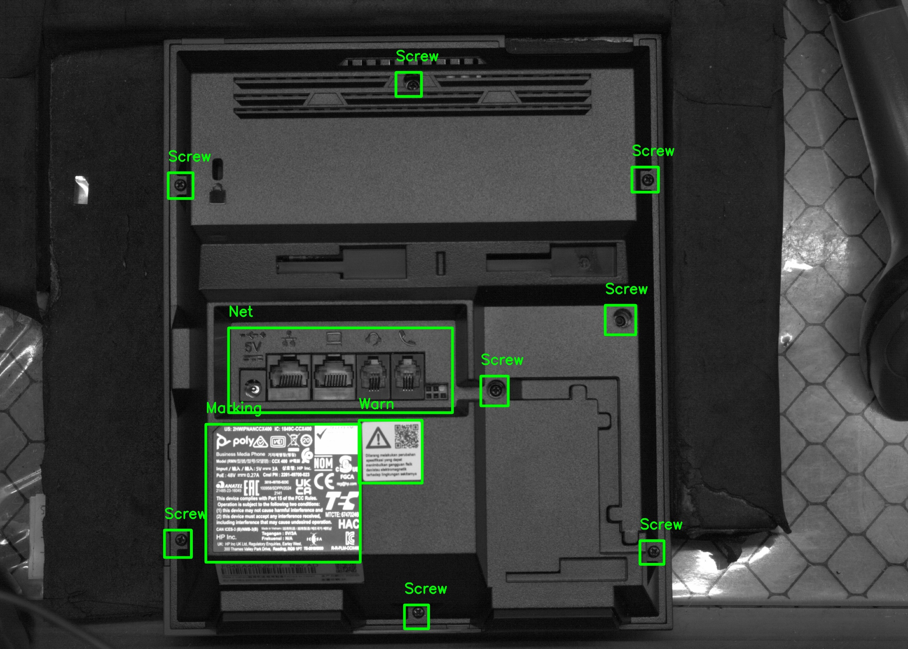
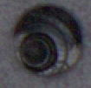
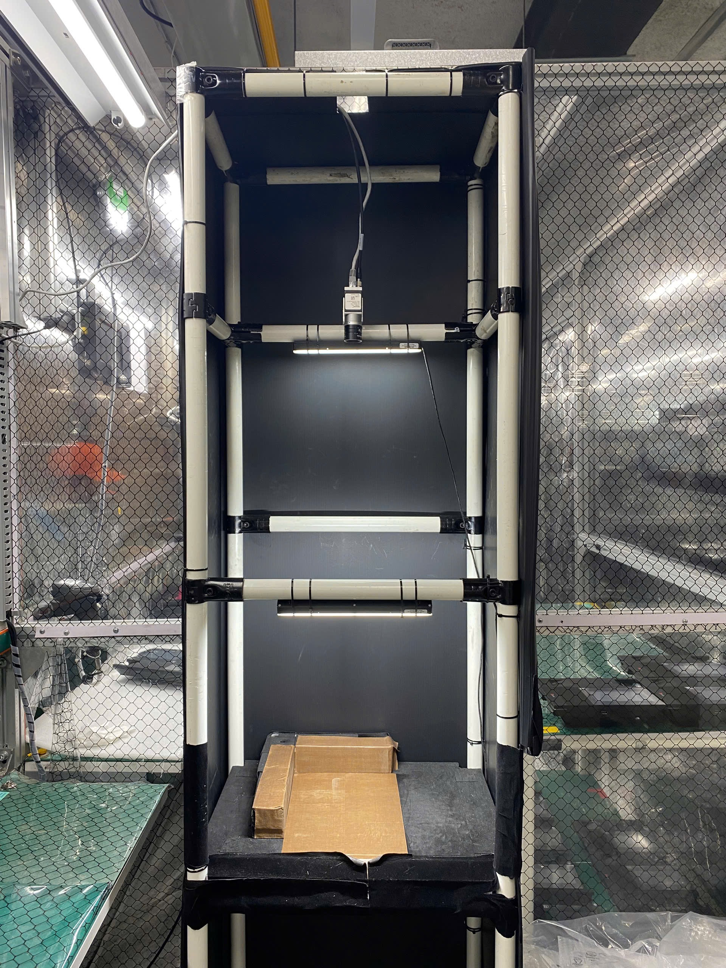
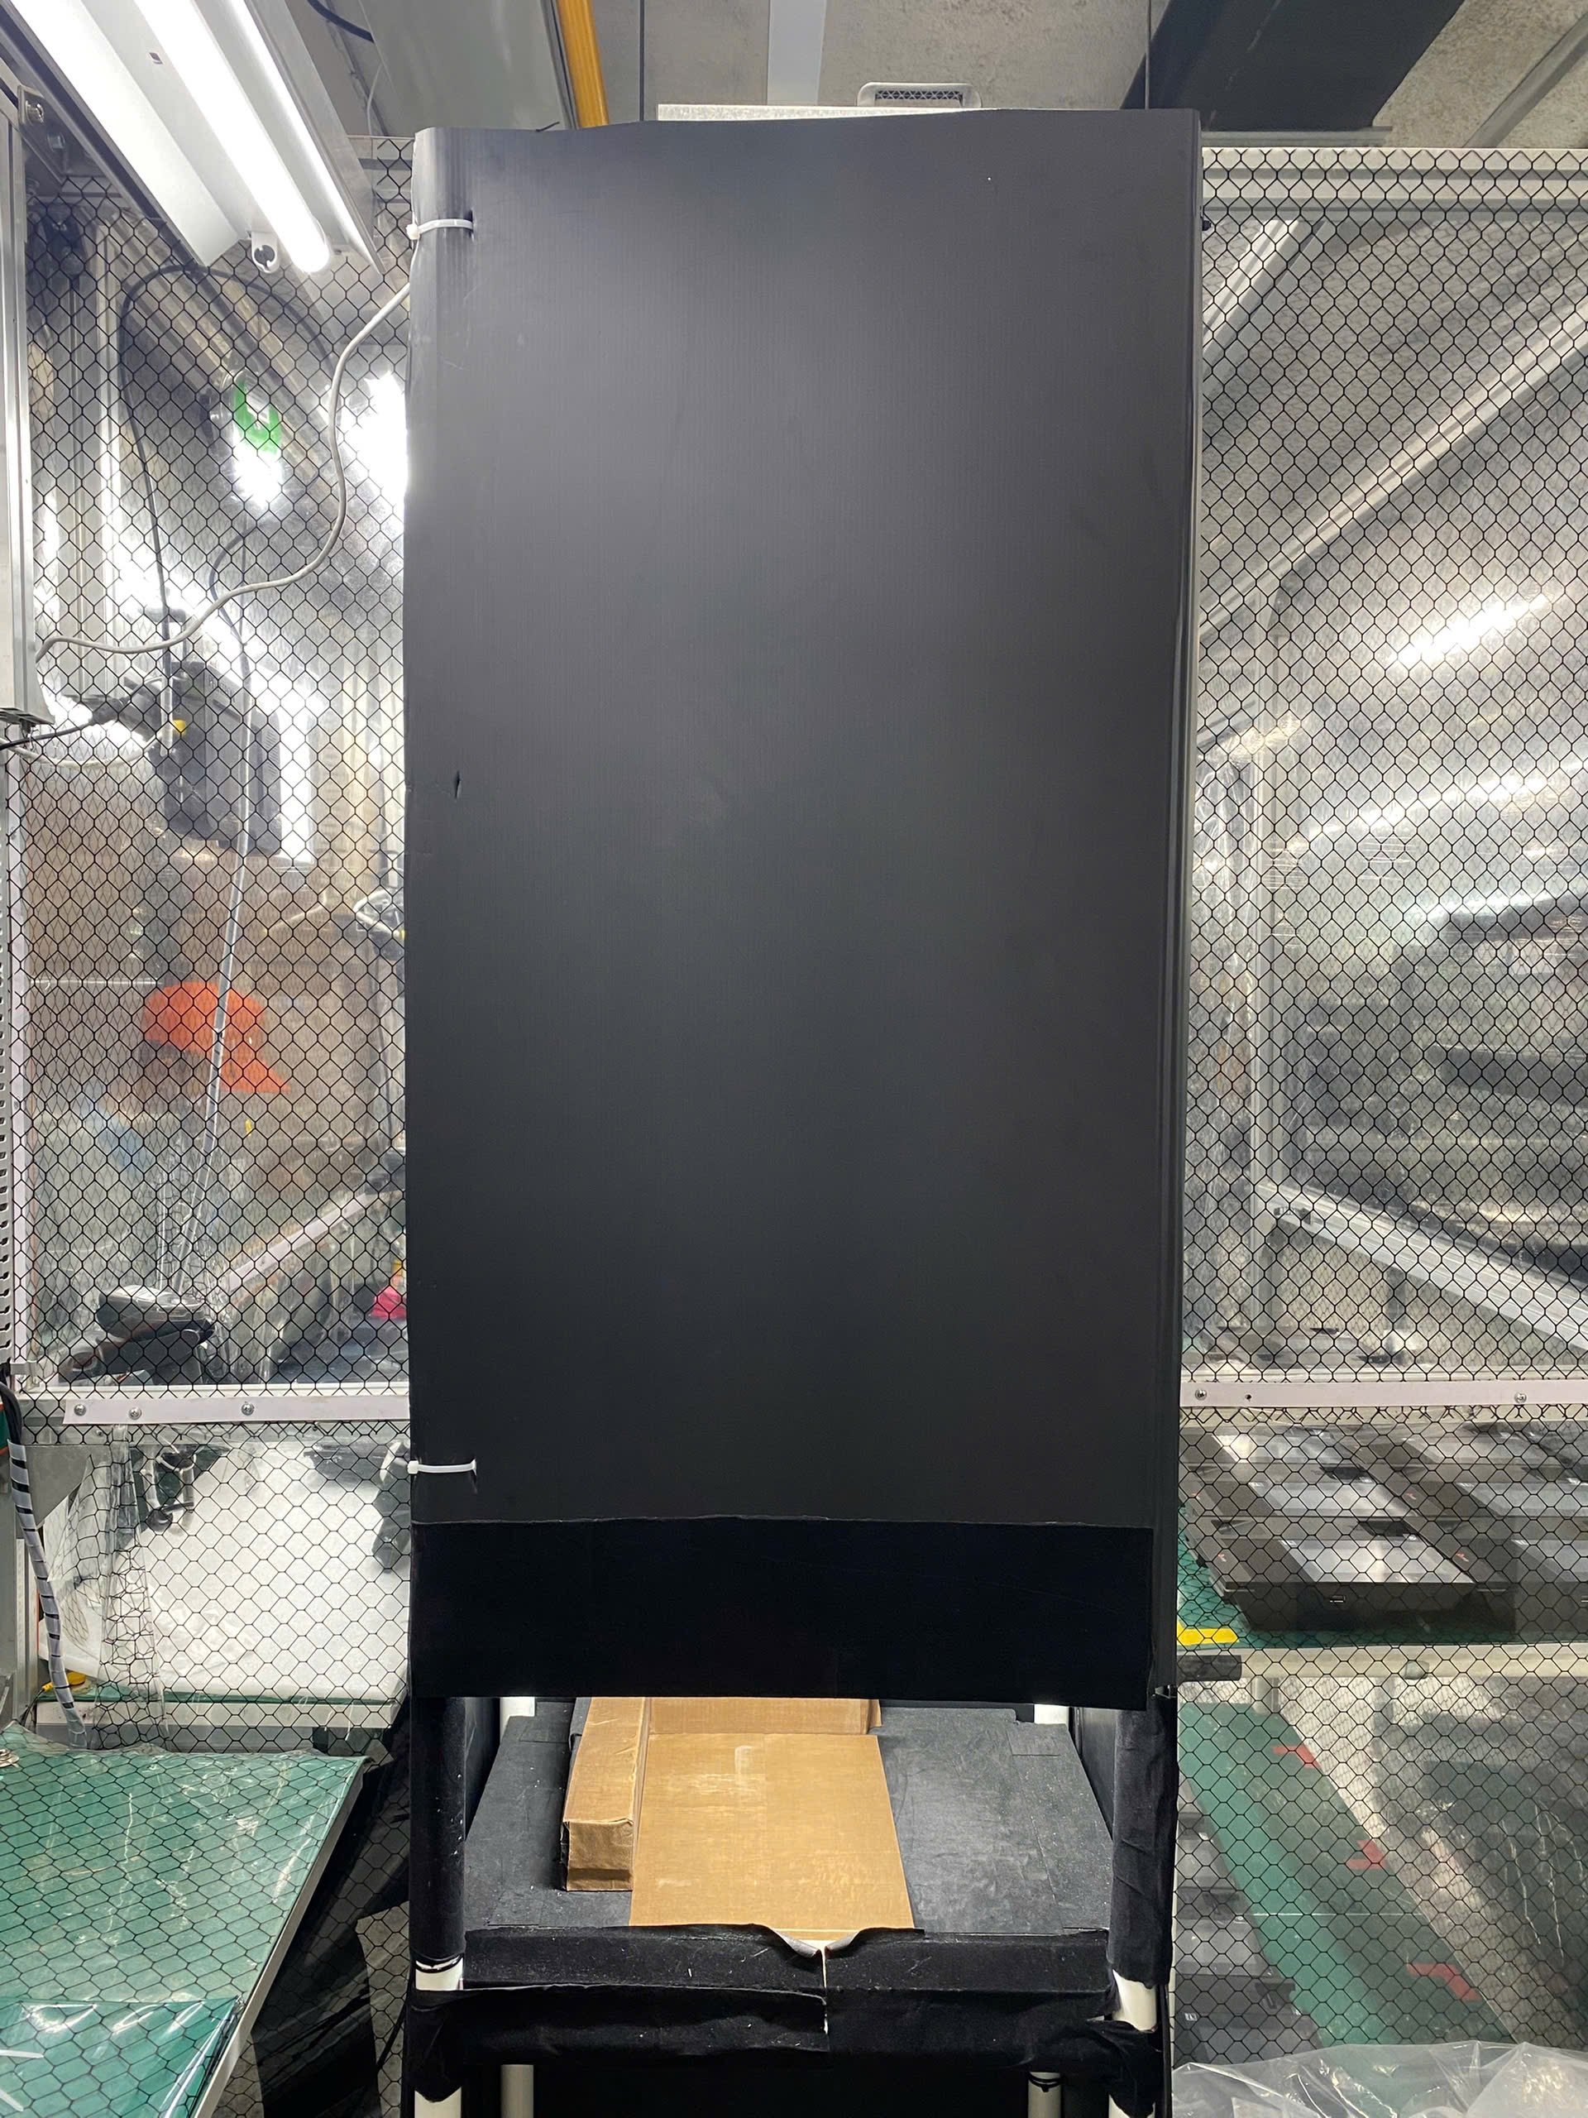
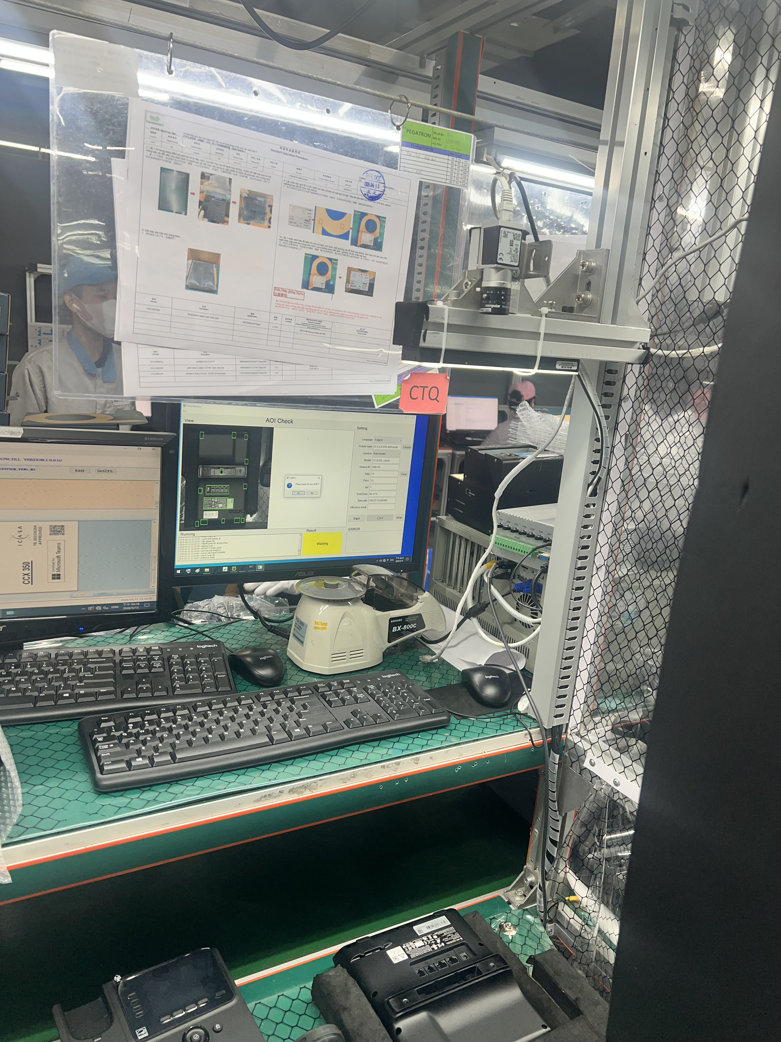
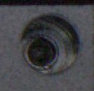
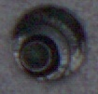
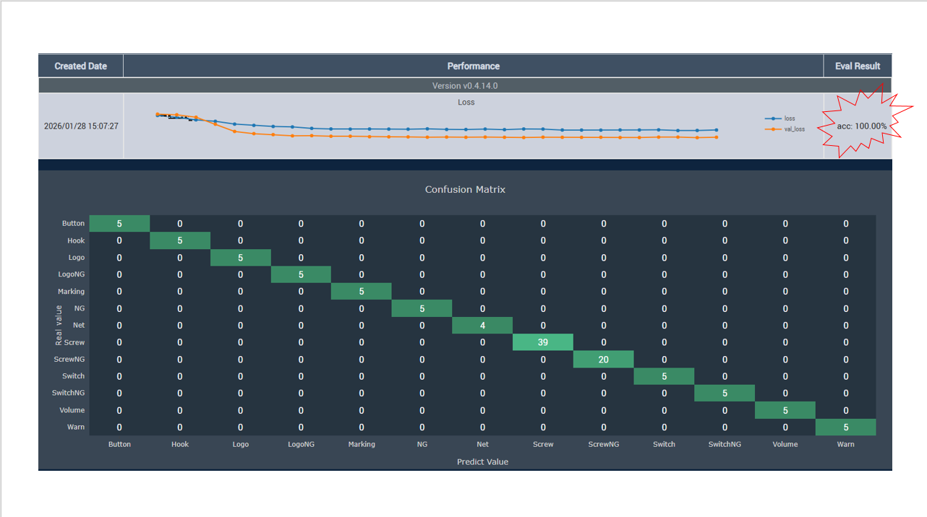
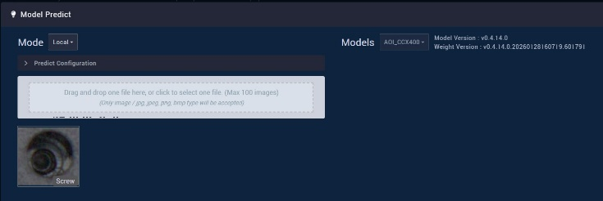
BG6
PVN
4P – CCX400 – Missing Screw Detection Accuracy Improvement
Before Improve
Issue
AOI External Station detects Missing Screw at Position 7 incorrectly.
AI recognition result is affected by environmental light variation.
Open inspection area allows external light to enter the camera field.
Brightness changes cause unstable image quality and false NG judgement.
Impact
Increased false call rate.
Reduced AOI inspection efficiency.
Risk of unnecessary product hold.
OK
Improvement #2 – Build Fixed Inspection Box
Design a closed inspection box for AOI External Station.
Use black internal panels to absorb ambient light.
Isolate external factory lighting.
Stabilize image acquisition conditions.
Details Improve
Improvement #1 – AI Model Optimization
Collect false detection cases from production and compare production images with training images.
Identify brightness variation at screw inspection area.
Retrain and update PegaAI recognition model.
After Improve
Quality
Reduce false NG judgement.
Improve Missing Screw detection accuracy
Increase customer confidence
Productivity
Reduce operator review workload
Improve AOI station efficiency
Shorten product verification time
NG
FME
BG6 PVN

