Slide 1

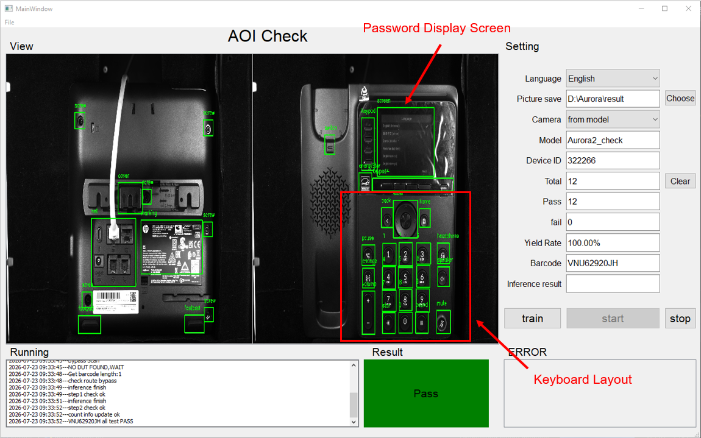
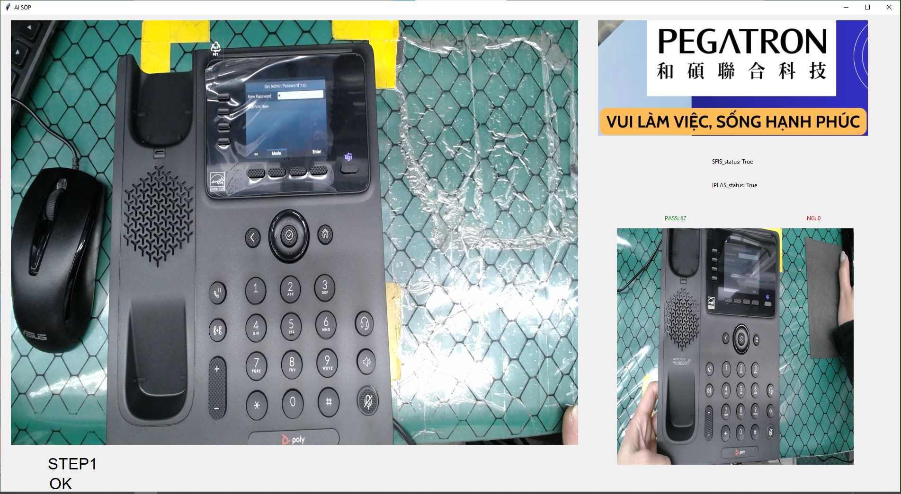
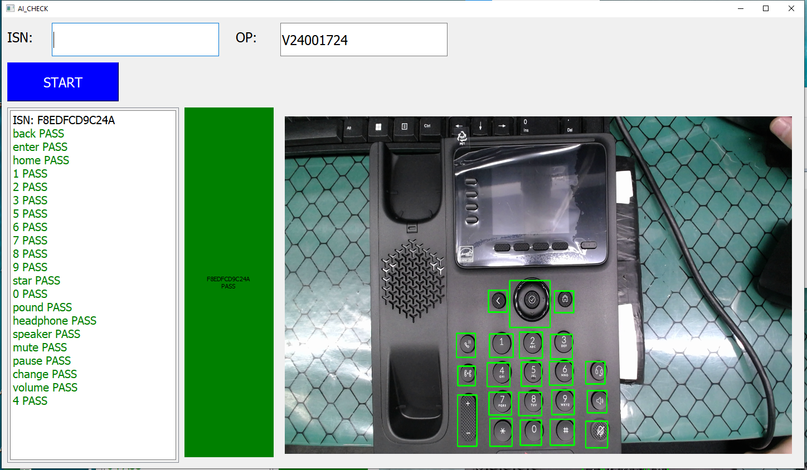
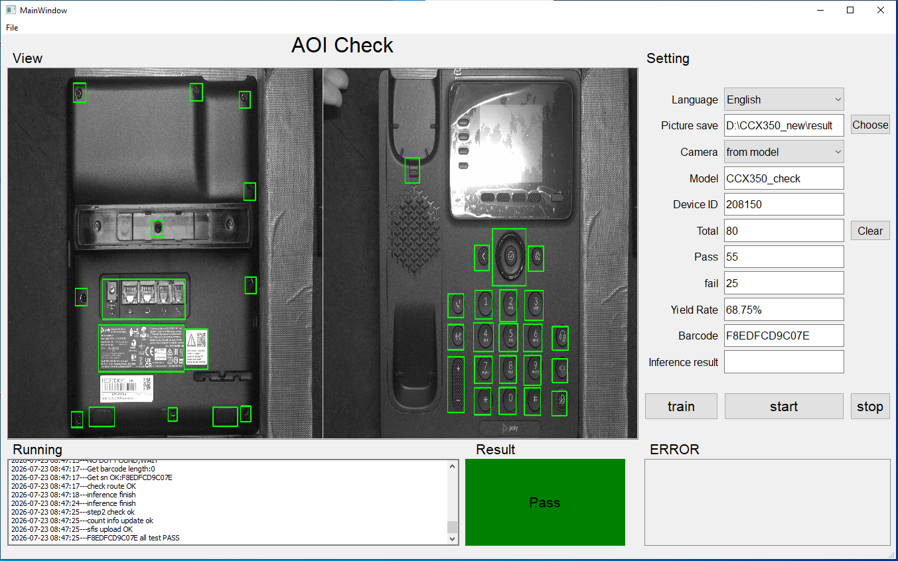
BG6
PVN
Revlon Series – Combine Function AOI Station
Before Improve
Details Improve
Issue
Current production line has 3 separate inspection station :
  External AOI ( Visual Inspection )
  Password Check
  Keyboard Inspection by AI
Multiple stations create duplicated inspection activities.
Increased operator manpower and production space.
Impact
Higher labor cost.
Longer production cycle time.
Lower production efficiency.
More handling increases risk of mistakes.
Improvement – Combine Inspection Process
Integrate External AOI, Password Check and Keyboard Inspection into one inspection station.
Training AOI Software to inspect :
  External Inspection of Components.
  Keyboard Layout.
  Password Display Screen.
After Improve
Quality
Reduce inspection variation.
Maintain inspection accuracy.
Reduce missing inspection items.
Standardize inspection process.
Productivity
Reduce 3 -> 1 stations.
Save operator manpower.
Improve production efficiency.
Shorten production cycle time.
Password Check
Keyboard Inspection
External AOI
FME
BG6 PVN

