Slide 1

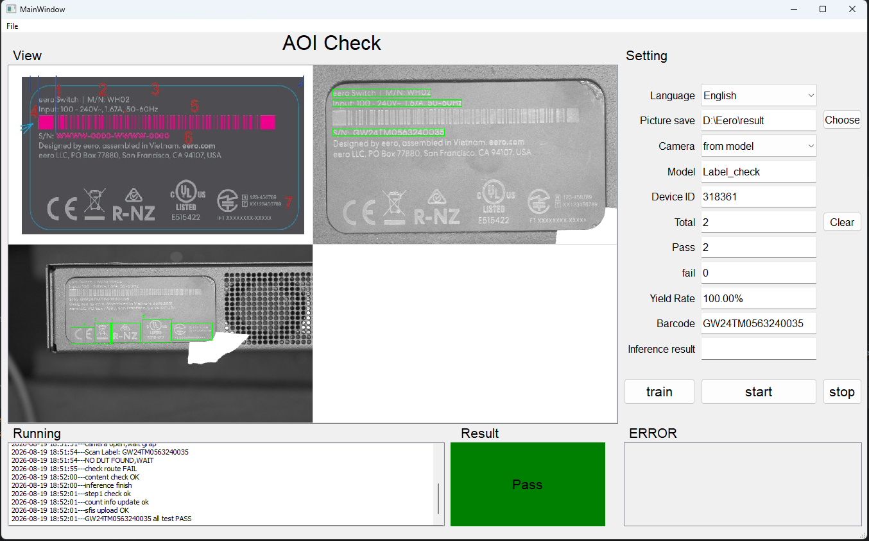
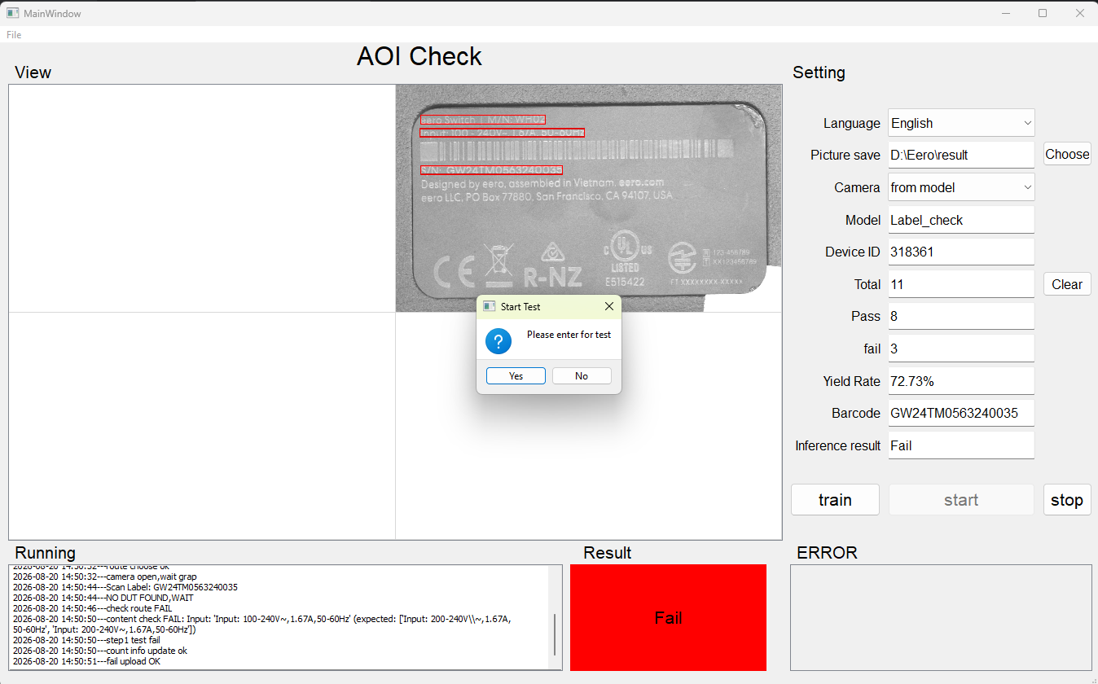
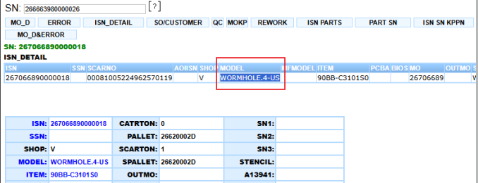
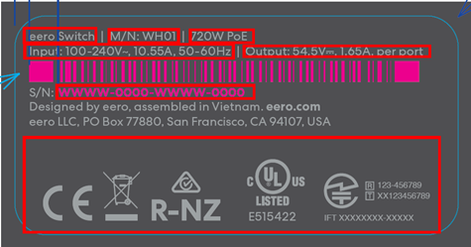
BG6
PVN
Eero W/X – Setup AOI Label Station to Prevent Wrong Product Label
Before Improve
Scan the DSN Label and retrieve the corresponding model information from SFIS.
AOI compares :
Model information from SFIS.
Actual model information on the physical label.
Label artwork/content according to the approved specification.
If the information matches -> PASS
If the information does not match -> FAIL / NG, preventing the wrong label from proceeding to the next process.
Issue
Current label inspection does not have an automatic check to verify actual product label vs model information in SFIS.
Operator mainly performs visual inspection, creating risk of :
Wrong product label applied to product.
Model/ artwork mismatch not detected before shipment.
Human error during label checking.
Impact
Risk of incorrect DSN/POD label on finished product.
Potential customer complaint and rework.
Additional inspection and handling time.
Inspection accuracy depends on operator.
Details Improve
Improvement – Setup AOI Label Inspection Station.
Set up an additional AOI Label Station at Packing VI to automatically verify DSN label content.
After Improve
Quality
Reduce inspection variation.
Maintain inspection accuracy.
Reduce missing inspection items.
Standardize inspection process.
Productivity
Reduce 3 -> 1 stations.
Save operator manpower.
Improve production efficiency.
Shorten production cycle time.
FME
BG6 PVN

