Slide 1
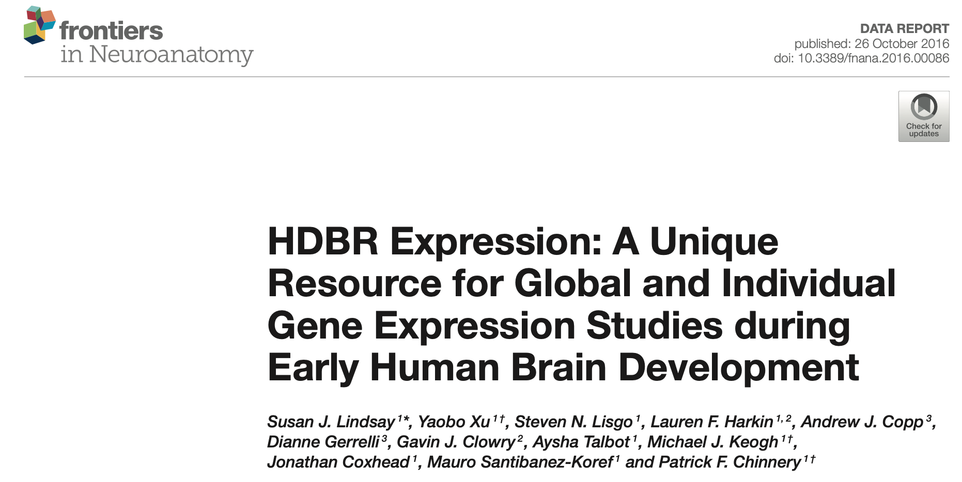
Analyses of the HDBR dataset (cont.)
Ngoc VU
03 Feb 2026

Slide 2
Next steps
Metadata check, sample selection
  - Check duplicated batches?
Quality control
  - PCA
  - Deconvolution
DGE analysis

Slide 3
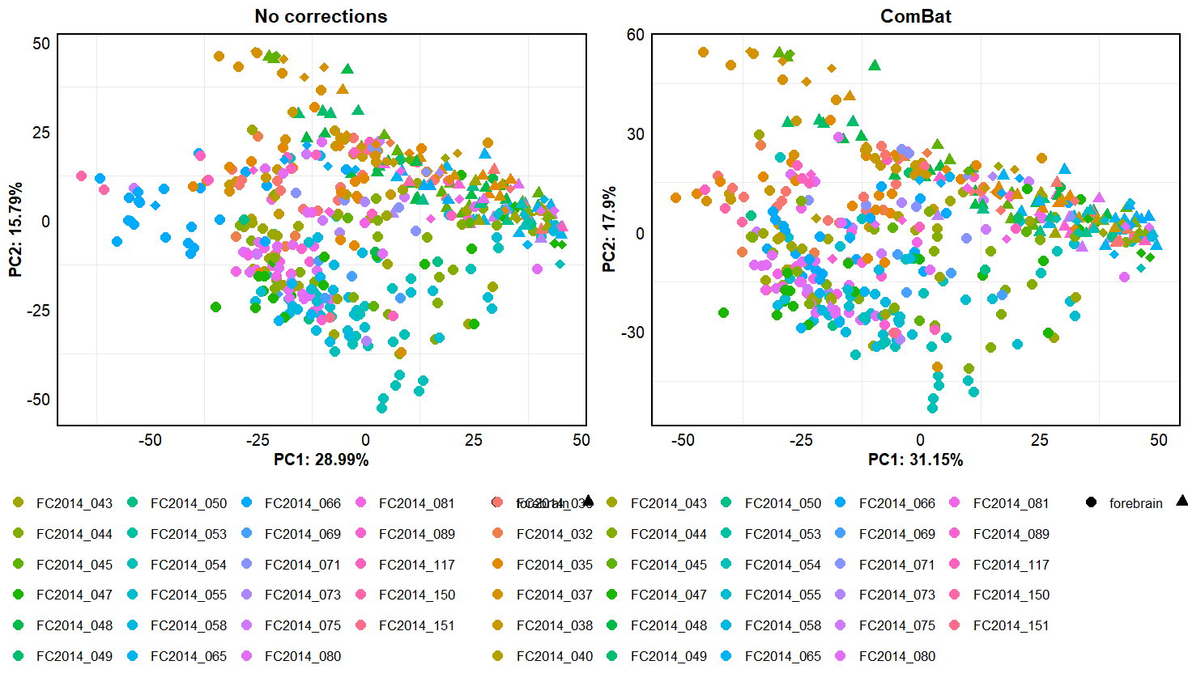
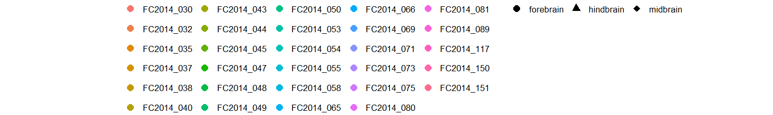
Batch corrections with ComBat
PCA

Slide 4
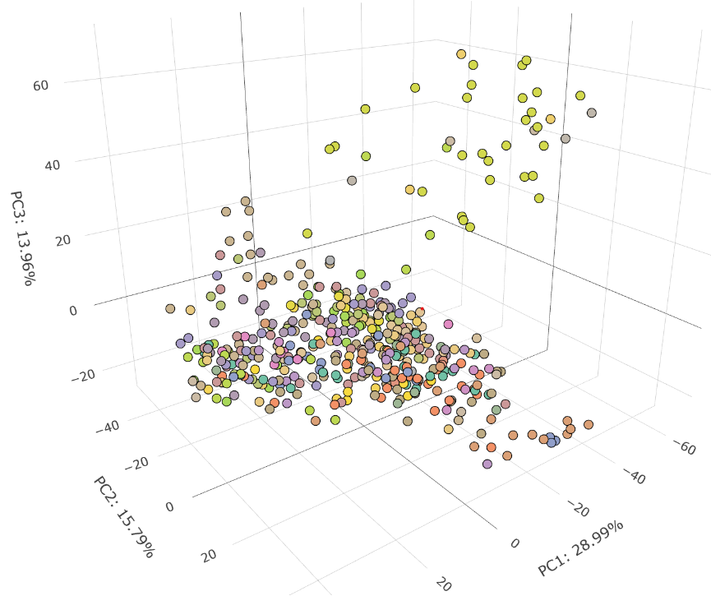
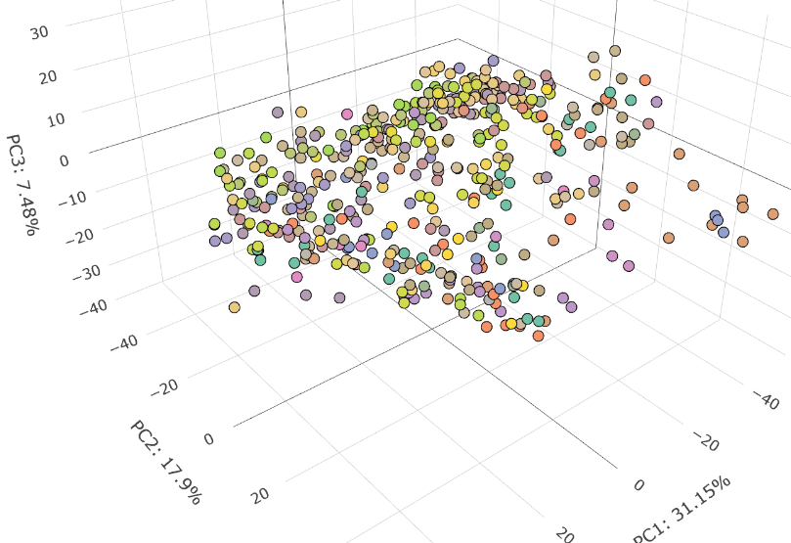
Batch corrections with ComBat
PCA
Batch effects revealed by PC3
Batch FC2014_066 contains 29 samples (cerebral cortex, temporal lobe, whole midbrain, etc.), all at 9 PCW

Slide 5
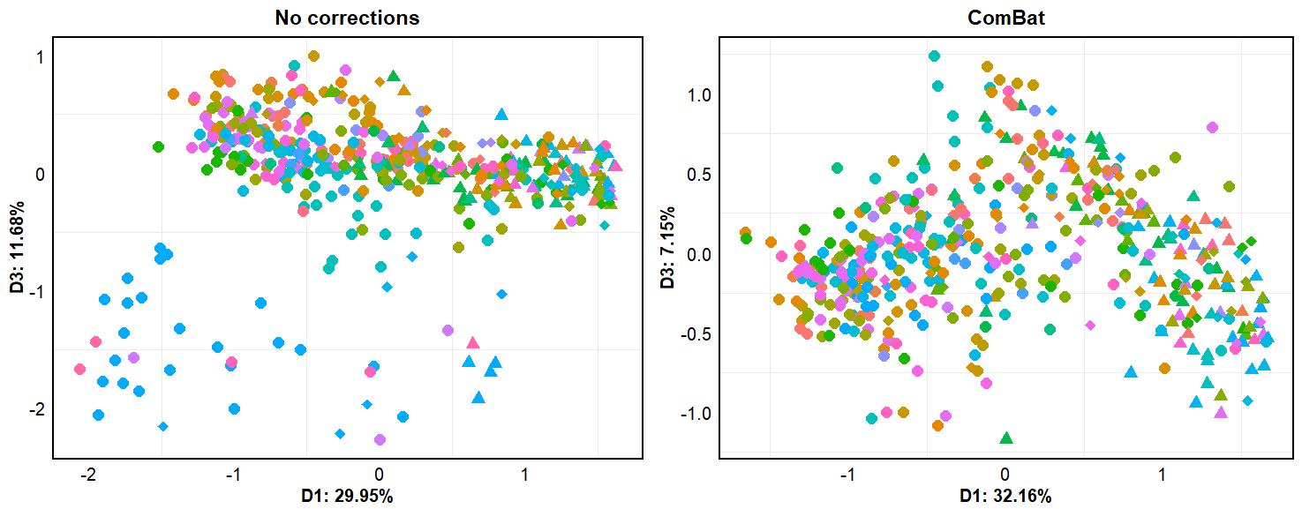
Batch corrections with ComBat
MDS
Same as PCA

Slide 6
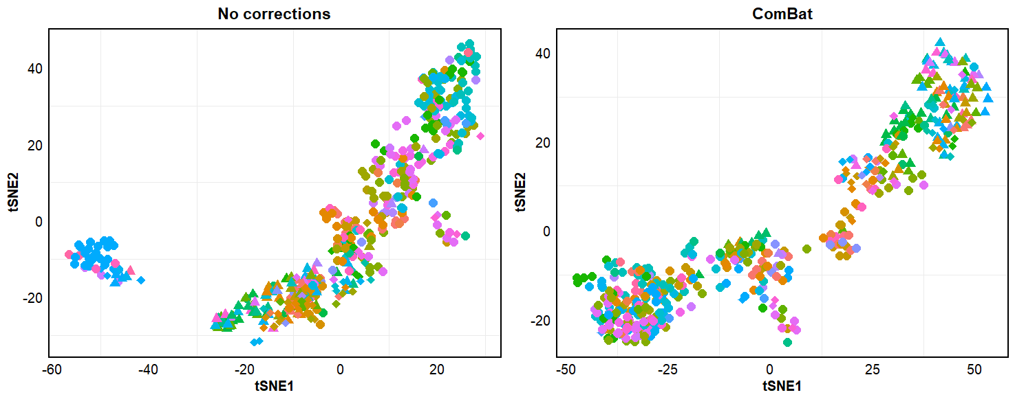
Batch corrections with ComBat
tSNE
In both tSNE and UMAP, batch effects are seen in the first two dimensions

Slide 7
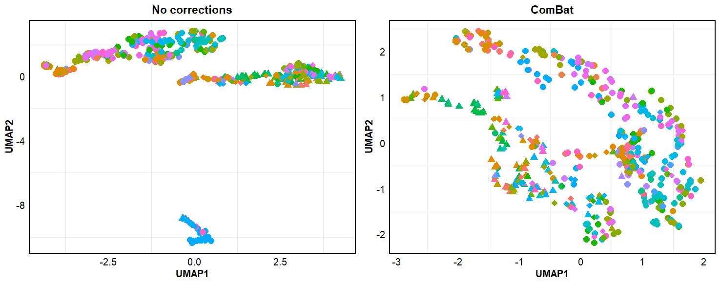
Batch corrections with ComBat
UMAP
In both tSNE and UMAP, batch effects are seen in the first two dimensions

Slide 8
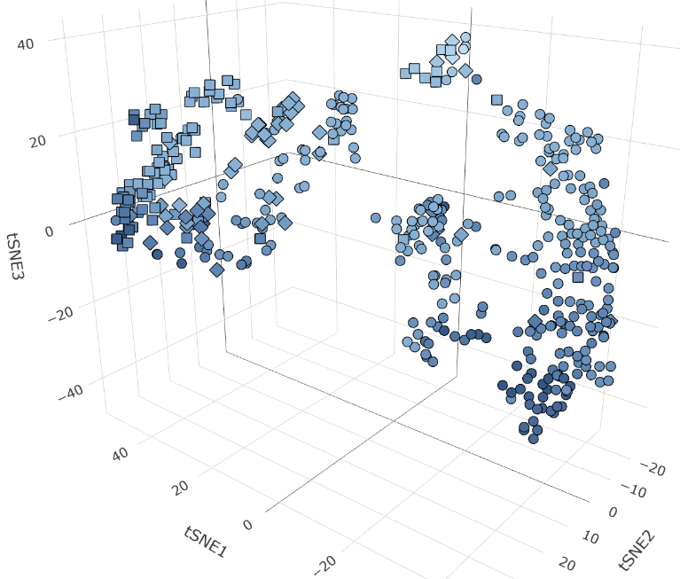
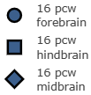
Sample distribution based on stage & 1st level structure
tSNE

Slide 9
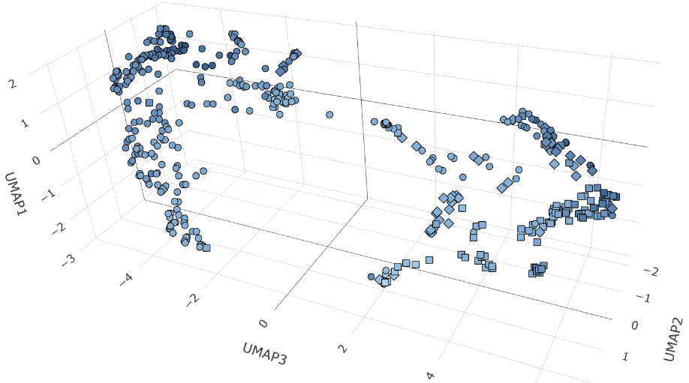
Sample distribution based on stage & 1st level structure
UMAP

Slide 10
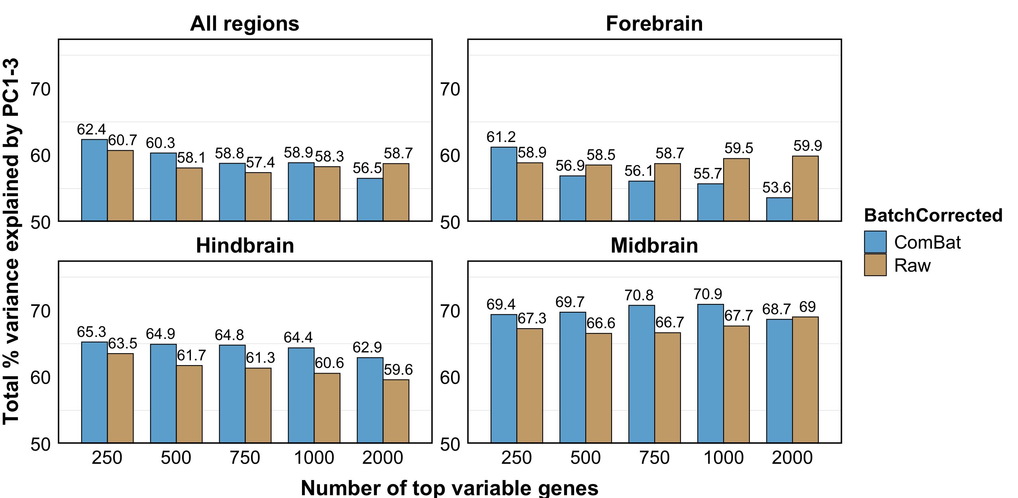

Slide 11
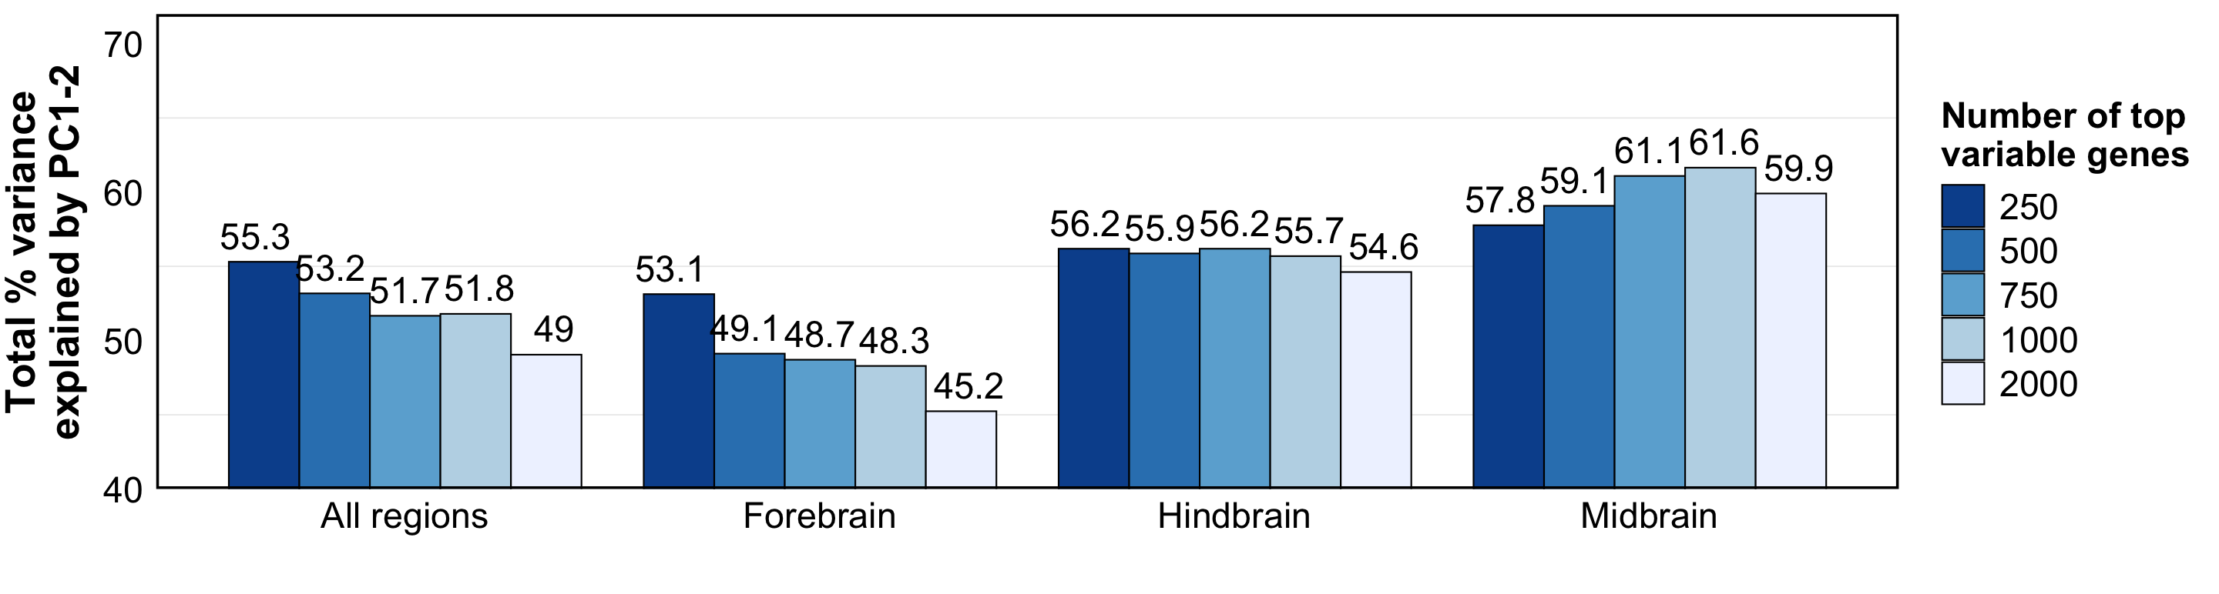
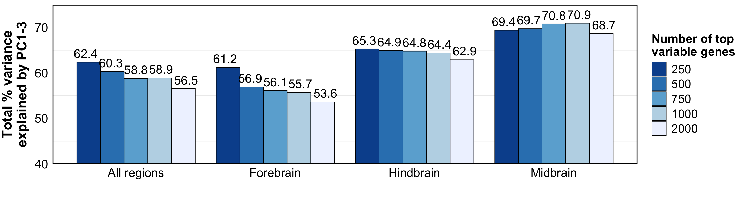

Slide 12
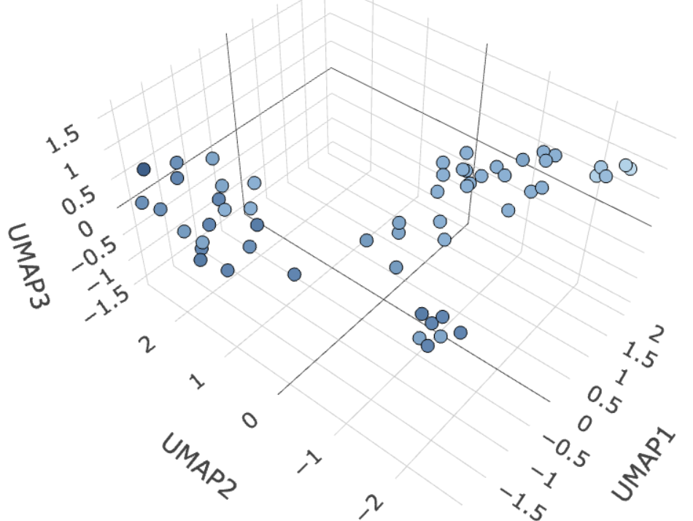
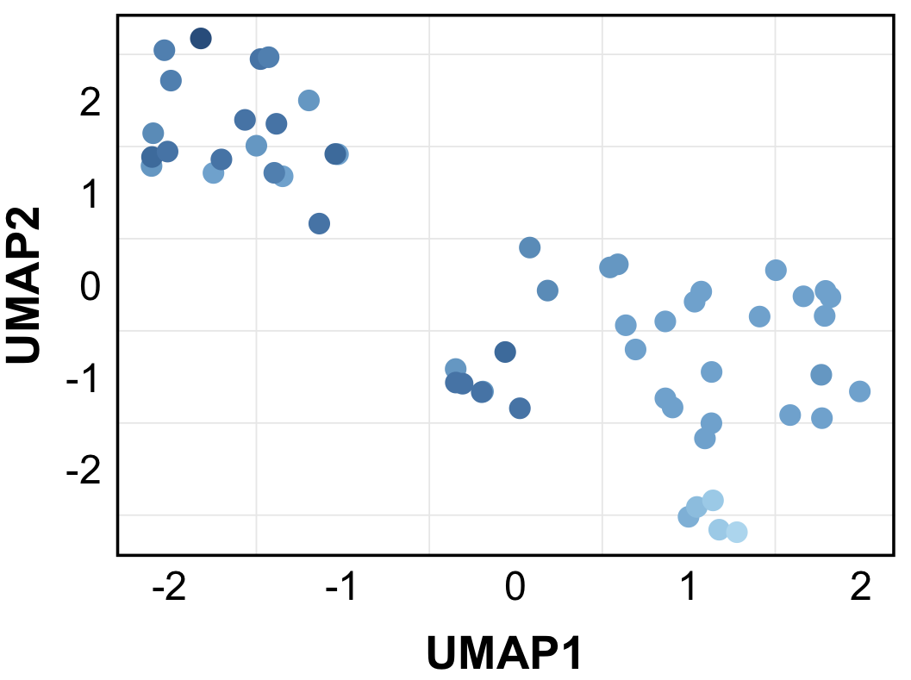
Top 500, mid brain

Slide 13
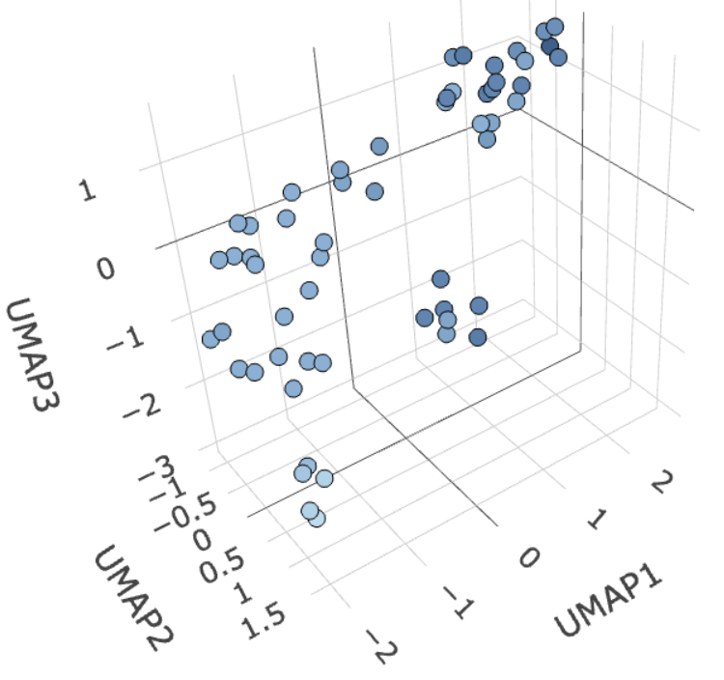
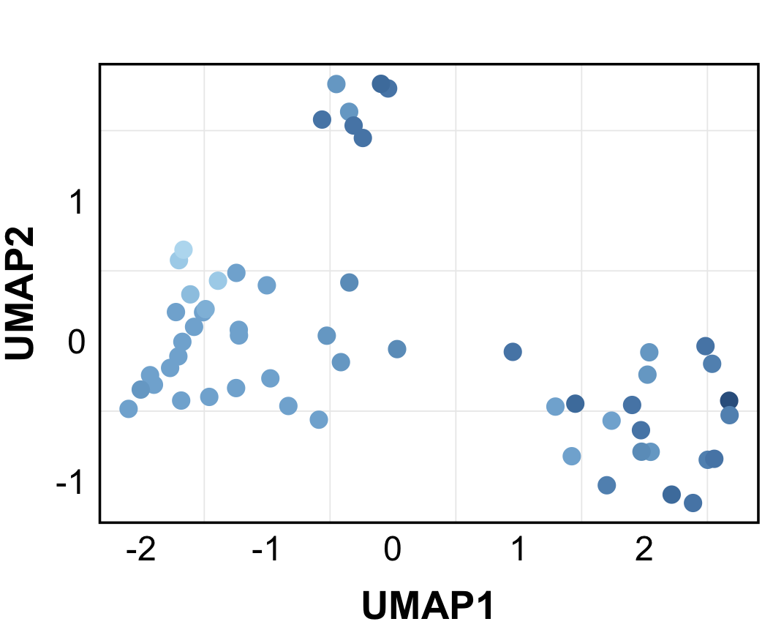
Top 1000, mid brain

Slide 14
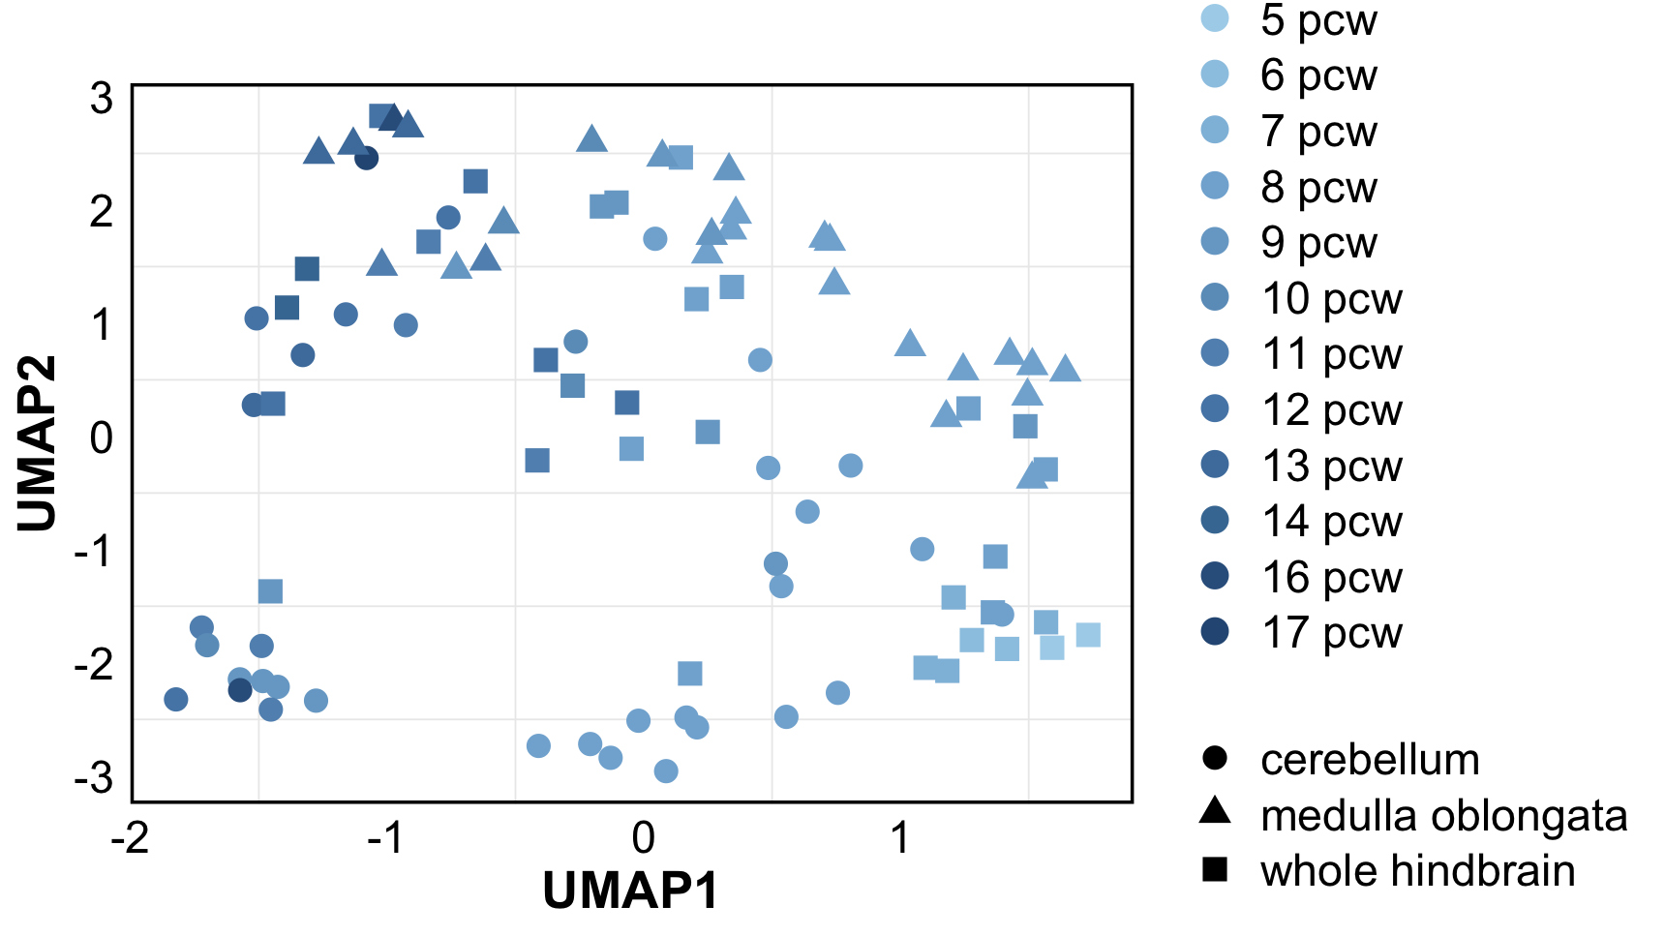

Slide 16
