Slide 1
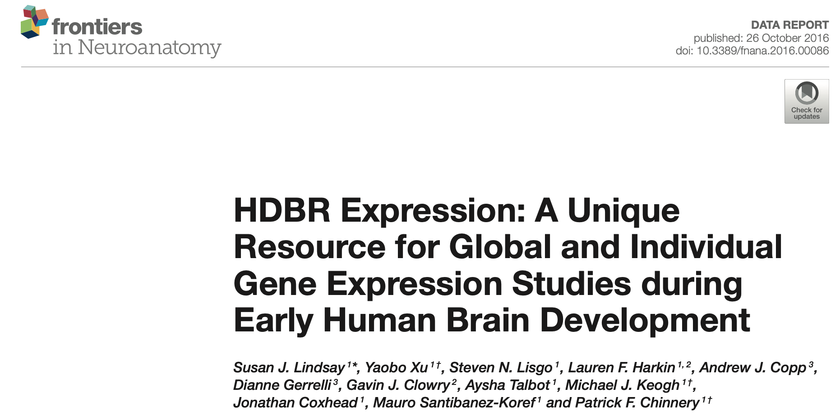
Analyses of the HDBR dataset
Ngoc VU
27 Jan 2026
Notes:
Contains bulk RNA-seq datasets from different brain regions at different stages
Vision? Establish a benchmark for future analyses, e.g. cerebellum organoids

Slide 2
Metadata check
Two sources of metadata: HDBR website & EBI
- EBI seems to be more updated: 3 individuals more
- 17 samples are sequenced in 2 different batches → 34 samples?
Notes:
Metadata consistency check

Slide 3
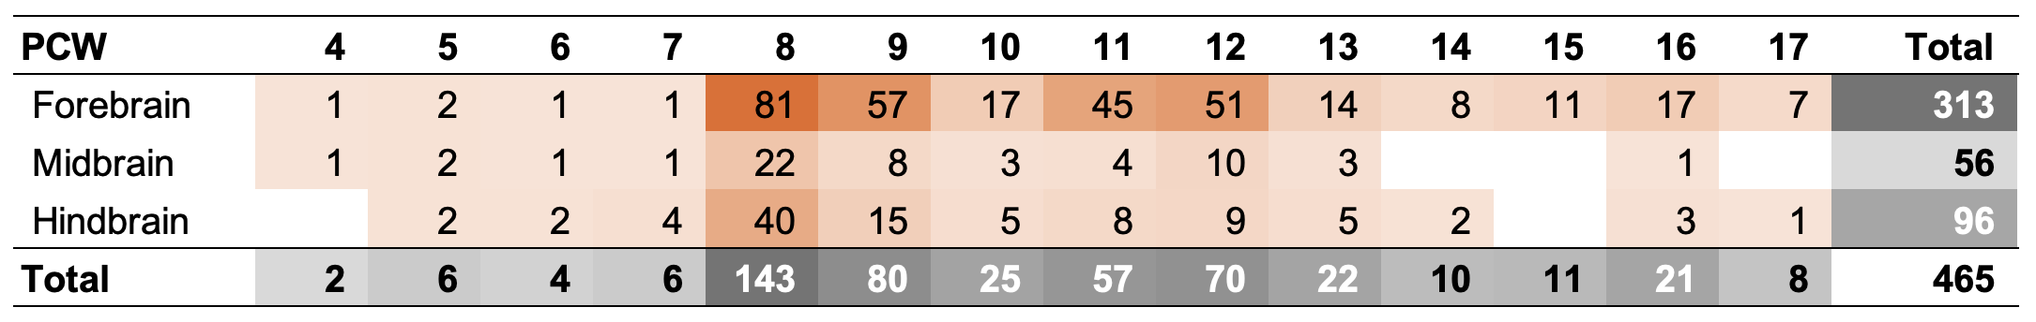
Sample selection
Filtering criteria:
brain fragments
mixed samples (diencephalon and midbrain, diencephalon and pituitary, forebrain and midbrain, whole hindbrain without cerebellum)
Developmental stage and tissue distribution of brain samples after filtering (84 individuals)
*samples where the precise region is unknown
Notes:
This still contains 15 samples sequenced in 2 batches

Slide 4
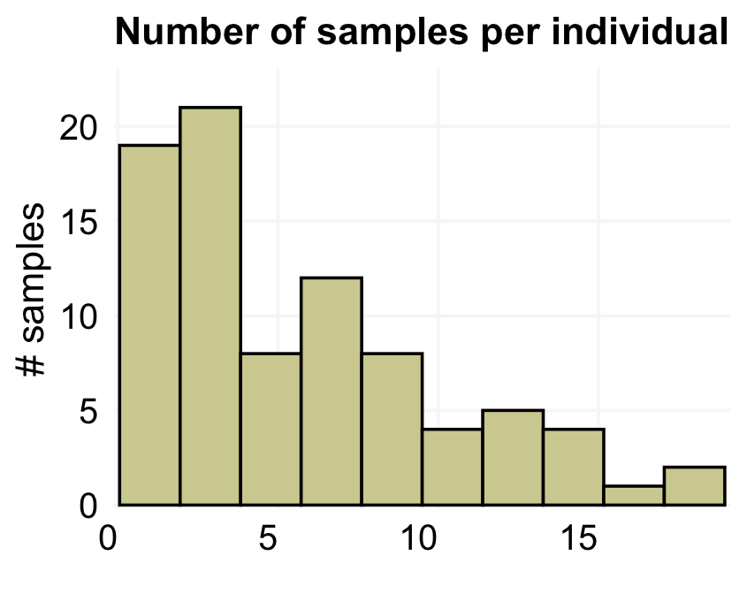
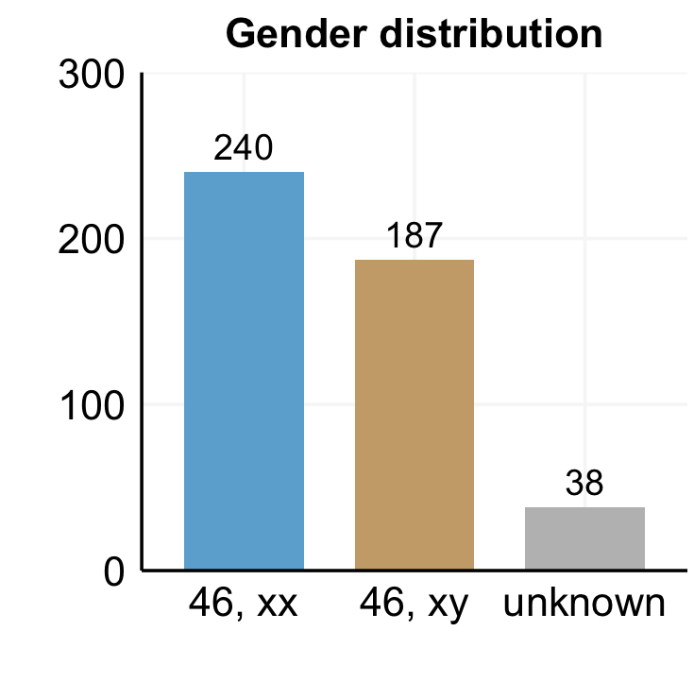
Sample selection
84 individuals (65 contributed more than 1 sample, most commonly from the cerebral cortex)

Slide 5
Next steps
Metadata check, sample selection
  - Check duplicated batches?
Quality control
  - PCA
  - Deconvolution
DGE analysis

Slide 6
