Slide 1

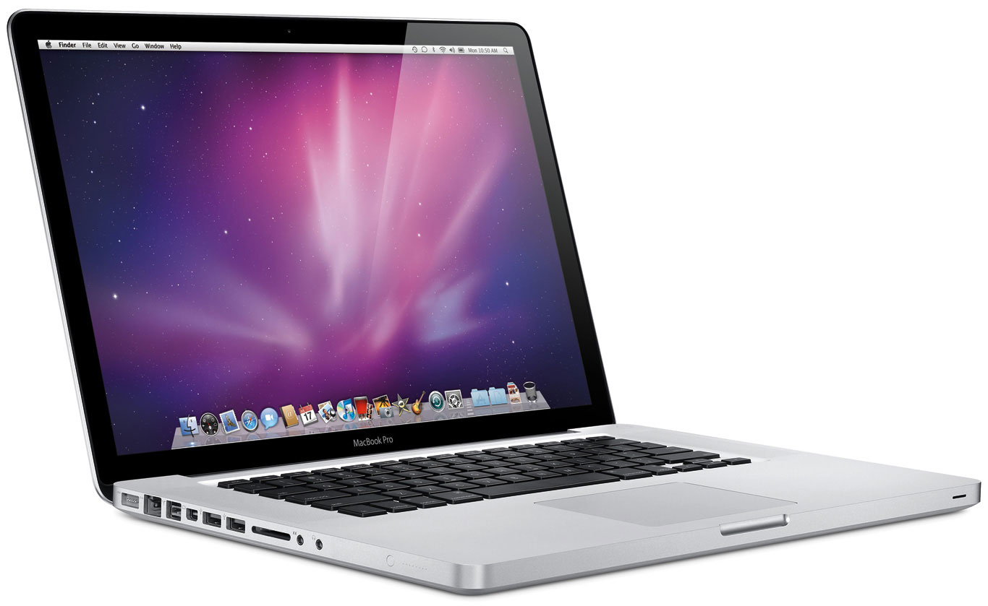
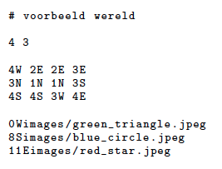


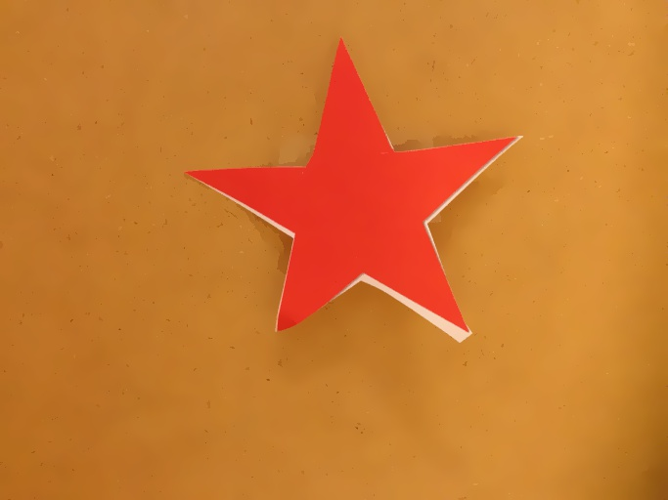
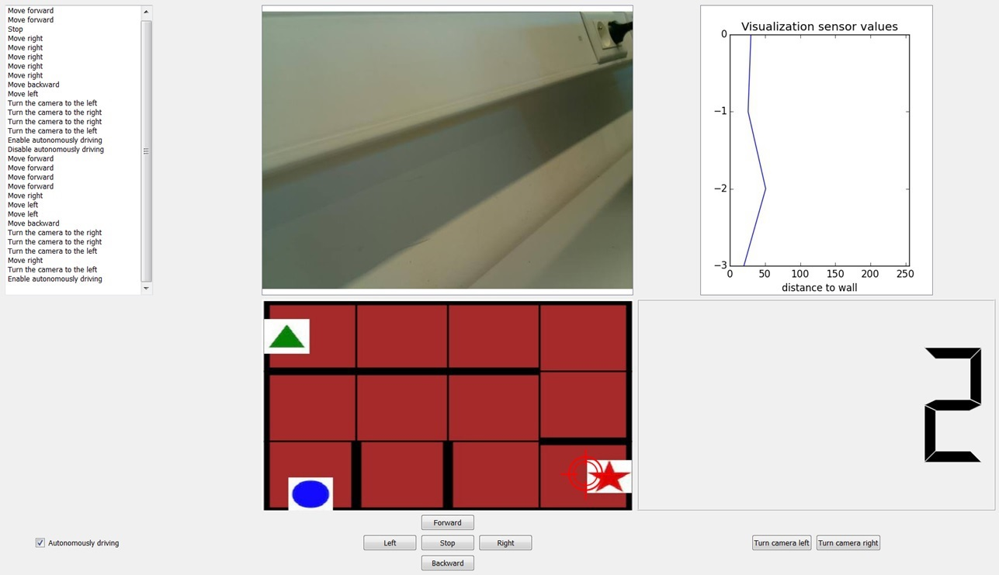
HTTP server
laptop
http
httpserver
(Sectie 4)
ssh
sudo python controller.py
Robot
httphandler
httpclient
controller
connection
socket
Robot.execute()
(Sectie 2)
(Sectie 6)
(Sectie 7)
ImRec
(Sectie 5)
GUI

Slide 2
Robot
socket.bind(HOST,PORT)
socket.listen()
GUI
socket.connect(HOST,PORT)
(1)
client = socket.accept()
connection
client.send(‘Autonomously driving’)
(2)
socket.send()
client.recv()
client.recv()
socket.send(‘ImRec:12043’)
…
client.recv()
…
(3)
client.send(‘Send Picture’)
socket.connect(HOST,PORT)
socket.bind(HOST,PORT)
socket.listen()
client = socket.accept()
(4)
Queue = { }
client.send(‘resultImRec:red_star’)
(5)

Slide 3
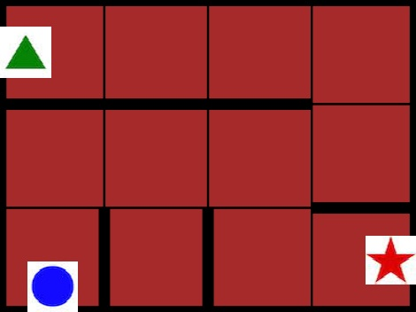
(a)
0
F
1
0
2E
1
walls = [1,0,0,1]
pattern = {(F,2E), (F,3E)}
walls = [1,0,0,0]
1
(b)
0
0
R
0
F
3E
2E
walls = [1,0,0,0]
pattern = {(F,2E), (F,3E), (R,1S)}

