Slide 1
A Brief Introduction to
Machine Learning

Slide 2
Not that long ago...
Dataset were not “too” big :
Size not too large
Not very diverse
Flowing at an reasonable pace
We were able to write programs dealing with almost any dataset

Slide 3
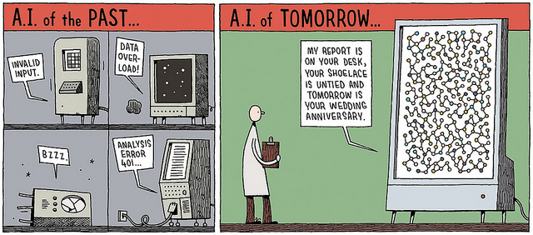
Why Machine Learning
… things have changed (recall the “V's”)
We now need optimized algorithms to deal with “Big Data”

Slide 4
Machine Learning
Machine Learning is scientific discipline that deals with the construction and study of algorithms that can learn from data. Such algorithms operate by building a model based on inputs and using that to make predictions or decisions, rather than following only explicitly programmed instructions
http://en.wikipedia.org/wiki/Machine_Learning

Slide 5
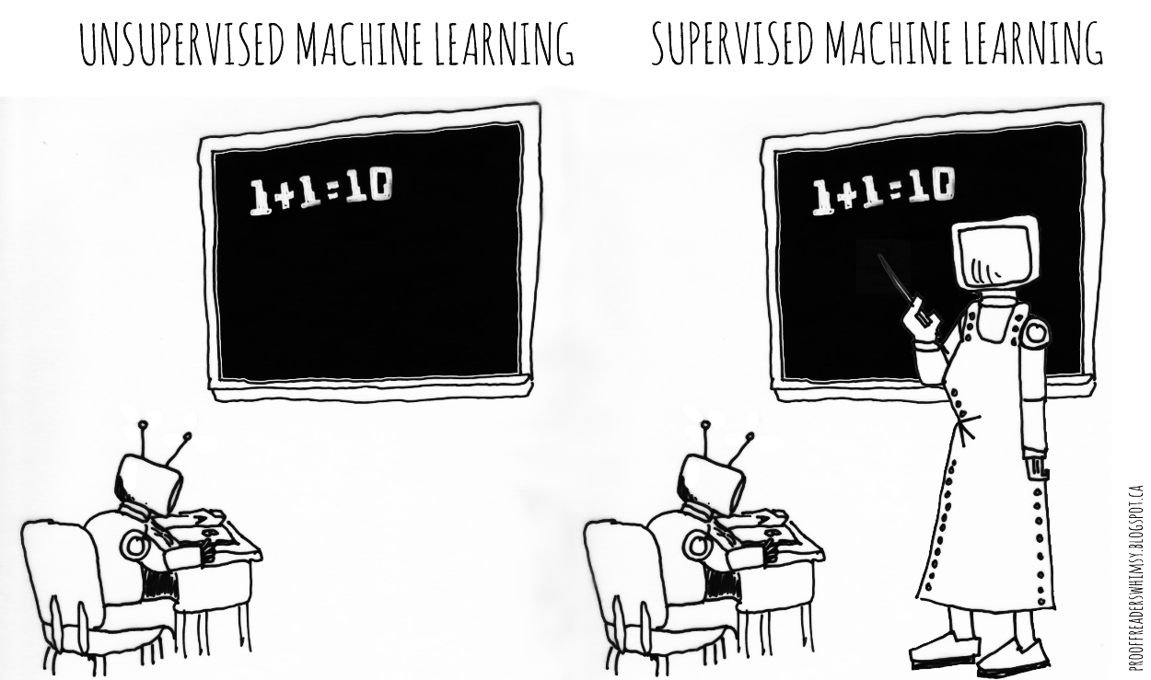
Machine Learning Categories
Algorithms can be divided in two types :
Supervised learning algorithm
Unsupervised learning algorithm

Slide 6
Supervised Learning
The machine learn from known data named “labeled data”
The machine should then be able to correctly respond to new inputs

Slide 7
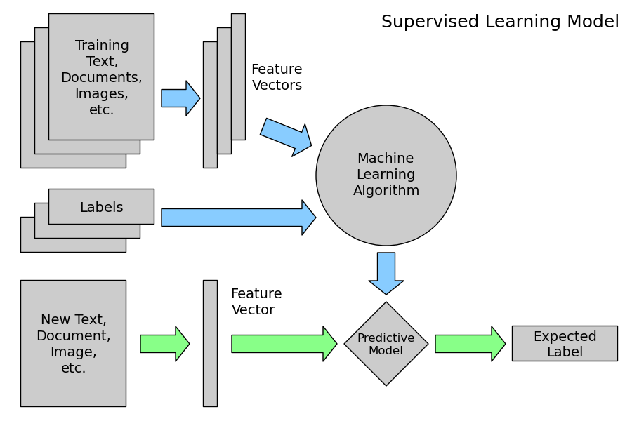

Slide 8
Algorithms Examples
Regression (continuous variable)
Linear and Polynomial
Decision Tree & Random Forest
Classification (categorical variable)
Naive Bayes
Nearest Neighbour
Support Vector Machine
...

Slide 9
The Different Sets
Training set : set of labeled data used to train the algorithm.
Validation set : set of labeled data used to verify and tune the algorithm. (not always used)
Test set : set of labeled data used to evaluate the accuracy.

Slide 10
Unsupervised Learning
The machine learn from unknown data. The purpose is to find similarity among the objects.
Somehow it consists in finding labels.
The machine has to learn things by itself

Slide 11
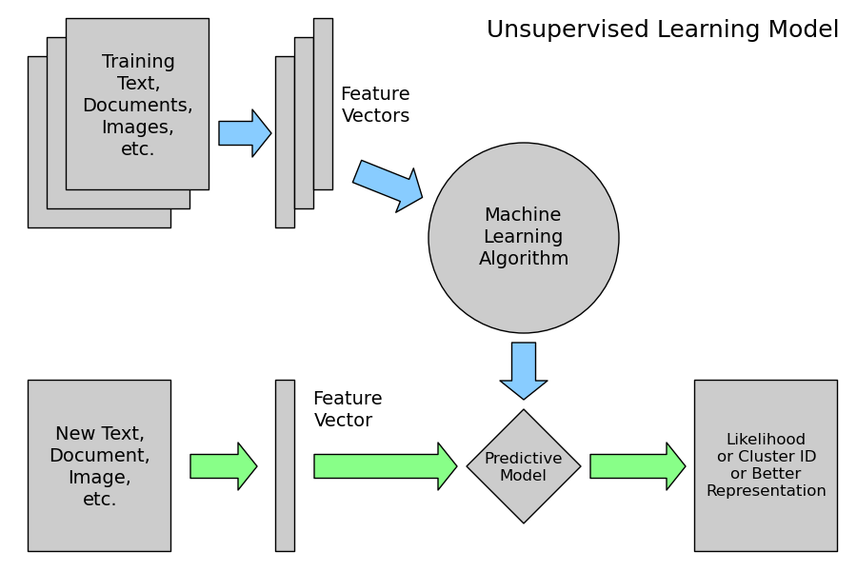

Slide 12
Algorithms Examples
Dimensionality reduction
PCA
Clustering
Kmeans
GMM
...

Slide 13
Python Scikit Library
Python library for machine learning
Use an object-oriented structure :
> from sklearn import my_algo
> tmp = my_algo(parameters)
> tmp.fit(training_set)
> tmp.predict(new_value)

Slide 14


