Slide 1
Decision Tree

Slide 2
Decision Tree - Reminder
http://www.r2d3.us/visual-intro-to-machine-learning-part-1/
Our goal is to create a model to predict an item target's value.
To built the model we use a decision tree.
Decision Trees can be used for both
Classification and Regression

Slide 3
Decision Tree Classification
It is a hierachical model for supervised learning.
The Tree is made of decision nodes where a test is performed to split samples in parts.
Starting from the root splitting is done recursively.
Finally leaf nodes contain output values.

Slide 4
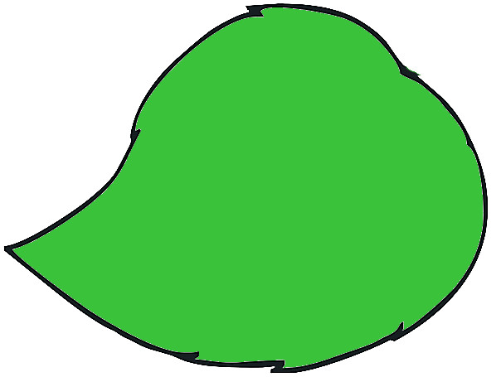
Decision Tree
Root
Decision
Node
Decision
Node
Leaf
Node
Leaf
Node
Decision
Node
Decision
Node
Leaf
Node
Leaf
Node
Leaf
Node
Leaf
Node

Slide 5
How to build it?
Ultimately we want the simplest and smallest decision tree possible.
What are then the main issues when building a decision tree?
  At a decision node which test shall we run ?
  (type, criterion, ...)
  Shall we stop the tree construction and when ?
  How to evaluate the quality of the tree ?

Slide 6
Making decision ...
At a decision node, we can decide to split using a single feature or several features.
Univariate vs multivariate
We can chose to limit the number of child per parent.
binary vs n-ary

Slide 7
… depends on the input
For instance :
  If categorical variable : naturally split in n types
(!careful when n is very large!)
  If continuous variable : Choose threshold value or interval(s)

Slide 8
Goodness of a Split
Impurity Measure (Classification)
  A split is pure if all samples in the child nodes belong to the same class.
For node m, let's first define :
Node m is pure if for all i ; p^{i}m is 0 or 1.

Slide 9
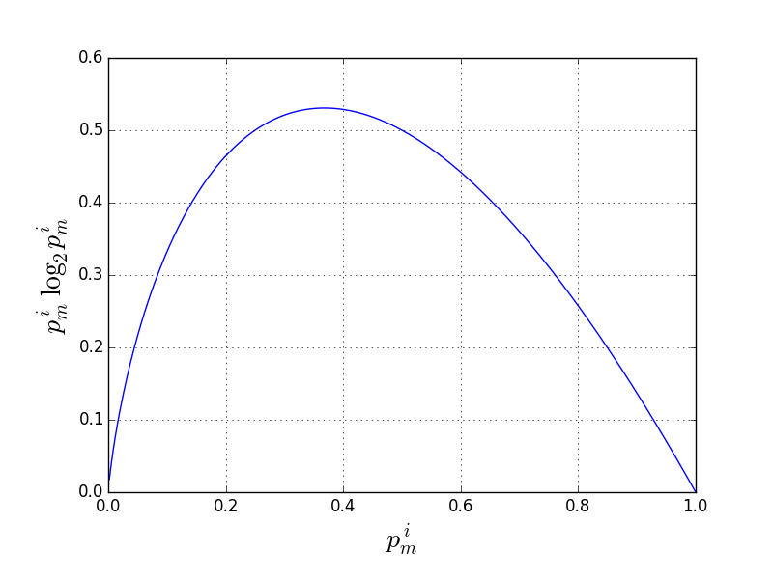
Impurity Measure
Using the “entropy” :
(Quinlan 1986)

Slide 10
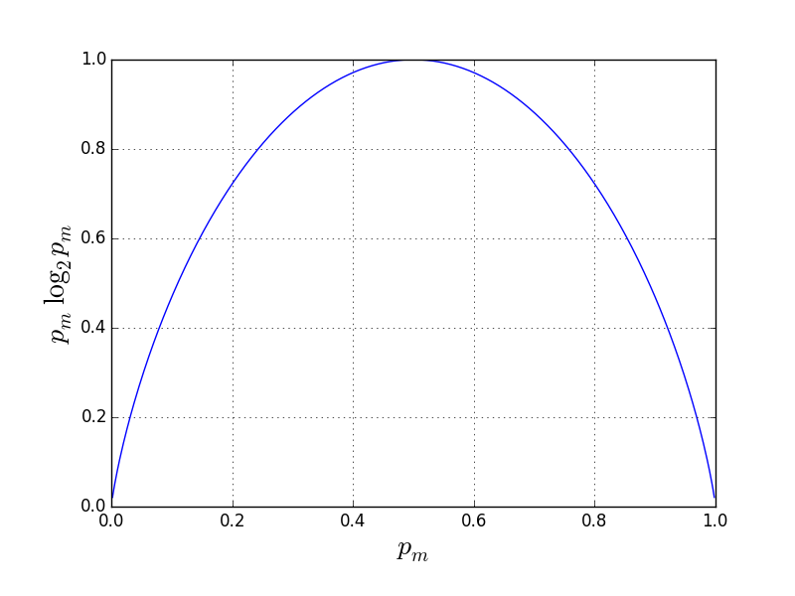
Impurity Measure
In the case of a binomial split (k=2) : Φ(p¹,p²)
  Φ(0,1) = Φ(1,0) = 0.0 and Φ(0.5,0.5) is a maxima

Slide 11
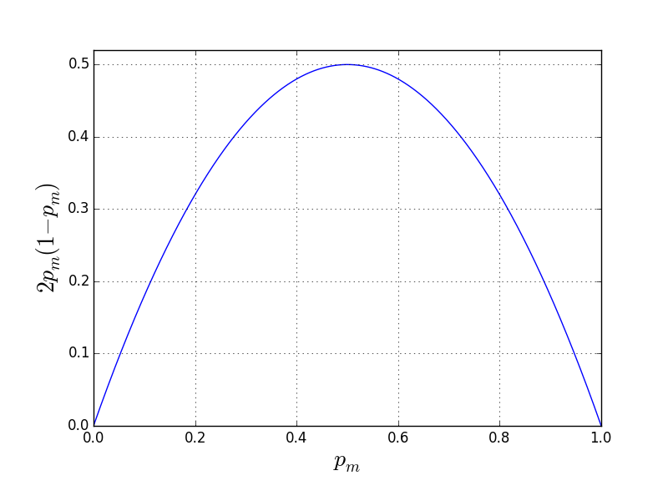
Impurity Measure
Using the “Gini index” :
(Breiman 1984)
Binomial case :
p = p¹ = 1-p²

Slide 12
Making Decision
At each decision node we chose the best feature for splitting ; i.e. the one that reduce the most impurity.
We can now construct the decision tree until each leaf node is totally pure…
  … which has disadvantages

Slide 13
Drawbacks
Time and resource consuming
Locally optimal decision does not imply globally optimal tree
Complex tree and overfitting
Unstable algorithm (small difference in training set can result in very different model)
  Setting limits can help here

Slide 14
Limiting the Tree
When new node reaches target purity.
We can also limit the depth of the tree.
We can ask to stop when the number of samples reaching a node is inferior to a minimum value or to a fraction of the whole dataset : Prepruning
We can cut useless branches causing overfitting (validation set) : Postpruning

Slide 15

Coding Time (1)
Apply the DecisionTreeClassifier algorithm to the iris dataset.
Try the two different purity estimators. Does it change the tree?
Play with the different parameters!

