Slide 1
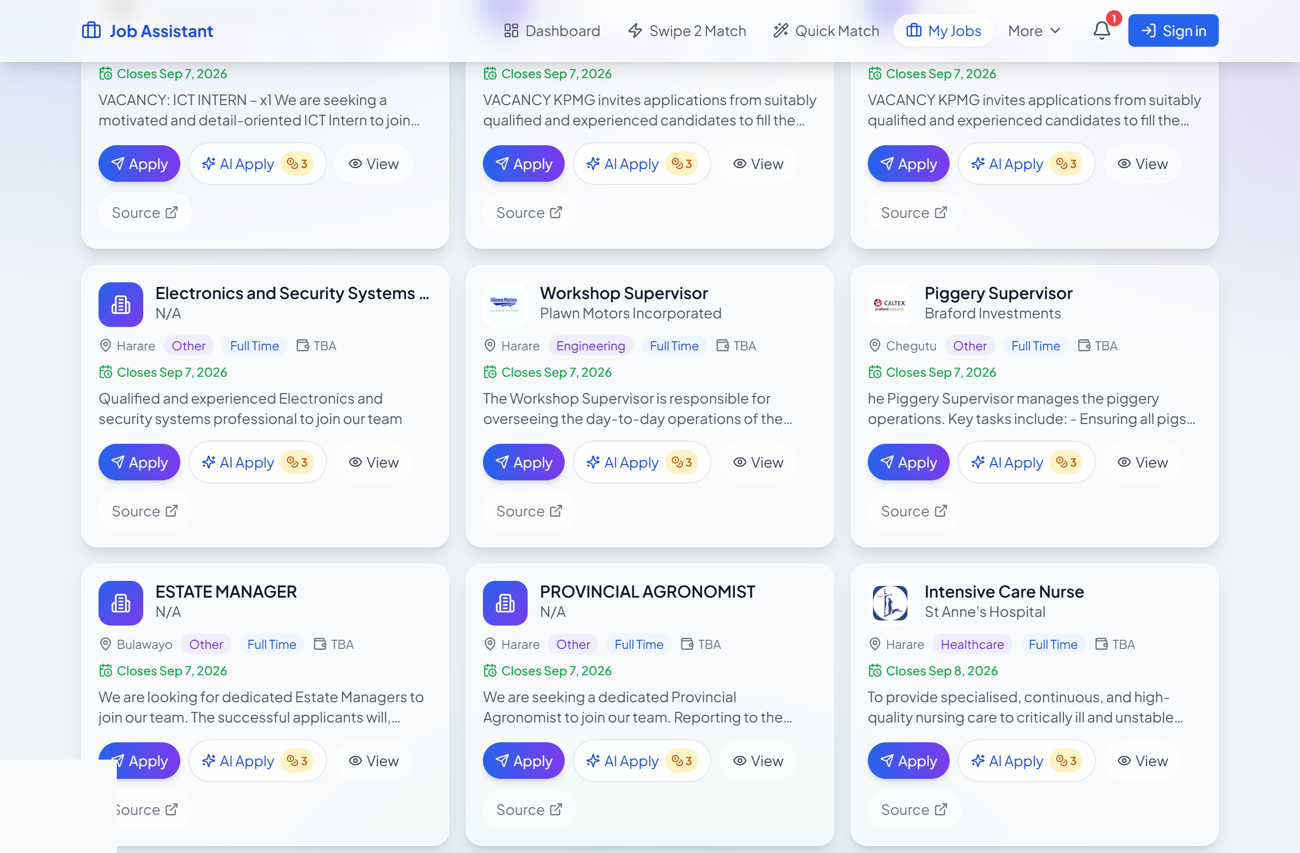
JOB ASSISTANT
Apply smarter.
Hire faster.
A two-sided AI talent marketplace for Zimbabwe & Southern Africa.
AI-tailored applications
Verified candidates
~85% gross margin
The live jobs board — Apply or AI Apply on every role
Investor & partner brief

Slide 2
THE PROBLEM
Applying is broken on both sides
RECRUITEE
RECRUITER
Job seekers apply blindly
Employers drown in noise
Generic CVs, no idea if they even match the role
Many first-timers have no CV at all
Good roles sit scattered across boards and expire unseen
Piles of unqualified, unverified applicants
No fast way to reach active, screened candidates
Hiring drags on and costs mount
2

Slide 3
THE SOLUTION
One platform, two doors
↓
“I’m looking for work”
↑
“I’m hiring”
Aggregated jobs, de-duplicated & enriched
AI-tailored applications sent from your own Gmail
Build a CV from scratch — no CV needed to start
Swipe-to-match + verification badges
Searchable pool of profiled candidates
Swipe-to-shortlist the right people
Pay-to-unlock verified contact details
In-app messaging, end to end
3

Slide 4
WHY NOW
The tailwinds line up
01
02
03
AI cost collapsed
Local-first
Two-sided moat
Running the tailoring model on Cloudflare Workers AI costs a fraction of a cent per action — margins impossible two years ago.
Zimbabwean job-board coverage, USD pricing with mobile money (Paynow/EcoCash) on the roadmap, Gmail-native sending employers trust.
Every verified candidate makes the employer side more valuable — and every employer makes the seeker side more valuable.
4

Slide 5
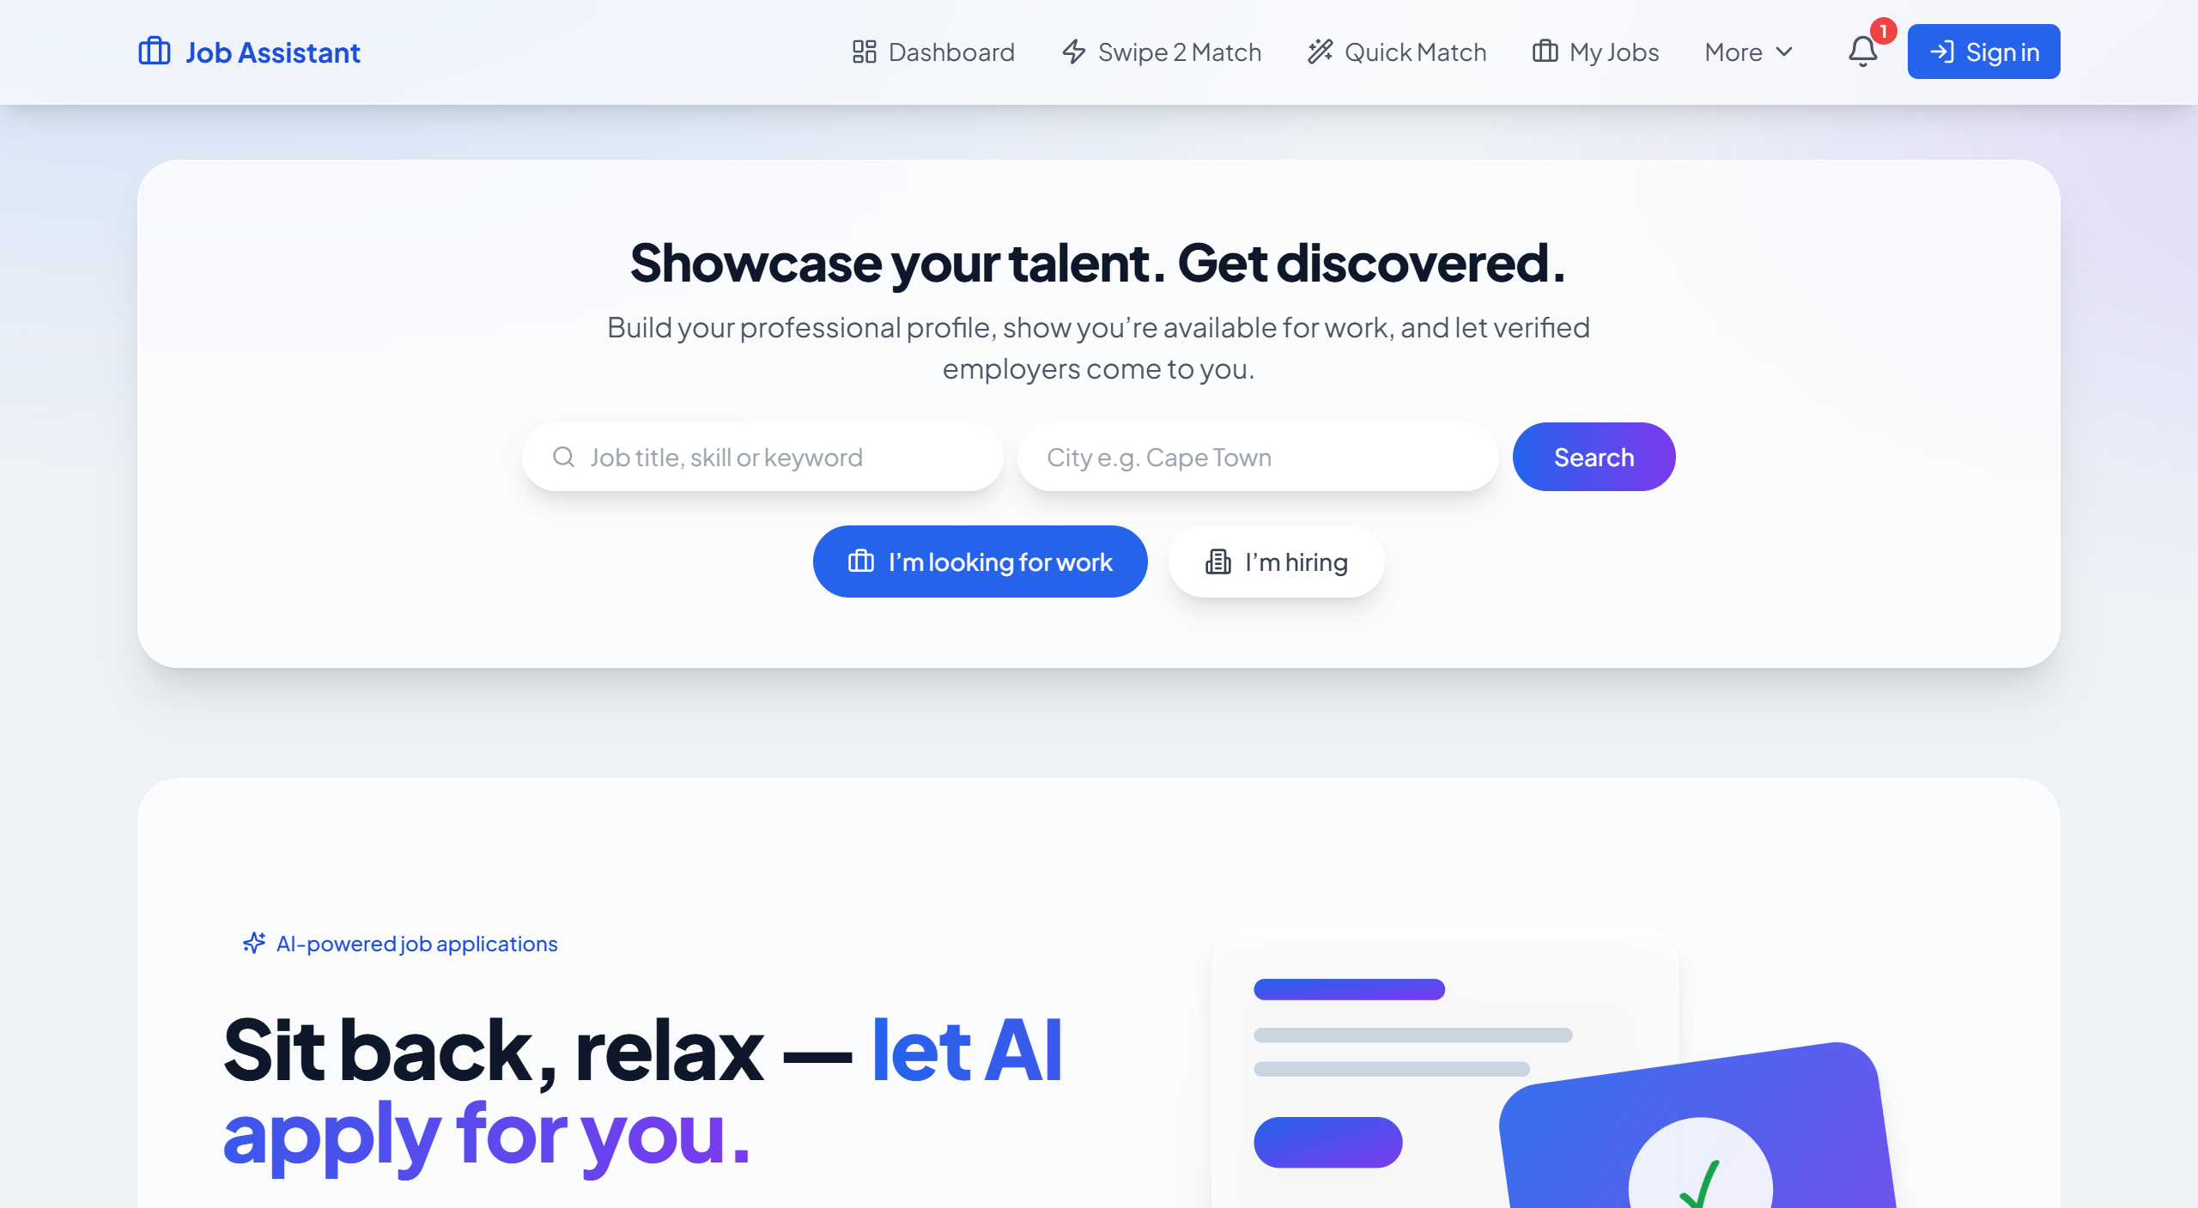
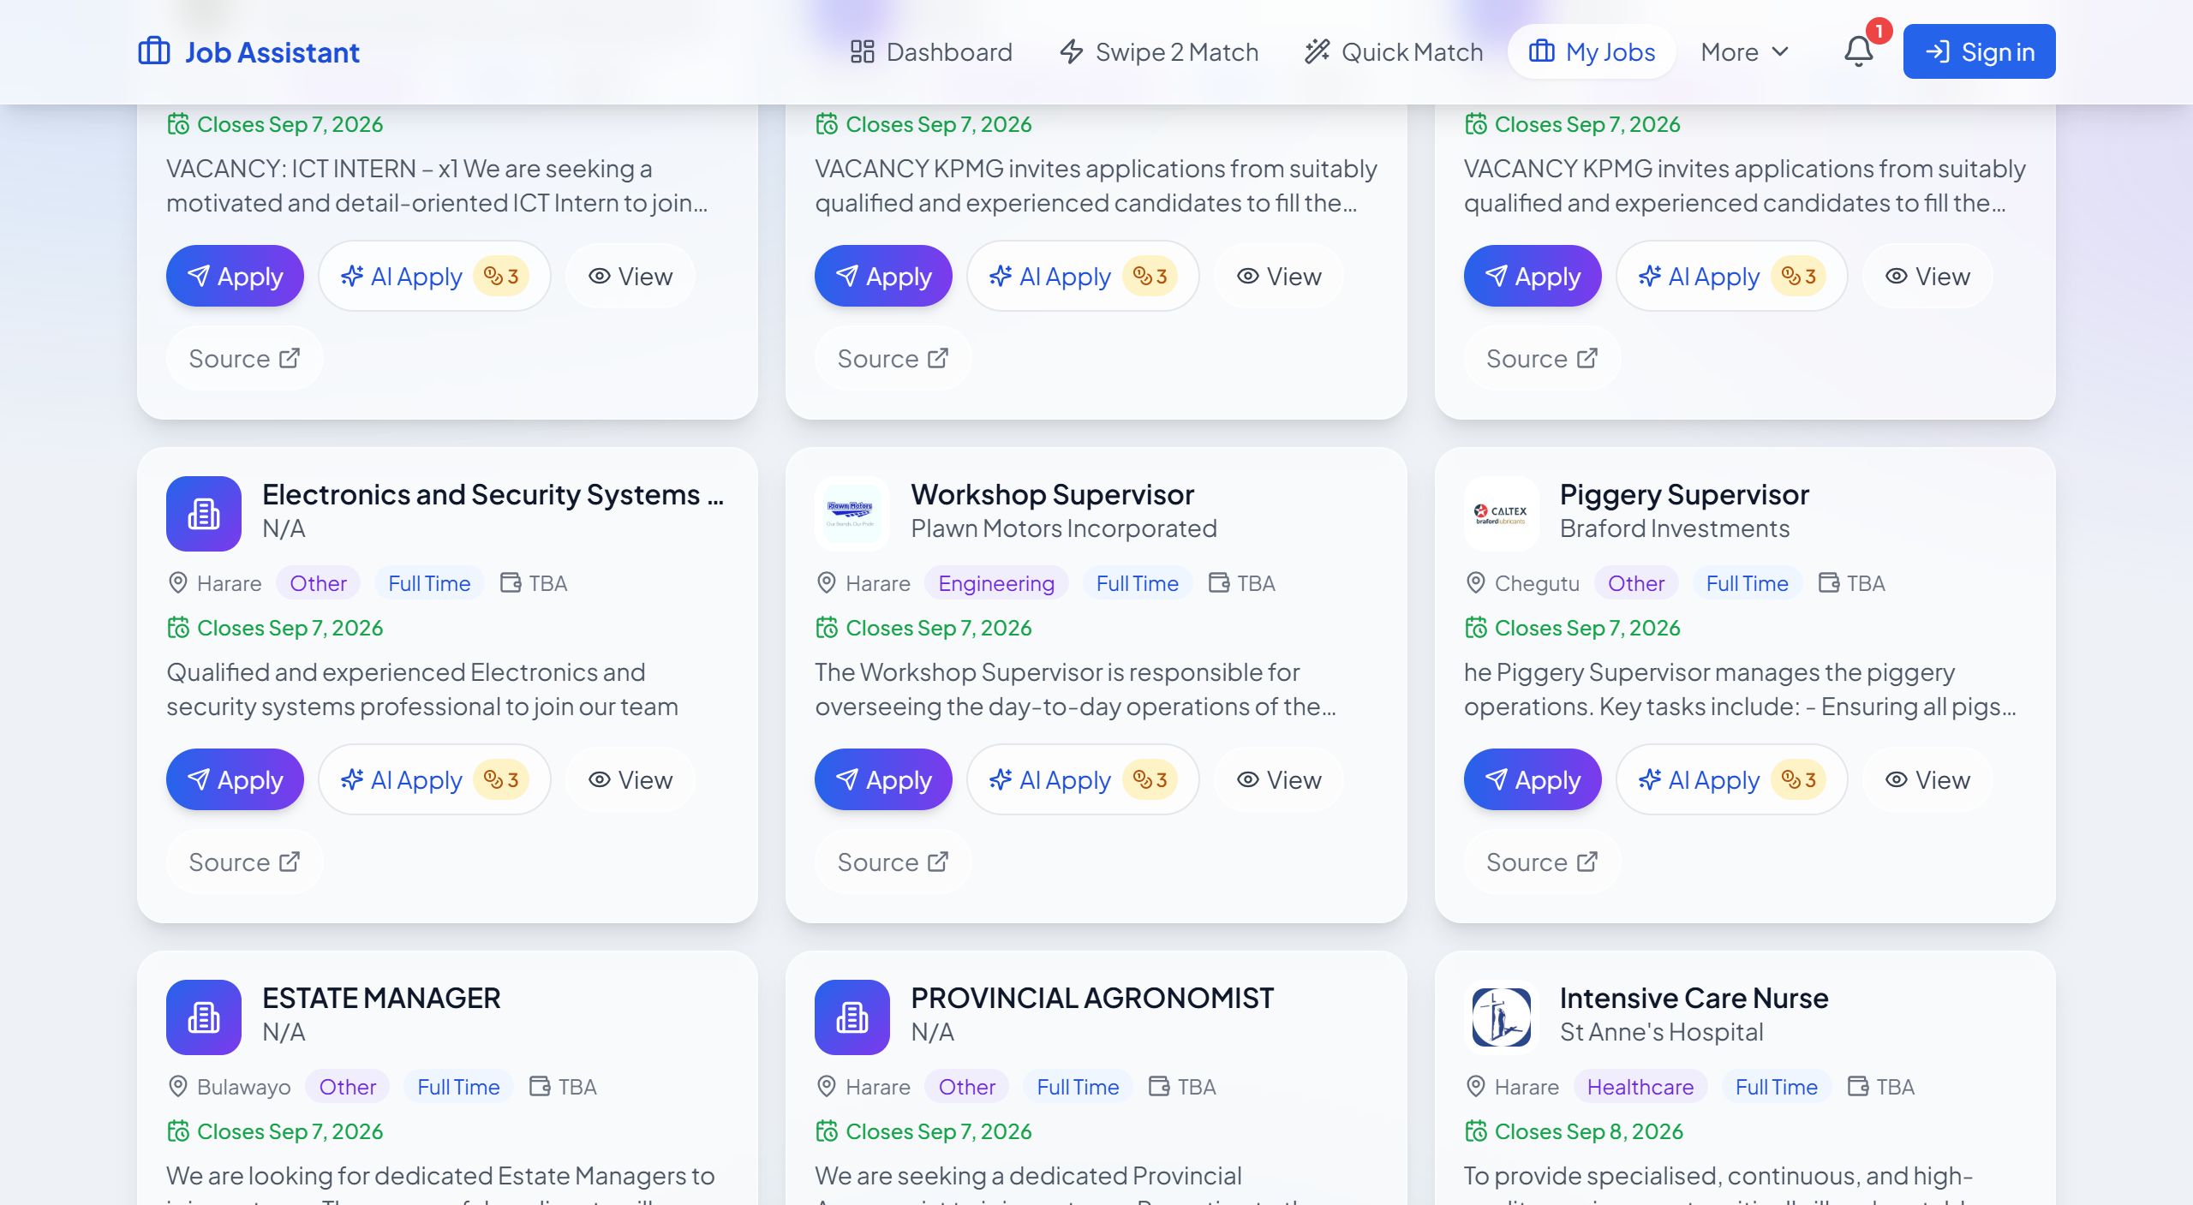
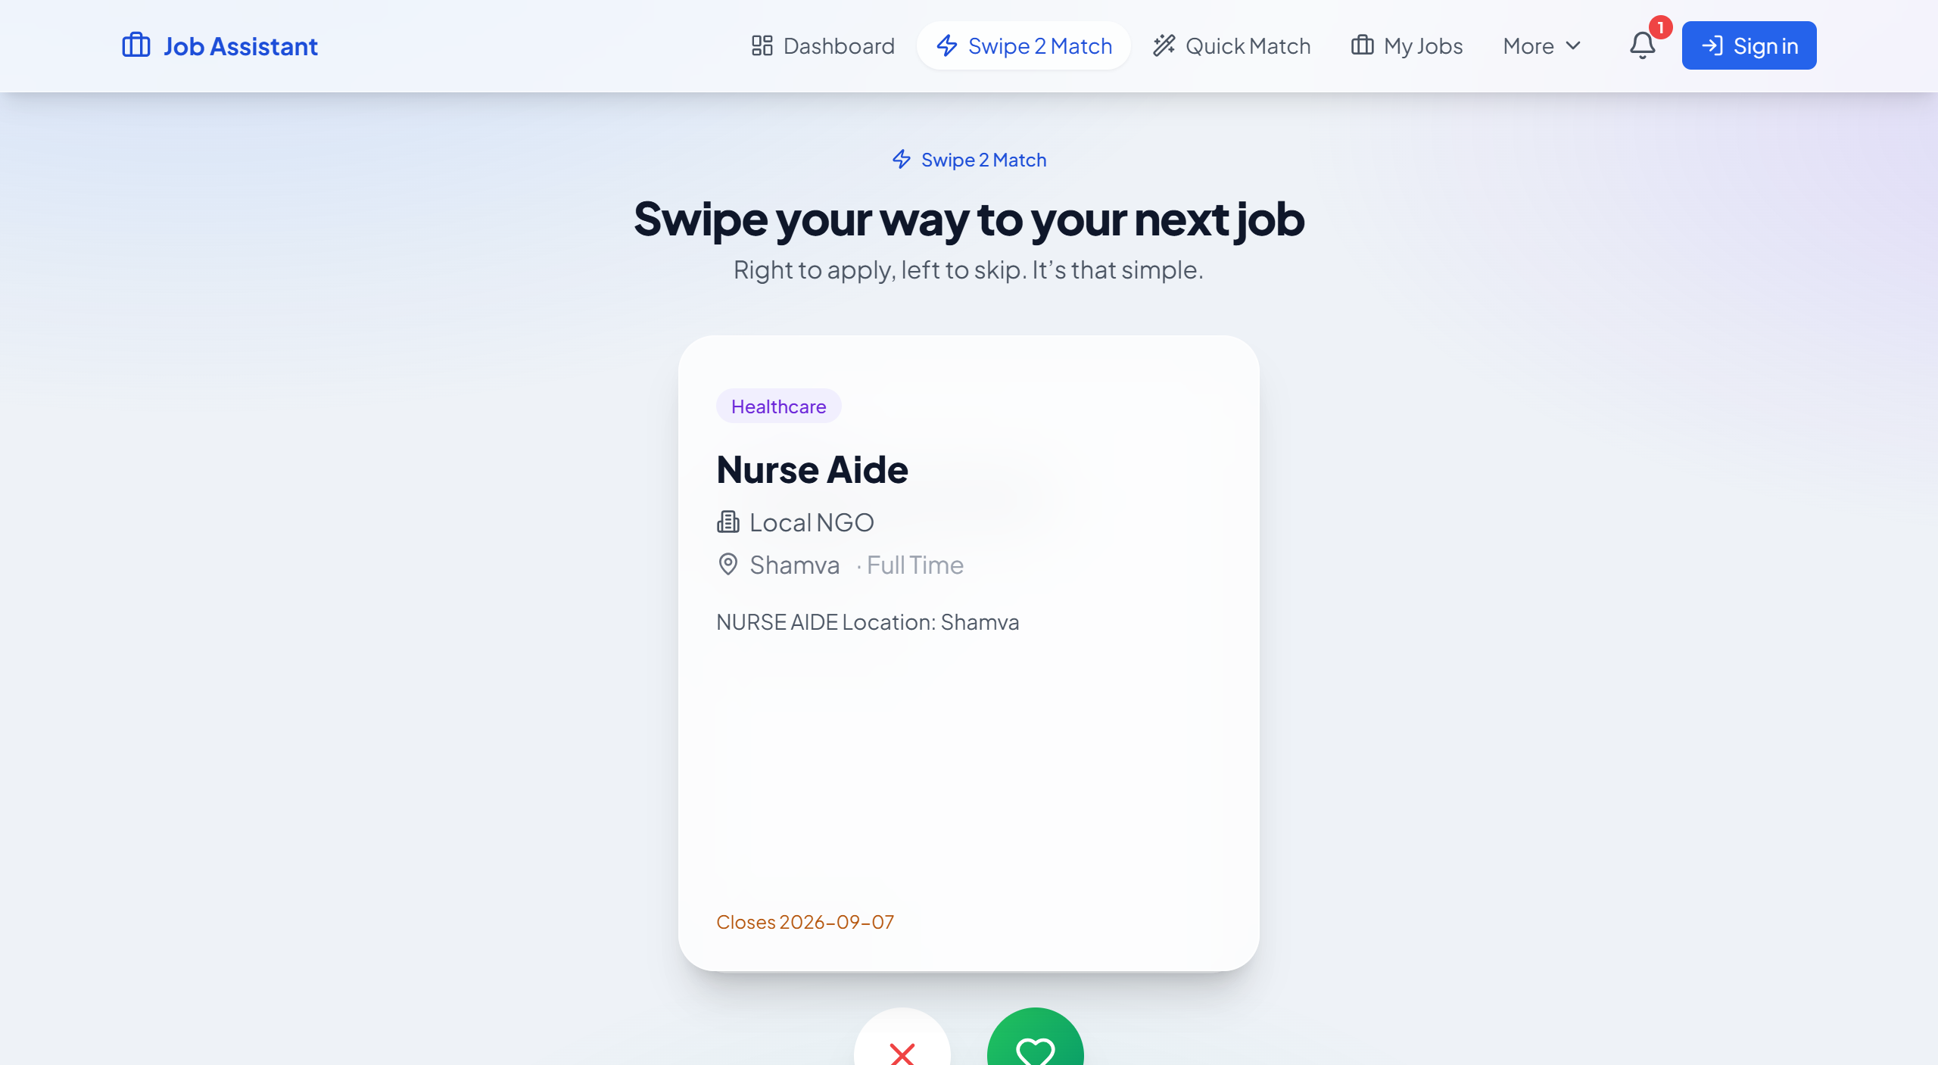
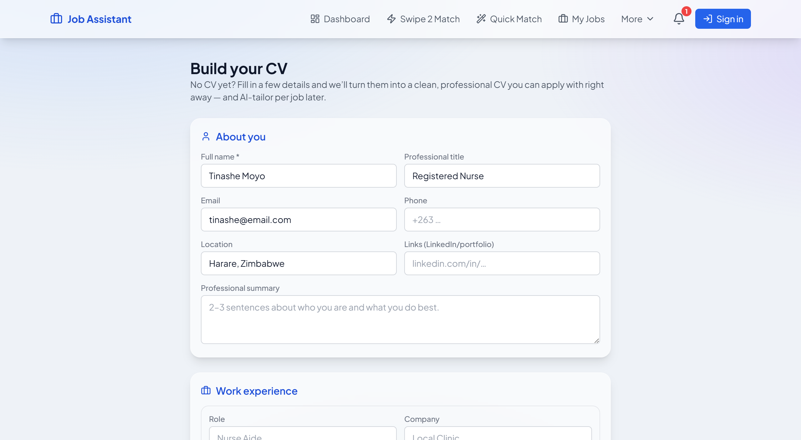
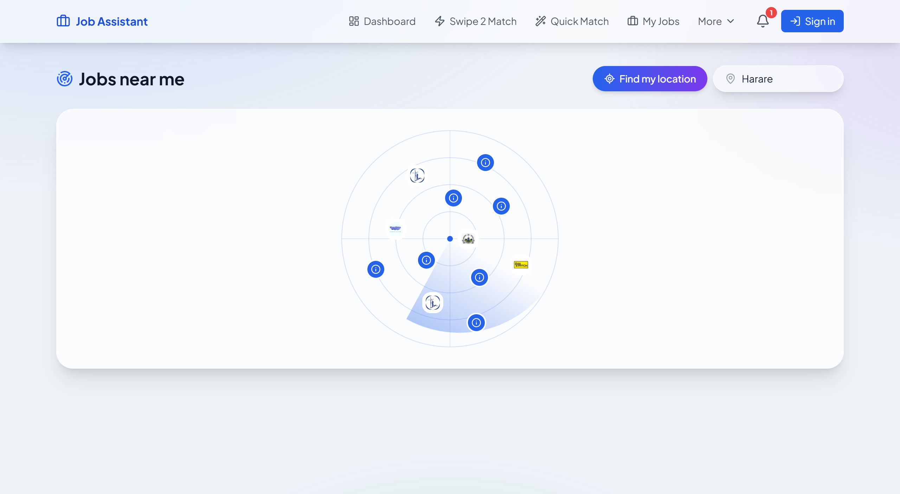
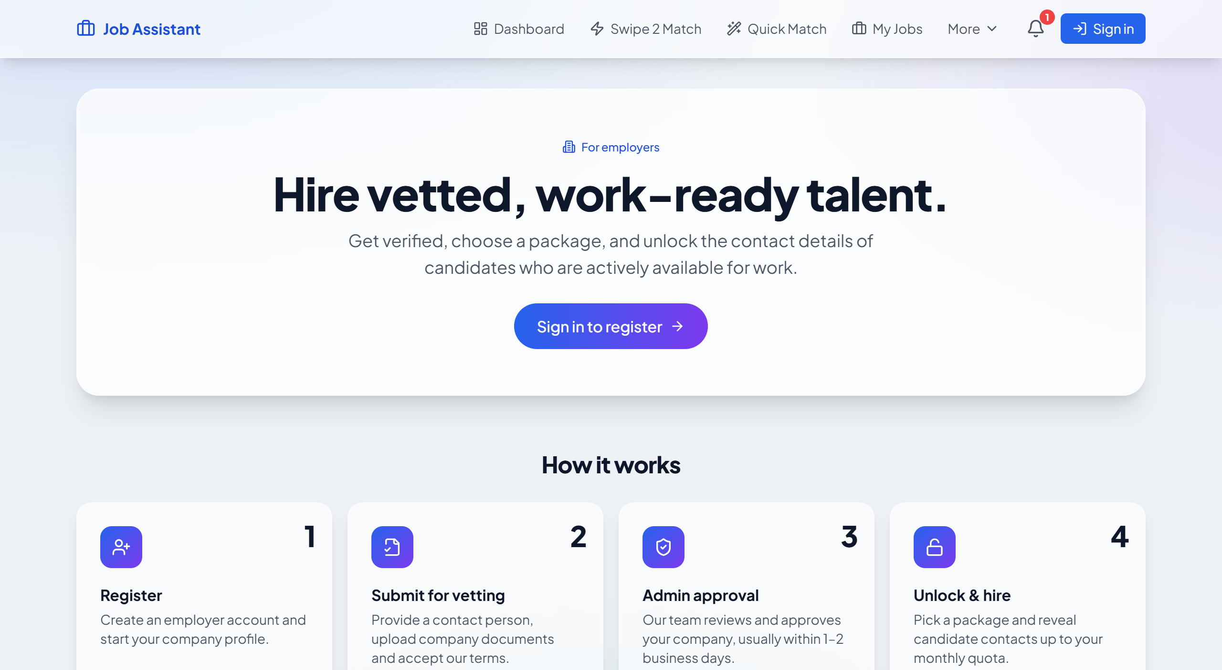
PRODUCT TOUR
The app today — not a mockup
Landing — “looking for work” or “hiring”
Jobs board — Apply / AI Apply / View / Source
Swipe 2 Match — right to apply, left to skip
CV Builder — no CV? build one in minutes
Jobs Near Me — radar by city
Employers — register, vet, unlock, hire
5

Slide 6
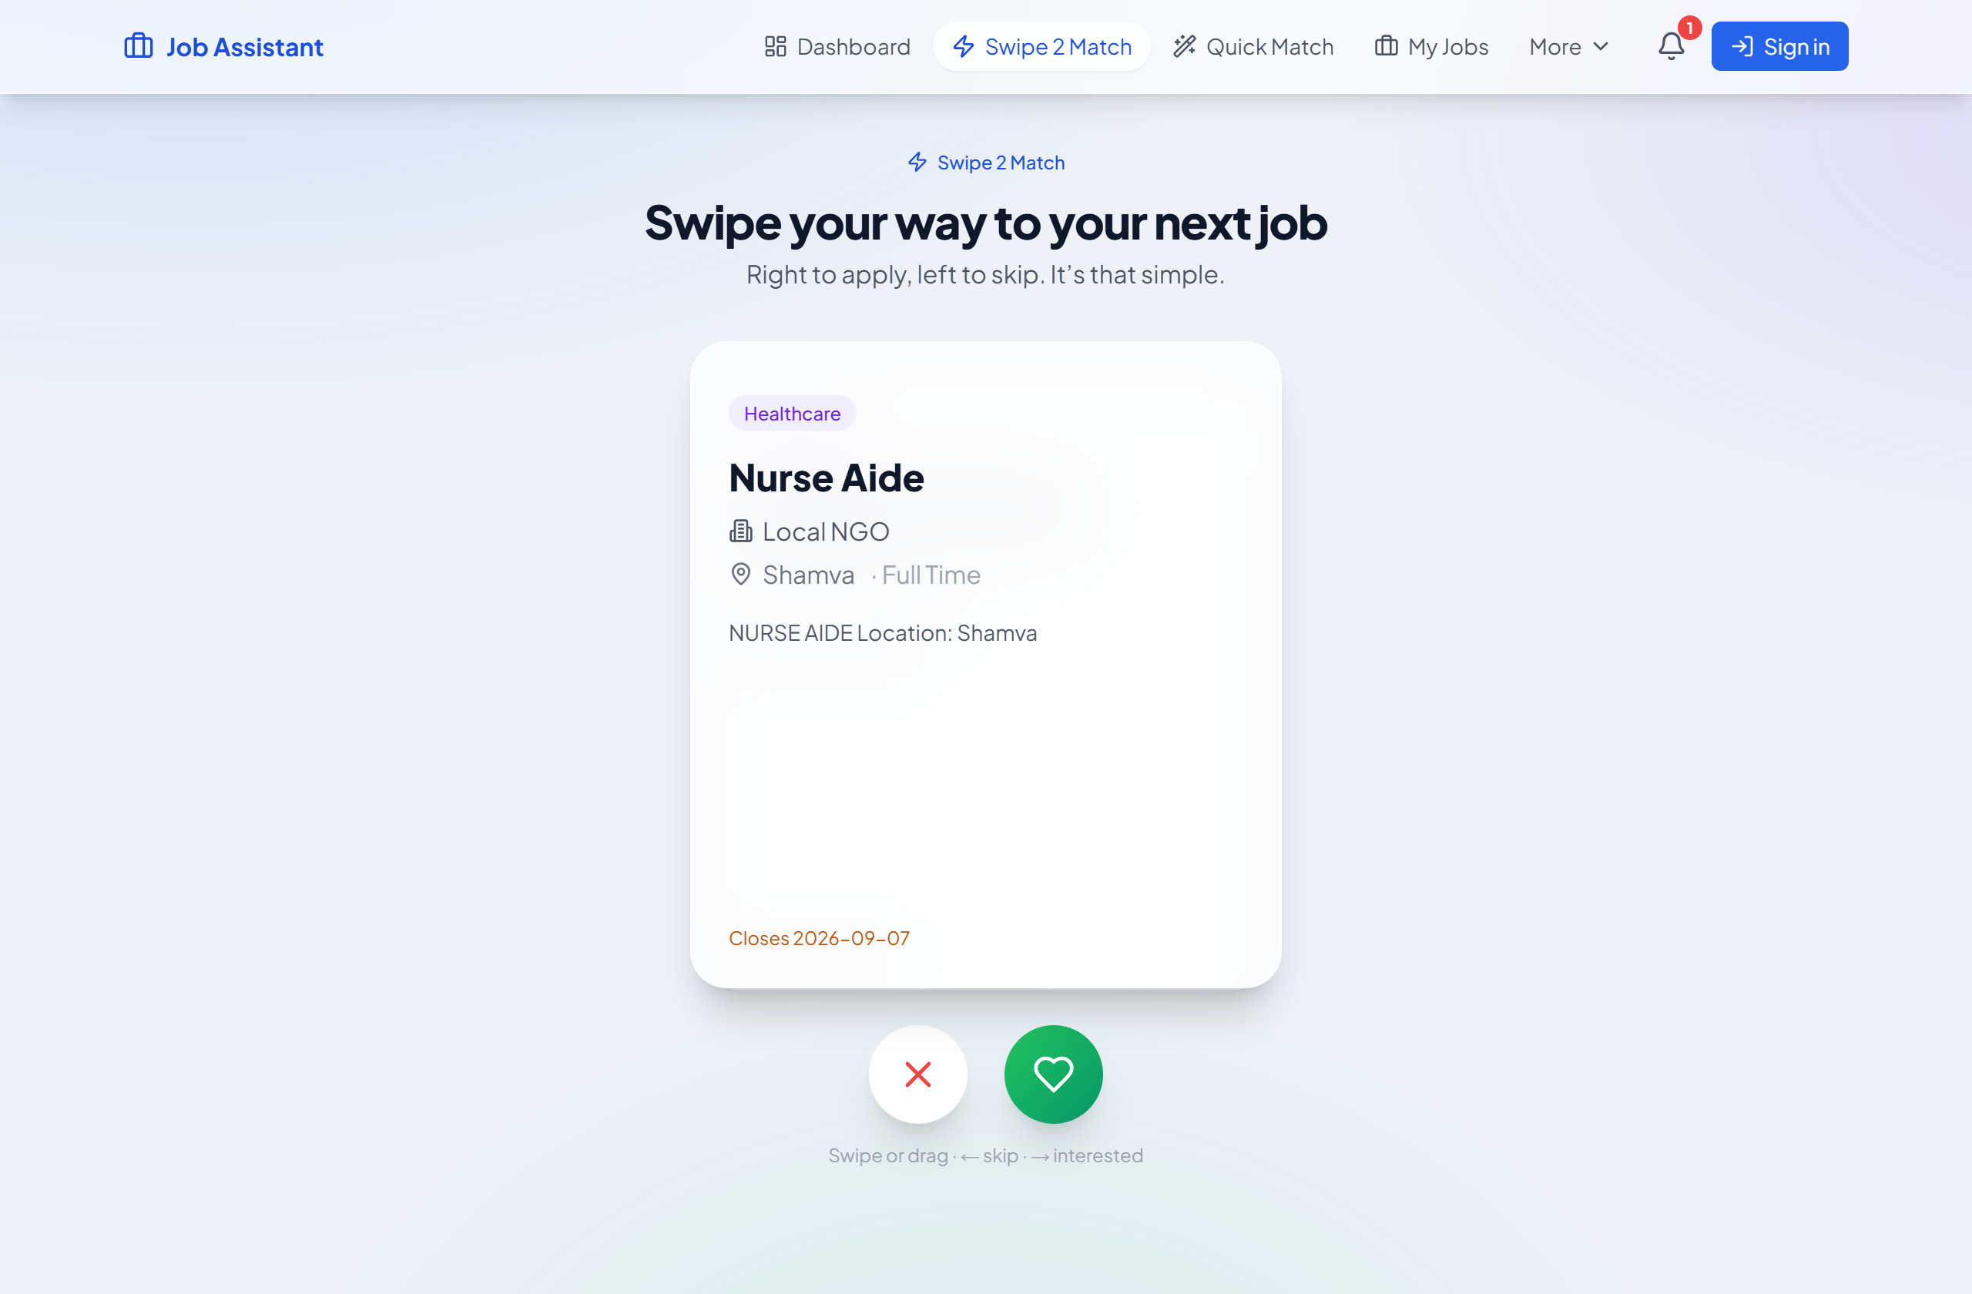
HOW IT WORKS · JOB SEEKER
From blank page to sent application
Upload or build a CV
›
Browse & swipe
›
Apply / AI Apply
›
Send from Gmail
›
Verified & tracked
1
2
3
4
5
Swipe 2 Match — a Tinder-style deck for jobs
6
Every job: Apply (free, your CV) or AI Apply (3 cr, tailored)

Slide 7
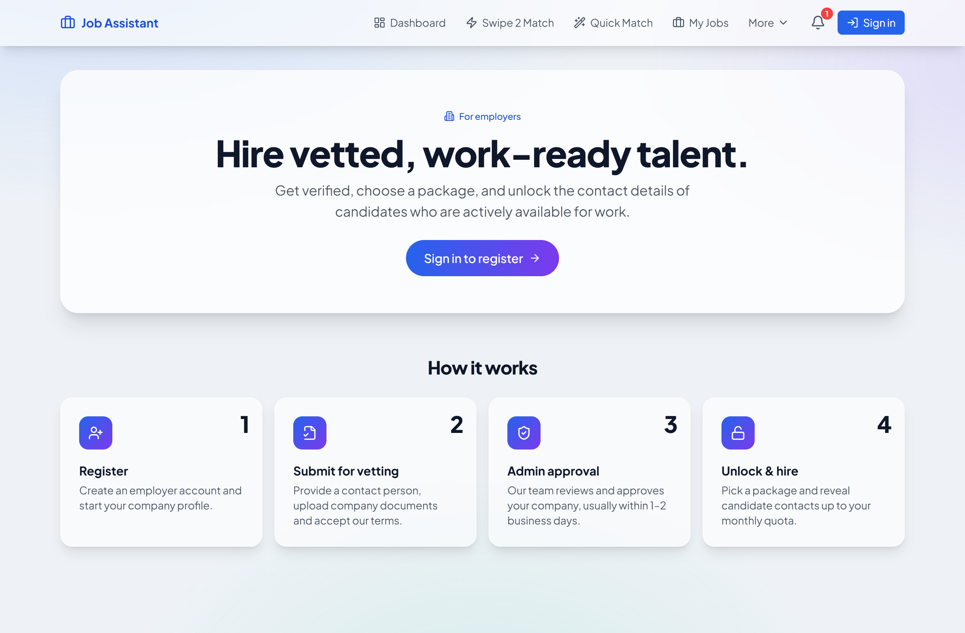
HOW IT WORKS · EMPLOYER
Register → discover → unlock → hire
1
Register & get approved
Company + verification doc reviewed by an admin before any unlock.
2
Browse candidates by sector
Profiled cards with skills + verified badges.
3
Swipe to shortlist
A recruiter swipe deck to shortlist fast.
4
Unlock & message
Two-sided marketplace — the employer entry point
Revealing contact spends credits — the core revenue event — then chat in-app.
7

Slide 8
WHERE THE MONEY IS
Prepaid credits — spend on what matters
Credit packs (live)
What credits are spent on (live)
Starter
Action
Cr
≈ USD
$5
100 cr
AI Apply — tailor CV + note
3
$0.11–0.15
Match all jobs to my CV
5
$0.18–0.25
Standard
$12
300 cr
Quick Match (batch)
10
$0.35–0.50
Unlock a candidate · employer
20
$0.70–1.00
Pro
$35
Background check
15–30
$0.53–1.50
1,000 cr
New accounts start with 50 free credits.
8

Slide 9
UNIT ECONOMICS
The AI is nearly free to run
~$0.003
~$0.12
~97%
cost to serve one AI Apply*
price charged for it
gross margin on Workers AI
Even a full switch to a premium model keeps AI actions ~80% margin.
The credit price is decoupled from the model. Non-AI costs (Workers, KV, Vercel, Stripe) stay small and flat.
*Illustrative estimates — recompute from current vendor rates × real token counts.
9

Slide 10
IF THE AI MODEL CHANGES
Provider-agnostic by design
The app runs Cloudflare Workers AI or OpenAI and falls back automatically. Four levers if model cost rises:
Absorb it
Re-price credits
1
2
Margins tolerate a flagship model (~80%).
AI Apply 3 → 4 restores margin instantly.
Tier by model
Cache & batch
3
4
Cheap default; premium as a paid “Pro tailoring” upsell.
Job detail + match results already cached in KV.
Expected result: cost/AI action moves ~$0.003 → ~$0.02–0.03 worst case; blended margin stays ~80%+ with no price change, or ~95%+ with a 1-credit bump.
10

Slide 11
EXPECTED RESULTS
Illustrative funnel — to validate
Seeker funnel · per 1,000 signups
Sign up (50 free credits)
~$480
1000
per 1,000 signups from seekers (before repeat purchases)
Add a CV (60%)
600
~$160 / mo
Use a paid AI action (25%)
250
20 active employers × 10 unlocks × ~$0.80
Convert to a top-up (8%)
~$1,280 / mo blended
80
2,000 seekers + 40 employers · ~85% margin
Planning assumptions to validate — not guarantees.
11

Slide 12
ROADMAP
Now → next → later
NOW
NEXT
LATER
Job aggregation & AI Apply
CV builder
Swipe match
Employer unlock & messaging
Verification + Stripe credits
Paynow / EcoCash top-ups
Employer subscriptions
Featured job posts
Referral credits
WhatsApp delivery
Recruiter analytics
ATS integrations
Regional expansion (SA first)
12

Slide 13
THE PITCH
From a blank page to a sent, tailored application in minutes — and that verified applicant into a hire.
On margins that work — because the AI is nearly free to run.
Let’s build the region’s hiring layer

