Slide 1

GROUP 22
Requirements
Analysis
TASK 3
Requirement Analysis
Presentation
BY GROUP 22
PRESENTED BY GROUP 22

Slide 2
PRESENTED BYGROUP 22
CONTENTS
01.
02.
03.
04.
Review of Requirements
Identifying Inconsistencies, Ambiguities, and Missing Information
Prioritizing Requirements Based on Importance and Feasibility
Classifying Requirements
05.
06.
Development of the SRS Document
Validate Requirements with Stakeholders

Slide 3

PRESENTED BYGROUP 22
01
Review of and Analysis of Requirements
Requirement Analysis
Presentation

Slide 4






PRESENTED BYGROUP 22
The requirements were assessed for:
COMPLETENESS
CLARITY
FEASIBILITY
www.website.com

Slide 5

PRESENTED BY GROUP 22
02
Identifying Inconsistencies, Ambiguities, and Missing Information
how often road condition data will be updated?
Can users submit reports offline?
What about multiple languages and accessibility features?
www.website.com

Slide 6


PRESENTED BY GROUP 22
03
Prioritizing Requirements Based on Importance and Feasibility
High Priority
Medium Priority
Low Priority
www.website.com

Slide 7

PRESENTED BY GROUP 22
04
Classifying Requirements
Requirement Analysis
Presentation

Slide 8
Functional Requirements
Road Sign Directory
Real-Time Road Condition Alerts
Map Integration
User Reporting System
Notification Customization

Slide 9
Non-functional Requirements
Usability
Performance
Reliability
Compatibility
Security
Scalability

Slide 10

PRESENTED BY GROUP 22
05
Software Requirement Specification
Overall description
System Features and Requirements
Data Requirements
System Attributes
Compliance Requirements
A formal SRS document was developed to include:

Slide 11
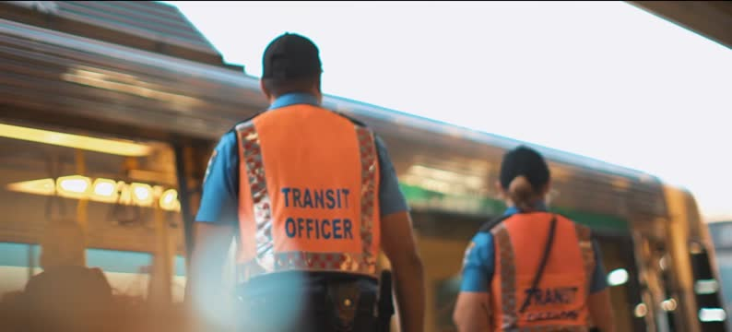


Validating Requirements with Stakeholders
PRESENTED BY GROUP 22
06
Transport authority officials
Local drivers and app users
Developers and designers
www.website.com

Slide 12
PRESENTED BY GROUP 22
THANK YOU
FOR LISTENING
Requirement Analysis
Presentation
GROUP 22
PRESENTATED BY GROUP 22

