Slide 1


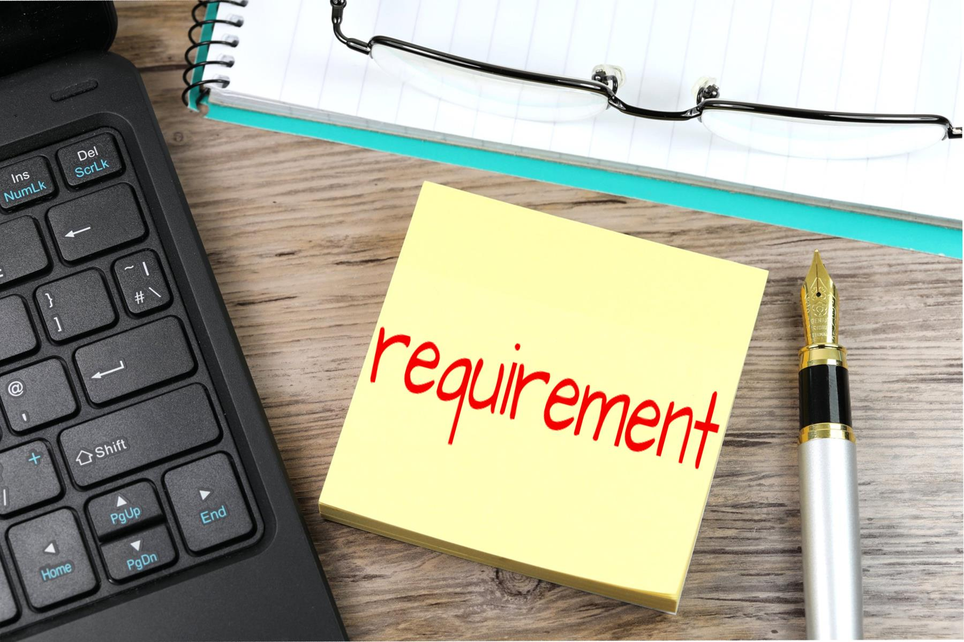
Requirement Gathering for
Road Sign and Road State
Mobile Application.
TASK 2 Presentation
By: Group 22

Slide 2
CONTENTS
Stakeholder Identification
Requirement Gathering Techniques
Data Gathering
Data Cleaning
User Reluctance Assessment

Slide 3
Introduction
For this phase of the project,the goal
was to collect the requirements
necessary to design a user-friendly
app that provides drivers with
real-time Road sign information
and Road condition updates.

Slide 4



Stake holder Identification
Drivers and Vehicle Owners
Transportation Authorities
The Team
Need real-time road condition updates and clear road sign information.
Responsible for maintaining road safety. Provide verified road sign data
Responsible for building, testing, and deploying the application

Slide 5
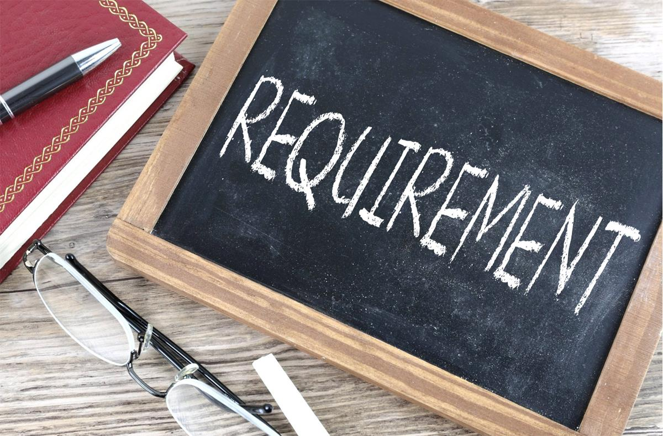



Requirement Gathering Techniques
Surveys
Gather opinions from drivers about their challenges
Interviews
Gain in-depth insights from key stakeholders
Brain storming
generate innovative ideas for the app’s features and functionality

Slide 6


Data Gathering
Type of Data Collected
Road Sign Data
User Preference Data

Slide 7



Data Cleaning
Removed Redundant Data
Validated Data Accuracy
Standardized Data Formats

Slide 8
User Reluctance Assessment
CONTENTS
1. Privacy Concerns
2. Notification Fatigue
3. Usability Challenges
4. Lack of Trust in Crowdsourced Data

Slide 9
Thank You
By: Group 22

