Slide 1

SERIES!
Notes:
Hi everyone! Welcome to the first video of my channel! I’m very excited to finally be sharing this series with you. This is something that I’ve been thinking about doing for a while but never round got around to it. With the whole world going in flames and everyone stuck at home, I finally have the time to jump start this So I’m just going to jump right ahead and talk about the type of videos that you’ll be seeing in the next upcoming months. The series is going to be called web security academy series and that’s because we’ll be using the web security academy platform that is developed by Portswigger. So the makers of Burp Suite, which is a pretty well known tool amongst web app pentesters.

Slide 2
What is the Web Security Academy?
Notes:
So for those of you that have never heard of the Web Security Academy. It’s a free online training center for web application security. It’s developed by the Portswigger team and one of the authors is actually the author of the web application hacker’s handbook which is considered to be the bible of web application security. This is the book that I read when I first got started into web application security and I’m a huge fan of it. Although it hasn’t been updated since 2011, the fundamentals are still the same and I always recommend it to anyone that asks me how they can get into web application security. However, it is true that we are in a constantly evolving field with new vulnerabilities and attack coming out every day, and so I’ve always recommended this book with an additional resource that tackled modern web technologies. Now when I heard that the author of the book had started a web security academy that not only tackles modern web technologies but also provides free hands on labs where you could practice in a safe environment, I immediately signed up. And just like I’m a huge fan of the book, I’m also a huge fan of the academy. I am not in any way affiliated to Portswigger, this is just me sharing a platform that I think is very useful to the community.
Let’s go to their website and look at the type of training that they provide.

Slide 3
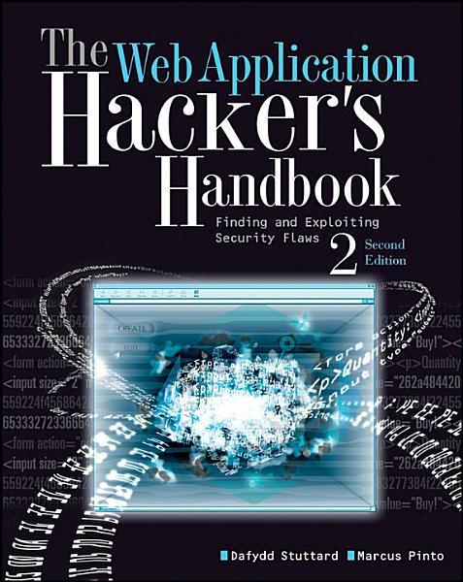

Notes:
So for those of you that have never heard of the Web Security Academy. It’s a free online training center for web application security. It’s developed by the Portswigger team and one of the authors is actually the author of the web application hacker’s handbook which is considered to be the bible of web application security. This is the book that I read when I first got started into web application security and I’m a huge fan of it. Although it hasn’t been updated since 2011, the fundamentals are still the same and I always recommend it to anyone that asks me how they can get into web application security. However, it is true that we are in a constantly evolving field with new vulnerabilities and attack coming out every day, and so I’ve always recommended this book with an additional resource that tackled modern web technologies. Now when I heard that the author of the book had started a web security academy that not only tackles modern web technologies but also provides free hands on labs where you could practice in a safe environment, I immediately signed up. And just like I’m a huge fan of the book, I’m also a huge fan of the academy. I am not in any way affiliated to Portswigger, this is just me sharing a platform that I think is very useful to the community.
Let’s go to their website and look at the type of training that they provide.

Slide 4
How will the Videos be Structured?

Slide 5


Theory Videos

Slide 6
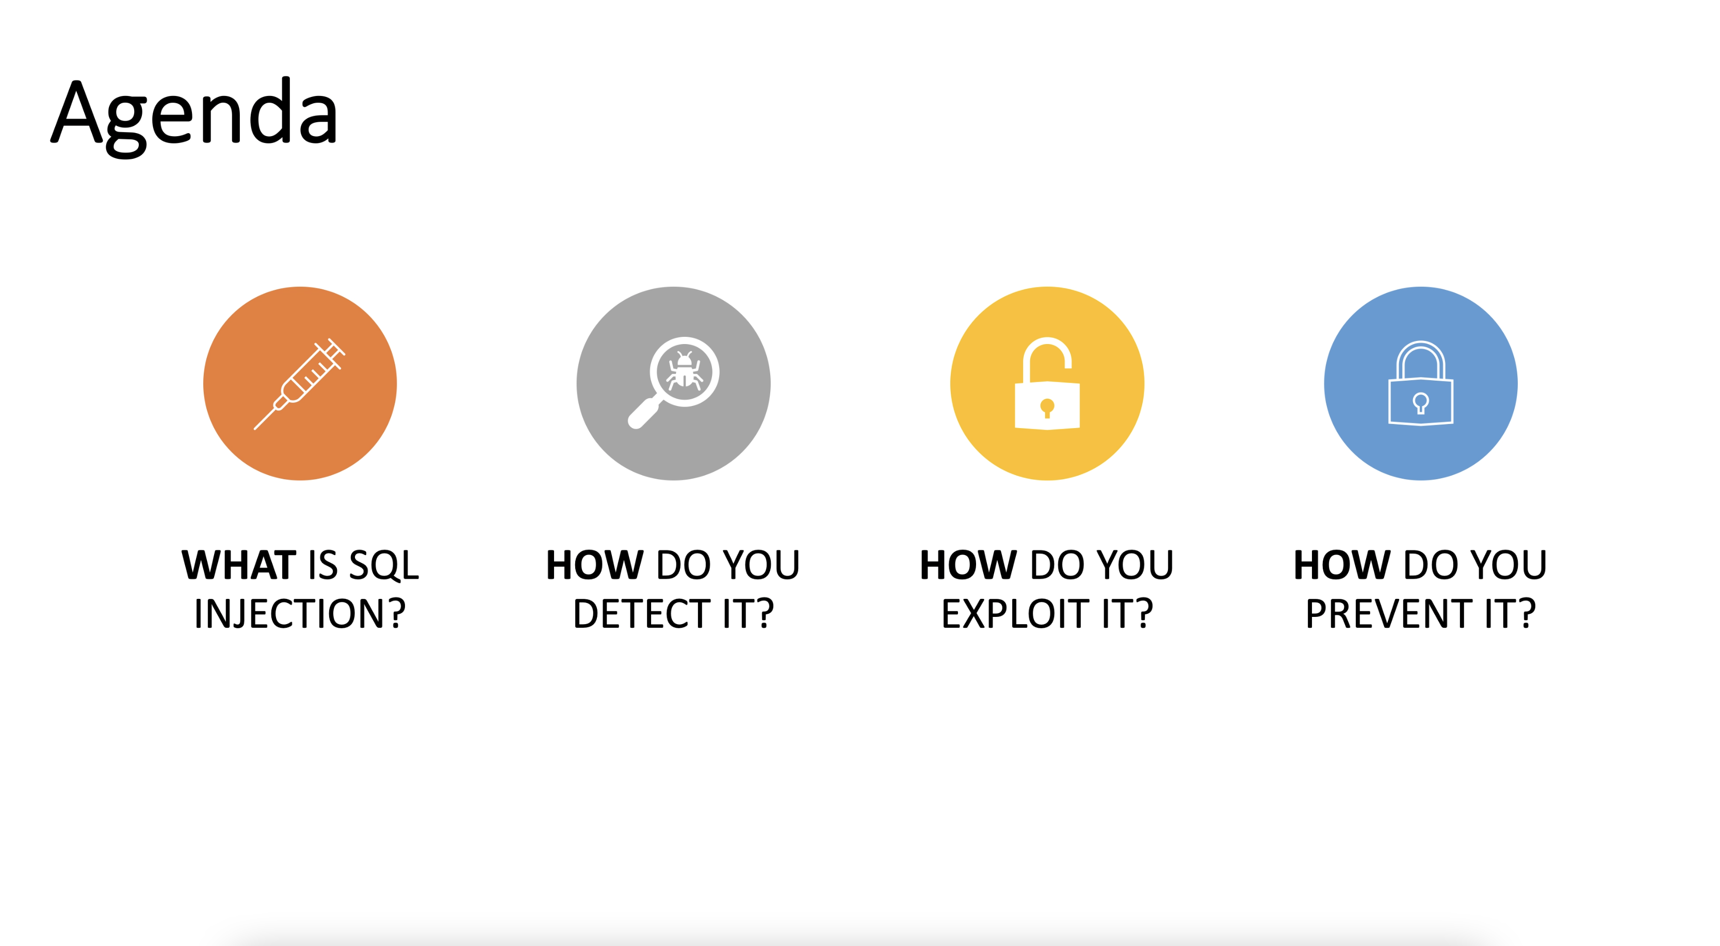
Theory Videos

Slide 7

Lab Videos

Slide 8
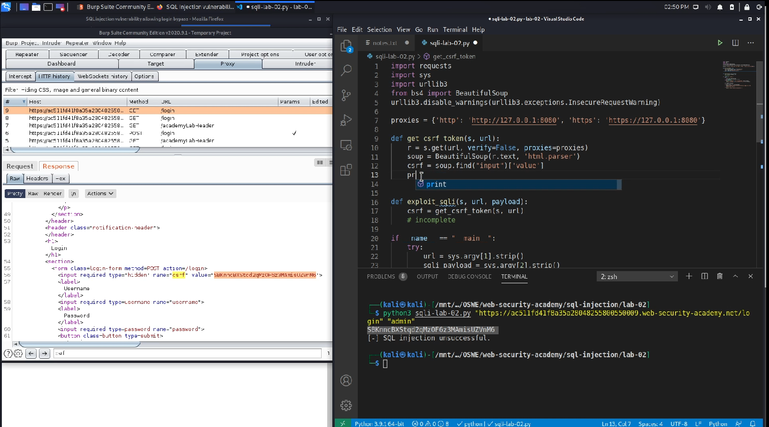
Lab Videos

Slide 9
Who are the Videos for?

Slide 10

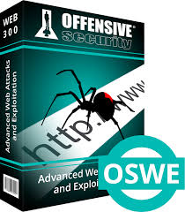

Web app pentesters
Web developers
Bug bounty hunters
OSWE
Everyone else!

Slide 11

Thank You!
SUBSCRIBE
FOR MORE VIDEOS

