Slide 1
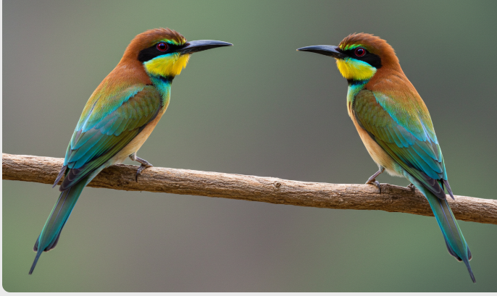
Birds of a Feather
Helping Secondary School Students become the next generation of tech leaders

Slide 2

Our Achievements (currently just wishful thinking)
32 Schools
1205 Students
The Go Programming Language
Servo motors and robotics
17 hired by Govtech
96 Contributors (Speakers / Workshop leaders)
27 Interest Groups
Introduction to Large Language Models
Getting Started with Embedded Systems

Slide 3
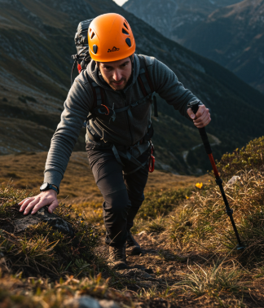
The Challenge
Secondary school students lack the opportunity to learn from tech professionals in person.
Tech events and networking opportunities are often not open to secondary school students.
Lack of structured programs to connect students with industry professionals.
No existing platform that bridges the gap between schools and the tech community.
Lack of network of professionals whom students can easily reach out to for guidance, mentorship, or collaboration.

Slide 4

Our Solution
Seamless approval process through the Ministry of Education (MOE) via School Entrepreneur clubs for tech events and interest groups.
Registry of pre-authorized volunteers (eg. GovTech certification).
A dedicated platform to organize tech events for secondary school students.
Events are hosted within schools via Entrepreneur Clubs.
Industry mentors, volunteers, and tech professionals share knowledge with students. MOE will credit them in their registry of volunteers.
Seamless approval process through the Ministry of Education (MOE).
Organize tech events like workshops, coding competitions or hackathons in schools via existing Entrepreneur clubs

Slide 5
Why ours is better than Meetup.com & Eventbrite.com
Feature | Birds of Feather | Meetup.com | Eventbrite.com
Focus on Secondary Students | Yes | No | No
School Partnerships | Integrated with MOE & Schools | No | No
Free Venue MOE School ‘s Classrooms | Yes | No | No
MOE approved Tech Mentors | Yes | No | No
Event Creation & Approval Process | Streamlined via MOE | Yes | Yes
Student Focused Learning Pathway | Yes | No | No
Incentive for Volunteer Tech Mentors | Yes | No | No

Slide 6
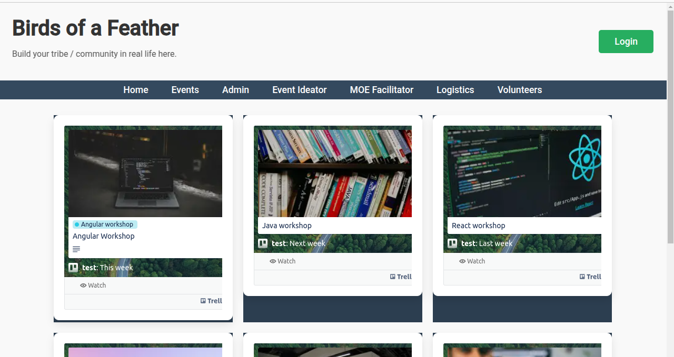
Prototype Walkthrough
Community Focus: Our website helps Community Builders, MOE, GovTech, Teachers and Student E-Club members
Interest-based discovery and Event Integration: Personal / Club profile driven matching (perhaps using a vector DB?) https://trello.com/b/A9EdtBKd
Geeky Identity: Diverse Interest Groups catering to a wide range of greeky preferences. Hackerspace-style tool sharing and learning. MOE / GovTech / Credly entry to recognize contributions.
Technical Exploration: Embedded Go Website deployed to Cloud Run with Firebase Authn/Authz
Social Impact: Create geek communitiy by connecting young geeks in school E-clubs to professional geeks

Slide 7

Key Partnerships
GovTech - example customer
Ministry of Education (MOE) – Approvals and access to schools.
Secondary Schools – Leverage Entrepreneur Clubs to host events. Cost Structure - Venue - Classrooms (free), Speakers and Workshop leaders (Volunteers)
Community builders – GeeksHacking
Tech Community – Mentors, speakers, and volunteers.
Sponsors – Provide funding, equipment, and learning resources.

Slide 8
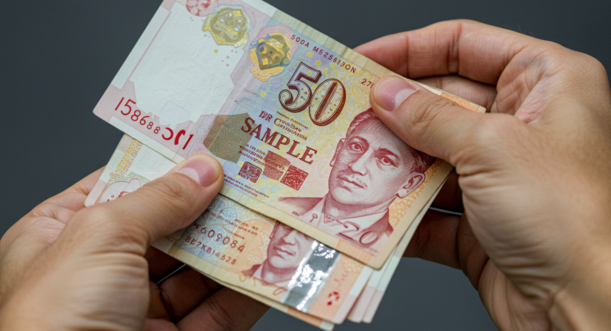
Business Model : Not for profit organisation
Value proposition - Grow the community by bringing together professional volunteers and secondary school students

Slide 9

Tech Stack
Github repo: https://github.com/siuyin/birds-of-a-feather
Web site: - Google Cloud Run - Golang embedded web-server - Firebase authentication - Firebase DB for authorisation - Vanilla HTML and javascript: focus on simplicity and maintainability

Slide 10
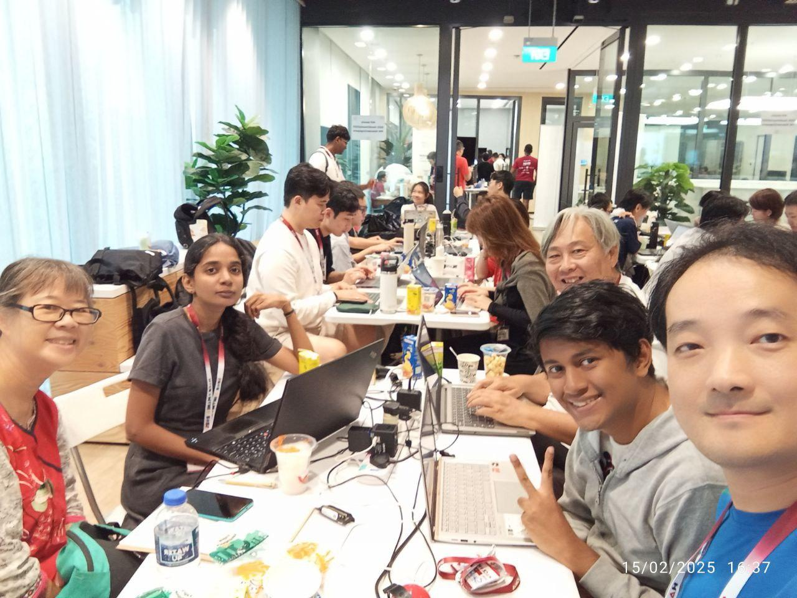
Team Members
(In Alphabet Order)
Haritha
Loh Siu Yin
Shirshajit
Weily
Yuen Kit Siew

Slide 11
Back Matter / Extra Details

Slide 12
User Roles & Event Flow
Guests: View confirmed and proposed events.
Registered Users: Sign up to attend or show interest.
Event Ideators: Propose events → Send to MOE Facilitator.
MOE Facilitators: Secure school approvals → Send to Logistics Team.
Logistics Team: Confirm sponsors & venues → Send to Admin.
Admin: Approves & Publishes events.
Once published, students can attend and participate

Slide 13
Who are we?
Name - Birds of a Feather
Organization - NGO
Purpose - Build tech community in Singapore

Slide 14
Initial Prototype / Demo
https://bof-585042202600.us-central1.run.app/
Key Features:
Event Listings & Registrations
Approval Workflow for School Events
Community-driven Mentorship

Slide 15
Join Us in Empowering Future Tech Leaders
Mentors & Sponsors – Support our initiative.
Schools & MOE – Partner with us to bring tech to students.
Hackathon Participants – Build with us and take this platform forward

