Slide 1
VLIW PROCESSORS

Slide 2
Introduction:
+ Very Long Instruction Word (VLIW) refers to a processor architecture designed to take advantage of instruction level parallelism.
+ Instruction of a VLIW processor consists of multiple independent operations grouped together.
+ There are multiple independent functional units in VLIW processor architecture.
+ Each operation in the instruction is aligned to a functional unit.
+ All functional units share the use of a common large register file.
+ This type of processor architecture is intended to allow higher performance without the inherent complexity of some other approaches.

Slide 3
Different approaches
Other approaches to improving performance in processor architectures
+ Pipelining: Breaking up instructions into sub-steps so that instructions can be executed partially.
+ Superscalar architecture: Dispatching individual instructions to be executed completely independently in different parts of the processor.
+ Out-of-order execution: Executing instructions in an order different from the program.

Slide 4
Instruction Level Parallelism (ILP)
+ Instruction Level Parallelism: is a measure of how many of the operations in a computer program can be performed simultaneously.
+ The overlap among instructions is called instruction level parallelism.
+ Ordinary programs are typically written under a sequential execution model where instructions execute one after the other and in the order specified by the programmer.
+ Goal of compiler and processor designers implementing ILP is to identify and take advantage of as much ILP as possible.

Slide 5
What is ILP?
Consider the following program:
Op1 e = a + b
Op2 f = c + d
Op3 m = e * f
+ Operation 3 depends on the results of operations 1 and 2, so it can not be calculated until both of them are completed
+ However, operations 1 and 2 do not depend on any other operation, so they can be calculated simultaneously
+ If we can assume that each operation can be completed in one unit of time then these three instructions can be completed in a total of two units of time.
+ Giving an ILP of 3/2
https://www.slideshare.net/shudhanshu29/vliw-processors
http://voer.edu.vn/c/may-tinh-co-lenh-that-dai-vliw-very-long-instruction-word/c046e931/b2fa34fb
https://courses.cs.washington.edu/courses/csep548/06au/lectures/vLIW.pdf
https://researcher.watson.ibm.com/researcher/view_group_subpage.php?id=2833

Slide 6
VLIW Compiler
+ Compiler is responsible for static scheduling of instructions in VLIW processor.
+ Compiler finds out which operations can be executed in parallel in the program.
+ It groups together these operations in single instruction which is the very large instruction word.
+ Compiler ensures that an operation is not issued before its operands are ready.

Slide 7
VLIW Instruction
+ One VLIW instruction word encodes multiple operations which allows them to be initiated in a single clock cycle.
+ The operands and operation to be performed by the various functional units are specified in the instruction itself.
+ One instruction encodes at least one operation for each execution unit of the device.
+ So length of the instruction increases with the number of execution units.
+ To accommodate these operation fields, VLIW instructions are usually at least 64 bits wide, and on some architecture are much wider up to 1024 bits.

Slide 8
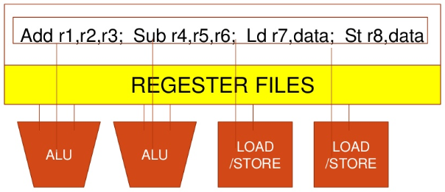
VLIW Instruction

Slide 9
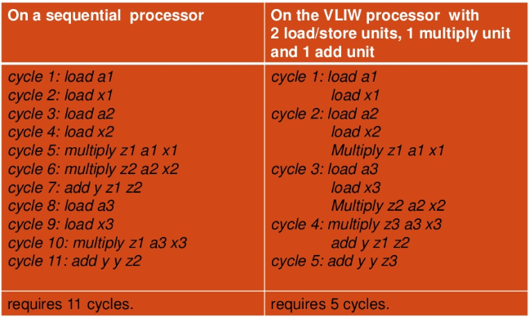
ILP in VLIW
Consider the computation of Y = a1 x 1 + a2 x 2 + a3 x3

Slide 10
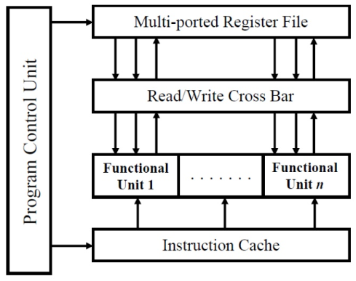
Block Diagram

Slide 11
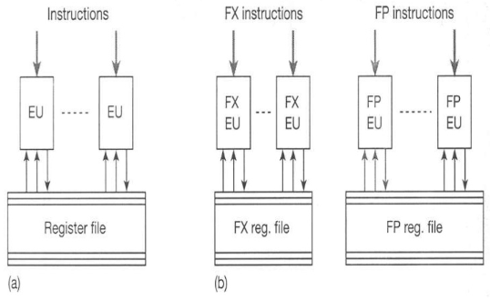
Diagram (Conceptual Instruction Execution)

Slide 12
Working
+ Long instruction words are fetched from the memory.
+ A common multi-ported register file for fetching the operands and storing the results.
+ Parallel random access to the register file is possible through the read/write cross bar.
+ Execution in the functional units is carried out concurrently with the load/store operation of data between RAM and the register file.
+ One or multiple register files for FX and FP data.
+ Rely on compiler to find parallelism and schedule dependency free program code.

Slide 13
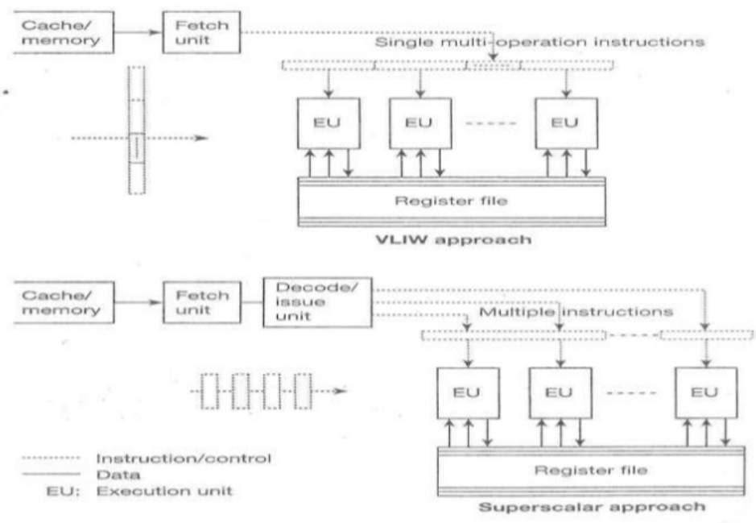
Difference Between VLIW & Superscalar Architecture

Slide 14
VLIW vs Superscalar Architecture
+ Instruction formulation
+ Superscalar: Receive conventional instructions conceived for sequential processors.
+ VLIW: - Receive long instruction words, each comprising a field (or opcode) for each execution unit.
- Instruction word length depends number of execution units and code length to control each unit (such as opcode length, registers).
- Typical word length is 64 – 1024 bits, much longer than conventional machine word length.

Slide 15
VLIW vs Superscalar Architecture
+ Instruction scheduling
+ Superscalar: - Done dynamically at run-time by the hardware.
- Data dependency is checked and resoled in hardware.
- Need a look ahead hardware window for instruction fetch.
+ VLIW: - Done statically at compile time by compiler.
- Data dependency is checked by compiler.
- In case of un-filled opcodes in a VLIW, memory space and instruction bandwidth are wasted.

Slide 16
Comparison: CISC, RISC, VLIW
ARCHITECTURE CHARACTERISTIC | CISC | RISC | VLIW
Instruction Size | Varies | One size, usually 32 bits | One size
Instruction Semantics | Varies from simple to complex; possibly many dependent operations per instruction | Almost always one simple operation | Many simple, independent operations
Register | Few, sometimes special | Many, general-purpose | Many, general-purpose
Hardware Design | Exploit microcode implementations | Exploit implementations with one pipeline and & no microcode | Exploit implementations with multiple pipelines, no microcode & no complex dispatch logic

Slide 17
Advantages of VLIW
+ Dependencies are determined by compiler and used to schedule according to function unit latencies.
+ Function units are assigned by compiler and correspond to the position within the instruction packet.
+ Reduces hardware complexity:
+ Tasks such as decoding, data dependency detection, instruction issues etc. becoming simple.
+ Ensures potentially higher Clock Rate.
+ Ensures Low power sonsumption.

Slide 18
Disadvantages of VLIW
+ Higher complexity of the compiler
+ Compatibility across implementations: Compiler optimization needs to consider technology dependent parameters such as latencies and load-use time of cache.
+ Unscheduled events (e.g cache miss) stall entire processor.
+ Code density: in case of un-filled opcodes in a VLIW, memory space and instruction bandwidth are wasted i.e low slot utilization.
+ Code expansion: Causes high power consumtion.

Slide 19
Applications
+ VLIW architecture is suitable for Digital Signal Processing applications.
+ Processing of media data like compression/decompression of image and speech data.

Slide 20
Examples of VLIW processor
+ VLIW Mini supercomputers:
+ Multiflow TRACE 7/300, 14/300, 28/300
+ Multiflow TRACE /500
+ Cydrome Cydra 5
+ IBM Yorktown VLIW Computer.
+ Single-chip VLIW processors:
+ Intel iWarp, Philip’s LIFE chips
+ Single-chip VLIW Media (through-put) rocessor:
+ Trimedia, Chromatic, Micro-Unity
+ DSP processors (TI TMS320C6x )

