Slide 1


FET_Piltover IoT Challenge 2022
Healthcare Wristband
for Covid-19 patients

Slide 2
Table of content
P1 : Idea to Production
P2 : Quick Overview
P3 : Into the details
P4 : Final result and Summary

Slide 3
Part 1: From a small idea to a big production
In middle of the global pandemic Covid-19, we find out one problem of our current health system:
We are unable to track down victims in the crowd out there every day.
The worst is they might not know about theirs infected.
The more late we find out, the more amount of people contaminated with Covid-19.
So how to stop this situation keep continue?
We find the infected faster!

Slide 4
Part 1: From a small idea to a big production
So how can we find them quick and efficiently?
We need to know when they have first symptoms of Covid-19
We need to know how to communicate and warn them as soon as we could
We can manage a lot of patients in real-time

Slide 5
And finally, we, our team decide to make a system to track multiple users health and a Healthcare Wristband. Everything to help protect patient and country from community transfer!
Our system could:
- Track and manage multiple users health in real-time.
Easy start, easy maintain.
Quick, convenient and efficient.

Slide 6
Quick Overview
Part 2:
Simple things to know about our
Project and final production

Slide 7
Part 2: Quick Overview!
What is it?
It’s a system that can record user’s health data and providing a “guess” then is a “warning” when user has symptoms of Covid-19 (the “guess” part is based on international data of thousand Covid-19 cases)
What does it do?
It get multiple user’s health data, push to a server to manage them and if user has symptoms which it detected. Then the server will raise a warning to user and the nearest health faciality.
How does it do that?
The Healthcare wristband measure user’s health data (including: Heart rate, SpO2 rate and Temperature) then send it to server using Bluetooth Low Energy technology
Server catch data records and check if there is any signature of Covid-19 symptoms
If there is, then server send warning to user and health faciality manager. Then save data in system’s database.

Slide 8



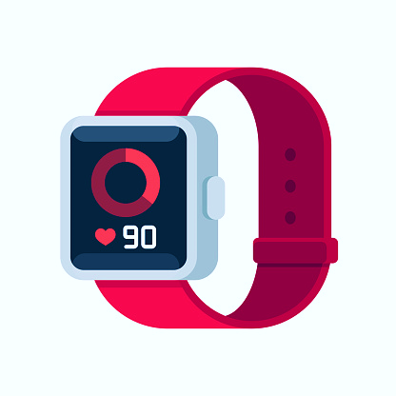
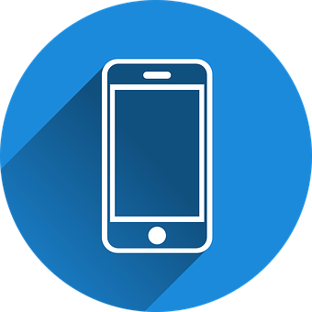
System structure:
Smart phone:
Get, show data
Get warning
User’s Key
Sign in, setup new user
Wristband:
Get health data
Send to server
BLE
Wi-fi API
Data
Server:
Receive data
“Judge”
Store system’s database
Hosting website
Data Warning

Slide 9
Part 3: Into the details
Go in to every single detail
to talk about how to re-create
this system exactly the same

Slide 10
From structure:

Slide 11
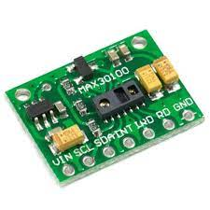
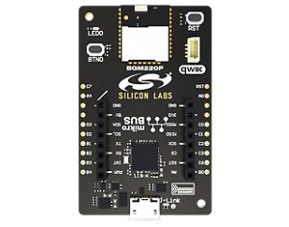
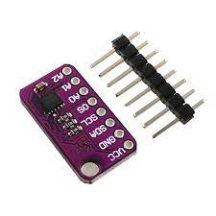
The Wristband
Is the combination of these components:
MAX30100:
Pulse Oximeter and Heart-Rate Sensor IC.
BGM220 Bluetooth Expl kit:
Main controller and communicate to server using BLE tech.
MAX30205:
Temperature sensor.

Slide 12

The Healthcare Wristband:
Communication method to connect these components are:
I2C (master - slave)
Slave 1
Time sequencers are:
Master get Heart-rate and SpO2 from Slave 1
Master get Temperature from Slave 2
Master generate a message and send to Server via BLE
Repeat from step 1
Master
Slave 2
Message are:
HR 60\r\n
SPO2 95\r\n
Temp 37\r\n
BLE
UART
Server
2nd Board server side

Slide 13
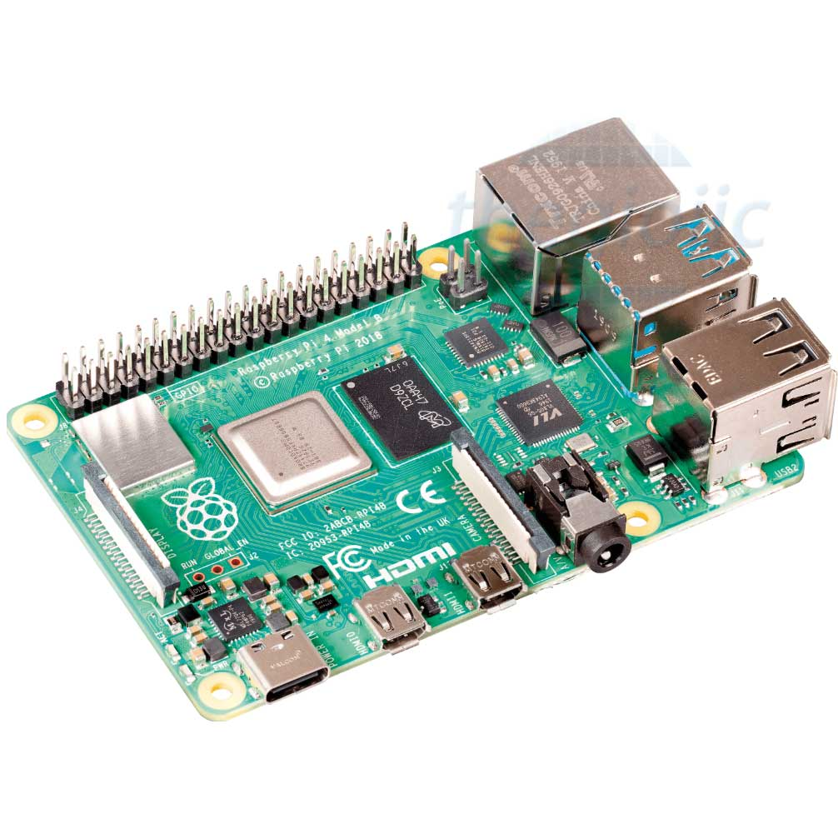

The Server
BGM220P Expl kit:
For server to communicate with wristband
Server:
Build-in the Raspberry pi 4
OS: Ubuntu server 20.04
LAMP stack installed
Hosting website, server, database

Slide 14
System server:
BGM220P Expl kit: Only for catch message and send to server via UART
LAMP-stack installed including:
Linux [Ubuntu Server 20.04]
Apache2 [Virtual server for access from devices]: hosting connection port and web pages for easy management.
MySQL [Database]: Save, manage users ‘s health data.
PHP: API for html and smartphone to get data from database
UART

Slide 15





What is going on at server side?
HTML://
API
UART
access
Serialport
package
MySQL
package
API
Node Js is very important in this system:
PHP in other side is
Important for UI and other devices
BLE
It get data in message.
Be the “judgement” if there a chance for user having Covid-19 symptoms.
Push data into database.
It help Web site and smartphones get data from server’s database!
Create API for quick and secure access
HR 60\r\n
SPO2 95\r\n
Temp 37\r\n

Slide 16
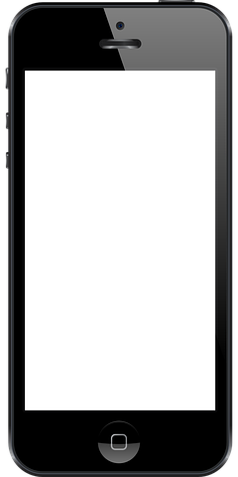
Android Application
Request
User: xxx_xxx
Response
Heart rate: __[BPM]
SpO2: __[%]
Temperature: __[oC]
Time: [HH:MM:SS
DD-YY_MM]
Server
- Built based on basic structure
- Communicate to server via API
- Get and Show data for user
- Warning device when user have symtomps
User In4mation
Client

Slide 17
Final result and Summary
Part 4:
What have we done!

Slide 18

This url will give you the answer!
https://youtu.be/tjxu79O637I
https://youtu.be/tjxu79O637I

Slide 19
Thank you for reading!
FET_Piltover members:
Ha Duyen Duc: Hardware, Embedded programing
Nguyen Hoang Huy: Research, Server & Connection
Pham Dang Dang: Software and Research
Nguyen Huu Hung: Hardware
Nguyen Van Duc: ///////
Special thank to our mentor: Mr. Phuc Dang

