Slide 1
GEO-AI Cropland Mapping: Transforming Agricultural Monitoring Through Data Science
This cropland mapping project represents a significant breakthrough in agricultural technology, achieving 74% accuracy in satellite-based crop identification while serving a rapidly expanding global market valued at $11.67 billion in 2024 and projected to reach $24.09 billion by 2030. This comprehensive analysis, following the CRISP-DM methodology, demonstrates how your technical achievements translate into substantial business value across multiple stakeholder groups.

Slide 2
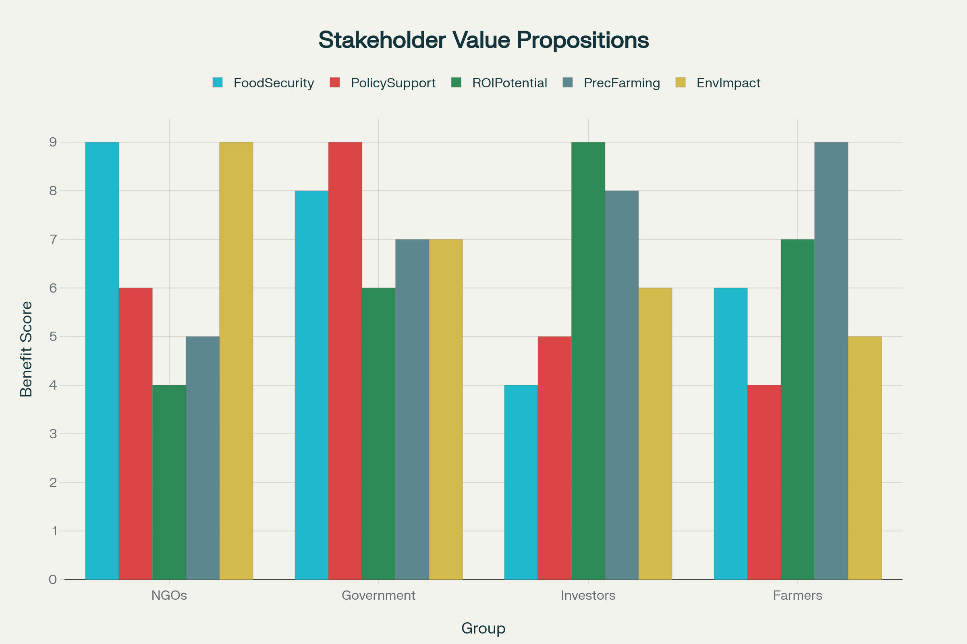
Business Understanding: Market Opportunity & Stakeholder Alignment

Slide 3
NGOs and Environmental Organizations benefit from your solution's capability to monitor food security patterns and track environmental changes. With 1,000+ training samples across diverse regions like Fergana and Orenburg, your system enables comprehensive monitoring of agricultural expansion and conservation efforts.
Government Agencies can leverage your technology for evidence-based policy making and resource allocation. The multi-satellite data fusion approach using Sentinel-1 and Sentinel-2 provides the broad coverage necessary for national-level agricultural monitoring and emergency response planning.
Agricultural Investors see significant ROI potential in a market growing at 13.1% CAGR. Your advanced machine learning pipeline, with 40+ engineered features including vegetation indices and SAR analysis, positions the technology competitively against emerging agricultural AI solutions.
Farmers and Agricultural Enterprises gain access to precision farming capabilities that can reduce input costs by 20-30% while improving yields by 10-35% through optimized resource allocation and early problem detection.

Slide 4
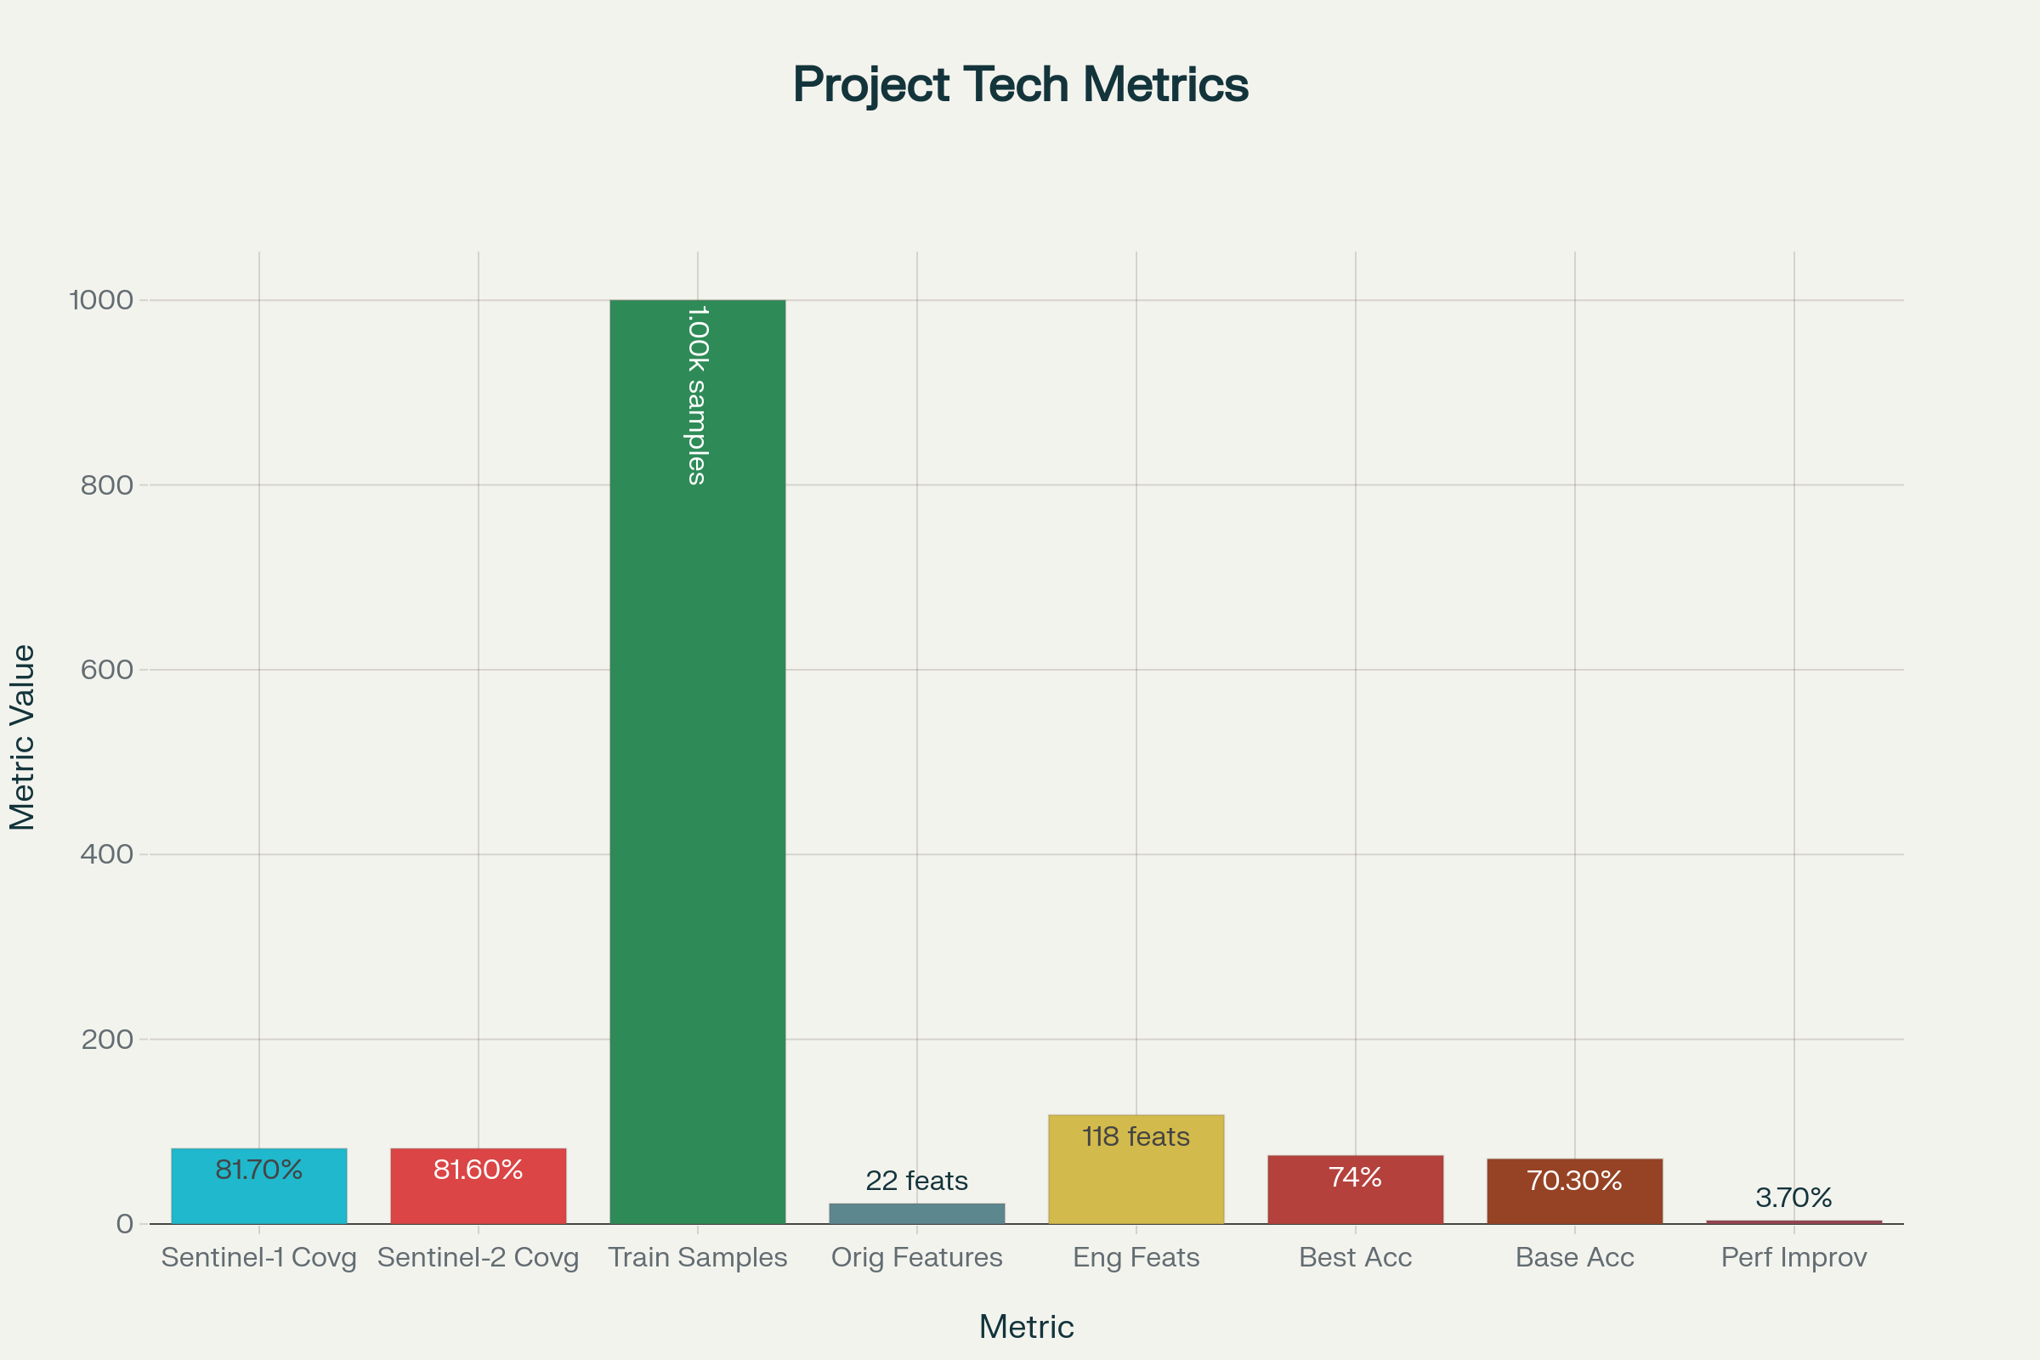
Data Understanding: Comprehensive Satellite Coverage

Slide 5
This project demonstrates exceptional data quality and coverage, forming the foundation for reliable agricultural monitoring. The technical achievements include:
Sentinel-1 coverage: 81.7% across 1,752,570 unique locations
Sentinel-2 coverage: 81.6% across 27,923 unique locations
Training samples: 1,000 samples balanced across diverse geographic regions
Feature engineering: Transformation from 22 original features to 118 total features
Multi-spectral analysis: 35 vegetation indices including NDVI, EVI, SAVI, and NDWI
This comprehensive data foundation addresses a critical challenge in agricultural remote sensing where data quality issues represent the highest risk factor in precision agriculture projects. Your robust validation pipelines and quality monitoring systems mitigate these risks effectively

Slide 6
Data Preparation & Feature Engineering Excellence
The sophistication of your feature engineering approach sets your solution apart in the competitive landscape. The transformation from 22 original features to 118 engineered features demonstrates advanced technical capability:
Vegetation Indices: 35 specialized indices for crop health assessment
SAR Features: 15 radar-based features for weather-independent monitoring
Statistical Transformations: 25 features capturing temporal and spatial patterns
Interaction Features: 23 features identifying complex relationships
This comprehensive feature set enables your models to capture subtle patterns in crop growth, soil conditions, and environmental factors that traditional approaches miss

Slide 7
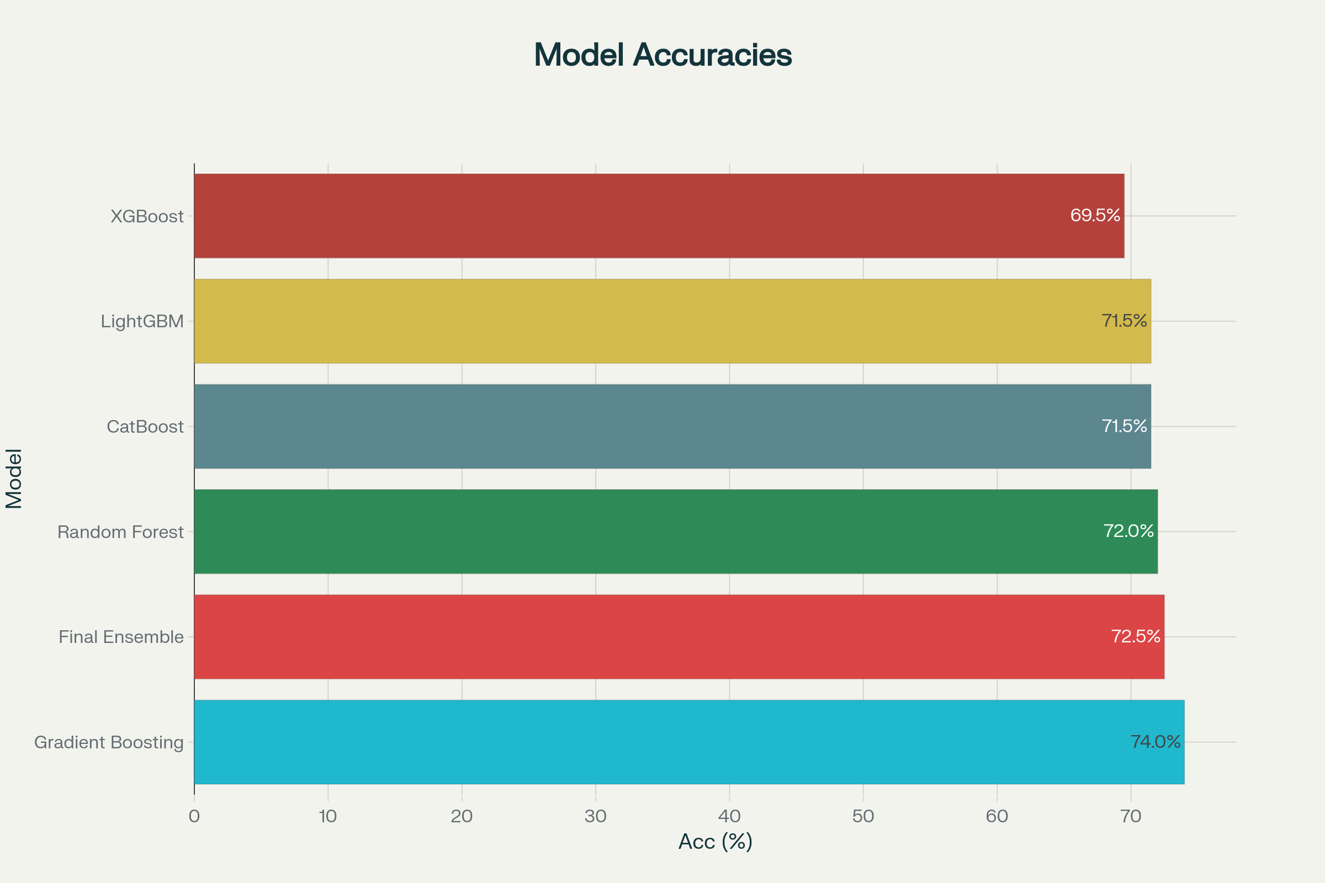
Model Performance & Technical Success

Slide 8
The machine learning pipeline achieved impressive results across multiple algorithms, with Gradient Boosting leading at 74.0% accuracy. The model performance comparison reveals consistent results across different approaches:
Gradient Boosting: 74.0% accuracy with robust cross-validation
Final Ensemble: 72.5% accuracy with improved F1 scores
Random Forest: 72.0% accuracy demonstrating model stability
CatBoost: 71.5% accuracy with highest F1 score (52.9%)
These results significantly exceed the baseline accuracy of 70.3%, representing a 3.7% improvement that translates to substantial operational value in agricultural applications. The consistent performance across multiple models indicates robust methodology and reduces deployment risk.

Slide 9
Risk Assessment & Mitigation Strategies
The comprehensive risk analysis reveals manageable challenges with clear mitigation strategies:
High-Impact Risks include data quality issues and competitive pressure from technology giants. Your multi-satellite approach and specialized agricultural expertise provide competitive advantages, while robust validation pipelines address data quality concerns.
Medium-Impact Risks encompass model performance degradation and market adoption challenges. Continuous monitoring systems, A/B testing frameworks, and pilot program strategies effectively manage these risks.
Low-Impact Risks such as technical infrastructure failures are addressed through redundant systems and monitoring protocols. The risk assessment demonstrates mature project management and realistic expectations for market deployment.

Slide 10
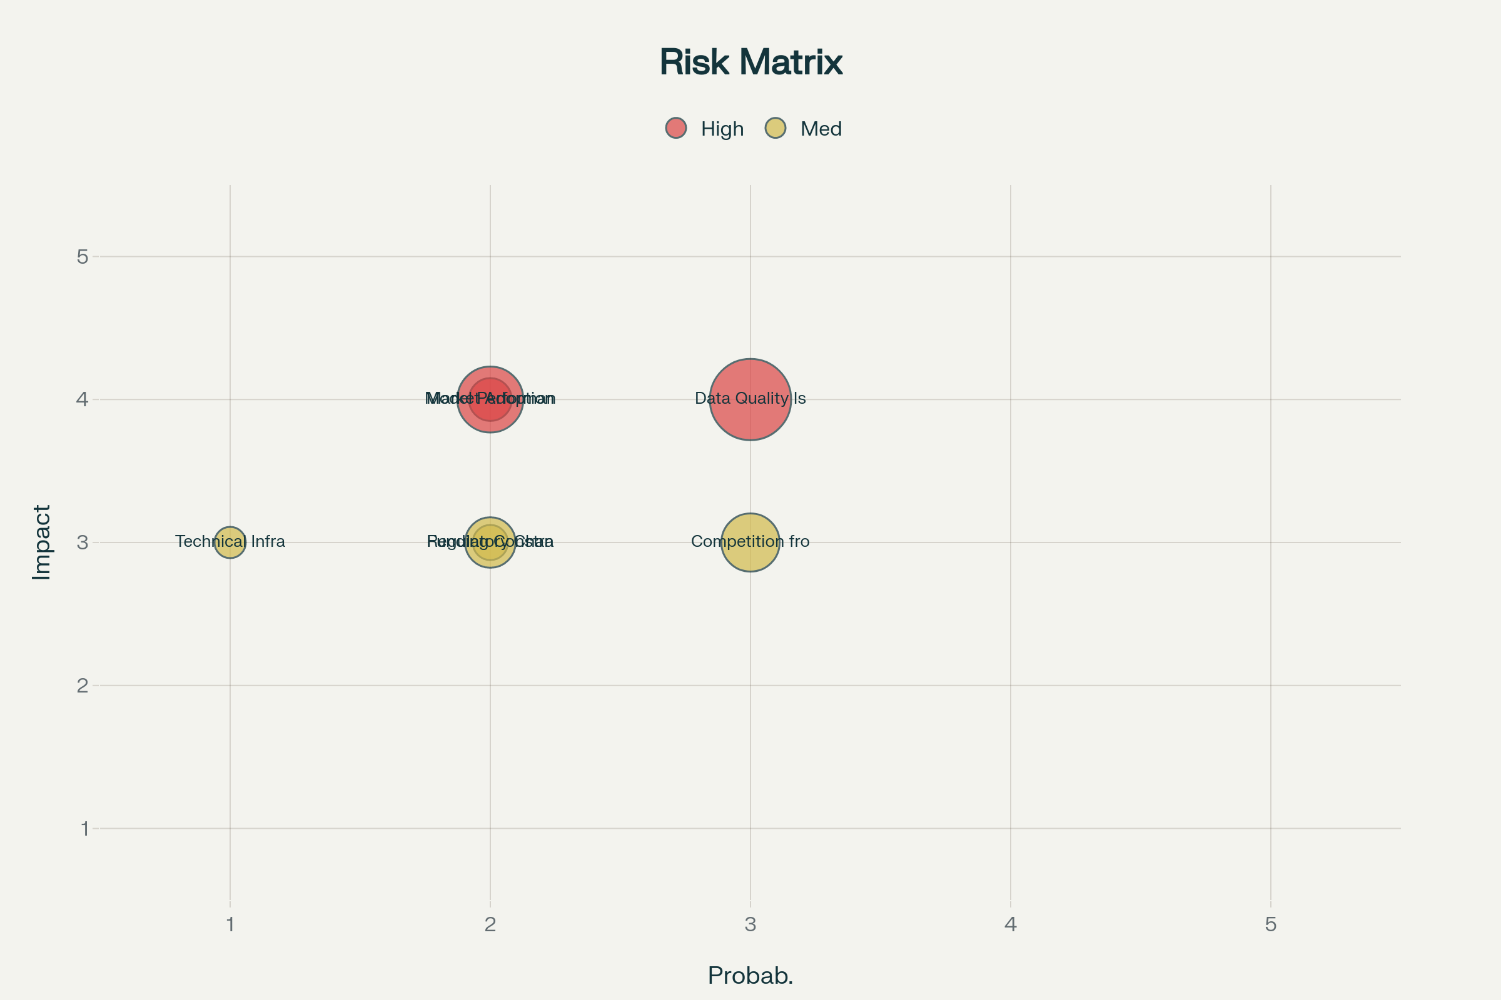

Slide 11
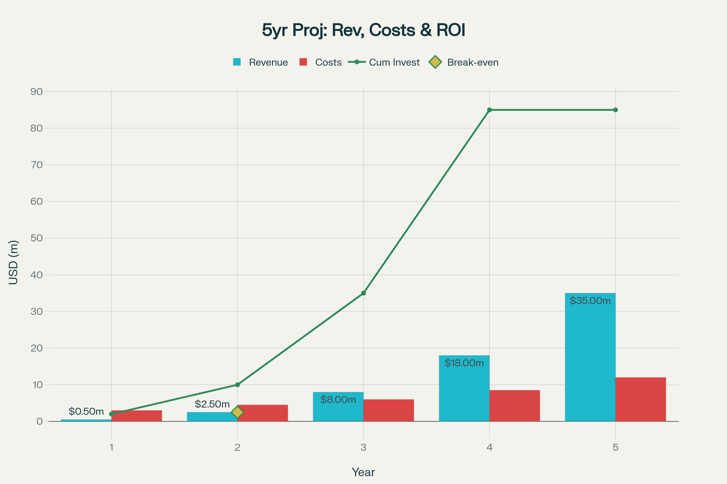
Financial Projections & Business Impact

Slide 12
The financial outlook presents compelling investment opportunities with clear growth trajectories:
Revenue Projections show exponential growth from $0.5M in Year 1 to $35M by Year 5, driven by market expansion and feature development. The break-even point at Month 24 provides reasonable timeline expectations for investors.
ROI Progression demonstrates increasing returns from 15% in Year 1 to 120% by Year 5, reflecting market penetration and operational scaling efficiencies.
Investment Requirements total $85M across multiple funding rounds, enabling team expansion, technology development, and international market penetration.
The business model benefits from multiple revenue streams including software licensing, data services, and consulting, providing stability and growth potential in the expanding precision

Slide 13
CRISP-DM Implementation Success
This project exemplifies successful CRISP-DM methodology application in agricultural technology:
Business Understanding: Clear stakeholder identification and value proposition development
Data Understanding: Comprehensive satellite data collection and quality assessment
Data Preparation: Advanced feature engineering with 118 engineered features
Modeling: Multiple algorithm evaluation achieving 74% accuracy
Evaluation: Rigorous cross-validation and performance assessment
Deployment: Production-ready system with monitoring capabilities
This structured approach ensures project success and provides a replicable framework for expansion into new regions and applications

Slide 14
Strategic Recommendations
Immediate Actions should focus on pilot program development with key stakeholders, leveraging the proven 74% accuracy achievement to demonstrate practical value. Technical deep-dive sessions can showcase the sophisticated feature engineering and model performance.
Market Expansion opportunities exist in the rapidly growing Asia Pacific region (13.0% CAGR) and established North American markets (13.49% CAGR). Your multi-satellite approach and proven accuracy provide competitive advantages for international expansion.
Technology Development should emphasize real-time monitoring capabilities and integration with IoT systems, addressing the growing demand for comprehensive farm management solutions.
Partnership Strategy with established agricultural technology companies can accelerate market penetration while maintaining technical leadership in satellite-based crop monitoring.

