Slide 1


Slide 2
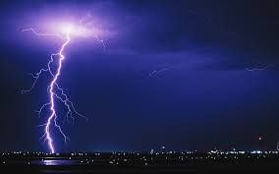
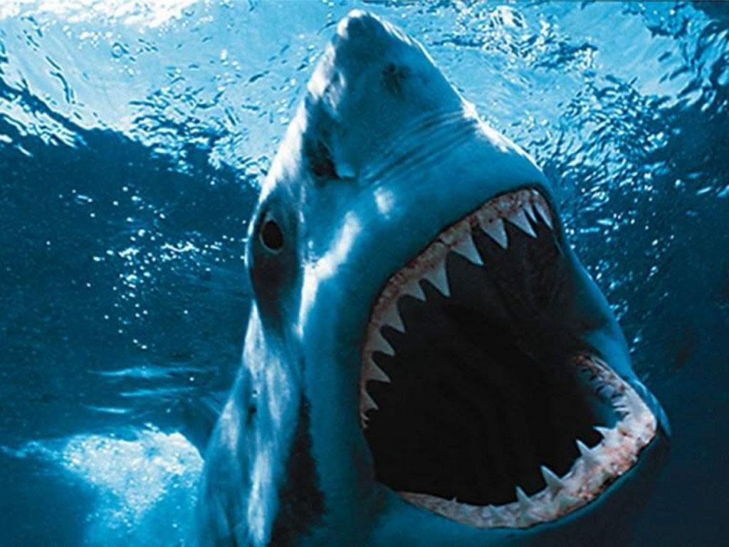
Which is more dangerous ?

Slide 3
The accient from lightning is more dangerous than accient from shark.

Slide 4
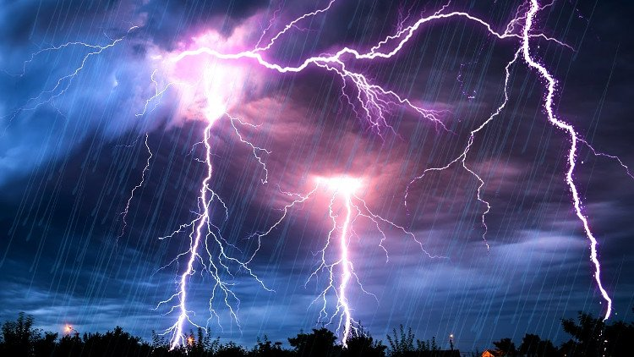
Lightning is natural phenomenon
all over the Earth
occurs during thunderstorms.

Slide 5
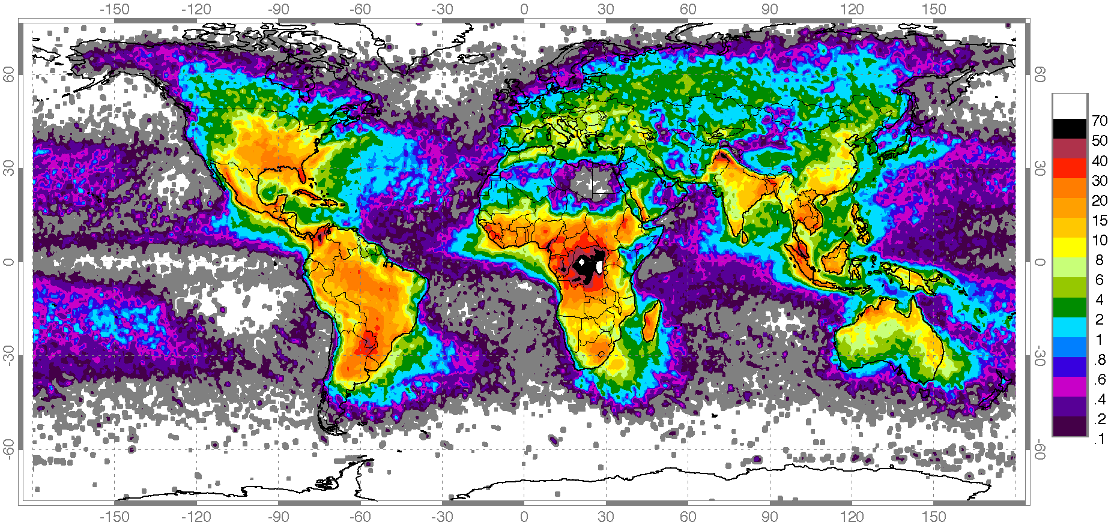

Slide 6
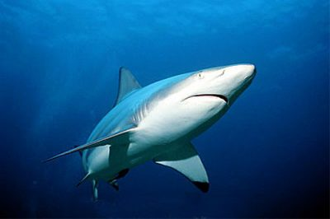
- Sharks are apex predators
sharks limit the populations
of the animals they eat
This maintains the balance of nature.
- Sharks bite people not for food
but to protect living space.

Slide 7
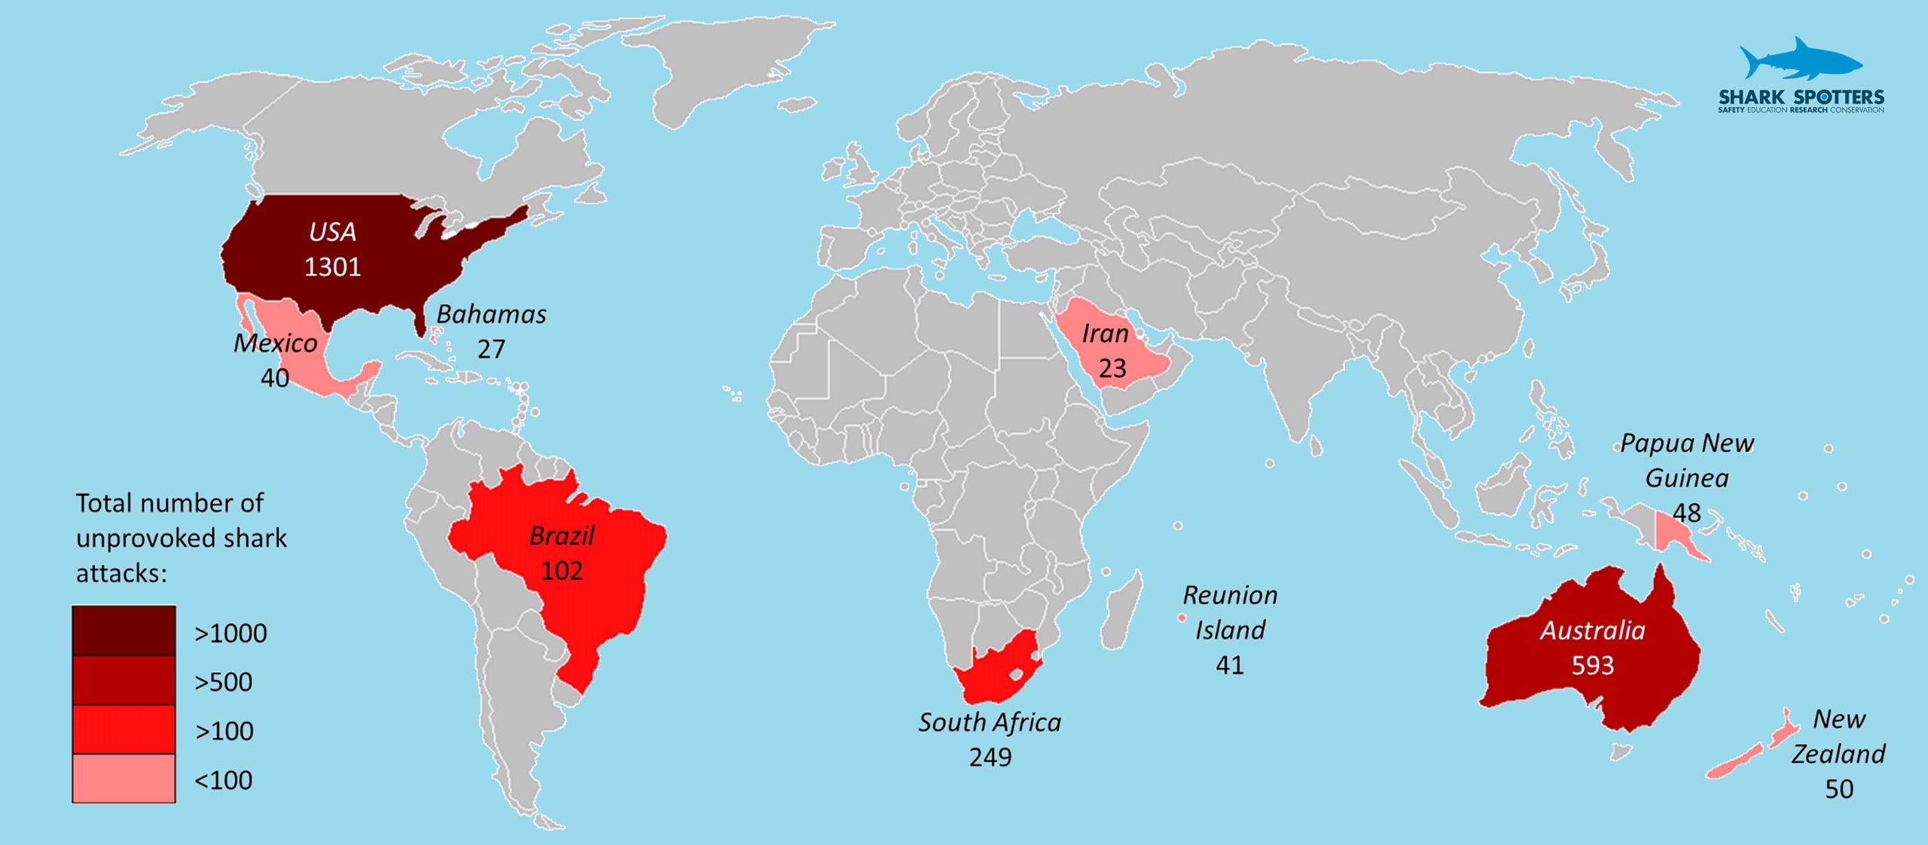

Slide 8
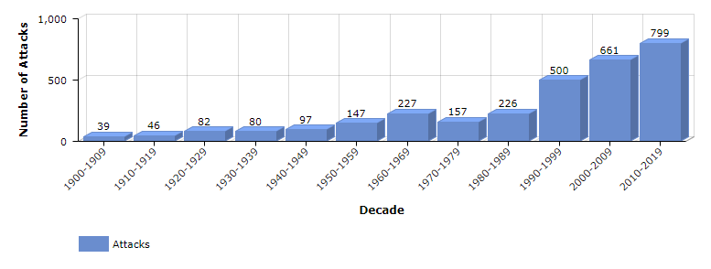
Unprovoked Shark Attack Trends Worldwide Over the Past Century

Slide 9
a breakthrough in communication with emergency responders and lifeguards, resulting in the reporting of a greater number of minor attacks that had previously gone unreported.

Slide 10
The yearly average of unprovoked shark attacks on humans is 100, resulting in about 17 deaths. These worldwide numbers are small given the millions of humans that enter the water.
We have a better chance of dying from lightning than from a shark attack.

Slide 11
Lightning bring more serious consequences than Shark
The number of Lightning’s victims is higher than that from Shark. Each year, about 240,000 incidents regarding Lightning strikes happen each year. There are 2000 people are killed worldwide by Lightning between 2007 and 2017

Slide 12
Lightning strike has a wider range than Shark attack
Lightning can strike anywhere, anytime
Shark can not attack people if they do not swim in the beach.

Slide 13
There are more ways to avoid a Shark attack than to avoid a Lightning strike
People can avoid Shark attack by : not go to beach, not swimming far from shore…
People can not know exactly when and where Lightning will strike

Slide 14
Lightning is much more dangerous than a shark attack

Slide 15
END
Thank you, teacher and everyone for listening

