Slide 1
Chapter 14
Conducting empirical research or doing
a project or dissertation in finance
‘Introductory Econometrics for Finance’ © Chris Brooks 2013

Slide 2
Why do an empirical project?
Conducting empirical research is one of the best ways to get to grips with the technical material, and to find out what practical difficulties econometricians encounter when conducting research
Conducting the research gives you the opportunity to solve a puzzle
Doing empirical work is usually less risky than trying to do theory
Your report-writing and time-management skills will improve
A project will provide something to discuss in job interviews
A dissertation may be a route into MPhil or PhD research.
‘Introductory Econometrics for Finance’ © Chris Brooks 2013

Slide 3
Where to Get Ideas for a Topic
Suggestions from your supervisor or other faculty
Work experience in the industry
Thinking about your own skills and interests (viz. qualitative versus quantitative research)
Recent editions of academic journals
Newspapers and practitioner magazines
‘Introductory Econometrics for Finance’ © Chris Brooks 2013

Slide 4
Examples of Possible Types of Research Project
An empirical piece of work involving quantitative analysis of data
The development of a theory to explain an observed phenomenon
The application of a technique in finance that originates from another discipline
Testing empirically a new model that has only been considered from a theoretical perspective
A critical review of an area of literature
An application of an existing model to new market
‘Introductory Econometrics for Finance’ © Chris Brooks 2013

Slide 5
A Good Project Will:
Contain an obvious and explicitly stated source of originality
Have a clear and logical structure
Contain an abstract that summarises the problem and findings
Start with an introduction that puts the problem studied into context and explains why the project is useful or important
Have carefully conducted empirical work
Use a sufficiently large sample of relevant data
Include robustness checks of any testable assumptions made
Be detailed but not contain superfluous material
Include a concluding section that summarises the investigation and key results, and presents some suggestions for further research
Contain no typos or grammatical errors
End with an accurate and consistently styled reference list.
‘Introductory Econometrics for Finance’ © Chris Brooks 2013

Slide 6
Conducting an Event Study
‘Introductory Econometrics for Finance’ © Chris Brooks 2013

Slide 7
What is an Event Study?
Event studies are extremely common in finance and in research projects!
They represent an attempt to gauge the effect of an identifiable event on a financial variable, usually stock returns
So, for example, research has investigated the impact of various types of announcements (e.g., dividends, stock splits, entry into or deletion from a stock index) on the returns of the stocks concerned
Event studies are often considered to be tests for market efficiency:
If the financial markets are informationally efficient, there should be an immediate reaction to the event on the announcement date and no further reaction on subsequent trading days
The “modern” event study literature began with Brown (1968) and by Fama et al. (1969).
‘Introductory Econometrics for Finance’ © Chris Brooks 2013

Slide 8
Event Studies: Background
We of course need to be able to define precisely the dates on which the events occur, and the sample data are usually aligned with respect to this
If we have N events in the sample, we usually specify an ‘event window’, which is the period of time over which we investigate the impact of the event
The length of this window will be set depending on whether we wish to investigate the short- or long-run effects
It is common to examine a period comprising, say, ten trading days before the event up to ten trading days after as a short-run event window, while long-run windows can cover a month, a year, or even several years after
MacKinlay (1997) shows that the power of event studies to detect abnormal performance is much greater when daily data are employed rather than monthly, quarterly or annual data
Intra-daily data are likely to be full of microstructure noise.
‘Introductory Econometrics for Finance’ © Chris Brooks 2013

Slide 9
Event Studies: The Event Window
Define the return for each firm i on each day t during the event window as R_{it}
We can conduct the following approach separately for each day within the event window – e.g., we might investigate it for all of 10 days before the event up to 10 days after (where t = 0 represents the date of the event and t = −10,−9,−8, . . . ,−1, 0, 1, 2, . . . , 8, 9, 10)
We need to be able to separate the impact of the event from other, unrelated movements in prices
For example, if it is announced that a firm will become a member of a stock index and its share price that day rises by 4%, but the prices of all other stocks also rise by 4%, it would be unwise to conclude that all of the increase in the price of the stock under study is attributable to the announcement
So we construct abnormal returns, denoted AR_{it}, which are calculated by subtracting an expected return from the actual return AR_{it} = R_{it} − E(R_{it})
‘Introductory Econometrics for Finance’ © Chris Brooks 2013

Slide 10
Event Studies: Abnormal Returns
There are numerous ways that the expected returns can be calculated, but usually this is achieved using data before the event window so that the event is not allowed to ‘contaminate’ estimation of the expected returns
Armitage (1995) suggests that estimation periods can comprise anything from 100 to 300 days for daily observations and 24 to 60 months when the analysis is conducted on a monthly basis
If the event window is very short then we are far less concerned about constructing an expected return since it is likely to be very close to zero over such a short horizon
In such circumstances, it will probably be acceptable to simply use the actual returns in place of abnormal return
The simplest method for constructing expected returns is to assume a constant mean return, so the expected return is the average return for each stock i which we might term
‘Introductory Econometrics for Finance’ © Chris Brooks 2013

Slide 11
Event Studies: The Market Model
A slightly more sophisticated approach is to subtract the return on a proxy for the market portfolio that day t from the individual return
This will certainly overcome the impact of general market movements in a rudimentary way, and is equivalent to the assumption that the stock’s beta in the market model or the CAPM is unity
Probably the most common approach to constructing expected returns, however, is to use the market model
This constructs the expected return using a regression of the return to stock i on a constant and the return to the market portfolio:
R_{it} = α_{i} + β_{i}R_{mt} + u_{it}
The expected return for firm i on any day t during the event window would then be calculated as the beta estimate from this regression multiplied by the actual market return on day t.
‘Introductory Econometrics for Finance’ © Chris Brooks 2013

Slide 12
Event Studies: The Market Model 2
In most applications, a broad stock index such as the FTSE All-Share or the S&P500 would be employed to proxy for the market portfolio
This equation can be made as complicated as desired – for example, by allowing for firm size or other characteristics – these would be included as additional factors in the regression with the expected return during the event window being calculated in a similar fashion
A final further approach would be to set up a ‘control portfolio’ of firms that have characteristics as close as possible to those of the event firm – for example, matching on firm size, beta, industry, book-to-market ratio, etc. – and then using the returns on this portfolio as the expected returns
‘Introductory Econometrics for Finance’ © Chris Brooks 2013

Slide 13
Event Studies: Hypothesis Testing
The hypothesis testing framework is usually set up so that the null to be examined is of the event having no effect on the stock price (i.e. an abnormal return of zero)
Under the null of no abnormal performance for firm i on day t during the event window, we can construct test statistics based on the standardised abnormal performance
These test statistics will be asymptotically normally distributed (as the length of the estimation window, T, increases)
AR_{it} ∼ N(0, σ²(AR_{it}))
where σ²(AR_{it}) is the variance of the abnormal returns, which can be estimated in various ways
A simple method is to use the time-series of data from the estimation of the expected returns separately for each stock.
‘Introductory Econometrics for Finance’ © Chris Brooks 2013

Slide 14


Event Studies: Hypothesis Testing 2
We could define as being the variance of the residuals from the market model, which could be calculated for example using
where T is the number of observations in the estimation period
If instead the expected returns had been estimated using historical average returns, we would simply use the variance of those
Sometimes, an adjustment is made to that reflects the errors arising from estimation of α and β in the market model
Including the adjustment, the variance in the previous equation becomes
‘Introductory Econometrics for Finance’ © Chris Brooks 2013

Slide 15

Event Studies: Hypothesis Testing 3
We can then construct a test statistic by taking the abnormal return and dividing it by its corresponding standard error, which will asymptotically follow a standard normal distribution:
where is the standardised abnormal return, which is the test statistic for each firm i and for each event day t
‘Introductory Econometrics for Finance’ © Chris Brooks 2013

Slide 16

Event Studies: Cumulative Abnormal Returns
It is likely that there will be quite a bit of variation of the returns across the days within the event window
We may therefore consider computing the time-series cumulative average return (CAR) over a multi-period event window (for example, over ten trading days) by summing the average returns over several periods, say from time T₁ to T₂:
The variance of this CAR will be given by the number of observations in the event window plus one multiplied by the daily abnormal return variance calculated previously:
This expression is essentially the sum of the individual daily variances over the days in T₁ to T₂ inclusive.
‘Introductory Econometrics for Finance’ © Chris Brooks 2013

Slide 17

Event Studies: A Test Statistic for the CAR
We can now construct a test statistic for the cumulative abnormal return as we did for the individual dates, which will again be standard normally distributed:
It is common to examine a pre-event window (to consider whether there is any anticipation of the event) and a post-event window – in other words, we sum the daily returns for a given firm i for days t−10 to t−1, say.
‘Introductory Econometrics for Finance’ © Chris Brooks 2013

Slide 18


Event Studies: Averaging Returns Across Firms
Typically, some of the firms will show a negative abnormal return around the event when a positive figure was expected
But if we have N firms or N events, it is usually of more interest whether the return averaged across all firms is statistically different from zero than whether this is the case for any specific individual firm
We could define this average across firms for each separate day t during the event window as
This firm-average abnormal return will have variance given by 1/N multiplied by the average of the variances of the individual firm returns:
‘Introductory Econometrics for Finance’ © Chris Brooks 2013

Slide 19

Event Studies: Averaging Returns Across Firms 2
Thus the test statistic (the standardised return) for testing the null hypothesis that the average (across the N firms) return on day t is zero will be given by
‘Introductory Econometrics for Finance’ © Chris Brooks 2013

Slide 20


Event Studies: Averaging Returns
Across Firms and Time
We can aggregate both across firms and over time to form a single test statistic for examining the null hypothesis that the average multi-horizon (i.e. cumulative) return across all firms is zero
We would get an equivalent statistic whether we first aggregated over time and then across firms or the other way around
The CAR calculated by averaging across firms first and then cumulating over time could be written:
Or equivalently, if we started with the CAR_{i}(T₁, T₂) separately for each firm, we would take the average of these over the N firms:
‘Introductory Econometrics for Finance’ © Chris Brooks 2013

Slide 21


Event Studies: Averaging Returns
Across Firms and Time 2
To obtain the variance of this CAR_{i}(T₁, T₂) we could take 1/N multiplied by the average of the variances of the individual CAR_{i}:
And again we can construct a standard normally distributed test statistic as:
‘Introductory Econometrics for Finance’ © Chris Brooks 2013

Slide 22
Event Studies: Cross-Sectional Regressions
It will often be the case that we are interested in allowing for differences in the characteristics of a sub-section of the events and also examining the link between the characteristics and the magnitude of the abnormal returns
For example, does the event have a bigger impact on small firms? Or on firms which are heavily traded etc.?
To do this, calculate the abnormal returns as desired and then to use these as the dependent variable in a cross-sectional regression of the form
where AR_{i} is the abnormal return for firm i, x_{ji}, (j = 1, . . . ,M) are a set of characteristics thought to influence the abnormal returns, γ_{j} measures the impact of the corresponding variable j on the abnormal return, and w_{i} is an error term
We can examine the sign, size and statistical significance of γ₀
‘Introductory Econometrics for Finance’ © Chris Brooks 2013

Slide 23
Event Studies: Cross-Sectional Dependence
A key assumption when the returns are aggregated across firms is that the events are independent of one another
Often, this will not be the case, particularly when the events are clustered through time
For example, if we were investigating the impact of index recompositions on the prices of the stocks concerned, typically, a bunch of stocks will enter into an index on the same day, and then there may be no further such events for three or six months
The impact of this clustering is that we cannot assume the returns to be independent across firms, and as a result the variances in the aggregates across firms will not apply since these derivations have effectively assumed the returns to be independent across firms so that all of the covariances between returns across firms could be set to zero.
‘Introductory Econometrics for Finance’ © Chris Brooks 2013

Slide 24
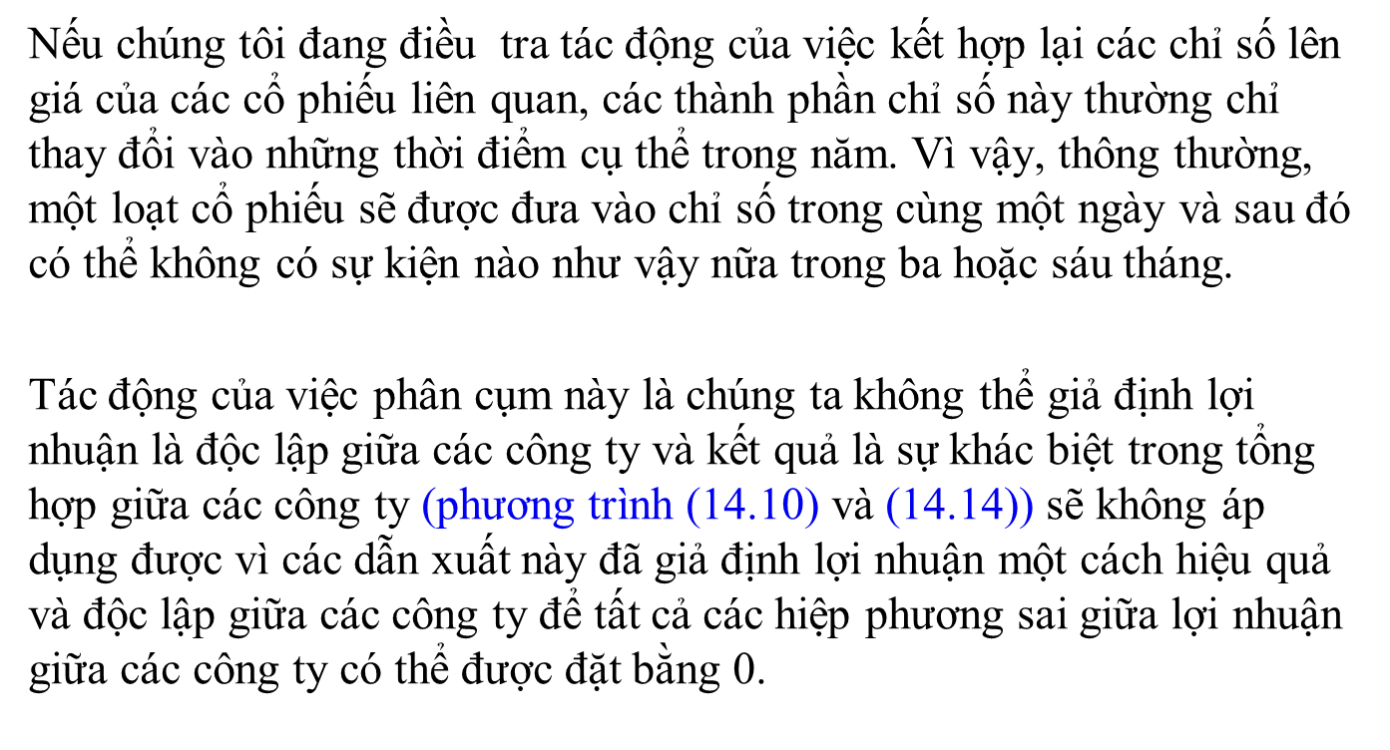
Phụ thuộc chéo

Slide 25
Event Studies: Cross-Sectional Dependence - Solutions
An obvious solution would be not to aggregate the returns across firms, but simply to construct the test statistics on an event-by-event basis and then to undertake a summary analysis of them (e.g., reporting their means, variances, percentage of significant events, etc.)
A second solution would be to construct portfolios of firms having the event at the same time and then the analysis would be done on each of the portfolios
The standard deviation would be calculated using the cross-section of those portfolios’ returns on day t (or on days T₁ to T₂, as desired)
This approach will allow for cross-correlations since they will automatically be taken into account in constructing the portfolio returns and the standard deviations of those returns
But a disadvantage of this technique is that it cannot allow for different variances for each firm as all are equally weighted within the portfolio.
‘Introductory Econometrics for Finance’ © Chris Brooks 2013

Slide 26
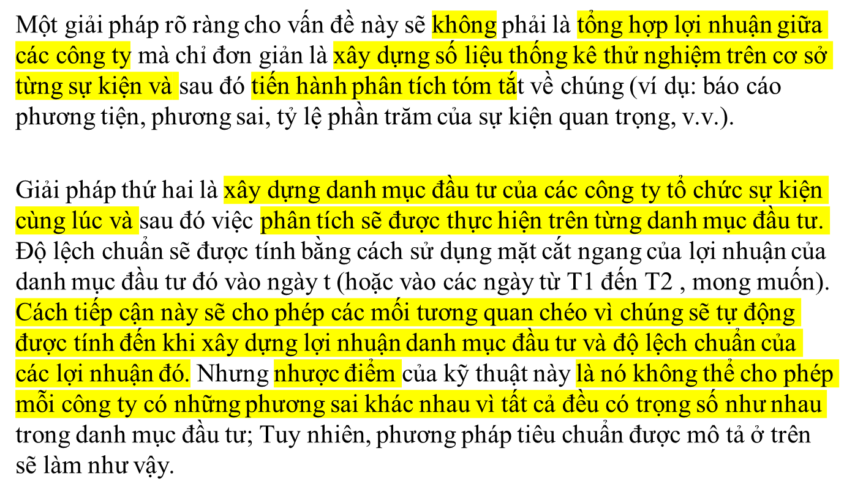
Phụ thuộc chéo – Giải pháp

Slide 27

Event Studies: Changing Variances of Returns
Often the variance of returns will increase over the event window
Either the event itself or the factors that led to it are likely to increase uncertainty and with it the volatility of returns
As a result, the measured variance will be too low and the null hypothesis of no abnormal return during the event will be rejected too often
To deal with this, Boehmer et al. (1991), amongst others, suggest estimating the variance of abnormal returns by employing the cross-sectional variance of returns across firms during the event window
Clearly, if we adopt this procedure we cannot estimate separate test statistics for each firm
The variance estimator would be:
The test statistic would be calculated as before.
‘Introductory Econometrics for Finance’ © Chris Brooks 2013

Slide 28
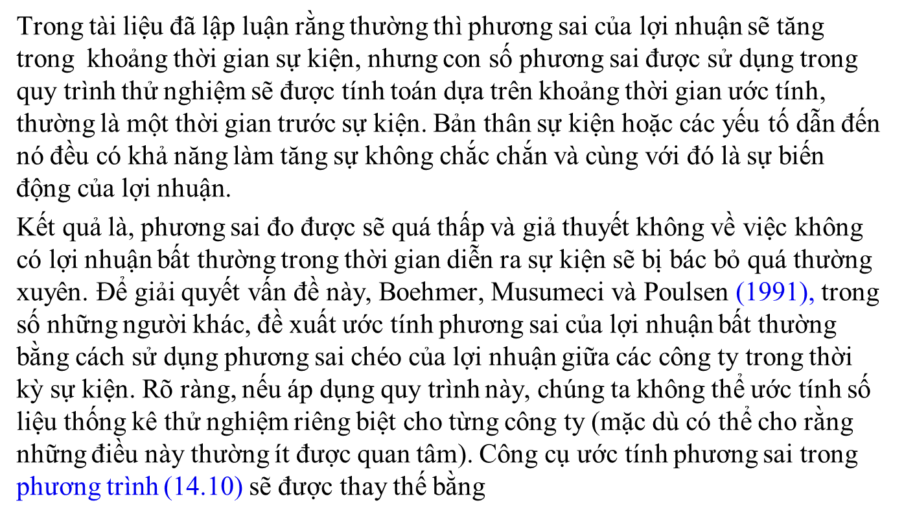
PS thay đổi

Slide 29
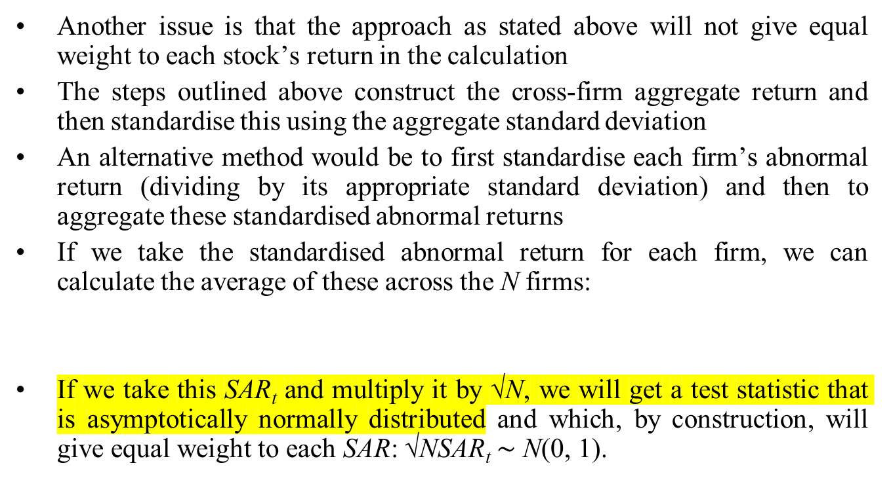

Event Studies: Weighting the Stocks
‘Introductory Econometrics for Finance’ © Chris Brooks 2013

Slide 30
Event Studies: Long Event Windows
Event studies are joint tests of whether the event-induced abnormal return is zero and whether the model employed to construct expected returns is correct
If we wish to examine the impact of an event over a long period we need to be more careful about the design of the model for expected returns
Over the longer run, small errors in setting up the asset pricing model can lead to large errors in the calculation of abnormal returns and therefore the impact of the event
A key question is whether to use cumulative abnormal returns (CARs) or buy-and-hold abnormal returns (BHARs)
There are important differences between the two:
  BHARs employ geometric returns rather than arithmetic returns in calculating the overall return over the event period of interest
  Thus the BHAR can allow for compounding whereas the CAR does not.
‘Introductory Econometrics for Finance’ © Chris Brooks 2013

Slide 31
Event Studies: Buy-and-Hold Abnormal Returns
A formula for calculating the BHAR is
If desired, we can then sum the BHAR_{i} across the N firms to construct an aggregate measure.
BHARs have been advocated, amongst others, by Barber and Lyon (1997) and Lyon et al. (1999) because they better match the ‘investor experience’
CARs represent biased estimates of the actual returns received by investors
However, by contrast, Fama (1998) in particular argues in favour of the use of CARs rather than BHARs.
‘Introductory Econometrics for Finance’ © Chris Brooks 2013

Slide 32
Event Studies: Buy-and-Hold Abnormal Returns 2
BHARs seem to be more adversely affected by skewness in the sample of abnormal returns than CARs because of the impact of compounding in BHARs
In addition, Fama indicates that the average CAR increases at a rate of (T₂−T₁) with the number of months included in the sum, whereas its standard error increases only at a rate √ (T₂−T₁)
This is not true for BHARs where the standard errors grow at the faster rate (T₂−T₁) rather than its square root
Hence any inaccuracies in measuring expected returns will be more serious for BHARs as another consequence of compounding.
‘Introductory Econometrics for Finance’ © Chris Brooks 2013

Slide 33
Event Studies: Event Versus Calendar Time
All of the procedures discussed above have involved conducting analysis in event time
An alternative approach involves using calendar time, which involves running a time-series regression and examining the intercept from that regression
The dependent variable is a series of portfolio returns, which measure the average returns at each point in time of the set of firms that have undergone the event of interest within a pre-defined measurement period before that time.
‘Introductory Econometrics for Finance’ © Chris Brooks 2013

Slide 34
Event Studies: Event Versus Calendar Time 2
So, for example, we might choose to examine the returns of firms for a year after the event that they announce cessation of their dividend payments
Then, for each observation t, the dependent variable will be the average return on all firms that stopped paying dividends at any point during the past year
One year after the event, by construction the firm will drop out of the portfolio
Hence the number of firms within the portfolio will vary over time and the portfolio will effectively be rebalanced each month
The explanatory variables may be risk measures from a factor model
The calendar time approach will weight each time period equally and thus the weight on each individual firm in the sample will vary
This may be problematic and will result in a loss of power if managers time events to take advantage of misvaluations.
‘Introductory Econometrics for Finance’ © Chris Brooks 2013

Slide 35
Event Studies: Small Samples and Non-normality
The test statistics presented in the previous section are all asymptotic, and problems may arise either if the estimation window (T) is too short, or if the number of firms (N) is too small when the firm-aggregated statistic is used
Outliers may cause problems, especially in the context of small samples
Bootstrapped standard errors could be used in constructing t-statistics
Another strategy for dealing with non-normality would be to use a non-parametric test
Such tests are robust in the presence of non-normal distributions, although they are usually less powerful than their parametric counterparts
We could test the null hypothesis that the proportion of positive abnormal returns is not affected by the event
In other words, the proportion of positive abnormal returns across firms remains at the expected level.
‘Introductory Econometrics for Finance’ © Chris Brooks 2013

Slide 36

Event Studies: A Non-parametric Test
We could then use the test statistic, Z_{p}:
where p is the actual proportion of negative abnormal returns during the event window and p∗ is the expected proportion
Under the null hypothesis, the test statistic follows a binomial distribution, which can be approximated by the standard normal distribution
p∗ is calculated based on the proportion of negative abnormal returns during the estimation window.
‘Introductory Econometrics for Finance’ © Chris Brooks 2013

Slide 37
Tests of the CAPM and the Fama-French Methodology
‘Introductory Econometrics for Finance’ © Chris Brooks 2013

Slide 38
Testing the CAPM: The Basics
The most commonly quoted equation for the CAPM is
E(R_{i}) = R_{f} + β_{i}[E(R_{m}) − R_{f} ]
So the CAPM states that the expected return on any stock i is equal to the risk-free rate of interest, R_{f} , plus a risk premium.
This risk premium is equal to the risk premium per unit of risk, also known as the market risk premium, [E(R_{m}) − R_{f} ], multiplied by the measure of how risky the stock is, known as ‘beta’, β_{i}
Beta is not observable from the market and must be calculated, and hence tests of the CAPM are usually done in two steps:
  Estimating the stock betas
  Actually testing the model
If the CAPM is a good model, then it should hold ‘on average’.
‘Introductory Econometrics for Finance’ © Chris Brooks 2013

Slide 39

Testing the CAPM: Calculating Betas
A stock’s beta can be calculated in two ways – one approach is to calculate it directly as the covariance between the stock’s excess return and the excess return on the market portfolio, divided by the variance of the excess returns on the market portfolio:
where the ^{e} superscript denotes excess return
Alternatively, and equivalently, we can run a simple time-series regression of the excess stock returns on the excess returns to the market portfolio separately for each stock, and the slope estimate will be the beta:
‘Introductory Econometrics for Finance’ © Chris Brooks 2013

Slide 40
Testing the CAPM: The Second Stage Regression
Suppose that we had a sample of 100 stocks (N = 100) and their returns using five years of monthly data (T = 60)
The first step would be to run 100 time-series regressions (one for each individual stock), the regressions being run with the 60 monthly data points
Then the second stage would involve a single cross-sectional regression of the average (over time) of the stock returns on a constant and the betas:
where is the return for stock i averaged over the 60 months
Essentially, the CAPM says that stocks with higher betas are more risky and therefore should command higher average returns to compensate investors for that risk
If the CAPM is a valid model, two key predictions arise which can be tested using this second stage regression: λ₀ = R_{f} and λ₁ = [R_{m} − R_{f} ].
‘Introductory Econometrics for Finance’ © Chris Brooks 2013

Slide 41
Testing the CAPM: Further Implications
Two further implications of the CAPM being valid:
  There is a linear relationship between a stock’s return and its beta
  No other variables should help to explain the cross-sectional variation in returns
We could run the augmented regression:
where β_{i}² is the squared beta for stock i and σ_{i}² is the variance of the residuals from the first stage regression, a measure of idiosyncratic risk
The squared beta can capture non-linearities in the relationship between systematic risk and return
If the CAPM is a valid and complete model, then we should see that λ₂ = 0 and λ₃ = 0.
‘Introductory Econometrics for Finance’ © Chris Brooks 2013

Slide 42
Testing the CAPM:
A Different Second-Stage Regression
It has been found that returns are systematically higher for small capitalisation stocks and are systematically higher for ‘value’ stocks than the CAPM would predict.
We can test this directly using a different augmented second stage regression:
where MV_{i} is the market capitalisation for stock i and BTM_{i} is the ratio of its book value to its market value of equity
Again, if the CAPM is a valid and complete model, then we should see that λ₂ = 0 and λ₃ = 0.
‘Introductory Econometrics for Finance’ © Chris Brooks 2013

Slide 43
Problems in Testing the CAPM
These are numerous, and include:
  Non-normality – e.g. caused by outliers can cause problems with inference
  Heteroscedasticity – some recent research has used GMM or another robust technique to deal with this
  Measurement errors since the betas used as explanatory variables in the second stage are estimated – in order to minimise such measurement errors, the beta estimates can be based on portfolios rather than individual securities
  Alternatively, the Shanken (1992) correction can be applied to adjust the standard errors for beta estimation error.
‘Introductory Econometrics for Finance’ © Chris Brooks 2013

Slide 44
The Fama-MacBeth Approach
Fama and MacBeth (1973) used the two stage approach to testing the CAPM outlined above, but using a time series of cross-sections
Instead of running a single time-series regression for each stock and then a single cross-sectional one, the estimation is conducted with a rolling window
They use five years of observations to estimate the CAPM betas and the other risk measures (the standard deviation and squared beta) and these are used as the explanatory variables in a set of cross-sectional regressions each month for the following four years
The estimation is then rolled forward four years and the process continues until the end of the sample is reached
Since we will have one estimate of the lambdas for each time period, we can form a t-ratio as the average over t divided by its standard error (the standard deviation over time divided by the square root of the number of time-series estimates of the lambdas).
‘Introductory Econometrics for Finance’ © Chris Brooks 2013

Slide 45


The Fama-MacBeth Approach
The average value of each lambda over t can be calculated using:
where T_{FMB} is the number of cross-sectional regressions used in the second
stage of the test, the j are the four different parameters (the intercept, the coefficient on beta, etc.) and the standard deviation is
The test statistic is then simply , , which is asymptotically standard normal, or follows a t-distribution with T_{FMB} − 1 degrees of freedom in finite samples.
‘Introductory Econometrics for Finance’ © Chris Brooks 2013

Slide 46
Fama-MacBeth: Their Key Results
We can compare the estimated values of the intercept and slope with the actual values of the risk-free rate (R_{f}) and the market risk premium [R_{m}−R_{f}], which are, for the full-sample corresponding to the results presented in the table, 0.013 and 0.143 respectively.
The intercept and slope parameter estimates (the lambdas) have the correct signs but they are too small
Thus the implied risk-free rate is positive and so is the relationship between returns and beta
Both parameters are significantly different from zero, although they become insignificant when the other risk measures are included as in the second row of the table
It has been argued that there is qualitative support for the CAPM but not quantitative support.
‘Introductory Econometrics for Finance’ © Chris Brooks 2013

Slide 47
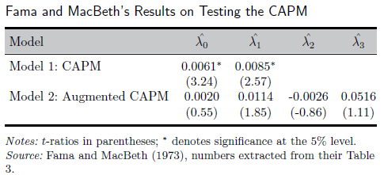
Fama-MacBeth: A Results Table
It is also worth noting from the second row of the table that squared beta and idiosyncratic risk have parameters that are even less significant than beta itself in explaining the cross-sectional variation in returns.
‘Introductory Econometrics for Finance’ © Chris Brooks 2013

Slide 48
The Fama-French Methodology
The ‘Fama-French methodology’ is a family of related approaches based on the notion that market risk is insufficient to explain the cross-section of stock returns
The Fama-French and Carhart models seek to measure abnormal returns after allowing for the impact of the characteristics of the firms or portfolios under consideration
It is widely believed that small stocks, value stocks, and momentum stocks, outperform the market as a whole
If we wanted to evaluate the performance of a fund manager, it would be important to take the characteristics of these portfolios into account to avoid incorrectly labelling a manager as having stock-picking skills.
‘Introductory Econometrics for Finance’ © Chris Brooks 2013

Slide 49
The Fama-French (1992) Approach
The Fama-French (1992) approach, like Fama and MacBeth (1973), is based on a time-series of cross-sections model
A set of cross-sectional regressions are run of the form
where R_{i,t} are again the monthly returns, β_{i,t} are the CAPM betas, MV_{i,t} are the market capitalisations, and BTM_{i,t} are the book-to-price ratios, each for firm i and month t
So the explanatory variables in the regressions are the firm characteristics themselves
Fama and French show that size and book-to-market are highly significantly related to returns
They also show that market beta is not significant in the regression (and has the wrong sign), providing very strong evidence against the CAPM.
‘Introductory Econometrics for Finance’ © Chris Brooks 2013

Slide 50
The Fama-French (1993) Approach
Fama and French (1993) use a factor-based model in the context of a time-series regression which is run separately on each portfolio i
where R_{i,t} is the return on stock or portfolio i at time t, RMRF, SMB, and HML are the factor mimicking portfolio returns for market excess returns, firm size, and value respectively
The excess market return is measured as the difference in returns between the S&P 500 index and the yield on Treasury bills (RMRF)
SMB is the difference in returns between a portfolio of small stocks and a portfolio of large stocks, termed ‘Small Minus Big
HML is the difference in returns between a portfolio of value stocks and a portfolio of growth stocks, termed ‘High Minus Low’.
‘Introductory Econometrics for Finance’ © Chris Brooks 2013

Slide 51
The Fama-French (1993) Approach 2
These time-series regressions are run on portfolios of stocks that have been two-way sorted according to their book-to-market ratios and their market capitalisations
It is then possible to compare the parameter estimates qualitatively across the portfolios i
The parameter estimates from these time-series regressions are factor loadings that measure the sensitivity of each individual portfolio to the factors
The second stage in this approach is to use the factor loadings from the first stage as explanatory variables in a cross-sectional regression:
We can interpret the second stage regression parameters as factor risk premia that show the amount of extra return generated from taking on an additional unit of that source of risk.
‘Introductory Econometrics for Finance’ © Chris Brooks 2013

Slide 52
The Carhart (1997) Approach
It has become customary to add a fourth factor to the equations above based on momentum
This is measured as the difference between the returns on the best performing stocks over the past year and the worst performing stocks – this factor is known as UMD – ‘up-minus-down’
The first and second stage regressions then become respectively:
Carhart forms decile portfolios of mutual funds based on their one-year lagged performance and runs the time-series regression on each of them
He finds that the mutual funds which performed best last year (in the top decile) also had positive exposure to the momentum factor (UMD) while those which performed worst had negative exposure.
‘Introductory Econometrics for Finance’ © Chris Brooks 2013

