Slide 1

Embrace
Uncertainty
why in Agile development knowing what you want may be an impediment to getting it
Jeff Patton
jpatton@acm.org
www.AgileProductDesign.com
Notes:
Incremental Releases Users & Stakeholders Will Love
Jeff Patton, jpatton@acm.org

Slide 2
XP circa 2000
and questioning what you think you know
Notes:
Incremental Releases Users & Stakeholders Will Love
Jeff Patton, jpatton@acm.org

Slide 3
XcrumP
towards an Agile Unified Process?
hmm…
Notes:
Incremental Releases Users & Stakeholders Will Love
Jeff Patton, jpatton@acm.org

Slide 4
process rigor
or rigor mortis?
Notes:
Incremental Releases Users & Stakeholders Will Love
Jeff Patton, jpatton@acm.org

Slide 5
a common problem,
and three strategies to deal with it
Notes:
Incremental Releases Users & Stakeholders Will Love
Jeff Patton, jpatton@acm.org

Slide 6
The stories you are about to hear are made up.
Only the names have been left unchanged to offend the innocent.
Notes:
Incremental Releases Users & Stakeholders Will Love
Jeff Patton, jpatton@acm.org

Slide 7
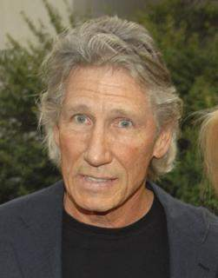
This is Roger
He’s a seasoned business person.
(he’s looking pretty seasoned)
“This XP stuff makes a lot of sense!
I just break my requirements down into user stories, and the team builds them one at a time.
It’s all just like adding bricks to a wall!”
Notes:
Incremental Releases Users & Stakeholders Will Love
Jeff Patton, jpatton@acm.org

Slide 8

This is Melanie
She works on the development team
(she’s good with people)
“Roger, let’s get your requirements down as user stories.
You’re the expert. So, tell me what you want.”
Notes:
Incremental Releases Users & Stakeholders Will Love
Jeff Patton, jpatton@acm.org

Slide 9

Roger & Melanie work together to capture user stories. Then after estimating Roger chooses the highest value stories for the first release.
“Melanie, I really need all this stuff on time or my stakeholders will kill me.”
“No worries Roger.”
Notes:
Incremental Releases Users & Stakeholders Will Love
Jeff Patton, jpatton@acm.org

Slide 10
Roger learns to use a burn-down chart to monitor the progress of Melanie and her team
Notes:
Incremental Releases Users & Stakeholders Will Love
Jeff Patton, jpatton@acm.org

Slide 11

“At the end of each iteration, I just count how many bricks, uh… stories are left. It couldn’t be more simple!”
scope
iterations
1
2
3
4
5
6
7
8
Notes:
Incremental Releases Users & Stakeholders Will Love
Jeff Patton, jpatton@acm.org

Slide 12
“Iteration 1…. things are going fine.”
scope
iterations
1
1
2
3
4
5
6
7
8
Notes:
Incremental Releases Users & Stakeholders Will Love
Jeff Patton, jpatton@acm.org

Slide 13
“Iteration 2…. the trend looks fine.”
scope
iterations
1
2
2
3
4
5
6
7
8
Notes:
Incremental Releases Users & Stakeholders Will Love
Jeff Patton, jpatton@acm.org

Slide 14


“Iteration 3 – velocity is getting even better!
But, look – there’s a big gap here. We can’t ship with data validation like this!
“No worries Roger. Let’s just add a couple more stories to address the problem.”
scope
iterations
1
2
3
3
4
5
6
7
8
Notes:
Incremental Releases Users & Stakeholders Will Love
Jeff Patton, jpatton@acm.org

Slide 15
“Iteration 4. We’ve got real problems here. Now that I’m seeing this – the things we built already won’t work – and we need to add some other things!”
“No worries Roger. Let’s just add a couple more stories.”
scope
iterations
1
2
3
4
4
5
6
7
8
Notes:
Incremental Releases Users & Stakeholders Will Love
Jeff Patton, jpatton@acm.org

Slide 16
“There are still more holes… Look – we’re in real trouble here! We’re not going to finish on time!”
“No worries Roger. Let’s just drop a few stories.”
scope
iterations
1
2
3
4
5
5
6
7
8
Notes:
Incremental Releases Users & Stakeholders Will Love
Jeff Patton, jpatton@acm.org

Slide 17


“You gotta be kidding!”
We
are so screwed
“No Rodger, that’s the real power of Agile – you can change your mind at any time!
Isn’t it great?”
scope
(Melanie is good with people.)
iterations
1
2
3
4
5
5
6
7
8
Notes:
Incremental Releases Users & Stakeholders Will Love
Jeff Patton, jpatton@acm.org

Slide 18
Roger’s made a common mistake in working within an Agile approach
He’s forgotten what iterate means
Notes:
Incremental Releases Users & Stakeholders Will Love
Jeff Patton, jpatton@acm.org

Slide 19
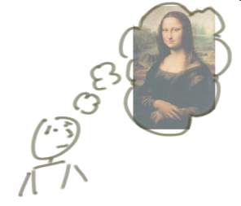



“incrementing” builds a bit at a time
But, incrementing calls for a fully formed idea
1
2
3
Notes:
Incremental Releases Users & Stakeholders Will Love
Jeff Patton, jpatton@acm.org

Slide 20



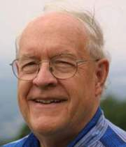
Fred & the Werewolf
“The hardest single part of building a software system is deciding precisely what to build.”
Grrr….
Steve
Fred Brooks,
author of “No Silver Bullet”
Notes:
Incremental Releases Users & Stakeholders Will Love
Jeff Patton, jpatton@acm.org

Slide 21
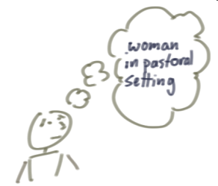
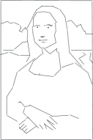


“iterating” builds a rough version, validates it, then slowly builds up quality
Iterating allows you to move from vague idea to realization
1
2
3
Notes:
Incremental Releases Users & Stakeholders Will Love
Jeff Patton, jpatton@acm.org

Slide 22
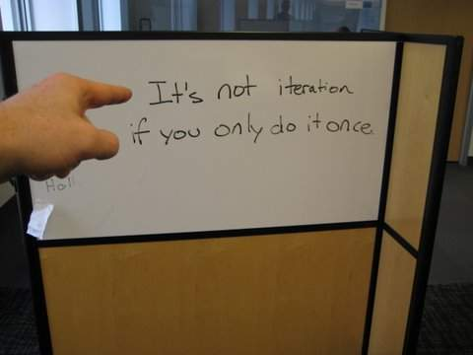
Notes:
Incremental Releases Users & Stakeholders Will Love
Jeff Patton, jpatton@acm.org

Slide 23
But, why would Roger not understand that?
Notes:
Incremental Releases Users & Stakeholders Will Love
Jeff Patton, jpatton@acm.org

Slide 24

Roger saw this model…
It’s called “the snowman model”
(see the snowman?)
Notes:
Incremental Releases Users & Stakeholders Will Love
Jeff Patton, jpatton@acm.org

Slide 25

It can’t be half-baked if you’re going to ship it… right?
Grrr….
Notes:
Incremental Releases Users & Stakeholders Will Love
Jeff Patton, jpatton@acm.org

Slide 26
But, it can if you intend to iterate.
Notes:
Incremental Releases Users & Stakeholders Will Love
Jeff Patton, jpatton@acm.org

Slide 27
It’s not Rogers fault he didn’t think about iteration…
the snowman is missing a couple balls
Notes:
Incremental Releases Users & Stakeholders Will Love
Jeff Patton, jpatton@acm.org

Slide 28
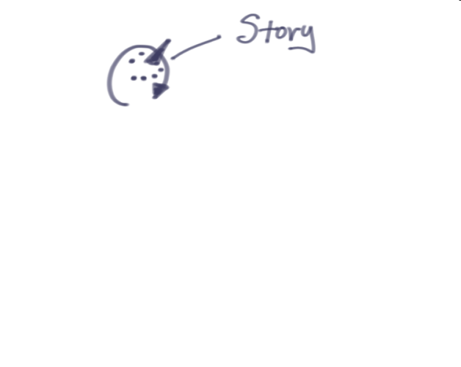
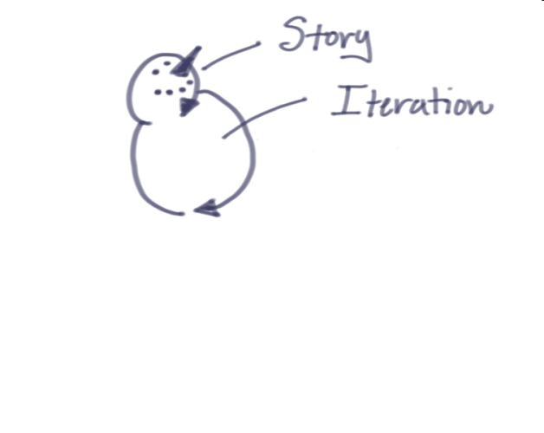
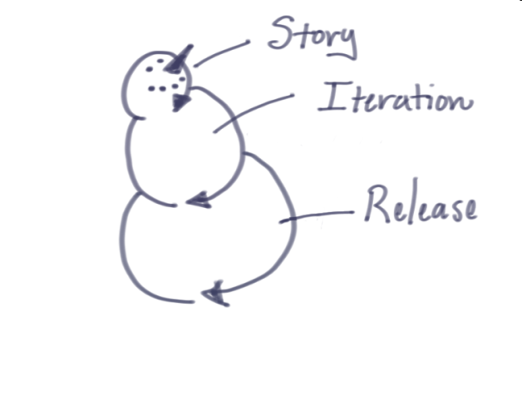
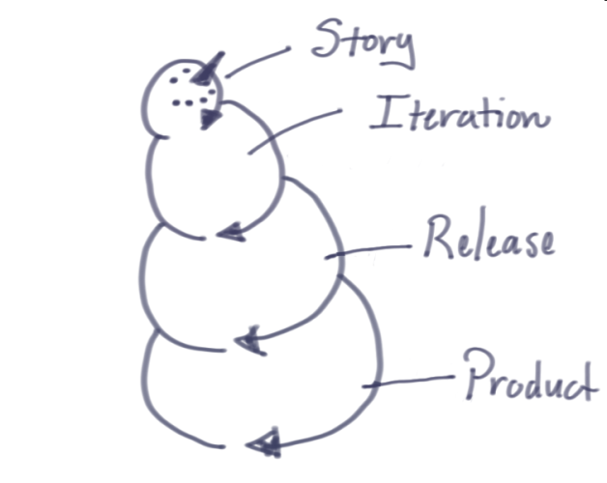
Notes:
Incremental Releases Users & Stakeholders Will Love
Jeff Patton, jpatton@acm.org

Slide 29
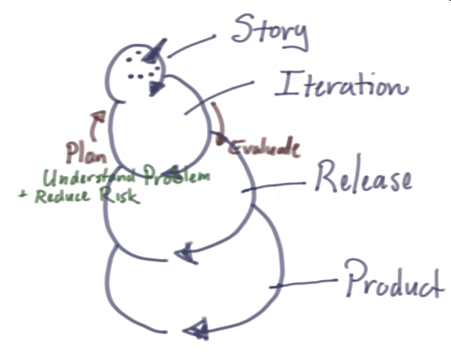
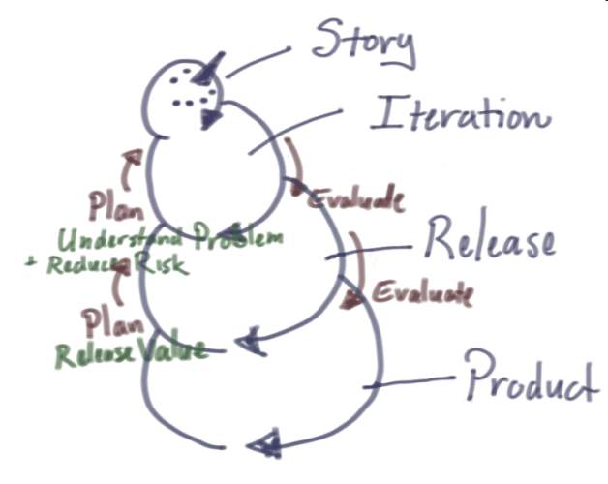
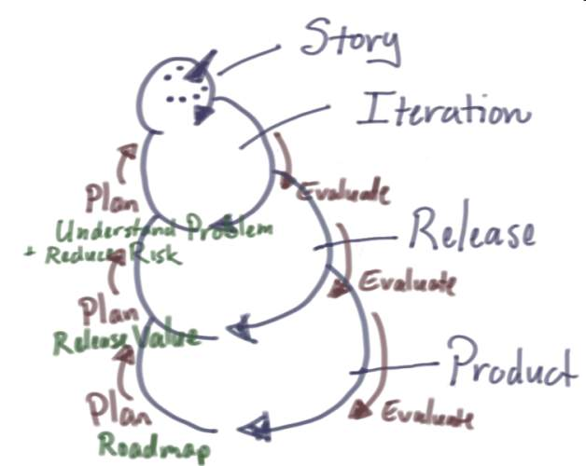
Notes:
Incremental Releases Users & Stakeholders Will Love
Jeff Patton, jpatton@acm.org

Slide 30
YAGRI
You Aint Gunna Release It
Notes:
Incremental Releases Users & Stakeholders Will Love
Jeff Patton, jpatton@acm.org

Slide 31
Look, that iteration stuff is fine, but we’ve got commitments to keep. How do I deal with the uncertainty of not knowing what I’ll get?
Notes:
Incremental Releases Users & Stakeholders Will Love
Jeff Patton, jpatton@acm.org

Slide 32
Roger’s got a point
Software is often a line item in a larger plan. Failing a release date may put that bigger plan at risk
(Failing the release date may put Roger’s career at risk)
Notes:
Incremental Releases Users & Stakeholders Will Love
Jeff Patton, jpatton@acm.org

Slide 33
It seems logical that we need to know what we want in order to estimate its construction and get it on schedule, right?
But we know that we can’t really know…
Grrr….
Notes:
Incremental Releases Users & Stakeholders Will Love
Jeff Patton, jpatton@acm.org

Slide 34
Planning for iteration might have helped Roger, but that still doesn’t solve Roger’s fear of uncertainty
Notes:
Incremental Releases Users & Stakeholders Will Love
Jeff Patton, jpatton@acm.org

Slide 35
Here are three strategies that might help
Notes:
Incremental Releases Users & Stakeholders Will Love
Jeff Patton, jpatton@acm.org

Slide 36
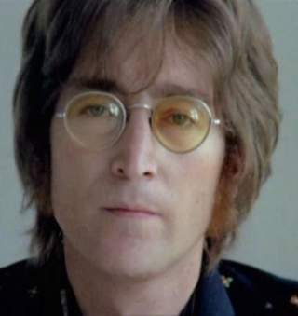
This is John
John is somewhat single minded.
He focuses on business value…
well sort of.
John’s Strategy: Follow the Money
Notes:
Incremental Releases Users & Stakeholders Will Love
Jeff Patton, jpatton@acm.org

Slide 37






Business Goals
(Increase Revenue, Reduce Costs)
John follows user stories back to their source
User Constituencies
(The people that will use some solution to meet business goals)
User Stories Build Software
Notes:
Incremental Releases Users & Stakeholders Will Love
Jeff Patton, jpatton@acm.org

Slide 38

Prioritize before you prioritize
Business Goals
(Increase Revenue, Reduce Costs)
John knows he can get money faster by prioritizing goals first
User Constituencies
(The people that will use some solution to meet business goals)
User Stories Build Software
Notes:
Incremental Releases Users & Stakeholders Will Love
Jeff Patton, jpatton@acm.org

Slide 39
Prioritize before you prioritize
Business Goals
(Increase Revenue, Reduce Costs)
“Fewer goals = less software”
User Constituencies
(The people that will use some solution to meet business goals)
User Stories Build Software
Notes:
Incremental Releases Users & Stakeholders Will Love
Jeff Patton, jpatton@acm.org

Slide 40

This is Paul
(It’s an old picture. He’s not looking quite as good these days)
Paul has a problem
“As a frustrated boyfriend,
I want to leave my lover
so that I can be happier with someone else.”
“I’ve got a lot of options.”
Paul’s Strategy: Don’t choose your solution too early
Notes:
Incremental Releases Users & Stakeholders Will Love
Jeff Patton, jpatton@acm.org

Slide 41
Paul defers writing user stories that describe software features till the last responsible moment.
Instead, he writes users stories about the users and what they need to accomplish.
When working with Melanie to estimate, he discusses all the ways – sometimes as many as 50 – that the user can satisfy their goals.
Notes:
Incremental Releases Users & Stakeholders Will Love
Jeff Patton, jpatton@acm.org

Slide 42



problem or goal
How I’d like to feel, or what I’d like to achieve
Paul knows we build software to support user’s task so they can reach their goals.
goal evaluation
is my goal met or problem resolved?
take some
action
action evaluation
did that action deliver that results I expected?
the world
information and tools
Notes:
Personas, Profiles, Actors & Roles: Modeling Users for Successful Product Design
Jeff Patton, jpatton@acm.org www.AgileProductDesign.com

Slide 43
problem or goal
How I’d like to feel, or what I’d like to achieve
goal
Paul thinks of it as a simple goal-user task-tool hierarchy
goal evaluation
is my goal met or problem resolved?
task
take some
action
action evaluation
did that action deliver that results I expected?
tool
the world
information and tools
Notes:
Personas, Profiles, Actors & Roles: Modeling Users for Successful Product Design
Jeff Patton, jpatton@acm.org www.AgileProductDesign.com

Slide 44
goal
Paul knows that software is a just a big gob of tools we often call features.
task
software
tool
features
tools
Notes:
Personas, Profiles, Actors & Roles: Modeling Users for Successful Product Design
Jeff Patton, jpatton@acm.org www.AgileProductDesign.com

Slide 45







hole
(to put the flower in)
Paul explains it this way…
dig hole
hold my options open
Notes:
Personas, Profiles, Actors & Roles: Modeling Users for Successful Product Design
Jeff Patton, jpatton@acm.org www.AgileProductDesign.com

Slide 46
hole
(to put the flower in)
Understand what users need to accomplish, and defer feature decisions untill the last responsible moment.
dig hole
Notes:
Personas, Profiles, Actors & Roles: Modeling Users for Successful Product Design
Jeff Patton, jpatton@acm.org www.AgileProductDesign.com

Slide 47
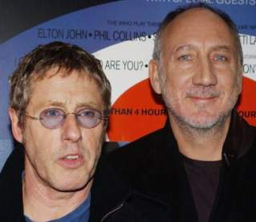
This is Pete and Roger
(It’s a different Roger - He looks a little less dazed than the other Roger)
They have a problem. Want the want may cost more than they can afford.
But, they know how to vary and build up quality to stay under budget, but maximize value.
Pete & Roger’s Strategy: Build up feature quality iteration by iteration
Notes:
Incremental Releases Users & Stakeholders Will Love
Jeff Patton, jpatton@acm.org

Slide 48





Pete & Roger prepare a backlog for their bus
They know they need all the features
But they know that all buses don’t cost the same
Each essential feature varies in quality affecting the final cost
He’s a real doofus.
engine
transmission
brakes
suspension
seats
steering wheel
beer cooler
…
Hey – you need to prioritize those!
low cost
moderate cost
high cost
Notes:
Incremental Releases Users & Stakeholders Will Love
Jeff Patton, jpatton@acm.org

Slide 49
Pete and Roger have a handy heuristic for slicing up quality
Necessity: what minimal characteristics are necessary for this feature?
Flexibility: what would make this feature useful in more situations?
Safety: what would make this feature safer for me to use?
Comfort, Luxury, and Performance: what would make this feature more desirable to use?
Notes:
Incremental Releases Users & Stakeholders Will Love
Jeff Patton, jpatton@acm.org

Slide 50
Pete and Roger have learned the hard way that building each story to an ideal quality level is risky.
(Although she has her qualities, Melanie isn’t as good at estimation as you might think.)
release
features
iterations
design & development
1
2
3
4
Notes:
Incremental Releases Users & Stakeholders Will Love
Jeff Patton, jpatton@acm.org

Slide 51
Pete and Roger leverage iteration
Iterating affords building up quality over time
1
2
3
Notes:
Incremental Releases Users & Stakeholders Will Love
Jeff Patton, jpatton@acm.org

Slide 52
Pete and Roger know that each bus feature can be split into user stories based on quality characteristics.
In early iterations Pete and Roger focus on necessity, then and flexibility and safety, then finish off with luxury
At each iteration they give their features a quality grade, then evaluate their bus report card.
D
B-
A-
A-
D
C
B
A
D
C-
B-
B
D
D
B
A
D
D
B
A-
I
D
B
A-
I
D
B-
B-
release
user tasks to support
iterations
design & development
1
2
3
4
Notes:
Incremental Releases Users & Stakeholders Will Love
Jeff Patton, jpatton@acm.org

Slide 53
Let’s review what our characters have learned today.
Notes:
Incremental Releases Users & Stakeholders Will Love
Jeff Patton, jpatton@acm.org

Slide 54
Roger now understands iteration and is a bit more cautious when interpreting his burn-down chart
He knows that building software isn’t like building a wall
Melanie thinks twice before asking what people want
She pays closer attention to their goals – the outcomes they’re looking for
Notes:
Incremental Releases Users & Stakeholders Will Love
Jeff Patton, jpatton@acm.org

Slide 55


Roger leverages these three strategies for managing uncertainty:
Prioritize your goals
Don’t choose your solution too early
Build up feature quality iteration by iteration
Notes:
Incremental Releases Users & Stakeholders Will Love
Jeff Patton, jpatton@acm.org

Slide 56
It’s best not to be too certain about specifically what you’re building
It’s Johnny’s wisdom that speaks clearly to this…
Notes:
Incremental Releases Users & Stakeholders Will Love
Jeff Patton, jpatton@acm.org

Slide 57

In the end, it’s Johnny’s approach that pays off when using XP and Agile development…
“Don’t know what I want, but I know how to get it.”
Question common practice
Trust your instincts
(I wonder if that hurts his eyes to bug them out like that…)
Notes:
Incremental Releases Users & Stakeholders Will Love
Jeff Patton, jpatton@acm.org

Slide 58
Embrace
Uncertainty
why in Agile development knowing what you want may be an impediment to getting it
Jeff Patton
jpatton@acm.org
www.AgileProductDesign.com
Notes:
Incremental Releases Users & Stakeholders Will Love
Jeff Patton, jpatton@acm.org
I’m with ThoughtWorks
I’m on leave of absence right now to write… and find myself
I’ve mostly been finding other people. Still no writing, and I can’t seem to track myself down.

