Slide 1


JavaScript 2015-ES6
Giảng viên: Từ Thị Xuân Hiền
Notes:
NOTE:
To change the image on this slide, select the picture and delete it. Then click the Pictures icon in the placeholder to insert your own image.

Slide 2
Overview
ES6 stands for ECMAScript 6. ECMAScript was created to standardize JavaScript, and ES6 is the 6th version of ECMAScript, it was published in 2015.
ES6 is so useful because all the ES6 features React, Angular and Vue apps typically use.

Slide 3


Javascript releases... (More about this later)
Biggest update to the language EVER
New updates to JS every single year
ES6/ ES2015
ES7/ ES2016
ES8/ ES2017
ES9/ ES2018
ES10/ ES2019
ES11/ ES2020
...
ES5
...
Modern JavaScript
ECMAScript
Learn modern JavaScript from the beginning, but without forgetting the older parts!
Let’s finally get started!

Slide 4
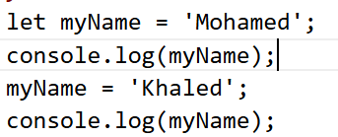
Let and const
let: allows you to declare a variable with block scope.
Example:
In ES6, We can use let keyword instead of var to create a variable

Slide 5
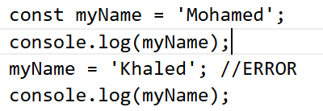
Let and const
const: allows you to declare a constant (a JavaScript variable with a constant value). Constants are similar to let variables, except that the value cannot be changed.
Example:
We get an ERROR because we try to reassign a constant variable

Slide 6
Objects and Primitives in ES6
In JavaScript (ES6), every value belongs to one of two categories:
Category | Description
Primitive types | Simple, basic data types
Objects | Complex data types that can store multiple values

Slide 7
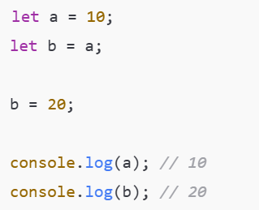
Objects and Primitives in ES6
Primitive Types in ES6
Is immutable (cannot be changed)
Stores the actual value directly
Is compared by value
Example
Notes:
Bất biến (immutable)
Lưu trữ trực tiếp giá trị
So sánh bằng giá trị

Slide 8
Objects and Primitives in ES6
Primitive Types in ES6
Có 7 loại
Kiểu | Ví dụ
Number | 10, 3.14
String | "Hello"
Boolean | true, false
Undefined | undefined
Null | null
Symbol (ES6) | Symbol("id")
BigInt | 123456789n

Slide 9
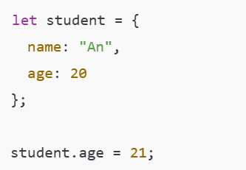
Objects and Primitives in ES6
Objects in ES6:
A reference type
A collection of key–value pairs
Mutable (can be changed after creation)
Example
Notes:
Kiểu dữ liệu tham chiếu (reference type)
Có thể chứa nhiều cặp key–value
Có thể thay đổi nội dung (mutable)

Slide 10
Objects and Primitives in ES6
Objects in ES6: Common Object Types
Type | Example
Object literal | { }
Array | [ ]
Function | function() {}
Date | new Date()
Map / Set | new Map(), new Set()

Slide 11
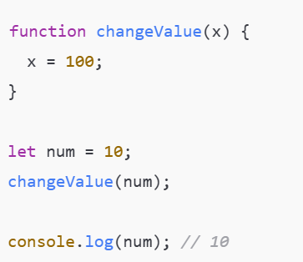
Passing Values to Functions
Primitives – Passed by Value

Slide 12
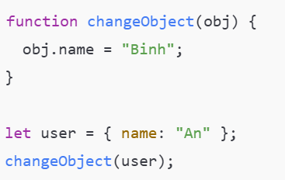
Passing Values to Functions
Objects – Passed by Reference

Slide 13
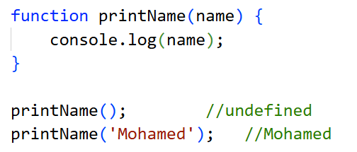
Arrow functions
Arrow functions is a different syntax for creating Javascript functions.
A normal JavaScript function:

Slide 14
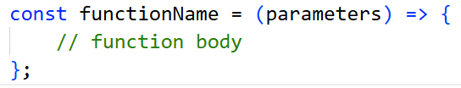
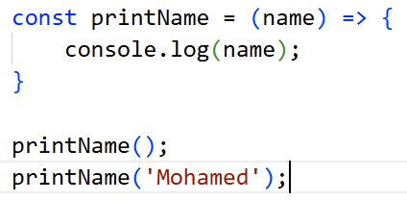
Arrow functions
Arrow functions is a different syntax for creating Javascript functions.
Arrow functions syntax:
Example:

Slide 15

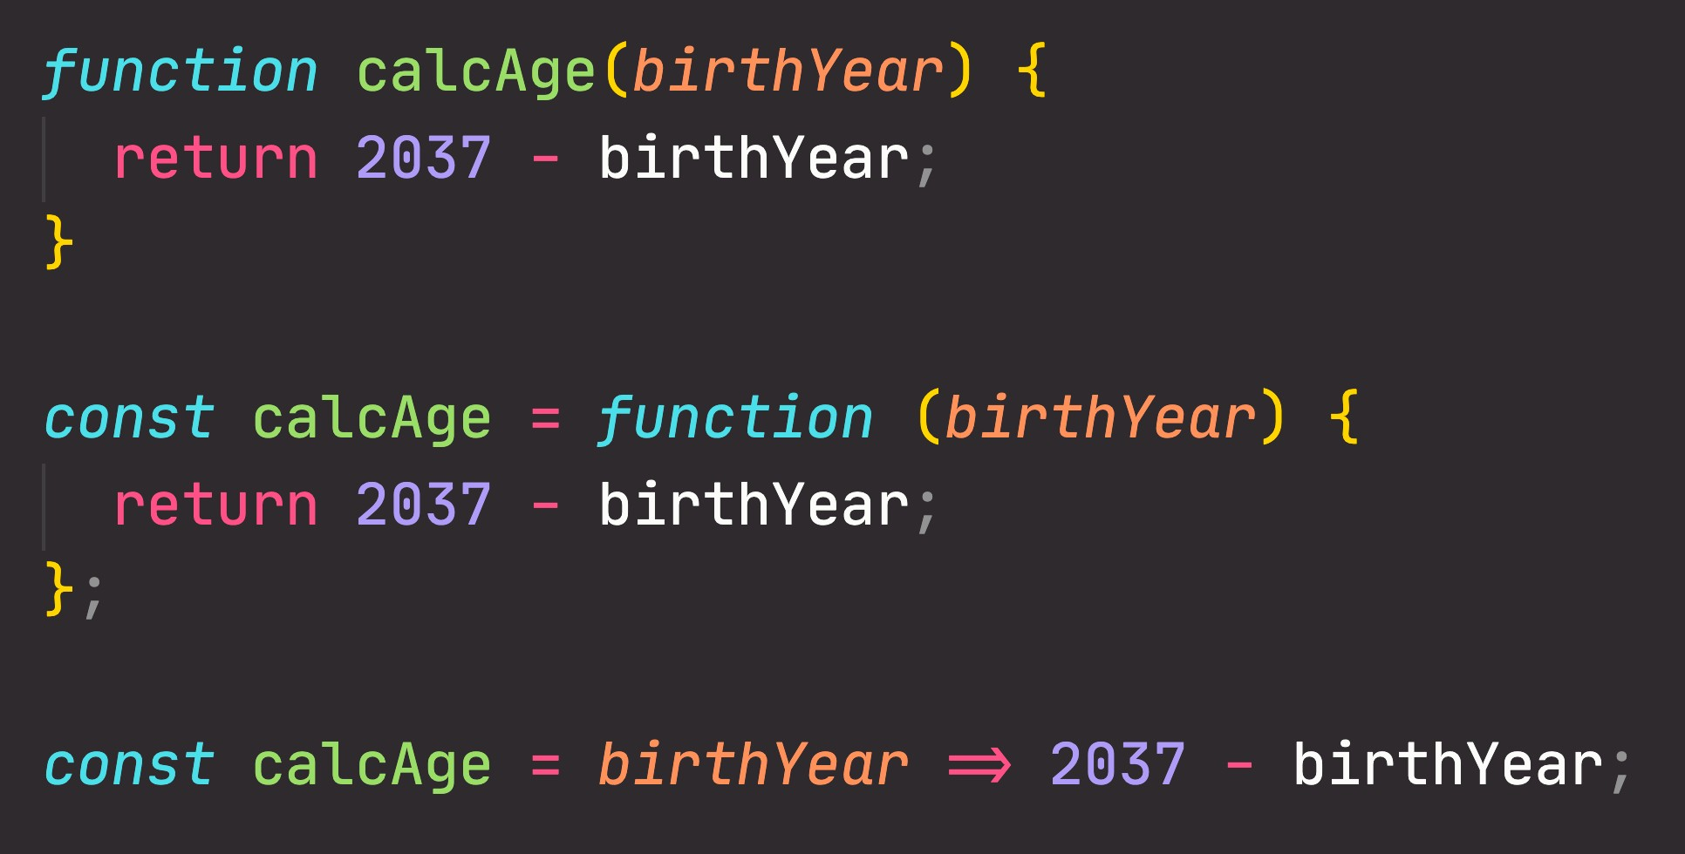

3 Different function types
Function declaration
Function that can be used before it’s declared
Function expression
Essentially a function
value stored in a variable
Arrow function
Great for a quick one-line functions. Has no this keyword (more later...)
Three different ways of writing functions, but they all work in a similar way: receive input data, transform data, and then output data.

Slide 16
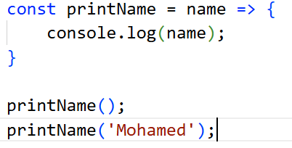
Arrow functions
Some advantages of using Arrow Functions
If we have one argument

Slide 17
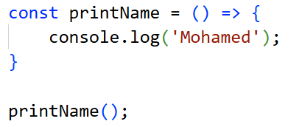
Arrow functions
Some advantages of using Arrow Functions
If we have a function which receives no arguments, we need to pass an empty pair of parentheses

Slide 18
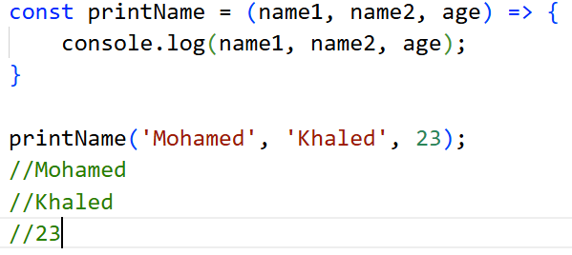
Arrow functions
Some advantages of using Arrow Functions
If we have a function which receives more than one argument, we need parentheses

Slide 19
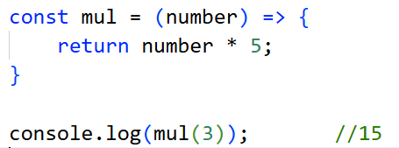

Arrow functions
Some advantages of using Arrow Functions
Also we can update our function body
We can update this function and remove braces and retrun keyword

Slide 20

Arrow functions
Some advantages of using Arrow Functions
We can update also

Slide 21
Modules (export, import)
JavaScript ES6 supports for exporting and importing functions, variables from one module to another.
There are two kinds of exports: A named export and a default export.

Slide 22
Modules (export, import)
Named Export are used to export multiple components from a module by adding the keyword export to their declaration.
These exports are distinguished by their names.
When importing, it is mandatory to use the exact exported names.
This is used when the module has many related functions.
Notes:
Named Export được sử dụng để xuất nhiều đối tượng từ một mô-đun bằng cách thêm từ khóa `export` vào phần khai báo của chúng.
Các Exportnày được phân biệt bằng tên của chúng.Khi nhập các hàm hoặc biến được đặt tên này,có thể sử dụng cùng tên đó để tham chiếu đến các hàm hoặc biến tương ứng.

Slide 23
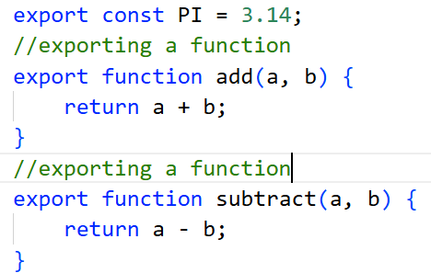
Modules (export, import)
Named Export
Example: file mathUtils.js
Notes:
export 3 thành phần: PI, add, subtract

Slide 24
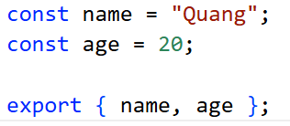
Modules (export, import)
Export multiple components at once.
Example:

Slide 25
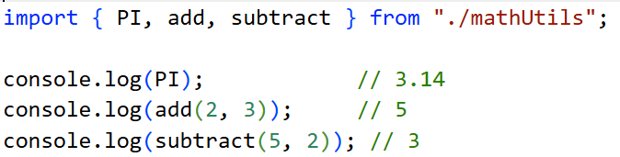
Modules (export, import)
Import Named Export
Example:
Notes:
Tên trong { } phải trùng với tên export

Slide 26

Modules (export, import)
Import Named Export
We can assign an alias with any name you choose after as keyword
Notes:
Dùng as để tránh trùng tên hoặc dễ đọc hơn

Slide 27
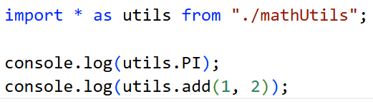
Modules (export, import)
Import all Named Exports
Example

Slide 28
Modules (export, import)
Default Export:
Default Export is a way to export a single default value from a JavaScript module.
Other modules can import it without using `{ }` and can name the imported value arbitrarily.
Each file can only have one default export.
Notes:
Default Export là cách xuất một giá trị mặc định duy nhất từ một module JavaScript. Module khác khi import không cần dùng { } và có thể đặt tên tùy ý cho giá trị được import.

Slide 29
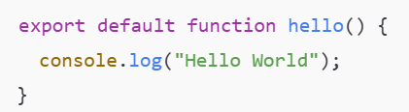
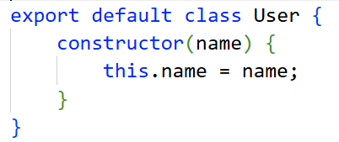

Modules (export, import)
Default Export:
Example
Or
Or export a value:

Slide 30
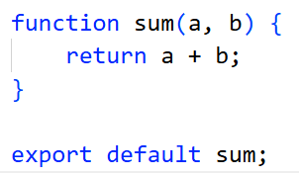
Modules (export, import)
Export after declaration
Example
Notes:
Khi export default không được dùng const, let, var phía trước.
export default const x = 10;//sai
const x = 10;
export default x; //đúng

Slide 31
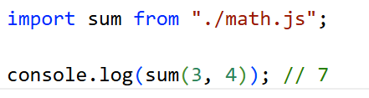

Modules (export, import)
Import Default Export
Example
Use any name you like when importing.
Notes:
Không dùng { }

Slide 32
Classes
In ES6 (ECMAScript 2015), class is a new syntax that allows developers to define classes in JavaScript in a cleaner and more readable way, similar to object-oriented languages such as C# or Java.
Notes:
Trong ES6, class là cú pháp mới giúp định nghĩa lớp (class) trong JavaScript một cách rõ ràng, dễ đọc, gần với các ngôn ngữ hướng đối tượng như C#, Java.
⚠️ Lưu ý quan trọng: class trong ES6 chỉ là “cú pháp đường” (syntactic sugar) cho prototype, không phải OOP thuần như C#.

Slide 33
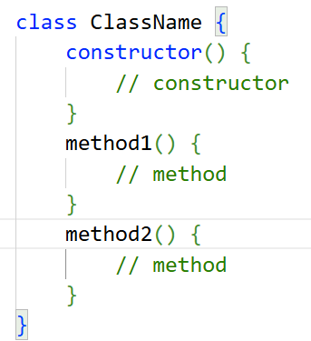
Classes
Syntax:

Slide 34
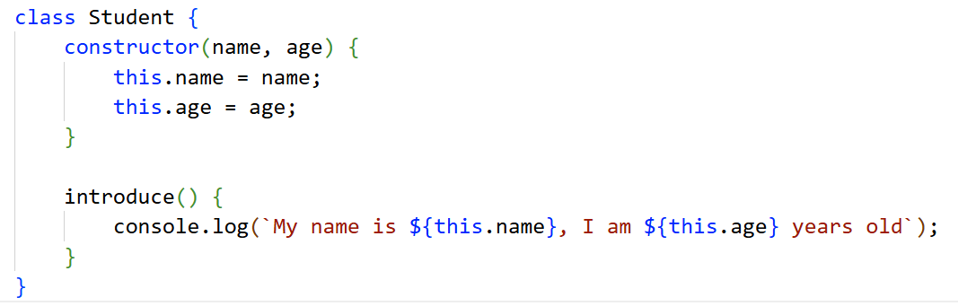
Classes
Simple Class Example

Slide 35

Classes
Creating an object from a class
Example
Notes:
My name is An, I am 20 years old

Slide 36
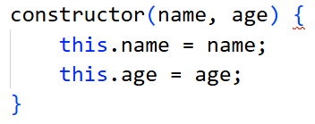
Classes
Constructor
The constructor() method is automatically called when using new
It is used to initialize object properties
Example

Slide 37
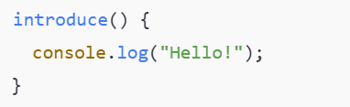
Classes
Methods in a Class
No need to use the function keyword
Methods are stored in the prototype

Slide 38
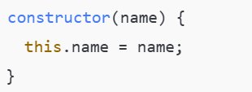
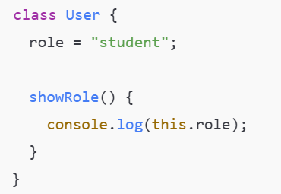
Classes
Properties in a Class
Method 1: Declare properties in the constructor (most common)
Method 2: Public class fields (ES2022+)

Slide 39
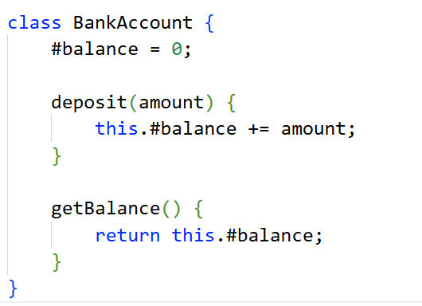
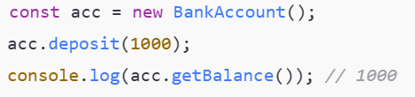
Classes
Private Properties and Methods (#)
Modern JavaScript supports private fields using #

Slide 40
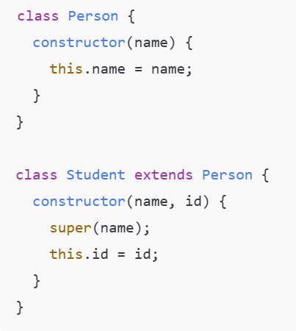
Classes
Calling the Parent Constructor (super)

Slide 41
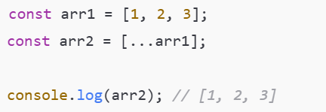
The threeDots ...
The three-dot operator ... is known as the Spread Operator or the Rest Operator. Although they use the same syntax, their meaning depends on the context
Spread Operator (...): Used to expand (spread) elements of an array, object, or iterable.
Copy an array
Notes:
Dùng để “trải” các phần tử của mảng, object hoặc iterable ra bên ngoài
Toán tử trải rộng và toán tử REST được gọi là ba dấu chấm.
Toán tử này chỉ đơn giản là ba dấu chấm...
Toán tử trải rộng được sử dụng để tách các phần tử mảng hoặc thuộc tính đối tượng. Nói cách khác, để sao chép mảng hoặc thêm thuộc tính vào một đối tượng trong khi vẫn sao chép an toàn đối tượng cũ. Toán tử trải rộng lấy ra tất cả các phần tử, tất cả các thuộc tính và phân phối chúng vào một mảng hoặc đối tượng mới hoặc bất cứ nơi nào bạn đang sử dụng nó.

Slide 42
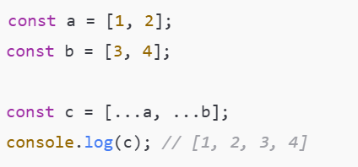
The threeDots ...
Spread Operator (...):
Merge arrays

Slide 43
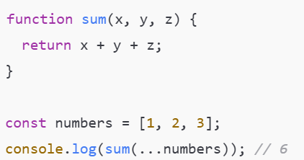
The threeDots ...
Pass arguments to a function

Slide 44
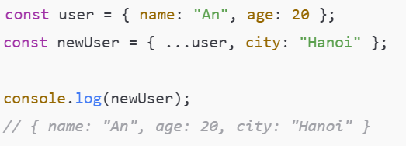
The threeDots ...
Copy and merge objects

Slide 45
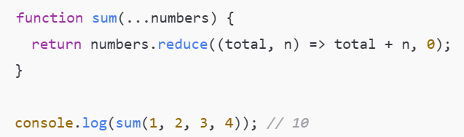
The threeDots ...
Rest Operator (...): Used to collect multiple elements or parameters into an array.
Rest parameters in functions

Slide 46
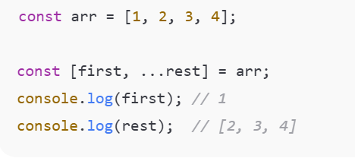
The threeDots ...
Rest in array destructuring

Slide 47
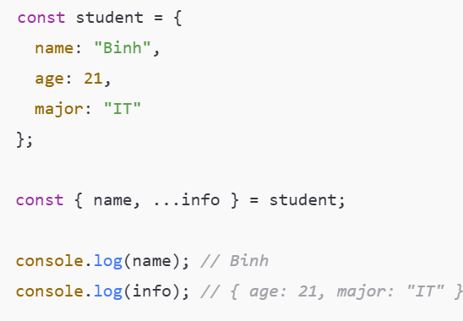
The threeDots ...
Rest in object destructuring

Slide 48
Destructuring in ES6
Destructuring is an ES6 feature that allows you to extract values from arrays or objects and assign them to variables in a shorter and more readable way.
Notes:
Destructuring trong ES6 là tính năng cho phép bạn "phá vỡ cấu trúc" (destructure) các giá trị từ mảng (Array) và đối tượng (Object) và gán chúng trực tiếp cho các biến riêng biệt, giúp code ngắn gọn, dễ đọc hơn rất nhiều, thay vì phải truy cập từng thuộc tính/phần tử thủ công như trước.

Slide 49
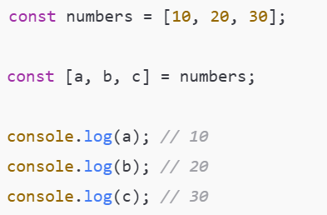
Array Destructuring
Basic Array Destructuring

Slide 50
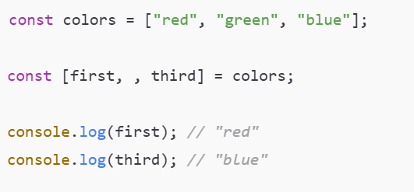
Array Destructuring
Skipping Elements

Slide 51
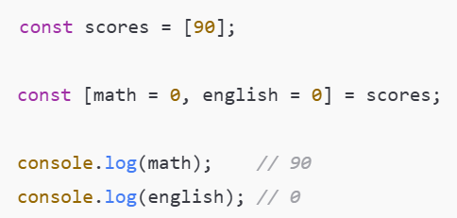
Array Destructuring
Default Values

Slide 52
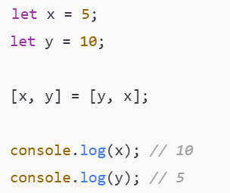
Array Destructuring
Swapping Variables

Slide 53
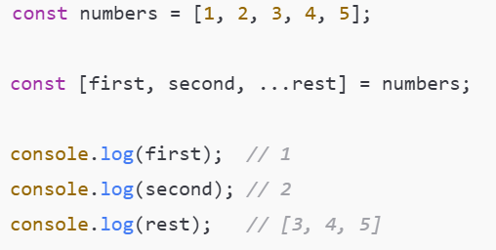
Array Destructuring
Rest Operator in Array Destructuring

Slide 54
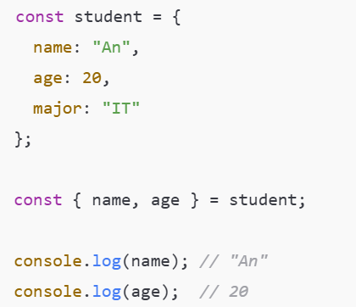
Object Destructuring
Basic Object Destructuring

Slide 55
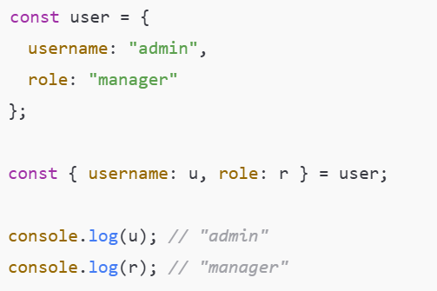
Object Destructuring
Renaming Variables

Slide 56
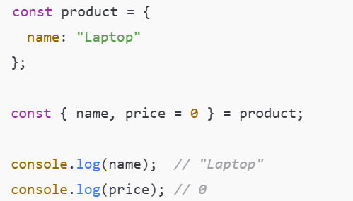
Object Destructuring
Default Values

Slide 57
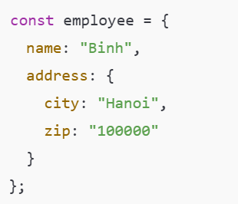
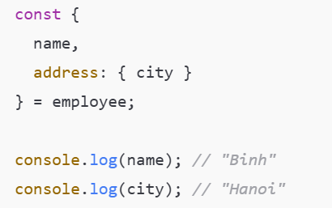
Object Destructuring
Nested Object Destructuring

Slide 58
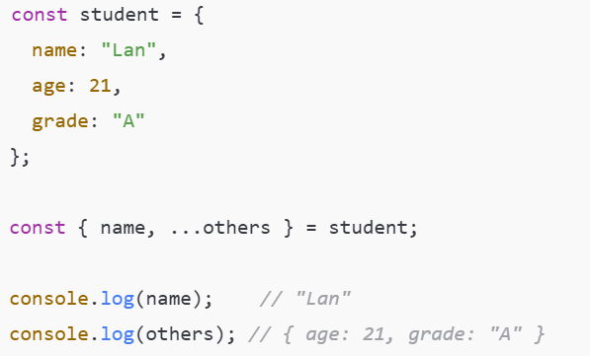
Object Destructuring
Rest Operator in Object Destructuring

Slide 59
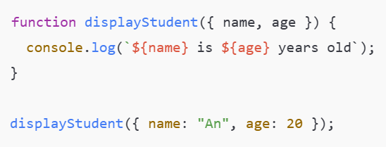
Destructuring in Function Parameters
Object Destructuring in Parameters

Slide 60

Destructuring in Function Parameters
Default Parameters with Destructuring

Slide 61
Traditional Web Applications
Traditional web applications are websites where each user action that navigates to a new page requires a full page reload.
Every request is sent to the server
The server processes the request and returns a complete HTML page
The browser reloads the entire page.

Slide 62
Traditional Web Applications
How it works
The user clicks a link or submits a form
The browser sends an HTTP request to the server
The server processes the request
The server returns a new HTML page
The browser reloads the entire page
Browser ──request──▶ Server
Browser ◀─ HTML─── Server
(browser reloads the entire page)

Slide 63
Single-Page Applications (SPA)
A Single-Page Application (SPA) is a web application that
Loads a single HTML page
Dynamically updates content using JavaScript
Does not reload the page when navigating

Slide 64
Single-Page Applications (SPA)
How it works
The browser loads the initial HTML page
JavaScript framework is initialized
User interactions trigger API calls (AJAX / Fetch)
The server returns JSON data
JavaScript updates the UI dynamically

Slide 65
Single-Page Applications (SPA)
Common technologies
Frontend frameworks:
React
Vue
Angular
Backend:
REST APIs / GraphQL
Node.js, ASP.NET Web API, Django REST
Data exchange format: JSON
Browser ──API request──▶ Server
Browser ◀── JSON ──── Server
(Partial UI update)

Slide 66
CSR – Client-Side Rendering
Client-Side Rendering (CSR) is a rendering approach where the UI is rendered in the browser (client) using JavaScript.
The server returns a minimal HTML file + JavaScript files
The browser executes JavaScript, calls APIs, and renders the UI
This is the default rendering model of Single-Page Applications (SPA).

Slide 67

CSR – Client-Side Rendering
How it works
The browser loads index.html
JavaScript bundle is downloaded
JavaScript fetches data from APIs (JSON)
The UI is rendered dynamically in the browser

Slide 68


CSR – Client-Side Rendering
Examples
React (Create React App)
Vue SPA
Angular SPA

Slide 69

CSR – Client-Side Rendering
Example: HTML file:
Content appears only after JavaScript runs

Slide 70
SSR – Server-Side Rendering
Server-Side Rendering (SSR) is a rendering approach where the server generates the HTML content for each request and sends a fully rendered HTML page to the browser.
This is how traditional websites and Next.js SSR pages work.

Slide 71

SSR – Server-Side Rendering
How it works
The browser sends a request
The server fetches required data
The server renders HTML
The browser displays the page immediately

Slide 72


SSR – Server-Side Rendering
Examples
PHP, ASP.NET MVC
Next.js with getServerSideProps
News websites, blogs

Slide 73

SSR – Server-Side Rendering
Example: HTML file
HTML already contains data

Slide 74
Hybrid Rendering – Next.js
Hybrid Rendering is a model that combines CSR, SSR, and SSG.
Each page can choose the most appropriate rendering strategy.
This flexibility is the key strength of Next.js.
Notes:
Kết xuất lai – Next.js
SSG (Static Site Generation) là một kỹ thuật render website trong đó HTML được tạo sẵn trước (tại thời điểm build), thay vì tạo mỗi khi người dùng truy cập.

Slide 75
Hybrid Rendering – Next.js
CSR (Client Components)
Rendering happens in the browser
Used for highly interactive UI
SSR (Server-Side Rendering)
Rendering happens on every request
Data is always up to date
SSG (Static Site Generation)
Pages are rendered at build time
Very fast and SEO-friendly

